Slide 1
Waiting for a Repair
Shared facilities in Sydney apartment housing
“How might we reduce the disruption that uncertain waits cause to people’s daily lives?
RhodesReg — Wenxi Ma · Ruifen Zheng · Anda Hao · Zeyu Li
IDEA9106 Design Thinking | A2b Progress Presentation | Tutorial 23

Slide 2
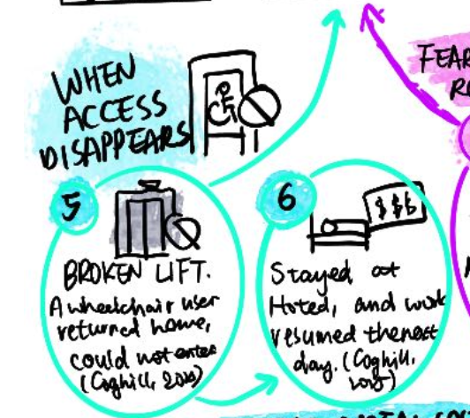
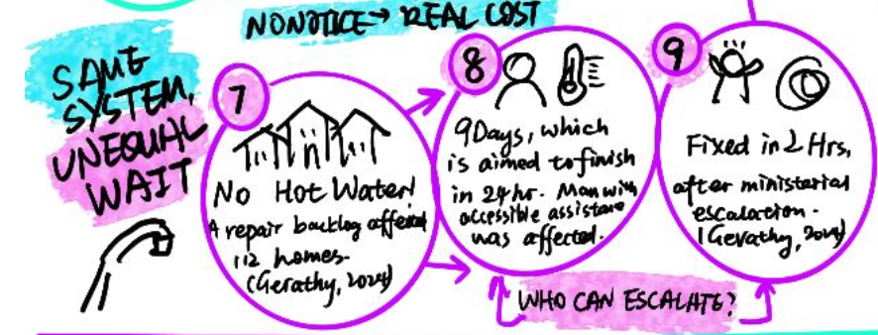
Introduction
Problem area
When a shared facility in an apartment building fails, a lift, hot water, a door, residents can report it, but almost never learn what happens next.
Target users
Student accommodation, social housing, and especially residents with access needs in Sydney apartment buildings. The law requires repairs but sets no timeframe (SSMA 2015 (NSW) s106; RTA 2010 (NSW) s63).
Why this
What differs between a fast fix and a slow one usually isn’t resources — it’s who can ask, and be answered.
RhodesReg · IDEA9106 A2b Progress Presentation
2

Slide 3




Research Process
How we collected the data behind this presentation
~12 semi-structured interviews
Across the 4 team members, each following the same protocol: last failure → who was told → what they were told about duration → what they did while it was broken → how they judged whether the wait was reasonable.
Purposive sampling
Participants who had experienced a shared-facility breakdown in the past 12 months, across housing types — so a shared finding reflects structure, not one provider’s failure.
Recruitment
University networks, personal contacts, and student/disability support networks — without identifying anyone by impairment.
Secondary research in parallel
Queueing psychology (Maister, 1985; Larson, 1987), legal repair obligations, and reported cases.
RhodesReg · IDEA9106 A2b Progress Presentation
3

Slide 4
Personas Extracted from Interviews
PERSONA 1
PERSONA 2
The one need additional access but end with waiting quiet
Persistent Asker
Has lived in many countries, mostly in apartments near campus; meets repair problems occasionally. He rarely report issues to the building management.
Student in USYD, Keeps raising the fault through the proper channels rather than letting it go, treats it as something that should be resolved, not lived with.
Frustration Doesn’t know who’s responsible or whether asking again would help — nothing is ever confirmed, so continuing to raise it starts to feel pointless.
Frustration Keeps raising the issue and keeps hearing “we’re looking into it” — no timeframe, no name attached; the effort never converts into clarity.
“I reported it once. After that I just stopped asking, I didn’t know who to ask, or if it would even matter.”
“I called three times. Every time it was ‘someone will look into it.’ Nobody ever told me who, or when.”
RhodesReg · IDEA9106 A2b Progress Presentation
5

Slide 5
Data Analysis – Affinity Map Told us:
The pain comes from the absence of visible status, a responsible party, and any expectation to hold onto.
1
Unclear standards for how issues are detected and resolved
4
Waits run longer than residents were led to expect
7
Residents check status repeatedly, with no better information each time
2
The wait disrupts other plans in residents’ lives
5
Replies are unhelpful, or there’s no reply at all
Reframe FROM:
Repair🔧
TO:
3
Status is never updated
6
Who’s actually responsible is unclear
The information and influence around the wait
4
RhodesReg · IDEA9106 A2b Progress Presentation

Slide 6

Data Synthesis — Reframed Brief
OUR PROBLEM / OPPORTUNITY SPACE
Residents across student accommodation, social housing, and residents with access needs who report a shared-facility fault but cannot see its status, who is responsible, or when they’ll next hear anything, for the entire undefined period between reporting and resolution. Left without that visibility, residents either disengage and wait it out, or repeatedly chase a response that stays ambiguous — either way, the uncertainty disrupts their ability to plan the rest of their lives around it.
HOW MIGHT WE
Make the status, timeline and responsible party of a reported issue visible — for residents who currently have no way to know where their case stands or who is acting on it?
Residents
Building management / landlord
who wait
who control the sequence
Capacity stays fixed — we’re redesigning the information and influence around the wait, not the repair itself.
RhodesReg · IDEA9106 A2b Progress Presentation
6

Slide 7



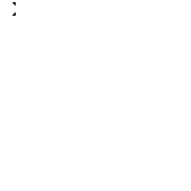
Proposed Solution
How we went from many ideas to one direction
Method: Brainwriting 6-3-5
Chosen because reporting-and-waiting is something every team member has experienced differently. Silent, parallel writing meant no one’s first idea anchored the group — every round built on what was already on the page.
IDEAS CLUSTERED INTO THREE DIRECTIONS
Visibility
Communication
Scheduling influence
Make status visible to residents.
Guarantee a defined reply.
Let residents affect order.
✓ DEVELOPED NOW
✓ DEVELOPED NOW
FUTURE EXTENSION
The “visibility” and “communication” clusters were the most testable at a 5-minute prototype fair, so we developed those. “Scheduling influence” needs longer validation, so it became a future extension.
RhodesReg · IDEA9106 A2b Progress Presentation
7

Slide 8


Lo-fi Prototype
Visible Queue + Receipt — both low-tech, both reuse information staff already hold
1. Visible Repair Queue Board
2. Repair Receipt Card
Lobby display or simple shared page, showing anonymised ticket stages plus an estimated stage range and who’s currently responsible.
Given the moment a fault is reported.
Reported:
Lift — Building B, Level 2
1
2
3
4
5
Next step owned by:
Facility manager
Reported
Assessed
Scheduled
In progress
Done
Next update by:
Thursday, 5pm
Currently: Scheduled — facility manager · est. 3–6 days
Not when it’ll be fixed — when you’ll next hear something.
Physical prototype — paper board + receipt card — brought to tutorial and demonstrated live alongside this slide.
RhodesReg · IDEA9106 A2b Progress Presentation
8

Slide 9

Reflection
Why this creates change, and what we test next
Unclear standards / status never updated
Visible Queue Board — stage always shown
NEXT STEPS TOWARD A2C
1
Build the lo-fi prototype into a testable 5-minute station
Checking status repeatedly
Board removes the need to ask — status is ambient
Reply not useful / no reply
Receipt Card guarantees a defined next update
2
Test with strangers: does seeing a stage change how long the wait feels?
Relevant parties unclear
Both show the current responsible party
3
Open question: does the “next update” promise hold up under real workload?
Longer than expected
Stage ranges replace silence — an “explained” wait
4
Explore Resident Constraints Input once the core loop is validated
Disrupts other life plans
A known next check-in replaces an unknown end date
RhodesReg · IDEA9106 A2b Progress Presentation
9

Slide 10
References & AI Appendix
REFERENCES (APA7)
Coghill, S. (2025, June 25). Aussie’s $230 hotel bill after being stranded outside home highlights ‘sad’ problem. Yahoo News Australia.
Gerathy, S. (2024, June 7). Social housing residents going without hot water as maintenance repair backlog builds. ABC News.
Larson, R. C. (1987). OR Forum—Perspectives on queues: Social justice and the psychology of queueing. Operations Research, 35(6), 895–905.
Maister, D. H. (1985). The psychology of waiting lines. In J. A. Czepiel, M. R. Solomon, & C. F. Surprenant (Eds.), The service encounter (pp. 113–123). Lexington Books.
Residential Tenancies Act 2010 (NSW).
Strata Schemes Management Act 2015 (NSW).
AI APPENDIX
Generative AI (Claude) was used in preparing this presentation to: structure the planning process and organise research the team had already gathered into this slide sequence; draft alternative phrasings of the reframed brief and How Might We question from insights the team identified in its own affinity mapping; help generate and evaluate concept directions grounded in the team’s research and the brief’s constraints, with the team selecting and confirming the final direction; and locate/verify primary legal sources (SSMA 2015, RTA 2010) carried over from earlier individual research.
It was not used to conduct interviews, perform affinity analysis, or generate the lo-fi prototype itself. The reframed brief, concept decisions and final content are the team’s own.
RhodesReg · IDEA9106 A2b Progress Presentation
10

