Slide 1
Finding Bolin
ECE590.03 IMAGE AND VIDEO PROCESSING:FROM MARS TO HOLLYWOOD WITH A STOP AT THE HOSPITAL
Group 7
JINXUAN REN
LEI LI
WEIYAN YIN
WENXIN SHI
YICHUAN ZHAO
Notes:
This presentation demonstrates the new capabilities of PowerPoint and it is best viewed in Slide Show. These slides are designed to give you great ideas for the presentations you’ll create in PowerPoint 2010!
For more sample templates, click the File tab, and then on the New tab, click Sample Templates.

Slide 2
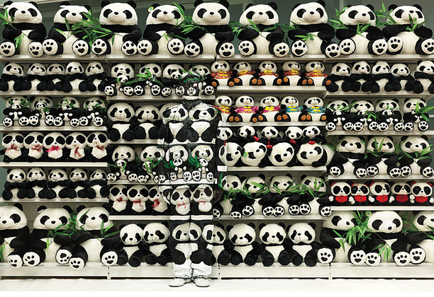
Background
Liu Bolin is Chinese artist, who is famous for camouflage image by hiding himself in the background. Our project is to expose the him to public in a efficient and accurate way.

Slide 3
1
Introduction

Slide 4

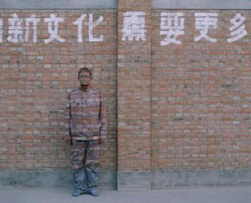
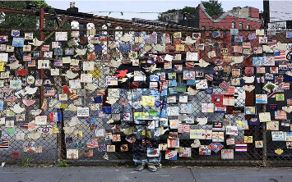
Characteristics Of the Images
In the majority of Bolin’s works, he is standing alone.
His posture is fixed.
Figure 1
No matter how the Bolin camouflage himself, some body details can still be identified by the difference between camouflage part and background part.
Figure 2
Notes:
We manipulate these three properties to be our breakthrough in this project.

Slide 5
How to find Bolin?
(1)Using method to indicate the pattern of Bolin
Chan-vese segmentation
(2)Find a pattern as prior to determine whether the part of image exists Bolin
Face Detection
Hough Ellipse Detection
Global hough line detection.
Our method: find the prior cover the largest information of Bolin so that we can identify the Bolin even when some information needed by prior is losing .
The body shape is carrying most information in identification of Bolin.

Slide 6
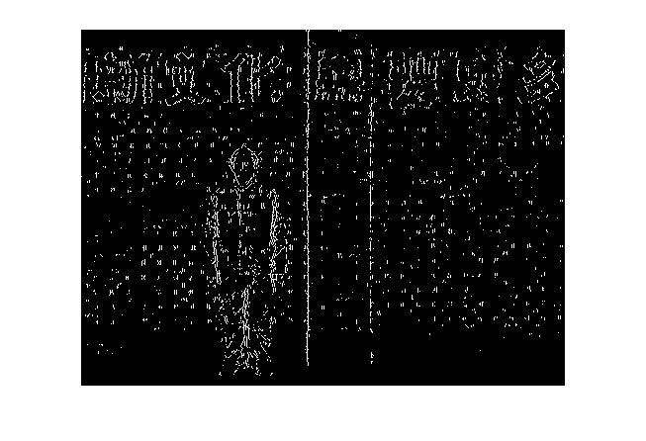
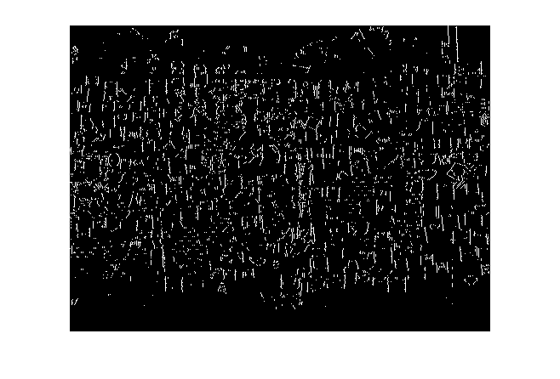
Figure 3
Figure 4
(1)Maximize enhancement of the weak Bolin body edge
(2)Minimize reduction of the useful information when greatly reducing interfered noisy.

Slide 7

Method
2

Slide 8

Prior
Template Construction
Original Image Normalization
Notes:
Firstly pick a clear edge detected image and make the template pattern by hand. Then Gaussian filter it to make the template suitable for different images.
Make images into same size

Slide 9
Color Enhancement
3D-histogram Equalization:
Divide color image into R,G,B channels.
Histogram equalization in each channel.
Combine the three channels to get enhanced color image.

Slide 10
Pattern searching
Sobel edge detection in vertical direction.
Convolve the edge image with different sizes of templates
Size range: 0.9 to 1
Find the maximal point of each pattern size, then normalize these values.
The location of the maximum of normalized maximum will be the critical point.
This critical point is the center of Bolin.
Notes:
Normalized maximal value for later deciding threshold
The size of template cannot be too small, because the noisy will have much more impact on the convolution result.

Slide 11
Making Decision
Support Vector Machine (SVM)
We use Normalized maximal value to decide the threshold.
20 Bolin images and 10 non-Bolin images are used to train
Threshold is trained to decide if Bolin is in the image.

Slide 12
Approximately Box out Bolin
What we have here?
critical point
size of the corresponding pattern
Decision whether Bolin is in the image
If threshold says yes!
Then roughly box out Bolin with a rectangle.

Slide 13
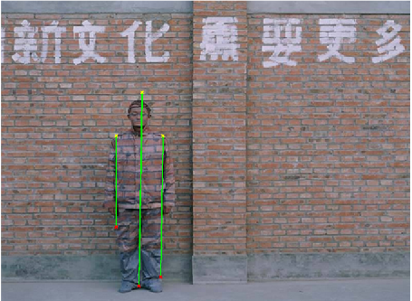
Exact pattern size
Local Hough Transformation
In the certain area where we have roughly obtained where Bolin is, Hough Transformation is implemented to obtain the exact size.
Two body boundary.

Slide 14
Working Flow
Convolution
Center point and rough pattern size
Decision
(SVM)
No
No Bolin in the image
Yes
Box out Bolin
Exact pattern size
(Hough Transformation)

Slide 15
3
Some other ideas

Slide 16
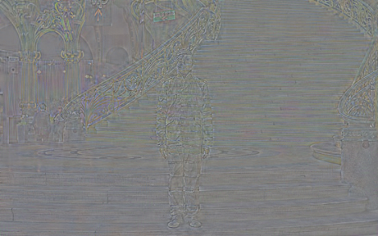
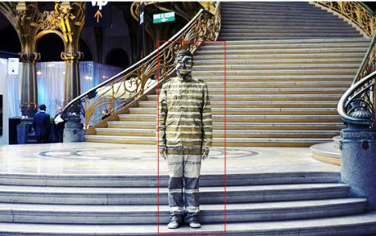
Some other ideas
DCT Image Denoising (12)

Slide 17
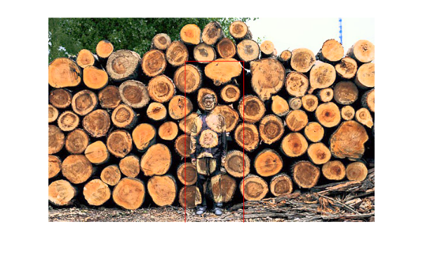
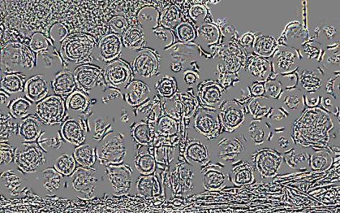
Some other ideas
Cartoon texture (7)

Slide 18
Results (Graph Show)

Slide 19
30 images will be tested
Advantages and Disadvantages
One extra work and An interesting discovery.

Slide 20
Advantage
(1) Real time
(2) Relatively high recognition rate about 24/30

Slide 21
Disadvantage:
(1)Only work for standing Bolin with fixed posture.
(2)Case sensitive for different threshold.

Slide 23

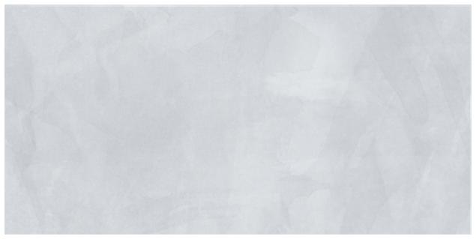
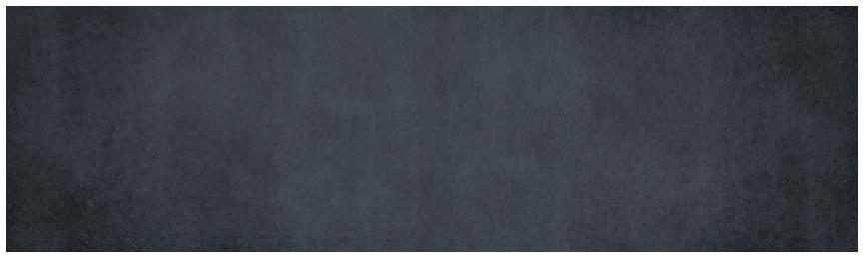
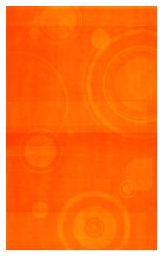

Thanks For Your Patience
What’s Your Message?

