Slide 1
Welcome to
CS 3250
Software Testing
Upsorn Praphamontripong upsorn@virginia.edu

Slide 2

Have You Ever Wondered
Why don’t we just test all possible things?
Why are some tests difficult to automate?
How do we know if we have tested enough?
How should we
test software?
When should we stop testing?
We write tests to test software, but how do we determine if our tests are good enough?
How many tests do we need?
How do we design effective tests?
[Ref: emoji by Ekarin Apirakthanakorn]

Slide 3
Why This Course
Software testing is a crucial activity to verify that programs fulfill requirements and to ensure software compliance
Testing software properly is a fundamental skill in modern software development
Software testing is about engineering tests that detect problems in software
Testing is so much more than writing a bunch of JUnit or Selenium tests
Software testing is about designing good and effective tests under time and
budget constraints
[Ref: emoji by Ekarin Apirakthanakorn]

Slide 4
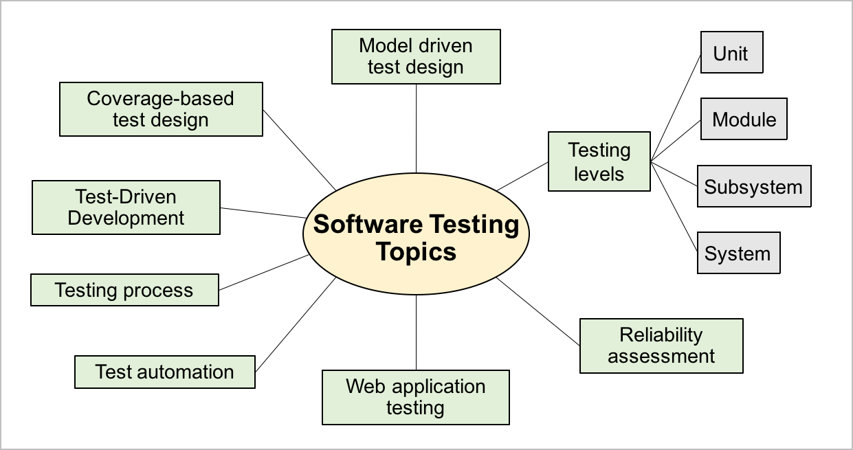
What This Course is About
Importance of Software Testing
Testing in Practice: design, automation, execution, evaluation
Test-Driven Development
Test Coverage Criteria
  Input space partitioning
  Graph coverage
  Logic coverage
  Syntax coverage
Web app testing
Bypass testing
Instead of how testing is done,
we focus on
how it should be done and
how it will be done
“The true subject matter of the tester is not testing, but the design of test cases” —Jeff Offutt

Slide 5
Our Focus
Designing effective tests
  How test engineers design tests
  Explore a variety of test design concepts
  Apply the theories to design tests
  Automate tests using JUnit and Selenium
  Be exposed to challenges and explore best practices in test automation
Principles over syntax
  Foundational principles rather than specific programming syntax
  Does not train specific test automation or software development frameworks
  Provide the fundamentals needed to explore any automation framework independently
Role of generative AI
  Does not teach how to use AI
  Focus on not blindly relying on AI outputs
  Explore, analyze, assess, and revise AI outputs to facilitate the testing process

Slide 6

You Will be Able to Answer
What is software testing?
Why do we test software?
When should we test software?
Who should test software?
How should we test software and why should we do it that way?
When should we stop testing? Good enough?
How many tests do we need to write?
How do we choose test inputs effectively?
How can we measure the quality of a test suite?
How can we improve the quality of a test suite?
How can we reduce the testing cost?

Slide 7
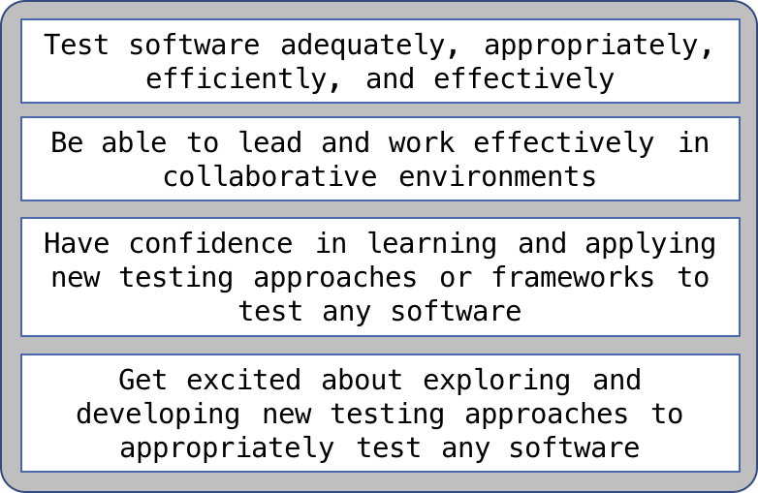
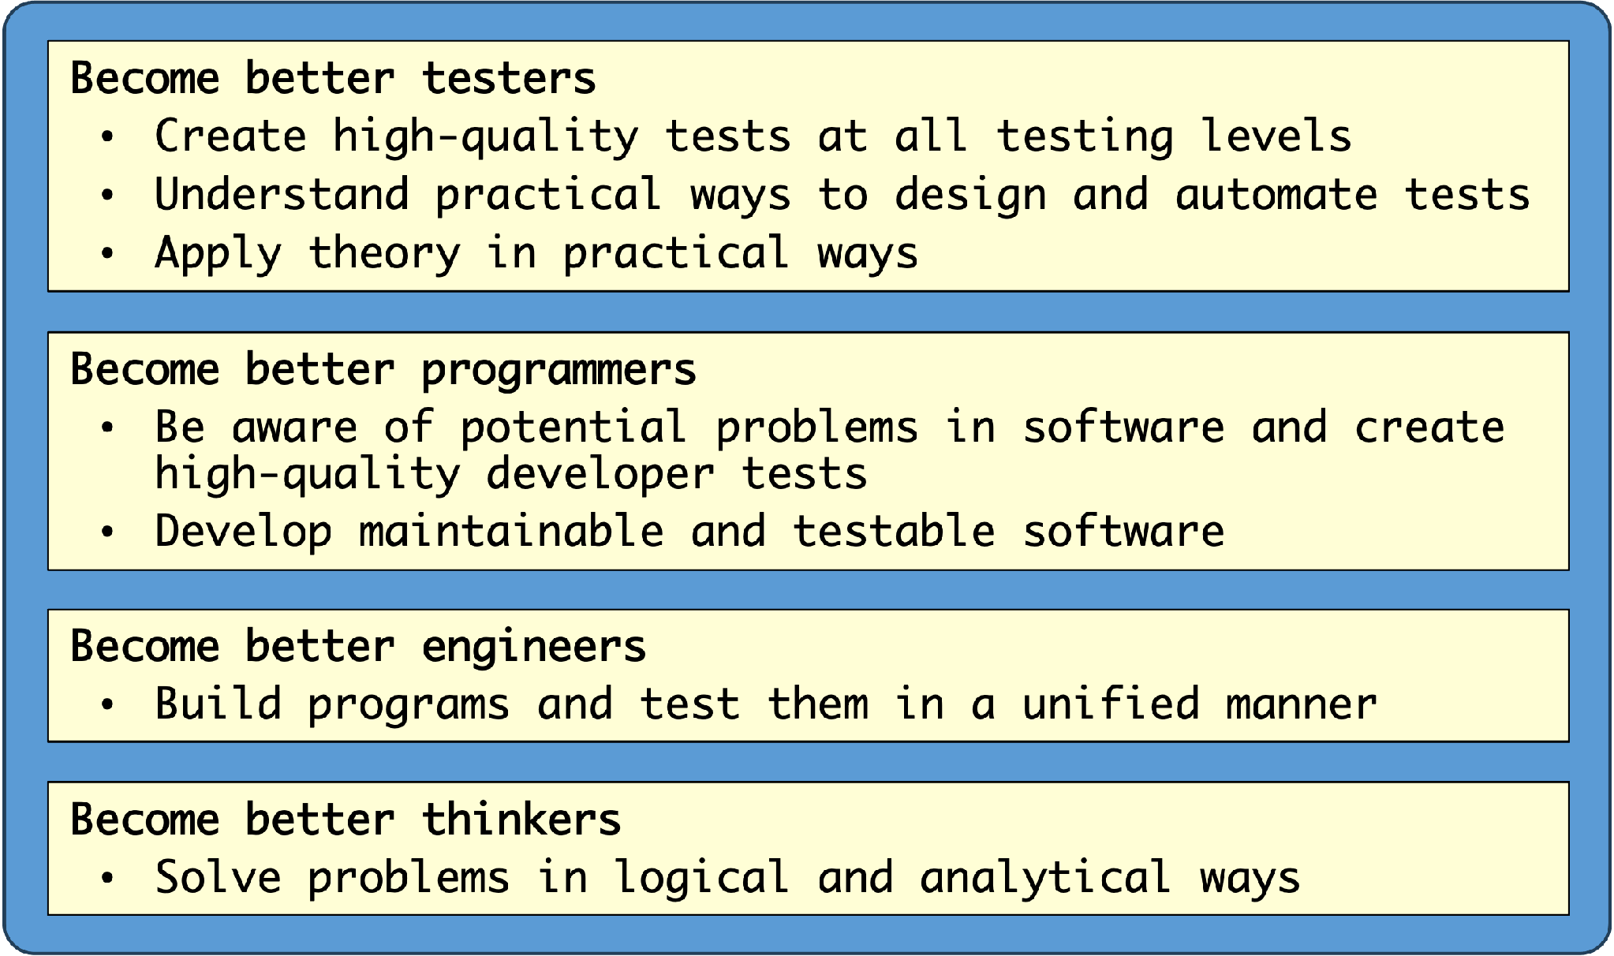
I Hope to Help You

Slide 8
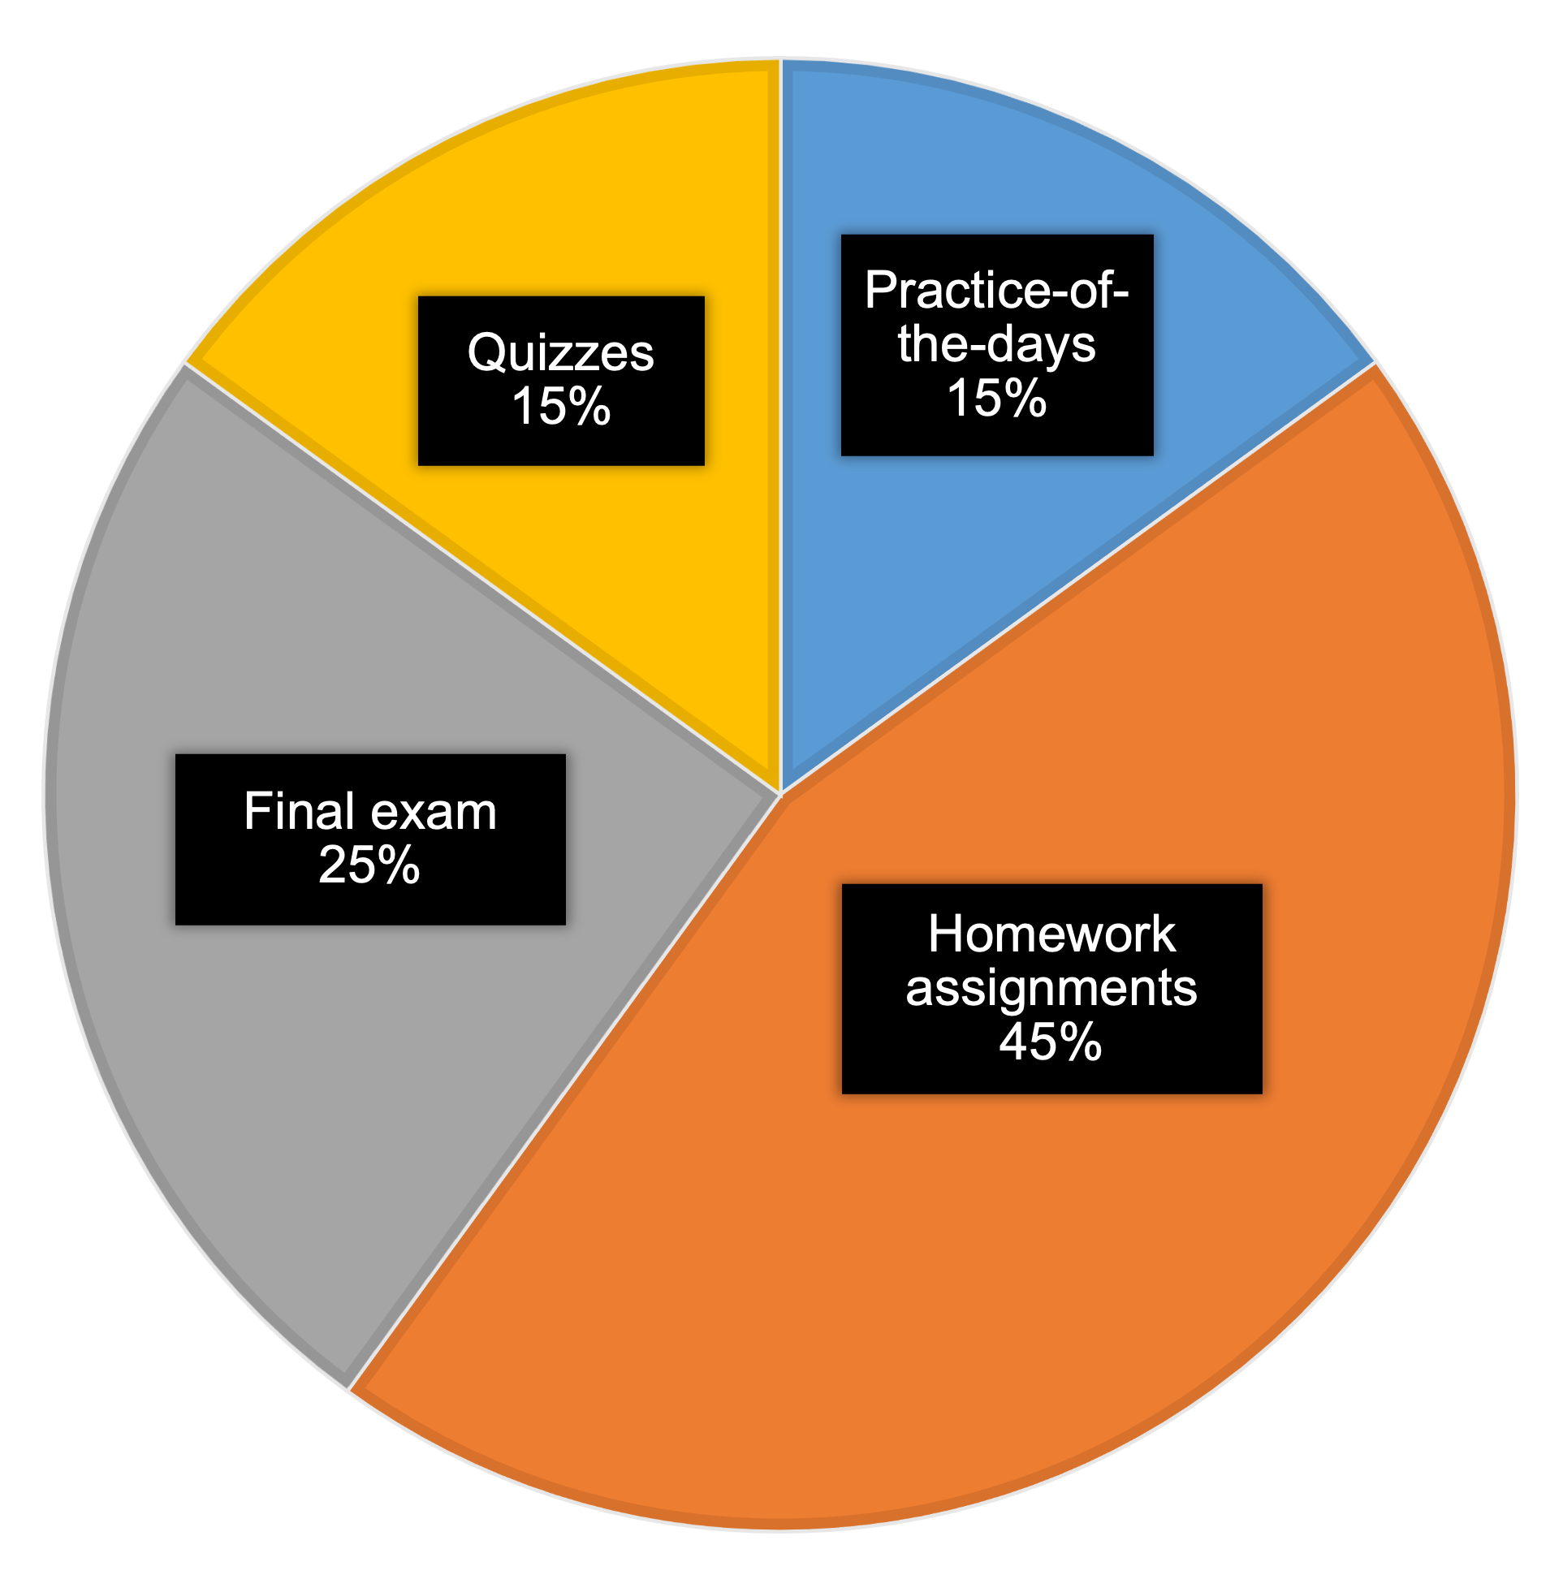
What You will Do & How Your Learning will be Evaluated
Quizzes:
  5 quizzes
  First 15 minutes of class
  Close book/note
  In class
  Reflection & correction
Practice-of-the-days:
  Weekly
  Grade on done/not done
  Due 1pm EST the next day
  -25% for 24 hours late; -50% for 48 hours late
  Not accepted after 48 hours past due
Final exam:
  Comprehensive
  Close book/note
  1 handwritten note sheet
  In class
Homework assignments:
  Almost weekly
  Due before class
  Early-submission bonus points
  -25% for 24 hours late;
  -50% for 48 hours late
  Not accepted after 48 hours past due
Hands-on activities:
  Almost every meeting
  No submission

Slide 9

More Info to Help You Learn
Class URL: http://www.cs.virginia.edu/~up3f/cs3250/
Readings: Check schedule page, please read before class
Textbook:
Emails: Use UVA email, check it regularly, include “CS 3250”
(book website)
https://www.albany.edu/faculty/offutt/softwaretest/
(student solution) https://www.albany.edu/faculty/offutt/softwaretest/exer-student.pdf

Slide 10
Share Ideas, Get Help, Just Talk
Instructor office hours: days/times on class website
Piazza: https://piazza.com/virginia/fall2026/cs3250
Questions should be posted to an appropriate thread
  Answered by instructor and your peers
  Public: general questions and answers
  Private: Grade/homework-specific questions – instructor and Tas
Do not email general homework or class questions, use Piazza

Slide 11
Learn with “Purpose” and “Vision”
Help yourself learn: https://forms.office.com/r/uwbbLJEGQT
To better support and emphasize your differences, energy, and passions, as well as to enhance your strengths
You are encouraged to be involved in designing and shaping this course to maximize your learning experience, skills, and knowledge
Please feel free to share your ideas / opinions / suggestions on things that we should do or try to help you learn software testing, using the “Help yourself learn” form

Slide 12
Additional Things to Know
Submission site: Gradescope
https://www.gradescope.com/courses/1341917
Regrade request: Submit to Gradescope
  Regrade the “entire” work
  Correct any grading mistakes
  May result in either an increase or a decrease in grade
  Not try to scare off students whose work was graded incorrectly, but try to avoid frivolous requests
Check schedule page regularly
  In case of emergency, email & post update on the schedule page

Slide 13

Prerequisites
CS 2120 and (CS 2100 or place out test) with C- or better
Discrete math, data representation, (some) software engineering
Java, syntax and semantics of multiple programming languages
Programming skills
Software installation and troubleshooting skills
Willingness and excitement to learn new concepts and experience new frameworks
Your and soul !!
Prerequisites define what you need to know before taking a class to succeed
in the class. Please do not ask if you can take the class without the prerequisites, I have to advise against it
The CS student services staff will monitor and remove students not meeting prerequisites in courses in which they are enrolled

Slide 14
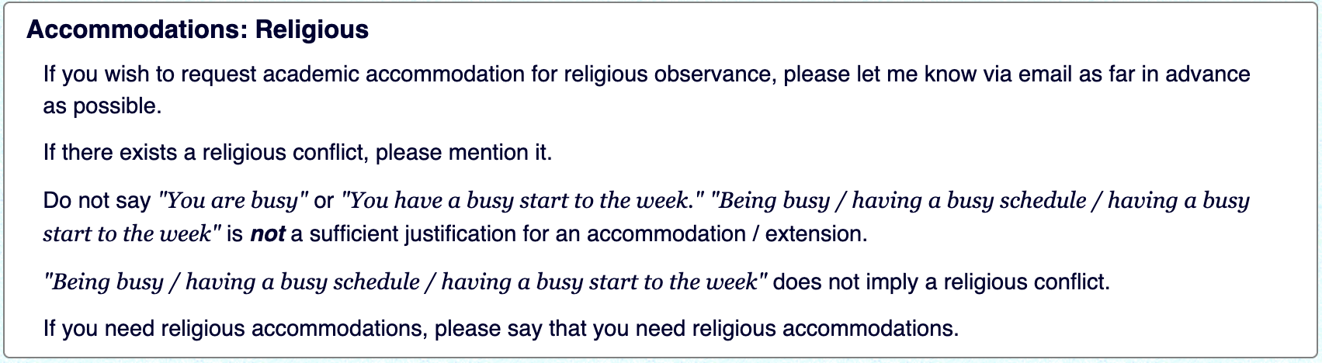
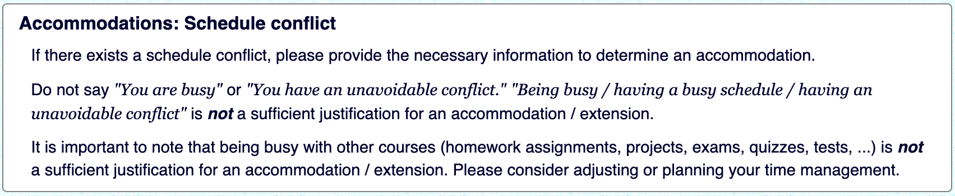
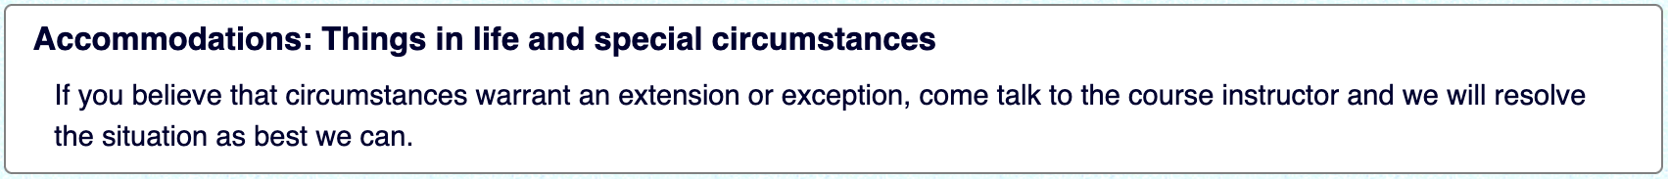
Accommodations
https://www.cs.virginia.edu/~up3f/cs3250/policies.html#no-extension

