Slide 1
Why Do We Test Software?
CS 3250
Software Testing
[Ammann and Offutt, “Introduction to Software Testing,” Ch. 1]

Slide 2

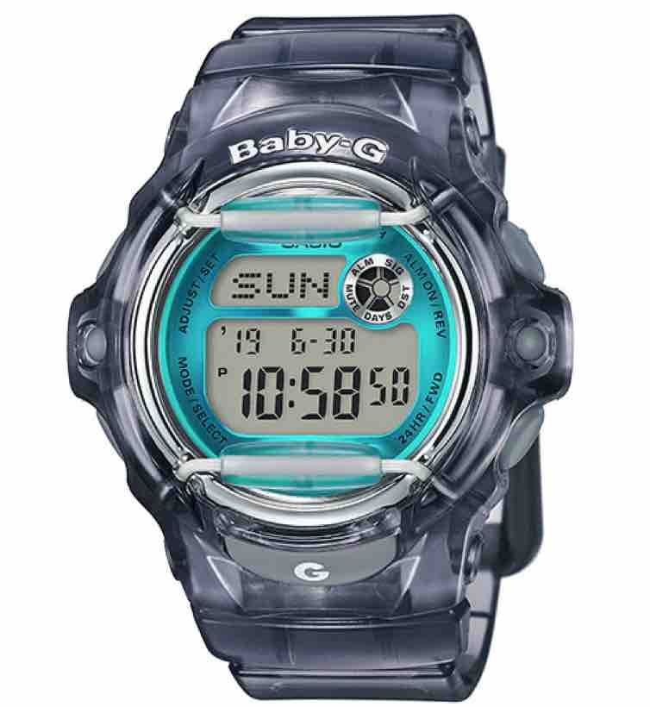
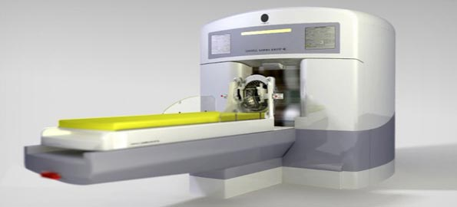

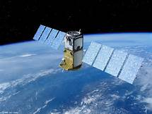




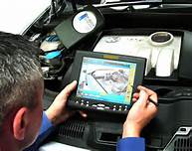
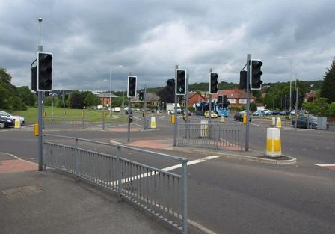

Software is Everywhere

Slide 3
What Could Go Wrong?
(Some bad things that could happen)
Functionality – doesn’t produce the results as expected
Reliability – sometimes work, sometimes doesn’t
Usability – works but frustrating to use
Accessibility – works but inaccessible
Predictability – random spikes in resources
Security – expose security vulnerabilities
Compliance – doesn’t handle sensitive information correctly
Observability – difficult to identify the cause of failures

Slide 4
(some) Software Failures
  2024: A fault in the CrowdStrike’s software update crashed machines running Microsoft’s Windows operating systems, resulting in an outage and massive domino effect on many companies, including major global banks, airlines, and healthcare and energy companies
  2023: Flights from coast to coast were grounded and unable to depart due to a software malfunction (FAA outage)
  2023: Military helicopter crash caused by failure to apply a software patch
  2022: Tesla recalled nearly 12K vehicles due to battery controller failures
  2022: Millions of web server vulnerability due to a defect in the Log4j software
  2021: Log4j did not sanitize its input, allowing malicious attackers to execute code remotely on any targeted computer
  2020: More than 100 flights to and from London’s Heathrow airport disruption due to issues with departure boards and check-in systems
  2020: A number of Hyundai and Kia recalls due to software park system malfunction
  2020: Microsoft Azure experienced a six-hour outage due to issues with the building automation control system that caused a cooling system failure

Slide 5
(some) Software Failures (cont.)
  2020: Google Cloud service disruptions affecting Gmail, Google Classroom, Nest, YouTube due to storage issues with Google’s authentication system and email configuration update
  2020: AWS suffered over 6 hours due to an operating system configuration issue
  2019: Facebook, Instagram, WhatsApp 14 hours downtime due to Facebook News Feed issue in routine maintenance
  2019: Boeing 737 Max crashed due to aggressive software flight overrides
  2018: Hawaii Emergency Management Agency sent out a false missile alert due to no visible alterations between live alert and testing environments
  2018: Pedestrian in Arizona was killed by an Uber car due to its self-driving software failure
  2018: Google shut down Google+ due to the undetected fault that was present for more than two years, causing nearly 500,000 users’ data to be compromised
  2018: TSB system upgrade causes months of online banking disruption
  2017: Cloudflare’s major software fault led to customer sensitive data leakage
  2017: 606 recorded software failures, impacting 3.7 billion people, 314 companies, $1.7 trillion in financial losses

Slide 6
(some) Software Failures (cont.)
  2016: Nissan recalled 4 millions cars from the market due to software failure in the airbag sensory detectors
  2016: Info lost due to the browser back button while using TurboTax software
  2015: Bloomberg’s trading terminal failures forced the British government to postpone $4.4 billion debt sale
  2014: Dropbox’s outage was due to a fault in a maintenance script
  2012: Faults in a new Knight Capital’s trading software causes $440 millions
  2007: Symantec concluded that most security vulnerabilities are due to faulty software
  2003: Northeast blackout due to the alarm system in the energy management system failure, affecting 40 million people in 8 US states, 10 million people in Ontario, Canada
  1999: NASA’s Mars lander crashed due to a unit integration fault
  1997: Ariane 5 explosion: Exception-handling bug forced self-destruct on maiden flight (64-bit to 16-bit conversion), causing $370 millions
  1986: 3 patients were killed by Therac-25 radiation machine due to poor testing of its safety-critical software

Slide 7
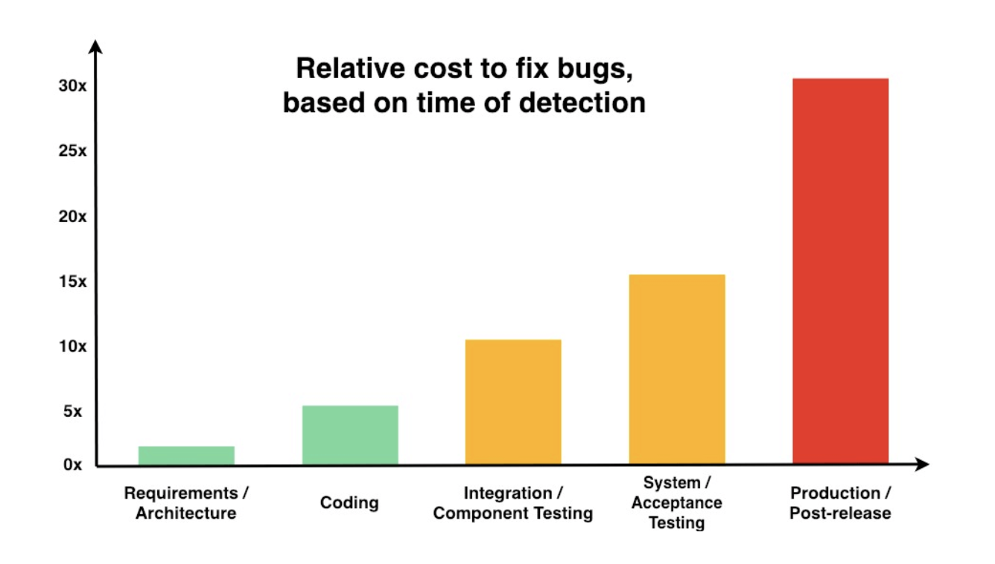
Cost of Late Testing
[Chart illustrated by https://www.diffblue.com/resources/cost-of-poor-test-coverage/
With data from https://www.nist.gov/system/files/documents/director/planning/report02-3.pdf]

Slide 8
Why Do We Test?
Guard software from regression
Improve the code quality
Reduce uncertainty
Increase the development pace
Enhance the specification density
Boost confidence and courage
Increase confidence for anyone who is affected
through some forms of evidence

Slide 9
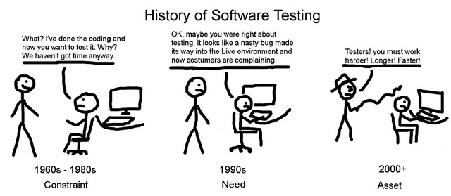
History of Software Testing
[image: http://ashishqa.blogspot.com/2012/12/history-of-software-testing.html]

Slide 10

Software Testing – Who Cares?
Software testing is not just for testers. As a developer:
It is also your responsibility to ensure the quality of your product.
Tests are the tool to help you with that responsibility.
If you design tests properly, you can test your code in an effective and systematic way.
If we don’t test a software, something could go wrong. Then, who should test it?
Software testing is time-consuming
Writing production code is more fun and challenging
My company has a dedicated team of testers, and it’s their job to ensure quality
Most developers
don’t really love
writing tests
[Ref: emoji by Ekarin Apirakthanakorn]

Slide 11
The Essence of Testing
Technical
investigation
to expose quality-related information
about the project or software under test
Models (ISP, graph, logic, syntax), tools or test automation frameworks
An organized and thorough search for information (~run tests and look carefully at the results)
Find sources or problems to get them fixed
Check intraoperability and interoperability
Help in decision making (release/no-release)
Minimize technical support costs
Assess conformance and compliance
Minimize safety-related lawsuit risk
Determine safe scenarios for use of the product

Slide 12
Wrap-up
Testing is the most time consuming and expensive part of software development
Not testing is even more expensive
Having too little testing effort early increases the testing cost
Planning for testing after development is prohibitively expensive
A tester’s goal is to eliminate faults as early as possible
What’s next?
Getting started – intro to software testing

