Slide 1
Introduction to
Software Testing
CS 3250
Software Testing
[Ammann and Offutt, “Introduction to Software Testing,” Ch. 1, Ch. 2.1]

Slide 2
How Do You Test?
Imagine we are testing a typical “add” functionality of a calculator program
The adder() function takes 2 numbers that a user enters and returns the sum of the 2 numbers.
The program displays the result of the adder() and then lets the user decide when the program should terminate.
How would you test the adder() function? What are test cases? How many test cases do we need? How do you know?
def adder():
n1 = int(input('Enter number1: '))
n2 = int(input('Enter number2: '))
return n1 + n2
end = 'n'
while end != 'y':
print('sum =', adder())
end = input('Enter \'y\' to end the program: ')

Slide 3
More Testing & AI Tests
Refer to “How do you test?” Activity, SUT 2: Prime numbers
Design tests for the computePrimes method
Consider the tests you created and the tests AI generated.
What are in common?
What are different?
Is there anything missing?
(https://www.cs.virginia.edu/~up3f/cs3250/inclass/activity-how-do-you-test.html)

Slide 4
How Do You Debug?
Something is not right about the adder() function below.
The “add” functionality takes 2 numbers that the user enters and then displays the sum of the 2 numbers. It also allows the user to decide whether the program terminates.
When the user enters 5 and 5, the program displays 10 as expected.
However, when the user enters 5 and -3, the program displays 10 instead of 2.
How would you debug the adder() function? What/how to fix?
def adder():
n1 = int(input('Enter number1: '))
n2 = int(input('Enter number2: '))
return n1 + n1
end = 'n'
while end != 'y':
print('sum =', adder())
end = input('Enter \'y\' to end the program: ')

Slide 5

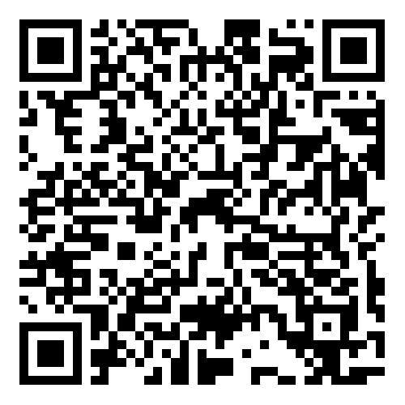
Let’s Debug a (bit) Bigger Program
Refer to “Rubber Duck Debugging” Activity on the schedule page
There is a problem with patternIndex.java. It fails to produce the expected output.
Rubber duck debugging
Talk to me
(http://www.cs.virginia.edu/~up3f/cs3250/inclass/activity-debugging.html)

Slide 6
Think about your experience.
What exactly is testing?
Is testing the same as debugging?
Is debugging a testing activity?

Slide 7
What is Software Testing?
Testing = process of finding input values to check against a software (focus of this course)
  Test case consists of test values and expected results
  Goal – reveal faults
Test values
(inputs)
Program
Actual results
vs
Expected results
Testing is fundamentally about choosing finite sets of values from the input domain of the software being tested
Given the test inputs, compare the actual results with the expected results
Debugging = process of finding a fault given a failure

Slide 8
Testing Categories
Static testing
Testing without executing the program
  Software inspection and some forms of analysis
  Effective at finding certain kinds of problems such as problems that can lead to faults when the program is modified
Inspection, walkthrough, code review, informal review, …
Dynamic testing
Testing by executing the program with real inputs
Unit testing, integration testing, system testing, acceptance testing, …

Slide 9
Testing Categories (2)
White-box
testing
Gray-box
testing
Black-box
testing
Test with
complete information
of the software (architecture, how components interact, functions and operations, code, rationale, …)
Test with
incomplete information
of the software or limited knowledge of internal details
(may know how components interact but not have detailed knowledge about internal program functions, source code, rationale, …)
Test from the outside (functionality and behavior).
Not require
source code, architecture, detailed knowledge about internal program functions,
rationale, …)

Slide 10


White-box vs. Black-box
Which one should we use?
Each technique has its strengths – use both
  Generally, first use black-box
  Then, white-box for missed code
Accept that we may not be able to detect all faults
  When to stop??
  Adequacy 🡪 Coverage level
  Coverage criteria provides “stopping rule”
White-box?
Both?
Black-box?
[images: Left fist https://unsplash.com/photos/ODzSyS5WsSo
Right hand https://www.juicyseo.co.uk/jg/wp-content/uploads/2016/02/Right-Hand.jpg]

Slide 11
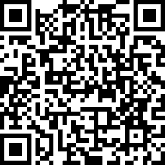
Testing Categories (3)
Functional testing
Unit testing
Integration testing
System testing
Smoke testing
Acceptance testing (Alpha / Beta
Agile testing
Regression testing
Continuous integration testing
… and many more …
Non-functional testing
Performance testing
Load testing
Stress testing
Security testing
Compatibility testing
Reliability testing
Usability testing
Compliance testing
Conformance testing
… and many more …
Explore & share your thoughts/ideas/examples/experience/concerns on
https://www.tldraw.com/f/xypCRh5ufr799rrrbDJsK?d=v-299.-30.1179.823.page
(link to the tldraw also on our schedule page)

Slide 12
Validation and Verification (IEEE)
Validation
Evaluate software at the end of software development
Ensure compliance with the intended usage
Done by experts in the intended usage of the software, not developers
Verification
Evaluate software at a given phase of the development process
Fulfill the requirements established during the previous phase
Requires technical background on the software
Done by developers at the various stages of development
IV&V stands for “independent verification and validation”

Slide 13
Testing and
SW Development Lifecycle
Requirements
Analysis
Acceptance
Test
Check if software does what the user needs
Test
Design
Information
Architectural
Design
System
Test
Check overall behavior w.r.t. specs
Check interface between modules
in the same subsystem
Subsystem
Design
Integration
Test
Detailed
Design
Module
Test
Check interactions of units and associated data structures
Implementation
Unit
Test
Check each unit (method) individually
[based in part on AO, p.23]

Slide 14
Testing and
SW Development Lifecycle
Requirements
Analysis
Acceptance
Test
Validation
Test
Design
Information
Architectural
Design
System
Test
Subsystem
Design
Integration
Test
Verification
Detailed
Design
Module
Test
Implementation
Unit
Test
[based in part on AO, p.23]

Slide 15
Principles of Software Testing
Why testing is so hard
Exhaustive testing is impossible
We need to know when to stop testing
There is no silver bullet in software testing
Faults happen in some places more than others
Bug-free software does not exist
Testing is context-dependent
Verification is not validation

Slide 16
Tactical Goals: Each Test
”If you don’t know why you’re conducting each test,
it won’t be very helpful” – Jeff Offutt
What is objective and requirement of each test?
What fact does each test try to verify?
What are the threshold reliability requirements?
What are the planned coverage levels?
How many tests are needed?

Slide 17
Wrap-up
A tester’s goal is to eliminate faults as early as possible
Testing
  Improves software quality
  Reduce cost
  Preserve customer satisfaction
What’s next?
Test automation
JUnit

