Slide 1
Test Automation
CS 3250
Software Testing
[Ammann and Offutt, “Introduction to Software Testing,” Ch. 3]

Slide 2
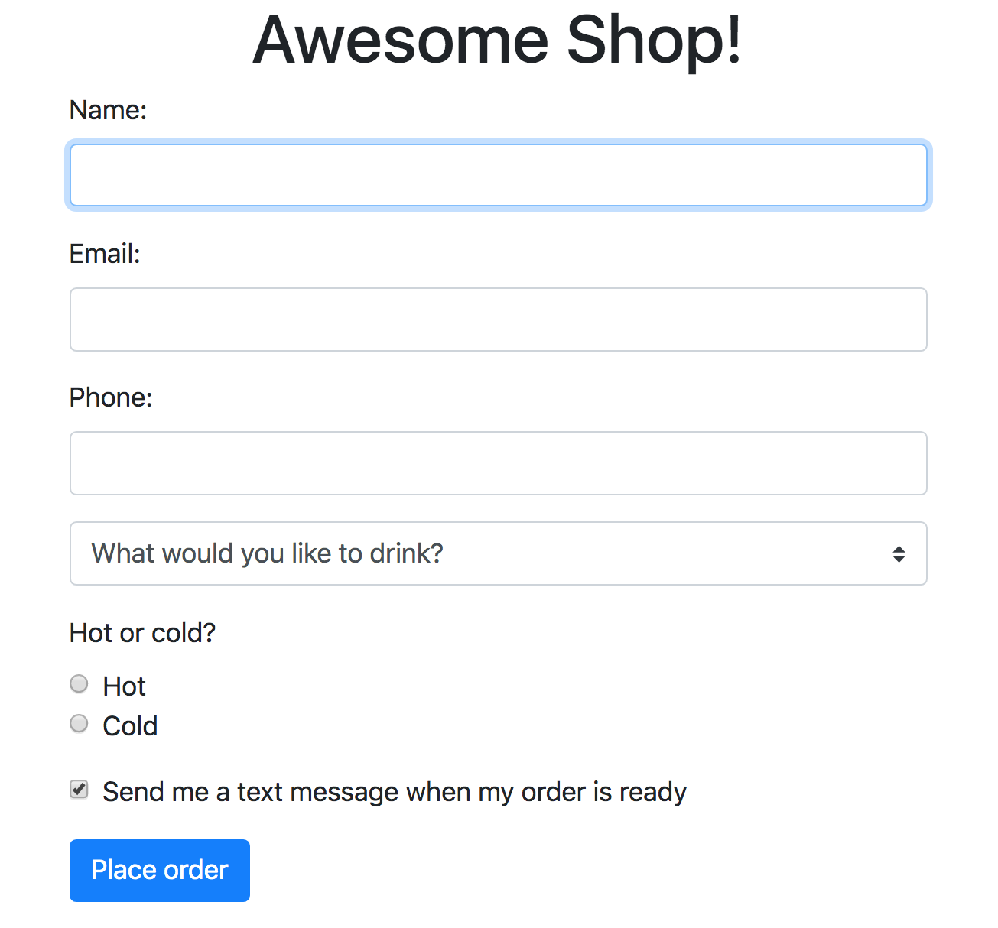

Manual Testing
Name [ valid, invalid ]
Email [ valid, invalid ]
Phone [ valid, invalid ]
Drink [ select, not select ]
Hot or cold [ hot, cold, not select ]
Send text [ send, not send ]
How many tests?
How many clicks, keystrokes?
Imagine you are testing a web program that takes a drink order
Load the web program
Enter all inputs
Click “Place order” button
Record the test result
Updated code?
Entered inputs incorrectly?
[Ref: emoji by Ekarin Apirakthanakorn]

Slide 3
Manual Testing
Benefits
Simple and straightforward
No up-front cost
Easy to set up
No additional software to learn, purchase, write
Flexible
More likely to test things that users care about
Possible to catch issues that automated testing does not
Drawbacks
(Extremely) boring
Often not repeatable
Some tasks are difficult or impossible to test manually
Human errors
Extremely time- and resource-intensive
Limit to black-box and gray-box testing

Slide 4
Tasks in Testing Process
Design tests
Revenue task
Enter inputs, run program, record results
Excise task
Enter
Test values
(inputs)
Program
Actual results
vs
Expected results
Comparison
Execute tests against the program under test (PUT)
or sometimes referred to as a software under test (SUT)
Analyze results
Revenue task

Slide 5

Software Testing Activities
Human-based or
Criteria-based
Test
Manager
Test
Engineer
automate
1. Test
Design
2. Test
Automation
3. Test
Execution
design
instantiate
Test
Engineer
Computer
P
analyze
execute
Test
Engineer
4. Test
Evaluation
Output
[AO, p.22]

Slide 6
Test Automation
Use of software to control the execution of tests
Comparison of actual outcomes to predicted outputs
Setting up of test preconditions, and other test control and test reporting functions
Test inputs
Actual results
Executable Tests
Precondition
Test control
Test inputs
Postcondition
Program
vs.
Report
Expected results
Set up
Execute
Assert

Slide 7
Automated Testing
Benefits
Reduce human errors
Reduce excise tasks
Free up time to focus on revenue tasks
Reduce cost, less resource-intensive
Reduce variance in test quality from different individuals
Easily repeatable
Significantly reduce the cost of regression testing
Cover aspects that manual testing is impossible
Scalable
Drawbacks
Setup time up-front
May miss some user-facing defects
Require training (programming languages, testing frameworks, tools)
Automate as much as possible

Slide 8
Challenges in Test Automation
Two common challenges: flaky tests and blind tests
Imagine Upsorn’s 12-year-old niece visited our class.
She asked, “What are flaky tests? What are blind tests? What do they look like? Are they bad? Why? What might cause them? How might we avoid them?”
Help Upsorn answer her niece. Feel free to share your opinions, experience, thoughts, or use your favorite search engine (or AI) to get ideas and examples.
To share ides, use (the link is also on the schedule page) https://www.tldraw.com/f/yNEXuP8KFY9eM6gMhaV7_?d=v0.0.1087.732.page

Slide 9

Flaky (Nondeterministic) Tests
“Tests that exhibits both a passing and a failing results with the same code”
– Google
Run #1
Test A on program P
Run #2
Test A on program P
Run #3
Test A on program P
Google says 16% of their tests are flaky
Controllability
Potential causes
Concurrency
Asynchronous behavior
Random inputs
Resource leaks
Test order dependency
Collection class assumptions
Relying on external systems
Not checking emails
[Thanks to Professor Jeff Offutt, CS 3250 Guest speaker, Fall 2019]

Slide 10
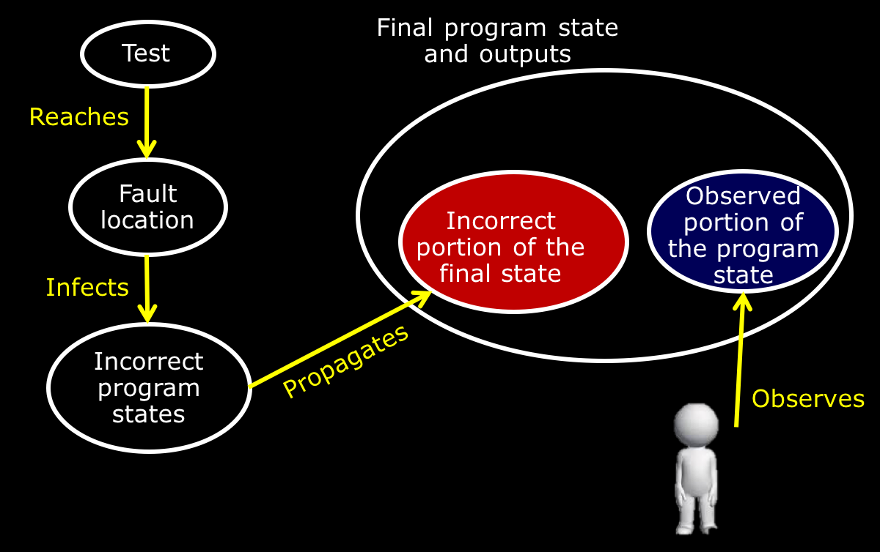
Blind Tests
Tests that do not notice failures
“Almost half the tests written by professional software engineers had broken test oracles” – Jeff Offutt
Observability
Potential causes
Unintended ignorance
Observe the wrong place
Overlooked information
[Thanks to Professor Jeff Offutt, CS 3250 Guest speaker, Fall 2019]

Slide 11
What Makes Test Automation Hard
Imagine you are tasked to test a company’s software.
You need to set up three different web services, create five different files in different folders of the system, and put SQL and NoSQL databases in specific states.
After all the setup, you execute the feature under test.
To assert the behavior of the software under test, you need to check if the three web services were invoked, the five files were manipulated correctly, and the databases were now in proper state.
Doable? Can this be simpler?

Slide 12
What Makes Test Automation Hard
Testability
“The degree to which a system or component facilitates that establishment of test criteria and the performance of tests to determine whether those criteria have been met”
Two practical problems:
  Controllability: how to provide the test values to the software
  Observability: how to observe the results of test execution
How hard it is to detect faults in the software

Slide 13
Aspects that Impact Testability
Controllability
“How easy it is to provide a program with the needed inputs, in terms of values, operations, and behaviors”
Example of software that often have low controllability:
  Embedded software often gets its inputs from hardware sensors
    Difficult to control
    Some inputs may be difficult, dangerous, or impossible to supply
  Component-based software
  Distributed software
  Web applications
  Mobile applications

Slide 14
(Some) Controllability Problems
State hidden in method
Difficult setup
Incomplete shutdown
State-leaks across tests
Framework frustration
Difficult mocking
Hidden effects
Hidden inputs

Slide 15
Aspects that Impact Testability
Observability
“How easy it is to observe the behavior of a program in terms of its outputs, effects on the environment and other hardware and software components”
Example of software that often have low observability:
  Embedded software often does not produce output for human consumption
  Component-based software
  Distributed software
  Web applications
  Mobile applications

Slide 16
Let’s Try (1)
Observability and controllability are two important concepts when it come to software testing.
Purpose: recognize observability and controllability problems
Consider the following problems. Identify whether it relates to observability or controllability. What could be the cause(s) of the problems?
Developer 1: “I can’t really assert whether the method under test worked well”
Developer 2: “I need to make sure this class starts with that Boolean variable sets to false, but I simply can’t do it.”
Developer 3: “I instantiated this object, but there is no way to inject it into the class.”

Slide 17
Let’s Try (2)
Purpose: reflect on your program, and recognize observability and controllability problems
Work with your peers. Think about your current program/project (or the program you recently developed):
Are parts of it hard to test? Can you explain why?
What is a specific thing that reduces controllability?
What is a specific thing that reduces observability?
What can you do to make it more testable?
If nothing is hard to test, can you explain why?
What is a specific thing that increases controllability?
What is a specific thing that increases observability?

Slide 18
Rules of Thumb
Design and implement your software for testability
Create good test code
If it is difficult to test your code, there may be problems with your design and implementation.
Writing testable code is harder than writing untestable code.
Solving design problems will solve testing problems.
Making code testable does not necessarily make the design better.
Design for testability is fundamental for systematic testing

Slide 19
(Some) Design Ideas for Testability
Separate the infrastructure from the domain code
If a class depends on another class, make it in a way that the dependency can easily be replaced by a mock, fake, or stub
Make your classes and methods observable
Passing values via method parameters to simplify the callers, instead of passing dependency via a constructor
Focus on a single responsibility
Try to minimize coupling
Keep Boolean expressions small and simple
If you need to test a private method, this private method may not belong in its current place 🡪 refactor your code

Slide 20
Let’s Try (3)
Purpose: Think about ways to increase the testability
Upsorn has joined a web app team that has been trying to write automated tests for a while. The team wants to write unit tests for part of their code, but “it is really hard” according to the developers.
After some code review, the developers listed the following problems:
Many classes mix infrastructure and business rules
The database has large tables and no indexes
There are lots of calls to libraries and external APIs
Some classes have too many attributes/fields
To increase the testability, the team has a budget to work on two out of the four issues above. Which items should Upsorn recommend them to tackle first?
Note: All four issues should be fixed. However, try to prioritize. Which influence the testability the most? Why?

Slide 21
Good Test Code
Test one thing (purpose, traceable) – one assertion per test
Clear, easy to understand, precise, concise
Keep it small (more small tests are better than few large tests)
Move repeated code to fixtures or shared methods
Independent (test frameworks don’t guarantee order of execution)
Repeatable
Avoid complicated control flow in tests
Remember to refactor test code
Test oracles should check the right place (no need to check the entire output state)
Use the right type of assertion

Slide 22
Components of a Test Case
Test case
A multipart artifact with a definite structure
Test case values, expected results,
prefix and postfix values necessary for a complete execution and evaluation of the software under test
Test case values
Inputs needed to complete an execution of the software under test
Inputs can be input values or series of actions
Determine the testing quality
Expected results
The result that will be produced by the test if the software behaves as expected
Test oracle
(pass or fail)

Slide 23
Components of a Test Case
Prefix values
Inputs needed to put the software into the appropriate state to receive the test case values
Affecting controllability and observability
Postfix values
Inputs needed to be sent to the software after the test case values are sent
Verification values: values needed to see the results of the test case values
Exit values: values or commands needed to terminate the program or otherwise return it to a stable state
Inputs can be input values or series of actions
Additional components: test case ID, purpose of the test

Slide 24
Putting Tests Together
Test case
  The test case values, prefix values, postfix values, and expected results necessary for a complete execution and evaluation of the software under test
Test set
  A set of test cases
Executable test script
  A test case that is prepared in a form to be executed automatically on the test software and produce a report

Slide 25
Test Case Execution
Execute
Assert
1
3
Execute SUT
4
Compare the results
Setup
prefix values
Program
Actual results
vs
Expected results
2
Setup
Test case values
5
Setup
postfix values
Set up

Slide 26
Let’s Try (4)
Purpose: Understand the 3-steps in test automation: set up, execute, and assert
Consider the GenericStack class with the following method signatures. Assume the usual semantics for the GenericStack.
public GenericStack();
public void push(Object X);
public Object pop();
public boolean isEmpty();
Design tests for the GenericStack. For each test, come up with:
  Set up: test inputs, prefix (if applicable), postfix (if applicable)
  Execute: series of executions
  Assert: expected outputs, what to observe
Use https://www.tldraw.com/f/HzI5N9BSrRuBYWLxeWsQK?d=v0.0.1147.721.ZuKxMmA5lKK99lQzd_ZUg to share ideas

Slide 27
Test Automation Framework
A set of assumptions, concepts, and tools that support test automation
Provides a standard design for test scripts and support for the test driver
Test driver
Runs a test set by executing the software repeatedly on each test
Supplies the “main” method to run the software if it is not standalone (i.e., a method, class, or other component)
Compares the results of execution with the expected results
Reports the results to the tester

Slide 28
Test Automation Frameworks (2)
Most test automation frameworks support
  Assertions to evaluate expected results
  The ability to share common test data among tests
  Test sets to easily organize and run tests
  The ability to run tests from either a command line or a GUI
Most test automation frameworks are designed for unit and integration testing; some specifically support system testing; some are built to support testing over the web
Example test automation frameworks
JUnit, HttpUnit, HtmlUnit, JWebUnit, Selenium, unittest, Jasmine, Jest, Cucumber, PHPUnit, Robotium

Slide 29
Wrap-up
Test automation
Testability, Observability, Controllability
Design software for testability
Write good test code
Components of a test case
What’s Next?
Test automation framework – JUnit

