Slide 1
Faults, Errors, Failures
RIPR Model
CS 3250
Software Testing
[Ammann and Offutt, “Introduction to Software Testing,” Ch.1, Ch. 2.1]

Slide 2

Software Testing
Test values
(inputs)
Program
Actual results
vs
Expected results
  Testing can only reveal the presence of faults;
  Not showing the absence of faults
  Test case consists of
  test input value(s)
  expected result(s)
Will all inputs trigger a problem in software? Will an input that triggers a problem always lead to a software failure?
[Ref: emoji by Ekarin Apirakthanakorn]

Slide 3
Today’s Objectives
Understand the differences between faults, errors, and failures
Understand how faults, errors, and failures affect the program
Understand the four conditions that must be satisfied when designing tests
  Reachability
  Infection
  Propagation
  Revealability
  “RIPR model”

Slide 4
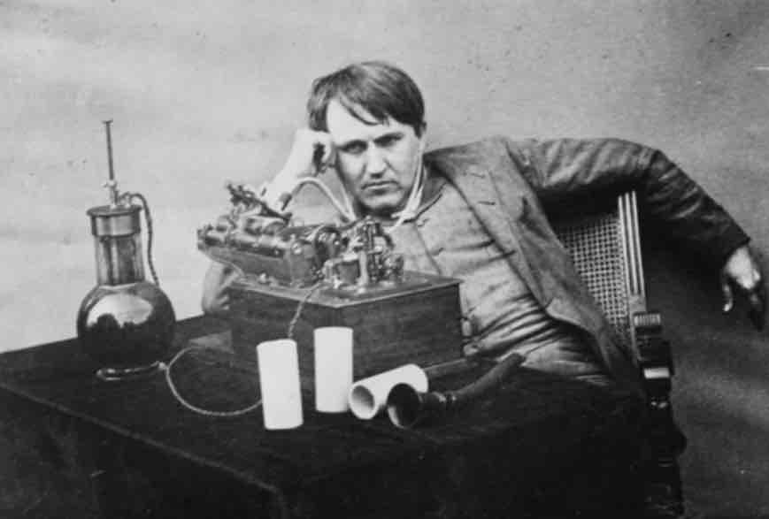
Bug?
“ ‘Bug’ – as such little faults and difficulties are called – show themselves, and months of anxious watching, study, and labor are requisite before commercial success – or failure – is certainly reached.” [Thomas Edison, 1878]
[Ref: Did You Know? Edison Coined the Term “Bug”, http://theinstitute.ieee.org/tech-history/technology-history/did-you-know-edison-coined-the-term-bug, IEEE 2013]
“A software bug is an error, flaw, failure or fault in a computer program or system that causes it to produce an incorrect or unexpected result, or to behave in unintended ways.”
[Ref: https://en.wikipedia.org/wiki/Software_bug]
“Bug” is used informally.
Fault? Error? Or failure?
This course will try to use words that have precise, defined, and unambiguous meaning – and avoid using the term “bug”
BUG

Slide 5
Fault, Error, and Failure in Action
Consider the following pseudo. Trace through & execute it
Test 1: doSomething(5,3)
Test 2: doSomething(5,5)
doSomething (int x, int y)
if (x >= y)
clap 3 times
else
stomp 5 times
What is the expected output?
Correct code
doSomething (int x, int y)
if (x > y)
clap 3 times
else
stomp 5 times
What is the actual output?
Faulty code

Slide 6
Fault, Error, and Failure
Fault: a static defect in the software’s source code
  Cause of a problem – “fault location”
Error: An incorrect internal state that is the manifestation of some fault
  Erroneous/infected program state caused by execution of the defect
Failure: External, incorrect behavior with respect to the requirements or other descriptions of the expected behavior
  Propagation of erroneous state to the program outputs

Slide 7
Let’s pause and think!!
Why do we care about
“fault, error, and failure”?
How can we benefit from
analyzing them?

Slide 8
Example
public static int numZero (int[] arr)
{ // If arr is null throw NullPointerException
// else return the number of occurrences of 0 in arr
int count = 0;
for (int i = 1; i < arr.length; i++)
if (arr[i] == 0)
count++;
return count;
}
There is a simple fault in numZero
Where is the fault location in the source code?
How would you fix it?
Can the fault location be reached? How does it corrupt program state? Does it always corrupt the program state?
If the program state is corrupted, does numZero fail? How?

Slide 9
Example – Let’s Analyze
public static int numZero (int[] arr)
{ // If arr is null throw NullPointerException
// else return the number of occurrences of 0 in arr
int count = 0;
for (int i = 1; i < arr.length; i++)
if (arr[i] == 0)
count++;
return count;
}
Fault: a defect in source code
Error: erroneous program state caused by execution of the defect
Failure: propagation of erroneous state to the program outputs
i = 1 [should start searching at 0, not 1]
i becomes 1 [array entry 0 is not ever read]
Happens as long as arr.length > 0 and arr[0] = 0

Slide 10
Example – Test Cases
public static int numZero (int[] arr)
{ // If arr is null throw NullPointerException
// else return the number of occurrences of 0 in arr
int count = 0;
for (int i = 1; i < arr.length; i++)
if (arr[i] == 0)
count++;
return count;
}
Fault: i = 1 [should start searching at 0, not 1]
Test 1: [4, 6, 0], expected 1
Test 2: [0, 4, 6], expected 1
Error: i is 1, not 0, on the first iteration
Failure: none
Error: i is 1, not 0, error propagates to the variable count
Failure: count is 0 at the return statement

Slide 11
Example – State Representation
public static int numZero (int[] arr)
{ // If arr is null throw NullPointerException
// else return the number of occurrences of 0 in arr
int count = 0;
for (int i = 1; i < arr.length; i++)
if (arr[i] == 0)
count++;
return count;
}
L1
L2
L3
L4
L5
Assume that we want to represent program states using the notation <var₁ = v₁, …, var_{n} = v_{n}, PC = program counter>
Sequence of states in the execution of numZero({0, 4, 6})
  1: < arr={0, 4, 6}, PC=[int count=0 (L1)] >
  2: < arr={0, 4, 6}, count=0, PC=[i=1 (L2)] >
  3: < arr={0, 4, 6}, count=0, i=1, PC=[i<arr.length (L2)] >
  …
  < arr={0, 4, 6}, count=0, i=3, PC=[return count (L5)] >

Slide 12
Example – Error State
Error state
  The first different state in execution in comparison to an execution to the state sequence of what would be the correct program
If the code had i=0 (correct program), the execution of numZero({0, 4, 6}) would be
  1: < arr={0, 4, 6}, PC=[int count=0 (L1)] >
  2: < arr={0, 4, 6}, count=0, PC=[i=0 (L2)] >
  3: < arr={0, 4, 6}, count=0, i=0, PC=[i<arr.length (L2)] >
  …
Instead, we have
  1: < arr={0, 4, 6}, PC=[int count=0 (L1)] >
  2: < arr={0, 4, 6}, count=0, PC=[i=1 (L2)] >
  3: < arr={0, 4, 6}, count=0, i=1, PC=[i<arr.length (L2)] >
  …
The first error state is immediately after executing i=1
(line L2)

Slide 13
RIPR Model
Four conditions necessary for a failure to be observed
Reachability
  The fault is reached
Infection
  Execution of the fault leads to an incorrect program state (error)
Propagation
  The infected state must cause the program output or final state to be incorrect (failure)
Revealability
  The tester must observe part of the incorrect portion of the program state

Slide 14

RIPR Model
Final program state and outputs
Test
Reaches
Observed portion of the program state
Fault location
Incorrect portion of the final state
Observed portion of the program state
Infects
Incorrect program states
Propagates
Observes
Reveals
Observes
[AO, p.21]

Slide 15
Example – Applying RIPR
public static int numZero (int[] arr)
{ // If arr is null throw NullPointerException
// else return the number of occurrences of 0 in arr
int count = 0;
for (int i = 1; i < arr.length; i++)
if (arr[i] == 0)
count++;
return count;
}
L1
L2
L3
L4
L5
Revisit the example, what characteristics (or constraints) the inputs should have (or satisfy)?
Reach a fault (i.e., execute the fault)
Cause the program state to be incorrect (i.e., error)
Cause the infected state to be propagated (i.e., failure)
  Did you consider “happy paths” or “non happy paths” ?

Slide 16
Example – RIPR (Error, No Failure)
public static int numZero (int[] arr)
{ // If arr is null throw NullPointerException
// else return the number of occurrences of 0 in arr
int count = 0;
for (int i = 1; i < arr.length; i++)
if (arr[i] == 0)
count++;
return count;
}
L1
L2
L3
L4
L5
Revisit the example, apply RIPR to design tests that
Reach a fault (i.e., execute the fault)
Cause the program state to be incorrect (i.e., error)
Does not propagate (i.e., no failure)
  One possible test is [4, 6, 0] – now, design some more
How does RIPR model help designing tests?

Slide 17
Example – RIPR (Error, Failure)
public static int numZero (int[] arr)
{ // If arr is null throw NullPointerException
// else return the number of occurrences of 0 in arr
int count = 0;
for (int i = 1; i < arr.length; i++)
if (arr[i] == 0)
count++;
return count;
}
L1
L2
L3
L4
L5
Revisit the example, apply RIPR to design tests that
Reach a fault (i.e., execute the fault)
Cause the program state to be incorrect (i.e., error)
Propagate (i.e., failure)
  One possible test is [0, 4, 6] – now, design some more
How does RIPR model help designing tests?

Slide 18
Wrap-up
Faults, errors, failures
Fault location
Infected state
RIPR model
Observability and revealibility
What’s Next?
Model-Driven Test Design (MDTD)

