Slide 1
COP2334
Linear Data Structures & Search Algorithms
Patrick Brooks

Slide 2
Searching and motivation
-What is searching, exactly?
Searching is a routine that will find a ‘key’ value (the value for which we are searching) in a collection of elements, if the value exists.
-When is this used?
Searching is one of the more common tasks in software development. We may search for the existence (and location) of elements in a collection in any one of a number of situations: user filtering/searching; selection of an element from a displayed list; and many more.
-Am I going to be tested on this?
Be prepared to see linear searching covered in quizzes/exams/assignments. As for binary search, this will be covered in COP3022 and beyond but it is important for us to understand even if we won’t be expected to reproduce it yet.

Slide 3
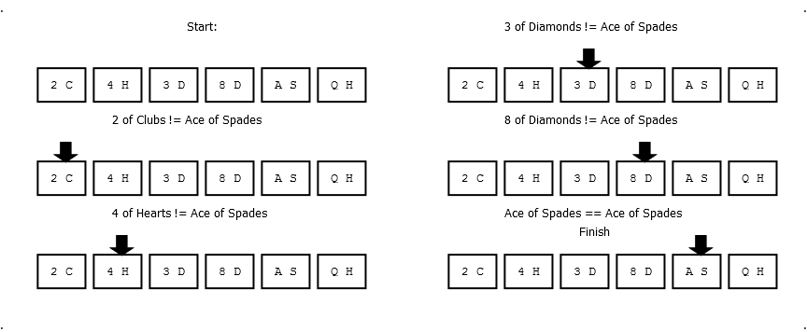
Linear Search
-A good, natural introductory example of searching would be linear search
This is somewhat analogous to how we might intuitively search for something in an unordered list, such as a shuffled deck of cards: look at the first item, and if that doesn’t match look at the second item, and if that doesn’t match look at the third item and so forth. Let’s say we’re looking for the Ace of Spades in a hand of 6 cards, and the hands is ordered as {2_clubs, 4_hearts, 3_diamonds, 8_diamonds, ace_spades, queen_hearts}:

Slide 4
Linear Search Complexity
-Do different search algorithms perform differently?
Of course. Linear search, although intuitive and easy to code, is not a very good performer.
-What is the performance of linear search?
We measure searching algorithms by the number of comparisons they perform in relation to the number of elements that they are searching. We can see here that linear search can be expressed as having a running time on the order of n, where n is the number of elements being sorted. We call this linear time, and more specifically we can see that on average our search time is .5*n, or .5n.
-Why .5n? After all, it took (5/6)*n in the example above.
This is true, but the average case falls in the middle of our collection. The more we get randomly sorted collections and take the average position of the 'found' element we see that it tends more to the middle (.5 * n) If you're familiar with calculus, we can say that the average location tends to converge to, or approaches, 0.5n as the sample size approaches infinity. The same principle could be applied to finding a card in a deck of cards or any other number of search circumstances.

Slide 5
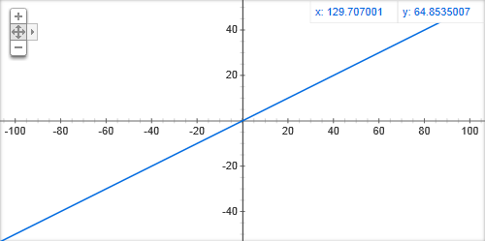

Linear Search Complexity II
-What is mean by ‘linear time’?
This means that the number of comparisons can be expressed in terms of the number of search elements (e.g., .5n) It is called linear because of its graphical properties (it looks like a line):
-Don’t trust me?
See the attached C++ program which shows that the average
location (and hence, complexity) tends toward .5n. It uses 100
element collections to repeatedly search and average the location
of the found elements. You are encouraged to read and understand
the program, as well as run it. Ask questions if needed!

Slide 6
Linear Search Code
-What does the actual code look like?
Check out the previously-provided program. See
also below for a linear search function example on an array:
int linearSearch(int array[], int size, int searchVal){
for(int i = 0; i < size; i++){
if(array[i] == searchVal)
return i;
}
return -1;
}
The input is an array, and we include the number of elements in the array when passing to functions,
We go through each element of the array in a loop
If we find our search value in the array, return its location
If we have completed walking through the entire array and our searched value was not found, return -1 as a ‘not found’ indicator

Slide 7
Binary Search
-Can we do better than the linear search?
Yes! As we saw, linear search’s performance is on the order of n, with an average case of 0.5n. Using binary search on linear data structures we can narrow this down to about log₂n
-Any downsides?
Yes. Binary search is more difficult to code and slightly less intuitive than linear search, and the elements in the collection must already be sorted for it to work.
-How does it work?
Since the elements are already sorted, we can think of the collection as a set of phone book entries. Binary search opens the middle page of the phone book and looks at the middle entry (midpoint element in any collection), and if the element value is equal to the value being searched for, we are done. Otherwise, if the search value is less than the element being searched for we treat the lower half of the phone book as a new book and go to the middle of it. Of course, if the search value is higher we use the higher half of the phone book and split it. We repeat this process until the search value is equal to the element value, or we have no more entries to search (we’ve split the book up so much that we are looking at adjacent entries that do not match.)

Slide 8
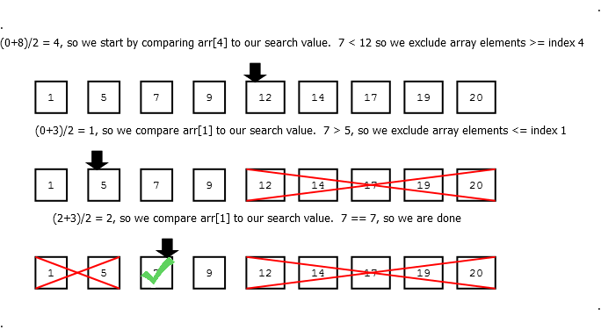
Binary Search II
-Can you illustrate an example? I’m having a hard time picturing this
Yes, see below for a simple example of a successful search for the value 7 to get the idea. Note that our midpoint for each iteration is (first array index + last array index)/2.

Slide 9
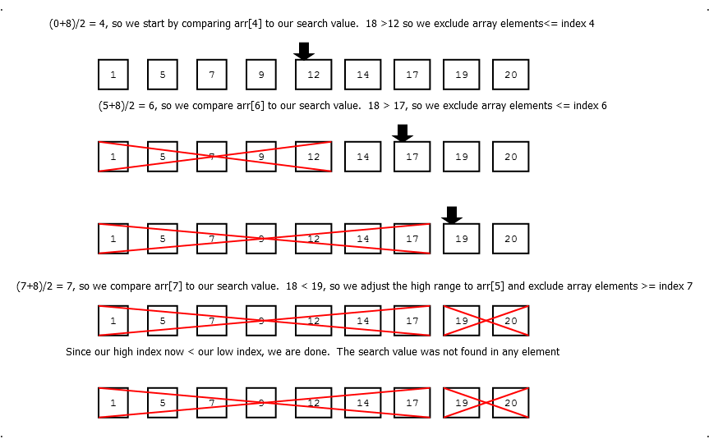
Binary Search III
-How about an example of an unsuccessful search?
See below for a search on the same array for 18. Note that if the lowest array index is greater than the highest array index, our search is done.

Slide 10

Binary Search Example
-What does the binary search look like?
See a fairly quickly coded binary search program attached which prints the average path length (and hence, complexity) for varying iterations over 1023 elements (log₂1023 ≈ 9.986). The varying iterations serve to reinforce that our average case (and hence, our path length) becomes more ‘average’ with more samples. See the ‘meat and bones’ of the function below:
int binarySearch(vector<int> v, int lowRange, int highRange, int srchVal){
pathHeight++;
int mid = (highRange+lowRange)/2;
if(srchVal == v[mid]){
return pathHeight;
}
else if(srchVal < v[mid]){
return binarySearch(v, lowRange, mid-1, srchVal);
}
else{
return binarySearch(v, mid+1, highRange, srchVal);
}
}
With each call we do another comparison, s o increment the path length
Get the midpoint for comparison
If the target value is less than the midpoint, partition the collection in half again and search the ‘lower’ half.
If success , return the number of comparisons so far
If the target value is greater than the midpoint, partition the collection in half again and search the ‘upper’ half.

Slide 11
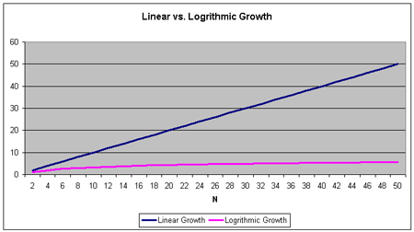
Binary Search Complexity
-How does 0.5n compare to log₂n?
logarithmic time < linear time. Look at the y-values on a graph for comparison:
-Why log₂n?
Look at the algorithm and note that we divide our analyzed collection in half each time we call the search function. This is the logarithmic function, and can be thought of as a ‘reverse exponent’: Just as 2⁸ ⁼ 256, log₂256 = 8. This means that we only require on average about 8 comparisons to completely search a collection of 256 elements. Compare that to 128 for linear search. It gets even better, though; see the next slide.

Slide 12
Searching Algorithm Analysis
-Why do we generally only concentrate on the highest degree polynomial in the number of operations equation (log_{x}n vs. n)?
When our number of elements is small we don’t have to worry about performance, and we can choose an algorithm that is easy to code and implement. As our number of elements gets very large we need to start worrying about performance, and it’s easy to see that our higher-degree polynomial becomes responsible for the lion’s share of the overhead, and the rest becomes insignificant. See the following example to view the relative ‘weight’ in terms of overall percentage of calculations that the n and n² portions are responsible for in the equation 100log₂n + n, and note how the n term quickly overcomes the logarithmic term log₂n even though log₂n is multiplied by 100:
Since it’s much cleaner and easier to recognize a single polynomial term and the rest is relatively insignificant (as seen above) we generally speak in terms of the leading polynomial. log(n) is much slower-growing than n and is preferable if we can obtain it with our algorithms.
# of Input Elements | Evaluation of 100log₂n + n | % of calculations log₂n | % of calculations of n
n = 2 | 100 + 2 | 98.04% | 1.96%
n = 256 | 800+ 256 | 75.76% | 24.24%
n = 65536 | 1600 + 65536 | 0.024% | 99.976%
n = 116777216 | 2400+ 116777216 | 0.00002% | 99.99998%
n = 4294967296 | 3200 + 4294967296 | 0.00000075% | 99.99999925%

Slide 13
Comparison Search Performance
-So, how good of performance can we expect with generic comparison-based searching algorithms?
The best performance we can obtain using a comparison search (testing for equality) on already-sorted, randomly distributed data inside linear data structures is log₂n . This is the best lower bound (least amount) we can obtain.
-Wait, why did you say ‘generic’ above? Can we get even better?
Sure, depending on the circumstance. To give one example, if we know in advance the frequency of the searches, we could put our most-searched data toward the front and use linear search, knowing that the most common search case will be made to be very fast. This could potentially compensate for the lesser-accessed, more ‘remote’ elements (see: amortized analysis). Another candidate could be interpolation search if the values are very evenly distributed. This allows for ‘guessing’ the approximate location of the data, similar to how you might open a phone book: if you’re looking for ‘Brooks’ then you would probably open the phone book to around the 10% mark. If the page you opened to started with ‘Bagui’ then you’d guesstimate and go a little further with your opening and then reassess.
-Why is log₂n the lower bound for comparison-based searching?
With each comparison decision that we make ,we can at best split the possible number of further decisions in half, since that last binary <, >, or = decision is behind us. Once we get down to only one decision we will have arrived there by repeatedly dividing our number of potential paths by two. This is logarithmic, base two.

Slide 14
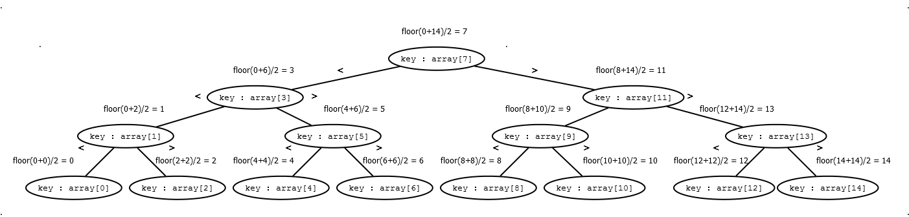
Comparison Search Performance II
-Still don’t see the logic behind the number of comparisons at log₂n?
See the decision tree below for an example of a search over a collection of 15 ordered elements. We can see that the worst case scenarios are where the node containing the search value is at index 0, 2, 4, 6, 8, 10, 12, or 14 of the array, because the search terminating at these nodes must use the longest path. Note that log₂15 is about 4 (≈ 3.90689, to be more precise), and see that the path length in terms of comparisons is 4 in the worst case. The worst case is where the element with the value corresponding to the search value is at the bottom of the decision tree.

Slide 15
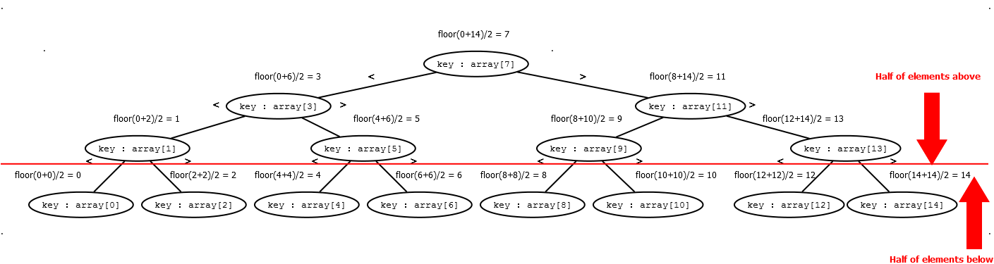
Comparison Search Performance III
-But surely the non-worst case scenarios will mean that the average comparison search case is less than log₂n?
for linear data structures (arrays and vectors.)
Not exactly. We’ll avoid heavy math and make this fairly simple. We have our same decision tree below with only a notation change. In full binary trees (this decision tree is a representation of one) we have floor(n/2)+1 nodes (leaves) in the bottom level. Note that this is only one more than half of the nodes. Remember, in the average case the node is found halfway through the collection. We see that we step through *about* half of the elements by the time we get to the next to last step. Since the last step is comparison number log₂n, it stands to reason that the average case complexity (number of comparisons) is *about* (log₂n) -1. This isn’t much less than log₂n at all, and keep in mind the demonstration of the inconsequential nature of coefficients (and hence, addition and subtraction of constants) from slide 12.

Slide 16

Go to the bottom-most (numerically highest) level
x = # elements in the collection
# elements in current level (for full tree)
Starting at level one
Path length = the number of the current level

Slide 17


