Slide 1

Credit Card Default Payments Analysis and Prediction
Diner’s Club
Mar 17, 2018
Yutao Lu, Wenyi Zhang, Fangyu Yan, Yu Liu

Slide 2
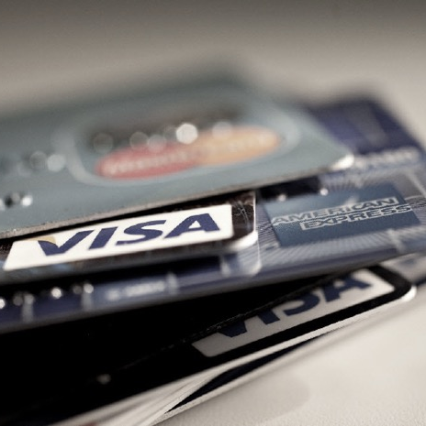
1
Background Information
Characteristics of credit card holders
2
Data Analysis
Initial analysis of trends, correlations
3
Forecasting
Predict the probability of being defaulted
CONTENTS
4
Decision Making
Provide a solution to make card issuer better off

Slide 3
01
Background Information
Characteristics of credit card holders

Slide 4
Potential Factors
Factors that might influence the July payment status
Sex
Monthly Repay Status
Age
Previous Monthly Statement
Marital Status
Previous Payment prior per month
Education

Slide 5
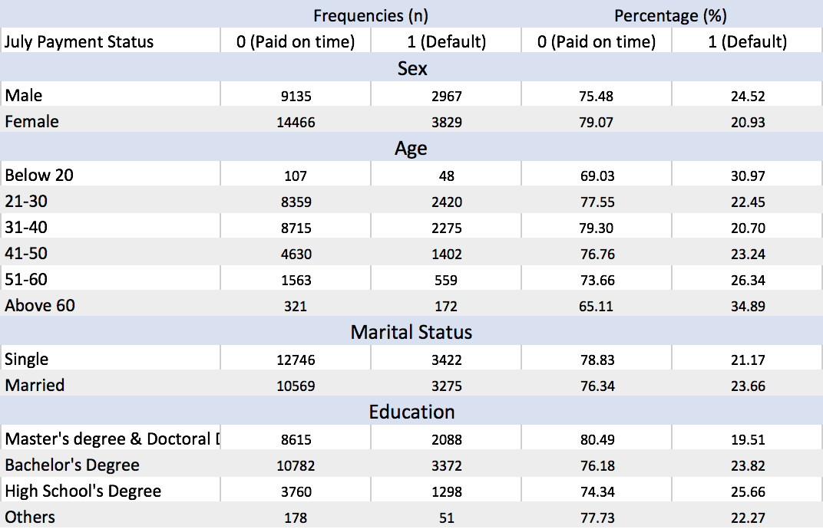
Characteristics of credit card holders

Slide 6
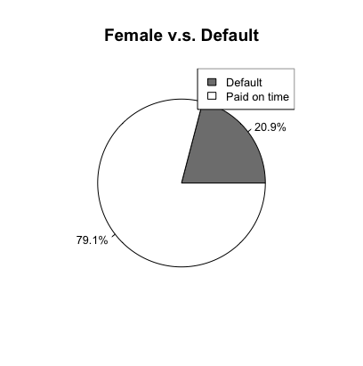
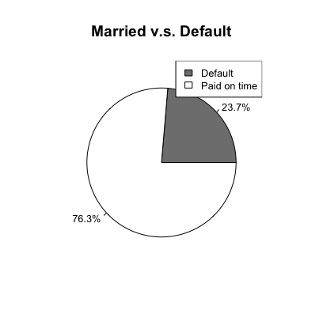
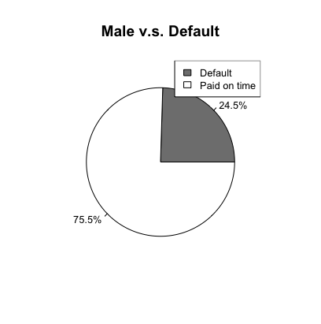
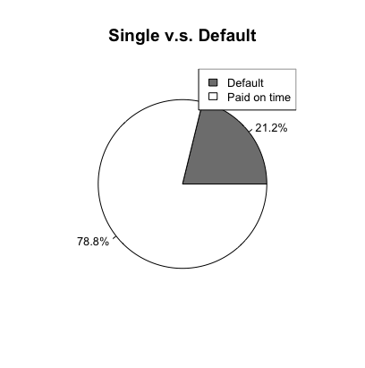
variables

Slide 7
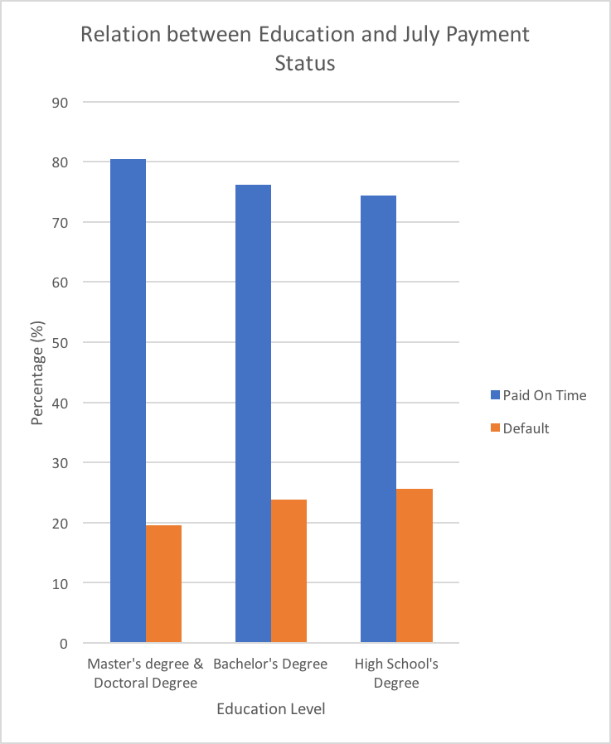
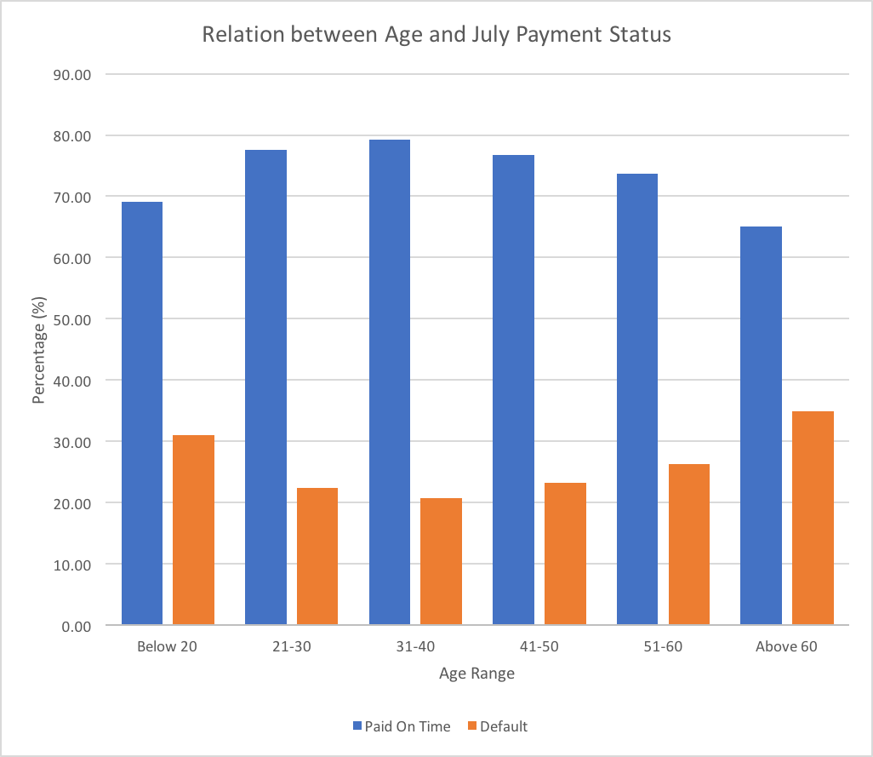
Trend
The trend observed from the data
公司一角
公司一角
办公室一角

Slide 8
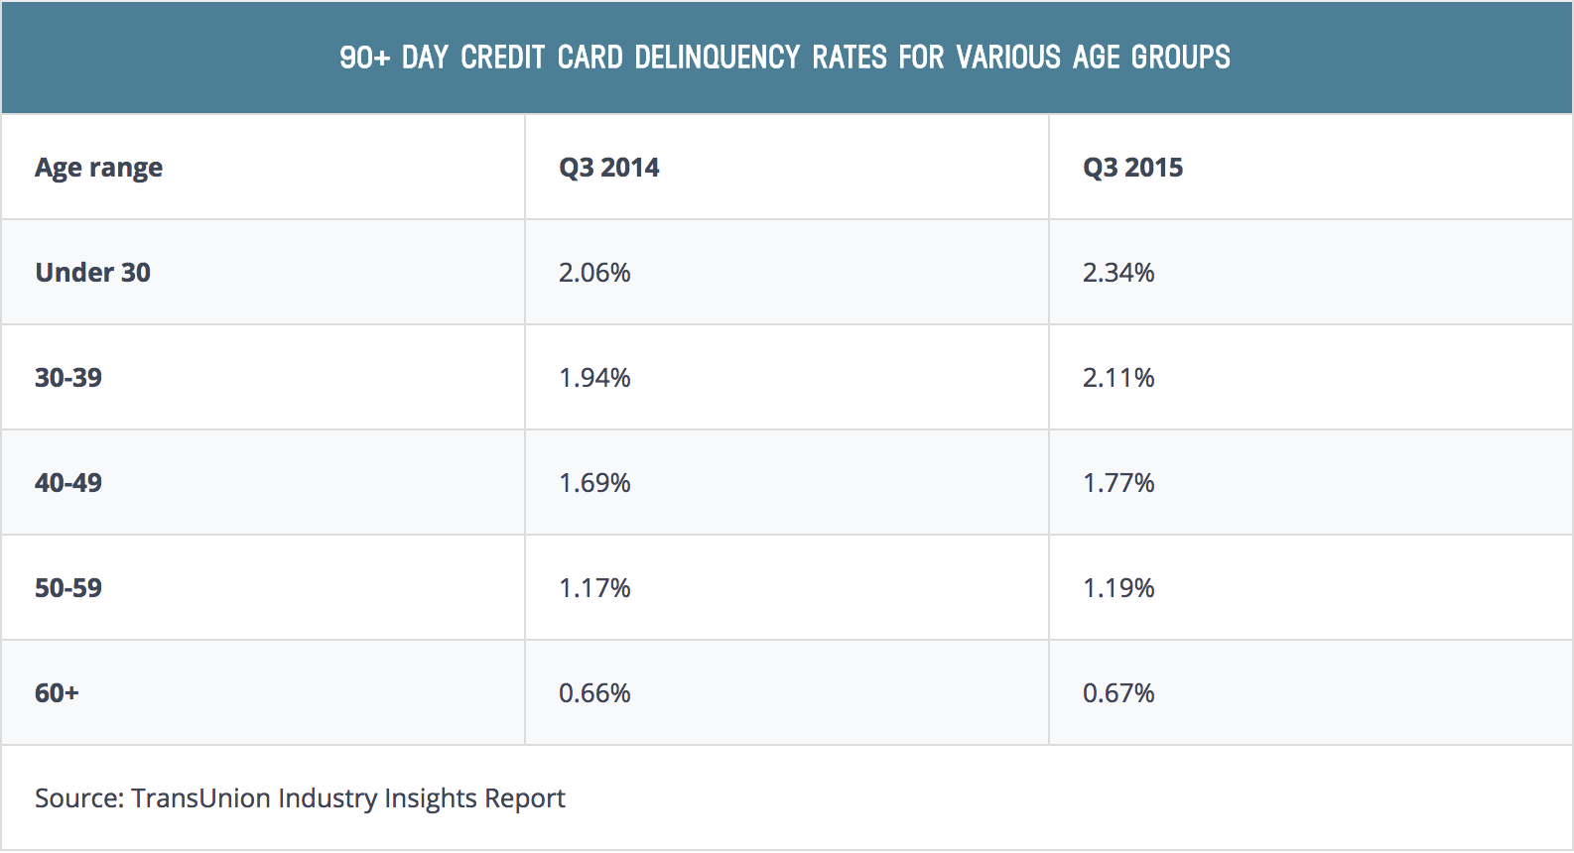
Who's falling behind
The user can demonstrate on a projector or computer
Some demographic groups are more likely than others to miss bill payments. Generally, the younger the consumer group, the higher their delinquency rates, with those under 40 years old seeing a slight increase in their delinquency rates between Q3 2014 and Q3 2015.

Slide 9

Primary Goal
The user can demonstrate on a projector or computer
Why our clients default on July Statement ?
What are the factors that influence clients’ payment behaviour?
How can we predict whether a client will pay their statement on time?

Slide 10
02
Data Analysis
Initial analysis of trends, correlations

Slide 11
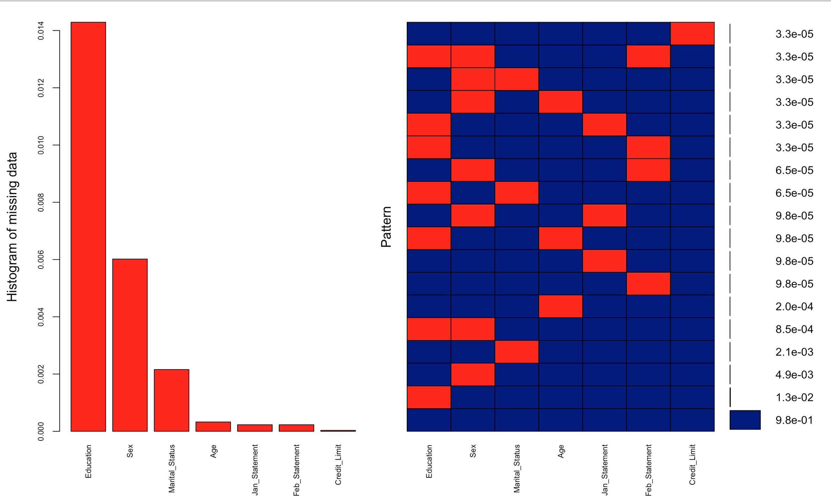
Predictive imputation
Replace negative values (-1, -2, -3) in columns: Jan_Repay_Status, Feb_Repay_Status, Mar_Repay_Status, Apr_Repay_Status, May_Repay_Status, Jun_Repay_Status by 0.

Slide 12
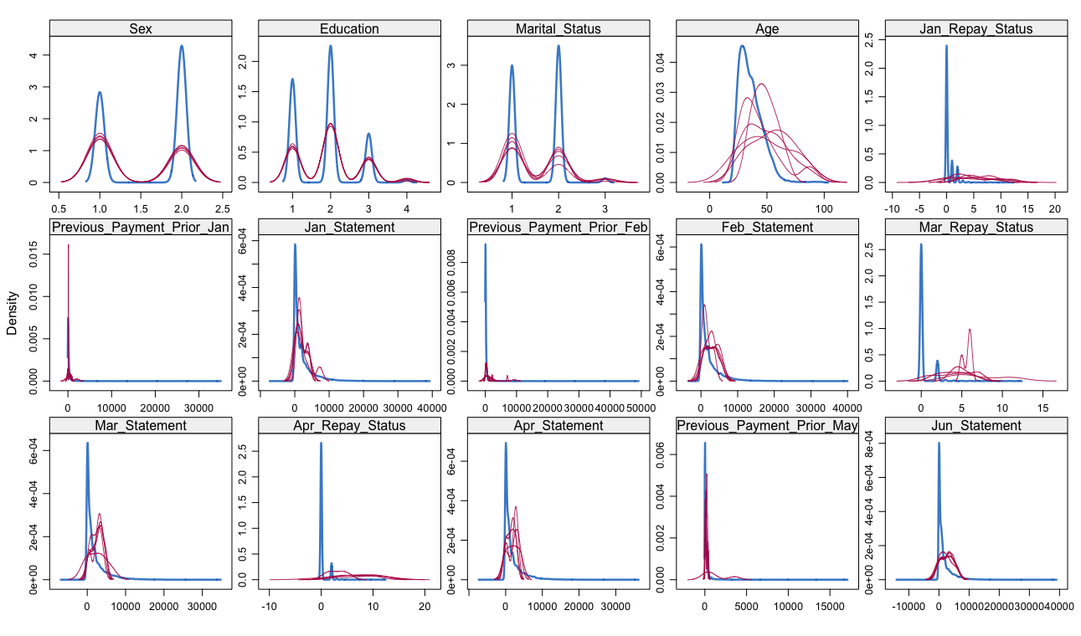
Mice transformation
Use mice to replace NA values.

Slide 13
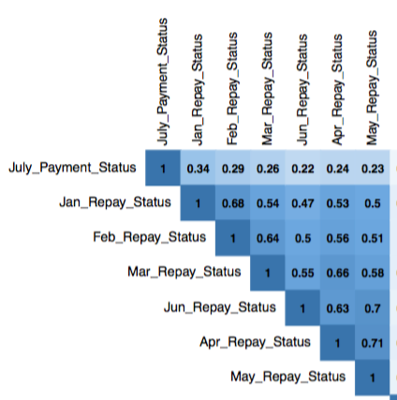
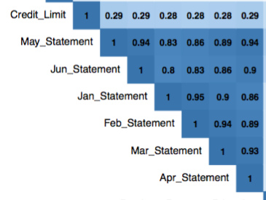
Pairwise Correlation Plot

Slide 14
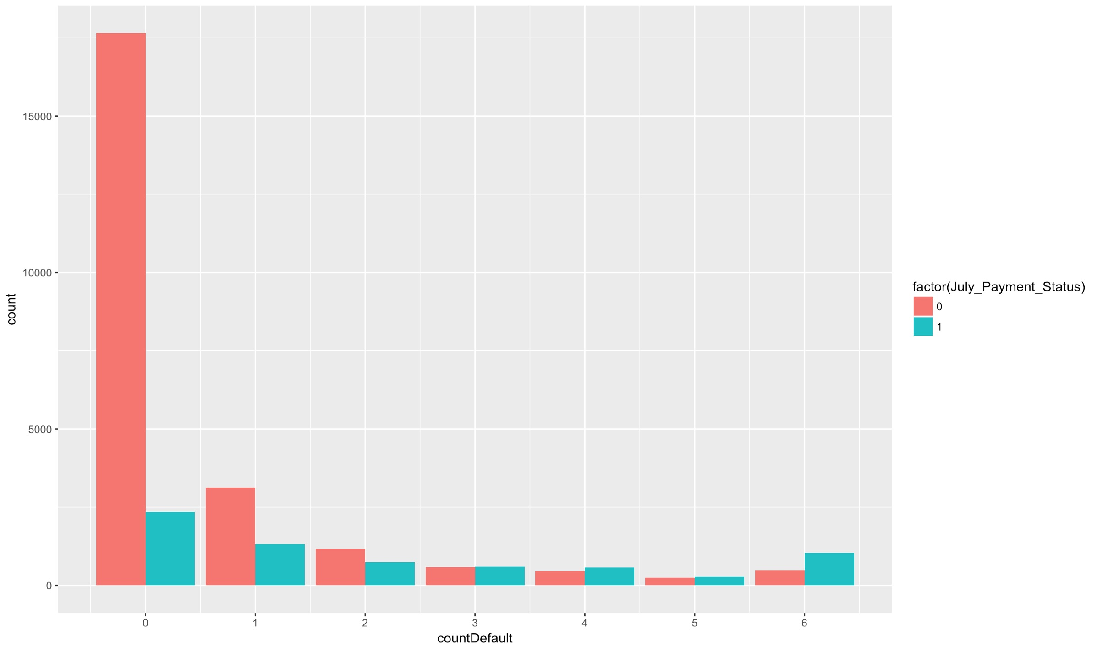
Histogram
The histogram of the number of time a client has been defaulted

Slide 15
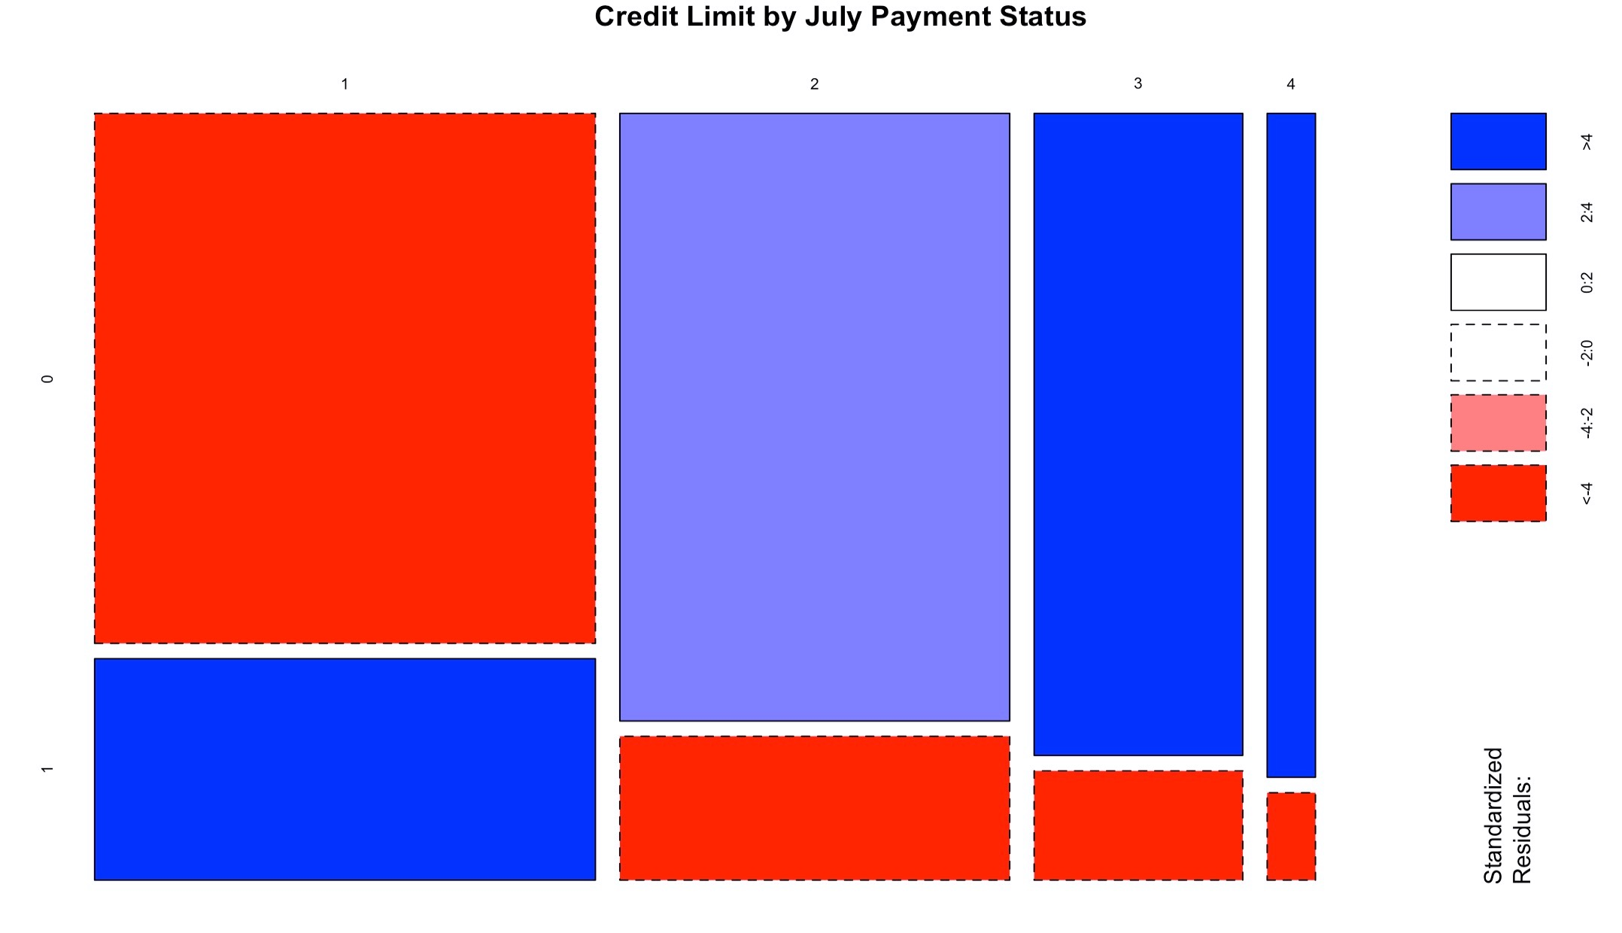
Credit Limit variable
Relation between credit limit and July Payment Status

Slide 16
03
Prediction
Predict the probability of being defaulted

Slide 17
Prediction Models
Models used to predict the result
Logistic Regression
Random Forest Model
Neural Network Model
PCA-Based Anomaly Detection Model

Slide 18
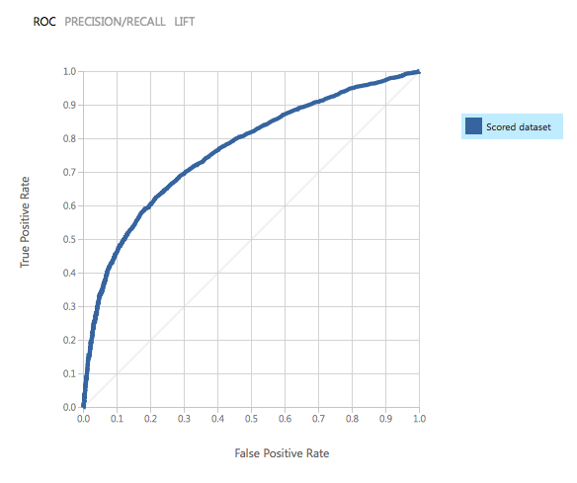
Logistic Regression
Logistic regression

Slide 19
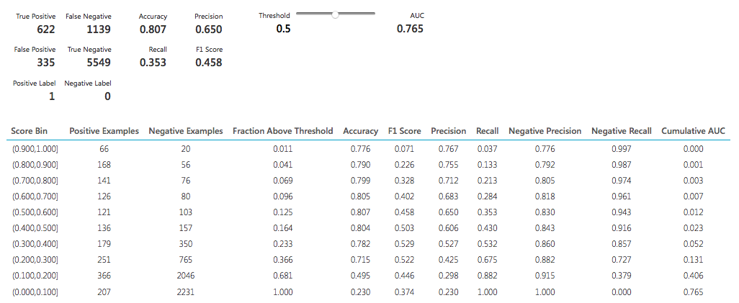
Summary
The user can demonstrate on a projector or computer

Slide 20
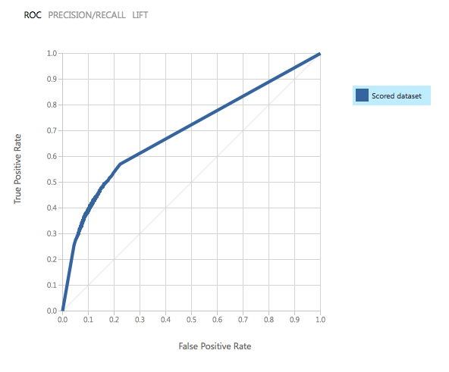
Neural Network

Slide 21
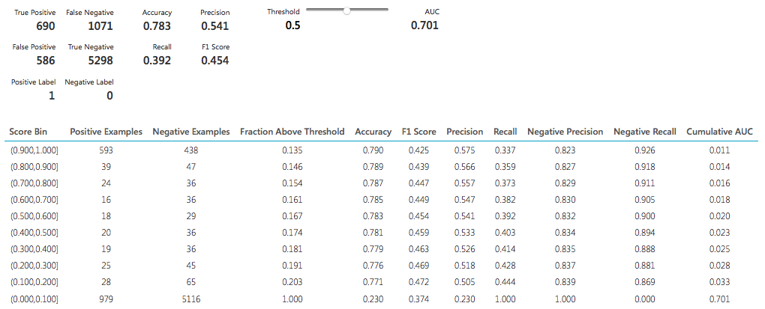
Neural Network
The user can demonstrate on a projector or computer

Slide 22
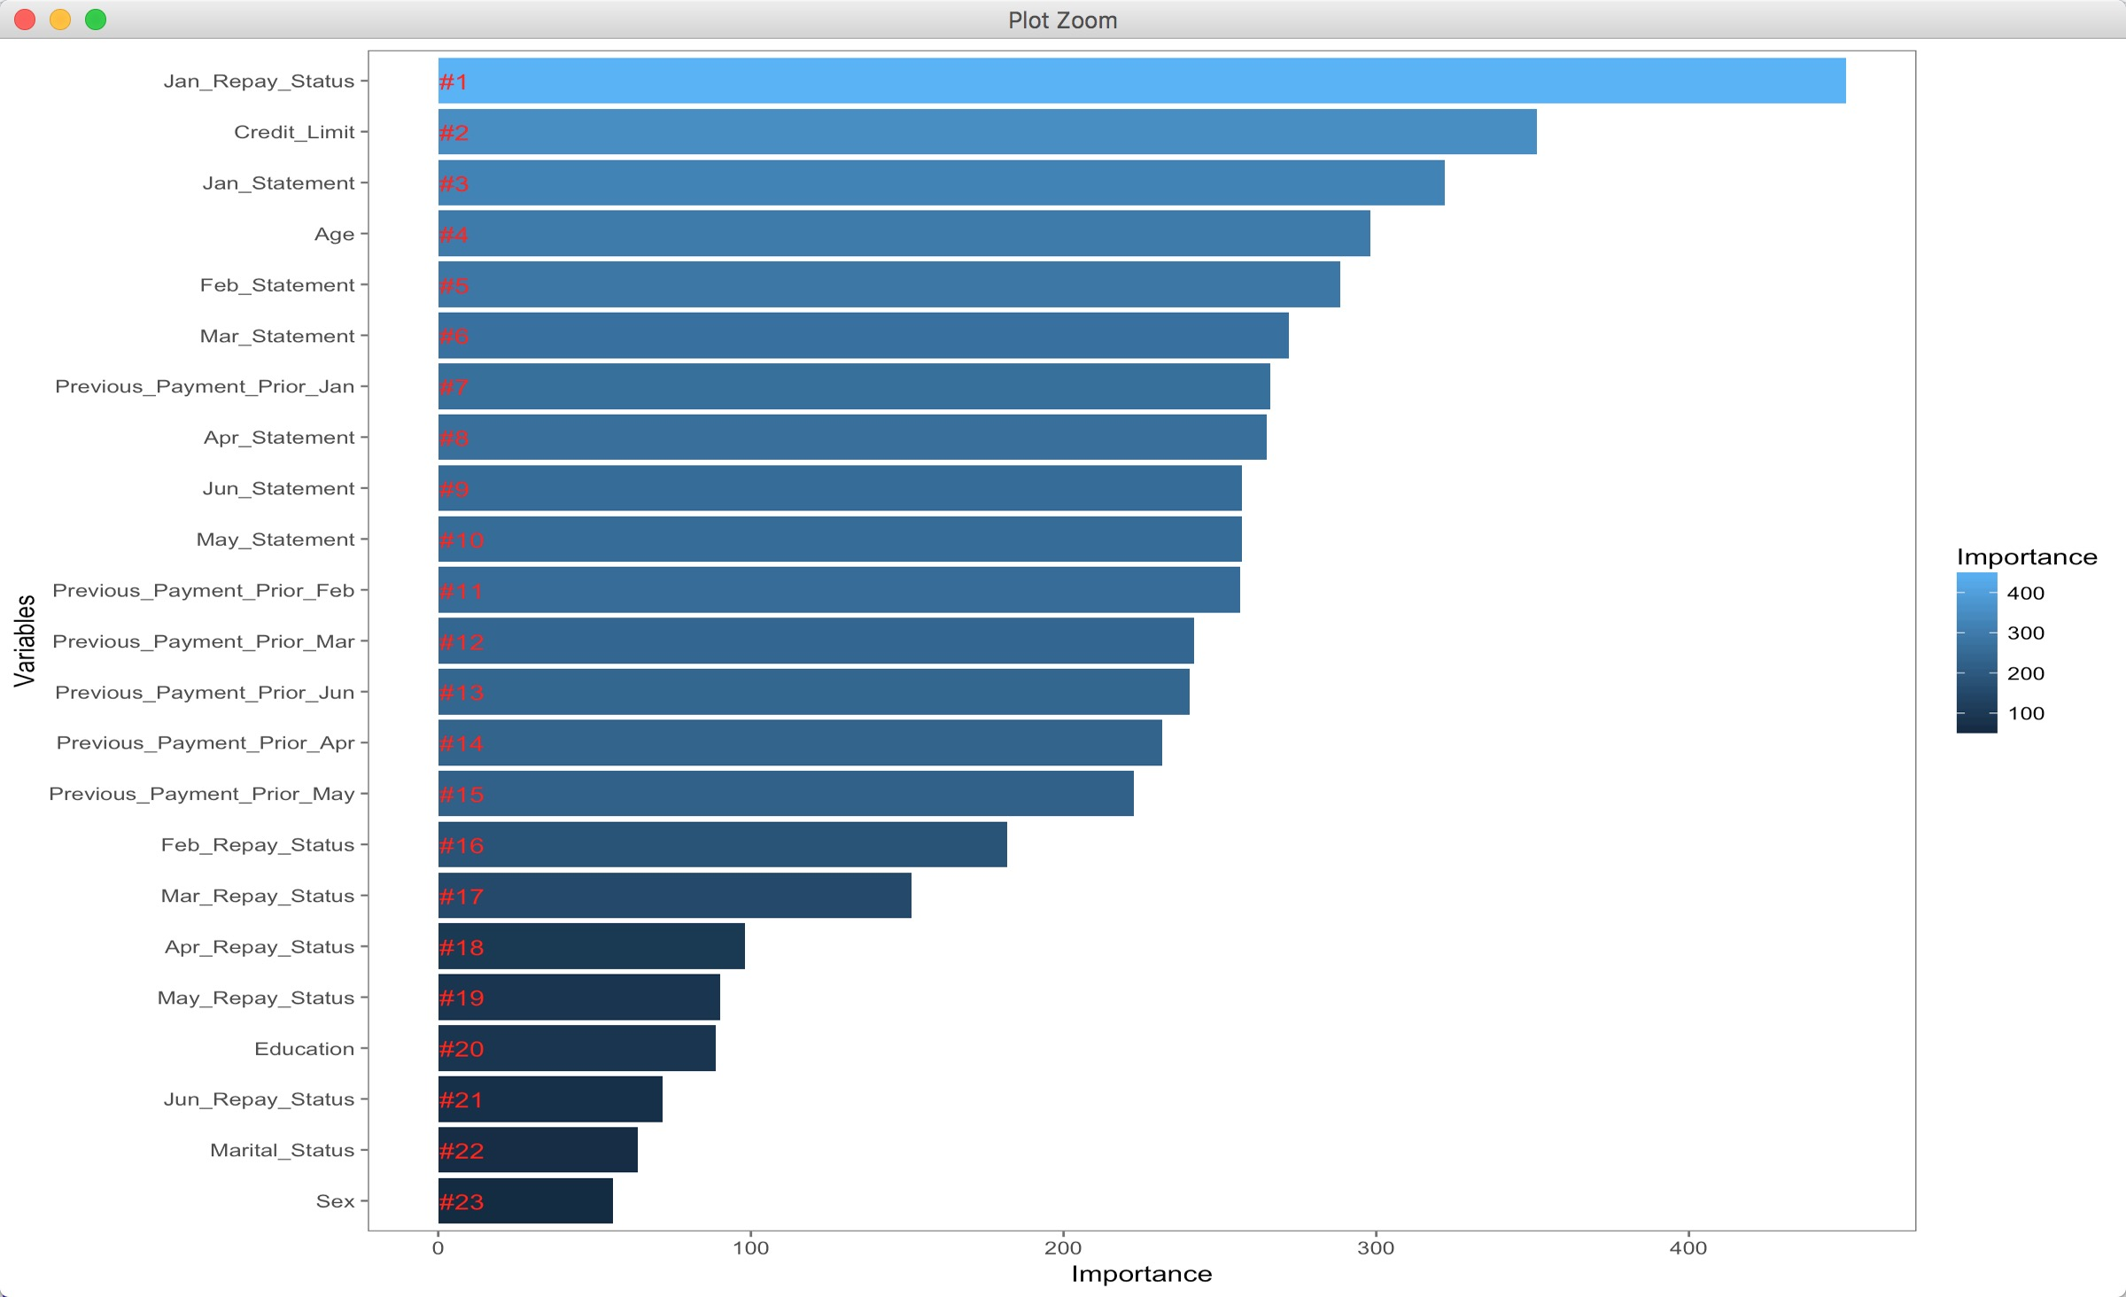
Random Forest
The importance of each variables

Slide 23
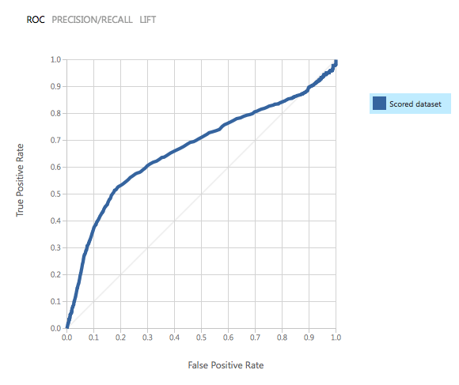
PCA Anomaly Detection
PCA Anomaly Detection

Slide 24
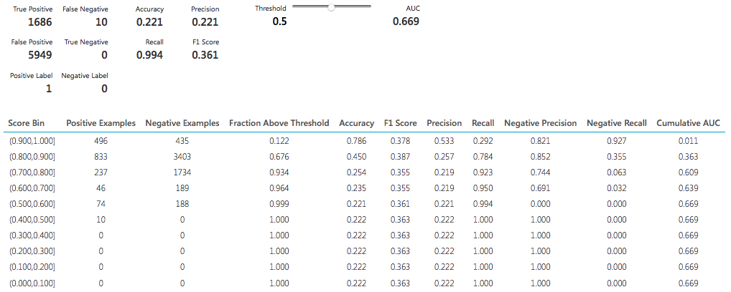
PCA Anomaly Detection

Slide 25
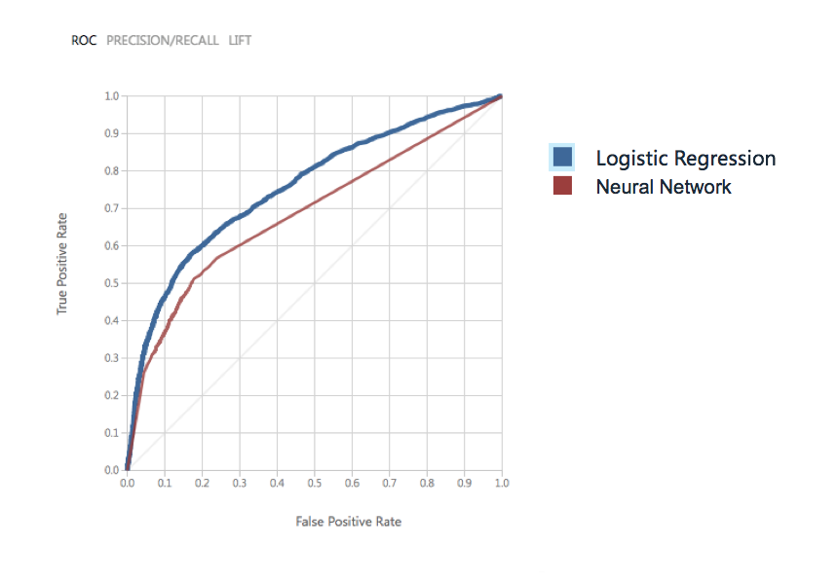
Comparison

Slide 26
Prediction
The user can demonstrate on a projector or computer
Split into training & test sets
01
02
Building the model
03
04
Variable Importance
Prediction!

Slide 27
04
Decision Making
Provide a solution to make card issuer better off

Slide 28
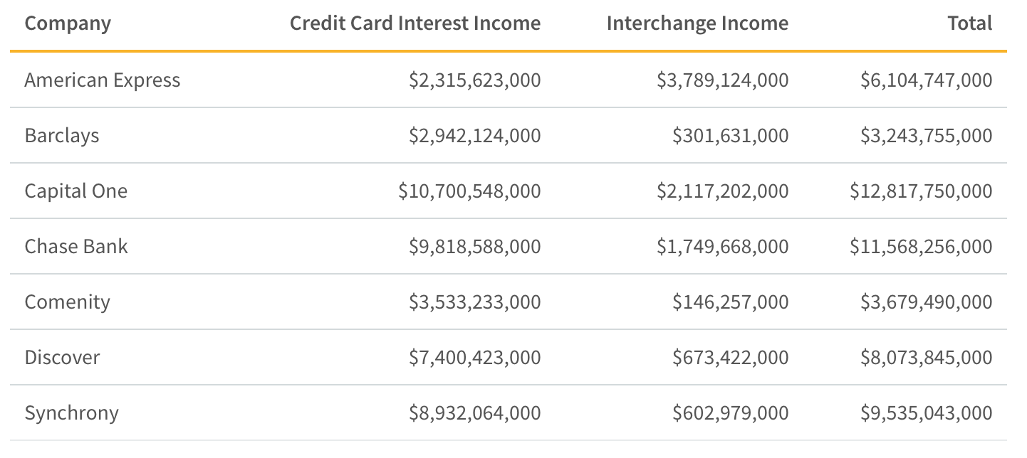
Income from Credit Card Interest and Merchant Fees
Source : https://www.valuepenguin.com/how-do-credit-card-companies-make-money

Slide 29
Variable Importance
The importance of each variables

Slide 30
Prominent Factors
Default ?
6-month repay status
Credit Limit

Slide 31
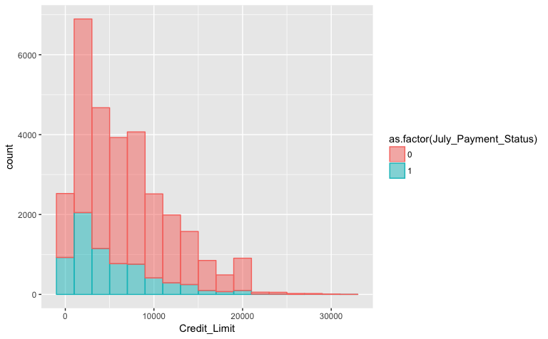
Credit Limit variable
Relation between credit limit and July Payment Status

Slide 32
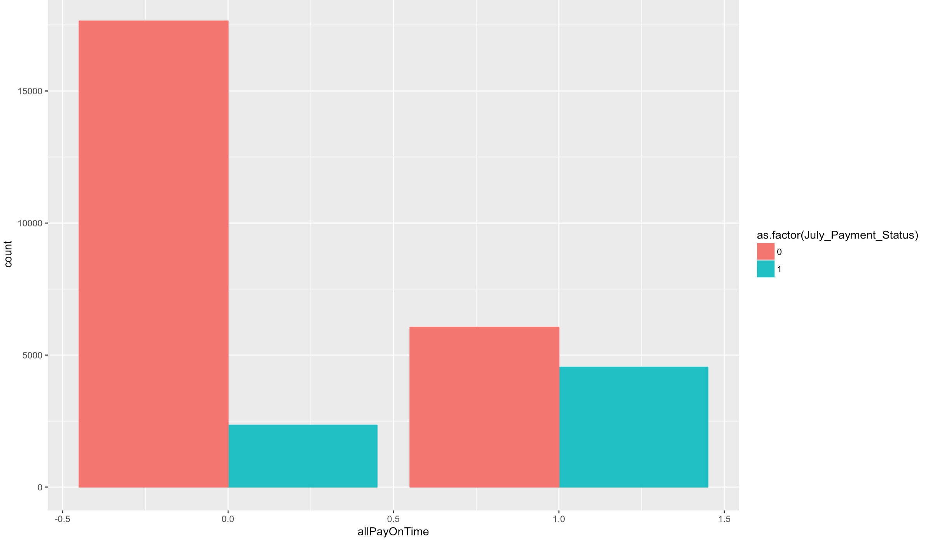
6-month repay status

Slide 33
Prediction Models
Models used to predict the result
Logistic Regression
Random Forest Model
Neural Network Model
PCA-Based Anomaly Detection Model

Slide 34
Model Performance
Default
Pay On Time
logistic regression, neural network, and random decision forest models are relatively good at classifying people who will pay their statements on time.
PCA-Based Anomaly Detection Model is good at predicting default behavior.

Slide 35
Life Cycles of a Business
Rapid Growth Stage
Maturity Stage

Slide 36
Strategy
Solution to make credit card issuer better off
Rapid Growth Stage
Maturity Stage
Focus: Increase its market share,
mitigating the risk
Focus: prioritizing risks,
Steady growth
Strategy
Strategy
employ models that have relatively higher default tolerance.
E.g. logistic regression, neural network, and random decision forest models
Employ models that are good at detecting default behavior.
e.g. PCA-Based Anomaly Detection model

Slide 37

Primary Principle
Solution to make credit card issuer better off
Built on the existing business model, the issuer would always be better off by issuing credit cards to people who paid their statements timely in the previous six consecutive months, but did not pay the full amount.

Slide 38
Thanks for watching
Diner’s Club
Mar 17, 2018
Yutao Lu, Wenyi Zhang, Fangyu Yan, Yu Liu

