Slide 1
Mentor, A Siemens Business
R-Car Gen3 Remote Update
October 11th , 2018
Source: Notes are in Tahoma, regular, 8 point, italic, flush left, vertically aligned from the bottom of text box.

Slide 2
Objectives
Simplify firmware flashing on Renesas R-Car Gen3 boards (ATF, u-boot, OP-TEE) – no MiniMonitor, no DIP switch handling
Remote full system update (Firmware and Linux)
Improved image versioning and management

Slide 3
Proposed solution
Framework for remote full-system update (file system + firmware):
Remote update server: hawkBit
Software update for Linux embedded system: SWUpdate
Firmware flashing, patched OP-TEE OS and static TA: flash_app

Slide 4

1. SWUpdate
https://github.com/sbabic/swupdate
Image based update application
Supports signed images, single/dual copy, local/remote updates, u-boot, …
Straight-forward Yocto Project integration (meta-swupdate)
https://wiki.yoctoproject.org/wiki/System_Update#babic.27s_SWUpdate
Configurable update images (sw-description + CPIO archive)
Various handler plugins (raw, file, archive, scripts …)
Already used by Siemens and Mentor Graphics PBU
https://stash.alm.mentorg.com/projects/MEL/repos/mel-meta-mentor-swupdate/browse

Slide 5
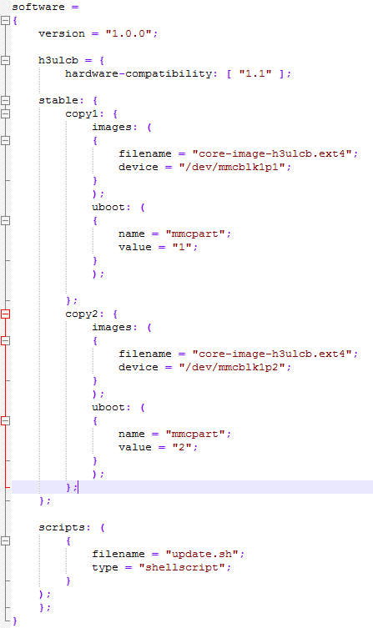
SWUpdate (2)
.swu images: simple CPIO archives
sw-description: configures the update parameters (JSON)
FILES="sw-description core-image-h3ulcb.ext4 update.sh“
for i in $FILES; do echo $i; done | cpio -ov -H crc > update-image-minimal.swu
Update intefaces
Locally triggered update
swupdate –i /path/update-image-minimal.swu
Web server running on the target
swupdate –w “-r </www_dir>”
Download from HTTP
swupdate –d <url>/update-image-minimal.swu
Use suricatta & hawkBit
swupdate -u “<suricatta options>

Slide 6

2. Eclipse hawkBit
https://www.eclipse.org/hawkbit/
“hawkBit is an domain independent back-end framework for rolling out software updates to constrained edge devices as well as more powerful controllers and gateways connected to IP based networking infrastructure”
swupdate contains a daemon called Suricatta to work with hawkBit
REST APIs available for pretty much everything
Support for scheduled updates, complex rollout mechanisms, targets filtering, software distributions management, …

Slide 7
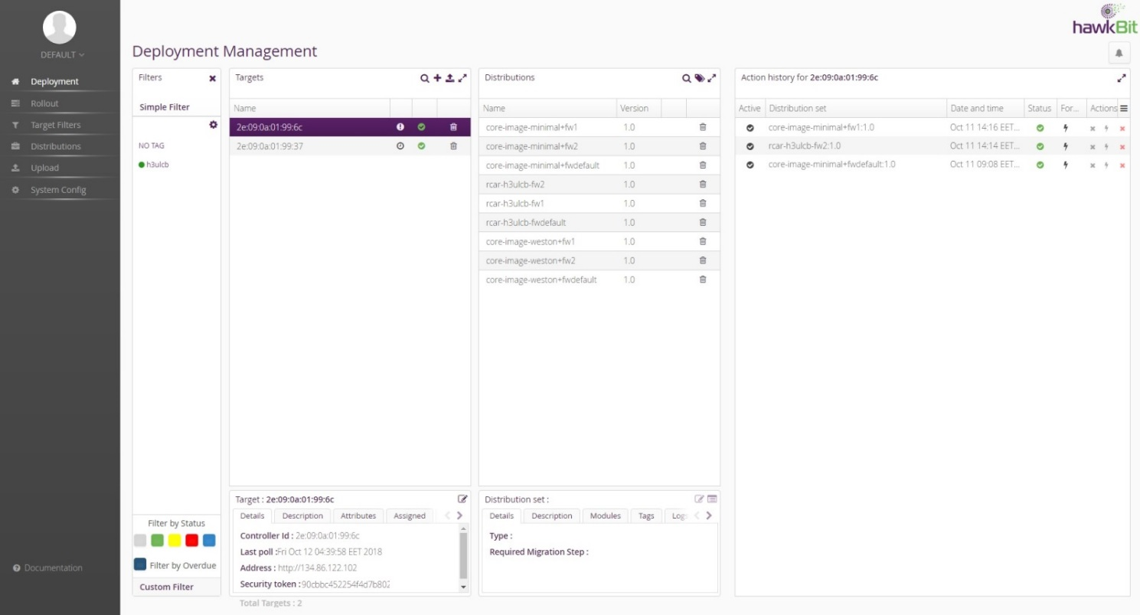
Eclipse hawkBit (2)

Slide 8
3. flash_app
https://stash.alm.mentorg.com/projects/SOCRENRCAR/repos/rcar-platform-tools/browse/rcar_flash_update
Challenge: Hyper Flash not visible from Linux!
Solution: have the OP-TEE OS flash the firmware images

Slide 9
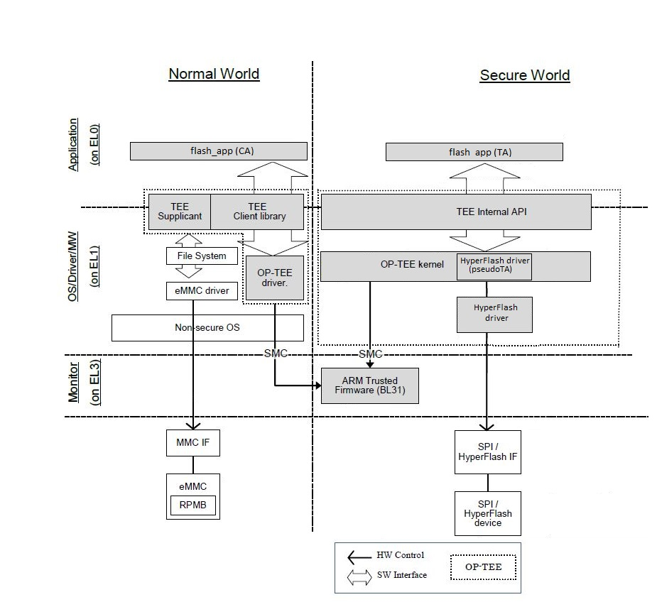
flash_app (2)

Slide 10
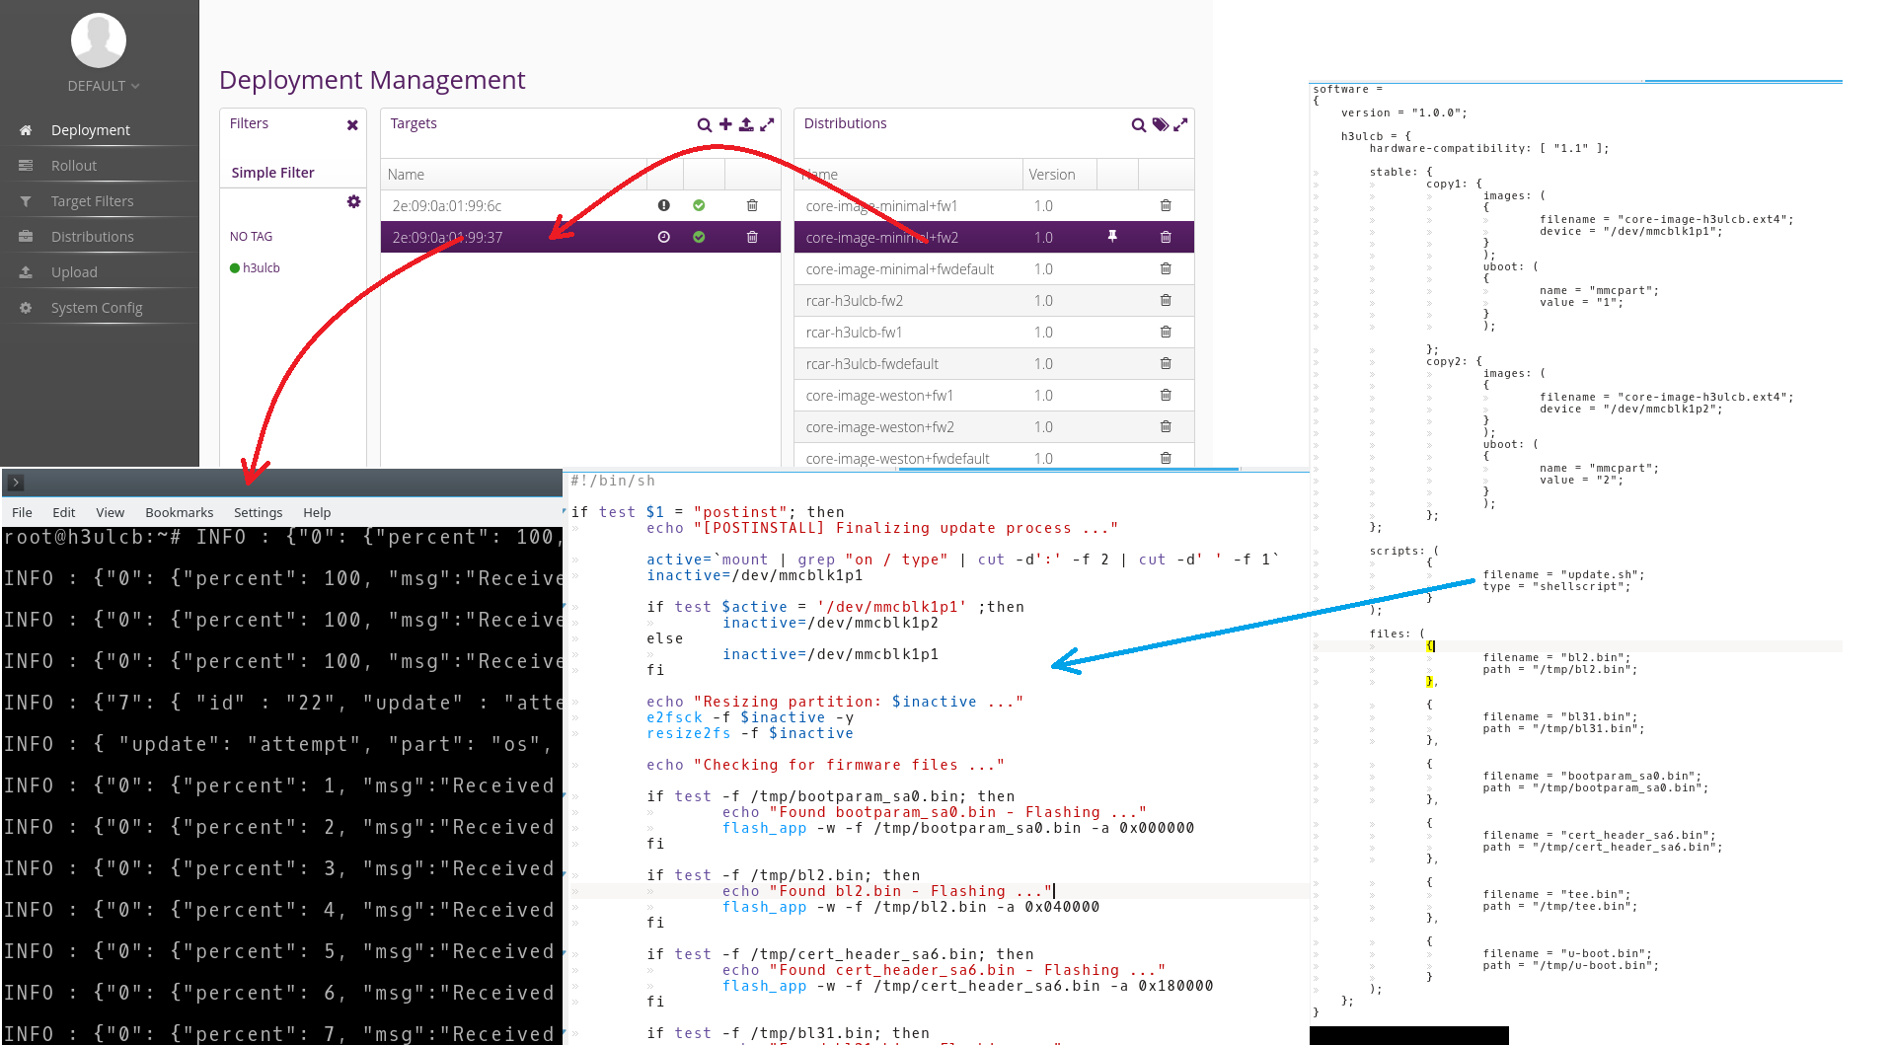
So, how is that working?

Slide 11
Pros
Straight-forward integration with a remote update server
Configurable update images
Complete local/remote system update (bl2, bl31, cert_header, boot_params, u-boot, optee-os, kernel, file system)
Sygned/encrypted update images supported

Slide 12
Challenges
Recovery mechanisms
Tied to the patched OP-TEE OS (hyperflash) and TA (MMC)
Currently relying on u-boot 18.03 envtools to switch active boot partition and report update status
No interactive remote update on the target side currently supported

Slide 13
Next steps
Add Integrity and Security support
Add full swupdate image build in Yocto
Secure OP-TEE OS flasher application
Add support for image signing and encryption
Recovery mechanisms

Slide 14
Next steps (2)
Drawlines for a roll back mechanism:
IPL A side – recovery branch (read only)
IPL B side – working branch
When BootROM integrity check fails or IPL detects a halt, the roll back mechanism is triggered

Slide 15
Thank you

