Slide 1

Introduction to 2D/3D Graphics Development with OpenGL ES on the Beagle Board
Clay D. Montgomery,
Graphics Software Engineer
September, 2009

Slide 2
Agenda
Introduction
Graphics APIs
  OpenGL ES 1.1
  OpenGL ES 2.0
  OpenVG 1.1
Graphics SDK
Compositing
Beagle Board Workshop

Slide 3
Introduction
  Applications
  PowerVR SGX Core

Slide 4
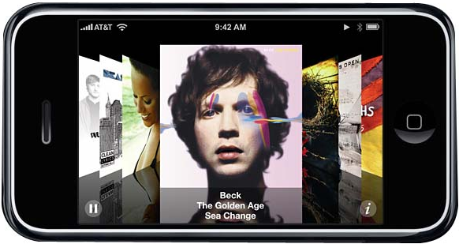
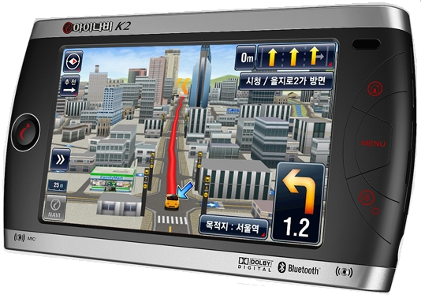
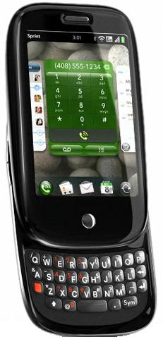
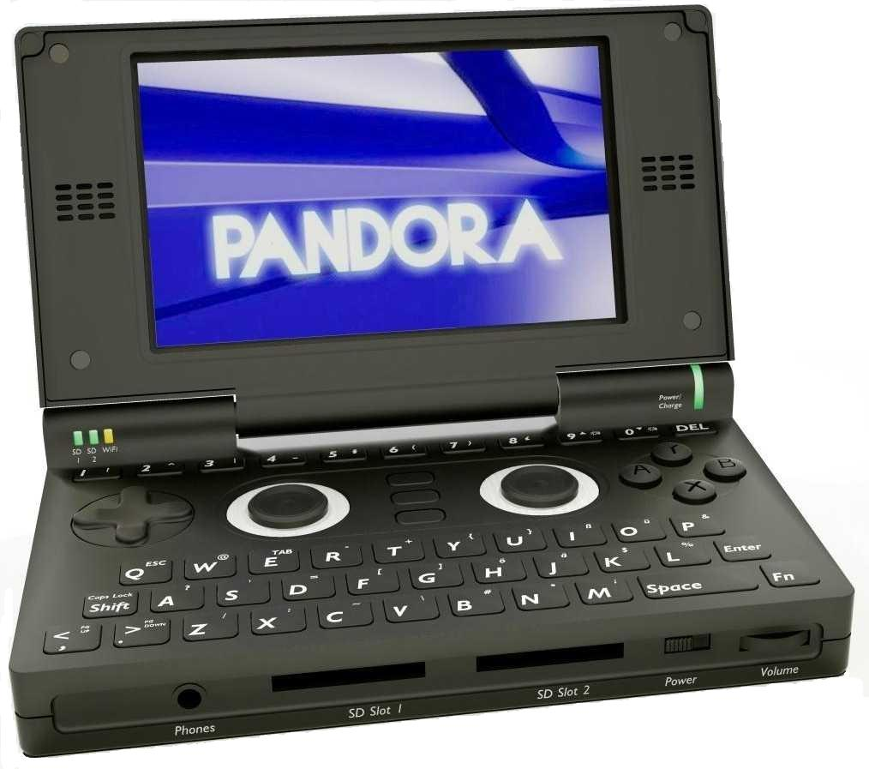
Graphics Applications
Accelerated 3D GUIs are pervasive today
Custom GUIs provide the best product differentiation
Larger display sizes require faster graphics
Hardware accelerators use less power than software implementations
Desktop technologies are rapidly moving to the mobile space (programmable shaders)
Major applications are:
  Scalable User Interfaces
  Navigation
  Games
  Visualizations (Music)
  Automotive

Slide 5
ARM Cortex-A8 + NEON VFP + SGX
The best combination for high performance mobile graphics
ARM Cortex-A8 is 2X faster than ARM11
NEON is a SIMD vector floating point processor (VFP)
  Accelerates many calculations in graphics applications another 2X to 4X
  Ideal for color space conversion, image filters, game physics, etc.
OMAP3530
Comparison of NEON to ARM11 VFP
Calculation ARM 11 VFP NEON
4 x 4 * 4x1 matrix mult 22 cycles/vertex 8 cycles/vertex
Vector normalization 30 cycles/vertex 6 cycles/vertex
3 term dot product 5.1 cycles/product 3 cycles/product
3 term cross product 11.7 cycles/product 3 cycles/product
Division by W 17 cycles/vertex 3.5 cycles/vertex
Data provided by ARM, Ltd.
ARM®
Cortex™- A8
with NEON VFP
PowerVR
SGX
Graphics
C64x+
DSP
Other
Peripherals
Display Subsystem

Slide 6
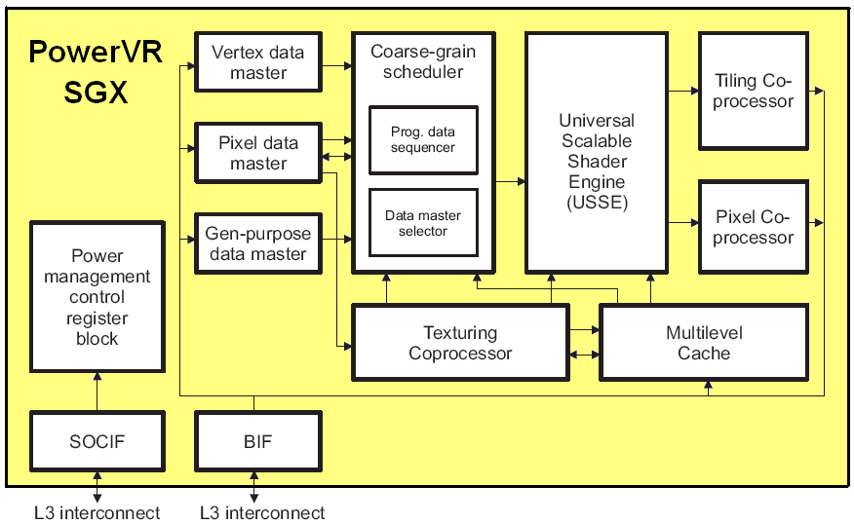
PowerVR SGX Core
Combination of hard-wired pipelines and programmable USSE (Universal Scalable Shader Engine)
Multithreaded
  Runs Vertex Shader Programs
  Runs Fragment Shader Programs
SIMD execution
32-bit IEEE floating point
Fine-grained task switching
Advanced geometry DMA
High quality antialiasing
Deferred rendering
Tiled-based architecture
~10M Polygons/sec.
275 Million Pixels/sec.
~0.9 GFLOPS

Slide 7

PowerVR SGX Core
The SGX is too complex to program at the register level!
Therefore, use the standard software APIs:
  OpenGL ES 1.1
  OpenGL ES 2.0
  OpenVG 1.1
Industry Standard APIs were defined by the Khronos Group
Protects your software development investment!

Slide 8
Graphics APIs
  The OpenGL Pipeline
  OpenGL ES 1.1
    Porting from Desktop Programming Example
  OpenGL ES 2.0
    Evolution
    GLSL ES Shader Programming Example
  OpenVG

Slide 9
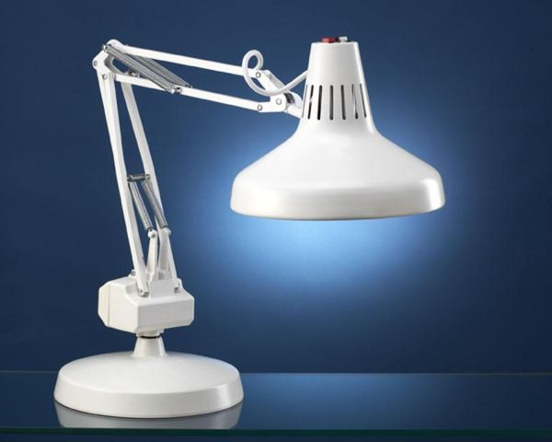
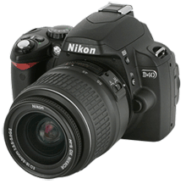
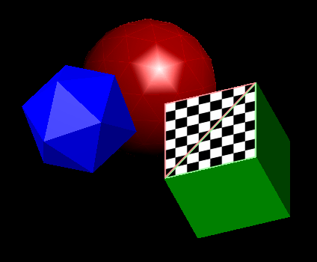
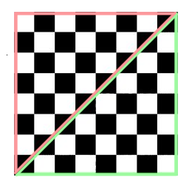

The OpenGL Graphics Pipeline
State Variables
Front Buffer
Geometry
Pipeline
Fragment
Pipeline
Camera Position
Light Sources
Etc.
F
C
G
E
Back Buffer
D
A
C
GL_TRIANGLES
B
A
B
GL_TRIANLE_FAN
A
C
E
F
B
D
GL_TRIANGLE_STRIP
Texture Maps

Slide 10

OpenGL ES – Porting from Desktop
Applications can be ported from desktop OpenGL
Features removed from desktop OpenGL:
  glBegin/glEnd and glVertex (See the following code porting example)
  Advanced: imaging subset, evaluators, display lists
  Legacy: Indexed colors, DrawPixels
  Double precision data types and entry points
Features added
  Fixed-point and byte data
  Fixed-point only profile available (but not supported for OMAP)
Features retained
  Vertex Transforms and Lighting (mostly)
  Multi-texturing (2D only)
  Full Scene Antialiasing via Multisampling
  Alpha blending
Other porting issues
  GLU and GLUT
Many excellent resources are available for learning OpenGL

Slide 11
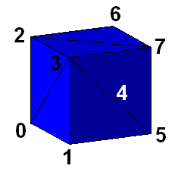
OpenGL 1.0
glVertex3fv(&Vertices[5][0]); // right
glVertex3fv(&Vertices[4][0]);
glVertex3fv(&Vertices[7][0]);
glVertex3fv(&Vertices[7][0]);
glVertex3fv(&Vertices[4][0]);
glVertex3fv(&Vertices[6][0]);
glVertex3fv(&Vertices[6][0]); // top
glVertex3fv(&Vertices[2][0]);
glVertex3fv(&Vertices[7][0]);
glVertex3fv(&Vertices[7][0]);
glVertex3fv(&Vertices[2][0]);
glVertex3fv(&Vertices[3][0]);
glVertex3fv(&Vertices[1][0]); // front
glVertex3fv(&Vertices[5][0]);
glVertex3fv(&Vertices[3][0]);
glVertex3fv(&Vertices[3][0]);
glVertex3fv(&Vertices[5][0]);
glVertex3fv(&Vertices[7][0]);
glVertex3fv(&Vertices[0][0]); // bottom
glVertex3fv(&Vertices[4][0]);
glVertex3fv(&Vertices[1][0]);
glVertex3fv(&Vertices[1][0]);
glVertex3fv(&Vertices[4][0]);
glVertex3fv(&Vertices[5][0]);
glEnd();
}
void DrawCube(void)
{
static GLfloat Vertices[8][3] =
{ // x y z
{-1.0, -1.0, -1.0}, // 0
{-1.0, -1.0, 1.0}, // 1
{-1.0, 1.0, -1.0}, // 2
{-1.0, 1.0, 1.0}, // 3
{ 1.0, -1.0, -1.0}, // 4
{ 1.0, -1.0, 1.0}, // 5
{ 1.0, 1.0, -1.0}, // 6
{ 1.0, 1.0, 1.0} // 7
};
glBegin(GL_TRIANGLES);
glVertex3fv(&Vertices[1][0]); // left
glVertex3fv(&Vertices[3][0]);
glVertex3fv(&Vertices[0][0]);
glVertex3fv(&Vertices[0][0]);
glVertex3fv(&Vertices[3][0]);
glVertex3fv(&Vertices[2][0]);
glVertex3fv(&Vertices[0][0]); // back
glVertex3fv(&Vertices[2][0]);
glVertex3fv(&Vertices[4][0]);
glVertex3fv(&Vertices[4][0]);
glVertex3fv(&Vertices[2][0]);
glVertex3fv(&Vertices[6][0]);
Example of porting old code from desktop OpenGL

Slide 12
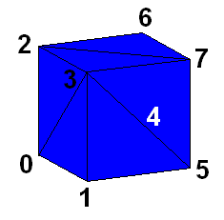
OpenGL ES 1.1
Embedded code with no lighting
void DrawCube(void)
{
static GLfloat Vertices[8][3] =
{ // x y z
{-1.0, -1.0, -1.0}, // 0
{-1.0, -1.0, 1.0}, // 1
{-1.0, 1.0, -1.0}, // 2
{-1.0, 1.0, 1.0}, // 3
{ 1.0, -1.0, -1.0}, // 4
{ 1.0, -1.0, 1.0}, // 5
{ 1.0, 1.0, -1.0}, // 6
{ 1.0, 1.0, 1.0} // 7
};
static GLuint Indices[6][6] =
{
{0, 1, 3, 3, 2, 0}, // left
{0, 2, 4, 4, 2, 6}, // back
{5, 4, 7, 7, 4, 6}, // right
{2, 3, 7, 7, 6, 2}, // top
{1, 5, 3, 3, 5, 7}, // front
{0, 4, 1, 1, 4, 5} // bottom
};
glVertexPointer(3, GL_FLOAT, 0, Vertices);
glDrawElements(GL_TRIANGLES, 36, GL_UNSIGNED_INT, Indices);
}

Slide 13
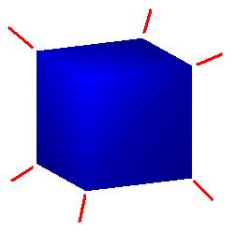
OpenGL ES 1.1
Embedded code with lighting
(Smooth Shaded)
void DrawCube(void)
{
static GLfloat Vertices[8][3] =
{ // x y z
{-1.0, -1.0, -1.0}, // 0
{-1.0, -1.0, 1.0}, // 1
{-1.0, 1.0, -1.0}, // 2
{-1.0, 1.0, 1.0}, // 3
{ 1.0, -1.0, -1.0}, // 4
{ 1.0, -1.0, 1.0}, // 5
{ 1.0, 1.0, -1.0}, // 6
{ 1.0, 1.0, 1.0} // 7
};
static GLuint Indices[6][6] =
{
{0, 1, 3, 3, 2, 0}, // left
{0, 2, 4, 4, 2, 6}, // back
{5, 4, 7, 7, 4, 6}, // right
{2, 3, 7, 7, 6, 2}, // top
{1, 5, 3, 3, 5, 7}, // front
{0, 4, 1, 1, 4, 5} // bottom
};
glVertexPointer(3, GL_FLOAT, 0, Vertices);
glNormalPointer(GL_FLOAT, 0, NormalsPerVertex);
glDrawElements(GL_TRIANGLES, 36, GL_UNSIGNED_INT, Indices);
}
Surface Normal Vectors
// One normal per vertex.
static GLfloat NormalsPerVertex[8][3] =
{ // x y z
{-0.5, -0.5, -0.5}, // 0
{-0.5, -0.5, 0.5}, // 1
{-0.5, 0.5, -0.5}, // 2
{-0.5, 0.5, 0.5}, // 3
{ 0.5, -0.5, -0.5}, // 4
{ 0.5, -0.5, 0.5}, // 5
{ 0.5, 0.5, -0.5}, // 6
{ 0.5, 0.5, 0.5} // 7
};

Slide 14
OpenGL ES 1.1
…and the rest of the program
main()
{
Allocate frame buffers in DDR
Bind the buffers to be displayed on the DSS (via EGL)
glEnable(GL_LIGHTING); // Setup a light for the scene.
glEnable(GL_LIGHT0);
glLightfv(GL_LIGHT0, GL_SPOT_DIRECTION, Position);
glViewport(0, 0, Width, Height); // Setup the viewport to the scene (camera).
for (Degrees = 0; Degrees < 360; Degrees++)
{
glClearColor(0.0, 0.0, 0.0, 1.0); // Clear drawing buffer to black.
glClear(GL_COLOR_BUFFER_BIT);
glPushMatrix();
glRotatef(Degrees, 1.0, 1.0, 0.0); // Rotate the cube model.
glColor3ub(0, 0, 255); // Set drawing color to blue.
DrawCube(); // Draw the Cube!
glPopMatrix();
eglSwapBuffers(eglDisplay, eglSurface); // Swap pointers to front and back buffers
}
}

Slide 15

Evolution of Embedded OpenGL
OpenGL 1.0 – 2.0 (Desktop)
  Large and impractical for embedded devices
  Customers are porting apps from these versions to OMAP
OpenGL ES 1.1
  Embedded version for fixed-function shading hardware
  Subset of desktop OpenGL
  Standard created by the Khronos Group Industry consortium in 2003
  Rapidly became the dominant standard for embedded 3D
  Also popular for scalable 2D applications
OpenGL ES 2.0
  Replaces 2 major sections of the 3D pipeline with shader programs
    Vertex Shader – Distort, morph and/or animate vertex positions
    Fragment Shader – Calculate pixel colors for shadows and/or reflections
  Smaller, more memory efficient OpenGL library and less texture maps
  Shaders are programmed with new GLSL ES Language
  Programmable cores already dominate 3D graphics on the desktop
  Will become dominate in embedded devices as well

Slide 16
OpenGL ES 1.1
Fixed-Function Pipeline for Vertex Shading
API
Triangles/Lines/Points
Primitive
Processing
Vertices
Transform
and
Lighting
Primitive
Assembly
Rasterizer
Vertex
Buffer
Objects
Texture
Environment
Color
Sum
Fog
Alpha
Test
Depth
Stencil
Color
Buffer
Blend
Dither
Frame Buffer

Slide 17
OpenGL ES 2.0
Programmable Pipeline for Vertex and/or Fragment Shading
API
Triangles/Lines/Points
Primitive
Processing
Vertices
Vertex
Shader
Primitive
Assembly
Rasterizer
Vertex
Buffer
Objects
Fragment
Shader
Depth
Stencil
Color
Buffer
Blend
Dither
Frame Buffer

Slide 18
OpenGL ES 1.1 - Programming Example
// Enable fixed-function shading (smooth or flat)
glShadeModel(GL_SMOOTH);
// Define the appearance of triangle surfaces
glMaterialfv(GL_FRONT_AND_BACK, GL_AMBIENT, fMaterialAmbient);
glMaterialf(GL_FRONT_AND_BACK, GL_SHININESS, Shininess);
// Define the appearance and position of a light source
glLightfv(GL_LIGHT0, GL_AMBIENT, fLightAmbient);
glLightModelfv(GL_LIGHT_MODEL_AMBIENT, fAmbient);
glLightfv(GL_LIGHT0, GL_POSITION, fLightPosition);
// Set pointers to geometry and other attributes and draw it
glVertexPointer(3, GL_FLOAT, 0, Vertices);
glTexCoordPointer(2, GL_FLOAT, 0, TexCoords);
glNormalPointer(GL_FLOAT, 0, NormalsPerVertex);
glDrawArrays(GL_TRIANGLES, 0, Count);

Slide 19
OpenGL ES 2.0 - Programming Example
// Create a vertex shader object, load source code and compile it
hVertexShader = glCreateShader(GL_VERTEX_SHADER);
glShaderSource(hVertexShader, 1, pVertexShaderSourceCode, NULL);
glCompileShader(hVertexShader);
// Create a shader program and attach the fragment and vertex shaders to it
hProgram = glCreateProgram();
glAttachShader(hProgram, hFragmentShader);
glAttachShader(hProgram, hVertexShader);
// Link and load the new shader programs into the PowerVR SGX
glLinkProgram(hProgram);
glUseProgram(hProgram);
// Set pointers to geometry and other attributes and send to the vertex shader
glVertexAttribPointer(Index, 3, GL_FLOAT, GL_TRUE, Stride, pAttributes);
glDrawArrays(GL_TRIANGLES, 0, Count);

Slide 20

OpenVG
New Khronos standard for scalable 2D on embedded devices
Not a subset of OpenGL!
Combines coordinate transformation features from OpenGL with new features to make it easier to draw and animate 2D graphics
Uses the smaller affine transforms (2 x 3)
Purpose is to accelerate Adobe Flash and SVG Tiny (Scalable Vector Graphics) and scalable GUIs built on these
Variety of tools available to author this content (Adobe Dreamweaver, Illustrator, Inkscape, etc.)
Design does not match the capabilities of 3D acceleration hardware well, so must limit the length of paths
Implemented with a combination of USSE and ARM code

Slide 21
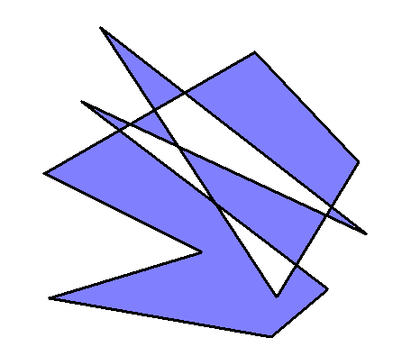
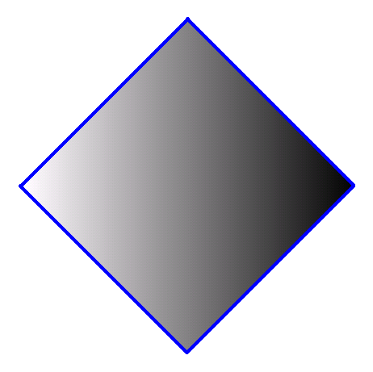
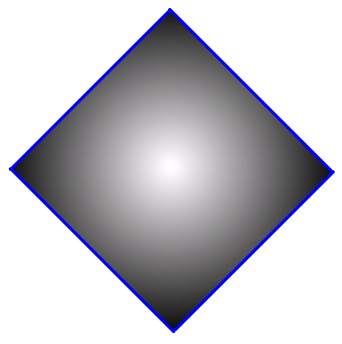
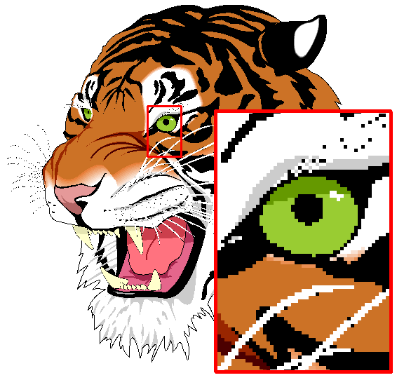
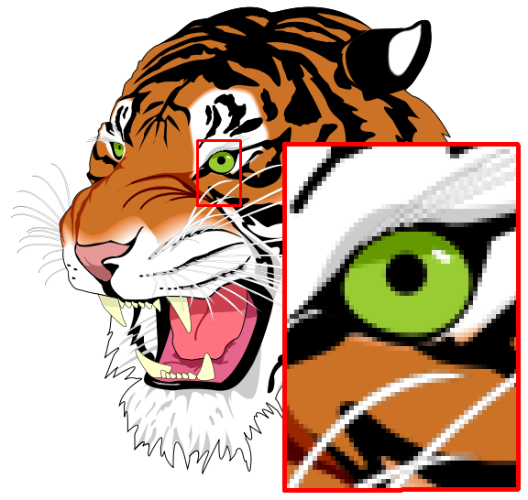
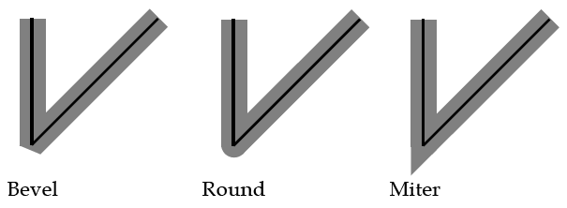
OpenVG
Drawing with polygons of arbitrary complexity
Line widths, end cap and join styles
Linear and radial gradient filling
Cubic and quadratic Bezier curves
Very high quality antialiasing
Animation paths
Alpha blending

Slide 22
Graphics SDK
- Contents of Graphics SDK
- Content Authoring Toolflow for OpenGL ES 2.0
- The PowerVR Utilities
- Demonstration Programs

Slide 23
Contents of Graphics SDK
OpenGL ES 1.1 Drivers for Linux and WindowsCE 6.0
  Compiled libraries and header files ready to link into applications
OpenGL ES 2.0 Drivers for Linux and WindowsCE 6.0
  Compiled libraries and header files ready to link into applications
OpenVG 1.1 Drivers for Linux and WindowsCE 6.0
  Compiled libraries and header files ready to link into applications
EGL Drivers for Linux and WindowsCE 6.0
  Compiled libraries and header files ready to link into applications
PVR Shell
  A C++ class to make programming for PowerVR platforms easier and more portable
Documentation
  Including SDK Users Guide, Programming Recommendations and Release Notes
Demos
  Several programs in C source code that demonstrate how to program OpenGL ES and OpenVG
Training Courses
  Tutorials for learning how to program OpenGL ES and OpenVG
Tools
  A library of some useful functions in C source code form to speed application development
Utilities
  A collection of essential tools to aid the development of graphics content for the SGX

Slide 24

Content Authoring Toolflow for OpenGL ES 2.0
UniSCo Editor and Compiler
Shader Library
GeoPOD
TexTool
Shader Code
Textures
Geometry
POD Viewer
PVR Tune
OMAP35x
Shaman Shader IDE
Integrated Development Environment
Demos
Performance
Data
VFrame PC Emulation
Tutorials

Slide 25
The PowerVR Utilities
VFrame
  A PC emulator for OpenGL ES 1.1 and 2.0
  Start application development without an EVM board!
  Function calls are mapped to equivalent desktop OpenGL functions
  Provided for both Windows and Linux
PVRTexTool and PVRTC Library
  Image format conversion and compression tool
  Converts common formats to proprietary PVRTC2 or PVRTC4 format for texture mapping
  Will also add borders and generate mipmaps
  Supplied for both Windows and Linux
  PVRTC Library is the source code form for custom authoring tools
PVRMAXExport and PVRGeoPOD
  Plug-ins for 3D StudioMax and/or Autodesk Maya authoring tools
  Exports compressed texture maps, geometry and animation models to the PowerVR POD file format
  Tight integration of these tools increases content developer productivity

Slide 26
The PowerVR Utilities
PVRVecEx
  Plug-in for Adobe Illustrator to export scalable 2D graphics to the PowerVR PVG file format for OpenVG
Collada2POD
  Converts geometry and animation models from the Collada format to the PowerVR POD file format
  Collada is a Khronos standard file format for exchanging 3D graphics content between authoring tools of different vendors
  Collada provides comprehensive encoding of visual scenes including geometry, texture maps, GLSL shaders and physics
PVRShaman
  Integrated editor, compiler and emulator for creating GLSL ES pixel shading programs for the SGX
  Imports models from either Collada or POD files
  Produces PowerVR PFX files which include shading programs and texture maps
  Displays shading program results after each compile
  Allows faster development and debug of new shading programs

Slide 27
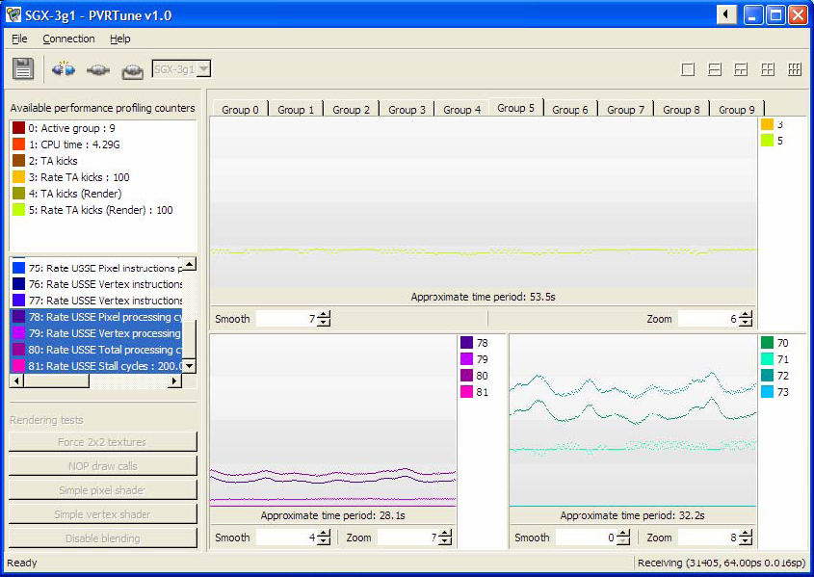
The PowerVR Utilities
PVRTune and PVRScope
  A remote performance profiling utility for the SGX
  Collects and reports information from an instrumented driver (SGXPerfServer) running on the target device
  Reports statistics on geometry, texture and shader memory usage
  Helps identify bottlenecks in the SGX processing pipeline
  Then improve the application software so that it avoids the identified bottleneck conditions
  Windows and Linux versions are provided

Slide 28
Demonstration Programs
Demonstrate how to program OpenGL ES 1.1, 2.0 and OpenVG for OMAP35x platform
These are complete programs provided in C source code form
Run on the OMAP35x EVM or on a PC with the VFrame emulator
  OpenGL ES 1.1: OpenGL ES 2.0:
  Cube - Cube2
  ChameleonMan - Shaders
  EvilSkull - Skybox2
  FiveSpheres
  Lighting OpenVG 1.1
  Mouse
  OptimizeMesh - Paints
  Particles - StrokeStyles
  PhantomMask - FillRule
  PolyBump - Transforms
  ShadowTechniques - BlendModes
  Skybox - ImageFilter
  Trilinear - Masking
  UserClipPlanes - SegmentTypes
  Vase - IntroducingSVG

Slide 29
Compositing
Windowing Systems
DSS Overlays
Video Texture Streaming

Slide 30
Windowing Systems - Linux
KDrive Implementation of EGL “X11WS”
  OpenGL ES/OpenVG renders directly into X11 windows
Null Window System “NullWS”
  A simple WSEGL implementation under Linux
  Supports only a single window the full size of the display (/dev/fb0)
  Directly uses the fbdev driver
  3 versions are provided
    null pvr2d blit – SGX renders to a back buffer and PVR2D copies to the display
    null pvr2d flip – Multiple render buffers are used and PVR2DPresentFlip() makes the current render buffer visible on the display
    null pvr2d front – SGX renders directly to the currently displayed buffer
QT – Developed by TrollTech/Nokia and now Open Sourced
  Rapidly gaining popularity
  Version 4.5.2 supports production OMAP35x silicon (ES3.x)

Slide 31
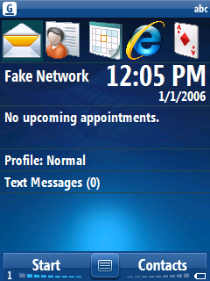


DSS Overlays – OMAP Display Subsystem
Dedicated windowing hardware offers the highest performance (DMA from DDR)
3 Windows - Graphics, Video1 and Video2
Alpha Blending
Supports 2 Displays; LCD and TV Out
Display sizes up to 2048 x 2048 pixels
Video color space conversion YCbCr 4:2:2 to RGB
256 x 24 bit Color Palette (Graphics Layer only)
Video Scaler with independent horizontal and vertical resampling
Mirroring and Rotation at 90, 180, or 270 degrees (VRFB)

Slide 32
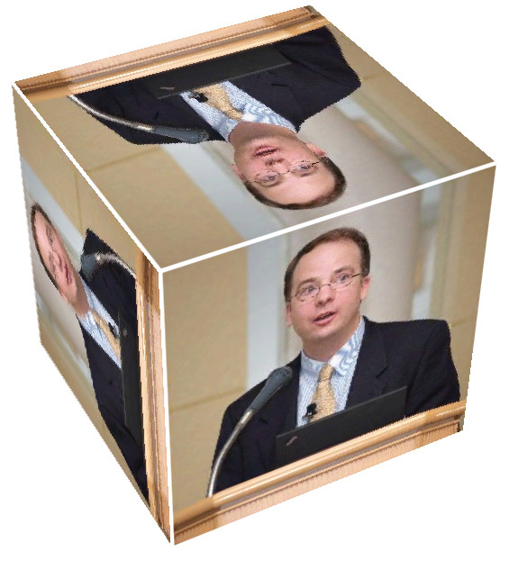
Video Texture Streaming to OpenGL ES
Use OpenGL ES to display motion video
Any geometry or blending mode is possible, as with any OpenGL ES texture
Source of video may be a codec (DSP) or camera
The SGX performs the required YUV to RGB color space conversion and image transformations
The load on the ARM can be as low as 5%
Requires PowerVR proprietary extensions to OpenGL ES
Will be supported in the OMAP35x Graphics SDK in early 2010

Slide 33
Graphics Lab 1- Installation and Building
Getting Started – Choose a Target
Exercise 1 – Install the Graphics SDK Overlay
Exercise 2 – Build and Run the Cube Demo
Exercise 3 – Build and Run the Vase Demo
Cube Demo Code Review

Slide 34
Getting Started – Choose a Target
VFrame on WindowsXP
  Download PC Emulation SDK for OpenGL ES 1.1 or 2.0 from: www.imgtec.com/PowerVR/insider
  Install Nvidia GeForce 6 series, or newer, graphics card with drivers for OpenGL 2.x. (integrated Intel graphics does not work).
  Install Microsoft Visual Studio 2005 or 2008 C++ Tools
  Install VFrame libraries
  Build OpenGL ES demo programs and run on the PC
Beagle Board (Exercises 1 – 2)
  Install the PowerVR OpenGL ES drivers for Linux
  Compile OpenGL ES 1.1 demo programs (Cube)
  Run demos on Beagle Board

Slide 35
Exercise 1 – Install Graphics SDK Overlay
Step 1 – Install the graphics overlay and accept the license (takes about 5 minutes to run)
sh esc_boston_graphics_overlay.bin
Step 2 – Create directory and install the graphics kernel modules
mkdir -p /lib/modules/2.6.29-rc3-omap1/
cd esc_boston_graphics_overlay/gfx_rel
./install.sh
Step 3 – Reboot Angstrom (2.6.29 kernel) on the Beagle Board
Step 4 – Install PowerVR drivers (Should display PVRSRV_PIXEL_FORMAT_RGB565)
/etc/init.d/rc.pvr start
Step 5 – Create the powervr.ini file to select the WSEGL driver
vi /etc/powervr.ini
[default]
WindowSystem=libpvrPVR2D_FRONTWSEGL.so
Step 6 – Test the PowerVR graphics
./gles1test1 200
cd esc_boston_graphics_overlay/GFX_Linux_SDK/OGLES/SDKPackage/Binaries/
CommonRaw/Demos/

Slide 36
Exercise 2 – Build and Run Cube Demo
Step 1 – Configure the build environment
export PLATFORM=LinuxOMAP3
Step 2 – Build the Cube demo program
cd GFX_Linux_SDK/OGLES/SDKPackage/Demos/Cube/OGLES/Build/LinuxGeneric
make
Step 3 – Copy the compressed texture map file and run the Cube demo
cd ../LinuxOMAP3/ReleaseRaw
cp ../../../bitmap.pvr .
./Cube
Step 4 – Use the Up/Down arrow keys to scale the Cube model. Type "q" on the console to quit the demo.

Slide 37
Exercise 3 – Build and Run Vase Demo
Step 1 – Build the Vase demo program
cd GFX_Linux_SDK/OGLES/SDKPackage/Demos/Vase/OGLES/Build/LinuxGeneric
make
Step 2 – Run the Vase demo
cd ../LinuxOMAP3/ReleaseRaw
./OGLESVase
Step 3 – Type "q" on the console to quit the demo.

Slide 38
Cube Demo Code Review – PVRShell
#include "PVRShell.h"
#include "OGLESTools.h"
class Cube : public PVRShell // Class that implements the required PVRShell functions
{
CPVRTPrint3D m_Print3D; // Class used to display text
PVRTMATRIX m_mProjection; // Projection matrix
PVRTMATRIX m_mView; // Model View matrix
Gluint m_hTexture; // Texture handle
bool m_bShadingFlag; // Indicates flat or smooth shading
GLfloat m_fCubeSize; // Size of the cube
GLfloat m_fAngleX; // Rotation angle about x axis in degrees
GLfloat m_fAngleY; // Rotation angle about y axis in degrees
void DrawCubeFlat(void); // Function that draws the cube with flat shading
void DrawCubeSmooth(void); // Function that draws the cube with smooth shading
public:
virtual bool InitApplication(); // Called by PVRShell to init the app
virtual bool InitView(); // Called by PVRShell to init the view
virtual bool ReleaseView(); // Called by PVRShell to release the view
virtual bool QuitApplication(); // Called by PVRShell to quit the app
virtual bool RenderScene(); // Called by PVRShell to render the next frame of the scene
};

Slide 39
Cube Demo Code Review – InitApp()
bool Cube::InitApplication()
{
m_bShadingFlag = false; // Initialize the shading type
m_fCubeSize = 1.0f; // Initialize the cube size
m_fAngleX = 0.0f; // Initialize the rotation angle
m_fAngleY = 0.0f;
PVRTMatrixTranslation(m_mView, 0, 0, -8.0); // Calculate the view matrix
return true;
}

Slide 40
Cube Demo Code Review – InitView()
bool Cube::InitView()
{
PVRTLoadTextureFromPVR("bitmap.pvr", &m_hTexture); // Load the texture map from a file
PVRTMatrixPerspectiveFovRH(m_mProjection, 0.6f, … // Calculates the projection matrix
glClearColor(0.0f, 0.0f, 0.0f, 1.0f); // Set the clear color to black
GLfloat fObjectMatAmb[] = { 0.1f, 0.1f, 0.1f, 1.0f }; // Set material properties
GLfloat fObjectMatDiff[] = { 0.5f, 0.5f, 0.5f, 1.0f };
GLfloat fObjectMatSpec[] = { 1.0f, 1.0f, 1.0f, 1.0f };
glMaterialfv(GL_FRONT_AND_BACK, GL_DIFFUSE, fObjectMatDiff);
glMaterialfv(GL_FRONT_AND_BACK, GL_AMBIENT, fObjectMatAmb);
glMaterialfv(GL_FRONT_AND_BACK, GL_SPECULAR, fObjectMatSpec);
glMaterialf(GL_FRONT_AND_BACK, GL_SHININESS, 5);
glLightfv(GL_LIGHT0, GL_AMBIENT, fLightAmb); // Set light properties
glLightfv(GL_LIGHT0, GL_DIFFUSE, fLightDif);
glLightfv(GL_LIGHT0, GL_SPECULAR, fLightSpec);
glLightf(GL_LIGHT0, GL_SPOT_EXPONENT, 5.0f);
glLightModelfv(GL_LIGHT_MODEL_AMBIENT, fAmbient);
GLfloat fLightPos[] = { 0.0f, 0.0f, 8.0f, 0 }; // Set the position of the light source
glLightfv(GL_LIGHT0, GL_POSITION, fLightPos);
glEnable(GL_COLOR_MATERIAL);
glShadeModel(GL_SMOOTH); // Set smooth shading
}

Slide 41
Cube Demo Code Review – RenderScene()
bool Cube::RenderScene()
{
if (PVRShellIsKeyPressed(PVRShellKeyNameUP)) // Process keyboard input to adjust cube size
m_fCubeSize += 0.1f;
else if (PVRShellIsKeyPressed(PVRShellKeyNameDOWN))
m_fCubeSize -= 0.1f;
glClear(GL_COLOR_BUFFER_BIT | GL_DEPTH_BUFFER_BIT); // Clear the back frame buffer to black
glEnable(GL_TEXTURE_2D); // Enable texture mapping
glBindTexture(GL_TEXTURE_2D, m_hTexture); // Bind and use the texture map loaded earlier
glColor4f(0.0f, 0.0f, 0.4f, 1.0f); // Set the cube color to blue
glRotatef(m_fAngleX, 1.0f, 0.0f, 0.0f); // Rotate the cube model
glRotatef(m_fAngleY, 0.0f, 1.0f, 0.0f);
glScalef(m_fCubeSize, m_fCubeSize, m_fCubeSize); // Scale the size of the cube model
DrawCubeSmooth(); // Draw the cube
m_fAngleX += 0.25f; // Rotate the cube model for the next frame
m_fAngleY += 1.00f;
}

Slide 42
Graphics Lab2 – OpenGL ES 1.1 Programming
Exercise 3 - Replace the Texture Map
Exercise 4 - Miscellaneous Experiments

Slide 43
Exercise 3 – Replace the Texture Map
Step 1 – Replace the file name in the Cube source code (bitmap.pvr -> Galileo.pvr)
cd GFX_Linux_SDK/OGLES/SDKPackage/Demos/Cube/OGLES/Build/LinuxGeneric
vi ../../Cube.cpp
// Load the texture map from a PVR file
if (!PVRTLoadTextureFromPVR("bitmap.pvr", &m_hTexture))
Step 2 –Recompile the Cube program
make
Step 3 – Copy the new texture map file and run the Cube demo
cd ../LinuxOMAP3/ReleaseRaw
cp ../../../../Media/Galileo.pvr .
./Cube
Step 4 – Use the Up/Down arrow keys to scale the Cube model. Type "q" on the console to quit the demo.

Slide 44
Exercise 4 - Miscellaneous Experiments
For each of these steps, edit Cube.cpp, recompile and run
Step 1 - Change the clear color:
// Set the clear color to black
glClearColor(0.0f, 0.0f, 0.0f, 1.0f); // R,G,B,A
Step 5 – Stretch the texture map:
static GLfloat TexCoords[4][2] =
{ // x y
{0.0, 1.0}, // 0 Range is 0 to 1
{1.0, 1.0}, // 1 Range is 0 to 1
{0.0, 0.0}, // 2 Range is 0 to 1
{1.0, 0.0}, // 3 Range is 0 to 1
…
Step 2 – Change the cube’s color:
// Set the cube color to blue
glColor4f(0.0f, 0.0f, 0.4f, 1.0f); // R,G,B,A
Step 3 – Change the cube’s rotation:
// Rotate the cube model for the next frame
glRotatef(m_fAngleX, 1.0f, 0.0f, 0.0f);
glRotatef(m_fAngleY, 0.0f, 1.0f, 0.0f);
m_fAngleX += 0.25f; // in Degrees
m_fAngleY += 1.00f; // in Degrees
Step 4 – Move the position of the light:
// Set the position of the light source
GLfloat fLightPos[] = { 0.0f, 0.0f, 8.0f, 0 }; // x = 0, y = 0, z = 8, w = 0
glLightfv(GL_LIGHT0, GL_POSITION, fLightPos); // Don’t change w!

Slide 45
Graphics Lab 3 – OpenGL ES 2.0 Programming
Exercise 5 - Build and Run Cube2 Demo

Slide 46
Exercise 5 – Build and Run Cube2 Demo
Step 1 – Build the Cube2 (OpenGL ES 2.0) demo program
cd GFX_Linux_SDK/OGLES2/SDKPackage/Demos/Cube2/OGLES2/Build/LinuxGeneric
make
Step 2 – Copy compressed texture map and shader program files and run the Cube2 demo
cd ../LinuxOMAP3/ReleaseRaw
cp ../../../bitmap.pvr .
cp ../../../FragShader.fsh .
cp ../../../VertShader.vsh .
./Cube2
Step 3 – Use Up/Down arrow keys to scale the Cube model
Step 4 – Use Left/Right arrow keys to adjust the specular light intensity in the shader program
Step 5 – Type "q" on the console to quit the demo

Slide 47
For More Information
White Papers on OMAP35x Graphics, Cortex-A8 and NEON
  www.ti.com/omap35x
Online forums for OMAPTM graphics software developers
  www.ti.com/omapgraphics
PowerVR Insider Developer Forum
  www.imgtec.com/PowerVR/insider
OpenGL ES and OpenVG specification documents
  www.khronos.org

