Slide 1
Graphics Accelerators and OpenGL
Presentation by Guy Benyei
guy.benyei@intel.com

Slide 2
Graphics Accelerators
Special thanks to Eyal Bar-Lev

Slide 3
Why GPU ?
Let’s take one vertex in 3D space and
Transform it to somewhere else, and Convert it to
camera space and screen space (The screen is 2D….)
These are three basic actions in a 3D world. How much computing power do they consume ?
A Vertex is represented by four sets of numbers (X,Y,Z,W)
Each operation is a Matrix Multiplication (i.e. 28 EU operations).
There are three matrices (i.e. 28 X 3 = 84 EU actions Per one Vertex)
A Fair flight simulator scene takes 120,000 Triangles/Frame at 60 Hz. (i.e. 7.2M Triangles/ Sec) X 84 = 604 M Calculations/Sec, and these are only three basic actions…… what about the rest ?
Conclusion : There has to be a powerful machine to handle such a calculation rate, Up till today, the solution is the GPU
April 2007
Intel Confidential

Slide 4
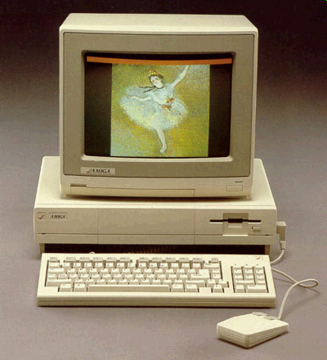
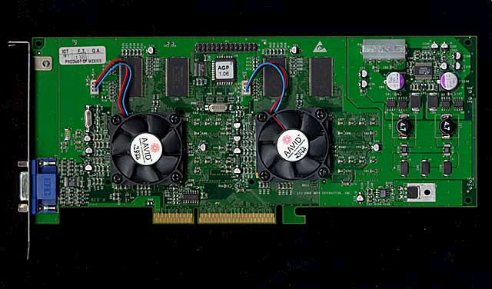
GPU History and Brands
1979 : Catmule invents the Z Buffer- Up till then Graphics is for Radar apps.
1980’s – SGI starts building RISC computers for graphics.
1985 – Amiga sets foot.
1996 – 3DFX and Voodoo
2000 – NVidia Brings Geforce II
2002 – ATI Brings Radeon 9700
….
2008 : ATI has 4870 as High end
NV has 290GTX as high end
April 2007
Intel Confidential

Slide 5


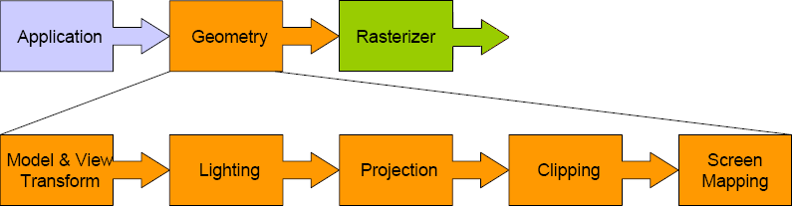
Fixed Functionality
The result :
A “Pipe” which multiplies vectors & matrices with adjustable attributes
April 2007
Intel Confidential

Slide 6
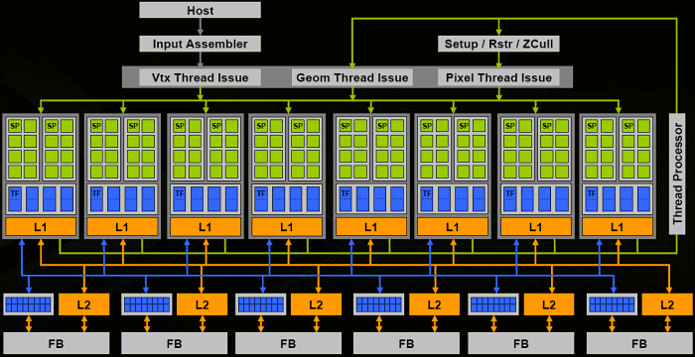
NVidia G80
April 2007
Intel Confidential

Slide 7
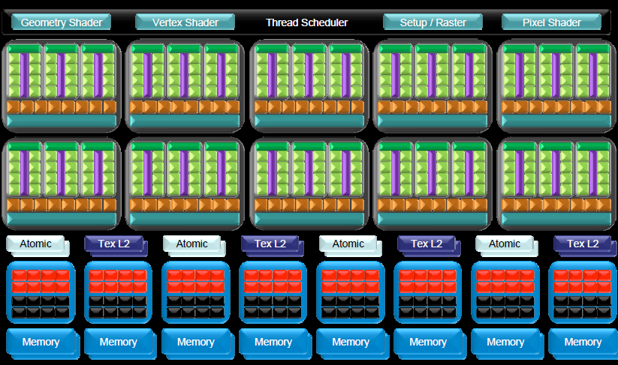
NVidia G200

Slide 8
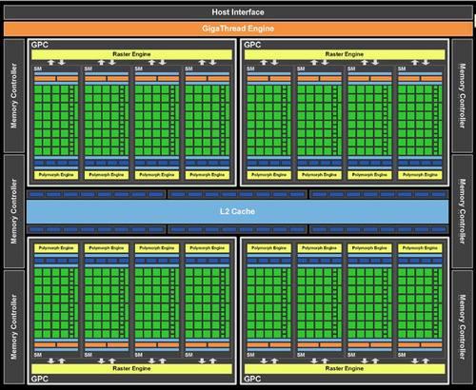
NVidia FERMI (GTX 580)

Slide 9
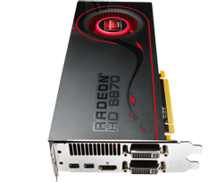
Today’s Hottest : ATI
(HD 6870)
1.7 billion transistors on 40nm fabrication process
1120 stream processing units
Processor clock: 900 MHz
Texture fill rate: 50.4 GPix/sec
PCI Express 2.1 x16 bus interface
Maximum Digital Resolution 2560x1600
Maximum VGA Resolution 2048x1536
Dual link DVI, HDMI 1.4a with Stereoscopic 3D Frame Packing Format, Deep Color, xvYCC wide gamut support, and high bit-rate audio…
April 2007
Intel Confidential

Slide 10
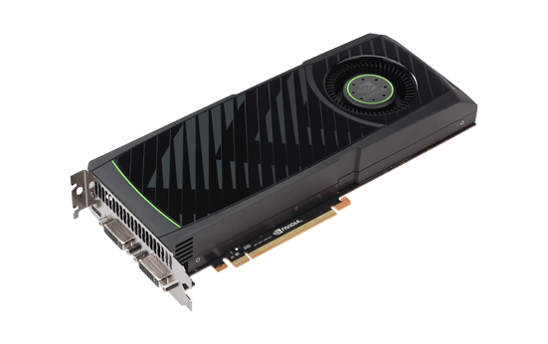
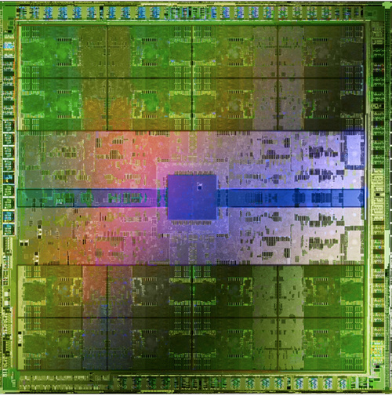
Today’s Hottest: Nvidia
(GTX 580)
3 billon transistors
Processor Cores : 512 (Yeh….)
Graphics Clock (MHz) 772 MHz
Processor Clock (MHz) 1544 MHz
Texture Fill Rate 49.4 GPix/sec : Tests measured less, as usual…
Bus Support PCI-E 2.0 x16
Maximum Digital Resolution 2560x1600
Maximum VGA Resolution 2048x1536
Two dual Link DVI Multi Monitor
April 2007
Intel Confidential

Slide 11



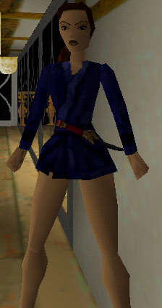




With time-GPUs improves and quality comes along
TR1-1996
TR2
TR4
TR3

Slide 12

Tomb Raider with today’s latest GPUs

Slide 13



Direct3D
Direct3D™
    A 3D Graphics API complements of Microsoft
    Works in COM Technology
    Went through some 32 Version changes most of them are architectures
    Newest version is OS dependant, Version 11 will not work on XP systems
    Works with Microsoft OS only
    All graphic cards are built to support this pipeline and thus its performance is better than OpenGL
April 2007
Intel Confidential

Slide 14



OpenGL
OpenGL®
    Short for “Open Graphics Language”
    Originally invented by SGI as “GL” and as a RISC Proprietary
    The first 3D API
    Works as a fixed- functionality pipe operator
    Robust, went through over 10 version changes , most of them are functionality additions, today at 4.1
    Easy User interface
    Works on every OS, and in PS2, PS3, Wii
April 2007

Slide 15
OpenGL APIs

Slide 16
Libraries in use…
Gl
  OpenGL API implementation (http://www.opengl.org)
Glu
  OpenGL Utility
Glut
  OpenGL Utility Toolkit (http://www.opengl.org/resources/libraries/glut/)
FLTK
  FlashLight ToolKit (http://www.fltk.org/)
GLEW…

Slide 17
Draw
glBegin(GL_POLYGON);
glVertex3f( 0.0f, 1.0f, 0.0f);
glVertex3f(-1.0f, 0.0f, 0.0f);
glVertex3f(-1.0f,-1.0f, 0.0f);
glVertex3f( 1.0f,-1.0f, 0.0f);
glVertex3f( 1.0f, 0.0f, 0.0f);
glEnd();
Other possibilities:
  #define GL_POINTS 0x0000
  #define GL_LINES 0x0001
  #define GL_LINE_LOOP 0x0002
  #define GL_LINE_STRIP 0x0003
  #define GL_TRIANGLES 0x0004
  #define GL_TRIANGLE_STRIP 0x0005
  #define GL_TRIANGLE_FAN 0x0006
  #define GL_QUADS 0x0007
  #define GL_QUAD_STRIP 0x0008
  #define GL_POLYGON 0x0009

Slide 18
Colors
glBegin(GL_POLYGON);
glColor3f(1.0f,0.0f,0.0f);
…

Slide 19
Z-buffer
glEnable(GL_DEPTH_TEST);
glDepthFunc(GL_LEQUAL);
Other options:
  #define GL_NEVER 0x0200
  #define GL_LESS 0x0201
  #define GL_EQUAL 0x0202
  #define GL_LEQUAL 0x0203
  #define GL_GREATER 0x0204
  #define GL_NOTEQUAL 0x0205
  #define GL_GEQUAL 0x0206
  #define GL_ALWAYS 0x0207

Slide 20
Projection
glMatrixMode(GL_PROJECTION);
glLoadIdentity();
Orthogonal:
  glOrtho(left, right, bottom, top, near, far);
  (gluOrtho2D)
Perspective:
  gluPerspective(fovy, aspect, zNear, zFar );
  (glFrustum)

Slide 21
Translation/Rotation/Scale
glMatrixMode(GL_MODELVIEW);
glLoadIdentity();
glTranslatef(x, y, z);
glRotatef(angle, x, y, z);
glScalef(x, y, z);

Slide 22
Camera Position
void gluLookAt(eyeX, eyeY, eyeZ, centerX, centerY, centerZ, upX, upY, upZ );

Slide 23
Backface culling
glCullFace(GL_BACK);
glEnable(GL_CULL_FACE);

Slide 24
Lighting
glLightfv(GL_LIGHT0, GL_AMBIENT, light_ambient);
glLightfv(GL_LIGHT0, GL_DIFFUSE, light_diffuse);
glLightfv(GL_LIGHT0, GL_SPECULAR, light_specular);
glLightfv(GL_LIGHT0, GL_POSITION, light_position);
glEnable(GL_LIGHTING);
glEnable(GL_LIGHT0);

Slide 25
Material
glMaterialfv(GL_FRONT_AND_BACK, GL_AMBIENT_AND_DIFFUSE, material_ambient1);
glMaterialfv(GL_FRONT_AND_BACK, GL_SPECULAR, material_specular1);
glMaterialf(GL_FRONT_AND_BACK, GL_SHININESS, material_shininess1);

Slide 26
Shading
glShadeModel(GL_SMOOTH);
glShadeModel(GL_FLAT);

Slide 27
Display Lists
glNewList(list, mode)
glEndList()
glCallList(list)
glCallLists(n, type, *lists)

Slide 28
Additional information
The Red Book
  http://www.opengl.org/documentation/red_book/

Slide 29
The End

Slide 30
Backup

Slide 31
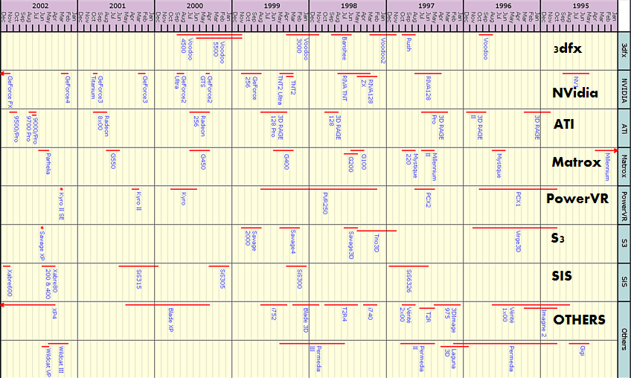
GPU History and Brands
April 2007
Intel Confidential

