Slide 1
OpenGL Basics
A Graphics Standard
©Mel Slater, Anthony Steed 1997-1999

Slide 2
Outline
Philosophy
Output primitives
Materials
The modelview matrix
The projection matrix
Specifiying a view
Utility library glu
GLUT for interfaces

Slide 3
Philosophy of OpenGL
Platform independent
Window system independent
Rendering only
Aims to be real-time
Takes advantage of graphics hardware where it exists
State system
Client-server system
Standard supported by major companies

Slide 4
Generating Output
Output generated within a glBegin(), glEnd() ‘block’:
  glBegin(GL_POINTS);
    glVertex2d(1.0,1.0);
    glVertex2d(2.0,1.0);
    glVertex2d(2.0,2.0);
  glEnd();
GL_POINTS is a GLenum
  one example of the ‘mode’ of drawing

Slide 5
Drawing Mode
glBegin(GLenum mode)
  mode includes
    GL_POINTS
    GL_LINES
    GLINE_STRIP
    GL_LINE_LOOP
    GL_POLYGON
      convex only
    triangles
    quadrilaterals
glBegin(GL_POLYGON);
    glVertex2d(1.0,1.0);
    glVertex2d(2.0,1.0);
    glVertex2d(2.0,2.0);
glEnd();

Slide 6
glVertexnt
glVertex2d(GLdouble x, GLdouble y);
glVertex3f(GLfloat x, GLfloat y, GLfloat z);
glVertex2i(GLint x, GLint y);
glVertex3d(GLdouble x,GLdouble y,
GLdouble z);
  n = 2,3,4
  t = d, f, i, s
  glVertex4f(GLdouble x, GLdouble y,
  GLdouble z, GLdouble w);

Slide 7
Shading and Colours
Shading properties
  glShadeModel(GL_SMOOTH | GL_FLAT)
Colour
  glColorNT{V}(r,g,b,{a})
    N=3,4
    T=b,s,i,ub,ui,us
    v implies passing a pointer to array of colours

Slide 8
Materials
Many lighting parameters
Specify a material
  emmisive, ambient, shininess, specular
  GLfloat mat_spec = { 0.5, 0.5, 1.0, 1.0};
  glMaterialfv(GL_FRONT, GL_SPECULAR, mat_spec)
  glColorMaterial(GL_FRONT, GL_DIFFUSE)

Slide 9
Lights
Must enable a light with materials
  GLfloat light_pos ={ 1.0, 2.0, 1.0, 0.0}
  glLightfv(GL_LIGHT0, GL_POSITION, light_pos)
  glEnable(GL_LIGHTING)
  glEnable(GL_LIGHT0)

Slide 10
Modeling and Viewing
OpenGL provides no functions itself for directly specifying a view
  it has no ‘policy’ for how a ‘camera’ is to be specified
It provides no data structures for model hierarchies.
Instead it provides fundamental tools that allow the construction of many different camera models and hierachies.

Slide 11
Modelview Matrix
A stack of matrices is maintained called the ‘modelview’ stack.
The current modelview matrix is used to multiply vertices at the first stage of the rendering pipeline
  equivalent to matrix C.M
    C = CTM, M:WC->VC
glMatrixMode(GL_MODELVIEW)
  making changes to modelview

Slide 12
Matrix Operations
glLoadMatrix{f}{d}(const GLfloat *m);
  replaces current matrix
glMultMatrix{f}{d} (const GLfloat *m);
  if t is current matrix then tm is the new one
glPushMatrix{f}{d} ();
  pushes copy of current matrix down on stack;
glPopMatrix();
  restores top of stack to be current matrix.

Slide 13
Example: Object Hierarchy
Suppose the current modelview matrix is M:WC->VC (ie, based on VRP, VPN,VUV).
GObject *object; //pointer to graphics object
    glMatrixModel(GL_MODELVIEW);
    /*push and duplicate current matrix*/
    glPushMatrix();
    /*premultiply M by CTM*/
    glMultMatrix(object->CTM);
    /*now draw all faces in object*/
    glPopMatrix(); //restore original M

Slide 14
The Projection Matrix
glMatrixMode(GL_PROJECTION);
  subsequent matrix ops affect this stack (only 2 deep)
A perspective projection can be specified by:-
  glLoadIdentity();
  glFrustum(left, right, bottom, top, near, far);
    each argument is GLdouble

Slide 15
Transformations
glTranslate{d}{f}(x,y,z);
  translation matrix T(x,y,z)
glScale{d}{f}(x,y,z);
  scaling matrix S(x,y,z)
glRotate{d}{f}(angle, x, y, z);
  matrix for positive (anti-clockwise) rotation
  of angle degrees about vector (x,y,z)
If M is current matrix, and Q is transformation matrix, then new current matrix is QM

Slide 16
Utility Library (glu)
Library that is constructed on top of OpenGL, performing many higher-level operations
  curves and surfaces
  other forms of primitive (quadrics)
  a simpler viewing mechanism

Slide 17
glu Viewing
Constructing an ‘M’ matrix
  gluLookAt(ex,ey,ez, //eye point COP(WC)
  cx,cy,cz, //point of interest
  upx,upy,upz //up vector
  )
Matrix that maps
  (cx,cy,cz) to -ve Z-axis
  (ex,ey,ez) becomes the origin
  (upx,upy,upz) becomes the y-axis
Premultiplies current matrix
c
VPN
e

Slide 18
glu Perspective
To specify projection matrix:
  gluPerspective(fovy, //field of view degrees
  aspect,//xwidth/yheight
  zNear,//front clipping plane
  zFar //back clipping plane
  )
y
fovy
-z

Slide 19
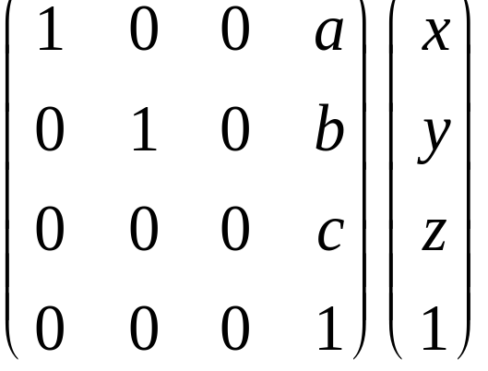
Cautions
OpenGL uses a RH coordinate system throughout (hence the default VPN is the negative z-axis).
It adopts the convention of points as column vectors and post-multiplication:
The transpose of all our
matrices should be used!

Slide 20
Windows and Interaction
GLX is the OpenGL extension to X11 Windows - provides basic window functions to provide OpenGL rendering context.
GLUT is a user interface toolkit (simple) that constructs windows and provides basic interaction mechanisms (see trapezium example).

Slide 21
Summary
OpenGL is a massive ‘basic’ powerful, flexible standard platform and windowing independent rendering system.
glBegin, glVertex, glEnd
glMatrixMode(GL_MODELVIEW)
glFrustum
gluLookAt, gluPerspective

