Slide 1
Video4Linux: Supporting SoCs
Hans Verkuil
Cisco Systems

Slide 2
Typical Consumer Hardware

Slide 3
SoC HW: TI OMAP3 ISP
CSI-1
CSI-2
Parallel
Control signals
Bridge lane Shifter
CCDC (Video Processing Front End)
Previewer
Resizer
H3A
HIST
VPBE
Statistics Collection
Shared Buffer Logic
MMU
Interconnect Bus
Courtesy of Texas Instruments

Slide 4
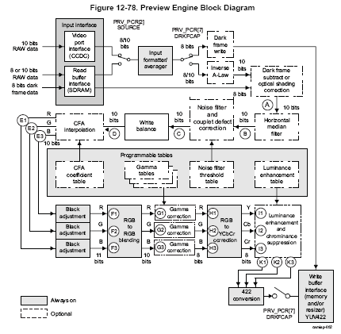
SoC HW: TI OMAP3 Previewer
Courtesy of Texas Instruments

Slide 5
SoC HW: OMAP3 Display Controller
DSS
Palette
GFX
TDM
Color
Conversion
Scaling
Overlay 1
Color Key
VID-1
LCD
Background color
TFT
Overlay 2
Color Key
TV out
Encoder
Video
DAC
TV
VID-2
Color
Conversion
Scaling
Bkground color
Video
DAC
Overlays/Pipeline
Overlays Manager
Display Sub System
Courtesy of Texas Instruments

Slide 6
SoC Video Devices
Very complex devices.
Multiple video and graphics streams.
Flexible video stream routing.
Applications require much more control.
Digital cameras, mobile phones, media players, TVs, surveillance applications, video conferencing, in-flight entertainment, etc., etc.
Since the V4L2 API does not support these advanced devices, SoC manufacturers make their own custom drivers.

Slide 7
SoC Support Developments
Initial talks with Texas Instruments Spring/Summer 2008.
First RFC July 2008.
Discussed during the Linux Plumbers Conference in August 2008.
Core framework required: mostly done by 2.6.30 (June 2009).
Organized a v4l-dvb mini-summit during the Linux Plumbers Conference in September 2009 with participants from Texas Instruments, Intel, Nokia, Samsung and independent v4l-dvb developers. Agreed on how to proceed with V4L SoC support.
Brainstorm meeting to discuss memory handling (videobuf) in March 2010.
Mini-summit in June 2010 in Helsinki.

Slide 8
Results from 2009/10 mini-summits
Need better V4L2 driver framework to provide solid foundation for the other tasks. (Mostly done)
Need new timings API for HDTV and other high-definition sources and sinks. (Done)
Need standard event passing API. (Done)
Need new core control framework. (Done)
Need better buffer pool management APIs. (Work started)
Need support for multi-planar framebuffers. (Mostly done)
Replacement for videobuf framework. (In progress)
Need a Media Controller. (Mostly done)

Slide 9
HDTV Timings API
Has presets for the common standards (e.g. 720p30, 1080p60, etc.)
Can get/set/query the preset.
If the hardware allows it, then it can also set custom timings (front & backporch, sync widths, pixelclock).
Merged in 2.6.33.

Slide 10
Events API
Standard API for V4L2 events.
Can be used with select() since it arrives as an exception.
Per-filehandle event queue and event subscription.
Merged in 2.6.35.

Slide 11
Control Framework
Too much hard work for drivers.
A lot of code duplication.
A lot of buggy code.
Inconsistencies between drivers.
All controls go through the new framework.
A driver only needs to supply a s_ctrl function in most cases.
Future enhancement: expose controls to debugfs.
Ability to have bridge drivers inherit controls from subdevs.
Merged in 2.6.36.

Slide 12
Off-Topic: RDS & IR & BKL
RDS = Radio Data System. Provides program name and type, traffic information, etc.
V4L2 has an API for this, both for receiving and for transmitting.
It has seen a lot of development recently (Nokia!), driven by the requirements of mobiles with radio support.
Infrared remote support is now integrated into the kernel and is part of the v4l-dvb subsystem. It still sees a fair amount of development.
BKL removal: added optional locking to the V4L2 core framework.

Slide 13
V4L2 Core Framework
Created a struct v4l2_device for basic device-global data.
Created a struct v4l2_subdev to communicate with (usually i2c) sub-devices. Register them with v4l2_device. When v4l2_device is removed, unregister the sub-devices automatically.
The 'sub-device' concept is an abstract concept: it does not care on what (if any) bus the sub-device is located.
Ensures a unified API towards sub-devices to make it easy to swap one chip for another.
Ensures re-use of the same sub-device driver.
Can also be used to expose internals of the video subsystem of a SoC.

Slide 14
V4L2 Core Framework

Slide 15
Media Controller
Modern v4l drivers often also support framebuffer, alsa, i2c, lirc and/or dvb devices, hard to keep track of by applications. Need some central authority to tell apps what is what.
Many SoCs can reroute the internal videostreams. E.g. capture from a sensor and do memory-to-memory resizing, or send the sensor output directly to the resizer.
Apps writing for SoCs want much more control about the various components of the device. A way is needed to provide that control without compromising the normal API which tends to hide complexity from the user.

Slide 16
Media Controller
Create a /dev/mediaX device (X >= 0) that can be used to enumerate the mesh-topology of the device.
Nodes in the mesh are sub-devices and device nodes. The general name for a mesh node is entity.
The mc will also enumerate the possible and current links between entities.
The mc allows you to change the links.
Some sub-devices will have their own device node for advanced control (/dev/v4l-subdevX).

Slide 17
Media Controller
Current drivers for consumer products can use the mc to let apps discover which alsa device is associated with which v4l device.
For embedded devices the mc controls the internal data flow of the device.
For embedded devices the /dev/v4l-subdevX device nodes allow direct control of the advanced and hardware-specific features of sub-devices.
For each particular SoC a userspace library will be required to use the hardware optimally. This allows us to keep the kernel driver simple.

Slide 18
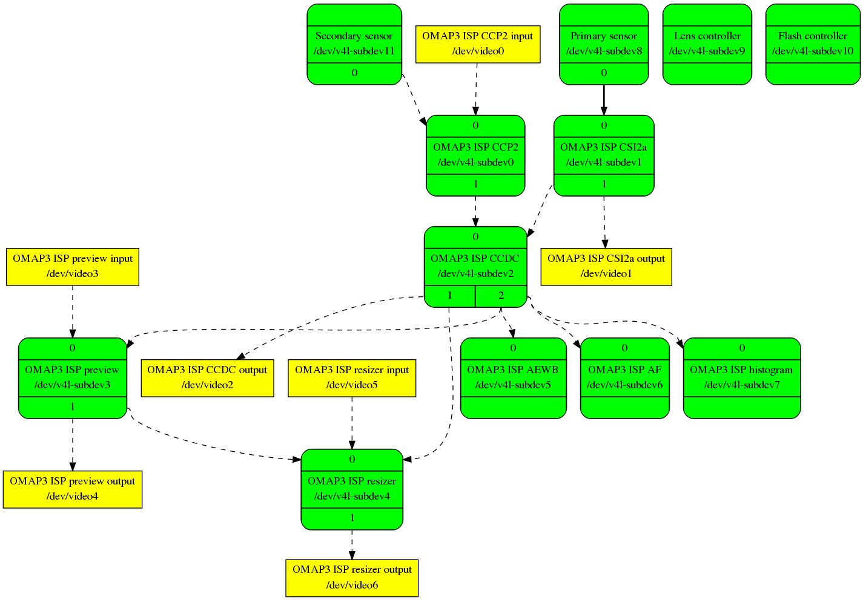
TI OMAP3 ISP: Media API
Courtesy of Laurent Pinchart

Slide 19
TI OMAP3 ISP: Block Diagram
CSI-1
CSI-2
Parallel
Control signals
Bridge lane Shifter
CCDC (Video Processing Front End)
Previewer
Resizer
H3A
HIST
VPBE
Statistics Collection
Shared Buffer Logic
MMU
Interconnect Bus
Courtesy of Texas Instruments

Slide 20
Memory Handling, Memory Pool
Existing videobuf framework is very bad code. Replace with videobuf2. Proper separation between buffer ops and memory ops. (In progress)
Prevent unnecessary cache and memory locking operations. New caching flags were proposed, nothing implemented yet.
Allow easy transfer of buffers from one video device node to another. Pending videobuf2 integration.
Contiguous Memory Allocator. (In progress, more research still needed)
Have a global pool of buffers. Still needs more R&D.
Multiplanar support (Mostly done)
Mem-to-Mem devices (Done)

Slide 21
Timeline
Timings API went into 2.6.33.
Event API went into 2.6.35.
Control framework went into 2.6.36.
videobuf2 is scheduled for 2.6.38.
Multiplanar is scheduled for 2.6.38.
Memory pool: not yet known.
Media Controller is scheduled for 2.6.38.
Improving the V4L2 driver framework is ongoing work.

Slide 22
Questions?
e-mail:
hverkuil@xs4all.nl
linux-media mailinglist:
http://www.linuxtv.org/lists.php

