Slide 1
Using a JTAG in Linux Driver Debugging
Supporting New Hardware
Mike Anderson
Chief Scientist
The PTR Group, Inc.
http://www.theptrgroup.com

Slide 2

What We Will Talk About
What are we trying to do?
Hardware debuggers
What is JTAG?
How does it work?
Board bring up
The Linux boot sequence
Debugging the kernel and device drivers

Slide 3
What are we trying to do?
The board bring-up process is loaded with potential gotchas
  Obtaining data sheets may be near impossible
  The hardware may or may not be working
  The boot firmware may have restrictive licensing issues
There are two phases of device driver development that we’ll need to address
  Getting the board to work at all
  Adding features for peripherals

Slide 4

Porting Linux
Bringing Linux up on a new board will require some knowledge of assembly language for your processor
  There are several transitions from assembly to “C” and back if we’re using zImages
Debugging at this level will require the use of JTAGs, or other hardware assistance
  Never underestimate the power of an LED

Slide 5
Device Drivers in Linux
Linux has several driver types
  Character, block, network, etc.
Linux uses a formal driver model
  Drivers present a common API such as open(), release(), read(), write(), etc.
User-mode device drivers are also possible
  Via /dev/mem, /dev/ioports, etc.
  Easier to debug using standard GDB

Slide 6
Statically Linked – Dynamically Loaded
The typical kernel-mode driver can be statically linked into the kernel at kernel build time
  Must be GPL
  Initialized in start_kernel() sequence
Dynamically-loaded drivers, a.k.a. kernel modules are loaded after the kernel is booted and init is running
  Can be loaded from initramfs/initrd
  Can have proprietary licenses

Slide 7
Driver Initialization Sequence
Drivers must register themselves with the kernel
  register_chrdev(), register_blkdev(), register_netdev(), etc.
For block and character drivers you’ll need to assign major/minor numbers
  Can be done statically or dynamically
  Coordinate with <linux>/Documentation/devices.txt
You’ll need to create device nodes as well
  Statically or via UDEV

Slide 8
Loadable Module Example
#include <linux/module.h>
#include <linux/init.h>
#include <linux/kernel.h>
#define MODULE_NAME “celf"
int __init celf_init_module(void) {
printk(“celf_init_module() called, ");
return 0;
}
void __exit celf_cleanup_module(void) {
printk(“celf_cleanup_module() called\n");
}
module_init(celf_init_module);
module_exit(celf_cleanup_module);

Slide 9

Old School Driver Registration
Kernel is made aware of a character device driver when the driver registers itself
  Typically in the __init function
Registration makes the association between the major number and device driver
int register_chrdev(unsigned int major, const char *name, struct file_operations *fops)

Slide 10
Old School Driver Registration #2
Likewise, when a device driver removes itself from the system, it should unregister itself from the kernel to free up that major number
Typically in the __exit function:
int unregister_chrdev(unsigned
int major, const char *name);

Slide 11
New-School Driver Registration
If you need to get beyond the 256 major limit, you’ll need to use a different approach
  This uses a different API, dev_t, cdev structures and a much more involved registration approach
All of this is beyond scope for the current discussion, however

Slide 12
Giving Your Driver Something to do
Character device driver exports services in file_operations structure
  There are 26 supported operations in the 2.6 kernel
    Up from 17 in the 2.4.kernel
You only supply those calls that make sense for your device
You can explicitly return error codes for unsupported functions or have the system return the default ENOTSUPP error
Typically, the file_operations structure is statically initialized
  Using C99 tagged initializer format

Slide 13
struct file_operations #1 of 2
struct file_operations {
struct module *owner;
loff_t (*llseek) (struct file *, loff_t, int);
ssize_t (*read) (struct file *, char __user *, size_t, loff_t *);
ssize_t (*aio_read) (struct kiocb *, char __user *, size_t, loff_t);
ssize_t (*write) (struct file *, const char __user *, size_t,
loff_t *);
ssize_t (*aio_write) (struct kiocb *, const char __user *,
size_t, loff_t);
int (*readdir) (struct file *, void *, filldir_t);
unsigned int (*poll) (struct file *, struct poll_table_struct *);
int (*ioctl) (struct inode *, struct file *, unsigned int,
unsigned long);
long (*unlocked_ioctl) (struct file *, unsigned int, unsigned long);
long (*compat_ioctl) (struct file *, unsigned int, unsigned long);
int (*mmap) (struct file *, struct vm_area_struct *);
int (*open) (struct inode *, struct file *);
int (*flush) (struct file *);

Slide 14
struct file_operations #2 of 2
int (*release) (struct inode *, struct file *);
int (*fsync) (struct file *, struct dentry *, int datasync);
int (*aio_fsync) (struct kiocb *, int datasync);
int (*fasync) (int, struct file *, int);
int (*lock) (struct file *, int, struct file_lock *);
ssize_t (*readv) (struct file *, const struct iovec *, unsigned long,
loff_t *);
ssize_t (*writev) (struct file *, const struct iovec *, unsigned long,
loff_t *);
ssize_t (*sendfile) (struct file *, loff_t *, size_t, read_actor_t, void *);
ssize_t (*sendpage) (struct file *, struct page *, int, size_t,
loff_t *, int);
unsigned long (*get_unmapped_area)(struct file *, unsigned long,
unsigned long, unsigned long, unsigned long);
int (*check_flags)(int);
int (*dir_notify)(struct file *filp, unsigned long arg);
int (*flock) (struct file *, int, struct file_lock *);
};

Slide 15

Which File Operations do I Need?
Typically, a driver will implement:
    open()
    release()
      a.k.a., the user-space close()
    read()
    write()
    ioctl()
Additional features like mmap(), poll(), fasync(), and flush() are nice to haves
  You can add them at any time during development
Some methods like llseek() and readv()/writev() may not apply to your device
  You decide what to support and errors to return

Slide 16
Initializing the file_operations
C99 tagged initialization of the structures allows you to initialize the fields by name
  No worry about the structure layout (which may change between kernel revisions)
Un-initialized function entries in the structure shown below will be initialized to NULL
struct file_operations fops = {
      .read = my_read,
      .write = my_write,
      .ioctl = my_ioctl,
      .open = my_open,
      .release = my_release
      };

Slide 17
Debugging Device Drivers
Statically-linked device drivers are notoriously difficult to debug
  An error can cause a panic or oops before you can even get printk() to work
  These will typically require a JTAG to debug them easily
Dynamically-linked drivers are marginally easier because you can get more debugging infrastructure into place before loading them
  The use of read_proc()/write_proc() functions and printk() are typical
  JTAGs can help here too

Slide 18
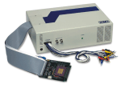

Hardware Debugging Tools
The traditional hardware debug tool was the In-Circuit Emulator (ICE)
  A device that plugged into the CPU socket and emulated the CPU itself
These were rather expensive
  $30K+ for the good ones
Today, most devices that call themselves an ICE are actually JTAGs
Source: Avocet Systems
Source: Hitex Devel Tools

Slide 19
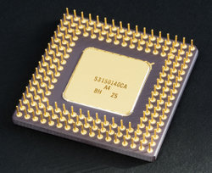
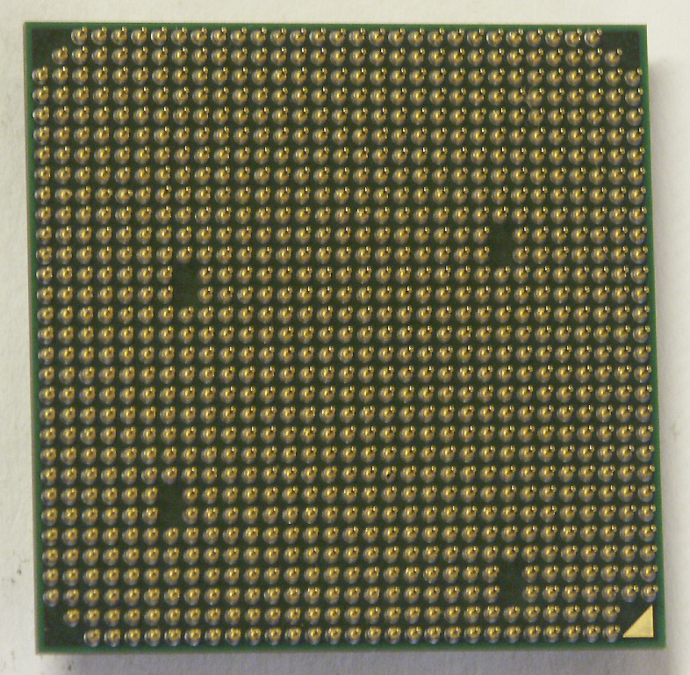

Why the Traditional ICE has Faded Away
The biggest problem faced by the ICE concept was the increasing pin counts of processors
  E.g., 939 pins for the Athlon-64
Each pin required a wire to the ICE
  Each wire started to become an antenna as frequencies increased
Processors also started to move to Ball Grid Array (BGA) packages
  No way to get to the pins in the center of the part because the part is soldered to the motherboard
Source: Intel
Source: AMD
Source: ESA

Slide 20
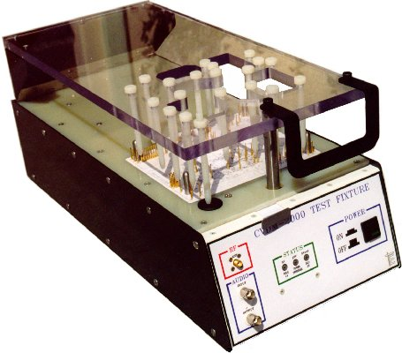
Enter the JTAG Port
The Joint Test Action Group (JTAG) is the name associated with the IEEE 1149.1 standard entitled Standard Test Access Port and Boundary-Scan Architecture
  Originally introduced in 1990 as a means to test printed circuit boards
  An alternative to the bed of nails
Source: Test Electronics

Slide 21
How JTAG Works
JTAG is a boundary-scan device that allows the developer to sample the values of lines on the device
  Allows you to change those values as well
JTAG is built to allow chaining of multiple devices
  Works for multi-core processors, too

Slide 22
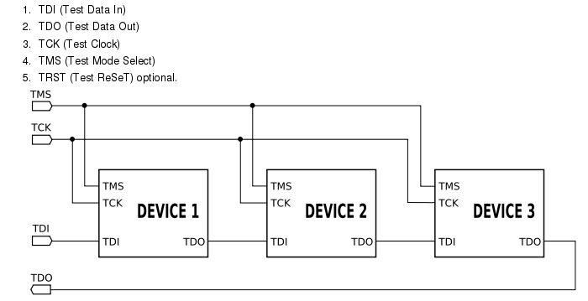
JTAG Details
JTAG is a simple serial protocol
Configuration is done by manipulating the state machine of the device via the TMS line

Slide 23
JTAG-Aware Processors
Most embedded processors today support JTAG or one of its relatives like BDM
  E.g., ARM/XScale, PPC, MIPS
Even the x86 has a JTAG port although it is rarely wired out
  Grandma can barely send e-mail, let alone know what to do with a JTAG port
Some processors like MIPS come in different versions
  Some with JTAG ports for development, some without in order to save $$$

Slide 24
JTAG Vendors
Several different vendors sell JTAG port interface hardware
  JTAG is also referred to as On-Chip Debugging (OCD)
Here are a few of the vendors:
  Wind River Systems (http://www.windriver.com)
  Abatron AG (http://www.abatron.ch)
  American Arium (http://www.arium.com)
  Mentor Graphics (http://www.epitools.com)
Some vendors do certain processors better than others
  MIPS will usually have a more custom EJTAG interface

Slide 25

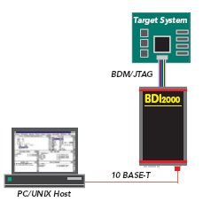
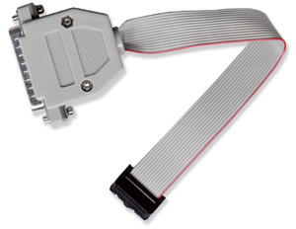
JTAG Connections
The maximum speed of JTAG is 100 MHz
  A ribbon cable is usually sufficient to connect to the target
Connection to the development host is accomplished via
  Parallel port
  USB
  Serial port
  Ethernet
Source: Wind River
Source: Olimex
Source: Abatron

Slide 26
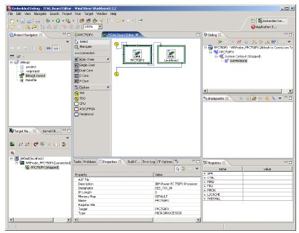
JTAG User Interface
Some JTAG interfaces use a GDB-style software interface
  Any GDB-aware front end will work
Others have Eclipse plug-ins to access the JTAG via an IDE
Some still use a command line interface
Source: Wind River

Slide 27
What can you do with a JTAG?
Typical JTAG usage includes reflashing boot firmware
  Even the really cheap JTAG units can do this
However, it is in the use as a debugging aid that JTAG comes into its own
  You can set hardware or software breakpoints and debug in source code
  Sophisticated breakpoint strategies and multi-core debugging usually require the more expensive units
JTAG units can also be used to exercise the address bus and peripherals
  This is what JTAG was originally designed for

Slide 28
Hardware Configuration Files
Most JTAG units require you to describe the hardware registers in a configuration file
  This is also how you describe what processor architecture you are using
All of that information about register maps that you collected earlier now goes into the configuration file
Unfortunately, there is no standard format for these configuration files
  Each JTAG vendor uses different syntax

Slide 29
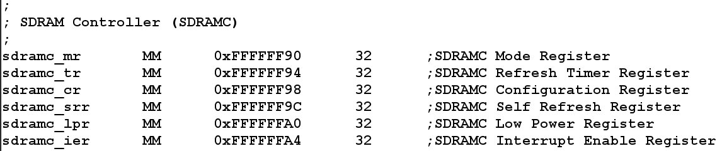
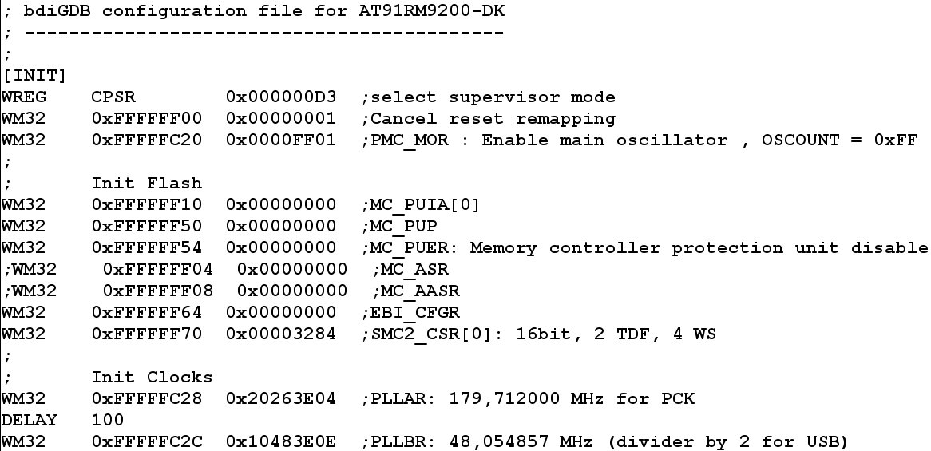
Example Configuration Files
Many JTAG units split the configuration files into a CPU register file and a board configuration file
Source: Abatron

Slide 30
Developing the Configuration File
The JTAG vendor will likely already have a register file for the processor
  ARM920, PPC8241, etc.
Your task will be to develop the board configuration file
  There may be a configuration file for the reference board that you can use as a starting point
The configuration file is essentially a script of commands to initialize the target board
  You keep working on it until you can initialize memory
  Once memory is on-line, you should then be able to write values into memory via the JTAG that can be read back
  Then, enhance the configuration to initialize other peripherals

Slide 31
Linux-Aware JTAGs
There are several rather tricky transitions during the Linux booting process
  Transitioning from flash to RAM
  Transitioning from physical addresses to kernel virtual addresses
  These transitions require the use of hardware breakpoints
Make sure that your JTAG is “Linux aware”
  It must understand Linux’s use of the MMU to be of much use for driver debugging

Slide 32
The Linux Boot Sequence
Like the boot firmware, the Linux kernel starts in assembly language
  Sets up the caches, initializes some MMU page table entries, configures a “C” stack and jumps to a C entry point called start_kernel() (init/main.c)
start_kernel() is then responsible for:
  Architecture and machine-specific hardware initialization
  Initializing virtual memory
  Starting the system clock tick
  Initializing kernel subsystems and device drivers
Finally, a system console is started and the init process is created
  The init process (PID 1) is then the start of all user-space processing

Slide 33
JTAG and Early Kernel Debug
An odd thing happens when the MMU is enabled
  All of the physical addresses suddenly get translated into virtual addresses
The kernel’s debug symbols are all built assuming a virtual address space
  You’ll need to turn debugging symbols on in the kernel
Consequently, while you can step through the early code by using a hardware breakpoint address, software breakpoint on symbols will only work after the MMU is enabled
  Fortunately, this happens fairly early in the kernel initialization
You can typically tell the JTAG to step so many instructions and then stop again
  Step past the MMU initialization, stop and then set additional breakpoints

Slide 34
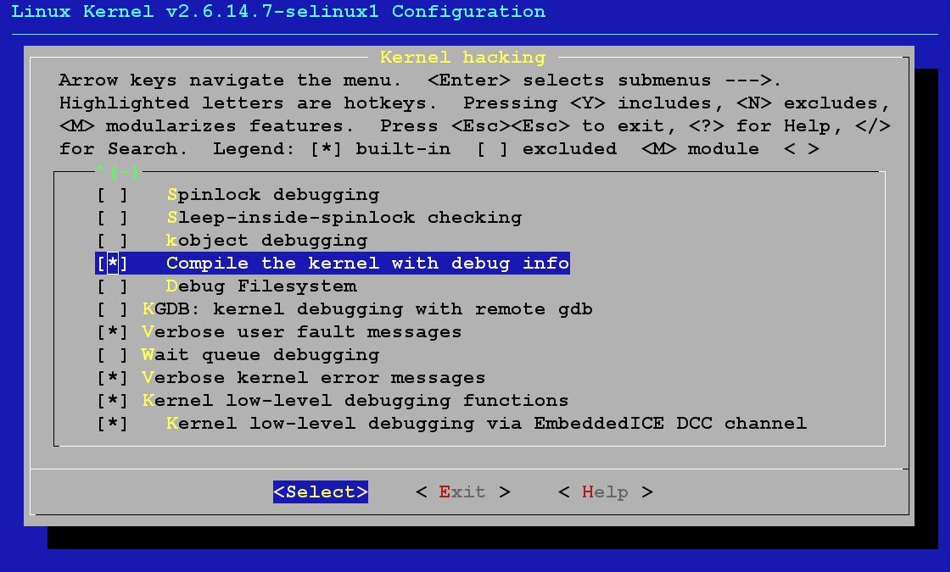
Configure Kernel for Debugging
Enable debugging info and rebuild the kernel

Slide 35
Loading Symbols into the JTAG UI
Depending on the JTAG UI, you may simply have to load the kernel’s vmlinux image to be able to access the symbols by name
  The techniques for doing this vary by JTAG vendor
Attach the JTAG to the hardware
  Reset the board via JTAG and hold in reset
  Set H/W breakpoint using the JTAG
  Load the vmlinux via the JTAG (this loads the symbols)
  Command the JTAG to tell the hardware to “go”
Once you encounter the hardware breakpoint, you can step in assembly until the MMU is enabled
  The MMU will translate physical addresses to virtual addresses
  Once virtual addressing is on, set breakpoints as normal

Slide 36
Using JTAG to Dump printk Buffer
If you kernel hangs right after displaying “Uncompressing Kernel Image … OK” message…
  You probably have printk() output, but the serial console isn’t initialized yet
We can dump the printk buffer using the JTAG!
  Look in the kernel’s System.map file for something like “__log_buf”
  $ grep __log_buf /boot/System.map
  c0445980 b __log_buf

Slide 37
Dumping printk Buffer #2
The address of the buffer is a translated kernel address
  Strip off the 0xC0000000 portion of the address to get (typically) the physical address on processors like the X86
  i.e., 0xc0445980 would typically be at physical address 0x445980
  You must understand your processor to do the translations correctly
Now, use the JTAG to dump that address
  Raw printk output, but you can get an idea of what it was doing when it crashed
  Data is still there even after reset (but not power-off)

Slide 38
GDB-Aware JTAGs
If the JTAG is GDB-aware, then you will be able to control it using normal GDB commands
  Attach to the JTAG via “target remote xx” command where “xx” is via Ethernet, serial or other connection between your JTAG and the host
Use the GDB “mon” command to pass commands directly to the JTAG

Slide 39
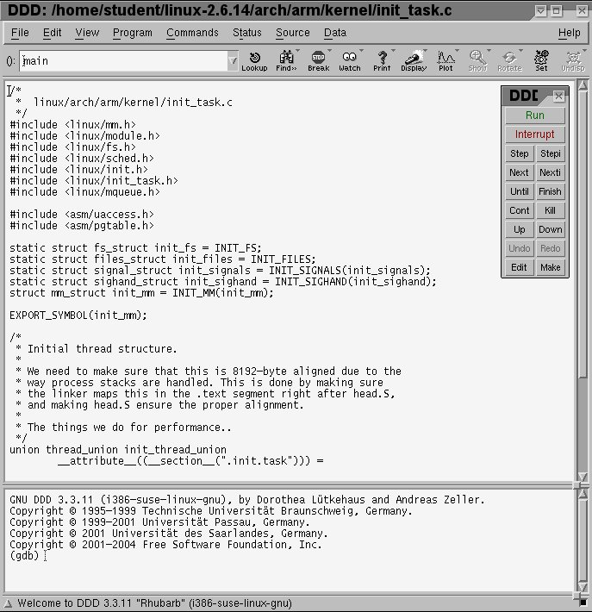
DDD GUI Front-End Example
Invoked from command line with vmlinux compiled for debugging
Then attach to JTAG using “target remote” command

Slide 40
Debugging Device Drivers
Statically linked driver symbols are already built into the kernel’s symbol table
  Simply set break points on the driver methods themselves
Dynamically loaded drivers require additional steps
  We need to find the addresses used by the driver
The next few charts assume a GDB-aware JTAG

Slide 41
Debugging Loadable Modules
In order to debug a loaded module, we need to tell the debugger where the module is in memory
  The module’s information is not in the vmlinux image because that shows only statically linked drivers
How we proceed depends on where we need to debug
  If we need to debug the __init code, we need to set a breakpoint in the sys_init_module() function

Slide 42
Debugging Loadable Modules #2
We’ll need to breakpoint just before the control is transferred to the module’s __init
  Somewhere around line 1907 of module.c
Once the breakpoint is encountered, we can walk the module address list to find the assigned address for the module
  We then use the add-symbol-file GDB command to add the debug symbols for the driver at the address for the loaded module
  E.g.,
  add-symbol-file ./mydriver.ko 0x<addr> -e .init.text

Slide 43
Debugging Loadable Modules #3
Now, you can set breakpoints via the GDB commands to the JTAG and tell the system to continue until a breakpoint in encountered

Slide 44
What if the __init is Working?
If you do not need to debug the __init code, then load the driver and look in the /sys/modules/<module name>/sections/.text for the address of the text segment
Next, use the add-symbol-file command again, but use the .text address and omit the “–e .init.text”
  Set your breakpoints and continue

Slide 45
User-Space Addresses
Within Linux, each user-space application occupy the same virtual address space
  The address spaces are physically different, but the addresses overlap
0x80000000
Stack
Stack
Stack
GUARD
GUARD
GUARD
Stack
Stack
Stack
GUARD
GUARD
GUARD
Heap
Heap
…
Heap
Data
Data
Data
Code
Code
Code
0x1000000
App 1
App 2
App n

Slide 46
JTAG Confusion
JTAGs normally run in what is called halt mode debugging
  The entire processor is stopped when a given breakpoint address is accessed
This works reasonably well in kernel space
  Only one kernel address space
While it is possible to debug user applications with the JTAG, the JTAG can get confused by seeing the same virtual address in different applications due to context switches
  This requires run mode support for the JTAG

Slide 47
Run-Mode Support
Using a debugging agent in user space and register support like the ARM’s Debug Communications Channel (DCC) we can associate a virtual address to a particular context
  This allows the breakpoint to only stop the one application instead of any application that matches the address
Only a few JTAGs support this run mode debugging mechanism
  Otherwise, we are left with normal GDB process trace (ptrace) debugging control via an application like gdbserver
Naturally, GDB already does a reasonable job for user-space debugging
  The need to use JTAG for user-space debug is rare

Slide 48

Summary
Hardware debuggers such as JTAG are invaluable for exercising new hardware
  They let us test address lines and registers
Once we can configure the board via the JTAG, we then take that info and use it to port the boot firmware
  We can usually burn the boot firmware into flash via the JTAG as well
Once the boot firmware is loading Linux, the JTAG can then help again in early kernel debugging and device driver debugging
Don’t start your next bring-up project without one!
Demo time…

