Slide 1
DRM/KMS

Slide 2
Why DRM/KMS ?
› Actively maintained
› Provides fine grained control on the display pipeline
› Widely used by user-space graphic stacks
› Provides a full set of advanced features
› Why not FBDEV ?
⁾ Less actively maintained
⁾ Does not provides all the features we needed (overlays, hw cursor, ...)
⁾ Developers are now encouraged to move to DRM/KMS
› Why not V4L2 ?
⁾ Well suited for video capture and specific video output devices but not for ”complex” display controllers

Slide 3
DRM/KMS: Definition
› DRM stands for Direct Rendering Manager and was introduced to deal with graphic cards embedding GPUs
› KMS stands for Kernel Mode Setting and is a sub-part of the DRM API
› Though rendering and mode setting are now splitted in two different APIs (accessible through /dev/dri/renderX and
/dev/dri/controlDX)
› KMS provide a way to configure the display pipeline of a graphic card (or an embedded system)
› KMS is what we’re interested in when looking for an FBDEV alternative

Slide 4
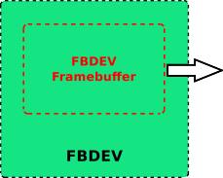


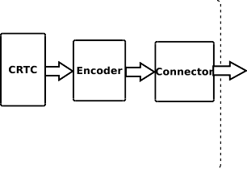

DRM/KMS: Architecture

Slide 5
DRM/KMS Components: Framebuffer
› This is a standard object storing informations about the content to be displayed
› Informations stored:
⁾ References to memory regions used to store display content
⁾ Format of the frame stored in memory
⁾ Active area within the memory region (content that will displayed)

Slide 6
DRM/KMS Components: Framebuffer
› DRM Framebuffer is a virtual object (relies on a specific implementation)
› Framebuffer implementation depends on:
⁾ The memory manager in use (GEM or TTM)
⁾ The display controller capabilities:
⁾ Supported DMA transfer types (Contiguous Memory or Scatter Gather)
⁾ IOMMU
› Default implementation available for GEM objects using CMA (Contiguous Memory Allocator): drivers/gpu/drm/drm_fb_cma_helper.c
› Other implementations usually depend on the Display Controller
⁾ Scatter Gather example: drivers/gpu/drm/tegra/
⁾ IOMMU example: drivers/gpu/drm/exynos/
10/49

Slide 7
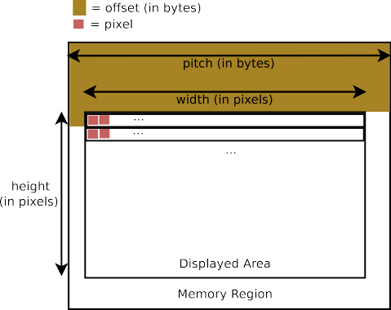
DRM/KMS Components: Framebuffer
structdrm_framebuffer { [...]
unsignedintpitches[4]; unsignedintoffsets[4]; unsignedintwidth; unsignedintheight;
[...]
};

Slide 8
DRM/KMS Components: Framebuffer
structdrm_framebuffer { [...]
uint32_tpixel_format;/* fourcc format */ [...]
};
› pixel_format describes the memory buffer organization
› Uses FOURCC format codes
› Supported formats are defined here:
include/drm/drm_fourcc.h
› These FOURCC formats are not standardized and are thus only valid within the DRM/KMS subsystem

Slide 9
DRM/KMS Components: Framebuffer
› Three types of formats used by the DRM/KMS subsystem:
⁾ RGB: Each pixel is encoded with an RGB tuple (a specific value for each component)
⁾ YUV: Same thing but with Y, U and V components
⁾ C8: Uses a conversion table to map a value to an RGB tuple
› YUV support different modes:
⁾ Packed: One memory region storing all components (Y, U and V)
⁾ Semiplanar: One memory region for Y component and one for UV components
⁾ Planar: One memory region for each component
› Each memory region storing a frame component (Y, U or V) is called a plane

Slide 10
DRM/KMS Components: Framebuffer
› Packed formats: only the first offsets and pitches entries are used
› Semiplanar formats: the first two entries are used
› Planar: the first 3 entries are used
› Don’t know what is the fourth entry used for (alpha plane ?)
structdrm_framebuffer { [...]
unsignedintpitches[4]; unsignedintoffsets[4];
[...]
};

Slide 11
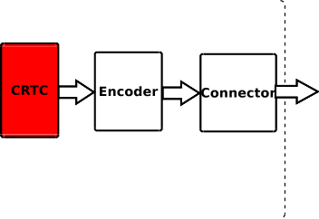

DRM/KMS Components: CRTC

Slide 12
DRM/KMS Components: CRTC
› CRTC stands for CRT Controller, though it’s not only related to CRT displays
› Configure the appropriate display settings:
⁾ Display timings
⁾ Display resolution
› Scan out frame buffer content to one or more displays
› Update the frame buffer
› Implemented through struct drm_crtc_funcs and
struct drm_crtc_helper_funcs
structdrm_crtc_funcs { [...]
int(*set_config)(structdrm_mode_set *set);
int(*page_flip)(structdrm_crtc *crtc, structdrm_framebuffer *fb,
structdrm_pending_vblank_event *event,uint32_tflags);
[...]
};

Slide 13
DRM/KMS Components: CRTC (mode setting)
› set_config is responsible for configuring several things:
⁾ Update the frame buffer being scanned out
⁾ Configure the display mode: timings, resolution, ...
⁾ Attach connectors/encoders to the CRTC
› Use drm_crtc_helper_set_config function and implement struct drm_crtc_helper_funcs unless you really know what you’re doing
structdrm_crtc_helper_funcs { [...]
int(*mode_set)(structdrm_crtc *crtc,
structdrm_display_mode *mode, structdrm_display_mode *adjusted_mode, intx,inty,
structdrm_framebuffer *old_fb);
[...]
};

Slide 14
DRM/KMS Components: CRTC (display timings)
› How display content is updated hasn’t changed much since the creation of CRT monitors (though technology has evolved)
› Requires at least 3 signals:
⁾ Pixel Clock: drive the pixel stream (1 pixel updated per clock cycle)
⁾ VSYNC: Vertical Synchronisation signal, asserted at the beginning of each frame
⁾ HSYNC: Horizontal Synchronisation signal, asserted at the
beginning of each pixel line

Slide 15
DRM/KMS Components: CRTC (display timings)
› HSYNC pulse is used to inform the display it should go to the next pixel line
› VSYNC pulse is used to inform the display it should start to display a new frame and thus go back to the first line
› What’s done during the VSYNC and HSYNC pulses depends on the display technology
› Front and back porch timings are reserved time around the sync pulses. Action taken during those periods also depends on the display technology

Slide 16
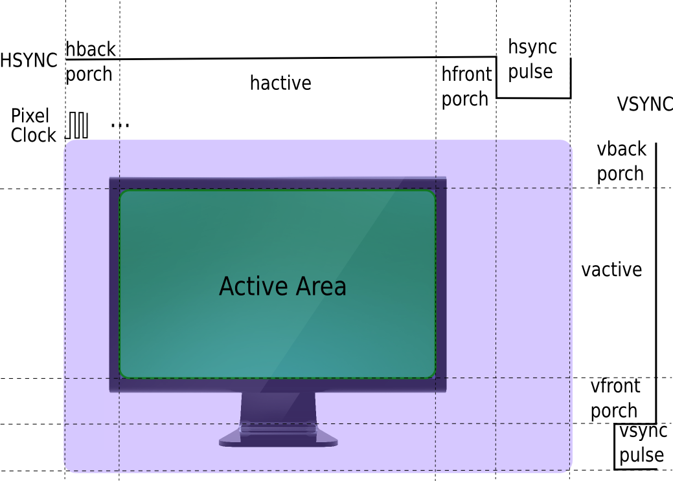
DRM/KMS Components: CRTC (display timings)
20/49

Slide 17
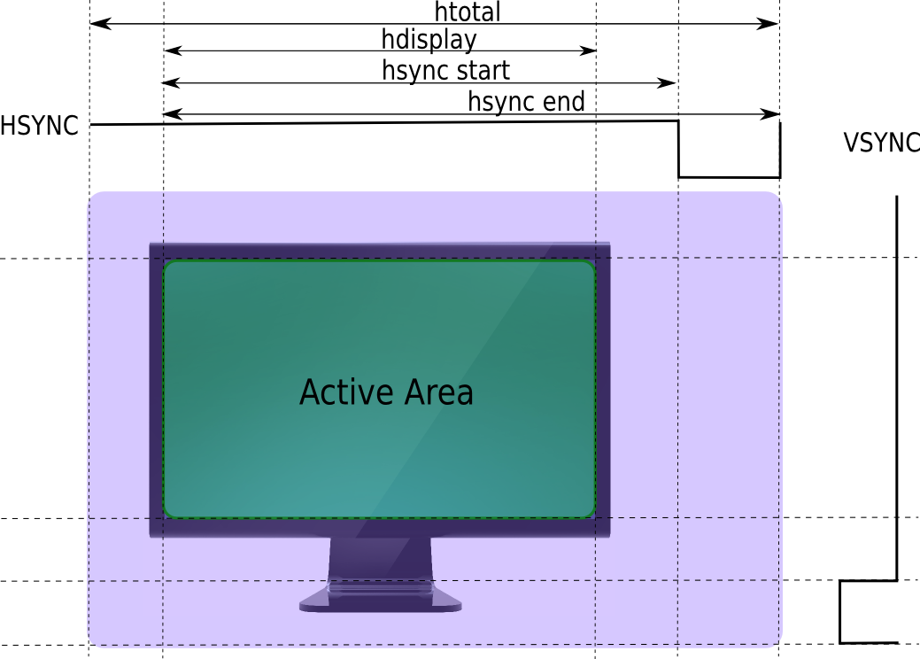
DRM/KMS Components: CRTC (display timings)

Slide 18

DRM/KMS Components: CRTC (mode setting)

Slide 19
DRM/KMS Components: CRTC (mode setting)
staticintatmel_hlcdc_crtc_mode_set(structdrm_crtc *c, structdrm_display_mode *mode, structdrm_display_mode *adj,
intx,inty,
structdrm_framebuffer *old_fb)
{
/* Initialize local variables */
structatmel_hlcdc_crtc *crtc = drm_crtc_to_atmel_hlcdc_crtc(c); [...]
/* Do some checks on the requested mode */ if(atmel_hlcdc_dc_mode_valid(crtc->dc, adj) != MODE_OK)
return-EINVAL;
/* Convert DRM display timings into controller specific ones */ vm.vfront_porch = adj->crtc_vsync_start - adj->crtc_vdisplay; [...]
/* Configure controller timings */
regmap_write(regmap, ATMEL_HLCDC_CFG(1), (vm.hsync_len -1) | ((vm.vsync_len -1) <<16)); [...]
/* Update primary plane attached to the CRTC */ fb = plane->fb;
plane->fb = old_fb;
returnplane->funcs->update_plane(plane, c, fb,0,0, adj->hdisplay, adj->vdisplay,
x <<16, y <<16, adj->hdisplay <<16,
adj->vdisplay <<16);
}

Slide 20






DRM/KMS Components: CRTC (page flipping)

Slide 21
DRM/KMS Components: CRTC (page flipping)
› page_flip is responsible for queueing a frame update
structdrm_crtc_funcs { [...]
int(*page_flip)(structdrm_crtc *crtc,
structdrm_framebuffer *fb, structdrm_pending_vblank_event *event, uint32_tflags);
[...]
};
› The frame is really updated at the next VBLANK (interval between 2 frames)
› Only one page flip at a time
› Should return EBUSY if a page flip is already queued
› event is used to inform the user when page flip is done (the 2 frames are actually flipped)

Slide 22
DRM/KMS Components: CRTC (page flipping)
staticintatmel_hlcdc_crtc_page_flip(structdrm_crtc *c,structdrm_framebuffer *fb,
structdrm_pending_vblank_event *event, uint32_tpage_flip_flags)
{
/* Initialize local variables */
structatmel_hlcdc_crtc *crtc = drm_crtc_to_atmel_hlcdc_crtc(c); [...]
/* Check if a there’s a pending page flip request */ spin_lock_irqsave(&dev->event_lock, flags);
if(crtc->event)
ret = -EBUSY;
spin_unlock_irqrestore(&dev->event_lock, flags); if(ret)
returnret;
[...]
/* Store the event to inform the caller when the page flip is finished */ if(event) {
drm_vblank_get(c->dev, crtc->id);
spin_lock_irqsave(&dev->event_lock, flags); crtc->event = event;
spin_unlock_irqrestore(&dev->event_lock, flags);
}
/* Queue a primary plane update request */
ret = atmel_hlcdc_plane_apply_update_req(plane, &req); [...]
returnret;
}

Slide 23

DRM/KMS Components: Planes

Slide 24
DRM/KMS Components: Planes
› A plane is an image layer (Be careful: not related to the planes referenced by a framebuffer)
› The final image displayed by the CRTC is the composition of one or several planes
› Different plane types:
⁾ DRM_PLANE_TYPE_PRIMARY (mandatory, 1 per CRTC)
⁾ Used by the CRTC to store its frame buffer
⁾ Typically used to display a background image or graphics content
⁾ DRM_PLANE_TYPE_CURSOR (optional, 1 per CRTC)
⁾ Used to display a cursor (like a mouse cursor)
⁾ DRM_PLANE_TYPE_OVERLAY (optional, 0 to N per CRTC)
⁾ Used to benefit from hardware composition
⁾ Typically used to display windows with dynamic content (like a video)
⁾ In case of multiple CRTCs in the display controller, the overlay planes can often be dynamically attached to a specific CRTC when required

Slide 25

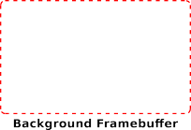

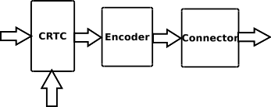


DRM/KMS Components: Planes

Slide 26
DRM/KMS Components: Planes
› Plane support implemented through
struct drm_plane_funcs
structdrm_plane_funcs { [...]
int(*update_plane)(structdrm_plane *plane,
structdrm_crtc *crtc, structdrm_framebuffer *fb, intcrtc_x,intcrtc_y, unsignedintcrtc_w,unsignedintcrtc_h, uint32_tsrc_x,uint32_tsrc_y, uint32_tsrc_w,uint32_tsrc_h);
[...]
};
30/49

Slide 27
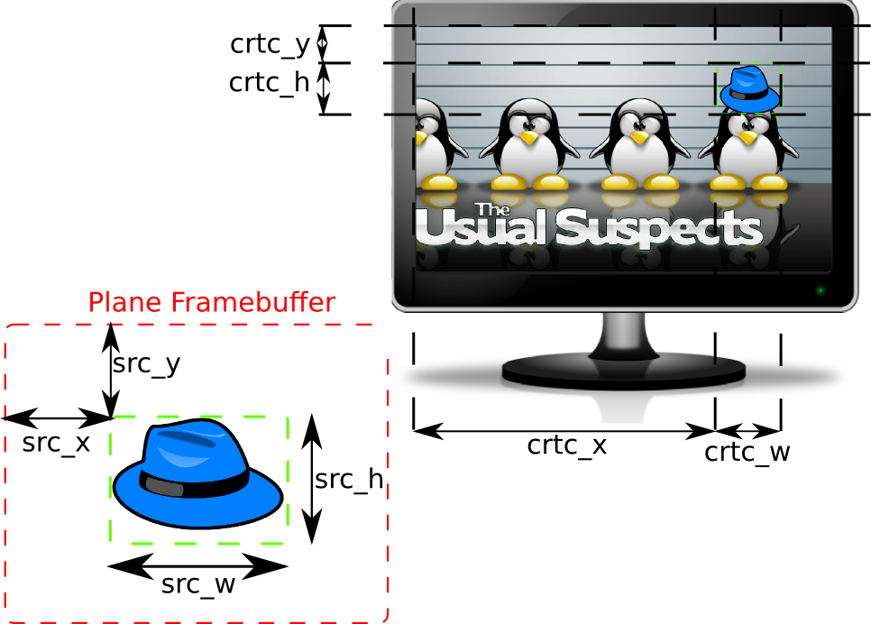
DRM/KMS Components: Planes (update)

Slide 28
DRM/KMS Components: Planes (update)
staticintatmel_hlcdc_plane_update(structdrm_plane *p,
structdrm_crtc *crtc, structdrm_framebuffer *fb, intcrtc_x,intcrtc_y, unsignedintcrtc_w,unsignedintcrtc_h, uint32_tsrc_x,uint32_tsrc_y, uint32_tsrc_w,uint32_tsrc_h)
{
structatmel_hlcdc_plane *plane = drm_plane_to_atmel_hlcdc_plane(p); structatmel_hlcdc_plane_update_req req;
intret =0;
/* Fill update request with informations passed in arguments */ memset(&req,0,sizeof(req));
req.crtc_x = crtc_x;
req.crtc_y = crtc_y; [...]
/* Prepare a plane update request: reserve resources, check request coherency, ... */
ret = atmel_hlcdc_plane_prepare_update_req(&plane->base, &req);
if(ret) returnret;
[...]
/* Queue the plane update request: update DMA transfers at the next VBLANK event */
returnatmel_hlcdc_plane_apply_update_req(&plane->base, &req);
}

Slide 29
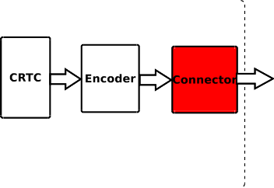
DRM/KMS Components: Connector

Slide 30
DRM/KMS Components: Connector
› Represent a display connector (HDMI, DP, VGA, DVI, ...)
› Transmit the signals to the display
› Detect display connection/removal
› Expose display supported modes

Slide 31
DRM/KMS Components: Connector
› Implemented through struct drm_connector_funcs and
struct drm_connector_helper_funcs
structdrm_connector_helper_funcs { int(*get_modes)(structdrm_connector *connector); enumdrm_mode_status
(*mode_valid)(structdrm_connector *connector,
structdrm_display_mode *mode); structdrm_encoder *
(*best_encoder)(structdrm_connector *connector);
};
structdrm_connector_funcs { [...]
enumdrm_connector_status
(*detect)(structdrm_connector *connector,boolforce);
[...]
};

Slide 32
DRM/KMS Components: Connector (get modes)
staticintrcar_du_lvds_connector_get_modes(structdrm_connector *connector)
{
structrcar_du_lvds_connector *lvdscon = to_rcar_lvds_connector(connector); structdrm_display_mode *mode;
/* Create a drm_display_mode */
mode = drm_mode_create(connector->dev); if(mode ==NULL)
return0;
/* Fill the mode with the appropriate timings and flags */ mode->type = DRM_MODE_TYPE_PREFERRED | DRM_MODE_TYPE_DRIVER;
mode->clock = lvdscon->panel->mode.clock;
mode->hdisplay = lvdscon->panel->mode.hdisplay; [...]
/* Give this name a name based on the resolution: e.g. 800x600 */ drm_mode_set_name(mode);
/* Add this mode to the connector list */ drm_mode_probed_add(connector, mode);
/* Return the number of added modes */ return1;
}

Slide 33
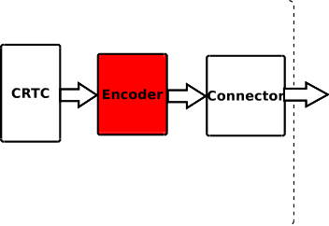
DRM/KMS Components: Encoder

Slide 34
DRM/KMS Components: Encoder
› Directly related to the Connector concept
› Responsible for converting a frame into the appropriate format to be transmitted through the connector
› Example: HDMI connector is transmiting TMDS encoded data, and thus need a TMDS encoder.

Slide 35
DRM/KMS Components: Encoder
› Implemented through struct drm_encoder_funcs and
struct drm_encoder_helper_funcs
structdrm_encoder_helper_funcs { [...]
bool(*mode_fixup)(structdrm_encoder *encoder,
conststructdrm_display_mode *mode, structdrm_display_mode *adjusted_mode);
[...]
void(*mode_set)(structdrm_encoder *encoder,
structdrm_display_mode *mode, structdrm_display_mode *adjusted_mode);
[...]
};

Slide 36
DRM/KMS Components: DRM device
40/49

Slide 37
DRM/KMS Components: DRM device
› Responsible for aggregating the other components
› Device exposed to the userspace (handles all user-space requests)
› Implemented through struct drm_driver
structdrm_driver {
int(*load) (structdrm_device *,unsignedlongflags); [...]
int(*unload) (structdrm_device *); [...]
u32 driver_features; [...]
};

Slide 38
DRM/KMS Components: DRM device
› Call drm_dev_alloc then drm_dev_register to register a DRM device
› load and unload are responsible for instantiating and destroying the DRM components attached to a DRM device
› driver_features should contain DRM_RENDER, DRM_MODE_SET or both depending on the DRM device features

Slide 39
DRM/KMS Components: DRM device
staticstructdrm_driver atmel_hlcdc_dc_driver = {
.driver_features = DRIVER_HAVE_IRQ | DRIVER_GEM | DRIVER_MODESET,
.load = atmel_hlcdc_dc_load,
.unload = atmel_hlcdc_dc_unload, [...]
.name ="atmel-hlcdc",
.desc ="Atmel HLCD Controller DRM",
.date ="20141504",
.major =1,
.minor =0,
};

Slide 40
DRM/KMS Components: DRM device
staticintatmel_hlcdc_dc_drm_probe(structplatform_device *pdev)
{
structdrm_device *ddev; intret;
ddev = drm_dev_alloc(&atmel_hlcdc_dc_driver, &pdev->dev); if(!ddev)
return-ENOMEM;
ret = drm_dev_set_unique(ddev, dev_name(ddev->dev)); if(ret) {
drm_dev_unref(ddev);
returnret;
}
ret = drm_dev_register(ddev,0); if(ret) {
drm_dev_unref(ddev);
returnret;
}
return0;
}

Slide 41
DRM/KMS Components: Other concepts
› DPMS: Display Power Management Signaling
› Properties: transversal concept used to expose display pipeline behaviors
⁾ Can be attached to all the component we’ve seen so far
⁾ Examples:
⁾ Rotation is a plane property
⁾ EDID (Unique display ID exposed by a monitor) is a connector property
⁾ ...
› Bridge: represent an external encoder accessible through a bus (spi, i2c)
› Encoder slave: pretty much the same thing (still don’t get the difference)
› FBDEV emulation
› Multiple CRTCs, Encoders and Connectors

Slide 42
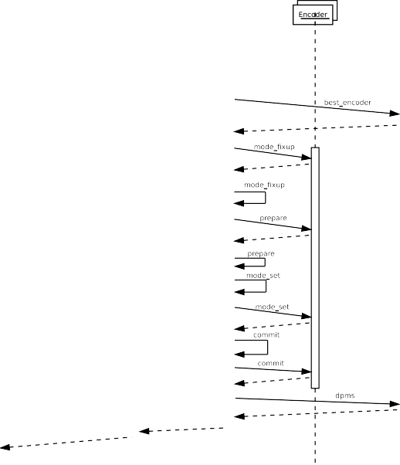

DRM/KMS Sequence Diagram: Mode Setting

Slide 43
KMS Driver: Development Tips
› Read the documentation: https://www.kernel.org/doc/htmldocs/drm/
› Take a look at other drivers
⁾ Choose a similar driver (in terms of capabilities)
⁾ Check that the driver you are basing your work on is recent and well maintained
› Check for new features: the DRM subsystem is constantly evolving
› Use helper functions and structures as much as possible
› Start small/simple and add new features iteratively (e.g. only one primary plane and one encoder/connector pair)
› Use simple user-space tools to test it like modetest

Slide 44
KMS Userland Graphic Stacks
› Tried weston (standard wayland implementation) and Qt with a KMS backend
› First thing to note: they’re not ready for KMS drivers without OpenGL support (DRM_RENDER capabilities)!
⁾ Wayland works (thanks to pixmam support) but does not support planes and hardware cursors when OpenGL support is disabled
⁾ Qt only works with the fbdev backend
⁾ WIP on the mesa stack to provide soft OpenGL when using a KMS driver without OpenGL support
⁾ But the window composition will most likely be done through
the soft OpenGL, which implies poor perfomances
› Not sure you can choose a specific plane when using a window manager (e.g. stream video content on a plane which support YUV format)

