Slide 1





A Deep Dive into Image Processing
for i.MX 6 Application Processors
FTF-CON-F0119
Oliver Brown | Senior Software Engineer
A P R . 1 0 . 2 0 1 4
TM
External Use

Slide 2

Agenda
Introduction
IPUv3 – system overview
IPUv3 – fundamentals
IPU & the iMX Linux BSP
Use case examples / tips
External Use 15

Slide 3
Introduction
IPU (Image processing Unit) is present on most of i.MX products
IPUv1 was 1st introduced on i.MX31 and upgraded on i.MX35
IPUv3 is a family of IPs that are present on MX37, i.MX51, i.MX53, i.MX6Q/D/DL
External Use 15

Slide 4
Introduction
This presentation will describe IPUv3 on i.MX5 and i.MX6.
The slides are based on i.MX6
IPUv3 architecture is common for all products
The differences between one product to another are on
Processing speed (from 133Mhz to 264Mhz)
The modules included (CSI, VDI, ISP etc)
The connectivity options and interfaces (HDMI, LVDS, MIPI etc)
External Use 15

Slide 5
Introduction
The following slide set is based on past versions of IPUv3
The slides used for the i.MX51’s NPI training can be found on:
http://compass.freescale.net/doc/195331621/0201_IPUv3EX_In_MX51.ppt
The slides used for the i.MX53’s NPI training can be found on:
http://compass.freescale.net/livelink/livelink/218704608/iMX53_IPUv3M.ppt?fun c=doc.Fetch&nodeid=218704608
The slides used for the i.MX6’s NPI training can be found on:
http://compass.freescale.net/livelink/livelink/224514161/Day2-1-iMX6_Dual- Quad_NPI_Training_-_IPU.pptx?func=doc.Fetch&nodeid=224514161
External Use 15

Slide 6
IPUv3 resources
Freescale Internal Links
IPU on Compass
http://compass.freescale.net/go/ipu
http://compass.freescale.net/go/ipudes
IPUv3 code examples for MX6/Q
http://compass.freescale.net/livelink/livelink?func=ll&objId=222977460&objAction=browse&viewType=1
IPUv3 code examples
http://compass.freescale.net/go/189478969
IPUv3 users mail list
IPUFORUM@freescale.com
External Links
https://community.freescale.com/community/imx
External Use 15

Slide 7

Video/Graphics System in i.MX6 D/Q
External Use 15

Slide 8







Video & Graphics System in i.MX6 D/Q
Full HW Support –> Multiple Advantages
The CPU does not have to touch pixels
–> available to run application
Optimized data path –> reduced DDR load
–> complex use cases with only 32-bit DDR memories
Lower power consumption (because of both aspects above)
Video Sources
Displays
DCICs
Display Content Integrity Check
Interface Bridges
LVDS, HDMI, MIPI
IPUs
(Image Processing Unit)
Connectivity to relevant devices
Image processing: conversions, enhancement…
Synchronization and control
VPU
(Video Processing Unit)
Video encoding and decoding
GPUs
(Graphics Processing Units)
Graphics generation
External Use 15

Slide 9


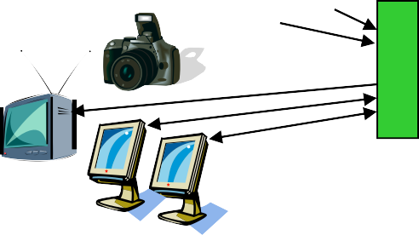



Video/Graphics Subsystem in i.MX6 D/Q
i.MX6 Dual/Quad
Data Control
ARM CPU
Memory Interface
Video Sources
GPUs
Bridges
IPUs
External Memories
DCICs
VDOA
Displays
VPU
IRAM
External Use 15

Slide 10
Multimedia Processing Chain
Image Sensor Display
Image Signal Processing
Bayer -> YUV conversion
Image quality
enhancement
Camera corrections
Display Enhancement
Image Signal Processing
Video/Graphics
Combining
Image Conversions
De-interlacing
Resizing (resolution adjustment)
Rotation & Inversion
Color Space Conversion
Pixel Format Conversion (packing…)
Image Conversions
Camera Preview
Image Conversions
Graphics Generation
De-blocking De-ringing
Compression
De-compression
Memory
Display Enhancement:
Color adjustments and gamut mapping
Gamma correction and contrast stretching
Compensation for low- light conditions and backlight reduction
Combining with Audio
Separation from Audio
Communication
Network
Audio Compression
Audio De-compression
External Use 15

Slide 11
imedia Processing Chain – Implementation
Mult
Image Sensor
Display
Comprehensive HW support:
Video/graphics fully handled by IPU, VPU and GPU.
-> The CPU does not have to touch pixels
Camera
Image Processing Unit (IPU)
Display Enhancement
Image Signal Processing
Video/Graphics
Combining
Image Conversions
Camera Preview
Image Conversions
Graphics Generation
Video Processing Unit (VPU)
Graphics Processing Units (GPUs) And ARM
De-blocking De-ringing
Compression
De-compression
Memory
Communication
Network
ARM
HW Accelerated
Combining with Audio
Separation from Audio
Audio Compression
Audio De-compression
External Use 15

Slide 12

Display Support
External Use 15

Slide 13
i.MX37, i.MX51, i.MX53, i.MX6 D/Q – Display Support
How to calculate the display resolution?
FW = Frame Width
FH = Frame Height
FPS = Frame rate (fps)
BI = Blanking interval
Provided in the display’s DS up to 35% (1.35).
Use min values
The pixel clock [MHz] is calculated according to:
F = FW X FH X FPS X BI
Few things to consider:
Data format (pixel per clock?)
Display’s clock source (DI#_CLK_EXT bit)
The load on the display controller (DC)
External Use 15

Slide 14


i.MX37, i.MX51, i.MX53, i.MX6 D/Q – Display Support
Feature |  | i.MX51 (IPUv3EX) i.MX37 (IPUv3D) | i.MX53 (IPUv3M) | i.MX6 D/Q (2 x IPUv3H)
Throughput | # of outputs | 2 |  | 4
 | Pixel clock rate | Up to 133 MHz | Up to 200 MHz | Up to 266 MHz per IPU
 | Resolution (@ 60 Hz) | WXGA+ (1600x900) 720p (1280x720) + SVGA (800x600) | WUXGA (1920x1200) 1080p (1920x1080) + WVGA (800x480) | 2 x 4XGA (2048x1536) 2 x [1080p + WXGA (1280x720)]
Interfaces | Parallel | Two ports 24 bits + 18 bits | Two ports 24 bits + 24 bits
 |  | Synchronous (for display refresh) and asynchronous (to memory) Very flexible - glue-less connection to RAM-less displays, display controllers, and TV encoders.
 | LVDS | No | Two channels; consumer version (multiple pairs); 2x 85 MHz or 170MHz
 | HDMI | No |  | One port
 | MIPI/DSI | No |  | One port, 2 lanes x 1 Gbps (non-Automotive)
 | Analog | One port; TV-out i.MX37: SDTV i.MX51: also 720p60 or 1080i/p30 | Also VGA Rate increased to 1080p60 | None (phased out)
Display Content Authentication (CRC) |  | No |  | Yes, for 2 displays
Processing | On-the-fly combining (for high resolution displays) | 2 planes (up to 3 more planes for lower resolutions) |  | For 2 displays, 2 planes for each (6 more planes for lower resolutions)
 | Off-line combining | Up to 20 MP/sec | Up to 200+ MP/sec | Up to 500+ MP/sec
 | Display enhancement | Color adjustment and smart gamut mapping; gamma correction and contrast enhancement Supporting effective proprietary algorithms
 | Backlight power optimization | Yes; Supporting efficient proprietary algorithms
External Use 15

Slide 15
in i.MX6 D/Q (IPUv3H) – Maximal Resolution & Refresh
IPU
Rate
Name | Resolution |  |  |  | Maximal Refresh Rate [Hz]
 | Width | x | Height | Total [MP]
VGA | 640 | x | 480 | 0.31 | 666
PAL | 720 | x | 480 | 0.35 | 592
WVGA | 800 | x | 480 | 0.38 | 533
NTSC | 720 | x | 576 | 0.41 | 493
SVGA | 800 | x | 600 | 0.48 | 426
WSVGA | 1024 | x | 600 | 0.61 | 333
XGA | 1024 | x | 768 | 0.79 | 260
HD720 | 1280 | x | 720 | 0.92 | 222
WXGA | 1366 | x | 768 | 1.05 | 195
WXGA+ | 1440 | x | 900 | 1.30 | 158
SXGA | 1280 | x | 1024 | 1.31 | 156
SXGA+ | 1400 | x | 1050 | 1.47 | 139
WSXGA+ | 1680 | x | 1050 | 1.76 | 116
UXGA | 1600 | x | 1200 | 1.92 | 107
HD1080 | 1920 | x | 1080 | 2.07 | 99
WUXGA | 1920 | x | 1200 | 2.30 | 89
9VGA | 1920 | x | 1440 | 2.76 | 74
4XGA | 2048 | x | 1536 | 3.15 | 65
HD1440 | 2560 | x | 1440 | 3.69 | 56
4WXGA | 2560 | x | 1600 | 4.10 | 50
4K x 2K | 4096 | x | 2048 | 8.39 | 25
Capabilities
Maximal display resolution: 4096x4096 pixels
Maximal pixel rate: 264 MP/sec (200MP/sec on MX53, 133MP/sec on MX51)
Display refresh rate
The maximal refresh rate is: 264M / (W * H * B)
W*H is the display resolution
B is a factor >1 reflecting blanking overhead, e.g. as specified by VESA, CEA-861- D, etc.
The table provides the maximal refresh rates for some typical resolutions
Usually, the refresh rate is required to be at least 60 Hz, to prevent blinking.
The blanking overhead factor assumed for the calculation is 1.3.
The actual factor depends on the display and is often closer to 1, allowing higher resolutions @ 60 Hz (e.g. HD1440).
For example, for HD1080, the standard specifies B~1.2
This is the capability of each of the two IPUs, so the total capability of the processor is doubled.
Note: these rates refer only to screen refresh, gated by the capabilities of the display port. A full use case typically includes additional activities and to confirm its support with a given refresh rate, additional aspects – video processing capabilities, capacity of the memory system, etc. – should be also analyzed carefully.
800 x 480 (WVGA) ~331 Hz
1280 x 720 (HD720) ~138 Hz
1024 x 768 (XGA) ~161 Hz
1920 x 1080 (HD1080) ~61 Hz 2048 x 1536 (4XGA) ~40 Hz
External Use 15

Slide 16
IPU in i.MX6 D/Q (IPUv3H) – Dual-Display Capabilities
Second Display First Display | SDTV 480i30/576i25 (27 MHz) | WSVGA (1024x600) (44-49 MHz) | HDTV 720p60/1080i30 (74.25 MHz) | WXGA (1366x768) (72-85 MHz) | WSXGA+ (1680x1050) (119-146 MHz) | HDTV 1080p60 (148.5 MHz)
WXGA (1366x768 ~ 1.0 MP; 72-85 MHz) | Full | Full | Full | Full | Full | Full
SXGA (1280x1024 ~ 1.3 MP; 91-109 MHz) | Full | Full | Full | Full | Partial | Partial
SXGA+ (1400x1050 ~ 1.5 MP; 101-122 MHz) | Full | Full | Full | Full | Partial
WSXGA+ (1680x1050 ~ 1.8 MP; 119-146 MHz) | Full | Full | Full | Full | Partial
UXGA (1600x1200 ~ 1.9 MP; 130-161 MHz) | Full | Full | Full | Partial
WUXGA (1920x1200 ~ 2.3 MP; 154-193 MHz) | Full | Partial | Partial
9VGA (1920x1440 ~ 2.8 MP; 185-234 MHz) | Partial | Partial
4XGA (2048x1536 ~ 3.2 MP; 209-267 MHz) | Partial
Notes
This is the capability of each of the two IPUs, so the total capability of the processor is doubled.
The maximal pixel clock rate supported by the display ports
Each display: 220 MHz
Total: 240 MHz
For a TV, the clock rate is fixed by the corresponding standards
For other displays
The assumed screen refresh rate is 60 Hz
The blanking overhead – impacting the pixel clock rate – may vary between displays.
The table refers – for concreteness – to the VESA CVT (Coordinated Video Timing) specification
“Full support”: allowing full blanking (which is typically required for CRTs)
“Partial support”: allowing only reduced blanking (which is still typically sufficient for digital displays, e.g. LCDs)
The above table describes only the capabilities of the display ports to perform screen refresh. A full use case typically
includes additional activities and to confirm its support with a given display configuration, additional aspects – video
processing capabilities, capacity of the memory system, etc. – should be also analyzed carefully.
External Use 15

Slide 17





















i.MX6 D/Q Display Ports Muxing
IPU #0
DI0 DI1
IPU #1
DI0 DI1
Six ports
Two parallel - driven directly by the IPU
Two LVDS channels - driven by the LVDS bridge
One HDMI – driven by the HDMI transmitter
One MIPI-DSI – driven by the MIPI-DSI transmitter
MIPI
DSI • Four simultaneous outputs
Each IPU has two display ports (DI0 and DI1)
Therefore, up to four external ports can be active at any given time.
Additional asynchronous data flows can be sent through the parallel ports and the MIPI-DSI port
Display Content Integrity Check (DCIC)
For parallel interfaces: probes the I/O loopback (essentially equivalent to probing the external wires)
For other integrated interfaces (e.g. LVDS): probes the IPU output (essentially equivalent to the inputs to the serializers)
MIPI DSI
Parallel
#0
Parallel
#1
LVDS #0
LVDS #1
HDMI
Lockable control
Lockable control
DCIC #0
DCIC #1
External Use 15

Slide 18
Max Display Port Resolutions on i.MX6Q/D
MIPI DSI, 2 lanes
− WXGA (1366 x 768) or 720p (1280 x 720)
RGB
− Port 1 – 4XGA (2048 x 1536)
− Port 2 – 4XGA (2048 x 1536)
LVDS
− Single channel – WXGA (1366 x 768) or 720p (1280 x 720)
− Dual channel – UXGA (1600 x 1200) or 1080p (1920 x 1080)
HDMI
− 1080p (1920 x 1080) or 4XGA (2048 x 1536)
Note: Assuming 30% blanking intervals overhead, 24bpp, 60fps
External Use 15

Slide 19
Connecting a display on the parallel interface
i.MX51 | LCD
 | RGB, Signal name (General) | RGB/TV Signal Allocation (Example) |  |  |  |  |  | Smart
Port Name (x=1,2) |  | 16 bit RGB | 18 bit RGB | 24 bit RGB | 8 bit YCrCb | 16 bit YCrCb | 20 bit YCrCb | Signal name
DISPx_DAT0 | DAT[0] | B[0] | B[0] | B[0] | Y/C[0] | C[0] | C[0] | DAT[0]
DISPx_DAT1 | DAT[1] | B[1] | B[1] | B[1] | Y/C[1] | C[1] | C[1] | DAT[1]
DISPx_DAT2 | DAT[2] | B[2] | B[2] | B[2] | Y/C[2] | C[2] | C[2] | DAT[2]
DISPx_DAT3 | DAT[3] | B[3] | B[3] | B[3] | Y/C[3] | C[3] | C[3] | DAT[3]
DISPx_DAT4 | DAT[4] | B[4] | B[4] | B[4] | Y/C[4] | C[4] | C[4] | DAT[4]
DISPx_DAT5 | DAT[5] | G[0] | B[5] | B[5] | Y/C[5] | C[5] | C[5] | DAT[5]
DISPx_DAT6 | DAT[6] | G[1] | G[0] | B[6] | Y/C[6] | C[6] | C[6] | DAT[6]
DISPx_DAT7 | DAT[7] | G[2] | G[1] | B[7] | Y/C[7] | C[7] | C[7] | DAT[7]
DISPx_DAT8 | DAT[8] | G[3] | G[2] | G[0] |  | Y[0] | C[8] | DAT[8]
DISPx_DAT9 | DAT[9] | G[4] | G[3] | G[1] |  | Y[1] | C[9] | DAT[9]
DISPx_DAT10 | DAT[10] | G[5] | G[4] | G[2] |  | Y[2] | Y[0] | DAT[10]
DISPx_DAT11 | DAT[11] | R[0] | G[5] | G[3] |  | Y[3] | Y[1] | DAT[11]
DISPx_DAT12 | DAT[12] | R[1] | R[0] | G[4] |  | Y[4] | Y[2] | DAT[12]
DISPx_DAT13 | DAT[13] | R[2] | R[1] | G[5] |  | Y[5] | Y[3] | DAT[13]
DISPx_DAT14 | DAT[14] | R[3] | R[2] | G[6] |  | Y[6] | Y[4] | DAT[14]
DISPx_DAT15 | DAT[15] | R[4] | R[3] | G[7] |  | Y[7] | Y[5] | DAT[15]
DISPx_DAT16 | DAT[16] |  | R[4] | R[0] |  |  | Y[6]
DISPx_DAT17 | DAT[17] |  | R[5] | R[1] |  |  | Y[7]
DISPx_DAT18 | DAT[18] |  |  | R[2] |  |  | Y[8]
DISPx_DAT19 | DAT[19] |  |  | R[3] |  |  | Y[9]
DISPx_DAT20 | DAT[20] |  |  | R[4]
DISPx_DAT21 | DAT[21] |  |  | R[5]
DISPx_DAT22 | DAT[22] |  |  | R[6]
DISPx_DAT23 | DAT[23] |  |  | R[7]
DIx_DISP_CLK | PixCLK
DIx_PIN1 |  |  |  |  |  |  |  | VSYNC_IN
DIx_PIN2 | HSYNC
DIx_PIN3 | VSYNC
DIx_PIN4
DIx_PIN5
DIx_PIN6
DIx_PIN7
DIx_PIN8
DIx_D0_CS |  |  |  |  |  |  |  | CS0
DIx_D1_CS |  |  |  |  |  |  |  | CS1
DIx_PIN11 |  |  |  |  |  |  |  | WR
DIx_PIN12 |  |  |  |  |  |  |  | RD
DIx_PIN13 |  |  |  |  |  |  |  | RS1
DIx_PIN14 |  |  |  |  |  |  |  | RS2
DIx_PIN15 | DRDY/DV |  |  |  |  |  |  | DRDY
DIx_PIN16
DIx_PIN17
External Use 15

Slide 20

IPUv3H – Video In Support
External Use 15

Slide 21



i.MX51, i.MX53, i.MX6 D/Q – Video In Support
Feature |  | i.MX51 (IPUv3EX) | i.MX53 (IPUv3M) | i.MX6 D/Q (2 x IPUv3H)
Video Input Interfaces | Parallel | Two ports, 20 bits + 8 bits
 |  | 120 MHz; e.g. 6 MP @ 15 fps | 180 MHz; e.g. 9 MP @ 15 fps | 200 MHz; e.g. 10 MP @ 15 fps
 | MIPI/CSI-2 | No |  | One port, 4 lanes x 1 Gbps
Video Rate | Playback | 720p30 (1280x720) @ 30 fps | 1080i/p (1920x1080) @ 30 fps | 1080i/p + D1 @ 30 fps
 | Record | D1 (720x480@30 fps or 720x576@25 fps) | 720p30 (1280x720) @ 30 fps | 1080p @ 30 fps
 | 2-way |  | 720p @ 20 fps | 720p @ 30 fps
Video Processing | De-interlacing | High-quality motion adaptive algorithm
 | Resizing | Yes – fully flexible
 | Rotation/inversion | Yes
 | Color conversion | Yes – fully flexible
Memory Interface | Protocol | AXI – Including split transaction
 | Throughput | 64-bit, 133 MHz | 64-bit, 200 MHz | 64-bit, 266 MHz
Efficient memory bus utilization |  | Selective read for combining
Control capabilities |  | Display controller, DMA controller, Internal synchronization Autonomous operations: display refresh/update, view-finder
Synchronization (to prevent tearing) |  | Double/triple buffering Frame-by-frame or tight – sub-frame (utilizing internal memory)
External Use 15

Slide 22


Video Input Ports In i.MX6 D/Q
Three ports; up to six input channels
Two parallel – connected directly to the IPUs; independent clock and format setting
One MIPI/CSI-2 – can transfer up to four concurrent channels
Each port: up to 150Mpxl/s @200MHz, e.g. 10Mpxl @ 15fps
Four concurrent channels
Each IPU has two input ports (CSI0 and CSI1), each can process an input channel from one of the external ports.
The MIPI/CSI-2 bridge sends all its channels to all the IPU input ports and each port can select for processing a different channel, identified by its DI (Data Identifier).
Additional channels can be transferred through a CSI transparently – as generic data – directly to the system memory.
Formats supported:
− BT.656
− BT.1120
YUV422, RGB888, YUV444 = over an 8 bit bus
RAW format up to 16bpp which will be translated to 8 bit using companding
Generic data up to 20bit
Video Sources
i.MX6 D/Q
Parallel 0
mux
CSI0
IPU #0
MIPI/CSI-2
Receiver
CSI1
MIPI/CSI-2
CSI1
IPU #1
Parallel 1
mux
CSI0
External Use 15

Slide 23

IPUv3H – The camera port
CSI (Camera
Sensor I/F)
SMFC (Sensor Multi FIFO Ctrl.)
IDMAC
(Image DMA
Controller)
CSI (Camera Sensor I/F)
Cameras
64-bit AXI
Memory
VDI (Video De-Interlacer)
IC (Image
Converter)
display
External Use 15

Slide 24
The Camera Sensor Interface - CSI
Role: controls the camera port
Provides direct connectivity to relevant image sensors and connectivity bridges: CSI-2, HDMI receiver, TV decoder…
Data bus – up to 20 bits
Single value – up to 16 bits
Two values – up to 10 bits each; e.g. HDTV YUV 4:2:2 input
Variety of data formats
Main (with on-the-fly processing): YUV 4:2:2/4:4:4, RGB 16/24 bpp
Other: as generic data, including compressed streams
All primary CSI-2 formats
Frame resolution
Up to 8192 x 4096 pixels
Input rate
240M values/sec peak (@ 264 MHz internal clock)
Additional features
Frame rate reduction – by skipping (reduction ratio: m:n, m<=n<=12)
Window-of-interest selection – by cropping
External Use 15

Slide 25
i.MX37, i.MX51, i.MX53, i.MX6 D/Q – Video in Support
How to calculate the video in pixel clock?
FW = Frame Width
FH = Frame Height
FPS = Frame rate (fps)
BI = Blanking interval
Provided in the device’s DS up to 35% (1.35).
D = Data format
How the data is arranged on the bus – (cycles/pixel)
The pixel clock [MHz] is calculated according to:
F = FW X FH X FPS X BI X D
External Use 15

Slide 26
16-bit camera support
16-bit YUV422
CSI receives 2 components per cycle.
CSI [16 bit generic data.] => SMFC => MEM [16bit generic data] => IPU[YUV422]
16-bit RGB as generic data
CSI receives 3 components per cycle.
Use a 16 bit sample of it (such as RGB565)
CSI [16 bit generic data.] => SMFC => MEM [16bit generic data] => IPU [16 bit RGB] =>
IPU [map to 24bpp RGB]
16-bit RGB565
On the fly processing of 16 bit data.
CSI is programmed to receive 16 bit generic data.
The interface is restricted to be in "non-gated mode" and the CSI#_DATA_SOURCE bit has
to be set
If the external device is 24bit - the user can connect a 16 bit sample of it (RGB565 format).
The IPU has to be configured in the same way as the case of CSI#_SENS_DATA_FORMAT=RGB565
External Use 15

Slide 27
BT.1120/BT.656 support
BT.656
CCIR progressive/interlaced modes
BT.1120
CCIR progressive/ interlaced mode
SDR/DDR mode
The timing reference signals (Sync events) are embedded in the
data.
The CCIR codes are defined in the standard. IPU can support non standard codes using the CCIR registers.
On the fly processing is supported in both modes
External Use 15

Slide 28
BT.1120/BT.656 support
IPUv3 is an 8bit per component system.
In a 10bit data inputs there are few ways to handle the data
Companding - programmable piecewise-linear map
Regular and tight packing to memory
BT.1120 mode | connectivity | companded | regular packing | tight packing
20bit, YUV422-10 | D[19:0] | {8DC,8DC,8DC,8R} | {16DE,16DE,16DE,16R } | {10DE,10DE,10DE,2R}
20bit, YUV422-8 | D[19:12], D[9:2] | {8DC,8DC,8DC,8R} | {8D,8D,8D,8R} | NA
DC - data after being companded DE - data after being extended. R- reserved bits
External Use 15

Slide 29
i.MX37, i.MX51, i.MX53, i.MX6 D/Q – Video in Support
Data Format | CSI Bus width | D (cycles/pixel) | comment
RGB888/YUV444 | 8 | 3 | D[19:12]
YUV422 | 8 | 2 | D[19:12]
YUV422 | 16 | 1 | D[19:4]
Generic data | 16 | 1 | D[19:4]
RGB565 | 8 | 1 | D[19:12]
RGB565 | 16 | 2 | D[19:4]
BT.1120 | 20 | 1 | D[19:0]
BT.1120 | 16 | 1 | D[19:12], D[9:2]
BT.656 | 8 | 2 | D[19:12]
Bayer | 16 | 1 | D[19:4]
F = FW X FH X FPS X BI X D
External Use 15

Slide 30
CSI data mapping
 | RGB888/ YUV444 | RGB565 8bit | RGB565 16bit | YUV4:2:2 | Generic data | BT.656 | YUV422 16 bit | BT.1120 (YUV422-10) | BT.1120 (YUV422-8)
CSI1_D19 | D7 | D7 | R4 | D7 | MSB | D7 | Y7 | Y9 | Y7
CSI1_D18 | D6 | D6 | R3 | D6 | MSB-1 | D6 | Y6 | Y8 | Y6
CSI1_D17 | D5 | D5 | R2 | D5 | MSB-2 | D5 | Y5 | Y7 | Y5
CSI1_D16 | D4 | D4 | R1 | D4 | MSB-3 | D4 | Y4 | Y6 | Y4
CSI1_D15 | D3 | D3 | R0 | D3 | MSB-4 | D3 | Y3 | Y5 | Y3
CSI1_D14 | D2 | D2 | G5 | D2 | MSB-5 | D2 | Y2 | Y4 | Y2
CSI1_D13 | D1 | D1 | G4 | D1 | MSB-6 | D1 | Y1 | Y3 | Y1
CSI1_D12 | D0 | D0 | G3 | D0 | MSB-7 | D0 | Y0 | Y2 | Y0
CSI1_D11 |  |  | G2 |  | MSB-8 |  | CrCb7 | Y1 | 0
CSI1_D10 |  |  | G1 |  | MSB-9 |  | CrCb6 | Y0 | 0
CSI1_D9 |  |  | G0 |  | MSB-10 |  | CrCb5 | CrCb9 | CrCb7
CSI1_D8 |  |  | B4 |  | MSB-11 |  | CrCb4 | CrCb8 | CrCb6
CSI1_D7 |  |  | B3 |  | MSB-12 |  | CrCb3 | CrCb7 | CrCb5
CSI1_D6 |  |  | B2 |  | MSB-13 |  | CrCb2 | CrCb6 | CrCb4
CSI1_D5 |  |  | B1 |  | MSB-14 |  | CrCb1 | CrCb5 | CrCb3
CSI1_D4 |  |  | B0 |  | MSB-15 |  | CrCb0 | CrCb4 | CrCb2
CSI1_D3 |  |  |  |  |  |  |  | CrCb3 | CrCb1
CSI1_D2 |  |  |  |  |  |  |  | CrCb2 | CrCb0
CSI1_D1 |  |  |  |  |  |  |  | CrCb1 | 0
CSI1_D0 |  |  |  |  |  |  |  | CrCb0 | 0
External Use 15

Slide 31

IPUv3H – Fundamentals
External Use 15

Slide 32




The Image Processing Unit
IPU
Sync & Control
Video Sources
Optional Interface Bridges
Camera Interface
Processing
Including Image Enhancements And Conversions
Memory Interface
MCU
Memory
Displays
Display Interface
Functions: comprehensive support for the flow of data from an image sensor and/or to a display device.
Connectivity to relevant devices
Related image processing and manipulation
Synchronization and control capabilities
External Use 15

Slide 33




IPUv3H – Internal Structure
Cameras
CSI (Camera Sensor I/F)
SMFC (Sensor Multi FIFO Ctrl.)
IDMAC
(Image DMA
Controller)
IPUv3H
VDI (Video De-Interlacer)
64-bit AXI
Memory
DI
(Display I/F)
IC (Image Converter)
Displays
DP (Display Processor)
DC
(Display Contr.)
DMFC (Display Multi FIFO Ctrl.)
CM (Control Module)
IRT (Image Rotator)
32-bit AHB
MCU
TM
External Use 33

Slide 34
IPUv3 Fundamentals - The display port
The display port handles all the IPUv3 features targeted for controlling and sending data to the display.
The display port consists of 4 modules:
DC - a display controller
DP - a display processor
DMFC - a display multi-FIFO controller
DI - a display interface. The DI is instantiated twice to provide two symmetrical display interfaces.

Slide 35
IPUv3 Fundamentals - Supported display interfaces
The total number of supported displays by IPUv3 is 4.
The display port has 2 DI interfaces.
Each interface can handle up to 3 displays.
Each DI can handle up to 2 asynchronous interfaces (e.g. Smart LCD, Graphic accelerator) - only one of them can be serial interface.
Each DI can handle one synchronous interface (e.g. TV, dumb LCD).

Slide 36
IPUv3 Fundamentals – display channels’ mapping
The display port supports multiple flows that may have different characteristics
In order to configure the IPU we need to identify some of the flow’s characteristics and allocate the IPUv3’s resources that will participate in that flow.
First we need to understand how the channels are distributed.

Slide 37
IPUv3 Fundamentals – display channels’ mapping
Ch # | Destination | DMFC/DC numbering | Flow’s nature | Alpha channel | comment
21 | DC |  | SYNC or ASYNC | NA | Direct flow via IC. If this flow is used it replaces once of the DMFC channels.
23 | DP - primary | 5B/5 | SYNC | 51 | Ch 23 is associated with ch27. when there’s only one plane in the flow – this channel should be used.
24 | DP - Primary | 6B/6 | ASYNC | 52 | Ch 24 is associated with ch29. 2 ASYNC flows can use this channel via alternate flow. when there’s only one plane in the flow – this channel should be used.
27 | DP -Secondary | 5F/5 | SYNC | 31
28 | DC | 1/1 | SYNC or ASYNC | NA | if ch28 is connected to DI0 then ch23 must be connected to DI1
29 | DP -Secondary | 6F/6 | ASYNC | 33

Slide 38
IPUv3 Fundamentals – display channels’ mapping
Ch # | Destination | DMFC/DC numberin g | Flow’s nature | Alpha channel | comment
40 | DC | 0/0 | Read | NA
41 | DC | 2/2 | ASYNC | NA
42 | DC | 1C | Command | NA | Refer to the spec for the command channel restrictions
43 | DC | 2C | Command | NA | Refer to the spec for the command channel restrictions
44 | DC | 3 | Mask | NA | Mask channel can be associated with ch 23 or ch 28

Slide 39
IPUv3 Fundamentals - DI
The DI is responsible for the timing waveforms of each signal in the display’s interface.
The DI is composed of
8 sets of waveform generators controlling signals associated with the DI’s clock; These signals drive PIN1-PIN8. These pins can be used for signals like VSYNC,HSYNC
12 sets of waveform generators controlling signals associated with the data; These signals drive PIN11-PIN17 + 2 CS signals.
These pins can be used for signals like DRDY,CS,RS
The DI generates the clock to the display
The DI clock can be derived from the IPUv3 hsp_clk
The DI clock can be derived from an external to the IPU clock (PLL or pin)

Slide 40
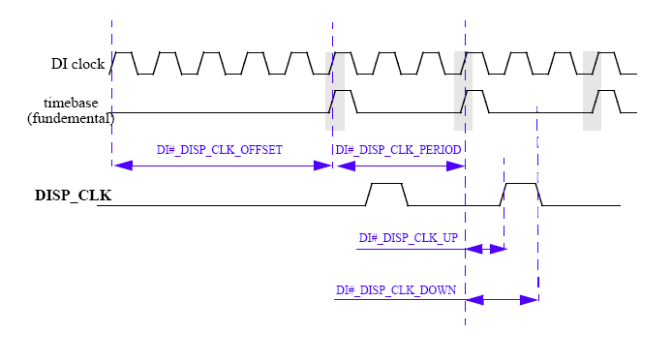
IPUv3 Fundamentals - DI
This waveform describe how the display clock’s parameters are set.

Slide 41
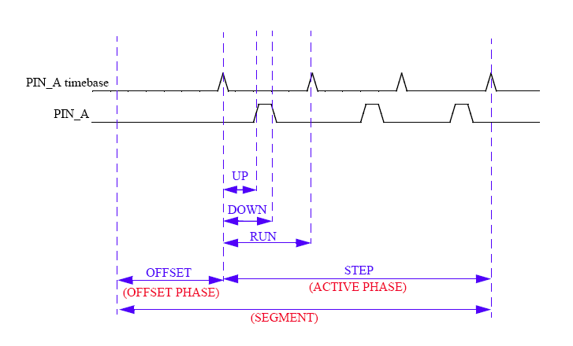
IPUv3 Fundamentals - DI
This waveform describe how the DI’s PIN parameters are set.

Slide 42
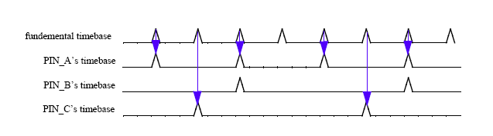
IPUv3 Fundamentals - DI
This waveform provides an example of waveform concatenation.

Slide 43
IPUv3 Fundamentals - DC
The DC (Display Controller) is responsible for:
Activation of a flow
When there’s new content to be displayed (asynchronous flow)
Upon an internal timer (synchronous flow)
Linkage between the microcode to
mapping units (within DC)
and timing units (within DI)

Slide 44
3 Fundamentals -
IPUv
DC
uCODE
Routine
Mapping
unit
DATA handling)
Mapping
unit
DATA handling)
Mapping Unit (DC)
(
(
(DATA handling)
Events
(NL, NF, New Data…)
uCODE
Routine
D
I’s Waveform generators
(timing characteristics)
D
I’s Waveform generators
(timing characteristics)
DI’s Waveform generators
(timing characteristics)
uCODE
Routine

Slide 45
IPUv3 Fundamentals - DMFC
The DMFC is a multi FIFO controller utilizing a single memory to serve the DC and DP channels.
The FIFO is partitioned to 8 equal segments. The segments can be allocated asymmetrically to the channels.
The memory allocation for a specific channel must not be greater than a certain number of rows. The exact number is different from one channel to another (see the spec).
When the direct path from the IC is used, this channel replaces one of the existing DMFC channels.

Slide 46
The Image DMA Controller – IDMAC
Role: control the memory ports; transfer data to/from system memory
Memory ports - AXI
IMDAC: 1 read, 1 write
Throughput:
External: 64 bits @ 264 MHz
Internal: up to 2 pixels/cycle @ 264 MHz (through each port)
Shared by all DMA channels: input from sensor, output to display and off-line processing
-> efficient utilization of the bandwidth in different use cases
Efficient pipelining: 4 AXI ID’s; multiple outstanding transactions: read – 8; write – 6
Data arrangement in memory
Row-after-row, with flexible line-stride – as needed for a window in a video/graphics buffer
Access order
Block-by-block – for rotation
Row-by-row – used for all other channels
Needed for output to display or input from sensor
Decreases the memory bus load by increasing its utilization efficiency

Slide 47
The Image DMA Controller – IDMAC (cont.)
A variety of pixel formats
− YUV 4:2:0/4:2:2/4:4:4 – for video
Conventionally packed RGB pixels – 8/16/32 bpp – for graphics
Tightly packed RGB pixels – 12/18/24 bpp
For reduced load on the memory bus and for power-efficient screen refresh
Optional independent alpha (translucency) input
For planes that do not have interleaved alpha
Coded color (using a LUT; 4/8 bpp)
An additional option to reduce bus load and power
Gray scale
Generic data
Additional features
Conditional read (for combining) – transparent pixels are not read
Pixel transparency – identified from the independent alpha input
Scrolling and panning
Uniform programming model for all channels
(stored in the CPMEM – channel parameter memory)

Slide 48
IPUv3 Fundamentals - IDMAC
The IDMAC of IPUv3 is connected to the AXI bus.
Full separation between read and write
All the channels are symmetric
64-bit AXI bus, internal bus of 128-bit (4 pixels)
Each channel uses 2X160 words of the CPMEM memory, holding
the channels settings
Ability to use alternate rows in the CPMEM for alternate flows
Usage of alpha located in separate buffers (ATC)
Dynamic and static arbitration between channels.
Prioritizing screen refresh channels over other IPU channels and other DDR masters

Slide 49
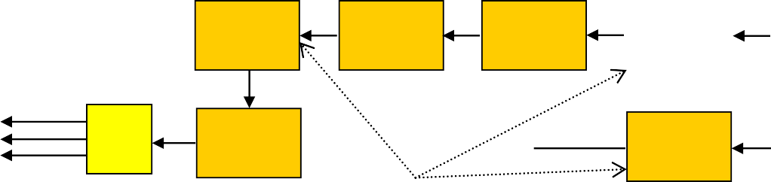
DP (Display Processor)
DP
Color
Co on
Cursor Overlay
Color Conversion & Correction
Input FIFO
Primary Secondary
Main Plane (full screen)
nversi
& ion
Combining
Correct
From DMFC
4x4x8 bits
4x3x8 bits
To DC
Output FIFO
Gamma Correction & Contrast Stretching
Color Conversion & Correction
Input FIFO
Primary Secondary
Additional Plane
Alternative
Locations
DP has following features;
Support input format YUVA/RGBA
Combining 2 video/graphics planes
Color conversion (YUV <-> RGB, YUV<->YUV) & Correction (gamut- mapping)
Gamma correction and Contrast stretching
Support output format YUV/RGB
Dynamic task switching between async and sync flows

Slide 50
IPUv3 Fundamentals - DP
The DP handles the content of the frame.
It performs image processing on the way to the display (combining, CSC, gamma correction)
The DP supports one synchronous flow and two asynchronous flows.
All the DP configuration is done only via the SRM. The control module handles the automatic switch between DP settings when the DP switches from one flow to another.

Slide 51
IC (Image Converter)
Resizing
Fully flexible resizing ratio
Maximal downsizing ratio: 8:1 Maximal upsizing ratio: 1:8192
Independent horizontal and vertical resizing ratios
Horizontal Bilinear Resizing
Down-Sizing Row Buffers
Power-Of-Two Down-Sizing
Video Input FIFOs
From IDMAC
Resizing Row Buffers
Graphics Input FIFOs
From IDMAC
Color conversion/correction
− YUV <-> RGB, YUV <-> YUV conversion
Vertical Bilinear Resizing
Color Conversion & Correction
Combining
Color Conversion & Correction
IC
Combining with a graphic plane
Output FIFOs
To IDMAC/DMFC
Max output width 1024 pixels. Larger images are processed in stripes

Slide 52


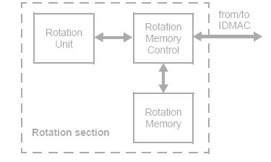







The Image Rotator - IRT
Role: performs rotation and inversion
− Rotation: 90, 180, 270
degrees
Inversion: horizontal and vertical
Rate: up to 100M pixels/sec
(depends on use case)
Additional features
Acts on 8x8 blocks
Multi-tasking: up to three tightly time-shared tasks – block-by-block
Pixel format: 24-bit

Slide 53
The Video De-Interlacer or combiner - VDIC
Role 1: performs de-interlacing – converting interlaced video to progressive
Method: a high-quality motion adaptive filter
For slow motion – retains the full resolution (of both top and bottom fields), by using temporal interpolation
For fast motion – prevents motion artifacts, by using vertical interpolation
Resolution: field size up to 968x1024 for i.MX6 and 720x1024 in i.MX5 pixels. Larger
frames are processed in stripes (split mode).
Output rate: up to 120M pixels/sec
Additional features
Uses three input fields for each output frame
(the minimum needed for a reliable motion detection)
Vertical interpolation – 4-tap filter; using an internal row buffer
Single concurrent flow
Input may come from a video decoder (VPU) or directly from the CSI

Slide 54
The Video De-Interlacer or combiner - VDIC
Role 2 : performs combining – overlaying of 2 frames at the same color space
As an alternative to the de interlacing function the VDIC HW can perform combining
Combining of 2 planes
Doesn’t have to be of the same size
Must be of the same color space (no CSC)
Perform 1 pixel per cycle
Color keying, alpha blending

Slide 55

IPUv3H – Combining

Slide 56
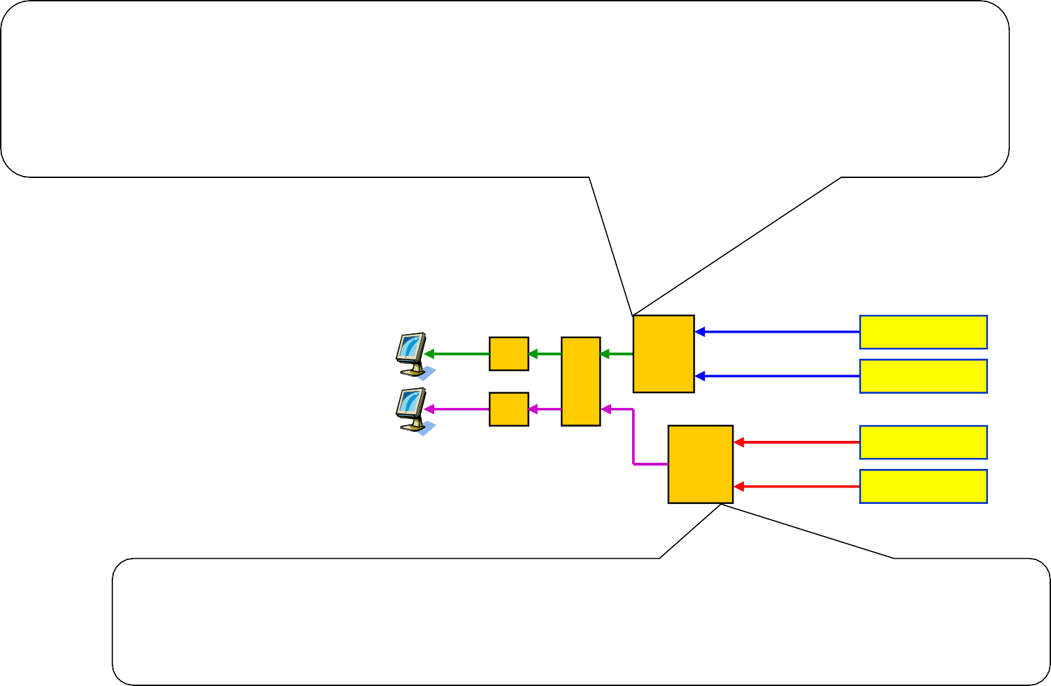
IPUv3 – Basic Combining Capabilities
Combining in the Display Processor (DP)
Two planes
One plane may have any size and location
The other one must be “full-screen” (cover the full output area)
Maximal rate: i.MX37/51 – 133 MP/sec, i.MX53 – 200 MP/sec, i.MX6 Dual/Quad – 264 MP/sec
i.MX37/51/53/6 Dual/Quad
DI DP DC DI IPUv3 ^{IC}
External Memory
Plane 1
Plane 2
Plane 3
Plane 4
Combining methods (in both cases)
Color keying and/or alpha blending
Alpha: global or per-pixel; interleaved with the pixels (upper plane) or as a separate input
Note: This is the capability per IPUs, so the total capability of the processor is doubled in i.MX6DQ.
Combining in the Image Converter (IC)
Two planes; both “full-screen” (cover the full output area)
Maximal rate: i.MX37/51 – 20 MP/sec , i.MX53 – 30 MP/sec, i.MX6 Dual/Quad – 40 MP/sec

Slide 57
IPUv3 – Off-Line Combining
i.MX37/51/53/6 Dual/Quad
External Memory
Result
VDIC
Or IC
Top plane
Unlimited number of planes combined sequentially
IPUv3
Temporary
VDIC Or IC
Plane 3
Temporary
Note: This is the capability per IPUs, so the total capability of the processor is doubled in i.MX6DQ.
VDIC Or IC
Plane 2
Same HW
Plane 1 (bottom)
Combining in the VDIC (Video De-Interlacer & Combiner) – i.MX53/6 Dual/Quad only
Available when de-interlacing is not needed
Two planes; each may have any size and location (supplemented by a “background color”)
Maximal rate: i.MX53 – 180 MP/sec, i.MX6 Dual/Quad – 240 MP/sec
Combining method – as in the DP and IC

Slide 58


IPUv3 – Maximal On-The-Fly Combining To A Single Display
3-planes i.MX37/51 – up to 20 MP/sec
4-planes
i.MX53 – up to 30 MP/sec i.MX6 Dual/Quad – up to 40 MP/sec
i.MX37/51
External Memory
i.MX53/6 Dual/Quad
External Memory
DP
Plane 3 (top)
DP
Plane 4 (top)
DI
DC
DI
DC
IC
Plane 2
IC
Plane 3
IPUv3
Plane 1 (bottom)
IPUv3
VDIC
Plane 2
Note: the bottom plane may be a result of additional off- line combining of several planes
Plane 1 (bottom)
Note: This is the capability per IPUs, so the total capability of the processor is doubled in i.MX6DQ.

Slide 59
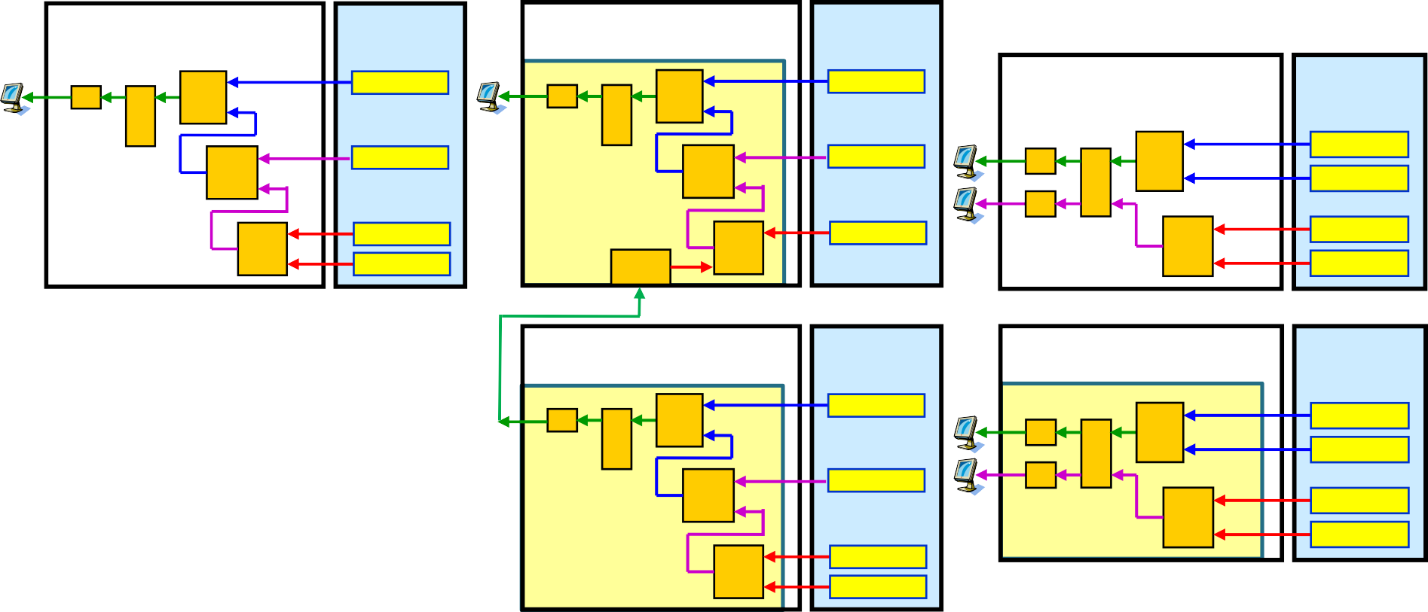

i.MX6 Dual/Quad: On-The-Fly Combining Using 2x IPUv3
Example 1: 2x 4 planes
Example 2: 1x 7 planes
Example 3: 4x 2 planes
i.MX6 Dual/Quad
External Memory
Plane 8 (top)
i.MX6 Dual/Quad
External
Memory
Plane 7 (top)
i.MX6 Dual/Quad
External
Memory
Plane 8
DI
DC
DP
DI
DC
DP
IC
Plane 7
IC
Plane 6
DI
DP
DC
Plane 7
IPUv3 - 1
IPUv3 - 1
DI
VDIC
Plane 6
VDIC
Plane 5
IPUv3 - 1
IC
Plane 6
Plane 5 (bottom)
CSI
Plane 5 (bottom)
i.MX6 Dual/Quad
External Memory
i.MX6 Dual/Quad
External
Memory
Plane 4
i.MX6 Dual/Quad
External Memory
Plane 4
DI
DC
DP
Plane 4 (top)
DI
DP
DC
DI
DC
DP
Plane 3
IC
Plane 3
IC
Plane 3
DI
IPUv3 - 0
IC
Plane 2
IPUv3 - 0
VDIC
IPUv3 - 0
Plane 1 (bottom)
Plane 2
VDIC
Plane 2
Plane 1 (bottom) Plane 1 (bottom)
Note: Some planes may be a result of additional off-line combining of several planes. Such combining may be performed either with IPUs or GPUs.

Slide 60
IPUv3 combining capabilities – summary
 | DP | IC | VDIC
Output | Display | Memory* | Memory
Relations between planes | PlaneA <= PlaneB | PlaneA = PlaneB | PlaneA <= PlaneB
Color space conversion | Yes | Yes | No
Performance | 1 cycle/pixel | 4 cycle/pixel | 1 cycle/pixel
HW cursor | 32x32 unified color | No | No
Output Image size | FW up to 2048 | FW up to 1024 | FW up to 1920
Color keying | Yes
Alpha blending | Yes
60
*The output of the IC can be sent directly to a smart display

Slide 61
IPUv3 Fundamentals – programming steps
This is a high level example of IPUv3 programming flow.
What are the displays connected in the use case?
Allocated the displays to each DI
Define the timing characteristics of each signal for each display.
Define each flow in the DC
sync/async
Define the events that trigger the flow – and what to do upon their arrival
Allocate mapping unit, and mapping scheme
Allocate waveform generator in the DI
Configure the DP for each flow
Configure the IDMAC
How the data is arranged in the memory (interleaved/not interleaved)
What’s the data’s format (PFS, BPP) , mapping
Processing: VDIC, IC (Resizing, CSC) and rotation settings
Control module configuration for activation of a flow
Define the trigger to start a flow
Define is the processing chain

Slide 62

IPUv3H – Control

Slide 63
The control Module - CM
The control module is responsible for the flow management within the IPU.
The module is composed of
General control Registers (GCR)
Frame synchronization unit (FSU)
Shadow registers module (SRM)
Interrupt controller
Low Power modes controller
Debug unit

Slide 64
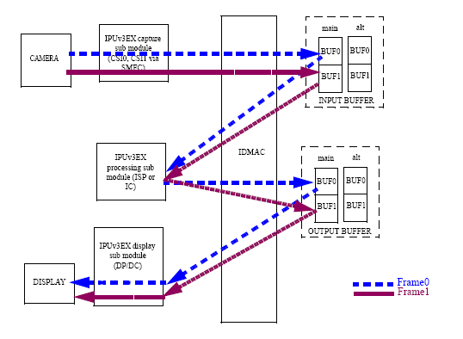
FSU – double buffering
Similar to IPUv1 the data is tightly pipelined using double buffering

Slide 65
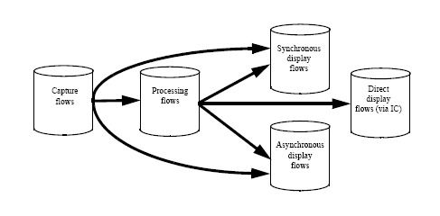
FSU – task chaining
65

Slide 66

Peripherals

Slide 67
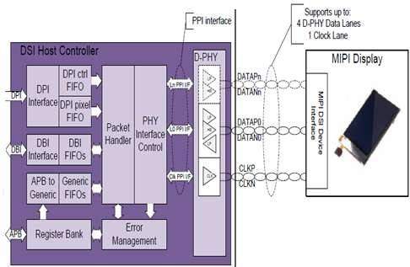
MIPI DSI
The DSI MIPI Interface is a digital core accompanied with a multi-lane D-PHY that implements all protocol functions defined in the MIPI DSI Specification, providing an interface between the System and MIPI DSI compliant Display
Features of the MIPI DSI complex: Supported standard version:
MIPI DSI Compliant
DSI Version 1.01
DPI Version 2.0
DBI Version 2.0
DSC Version 1.02
PPI for D-PHY
MIPI D-PHY Version 1.0
Configuration: one clock lane, two data lanes
Speed: Up to 1Gb/s per lane (fast speed). Low speed/low power signaling supported
DSI can support both command and video modes and up to four virtual channels to accommodate multiple displays.
Command and video mode support (type 1, 2, 3, and 4 display architecture)
Mode switching: low power and ultra low power
Burst mode/Non-burst mode
Bus turnaround
Fault error recovery scheme
Both DPI and DBI coexist in the system but only one of them could be active in a certain time

Slide 68
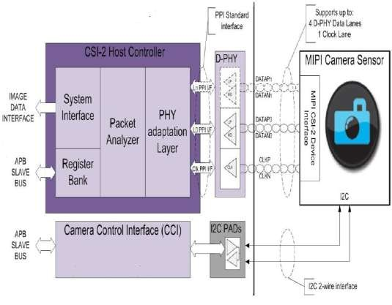
MIPI CSI-2
The CSI-2 MIPI Interface is a digital core accompanied with multi-lane D-PHY that implements all protocol functions defined in the MIPI CSI-2 Specification, providing an interface between the System and MIPI CSI-2 compliant Camera Sensor
The features of the MIPI CSI-2 complex:
Supported standard version: MIPI CSI-2 Version 1.0
Configuration: one clock lane, four data lanes
Speed: Up to 1Gb/s per lane
Throughput: 250MB/sec
Timing accurate signaling of Frame and Line synchronization packets;
Support for several frame formats such
as:
General Frame or Digital Interlaced Video with or without accurate sync timing
Data type (Packet or Frame level) and Virtual Channel interleaving
32-bit Image Data Interface delivering data formatted as recommended in CSI-2 Specification;
Directly supports all primary data formats conversion to IPU input. Some secondary formats are treated as “generic” data
RGB, YUV and RAW color space definitions;
From 24-bit down to 6-bit per pixel;
Generic or user-defined byte-based data types

Slide 69
LVDS Interface in i.MX53 & i.MX6 D/Q – Key Features
Structure
Two Channels
Each channel contains 4 data pairs + 1 clock pair
Data
18 bpp pixels – using 3 LVDS data pairs
24 bpp pixels – using 4 LVDS data pairs
Control signals: HSYNC, VSYNC, DE
Pixel clock rate
Single Channel: up to 85 MHz; e.g. WXGA @ 60 fps or 720p60
Dual Channel: up to 170 MHz; e.g. UXGA @ 60 Hz or 1080p60
Relevant Standards
PHY Standard: ANSI EIA-644A
Display Protocol Standards:
SPWG Standard Panel Working Group Specification 3.8 (May 2007)
VESA PSWG – Panel Standardization Working Group – set of standards for panels using LVDS.
JEIDA/JEITA DISM Standard JEIDA-59-1999
OpenLDI (National) – Revision 0.95 13/May/1999. *Only* Unbalanced operating mode supported (aligned with vast majority of LCD vendors).

Slide 70
LVDS – what is supported?
Single Channel configuration
Pixel clock: up to 85 MHz; e.g. WXGA @ 60 fps or 720p60
LVDS Clock frequency = Pixel clock x 7 = 85*7 = 595Mhz
Data :
18 bpp pixels – using 3 LVDS data pairs
24 bpp pixels – using 4 LVDS data pairs
Dual Channel configuration
Pixel clock: up to 170 MHz; e.g. UXGA @ 60 Hz or 1080p60
LVDS Clock frequency = Pixel clock x 7/2 = 170*7/2 = 595Mhz
Data :
18 bpp pixels – using 3 LVDS data pairs per channel
24 bpp pixels – using 4 LVDS data pairs per channel

Slide 71
LDB Features
LDB Structure:
2 Channels , same/independent data
Each channel contains 4 data pairs + 1 clock pair
Resolutions/Rates:
Single Channel (up to WXGA): Up to 85 MHz, 3 or 4 data pairs
Dual Channel (up to UXGA): Up to 170 MHz, 6 or 8 data pairs
For example: can support 1080p60 or UXGA @60fps
Pixel Depths:
18 bpp – 3 LVDS data pairs
24 bpp – 4 LVDS data pairs
Control signals:
Supports HSYNC, VSYNC, DE

Slide 72
HDMI General Features
Description: High-Definition Multimedia Interface (HDMI) Transmitter including both HDMI TX Controller and PHY
Standard Compliance: HDMI 1.4a, DVI 1.0, HDCP 1.4 (with keys stored in embedded eFuses)
− Supporting majority of primary 3D Video formats
TMDS Core Frequency: From 25 MHz to 340 MHz
Consumer Electronic Control: Supported
Monitor Detection: Hot plug/unplug detection and link status monitor support
Testing Capabilities: Integrated test module
Maximal Power Consumption: 70mW
Temperature Range: -40C to +125C (Tj)

Slide 73
i.MX6 Dual/Quad: HDMI Video/Audio Features
Video Standard Compliance: EIA/CEA-861D
Supported Video Resolutions: Up to 1080p@60Hz and 720p/1080i@120Hz HDTV display; up to QXGA graphics display
Pixel Clock Frequency: From 25 MHz to 240 MHz
Video Data Formats: YCbCr 4:4:4; RGB 4:4:4; YCbCr 4:2:2
Internal Video Processing: Interpolation YCbCr 4:2:2 to 4:4:4;
conversion YCbCr to RGB and vice versa
Audio Standard Compliance: IEC60958, IEC61937
Supported Audio Formats: All audio formats as specified by the
HDMI Specification Version 1.4a
Audio Input Interfaces: Embedded Audio DMA
Audio Sampling Rate: Up to 192 kHz

Slide 74

IPU & the iMX Linux BSP

Slide 75
IPU Drivers
IPU drivers are based on code re-used from MX5x IPU driver
Key modification: Support for multiple instances provides support for the 2
IPU modules in i.MX 6Quad/Dual
IPU functionality accessed through multiple interfaces:
IPU framebuffer (FB) driver: Accessed through the Linux standard FB interface
Introduction of MXC Display Driver framework, to manage interaction between IPU and display device drivers (e.g., LCD, LVDS, HDMI, MIPI, etc.)
IPU processing driver: A custom API exposes IPU processing functionality
Resizing
Rotation
Combining of graphics planes
CSC
De-interlacing
Video 4 Linux 2 (V4L2) output driver: Based on V4L2 video API, leverages IPU
processing driver
V4L2 capture driver: Based on V4L2 capture API; leverages IPU processing driver and IPU core driver

Slide 76
IPU Drivers
Architecture Design:
IPU sub-module (CSI, IC, DI, DP, IDMAC, etc) functionality provided in a set of IPU Core driver functions
Largely unmodified between MX5x and MX 6Quad
Leverage existing Linux APIs:
For framebuffer access (IPU FB driver)
Video image processing and display (V4L2 output driver)
Image capture (V4L2 capture driver)
Fill in gaps with custom APIs and API extensions:
Extensions to FB interface to control certain IPU functionality – local and global alpha, gamma correction, etc.
IPU Processing driver to provide user space access to IPU processing capabilities
Provide MXC Display Driver (mxc_dispdrv.h) framework to simplify connection between display devices and IPU modules.

Slide 77
IPU Drivers
Kernel Core Software Freescale BSP Software Hardware
User space
V4L2 Soc-Camera Subsystem
Cameras |  | mxc v4l2 capture
V4L2 Video Framework
 | mxc v4l2 output
Frame Buffer Core
 | IPU FB driver
Display Device Drivers
(LCD, LVDS,
HDMI, etc)
IPU Processing Driver
MXC Display Driver Framework
IPU Core Driver (CSI/IDMA/IC/DC/DP)
Hardware

Slide 78

Overview of IPU Drivers
• MXC Display Driver
− Simple framework to manage MXC display device drivers.
− Examples: LCD, TVE, MIPI, VGA, HDMI
IPU Processing Driver
Manage IPU IC tasks in kernel space.
MXC V4L2 Drivers
Based on IPU processing driver.

Slide 79
MXC Display Driver - Files
MXC Display Driver files drivers/video/mxc/mxc_dispdrv.h drivers/video/mxc/mxc_dispdrv.c
IPU framebuffer driver drivers/video/mxc/mxc_ipuv3_fb.c
Display device drivers drivers/video/mxc/mxc_lcdif.c drivers/video/mxc/mxc_hdmi.c drivers/video/mxc/mipi_dsi.c
…

Slide 80
MXC Display Driver - Structures
struct mxc_dispdrv_driver { const char *name;
int (*init) (struct mxc_dispdrv_handle *, struct mxc_dispdrv_setting *); void (*deinit) (struct mxc_dispdrv_handle *);
/* display driver enable function for extension */
int (*enable) (struct mxc_dispdrv_handle *, struct fb_info *);
/* display driver disable function, called at early part of fb_blank */ void (*disable) (struct mxc_dispdrv_handle *, struct fb_info *);
/* display driver setup function, called at early part of fb_set_par */ int (*setup) (struct mxc_dispdrv_handle *, struct fb_info *fbi);
};
struct mxc_dispdrv_setting {
/*input-feedback parameter*/ struct fb_info *fbi;
int if_fmt;
int default_bpp; char *dft_mode_str;
/*feedback parameter*/ int dev_id;
int disp_id;
};

Slide 81
MXC Display Driver - Functions
struct mxc_dispdrv_entry *mxc_dispdrv_register(
struct mxc_dispdrv_driver *drv);
int mxc_dispdrv_unregister(struct mxc_dispdrv_entry *entry); struct mxc_dispdrv_handle *mxc_dispdrv_gethandle(char *name,
struct mxc_dispdrv_setting *setting);
int mxc_dispdrv_setdata(struct mxc_dispdrv_entry *entry, void *data);
void *mxc_dispdrv_getdata(struct mxc_dispdrv_entry *entry);

Slide 82
MXC Display Driver – Configuration Flow
LDB
RGB666 LDB-XGA
Ipu0
di1
mxc_dispdrv_register mxc_dispdrv_setdata
1
mxc_dispdrv List
3
init
4
fb_add_videomode fb_set_var
IPUv3 fb driver dev=ldb mode_str=? fbi
2
mxc_dispdrv_gethandle

Slide 83
MXC Display Driver
Command Line Options: first display:
video=mxcfb0:dev=dispdrv_name,mode_str,if=if_fmt
second display:
video=mxcfb1:dev=dispdrv_name,mode_str,if=if_fmt
For example: video=mxcfb0:dev=hdmi,1920x1080M@60,if=RGB24 video=mxcfb1:dev=ldb,LDB-XGA,if=RGB666 video=mxcfb2:dev=lcd,800x480M@55,if=RGB565

Slide 84
MXC Display Driver – Multi-Display Options
hdmi + lvds video=mxcfb0:dev=hdmi,1920x1080M@60,if=RGB24 video=mxcfb1:dev=ldb,LDB-XGA,if=RGB666
lvds + lvds
video=mxcfb0:dev=ldb,LDB-XGA,if=RGB666 video=mxcfb1:dev=ldb,LDB-XGA,if=RGB666
lcd + lvds video=mxcfb0:dev=lcd,800x480M@55,if=RGB565 video=mxcfb1:dev=ldb,LDB-XGA,if=RGB666
hdmi + lvds + lvds video=mxcfb0:dev=hdmi,1920x1080M@60,if=RGB24 video=mxcfb1:dev=ldb,LDB-XGA,if=RGB666 video=mxcfb2:dev=ldb,LDB-XGA,if=RGB666

Slide 85
Example of MXC Display Driver - HDMI
Software Architecture:
HDMI multifunction driver (MFD) manages software resources common to video and audio drivers
Audio driver uses ALSA/SoC audio framework.
Video driver:
MXC Display Driver API to register with IPU FB driver
Linux Framebuffer (FB) API to change the video mode and receive notifications
of mode changes

Slide 86
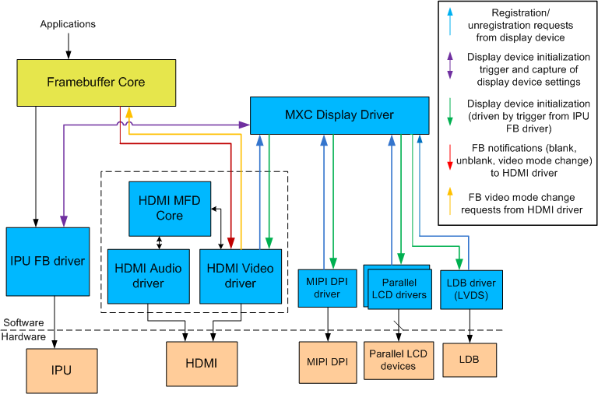
I and the i.MX 6Quad Framebuffer and Display Device
Architecture
HDM

Slide 87
Overview of IPU Drivers
MXC Display Driver
Simple framework to manage MXC display device drivers.
Examples: LCD, TVE, MIPI, VGA, HDMI
IPU Processing Driver
− Manage IPU IC tasks in kernel space.
MXC V4L2 Drivers
− Based on IPU processing driver.

Slide 88
IPU Processing Driver - Introduction
Each IPU has two kernel threads for IC task PP&VF
Each kernel thread performs the tasks on its task queue list
Each task executes the following sequence:
ipu_init_channel → ipu_init_channel_buffer → request_ipu_irq → ipu_enable_channel → wait_irq (task finish) → ipu_disable_channel → ipu_uninit_channel
Tasks are based on single buffer mode
Split mode tasks will be split into 2 tasks per IPU.
An application only needs to prepare a task and queue it
Task operations include
Setting the task input/overlay/output/rotation/deinterlacing/buffer
Call ioctl IPU_CHECK_TASK first to adjust parameters according to
feedback
Call ioctl IPU_QUEUE_TASK to queue task
IPU_QUEUE_TASK is a blocking ioctl.

Slide 89
IPU Processing Driver
Files
include/linux/ipu.h
drivers/mxc/ipu3/ipu_device.c
Structures
see include/linux/ipu.h
Ioctls
#define | IPU_CHECK_TASK | _IOWR('I', 0x1, struct ipu_task)
#define | IPU_QUEUE_TASK | _IOW('I', 0x2, struct ipu_task)
#define | IPU_ALLOC | _IOWR('I', 0x3, int)
#define | IPU_FREE | _IOW('I', 0x4, int)

Slide 90
IPU Processing Driver
Example
linux-test/test/mxc_ipudev_test/mxc_ipudev_test.c

Slide 91
IPU Processing Driver
Advantages
Easy to use.
Provides workaround for IPU suspend/resume issue
Cannot suspend when double buffering is enabled
All IC tasks may be based on this IPU processing driver, including
user applications and V4L2 output and capture drivers
Reason: Easier to debug if there is an issue.
Disadvantages
Based on kernel thread, all control is done by software, so Linux scheduler may have undesirable impact on the system.
Single-buffer mode doesn’t perform as well as double-buffer mode

Slide 92
Overview of IPU Drivers
MXC Display Driver
Simple framework to manage MXC display device drivers.
Examples: LCD, TVE, MIPI, VGA, HDMI
IPU Processing Driver
Manage IPU IC tasks in kernel space.
• MXC V4L2 Drivers
− Based on IPU processing driver.

Slide 93
V4L2 – Common Kernel API
What is Video4Linux (V4L)?
V4L is the original video capture/overlay API of the Linux kernel. It appeared late the 2.1.x development cycle in the Linux kernel.
What about V4L2?
V4L2 is the second generation of the video4linux API which fixes a number of design bugs of the first version. It was integrated into the standard kernel in 2.5.x.
V4L2 is an interface for analog radio, video capture and output drivers.
Hardware acceleration capabilities (IPUv3) are leveraged in V4L2 drivers and provided in the Linux BSP
Upper level software that uses the V4L2 API, such as G-streamer source/sink and Android
camera HAL, does not need to understand the underlying hardware.
Documentation / Web Resource / API spec
Documentation/video4linux/ subdirectory in kernel tree.
http://v4l2spec.bytesex.org - the spec of V4L2
http://www.linuxtv.org/wiki/index.php/Main_Page - wiki for V4L and DVB

Slide 94
MXC V4L2 – User APIs
VIDIOC_QUERYCAP
VIDIOC_G_FMT / VIDIOC_S_FMT
VIDIOC_REQBUFS
VIDIOC_QUERYBUF
VIDIOC_QBUF / VIDIOC_DQBUF
VIDIOC_STREAMON / VIDIOC_STREAMOFF
VIDIOC_G_CTRL / VIDIOC_S_CTRL
VIDIOC_CROPCAP / VIDIOC_G_CROP / VIDIOC_S_CROP
VIDIOC_ENUMOUTPUT / VIDIOC_G_OUTPUT / VIDIOC_S_OUTPUT
APIs used only for MXC V4L2 capture:
VIDIOC_ENUMINPUT / VIDIOC_G_INPUT / VIDIOC_S_INPUT
APIs used only for MXC V4L2 TV-in:
VIDIOC_ENUMSTD / VIDIOC_G_STD / VIDIOC_S_STD

Slide 95
MXC V4L2 – Internal APIs
New version of V4L2 framework supports master / slave device drivers:
Support multiple master devices and multiple slave devices
mxc_v4l2_capture driver is the V4L2 master driver
Camera drivers and tv-in driver are V4L2 internal slave drivers
These ioctls are used in kernel internally for MXC V4L2 capture/tvin especially:
ioctl_dev_init / ioctl_dev_exit
ioctl_s_power
ioctl_g_ifparm
ioctl_init
ioctl_g_fmt_cap
ioctl_g_parm / ioctl_s_parm
ioctl_queryctrl / ioctl_g_ctrl / ioctl_s_ctrl

Slide 96
V4L2 – Usage and Examples
How to use V4L2:
Generally, programming a V4L2 device consists of these steps:
Opening the device
Changing device properties, selecting a video and audio input, video standard, picture brightness, etc.
Negotiating a data format
Negotiating an input/output method
Executing the actual input/output loop
Closing the device
Please refer to the following examples:
BSP team’s test cases:
git clone git://sw-git01-tx30.am.freescale.net/linux-test.git
(without password)
Test team’s VTE test cases
Camera HAL in Android source code
G-streamer source/sink source code

Slide 97
Features of MXC V4L2 Capture
Still capture: capture a frame in a buffer, users can read the buffer and store the picture in a file.
Preview: show the capture frames directly onto the framebuffer. Users
can choose the framebuffer number on which the video will be shown.
Video capture: capture frames in allocated buffers. Users can get the frames by calling VIDIOC_DQBUF and then send them to VPU for encoding or save them in a file.

Slide 98
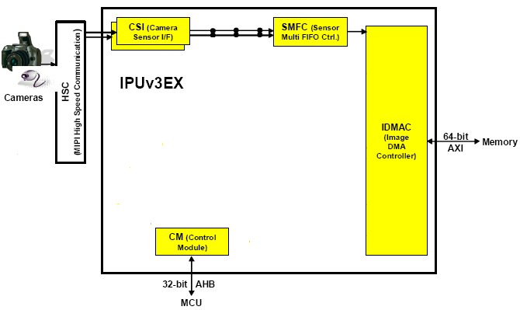
Features of MXC V4L2 Capture
To capture a still image
No resizing/rotation/CSC can be done.
− One image can be converted to be in a different pixel format within the same color space with the raw data by using CSI->SMFC->MEM IDMAC channel.

Slide 99
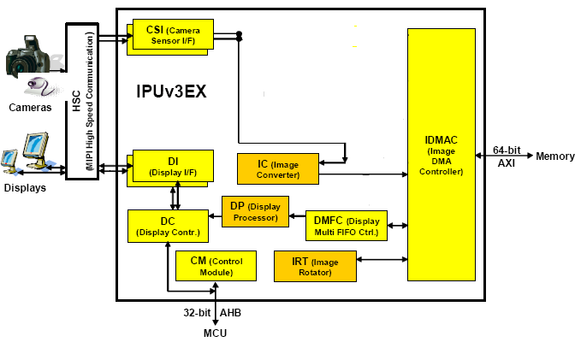
Features of MXC V4L2 Capture
To preview a captured video on frame buffer
Preview on fb0 – Resizing/rotation/CSC can be done in IC(PRP_VF) channels. Manually control the buffer ready flags in interrupt handler. Use DP(DP_BG) channel to display the captured frames.
Preview on fb2 - Resizing/rotation can be done in IC(PRP_VF) channels. CSC can be done in DP(DP_FG) channel. The flow is totally controlled by FSU.

Slide 100
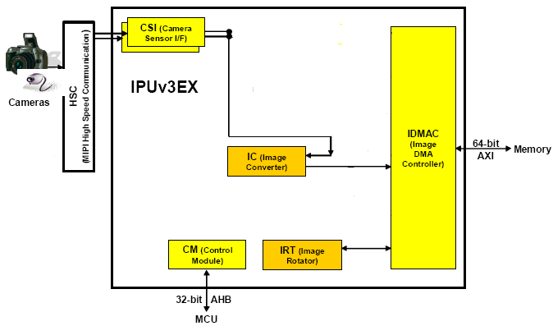
Features of MXC V4L2 Capture
To capture frames in allocated buffers (using IC channel)
Resizing/rotation/CSC can be done in IC(PRP_ENC) channels. Manually control the buffer ready flags in interrupt handler.
MXC V4L2 capture maintains the numbers of buffers.
Users can get the captured buffer by calling VIDIOC_DQBUF ioctl and return the buffer to the kernel by calling VIDIOC_DQBUF ioctl .
NOTE: Camera preview and capturing frames into buffers can be used at the same time.

Slide 101
Features of MXC V4L2 Capture
To capture frames in allocated buffers (using SMFC channel)
No resizing/rotation/CSC can be done. Manually control the buffer ready flags in interrupt handler.
MXC V4L2 capture maintains numbers of buffers.
Users can get the captured buffer by calling VIDIOC_QBUF ioctrl and return the buffer to the kernel by calling VIDIOC_QBUF ioctrl.

Slide 102
Features of MXC V4L2 Output
Support for playing video using one framebuffer at a time:
DP-BG framebuffer
DP-FG framebuffer
DC framebuffer
Support for the following modes:
IC normal mode – resizing / CSC / rotation, using PP channel
IC bypass mode – CSC, using DP or DC channel directly
IC horizontal/vertical split mode – resizing / CSC / rotation, support high resolution output, using PP channel
VDI-IC video deinterlacing mode - deinterlacing / resizing / CSC / rotation, using PRP_VF channel, including high motion mode and low motion mode.
Note: V4L2 output and V4L2 capture can run at the same time if there is no IC or DP/DC channel conflict.

Slide 103
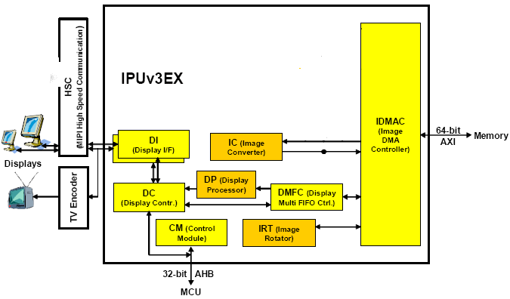
Features of MXC V4L2 Output
IC normal mode (using PP channel)
Resizing/rotation/CSC. Manually control the IC output/display input buffer ready flags in interrupt handler and control IC input buffer ready flags in timer handler.
MXC V4L2 output maintains numbers of buffers.
Users can show the buffer on one framebuffer by calling VIDIOC_DQBUF ioctrl and return the buffer to the kernel by calling VIDIOC_DQBUF ioctrl.

Slide 104
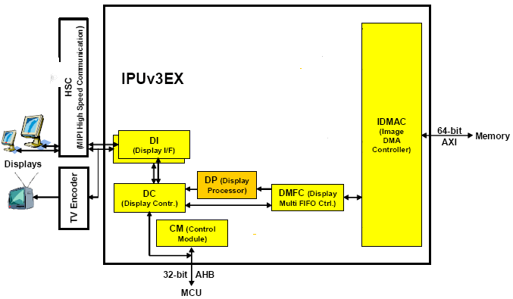
Features of MXC V4L2 Output
IC bypass mode (using DP or DC channel)
CSC can be done, but no resizing or rotation can be done. Manually control the display output buffer ready flags in the interrupt handler.
MXC V4L2 output maintains numbers of buffers.
Users can show the buffer on one VIDIOC_QBUF VIDIOC_QBUF ioctrl.

Slide 105
Features of MXC V4L2 Output
IC horizontal split mode (using PP channel)
Resizing/rotation/CSC. Manually control the IC output/IC input (right stripe)/display input buffer ready flags in the interrupt handler and control IC input (left stripe) buffer ready flags in the timer handler.
MXC V4L2 output maintains the number of buffers.
Users can show the buffer on one framebuffer by calling VIDIOC_QBUF ioctrl and return the buffer to kernel by calling VIDIOC_QBUF ioctrl.
TM

Slide 106
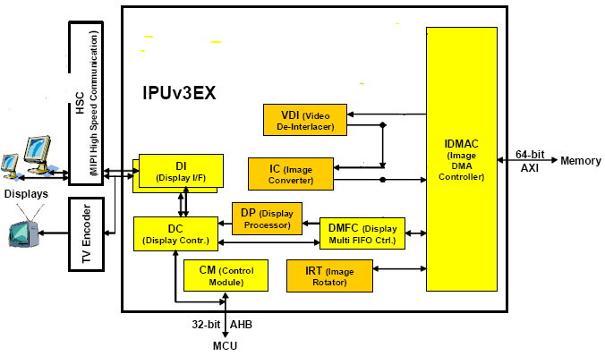
Features of MXC V4L2 Output
VDI-IC video deinterlacing mode (using PRP_VF channel)
Resizing/rotation/CSC can be done. Manually control the IC output/display input buffer
ready flags in interrupt handler and control IC input buffer ready flags in timer handler.
MXC V4L2 output maintains the numbers of buffers.
Users can show the buffer on one framebuffer by calling VIDIOC_DQBUF ioctrl and return the buffer to the kernel by calling VIDIOC_QBUF ioctrl.
TM

Slide 107
How do we integrate IPUv3 into MXC V4L2?
Based on analysis of the IPUv3 spec
What channel should we use for the framebuffer?
What channel should we use for V4L2 capture and V4L2 output?
IPU low-level API design – enable/disable channel, init/unit channel, init channel buffer, interrupt handler register interface…
Invoke IPU low-level APIs from the MXC V4L2 driver.
Ensure backwards compatibility in the IPU low-level APIs in cases
where the hardware has not changed dramatically.

Slide 108

Use case Examples & Tips

Slide 109
IPUv3 tips
Use VDOA
For more efficient DDR access pattern
Refresh the display at the rate of the content
For displays the perform frame rate conversion.
Sometimes called 24P cinema
Significantly reduces the amount of data read by IPU.

Slide 110
IPUv3 tips
Buffer management
IPU write channel needs a free buffer in the DDR to start writing data.
If there’s no free buffer IPU’s internal FIFOs are filled, causing additional latencies
Buffer management system should guarantee that there’re always a free buffer for IPU’s usage.
IPU can start writing the data to that free buffer immediately avoiding
unnecessary

Slide 111
IPUv3 tips
Move load from the IC
Perform CSC (Color Space Conversion), in DP (Display Processor), and not in the IC. (Save memory bandwidth, and lower load on the IC).
Move combining tasks to the VDIC (if not used as de interlacer)
Consider the IC processing speed, for the tasks
Resize – 2 cycles/pixel
Combine – 2 cycles/pixel
CSC – 3 cycles/pixel
Flipping an image (a.k.a 180º rotation)
Use H-flip and V-flip transfers, done by IDMAC and IC, and not using the
IRT module.

Slide 112

IPUv3 tips- Optimizing memory accesses
Optimize Pixel formats
The larger the chunks of data are – the easier it is on the DDR
The smaller amount of bursts – better for the memory bus system
Choose the mode that works best for the specific use case and avoid the rest
Format | Amount of data per macro block | Burst size | DDR3 x64 BL | Amount of bursts per macro block | Target
YUV422 interleaved | 256 bytes | 16 bytes | 2 | 16 | Best: IPU => IPU; VDOA => IPU
YUV422 partial interleaved | 256 bytes | 8 bytes + 8 bytes | 1 + 1 | 32
YUV422 non interleaved | 256 bytes | 8 bytes + 4 bytes + 4 bytes | 1 +1+1 | 48
YUV420 interleaved | 256 bytes | 16 bytes | 2 | 16
YUV420 partial interleaved (NV12) | 192 bytes | 8 bytes + 8 bytes | 1 + 1 | 32 | Best: VPU => VDOA (decode) Best: IPU => VPU (encode)
YUV420 non interleaved | 192 bytes | 8 bytes + 4 bytes + 4 bytes | 1 +1+1 | 48

Slide 113
IPUv3M tips
How to work efficiently with the memory system
Use real time channels
Marking IPU accesses with an AXI ID to bypass the PL301’s arbitration
Lock feature
issue a series of IPU bursts the belong to the same channel – better chance for DDR hit
Conditional read
If an alpha mask is provided to the overlay plane transparent pixels are not read from memory.

Slide 114
IPUv3 tips
Recommended Display Connectivity
i .MX51
IPU_DISP1 port | 24-bi t RGB |  | RGB666 | RGB565 | RGB555 | 24-bi t YCbCr | YCbCr4:4:4
DISP1_DAT0 | B0 |  | B0 | B0 | B0 | Y0 | Y0
DISP1_DAT1 | B1 |  | B1 | B1 | B1 | Y1 | Y1
DISP1_DAT2 | B2 |  | B2 | B2 | B2 | Y2 | Y2
DISP1_DAT3 | B3 |  | B3 | B3 | B3 | Y3 | Y3
DISP1_DAT4 | B4 |  | B4 | B4 | B4 | Y4 | Y4
DISP1_DAT5 | B5 |  | B5 | G0 | G0 | Y5 | Y5
DISP1_DAT6 | B6 |  | G0 | G1 | G1 | Y6 | Y6
DISP1_DAT7 | B7 |  | G1 | G2 | G2 | Y7 | Y7
DISP1_DAT8 | G0 |  | G2 | G3 | G3 | Cb0 | Cb0
DISP1_DAT9 | G1 |  | G3 | G4 | G4 | Cb1 | Cb1
DISP1_DAT10 | G2 |  | G4 | G5 | R0 | Cb2 | Cb2
DISP1_DAT11 | G3 |  | G5 | R0 | R1 | Cb3 | Cb3
DISP1_DAT12 | G4 |  | R0 | R1 | R2 | Cb4 | Cb4
DISP1_DAT13 | G5 |  | R1 | R2 | R3 | Cb5 | Cb5
DISP1_DAT14 | G6 |  | R2 | R3 | R4 | Cb6 | Cb6
DISP1_DAT15 | G7 |  | R3 | R4 |  | Cb7 | Cb7
DISP1_DAT16 | R0 |  | R4 |  |  | Cr0 | Cr0
DISP1_DAT17 | R1 |  | R5 |  |  | Cr1 | Cr1
DISP1_DAT18 | R2 |  |  |  |  | Cr2 | Cr2
DISP1_DAT19 | R3 |  |  |  |  | Cr3 | Cr3
DISP1_DAT20 | R4 |  |  |  |  | Cr4 | Cr4
DISP1_DAT21 | R5 |  |  |  |  | Cr5 | Cr5
DISP1_DAT22 | R6 |  |  |  |  | Cr6 | Cr6
DISP1_DAT23 | R7 |  |  |  |  | Cr7 | Cr7
DI1_PIN2 | HSYNC
DI1_PIN3 | VSYNC
DI1_PIN15 | DRDY
DI1_DISP_CLK | CLK

Slide 115
IPUv3 - debug
IPU error interrupts & status bits
IPU errors are reported on the IPU_INT_STAT_5, IPU_INT_STAT_6, IPU_INT_STAT_9 and IPU_INT_STAT_10 registers. The 1st debug step should be inspecting these bits
A flickering display is normally a result of a system bus load (DDR).
These will be reported as “new frame before end of frame error” on
IDMAC_NFB4EOF register.
Bus loads that causes errors on the CSI side will be reported on *FRM_LOST* status bits
Some of IPU internal signals can be routed to pins and measured using the IPU diagnostics unit. These can be used to capture errors/interupts and track internal flows. (the IOMUX needs to be configured to output the ipu_diagbus signals)

Slide 116
IPUv3 - debug
IPU diagnostics unit
Some of IPU internal signals can be routed to pins and measured using the IPU diagnostics unit.
These can be used to capture errors/interupts and track internal flows.
The IOMUX needs to be configured to output the ipu_diagbus signals.
Task status and flow control
A frozen display is sometimes a result of wrong control of the buffer management within the IPU.
The status of each flow controlled by the FSU can be monitored using the TASKS_STAT status registers.
In some cases a user may track the BUF_RDY and CUR_BUF
indications of the flow to track the flow.

Slide 117
Dual video-in use case example
YUV, 20Hz ITU 656
Temp is needed for cases BG freq > Vid one
Rear-View Cam
IPU
Memory
Vid in YUV
IC (VF)
Inverted
Inverted
CSI
2x
Temp
Vid in RGB
RGB, 60Hz
IC
CSI
(PP - copy)
3x
Bypass path, depending on needs
Background
DISPLAY
DP
DI
Instrumental Layer
GPU
Inverted, 60Hz ?
Inverted, 60Hz ?

Slide 118
Playback, HD1080p H.264 HP –> Display
IPU
Memory
CSI
Video 720p YUV 4:2:0
DISPLAY
VDI
IC
WXGA YUV 4:2:2
DC/DI
DP
GUI RGBA 8888
60 Frames per sec 30 Frames per sec

Slide 119
Dual Playback, HD720p H.264 HP –> WSVGA Display
IPU
Memory
CSI
Video 720p YUV 4:2:0
VDI
DISPLAY
DISPLAY
IC
WSVGA YUV 4:2:2
RGB 888
DC/DI
DP
GUI RGBA 8888
60 Frames per sec 30 Frames per sec

Slide 120

Demo

Slide 121

Q & A

Slide 122
TM
www.Freescale.com
© 2014 Freescale Semiconductor, Inc. | External Use

