Slide 1
MESA

Slide 2
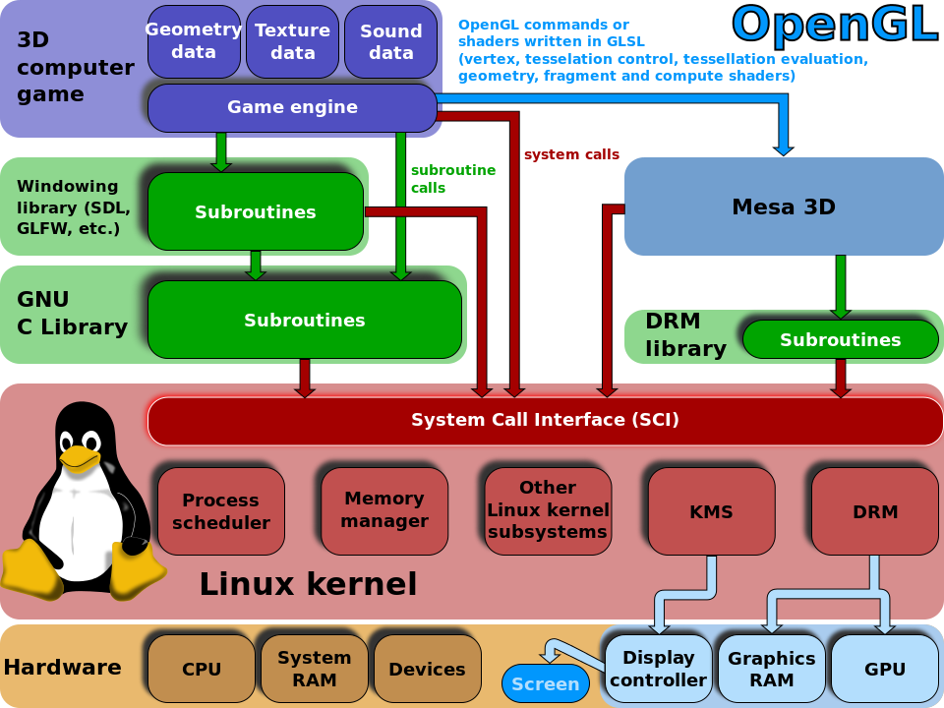
OpenGL/Mesa in the context of 3D Linux games

Slide 3
MESA
DRI/DRM provide the building blocks that enable userspace applications to access the graphics hardware directly in an efficient and safe manner
To use OpenGL another software component ( MESA) that uses the DRI/DRM infrastructure, to implement the OpenGL API while respecting the X server requirements needed.

Slide 4
MESA
A free software implementation of the OpenGL specification
Provides a libGL.so, which OpenGL based programs can use to output 3D graphics in Linux.
Can provide accelerated 3D graphics by taking advantage of the DRI architecture to gain direct access to the underlying graphics hardware in its implementation of the OpenGL API.

Slide 5
When 3D application runs in an X11 environment it will output its graphics to a surface (window) allocated by the X server but without intervention of the X server using DRI.
Synchronization needed between OpenGL application and X server since X server still owns the window Mesa is rendering to and is responsible for displaying window contents on the screen.

Slide 6
Synchronization between the OpenGL application and the X server is part of DRI.
Mesa’s implementation of GLX (the extension of the OpenGL specification that addresses the X11 platform) uses DRI to talk to the X server and accomplish this.

Slide 7
Communication with the graphics hardware happens by sending commands (for example “draw a triangle”) and data (for example the vertex coordinates of the triangle, their color attributes, normals, etc).
This process involves allocating a bunch of buffers in the graphics hardware where all these commands and data are copied so that the GPU can access them and do its work.
DRM driver provides the support

Slide 8
DRM
DRM driver takes care of managing video memory in a target hardware specific manner and offers APIs to userspace (Mesa).
DRM is also required whenever we need to allocate and manage video memory in Mesa, so things like creating textures, uploading data to textures, allocating color, depth or stencil buffers, etc all require to use the DRM APIs for the target hardware.

Slide 9
OpenGL/Mesa in the context of 3D Linux games

Slide 10
MESA
Graphics driver in Linux is actually a combination of three different drivers:
the user space X server DDX driver, which handles 2D graphics.
the user space 3D OpenGL driver, that can be provided by Mesa.
the kernel space DRM driver.

Slide 11
DRI drivers and non-DRI drivers
Mesa handles 3D graphics by providing an implementation of the OpenGL API.
Mesa OpenGL drivers are also termed as DRI drivers .
DRI architecture was defined to enable efficient implementation of OpenGL drivers in Linux
DRI/DRM serve as the building blocks of OpenGL drivers in Mesa.

Slide 12
MESA
There are other implementations of the OpenGL API available.
Hardware vendors that provide drivers for Linux may provide their own implementation of the OpenGL API (usually in the form of a binary blob).
Example: With NVIDIA GPU installing NVIDIA’s proprietary driver will install its own libGL.so.

Slide 13
Non-DRI Scenario
It is possible to create graphics drivers that does not follow the DRI architecture in Linux.
For example, the NVIDIA proprietary driver can install a Kernel module that implements similar functionality to DRM but with a different set of API designed by NVIDIA
Their corresponding user space drivers (DDX and OpenGL) will use this API instead of DRM to communicate with the NVIDIA kernel space driver.

Slide 14
Mesa Framework
Mesa itself is not really a driver, but a project that hosts multiple drivers (that is, multiple implementations of the OpenGL API).
Mesa is best seen as a framework for OpenGL implementators that provides abstractions and code that can be shared by multiple drivers.
Many aspects of OpenGL implementation are independent of the underlying hardware that can be abstracted and reused.

Slide 15
MESA Framework
OpenGL provides a state based API.
Many API calls do not have an immediate hardware effect.
APIs modify the values of certain driver space variables that need not be pushed to the hardware immediately.
Hardware level action will happen subsequently when rendering APIs such as glDrawArrays() is actually called.
at that point that the driver will configure the 3D pipeline for rendering according to all the state that has been set by the previous API calls.
Since these APIs do not interact with the hardware their implementation can be shared by multiple drivers.
Each driver, in their implementation of glDrawArrays(), can fetch the values stored in this state and translate them into something meaningful for the hardware at hand.

Slide 16
MESA Framework
Mesa provides abstractions for complete implementations for multiple OpenGL APIs that do not require immediate hardware interaction.
Mesa also defines hooks for the parts where drivers may need to do hardware specific action,
Such as in the implementation of glDrawArrays().
Mesa generic functions may check for API use errors and reformat inputs appropriate for later processing or fetch additional information from the current state needed to implement the actual operation in the hardware.

Slide 17
MESA Framework
Actual rendering involves configuring the hardware pipeline according to the command issued and the relevant state set in prior API calls.
XXX_draw_prims() is a function call and is part of the target specific DRI driver.
It is the hook where the driver does the action required to configure the GPU for drawing.

Slide 18
Hardware Hooks
A later call to something named XXX_upload_state() will upload a bunch of state to the hardware to possibly configure the various shader stages required by the current program, etc.
Two types of hardware related hooks
Hooks to link the driver into the DRI implementation (which are the main entry points of the driver in Mesa)
Hooks added by DRI for tasks that are related to the hardware implementation of OpenGL bits, typically registered by the driver at context creation time.
To write a new DRI driver one would only have to write implementations for all these hooks, the rest is already implemented in Mesa and reused across multiple drivers.

Slide 19
Hardware and Software drivers
Mesa provides multiple implementations (drivers) of OpenGL, most of which are hardware accelerated drivers
Mesa also provides software drivers.
Software drivers are useful for:
developing and testing purposes, when the hardware should be taken out of the equation.
From this point of view, a software representation can provide a reference for expected behavior that is not tied or constrained by any particular hardware.

Slide 20
Hardware and Software drivers
Example: If an OpenGL program that does not work correctly works fine with the software driver then the problem is in the hardware driver, otherwise the problem could be in the application itself.
To allow execution of OpenGL in systems that lack 3D hardware drivers.
Would obviously be slow, but in some scenarios it may be sufficient and may be better than not having any 3D support at all.

Slide 21
Driver selection
How do we tell Mesa the driver we need?
Mesa automatically selects the right driver for the GPU, when libGL.so is loaded.
The part of Mesa that takes care of this is called the ‘loader’.
Mesa can be made to look for suitable drivers in a specific directory other than the default, or can be forced to use a software driver, through environment variables.

Slide 22
Driver loading
The code in src/loader/loader.c (loader_get_driver_for_fd) is the one responsible for detecting the right driver to use.
This receives a device fd as input parameter that is acquired previously by calling DRI2Connect() as part of the DRI bring up process.
Then the actual driver file is loaded in glx/dri_common.c (driOpenDriver).
A more descriptive info about the driver loaded can be had by using the glxinfo program that comes with the mesa-utils package:

Slide 23
Forcing a software driver
Setting the environment variable LIBGL_ALWAYS_SOFTWARE will make the loader select a software driver (swrast).

Slide 24
Querying the driver for OpenGL features
The glxinfo utility can be used to obtain information about the specific OpenGL features implemented by the driver.
To check if the Mesa driver for the current target hardware implements a specific OpenGL extension, inspect the output of glxinfo and look for that extension
glxinfo can also be used to include hardware limits for certain OpenGL features

Slide 25
Source Tree
src/egl/
Implementation of the EGL standard.
If working on EGL-specific features, tracking down an EGL-specific problem or simply curious about how EGL links into the GL implementation, this is the place you want to visit.
This includes the EGL implementations for the X11, DRM and Wayland platforms.

Slide 26
src/glx
src/glx/
we have the OpenGL bits relating specifically to X11 platforms, known as GLX.
If working on the GLX layer, this is the place to go.
Implements Xserver interaction, the client-side DRI implementation, etc.

Slide 27
grc/glsl
src/glsl/
contains a critical aspect of Mesa:
Contains the GLSL compiler used by all Mesa drivers.
It includes a GLSL parser, the definition of the Mesa IR, also referred to as GLSL IR, used to represent shader programs internally, the shader linker and various optimization passes that operate on the Mesa IR.
The resulting Mesa IR produced by the GLSL compiler is then consumed by the various drivers which transform it into native GPU code that can be loaded and run in the hardware.

Slide 28
src/mesa/main
src/mesa/main/
contains the core Mesa elements.
This includes hardware-independent views of core objects like textures, buffers, vertex array objects, the OpenGL context, etc as well as basic infrastructure, like linked lists.

Slide 29
src/mesa/drivers
src/mesa/drivers/
contains the actual classic drivers.
DRI drivers in particular go into src/mesa/drivers/dri.
For example the Intel i965 driver goes into src/mesa/drivers/dri/i965.
The code here is, for the most part, very specific to the underlying hardware platforms.

Slide 30
src/mesa/swrast & src/mesa/tnl
src/mesa/swrast*/ and src/mesa/tnl*/
provide software implementations for things like rasterization or vertex transforms.
Used by some software drivers and also by some hardware drivers to implement certain features for which they don’t have hardware support or for which hardware support is not yet available in the driver.

Slide 31
src/mesa/vbo
src/mesa/vbo/
Across its various versions, OpenGL has specified many ways in which a program can tell OpenGL about its vertex data, from using functions of the glVertex*() family inside glBegin()/glEnd() blocks, to things like vertex arrays, vertex array objects, display lists, etc…
The drivers do not need to deal with all this.
Mesa makes it so that they always receive their vertex data as collection of vertex arrays, significantly reducing complexity on the side of the driver implementation.

Slide 32
src//loader
src/loader
contains the Mesa driver loader, which provides the logic necessary to decide which Mesa driver is the right one to use for a specific hardware so that Mesa’s libGL.so can auto-select the right driver when loaded.

Slide 33
What to look Where
If we are interested in how vertex data provided to OpenGL is manipulated and uploaded to the GPU, lookup the vbo module.
If we are looking to work on a specific aspect of a concrete hardware driver, we should go to the corresponding directory in src/mesa/drivers/ if it is a classic driver,

Slide 34
What to look Where
If we want to know about how Mesa, the framework, abstracts various OpenGL concepts like textures, vertex array objects, shader programs, etc. look into src/mesa/main/.
If we are interested in the platform specific support, be it EGL or GLX, look into src/egl or src/glx.
If interested in the GLSL implementation, which involves anything from the compiler to the intermediary IR and the various optimization passes, look into src/glsl/.

