Slide 1
Data Structures in the Kernel
Linux Kernel Programming
CIS 4930/COP 5641

Slide 2
LINKED LISTS

Slide 3
Linked Lists
Standard implementation of circular, doubly linked lists
  Locking NOT provided
To use the list mechanism, include <linux/list.h>, which contains
  struct list_head {
  struct list_head *next, *prev;
  };

Slide 4
Linked Lists
To use the Linux list facility
  Need to embed a list_head in the structures that make up the list
    struct todo_struct {
    struct list_head list;
    int priority; /* driver specific */
    /* ... add other driver-specific fields */
    };

Slide 5
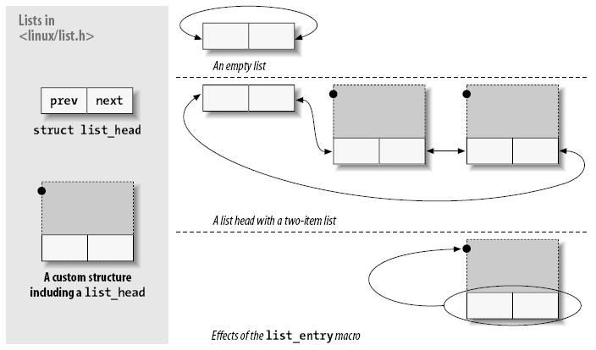
Linked Lists

Slide 6
More Fun with Linked Lists
Can allocate list elements as an array
C
2
A
3
list_head sorted_by_char
list_head sorted_by_num
B
1

Slide 7
Linked Lists
The head of the list is usually a standalone structure
To declare and initialize a list head, call
  struct list_head todo_list;
  INIT_LIST_HEAD(&todo_list);
To initialize at compile time, call
  LIST_HEAD(todo_list);

Slide 8
Linked Lists
See <linux/list.h> for a list of list functions
/* add the new entry after the list head */
/* use it to build stacks */
list_add(struct list_head *new, struct list_head *head);
/* add the new entry before the list head (tail) */
/* use it to build FIFO queues */
list_add_tail(struct list_head *new, struct list_head *head);

Slide 9
Linked Lists
/* the given entry is removed from the list */
/* if the entry might be reinserted into another list, call list_del_init */
list_del(struct list_head *entry);
list_del_init(struct list_head *entry);
/* remove the entry from one list and insert into another list */
list_move(struct list_head *entry, struct list_head *head);
list_move_tail(struct list_head *entry,
struct list_head *head);
/* return a nonzero value if the given list is empty */
list_empty(struct list_head *head);

Slide 10
Linked Lists
/* insert a list immediately after head */
list_splice(struct list_head *list, struct list_head *head);
To access the data structure itself, use
  list_entry(struct list_head *ptr, type_of_struct,
  field_name);
  Same as container_of()
  ptr is a pointer to a struct list_head entry

Slide 11
Linked Lists
  type_of_struct is the type of the structure containing the ptr
  field_name is the name of the list field within the structure
  Example
struct todo_struct *todo_ptr
= list_entry(listptr, struct todo_struct, list);
#define container_of(ptr, type, member) ({
const typeof(((type *)0->member) *__mptr = (ptr);
(type *) ((char *)__mptr – offsetof(type, member)); })
Type checking

Slide 12
Linked Lists
To traverse the linked list, one can follow the prev and next pointers
void todo_add_entry(struct todo_struct *new) {
struct list_head *ptr;
struct todo_struct *entry;
for (ptr = todo_list.next; ptr != &todo_list;
ptr = ptr->next) {
entry = list_entry(ptr, struct todo_struct, list);
if (entry->priority < new->priority) {
list_add_tail(&new->list, ptr);
return;
}
}
list_add_tail(&new->list, &todo_struct)
}

Slide 13
Linked Lists
One can also use predefined macros
void todo_add_entry(struct todo_struct *new) {
struct list_head *ptr;
struct todo_struct *entry;
list_for_each(ptr, &todo_list) {
entry = list_entry(ptr, struct todo_struct, list);
if (entry->priority < new->priority) {
list_add_tail(&new->list, ptr);
return;
}
}
list_add_tail(&new->list, &todo_struct)
}

Slide 14
Linked Lists
Predefined macros avoid simple programming errors
  See <linux/list.h>
/* creates a loop that executes once with cursor pointing at each successive entry */
/* be careful about changing the list while iterating */
list_for_each(struct list_head *cursor,
struct list_head *list)
/* iterates backward */
list_for_each_prev(struct list_head *cursor,
struct list_head *list)

Slide 15
Linked Lists
/* for deleting entries in the list */
/* stores the next entry in next at the beginning of the loop */
list_for_each_safe(struct list_head *cursor,
struct list_head *next,
struct list_head *list)
/* ease the process of dealing with a list containing a given type */
/* no need to call list_entry inside the loop */
list_for_each_entry(type *cursor, struct list_head *list,
member)
list_for_each_entry_safe(type *cursor, type *next,
struct list_head *list, member)

Slide 16
hlist
Used where storing 2 pointers of the list head is wasteful
  E.g., hash tables
struct list_head {
struct list_head *next, *prev;
};
struct hlist_head {
struct hlist_node *first;
};
struct hlist_node {
struct hlist_node *next, **pprev;
};

Slide 17
hlist
hlist_head
hlist_node *first
hlist_node
hlist_node *next
hlist_node *prev
hlist_node
hlist_node *next
hlist_node *prev

Slide 18
hlist
hlist_head
hlist_node *first
hlist_node
hlist_node *next
hlist_node **prev
hlist_node
hlist_node *next
hlist_node **prev

Slide 19
QUEUES

Slide 20
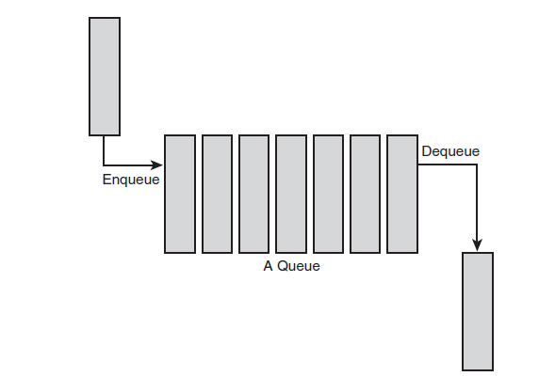
Queues
Producer/consumer model
Notes:
Have we seen this before?

Slide 21
Queues
Called kfifo in <linux/kfifo.h>
Two main operations
  Enqueue called kfifo_in
  Dequeue called kfifo_out

Slide 22
Queues
Create a queue
int kfifo_alloc(struct kfifo *fifo,
unsigned int size, gfp_t
gfp_mask);
  fifo – pointer to a struct kfifo
  size – total size of kfifo
  gfp_mask – memory alloctation flag (e.g. GFP_KERNEL)

Slide 23
Queues
Enqueuing data
unsigned int kfifo_in(struct kfifo
*fifo, const void *from,
unsigned int len);
  Copies the len bytes starting at from into the queue represented by fifo
  Returns number of bytes enqueued
    May return less than requested if insufficient space

Slide 24
Queues
Dequeuing data
unsigned int kfifo_out(struct kfifo
*fifo, void *to, unsigned
int len);
  Copies at most len bytes from the queue pointed at by fifo to the buffer pointed at by to
  Returns number of bytes dequeued

Slide 25
Queues
kfifo_out_peek
  Same as kfifo_out, but does not actually dequeue data
kfifo_size
  Obtain size of buffer in fifo
kfifo_len/kfifo_available
  Obtain number of bytes used/number of bytes available
Other macros
  kfifo_is_empty
  kfifo_is_full

Slide 26
Queues
Reset the queue
static inline void kfifo_reset(struct
kfifo *fifo);
Destroy the queue
void kfifo_free(struct kfifo *fifo);

Slide 27
RED-BLACK TREES

Slide 28
Red-Black Tree
  Self-balancing binary search tree
Properties
  Each node is either red or black
  Each path to leaf traverses same number of black nodes
  Each red node has two black children
  All leaves are black (NIL)
Notes:
Shortest path, all black nodes
Longest path, maximum number of red nodes. Since all paths have an equal number of black nodes, the number of red nodes must be less than the number of black nodes.

Slide 29
Red-Black Tree
Coloring of nodes specified to constrain the maximum amount of “unbalance”
  O(log n) for searching, insertion, deletion
  Difference in traversed nodes between furthest and nearest node from the root is no more than 2
    Why?
Notes:
Shortest path, all black nodes
Longest path, maximum number of red nodes. Since all paths have an equal number of black nodes, the number of red nodes must be less than the number of black nodes.

Slide 30
Red-BlackTrees
Linux implementation of red-black trees
  rbtree
  <linux/rbtree.h>
Search and insert routines must be defined

Slide 31
Allocating a rbtree
The root of an rbtree is represented by the rb_root structure
To create a new tree, we allocate a new rb_root and initialize it to the special value RB_ROOT
struct rb_root root = RB_ROOT;

Slide 32
Searching a rbtree
The following function implements a search of Linux’s page cache for a chunk of a file
Each inode has its own rbtree, keyed off of page offsets into file
This function thus searches the given inode’s rbtree for a matching offset value

Slide 33
rbtree Find Example
struct page * rb_search_page_cache(struct inode *inode,
unsigned long offset)
{
struct rb_node *n = inode->i_rb_page_cache.rb_node;
while (n) {
struct page *page = rb_entry(n, struct page, rb_page_cache);
if (offset < page->offset)
n = n->rb_left;
else if (offset > page->offset)
n = n->rb_right;
else
return page;
}
return NULL;
}

Slide 34
rbtree Insert Example
struct page * rb_insert_page_cache(struct inode *inode, unsigned long offset, struct rb_node *node)
{
struct rb_node **p = &inode->i_rb_page_cache.rb_node;
struct rb_node *parent = NULL;
struct page *page;
while (*p) {
parent = *p;
page = rb_entry(parent, struct page, rb_page_cache);

Slide 35
rbtree Insert Example
if (offset < page->offset)
p = &(*p)->rb_left;
else if (offset > page->offset)
p = &(*p)->rb_right;
else
return page;
}
/* Insert new node */
rb_link_node(node, parent, p);
/* Perform tree rebalancing */
rb_insert_color(node, &inode->i_rb_page_cache);
return NULL;
}

Slide 36
rbtree
Removal of a node
void rb_erase(
struct rb_node *victim, struct rb_root *tree);

Slide 37
MAPS

Slide 38
Maps
Implemented via binary search tree (not hash)
Collection of unique keys, where each key is associated with specific value
Relationship between key and its value is called a mapping
Linux implementation used to map a unique ID number (UID) to a pointer

Slide 39
Maps
idr data structure used to map unique identification number (UID) to a pointer
  E.g., associated kernel data structure
Initialize an idr
void idr_init(struct idr *idp);

Slide 40
Maps
Allocating a new UID
  Done in two steps so that backing store resize does not need to lock
int idr_pre_get(struct idr *idp, gfp_t gfp_mask);
  Resizes the backing tree

Slide 41
Maps
int idr_get_new(struct idr *idp, void
*ptr, int *id);
  Uses the idr pointed at by idp to allocate a new UID and associate it with the pointer ptr
  On success, returns zero and stores the new UID in id
  On error, returns a nonzero error code: -EAGAIN if you need to (again) call idr_pre_get() and -ENOSPC if the idr is full

Slide 42
Maps
Look up a UID
void *idr_find(struct idr *idp,
int id);
  On success, returns pointer associated with the UID in the idr pointed at by idp
  On error, the function returns NULL

Slide 43
Maps
Remove a UID from an idr
void idr_remove(struct idr *idp,
int id);
Destroy entire idr
void idr_remove_all(struct idr *idp);
void idr_destroy(struct idr *idp);

Slide 44
USAGE

Slide 45
What to Use?
Goal | Structure
Iteration over data | Linked lists
Producer/consumer patter | Queue (FIFO)
Map a UID to an object | Maps
Store large amount of data and look it up efficiently | Red-black tree

