Slide 1


The latest UART driver model for porting serial devices as standard Linux serial ports
Jim Chen
( jim.chen@hytec-electronics.co.uk )

Slide 2
Contents
Overview of the hardware and software
TTY device driver
New UART device driver
An example in brief
Summary

Slide 3
We all familiar with
drvAsynSerialPortConfigure(“port1","/dev/ttyS0",0,0,0)
asynSetOption(" port1 ", -1, "baud", "9600")
asynSetOption(" port1 ", -1, "bits", "8")
asynSetOption(" port1 ", -1, "parity", "none")
asynSetOption(" port1 ", -1, "stop", "1")
asynSetOption(" port1 ", -1, “clocal", "Y")
asynSetOption(" port1 ", -1, “rtsts", "N")

Slide 4
Serial Communication Hardware
PCI/PCIe/VME BUS
Processor
UART
RS232
Devices
RS485
Devices
Devices
Other Devices
Settings
UART
Tx
Baud rate
Data bit
Start/stop bit
Parity check
Flow control
Rx

Slide 5
Software Overview
PCI/PCIe/VME BUS
Processor
UART
RS232
Devices
RS485
Devices
Devices
Other Devices
ttyS0/ttyS1 Kernel
Device Driver
User App
EPICS
Char Driver TTY Core
Line Discipline
Device Driver
UART
Devices
Console
minicom

Slide 6
What is our goal
Majority of serial users – sending/receiving data over 3/2/4 wires
Set up serial port in the simplest way – baud rate, data bit, stop bit
No parity check, no flow control, no echo etc.
Sending data via Tx.
Receiving data via Rx.
Options (most apps don’t)
Manage modem – CTS, DSR, DTR, RTS, CD, RI etc, etc.
Manage flow control and handshake.
Manage special characters etc.

Slide 7
What the driver used to be
– TTY device driver
User App
Before kernel 2.6 (2.5.28)
Serial ports must be visible
as TTY devices
Must be part of the kernel
TTY core
Direct implementation by
TTY driver
Char Driver TTY Core
Kernel
Line Discipline
TTY Driver
UART/Hardware

Slide 8
A glance at TTY device driver
Operations
Detecting devices
In init routine:
- Allocate tty_driver
- Register tty_driver: name,
driver name, major, minor,
subtype, termios etc
- Register devices
Implement operations
Use ‘write’ operation to send
Use interrupt (receiving
chars) or timer (polling) for
receiving.
static struct tty_operations serial_ops = {
.open = my_open,
.close = my_close,
.write = my_write,
.write_room = my_write_room,
.set_termios = my_set_termios,
.ioctl = my_ioctl,
.put_char = my_put_char,
.flush_chars = my_flush_chars,
.wait_until_sent = my_wait_until_sent,
.chars_in_buffer = my_chars_in_buffer,
.throttle = my_throttle,
.unthrottle = my_unthrottle,
.stop = my_stop,
.start = my_start,
.hangup = my_hangup,
.break_ctl = my_break_ctl,
.set_ldisc = my_set_ldisc,
.send_xchar = my_send_xcahr,
};

Slide 9
Problems
We need to deal with TTY stuff all the time
A bit messy with numerous #ifdef lines
Very complicated to implement
Not UART oriented
Flip Buffer issue. A device driver receive handler can run
in parallel with the flush routine in SMP system
Multiple instances of the flush routine can run in parallel
Since the tty buffers are attached directly to the tty. It
is causing a lot of the problems related to tty layer locking,
also problems at high speed and also with bursty data etc
……

Slide 10
What it is now – UART driver
User App
After kernel 2.6, TTY driver
split into two
kernel programmer has
implemented serial_core
which is equivalent to a tty
wrapper
Driver developer only need
to deal with UART operations
Char Driver TTY Core
Line Discipline
Kernel
Serial Core
UART Driver
UART/Hardware

Slide 11
The UART driver Implementation
Operations
Detecting devices via PCI
enumeration
Register UART driver structure
Add UART ports
Implement the operations
Implement the console
operations (optional)
Use interrupt (receiving
chars) or timer (polling) for
receiving.
Sending upon TX holding register
empty interrupt
static struct uart_ops ioc9010_uart_pops = {
.tx_empty = ioc9010_tx_empty,
.set_mctrl = ioc9010_set_mctrl,
.get_mctrl = ioc9010_get_mctrl,
.stop_tx = ioc9010_stop_tx,
.start_tx = ioc9010_start_tx,
.stop_rx = ioc9010_stop_rx,
.enable_ms = ioc9010_enable_ms,
.break_ctl = ioc9010_break_ctl,
.startup = ioc9010_startup,
.shutdown = ioc9010_shutdown,
.set_termios = ioc9010_set_termios,
.type = ioc9010_type,
.release_port = ioc9010_release_port,
.request_port = ioc9010_request_port,
.config_port = ioc9010_config_port,
.verify_port = ioc9010_verify_port,
};

Slide 12
Implementation Details
static struct uart_ops ioc9010_uart_pops = {
.tx_empty = ioc9010_tx_empty, check transmt FIFO empty
.set_mctrl = ioc9010_set_mctrl, set modem control lines, RTS, DTR etc
.get_mctrl = ioc9010_get_mctrl, get modem control status, CTS, DCD, DSR RI etc
.stop_tx = ioc9010_stop_tx, stop transmitting
.start_tx = ioc9010_start_tx, enable transmitting
.stop_rx = ioc9010_stop_rx, stop receiving, stop receive interrupt
.enable_ms = ioc9010_enable_ms, set modem timer
.break_ctl = ioc9010_break_ctl, control the transmission of a break signal
.startup = ioc9010_startup, initialise port, register and enable interrupt
.shutdown = ioc9010_shutdown, stop using port. Disable and free interrupt resources
.set_termios = ioc9010_set_termios, set line pararmeters: baud rate, data bit, stop bit etc
.type = ioc9010_type, return the string of the port device
.release_port = ioc9010_release_port, release memory and IO region used by the port
.request_port = ioc9010_request_port, request memory and IO region
.config_port = ioc9010_config_port, perform any auto configuration steps
.verify_port = ioc9010_verify_port, verify the port info is suitable for this port type
};

Slide 13
What can we tell from the new model
This is much closer to the nitty-gritty of it -- the
UART business. We are talking the same
language.
Very neat in design.
No need for complicated TTY stuff contemplation.
The UART structure replaces the TTY structure
Let’s look at an example…

Slide 14
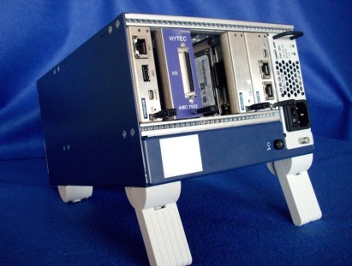
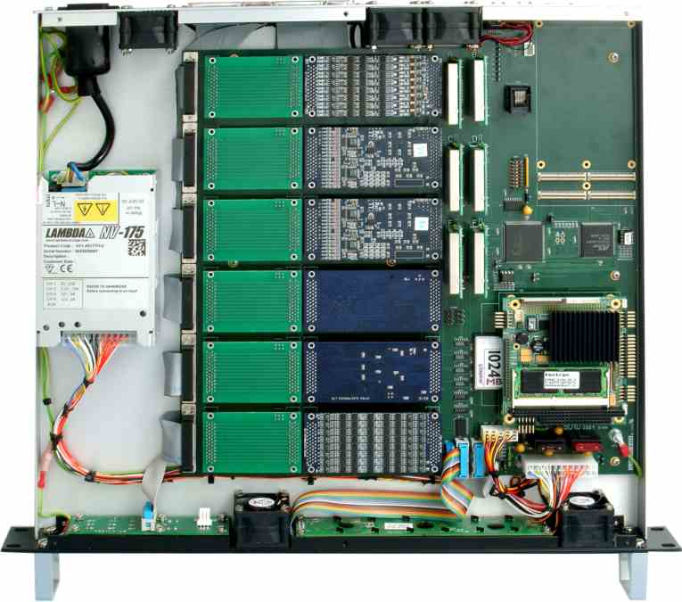
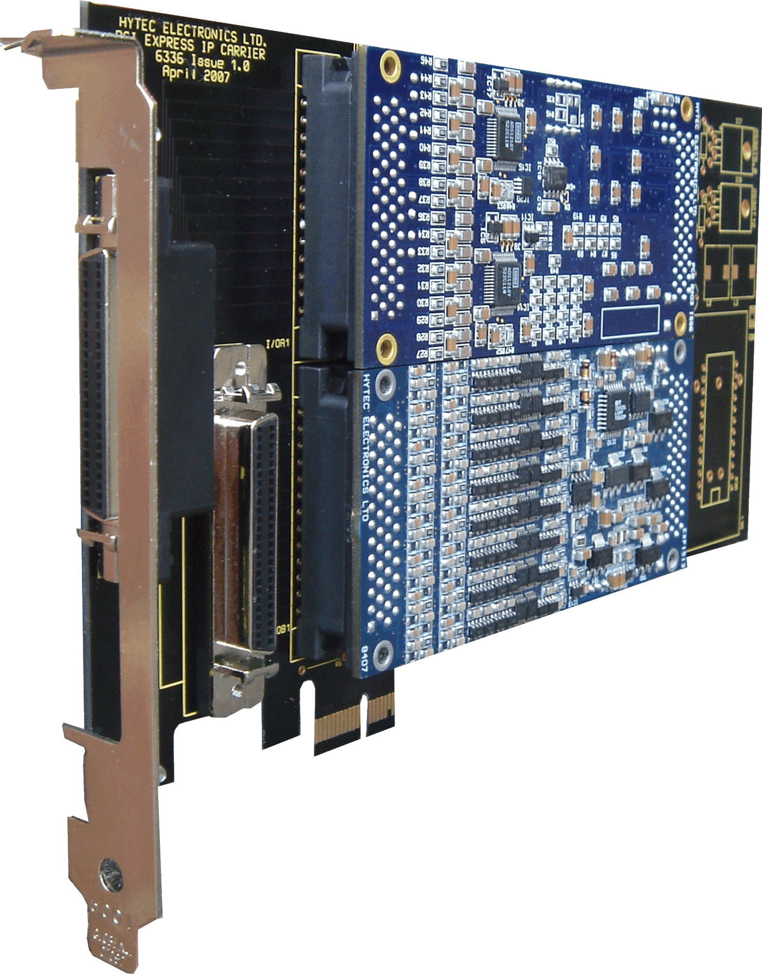
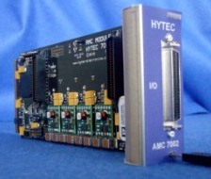
Example: Steps for building Hytec 8515/8516 8 channel serial IP UART driver
6335 PCIe Carrier
2 IPs
7002 uTCA Carrier
1 IP
IOC9010 Blade
6 IPs
PCI/PCIe arch

Slide 15
Example: Hytec 8515/8516
(Continued 1)
1. Register driver structure

Slide 16
Example: Hytec 8515/8516
(Continued 2)
2. Identify PCI/PCIe and uart devices

Slide 17
Example: Hytec 8515/8516
(Continued 3)
3. Register UART port

Slide 18
Example: Hytec 8515/8516
(Continued 4)
4. Implement startup
/* Enable interrupts */

Slide 19
Example: Hytec 8515/8516
(Continued 5)
4. Implement shut down
/* Enable interrupts */

Slide 20
Example: Hytec 8515/8516
(Continued 6)
5. Implement start_tx
/* Enable interrupts */

Slide 21
Example: Hytec 8515/8516
(Continue 7)
6. Implement stop_tx
/* Enable interrupts */

Slide 22
Example: Hytec 8515/8516
(Continue 8)
7. Implement stop_rx
/* Enable interrupts */

Slide 23
Example: Hytec 8515/8516
(Continue 9)
8. Implement interrupt service routine
irqreturn_t ioc9010_isr(int irq, void *dev_id, struct pt_regs *regs)
{
struct ioc9010_uart_port *ioc9010 = (struct ioc9010_uart_port *)dev_id;
spin_lock(&ioc9010->port.lock);
......
Hy85156_INTReason(ioc9010, &port, &reason);
if ((reason & INTERRUPT_REASON_RXRDY) || ((reason & INTERRUPT_REASON_LSR) && (reason &
INTERRUPT_REASON_LSR_RX_BREAK)))
ioc9010_rx_chars(ioc9010); /* Byte or break signal received */
if (reason & INTERRUPT_REASON_TXRDY)
ioc9010_tx_chars(ioc9010); /* TX holding register empty - transmit a byte if there is */
Hy85156_ResetInterrupt(ioc9010, ioc9010->portNo, reason);
spin_unlock(&ioc9010->port.lock);
return IRQ_HANDLED;
}

Slide 24
Example: Hytec 8515/8516
(Continue 10)
9. Implement transmitting: tx_char
/* Enable interrupts */

Slide 25
Example: Hytec 8515/8516
(Continue 11)
10. Implement receiving: rx_char
/* Enable interrupts */

Slide 26
Recommendations
Download the latest Linux source, say 2.6.37
Look at the source examples in linux-2.6.37/drivers/serial
A number of devices have been ported as the uart driver.
Good examples: bcm63xx_uart.c, pnx8xxx_uart.c
It is worth reading the serial_core.c which wraps the tty
driver stuff.

Slide 27
Things to know and Caveats
Continuous changing (improvement) from version to version
port.info->tty ⬄ port.state->port.tty
uart_event(port, EVT_WRITE_WAKEUP);
=> uart_write_wakeup(&ioc9010->port);
new tty_port structure. 2.6.27 (October 9, 2008)
tty buffering layer revamp 2.6.16 (Aug 4, 2006)
We still end up with some #if … #endif
Console implementation
Platform implementation

Slide 28
References
Linux Device Driver, 3rd edition 2005 (a bit obsolete)
Low Level Serial API
http://rhkernel.org/RHEL6+2.6.32-19.el6/Documentation/serial/driver
The Serial Driver Layer http://www.linuxjournal.com/article/6331
TTY flip buffer SMP changes
http://lwn.net/Articles/105770/
Linux: tty Cleanup http://kerneltrap.org/node/5473
API changes in the 2.6 kernel series
http://lwn.net/Articles/2.6-kernel-api/, http://lwn.net/Articles/183225/
The TTY demystified
http://www.linusakesson.net/programming/tty/index.php

Slide 29

Thanks for your patience!
Well Jim, it looks as clear as mud to me!

