Slide 1
THE RGB AND YUV COLOR SPACE MODEL
ULSI Lab SOC1
Wang Yong

Slide 2
Contents
RGB Color Model
YUV Color Model
RGB AND YUV conversion
Color Science

Slide 3
3 Primary Colors
3 Primary Colors
  Red, Green, Blue
Secondary Colors: the primary color can be added to produce
  Yellow = Red ＋ Green
  Magenta = Red ＋ Blue
  Cyan = Green ＋ Blue
Trichromatic theory: Certain wavelengths of red, green, and blue, when combined with each other, in various proportion will produce a wider rang of color.
Multimedia Communication, Spring 2009

Slide 4
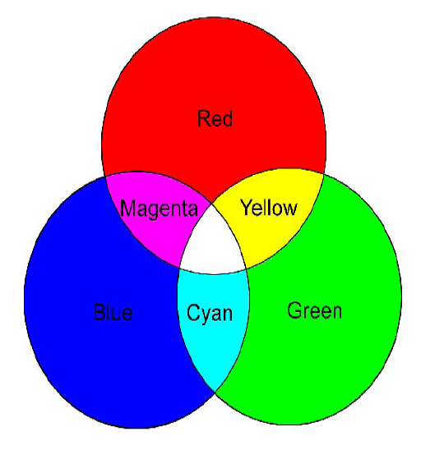
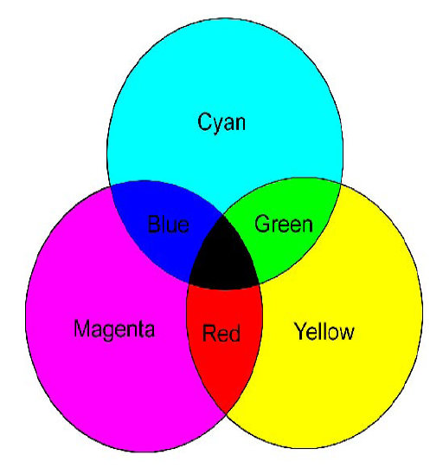
Color Theory
Primary and secondary colors
Pigment
Mixtures of light (additive primaries)
Mixtures of pigments (subtractive primaries)

Slide 5
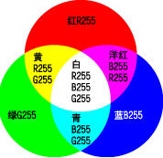
Triangular Dot Patterns
 | R | G | B
1 | 255 | 255 | 0 | Yellow
2 | 255 | 0 | 255 | magenta
3 | 0 | 255 | 255 | cyan
4 | 255 | 128 | 0 | orange
5 | 128 | 0 | 128 | purple
6 | 0 | 0 | 128 | navy
… | x | x | x | ?
16,777,216
256x256x256=
Triangular Dot Patterns (RGB Color Model)

Slide 6
Color space——RGB
Color vision is achieved through three signals, proportional to the relative intensities of Red, Green and Blue light (RGB) in each portion of the scene
  The three signals are conveyed separately to the input terminals of the picture tube,
    Picture tube: reproduces at each point the relative intensities of red, green and blue discerned by the camera.
  Other colors can be coded as a combination of these primary colors.

Slide 7

Using VGA
the VGA synchronization signals are provided directly from the Cyclone 2 FPGA, and the Analog Devices ADV7123 triple 10-bit high-speed video DAC is used to produce the analog data signals (red,green,and blue)
monitor
CLK
R
VGA control（FPGA)
G
DAC
(ADV7123)
VGA interface
B
HS
vs

Slide 8
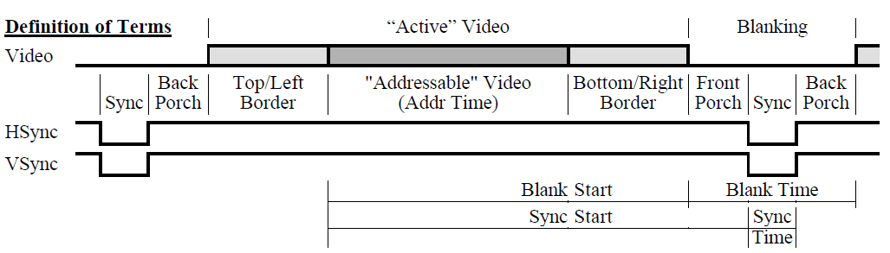
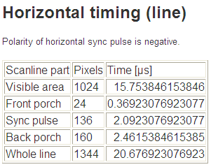
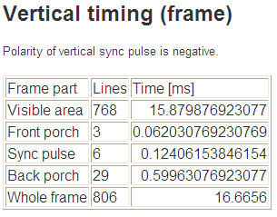
Using VGA
The data(RGB) input on the monitor must be given during “addressable” video.
XGA signal 1024x768@60HZ timing

Slide 9
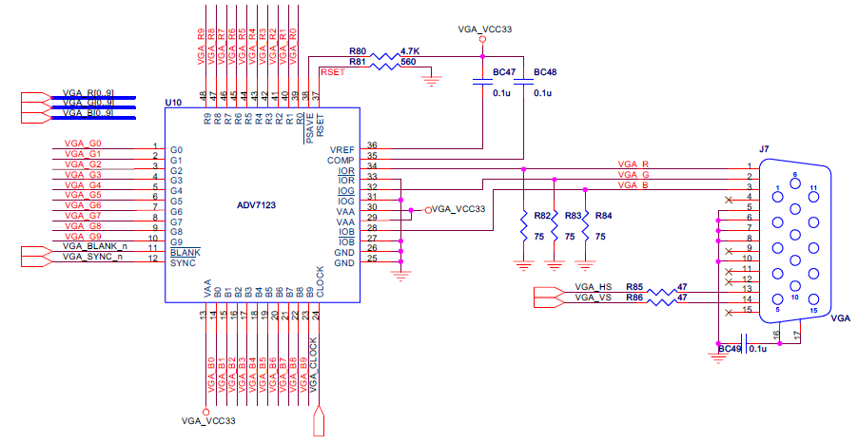
Using VGA
Hardware implementation
Multimedia Communication, Spring 2009

Slide 10
Using VGA
Display a pattern bar in a monitor using VGA(ADC7123) based on FPGA .

Slide 11
Color space——YUV
Video signal transmission: color encoding use luminance(Y) and two chrominance(UV) signals. U and V are blue-luminance and red-luminance difference.
Human perception is more sensitive to brightness than any chrominance information
  The luminance values can be coded using higher bandwidth than the chrominance values.
A more suitable coding distinguished between luminance and chrominance —Data compression 4:2:2,4:1:1,4:2:0

Slide 12
The advantage of YUV
Previous black-and-white system used only luma(Y) information.
Color information (U and V) was added separately, so that a black-and-white receiver would still be able to receive and display a color picture transmission in the receiver’s native black-and-white format.
Using the YUV can reduced data storage space and data transmission bandwidth.

Slide 13
Chroma subsampling
A reduced color resolution in digital component video signals, to accommodate storage and bandwidth limitations, the two color components (Cb,Cr) in digital video signal are compressed by sampling them at a lower rate than the brightness (Y).
color information is actually discarded.
In chroma subsampling, only the color are compressed, not the luma because the eye is more senstive to brightness than the color.

Slide 14
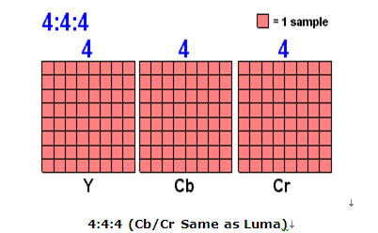
Chroma subsampling
4:4:4 subsampling
MPEG-2 supports 4:4:4 coding, it is considered not worth the additional bandwidth to transmit it, but when video is converted from one color space to another, it is often resampled to 4:4:4 first.

Slide 15
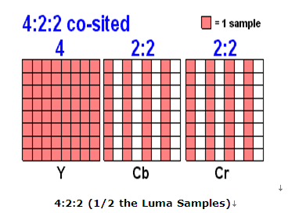
Chroma subsampling
4:2:2 subsampling,
4:2:2 color sampling is widely used and considered very high quality. it is used for prosumer and professional digital video recording.

Slide 16
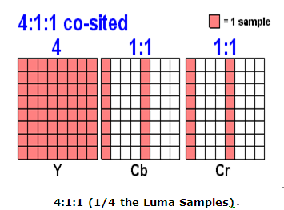
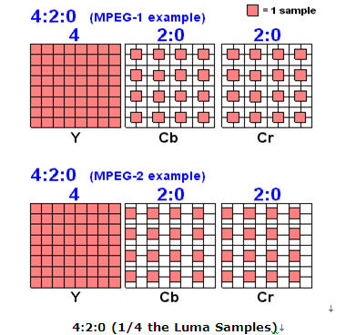
Chroma subsampling

Slide 17
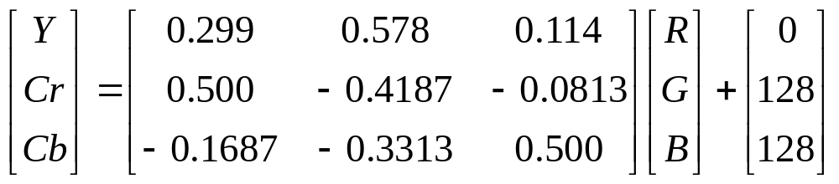

YCrCb and RGB conversion
RGB transform to YCrCb
YCrCb transform to RGB

Slide 18
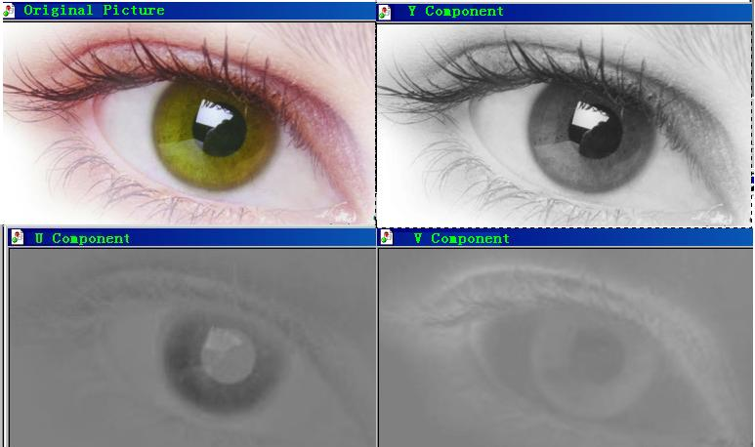
YUV

Slide 19
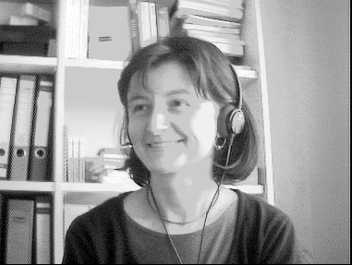
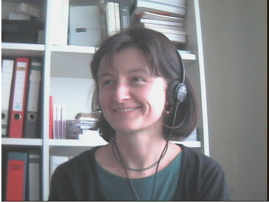
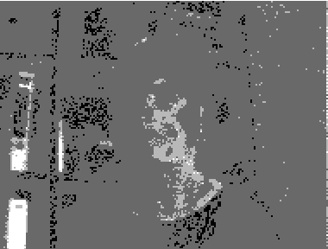
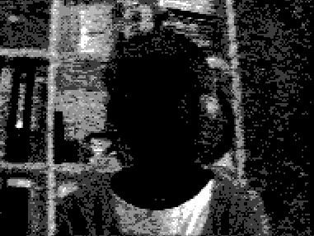
YUV
Y component
U component
V component

Slide 20
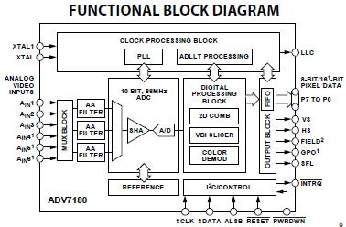
TV Decoder(ADV7180)
The ADV7180 is an integrated video decoder that automatically detects and converts a standard analog baseband signal (NTSC,PAL,and SECAM )into 4:2:2 component video data compatible with the 8-bit ITU-R BT.656 interface standard.

Slide 21

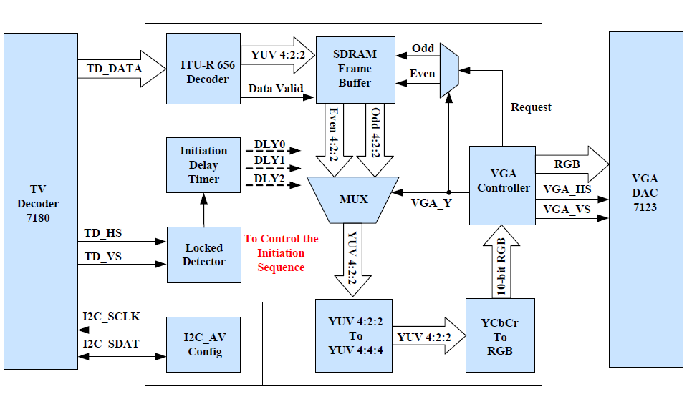
TV Demonstration using VGA as output
Multimedia Communication, Spring 2009

Slide 22
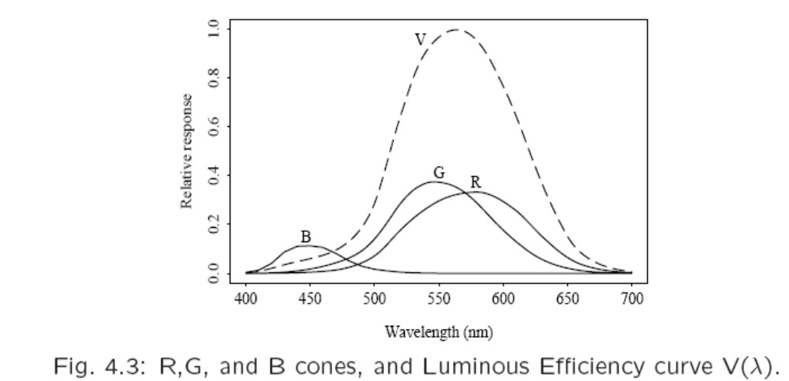
Spectral Sensitivity of the Eye
The overall sensitivity as a dashed line--this important curve is called the luminous-efficiency function.
the sum of the response curves for Red, Green, and Blue
Multimedia Communication, Spring 2009

Slide 23
Characteristics of human visual system (HVS)
Sensitive to edges and contours
  Example: Match-band effect
Contrast simultaneously
More sensitive to luminance than chrominance: Example
More sensitive to low frequency components than high frequency components
Parallax: 3-D perception
Error of human vision Example

Slide 24

Example
Match-band effect, which shows that brightness is not a monotonic function of luminance.
Contrast simultaneously
  Our perception is sensitive to luminance contrast, rather than absolute luminance.
Back
2009

Slide 25
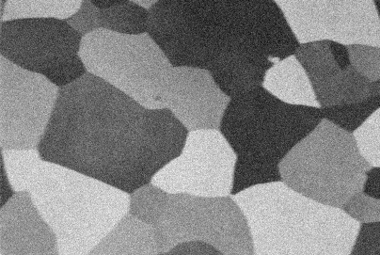
Example
The grainy appearance due to noise is more pronounced in the darker uniform regions than in lighter regions.
Back

Slide 26
Example
YUV Components Back
Multimedia Communication, Spring 2009

Slide 27
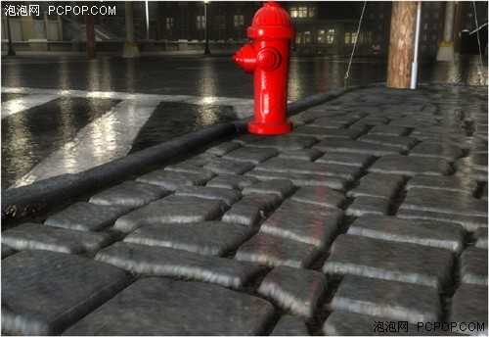
Parallax Occlusion Mapping

Slide 28
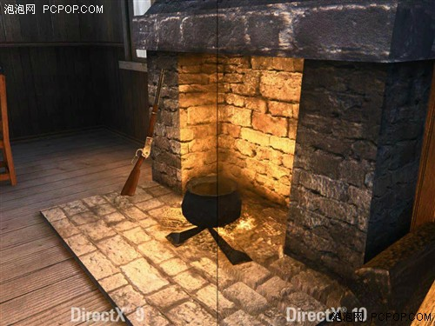
Parallax Occlusion Mapping
Back

Slide 29
Example
Error of human vision

Slide 30
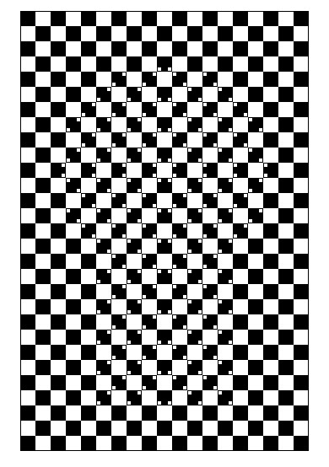
Example
Multimedia Communication, Spring 2009

Slide 31
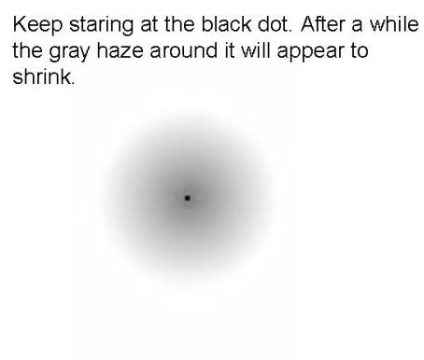
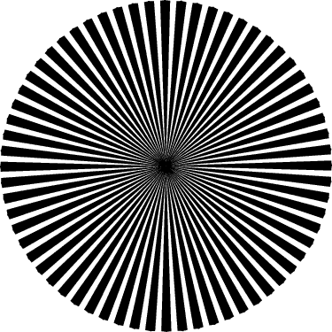
Example

Slide 32
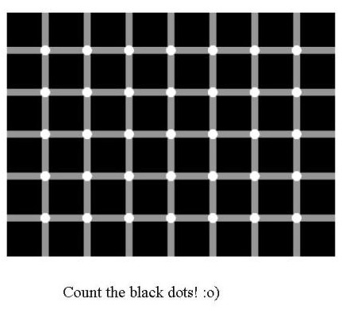
Example

Slide 33
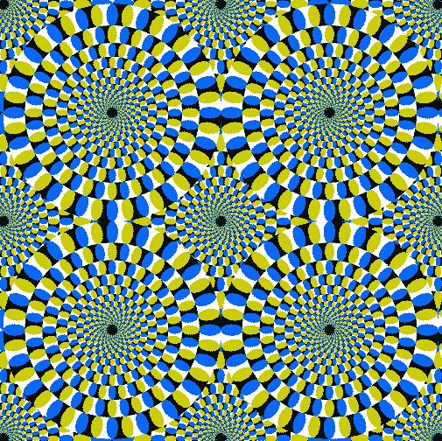
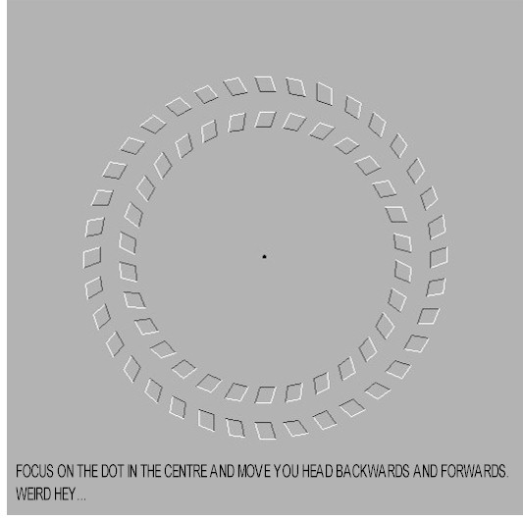
Example

Slide 34
The end.
Thank you!

