Slide 1
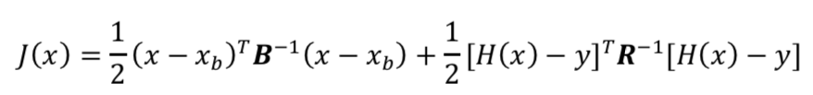
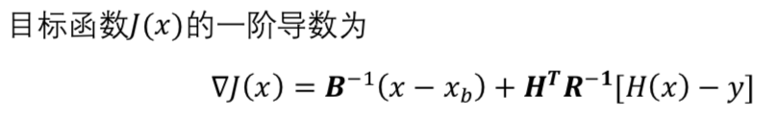
变分同化原理

Slide 2
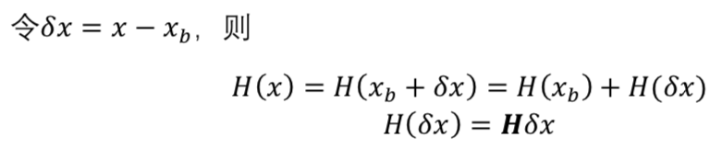

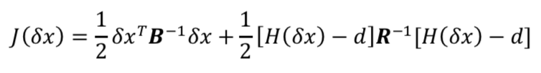
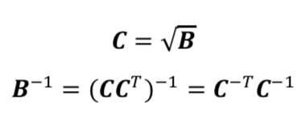
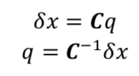
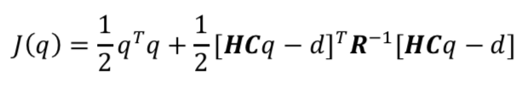


变分同化原理
1
2
3
LAPACK矩阵软件包求解

Slide 3
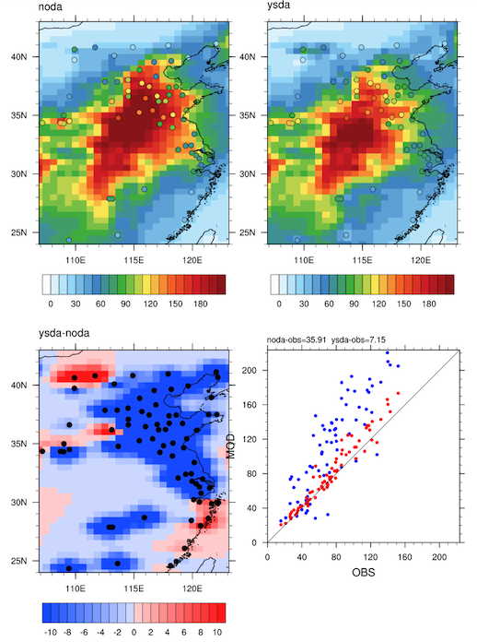
PM2.5变分同化测试：GEOS-Chem模拟PM2.5 + AQI PM2.5
2013-2014
注：模拟与观测时间不匹配，仅用于显示同化效果

Slide 4
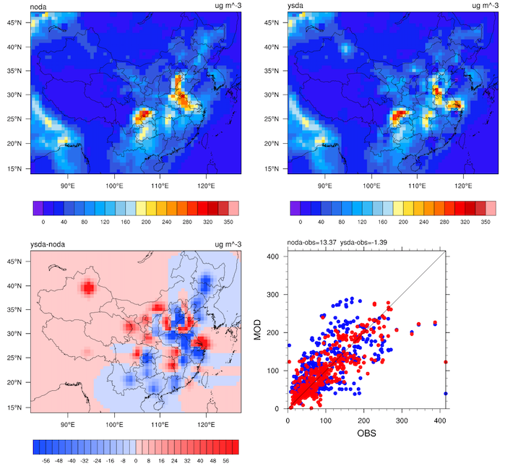
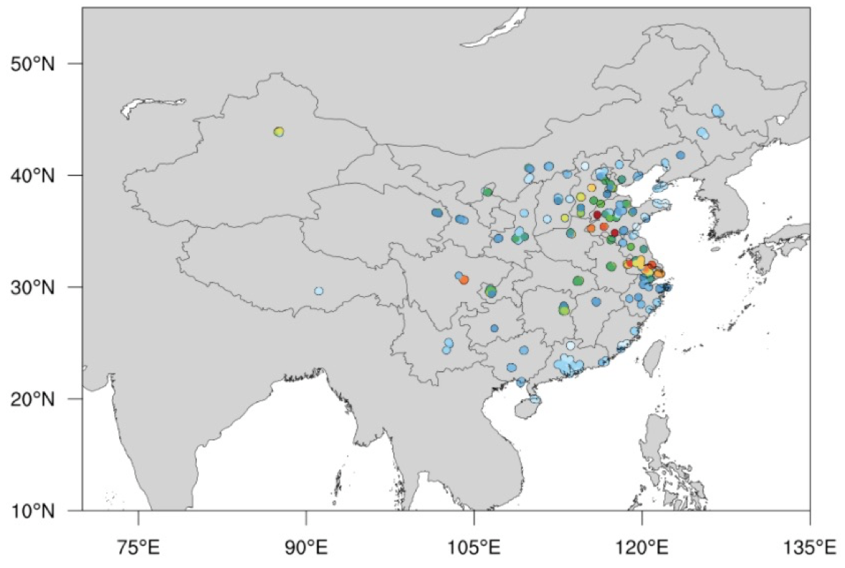
PM2.5变分同化测试：WRF-Chem模拟PM2.5 + AQI PM2.5
20131201_04:00 UTC

Slide 5
LAPACK软件包安装
LAPACK下载网址：http://www.netlib.org/lapack/
cp make.inc.example make.inc
make
make.inc.example供linux下使用gnu编译器，可作相应修改。make后生成3个库文件
liblapack.a librefblas.a libtmglib.a
连接：
将上述3个库文件移至某处
设置LD_LIBRARY_PATH路径指向库文件目录
gfortran step01.lapack.f90 -o s01.lapack.out -L$HOME/lib/lapack-3.8.0 -llapack -lrefblas
函数查询：http://www.netlib.org/lapack/explore-html/index.html
若为GSI使用，需在.bashrc文件中设置LAPACK变量
export LAPACK_PATH=$HOME/bin/lapack-3.8.0

Slide 6
NETCDF软件包安装
安装netcdf-c
export CC=icc
export FC=ifort
export CXX=icpc
export CPPFLAGS="-I$HOME/bin/hdf5-1.10.5/include -I$HOME/bin/zlib-1.2.11/include"
export LDFLAGS="-L$HOME/bin/hdf5-1.10.5/lib -L$HOME/bin/zlib-1.2.11/lib"
./configure --prefix=$HOME/bin/netcdf-4.6.3-intel --disable-dap --enable-netcdf4
make check
make install
安装netcdf-fortran
export CC=icc
export FC=ifort
export CXX=icpc
export CPPFLAGS="-I$HOME/bin/netcdf-4.6.3-intel/include"
export LDFLAGS="-L$HOME/bin/netcdf-4.6.3-intel/lib"
./configure --prefix=$HOME/bin/netcdf-4.6.3-intel
make
make install
若安装失败要重试，先运行 make distclean
.bashrc设置NETCDF
export LD_LIBRARY_PATH=$HOME/bin/hdf5-1.10.5/lib:$LD_LIBRARY_PATH
export NETCDF=$HOME/bin/netcdf-4.6.3-intel
export NETCDF_LIB=$HOME/bin/netcdf-4.6.3-intel/lib
export NETCDF_INC=$HOME/bin/netcdf-4.6.3-intel/include
export LD_LIBRARY_PATH=$NETCDF_LIB:$LD_LIBRARY_PATH
export PATH=$NETCDF/bin:$PATH
netcdf下载网址：https://www.unidata.ucar.edu/downloads/netcdf/
测试 netcdf 安装成功的fortran程序
program main
implicit none
include 'netcdf.inc'
integer :: ncid
call handle_err( nf_open('pm2p5.nc',0,ncid) )
contains
subroutine handle_err(kstu)
integer, intent( in ) :: kstu
if( kstu/=nf_noerr ) then
print *, trim(nf_strerror(kstu))
print *, 'Abort !!!'
stop
end if
end subroutine handle_err
end program main
ifort -check all main.f90 -o main.out -I$NETCDF_INC -L$NETCDF_LIB -lnetcdff
./main.out
rm main.out

