Slide 1
TEAM PRESENTATION by GROUP 06
FOR
Rice University Data Analytics Boot Camp
Project 01
11 September, 2019
@ The Bio Research Center (BRC)
Group Members
Adrian Sadri
Rashid Khokhar
Wenyuan Qiu
Using FBI Crime Data (1991 – 2017) to explore Underlying Geographical Dependencies

Slide 2
Technical Requirements
Below are shown the requirements provided by instructional team via file: “TechnicalRequirements.md”
Reference is also made to the files “PresentationGuidelines.md” & “PresentationRequirements.md” which were used
To prepare this presentation.
# Technical Requirements
The technical requirements for Project 1 are as follows.
* [ ] Use Pandas to clean and format your data set(s)
* [ ] Create a Jupyter Notebook describing the **data exploration and cleanup** process
* [ ] Create a Jupyter Notebook illustrating the **final data analysis**
* [ ] Use Matplotlib to create a total of 6-8 visualizations of your data (ideally, at least 2 per "question" you ask of your data)
* [ ] Save PNG images of your visualizations to distribute to the class and instructional team, and for inclusion in your presentation
* [ ] Optionally, use at least one API, if you can find an API with data pertinent to your primary research questions
* [ ] Create a write-up summarizing your major findings. This should include a heading for each "question" you asked of your data, and under each heading, a short description of what you found and any relevant plots.

Slide 3
Preparations
Quick consensus within the Group to look at FBI Crime Data to come up with a proposed project objective
API Key(s) were acquired to access the data at: https://api.usa.gov/crime/fbi/sapi/api/summarized/agencies/?ori /offenses/’ ………….
Lots of effort went into understanding how this particular API functions
Efforts were also spent on understanding the ORIs and preparing a listing of same
There were several datum with different formats were acquired over several days.
This required finding workarounds to several restrictions imposed by the FBI site as well as the API limitations
Several iterations with viewing the data as pandas DataFrame as well as using Excel were needed to properly understand and arrange the data.
Next slide shows some snap shots from the Excel files as well as from Jupyter Notebook

Slide 4
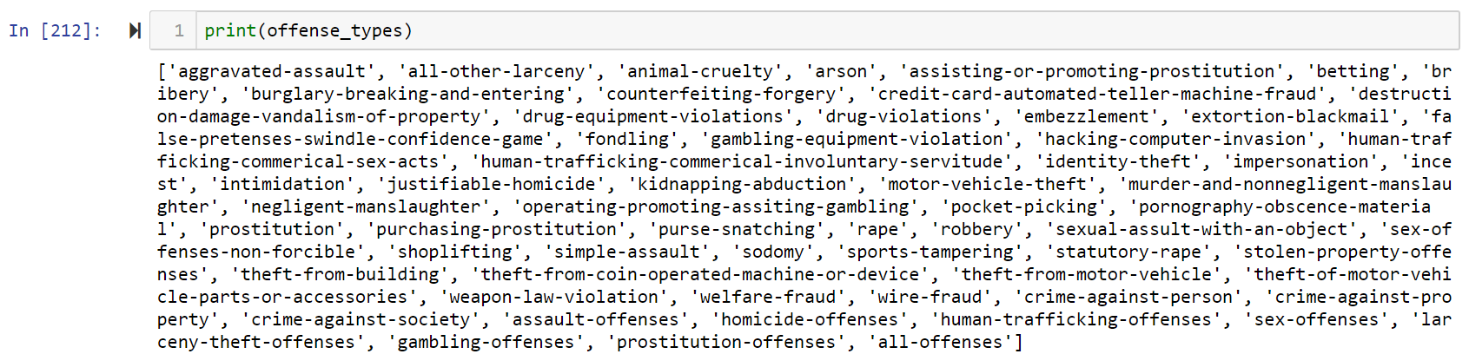
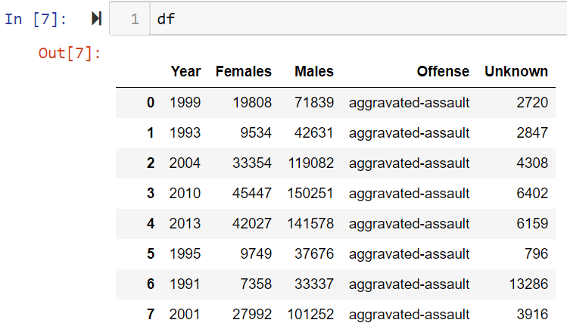
Preparations …… (contd)

Slide 5
Objectives & Questions, Initial
The Group initially set out to prove (or disprove) certain perceptions (Hypothetically) about social, demographic, and geographical factors and crime rates.
However, in depth data review showed that there are several gaps in the available data that would preclude rigorous, and valid, data analysis that could provide answers to sociological questions.
Emphasis was then shifted to exploring crime rate(s) and geography
Questions thus being focused are:
How size and population of a locality effects crime
How can this data help anyone wanting to move/migrate from on locale in US to another
These new objectives and questions to find answers for required the Group to use additional APIs and data from Census as well as mapping organizations.

