Slide 1

SIT737-11.1HD Mock-Bank
Yupeng Wen
s224212855

Slide 2
Outlines
Project Architectures
System Interaction
Features
Entity Relation
Deployment
Monitor

Slide 3
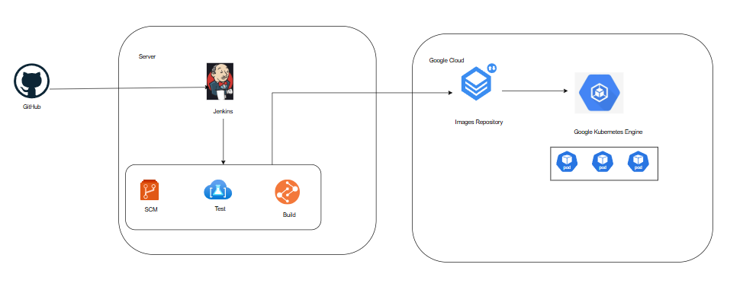
Project Architecture

Slide 4
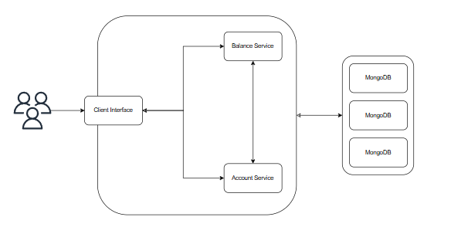
System Interaction

Slide 5
Features
Login
User Dash Board
Withdraw
Deposit
Transfer

Slide 6
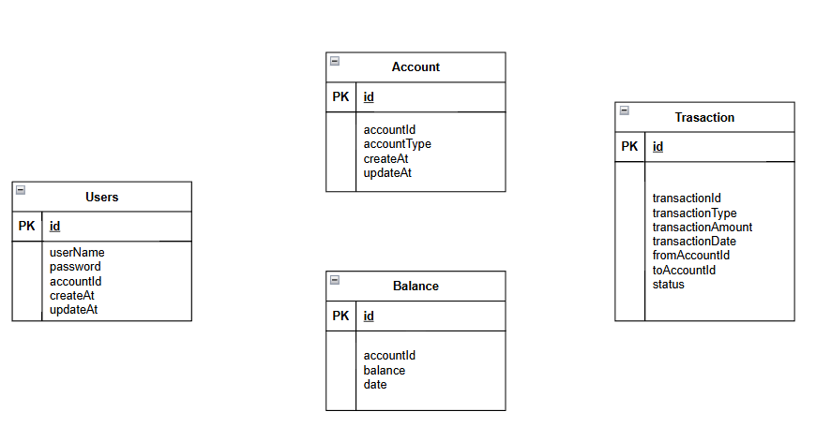
Entity Relation

Slide 7
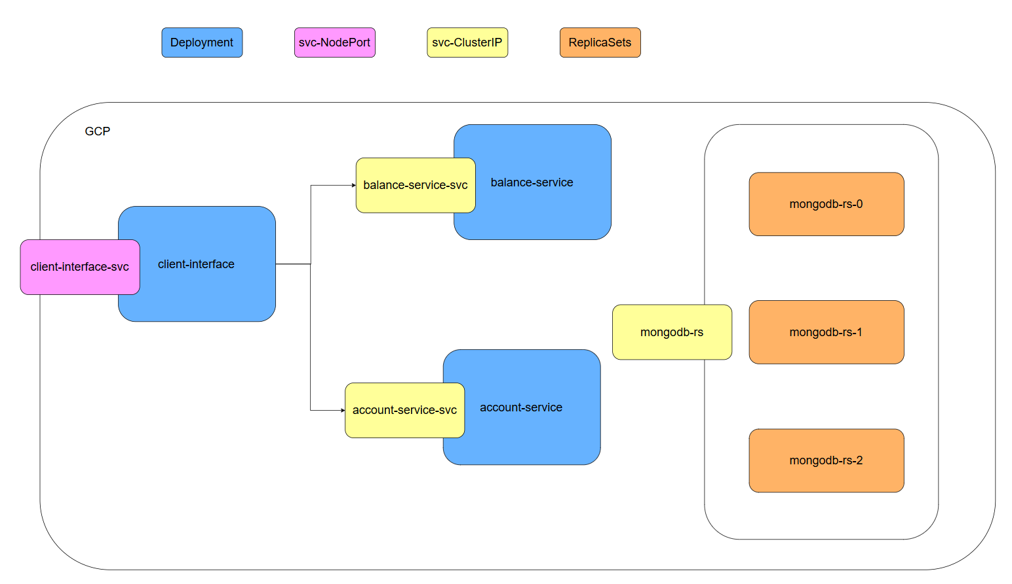
Deployment

Slide 8
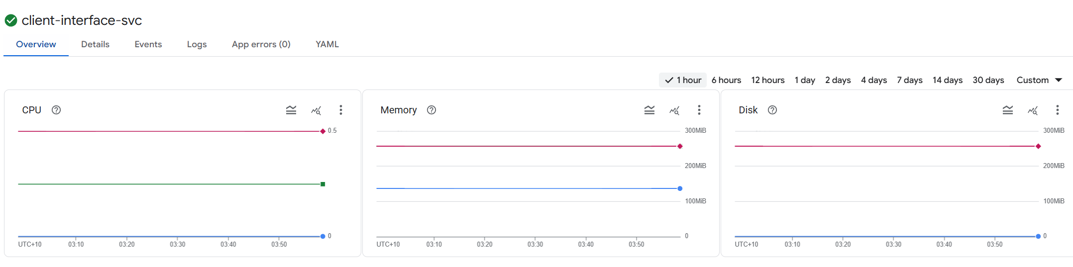
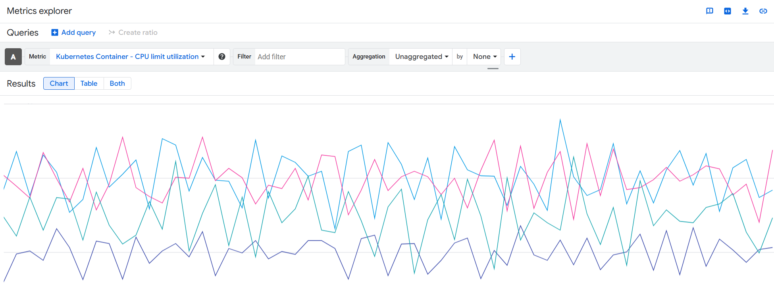
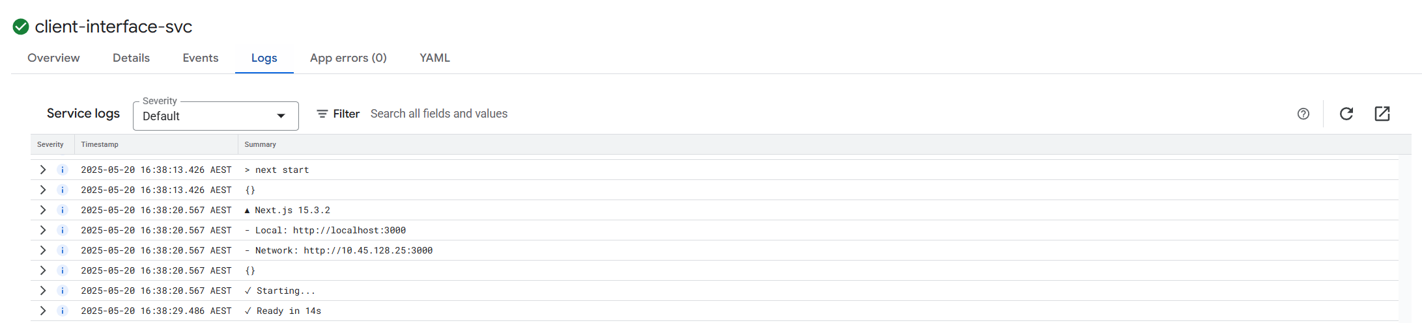
Monitor

Slide 9
Thank You for Listening

