Slide 1
Computational and Theoretical Analysis of Structured Light: Quadrupole Interactions in Chiral Molecules
Physics Project PHY-6004Y — Presentation
James (Wenzhao) Jia
Notes:
Computational: graphing and visualization

Slide 2
Structure of the Presentation
First, the introduction of important background aspects,
Angular momentum of light
Laguerre-Gaussian beams
Circular Vortex Dichroism
Later, a summary of the research, and the computation of:
Electric dipole-quadrupole coupling
Electric quadrupole-quadrupole coupling
These couplings in a paraxial and non-paraxial field

Slide 3
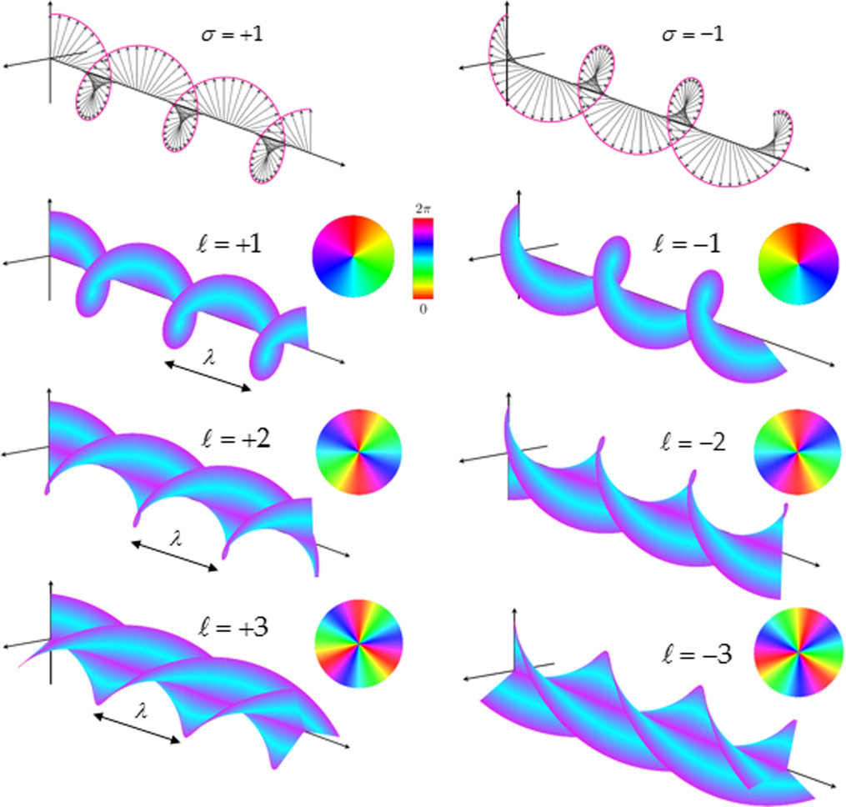
The Angular Momentum of Light
Angular momentum in light manifests itself in two different ways:
Spin angular momentum (SAM), from to the circular polarization of light: ℏσ per photon
Orbital angular momentum (OAM), from its twisted wavefront: ℓℏ per photon
Notes:
Mention the quantization per photon. Arrows represent the electric field vector. Colours represent intensities and the colour wheel represents the phase.

Slide 4
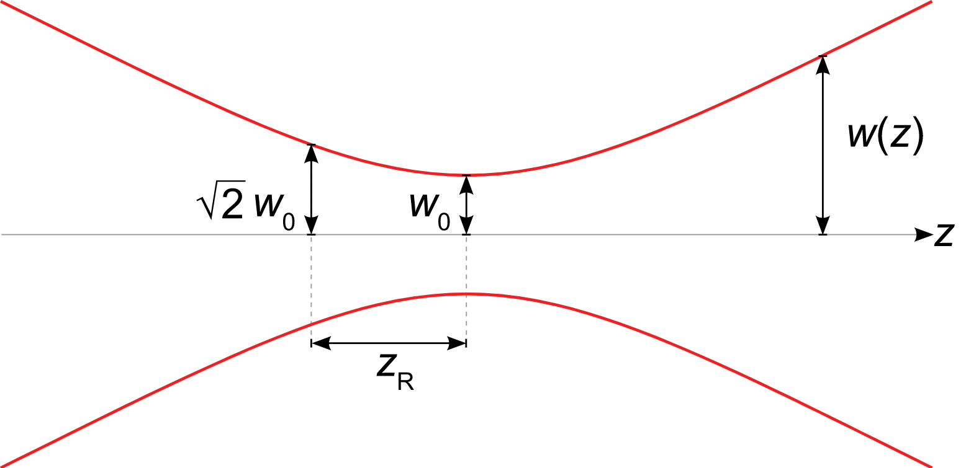
Laguerre-Gaussian Beams
A convenient mathematical description of a beam of light with angular momentum are Laguerre-Gaussian modes.
To simplify equations, we assume w(z ) ≈ w₀, i.e., in the long Rayleigh range.
Notes:
Convenient because of cylindrical symmetry. Middle figure: typical beam profile. Laguerre-Gaussian beams from the paraxial scalar Helmholtz equation, a particular representation of the time-independent wave equation.

Slide 5
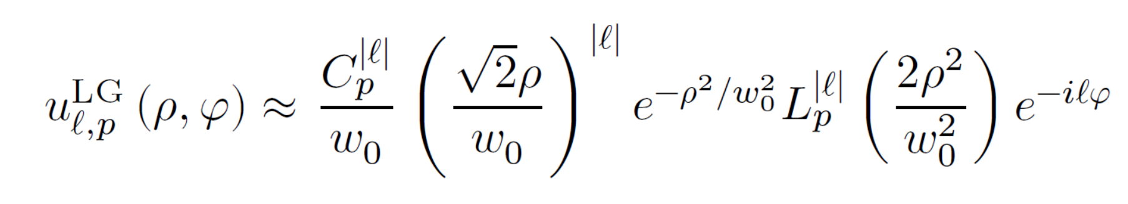
Laguerre-Gaussian Beams
The amplitude of an L-G beam is now approximated as
Radial distribution function
Note the lack of z dependence from our assumption in the previous slide.
ℓ : Topological charge
p : Radial Index
Notes:
Mention each quantity in the equation. Last term determines the phase. Azimuthal dependence which determines the “twist” structure. Next slides: Importance of RDF in couplings.

Slide 6
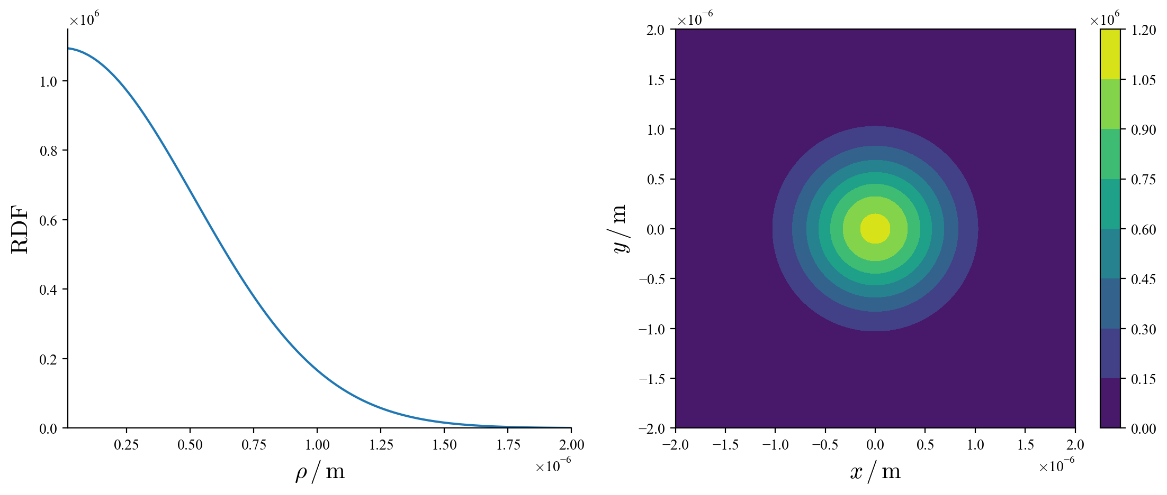
Radial Distribution function
w₀ = 729 nm, p = 0, ℓ = ±0.
Notes:
Normal Gaussian beam.

Slide 7
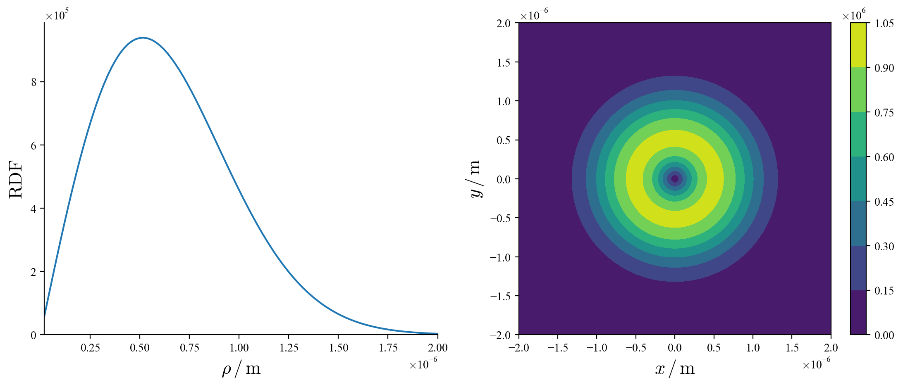
Radial Distribution function
w₀ = 729 nm, p = 0, ℓ = ±1.

Slide 8
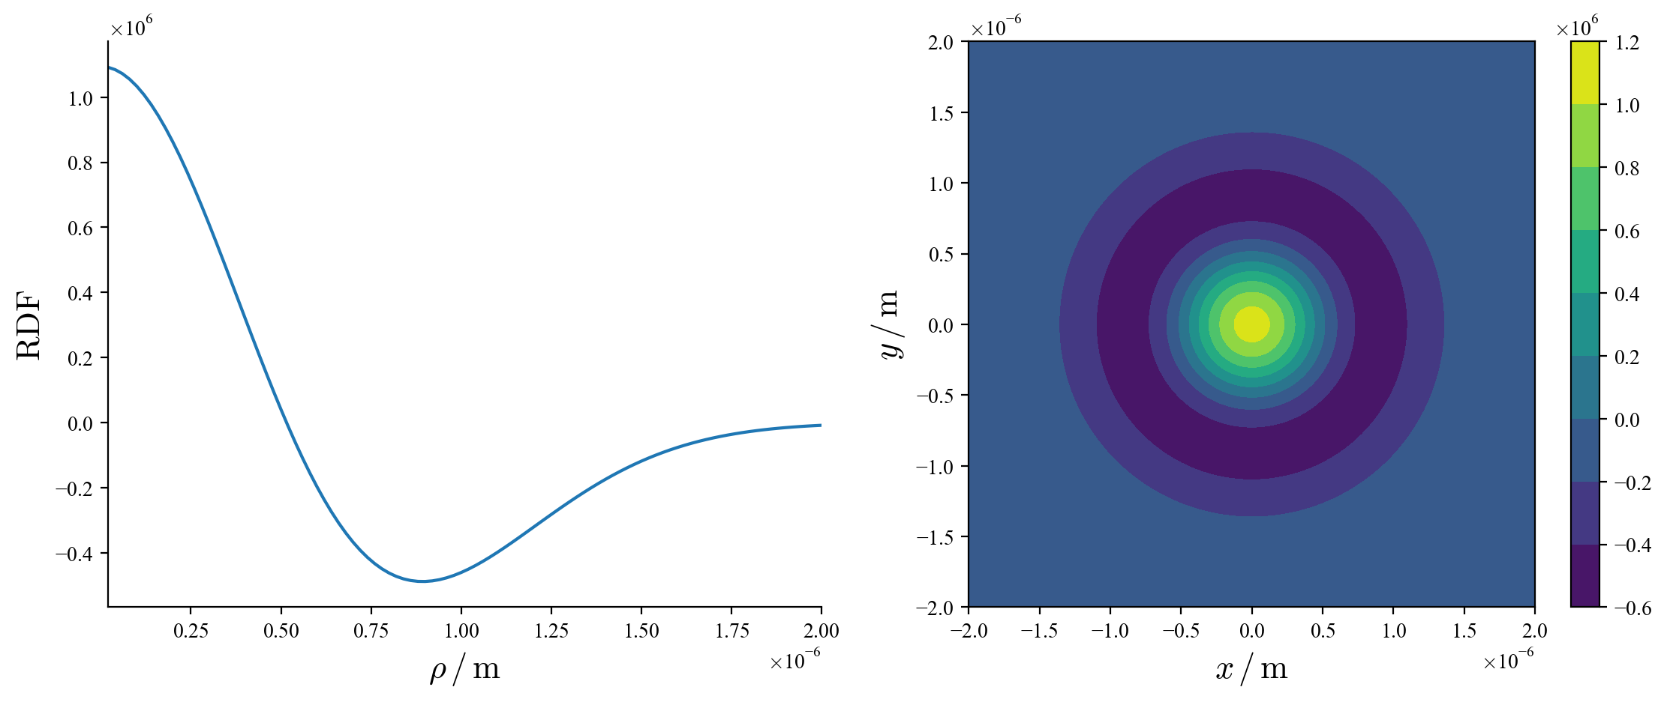
Radial Distribution function
w₀ = 729 nm, p = 1, ℓ = ±0.

Slide 9
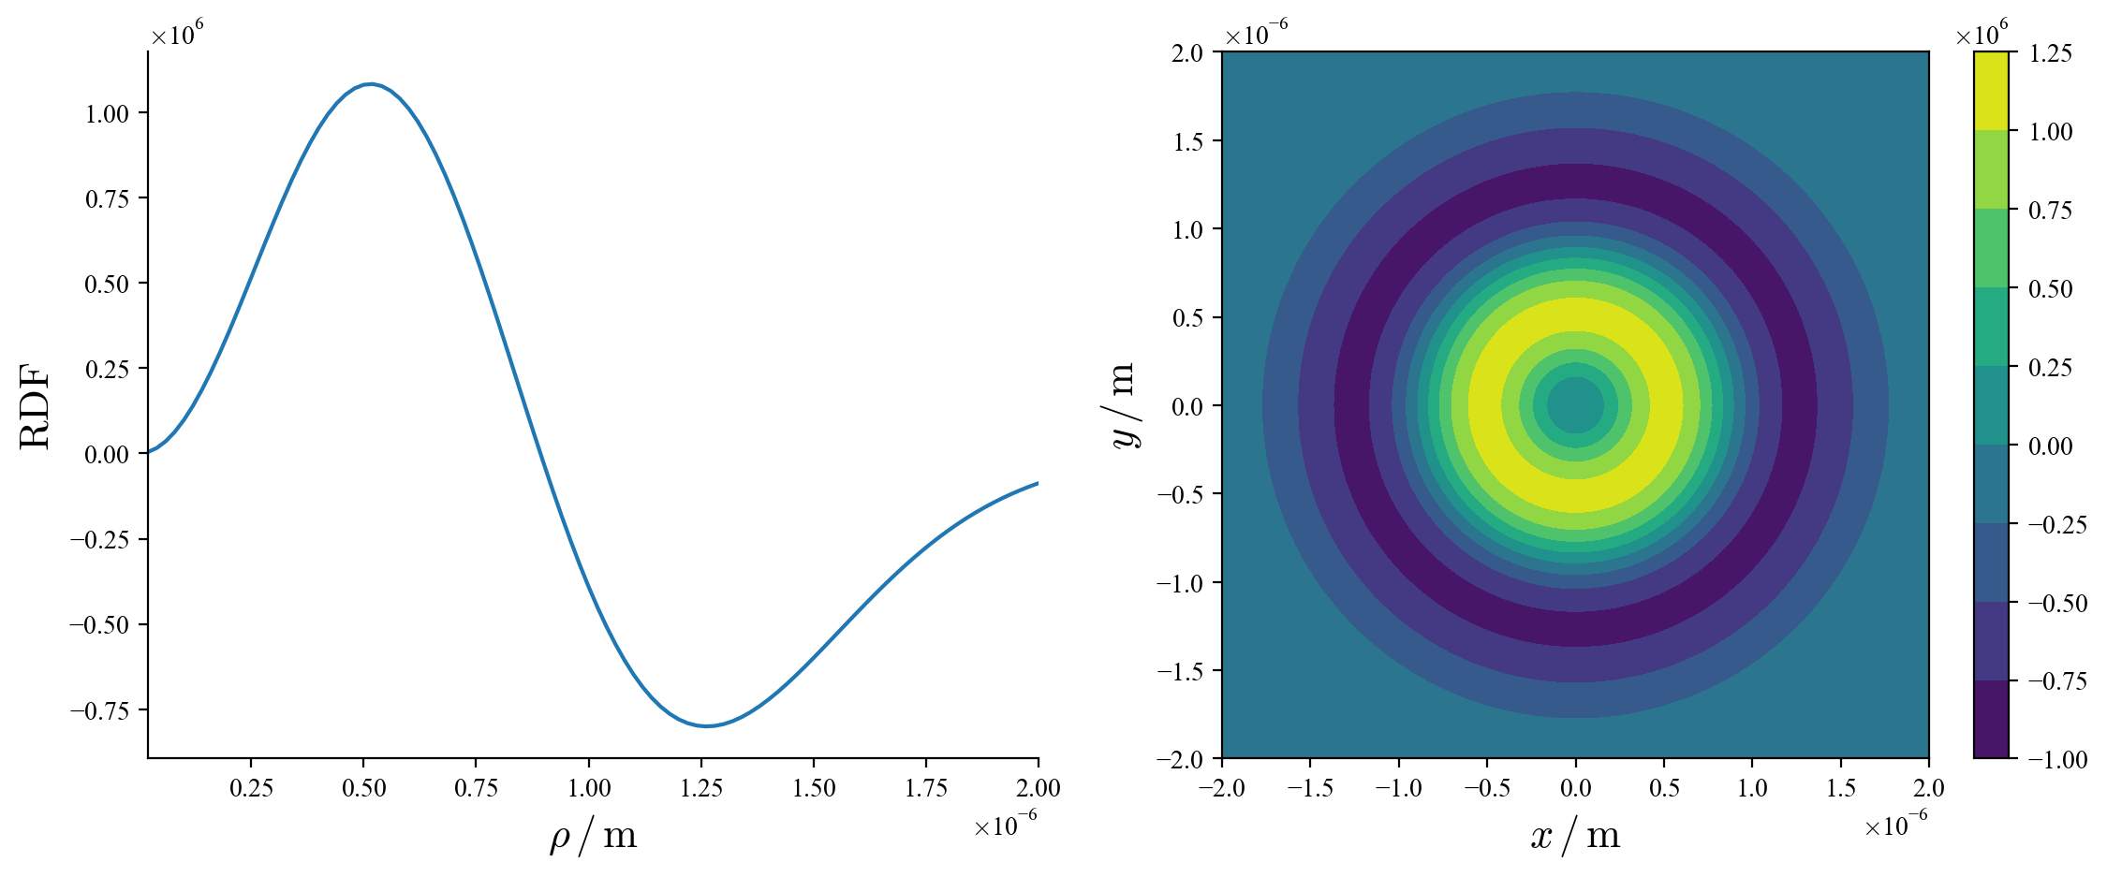
Radial Distribution function
w₀ = 729 nm, p = 1, ℓ = ±2.

Slide 10
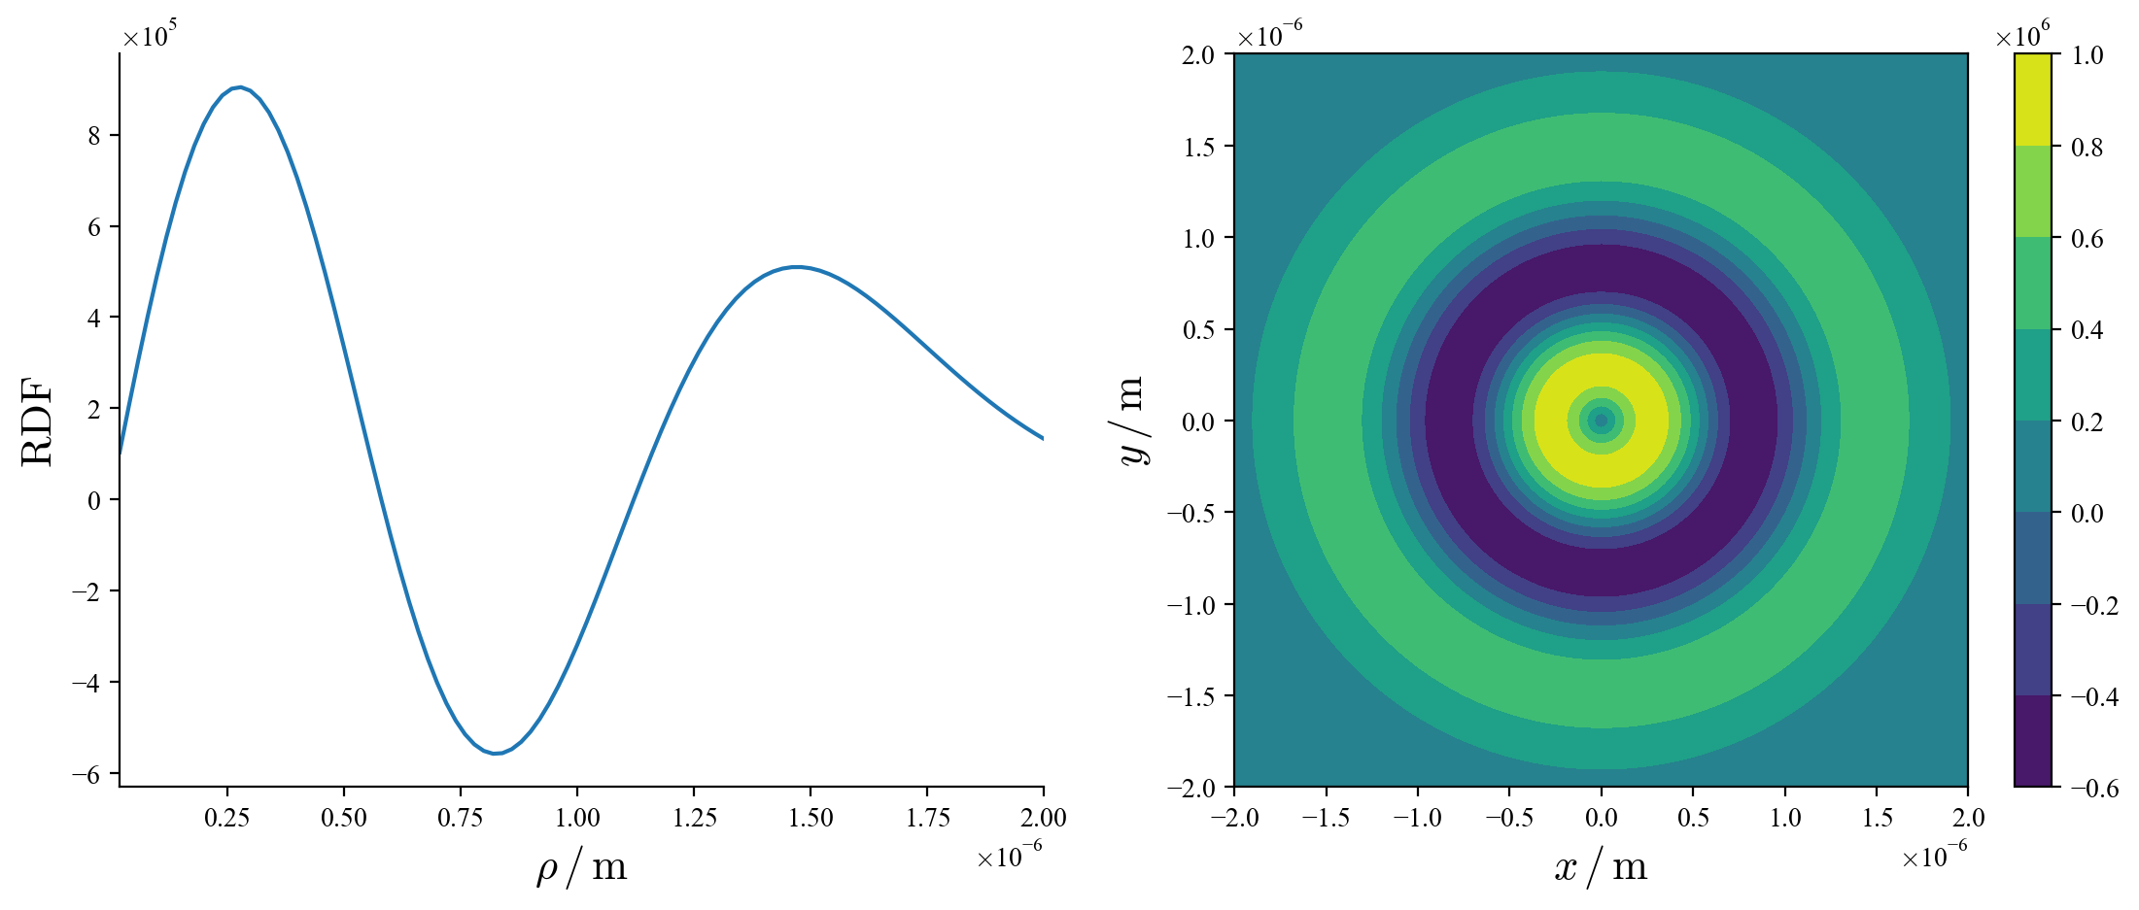
Radial Distribution function
w₀ = 729 nm, p = 2, ℓ = ±1.

Slide 11
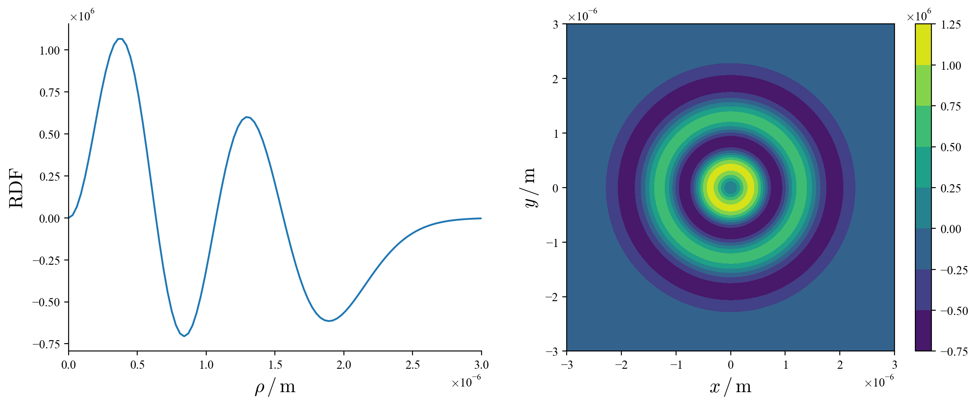
Radial Distribution function
w₀ = 729 nm, p = 3, ℓ = ±2.
Notes:
Intensity is proportional to amplitude squared. There should be p+1 crests and troughs.

Slide 12
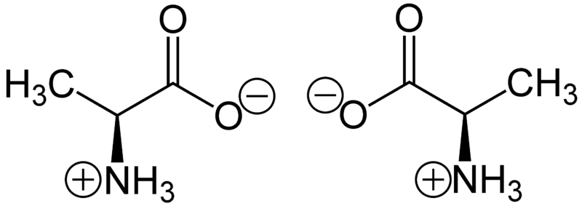
Circular Vortex Dichroism
Chiral molecules are molecules whose mirror images are not superimposable, and absorb light differently, depending on the light:
having SAM, in circular dichroism (CD);
having OAM, in vortex dichroism (VD);
In conjunction, circular vortex dichroism (CVD).
By using perturbative QED methods, the difference in absorption rates can be theoretically calculated.
Notes:
Chiral molecules (also optically active). Superimposable - able to turn one mirror image into the other by means of rotation or translation. Molecule is Alanine, an amino acid.

Slide 13
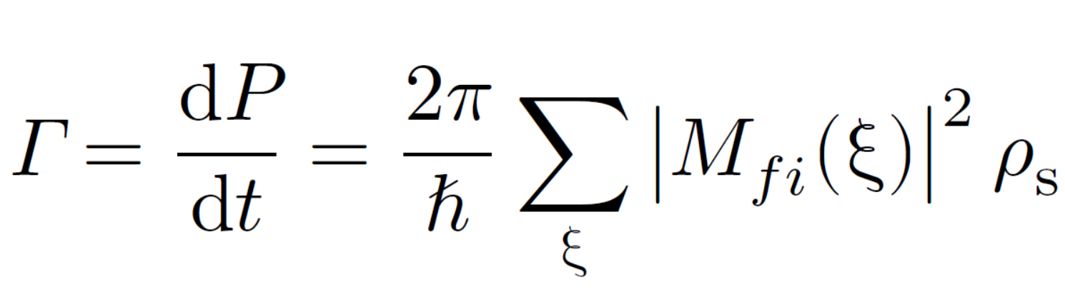
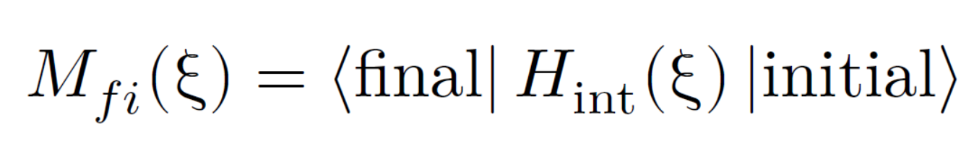
Circular Vortex Dichroism
The Fermi Golden rule,
The matrix element,
The interaction Hamiltonian,
Notes:
FGR, an expression equal to the rate of transition probability per unit time. In perturbation theory, the interaction Hamiltonian is considered the perturbation.

Slide 14
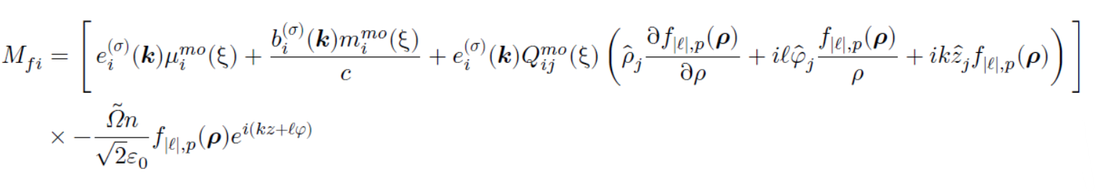
Circular Vortex Dichroism
Electric dipole E1, magnetic dipole M1, electric quadrupole E2

Slide 15
Circular Vortex Dichroism
When squaring with 3 terms, we get 9 couplings.
Important couplings are:
E1M1: Leading term of circular dichroism
E1E2: Leading term of vortex dichroism
E2E2: Has no chiroptical influence in standard VD/CVD, but could interact with polarization
The E1E2 and E2E2 couplings are computationally analysed and graphed.

Slide 16
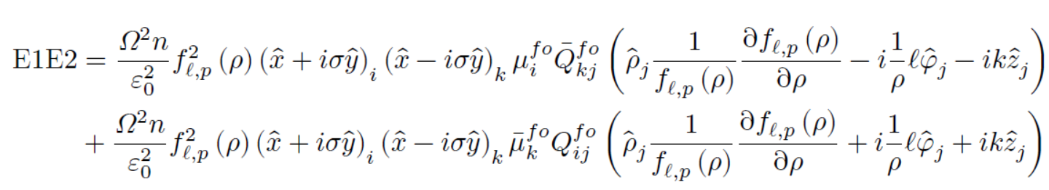
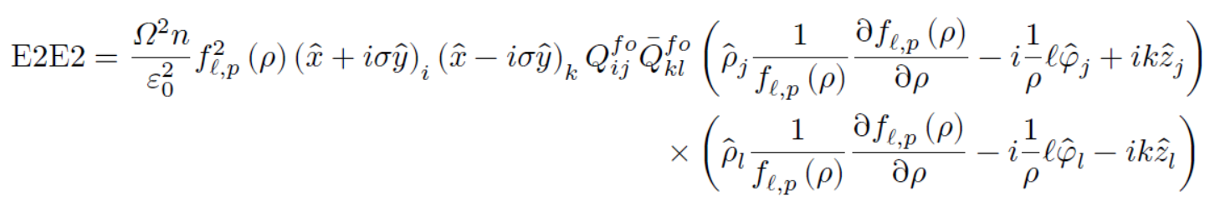
Circular Vortex Dichroism
Radial distribution function

Slide 17
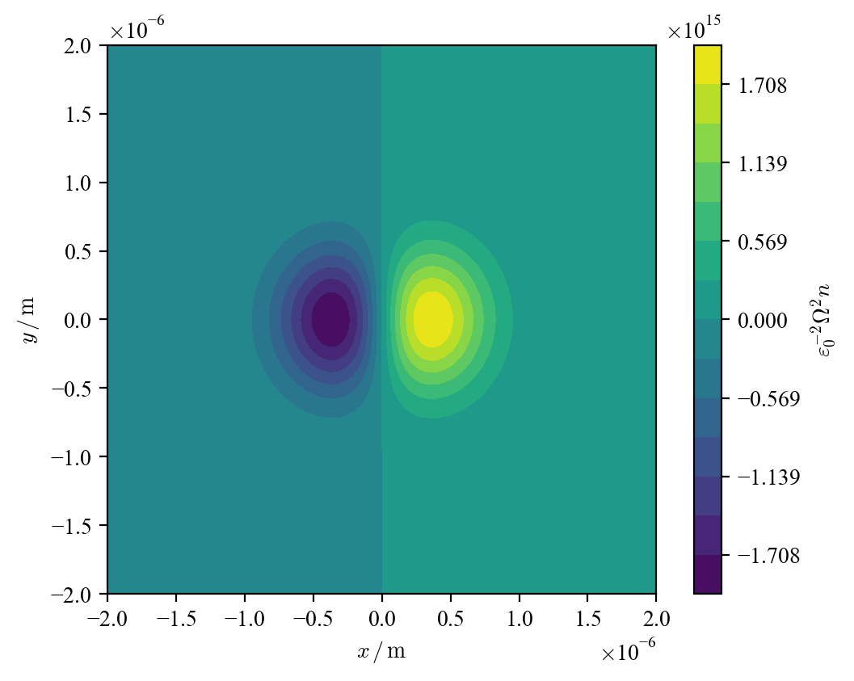
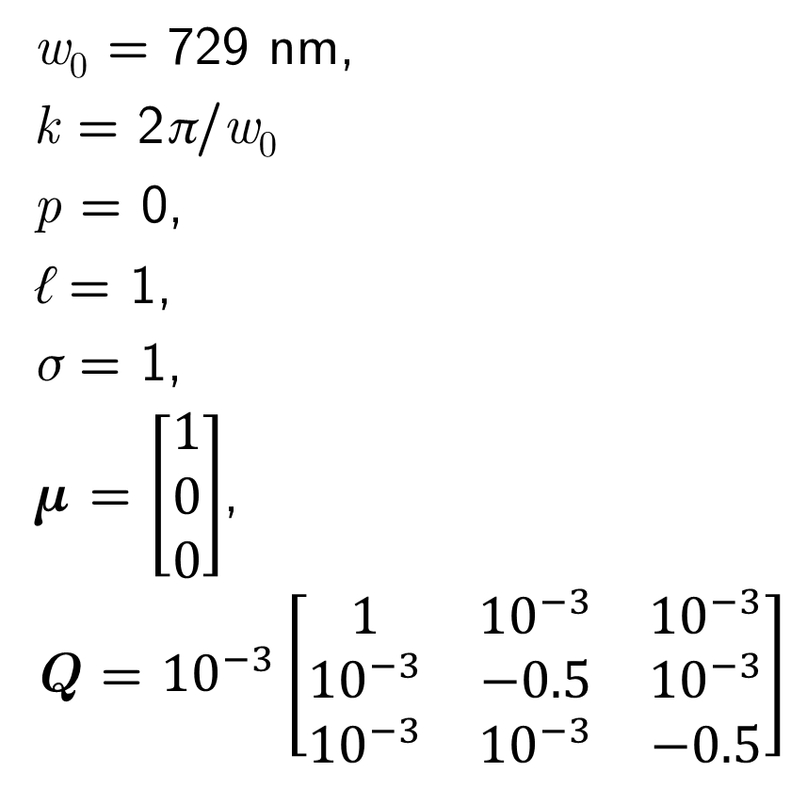
E1E2 couplings
w₀ = 729 nm,
k = 2π/w₀
p = 0,
ℓ = 1,
σ = 1,
μ = $\left[\begin{matrix}1 \\ 0 \\ 0\end{matrix}\right]$,
Q = ${10}^{−3}\left[\begin{matrix}1 & {10}^{−3} & {10}^{−3} \\ {10}^{−3} & −0.5 & {10}^{−3} \\ {10}^{−3} & {10}^{−3} & −0.5\end{matrix}\right]$
Notes:
Methodology, code. Prepare for next 2 slides

Slide 18
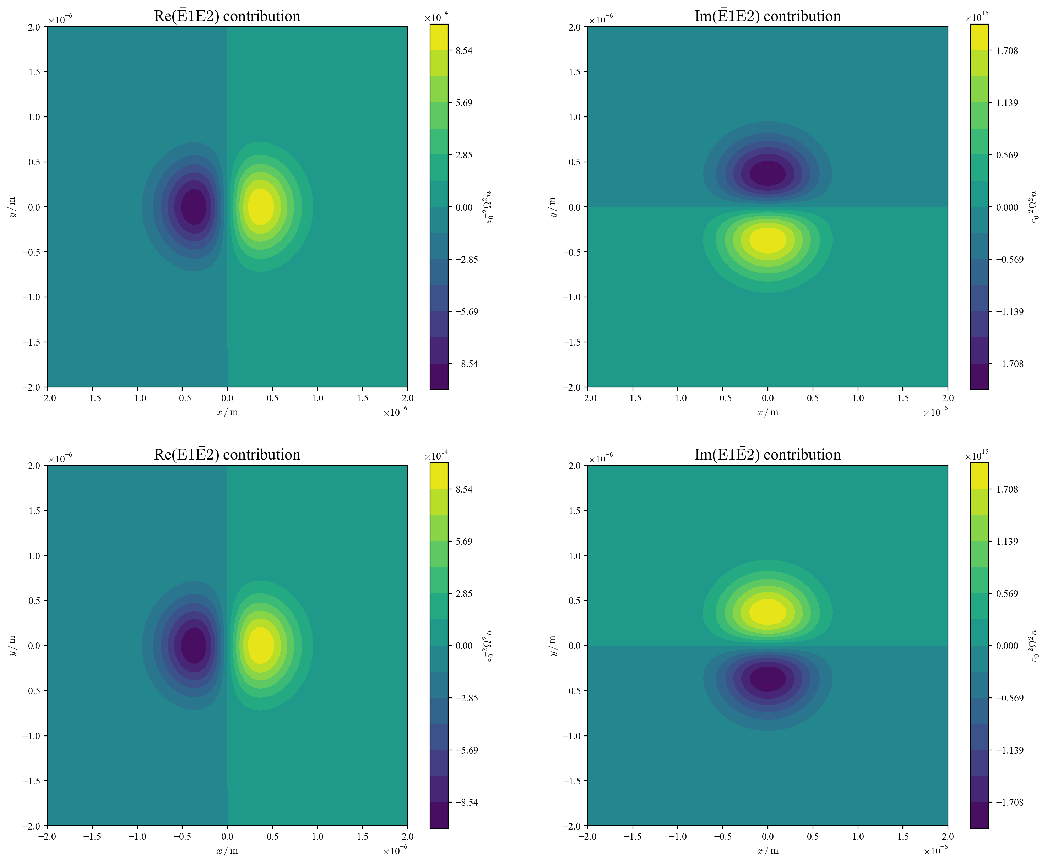
E1E2 = E1E2
+ E1E2
Coupling is
always real

Slide 19
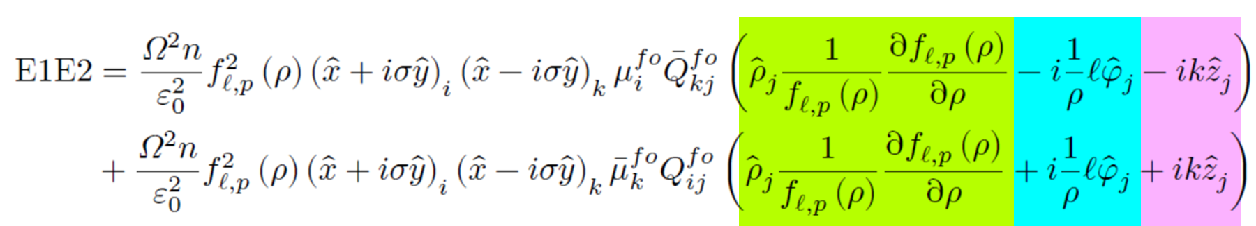
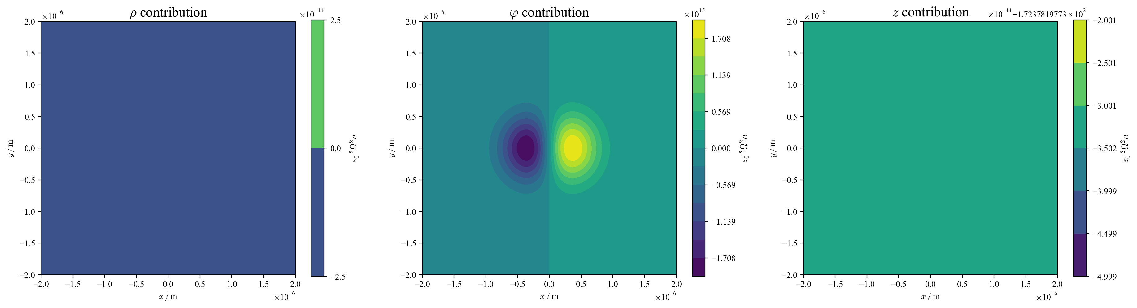

Slide 20
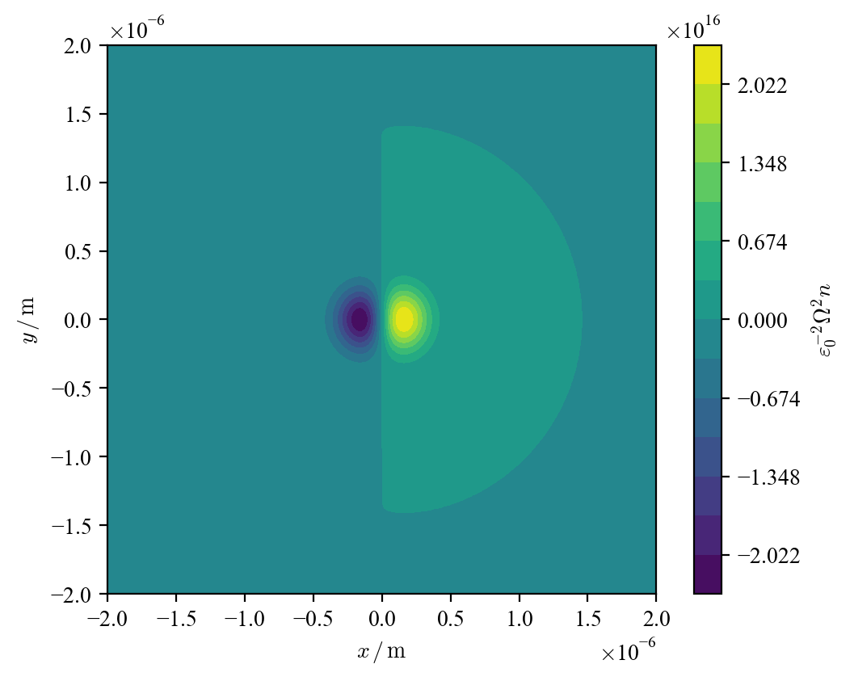
E1E2 couplings
w₀ = 729 nm
w₀ = 320 nm

Slide 21
E1E2 couplings
k = 2π/w₀
k = 20π/w₀

Slide 22
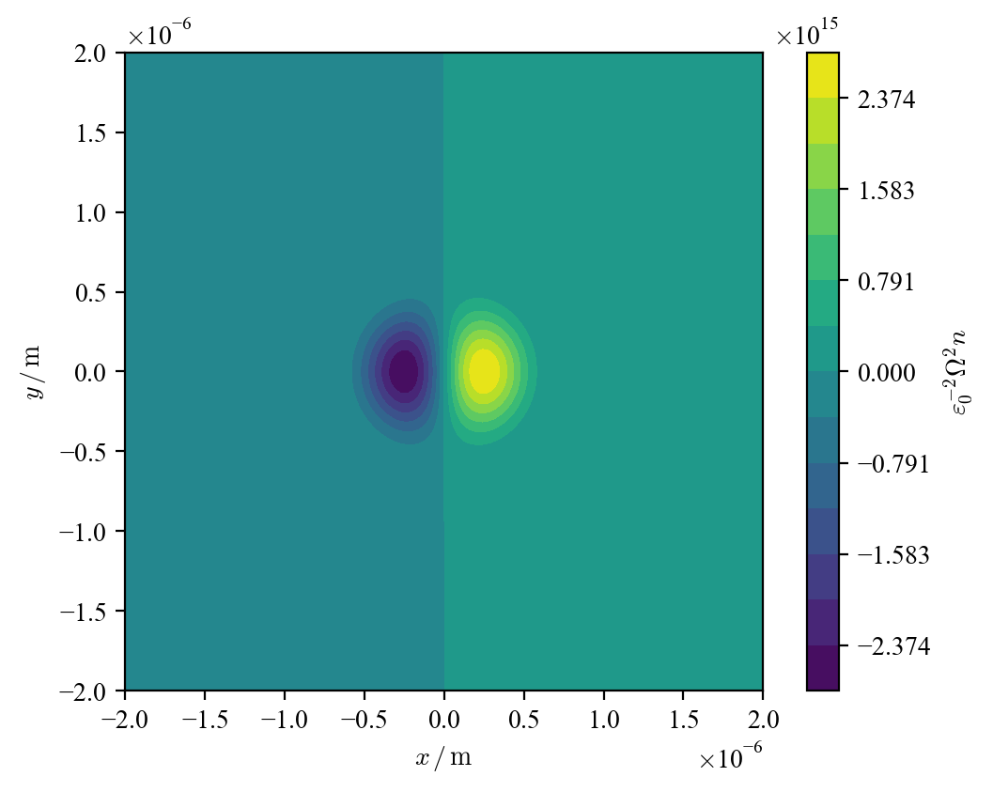
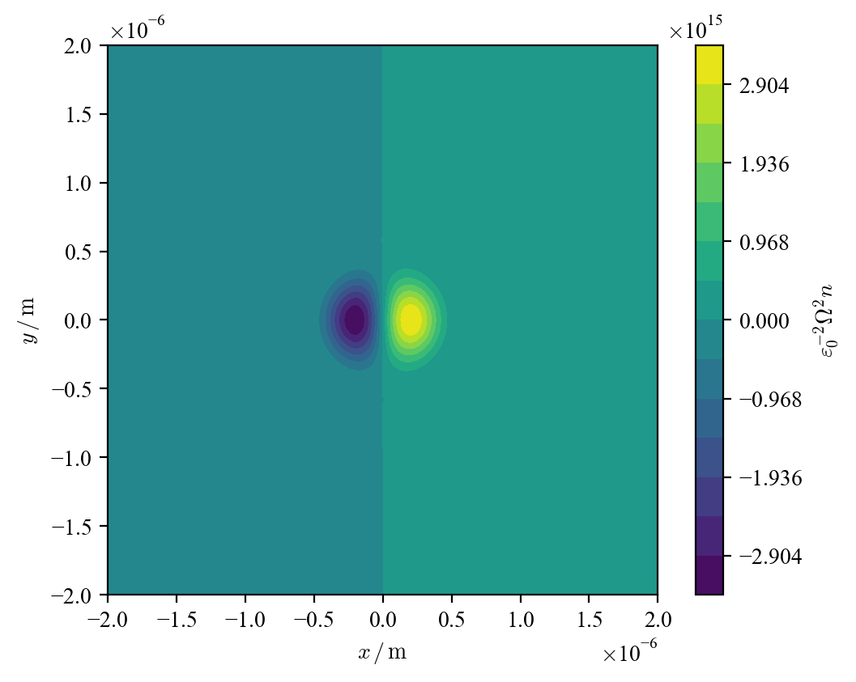
E1E2 couplings
p = 0
p = 1
p = 2

Slide 23
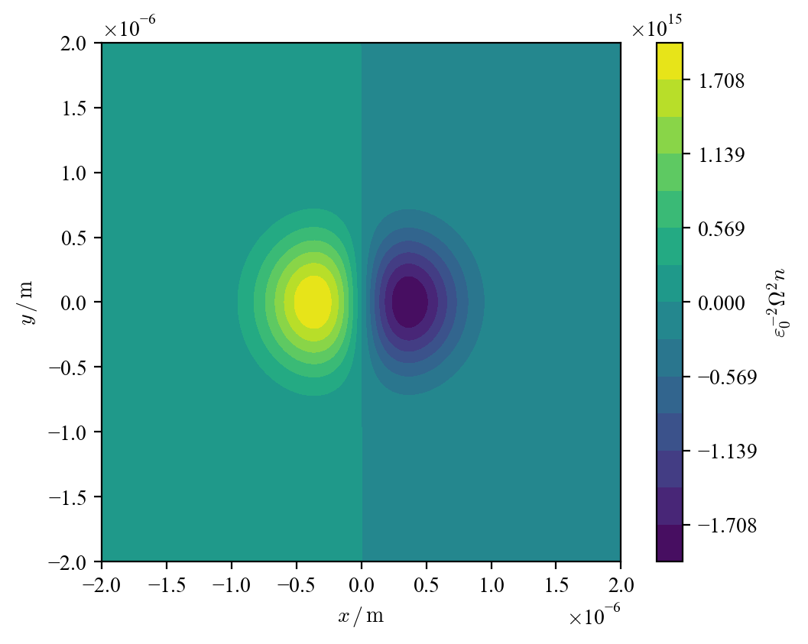
E1E2 couplings
σ = 1
σ = −1
Notes:
Chiroptic effect

Slide 24
E1E2 couplings
ℓ = 1
ℓ = −1
Notes:
Chiroptic effect

Slide 25
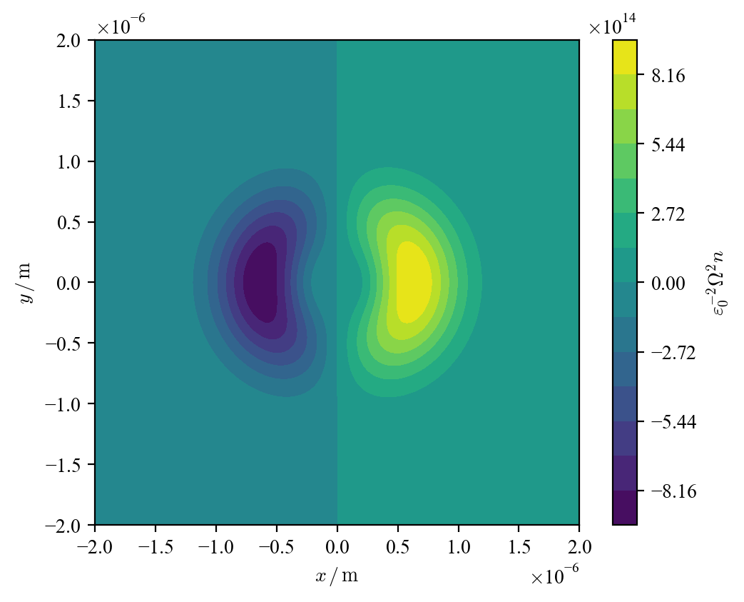
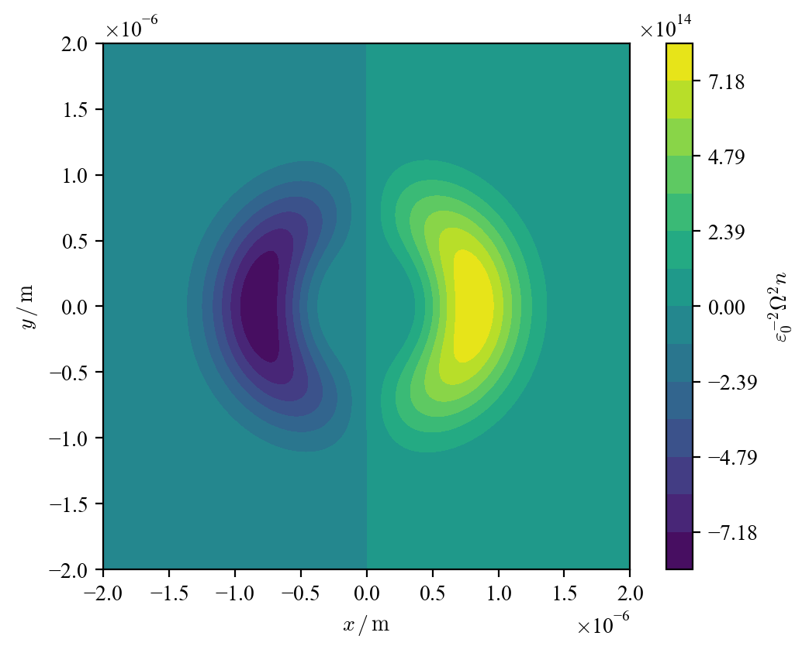
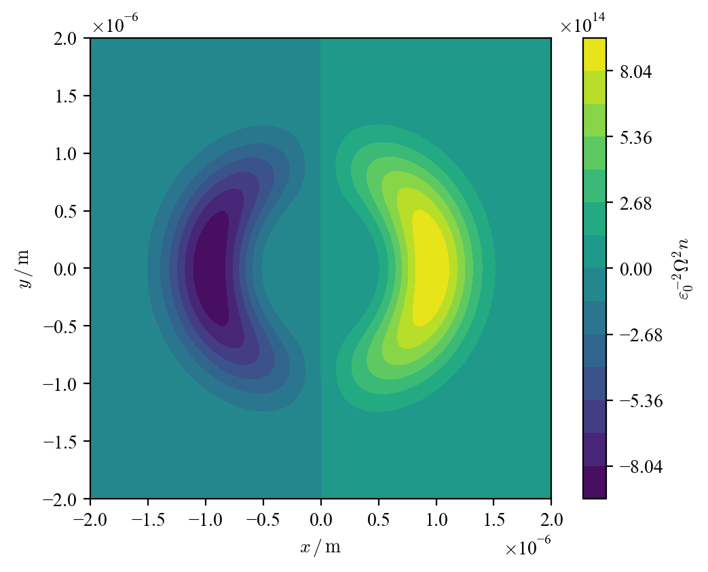
E1E2 couplings
ℓ = 2
ℓ = 4
ℓ = 3

Slide 26
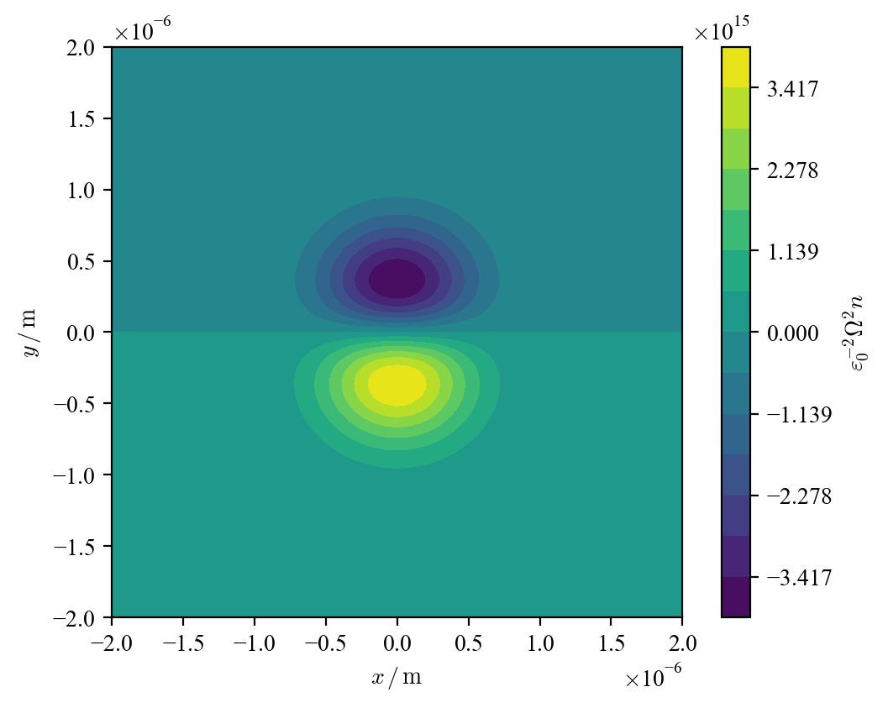
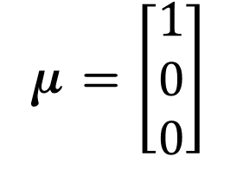
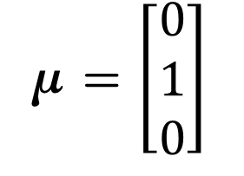
E1E2 couplings
μ = $\left[\begin{matrix}1 \\ 0 \\ 0\end{matrix}\right]$
μ = $\left[\begin{matrix}0 \\ 1 \\ 0\end{matrix}\right]$

Slide 27

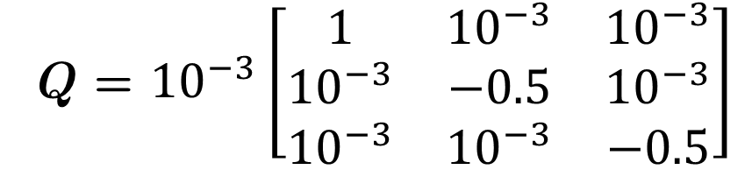
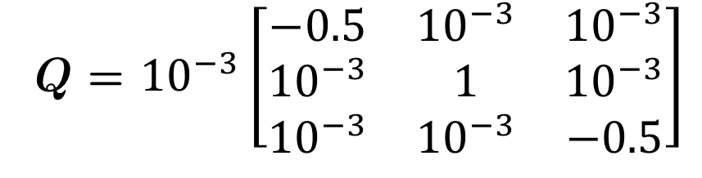
E1E2 couplings
Q = ${10}^{−3}\left[\begin{matrix}1 & {10}^{−3} & {10}^{−3} \\ {10}^{−3} & −0.5 & {10}^{−3} \\ {10}^{−3} & {10}^{−3} & −0.5\end{matrix}\right]$
Q = ${10}^{−3}\left[\begin{matrix}−0.5 & {10}^{−3} & {10}^{−3} \\ {10}^{−3} & 1 & {10}^{−3} \\ {10}^{−3} & {10}^{−3} & −0.5\end{matrix}\right]$

Slide 28
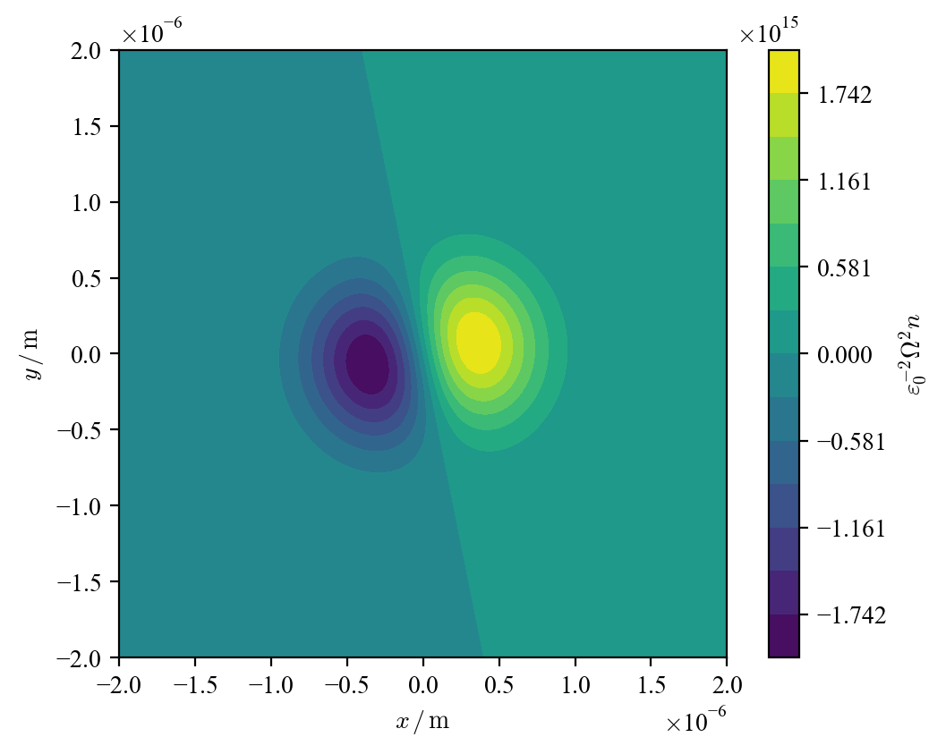
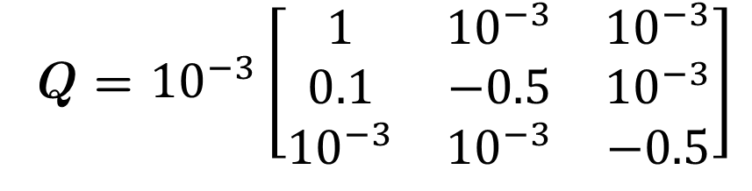
E1E2 couplings
Q = ${10}^{−3}\left[\begin{matrix}1 & {10}^{−3} & {10}^{−3} \\ {10}^{−3} & −0.5 & {10}^{−3} \\ {10}^{−3} & {10}^{−3} & −0.5\end{matrix}\right]$
Q = ${10}^{−3}\left[\begin{matrix}1 & {10}^{−3} & {10}^{−3} \\ 0.1 & −0.5 & {10}^{−3} \\ {10}^{−3} & {10}^{−3} & −0.5\end{matrix}\right]$

Slide 29
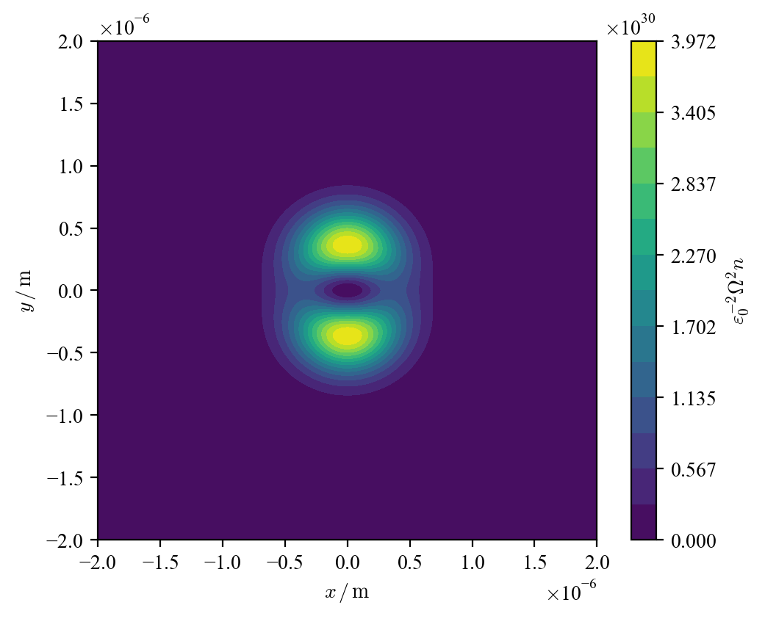
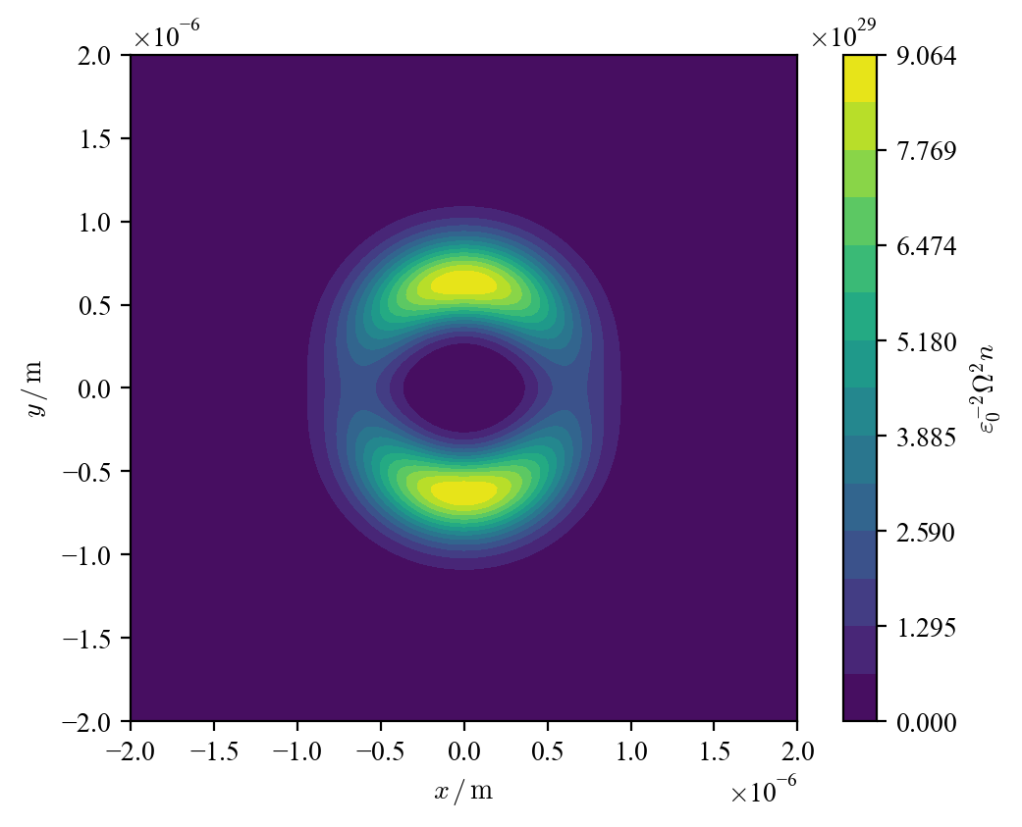
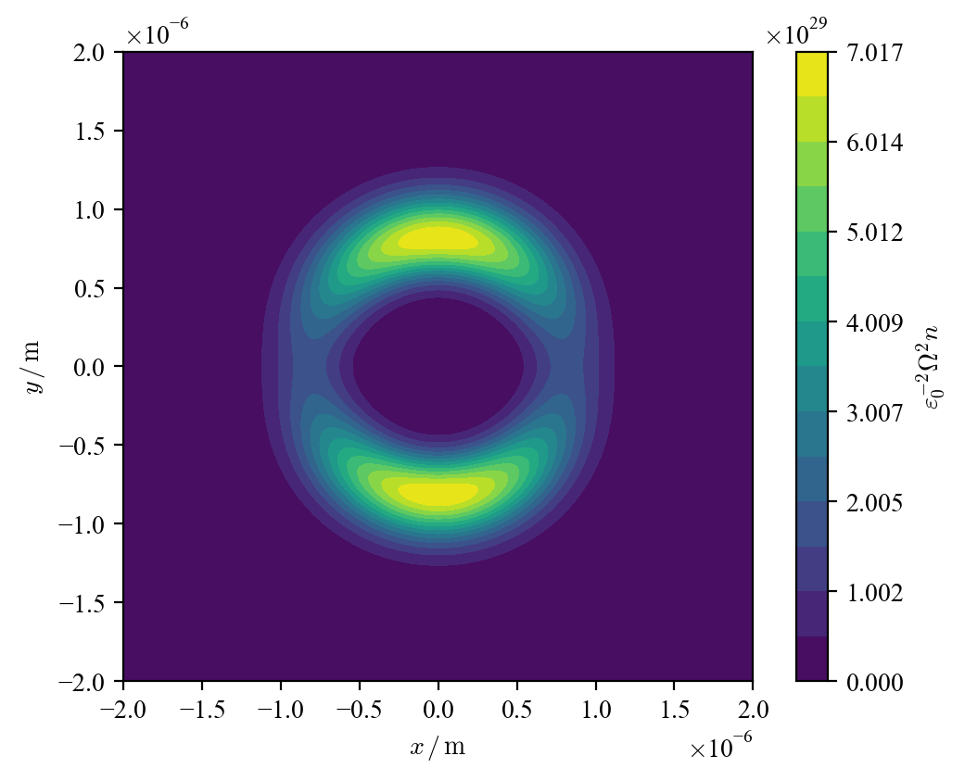
E2E2 couplings
ℓ = 1
ℓ = 3
ℓ = 2

Slide 30
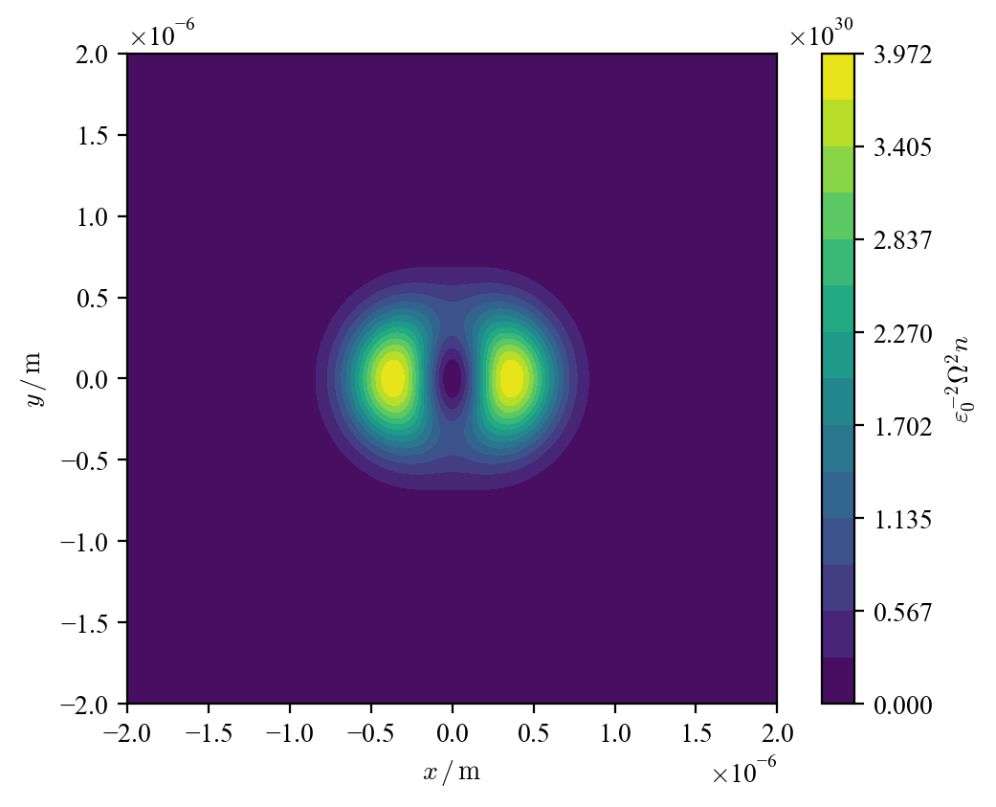
E2E2 couplings
Q = ${10}^{−3}\left[\begin{matrix}1 & {10}^{−3} & {10}^{−3} \\ {10}^{−3} & −0.5 & {10}^{−3} \\ {10}^{−3} & {10}^{−3} & −0.5\end{matrix}\right]$
Q = ${10}^{−3}\left[\begin{matrix}−0.5 & {10}^{−3} & {10}^{−3} \\ {10}^{−3} & 1 & {10}^{−3} \\ {10}^{−3} & {10}^{−3} & −0.5\end{matrix}\right]$

Slide 31
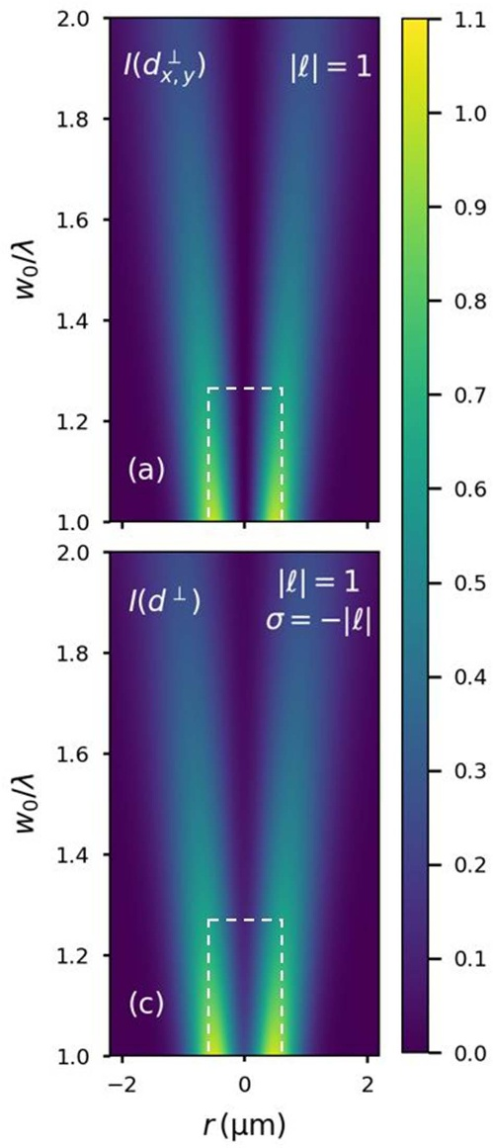
Longitudinal ﬁ elds
In the calculation, we assumed the beam is fully transverse.
When we consider polarization in the direction of propagation, we encounter additional terms, viz. a longitudinal ﬁeld.
By including this, VD terms appear in the E1M1 coupling, and in beams with plane polarization.
The E1E2 and E2E2 couplings become mathematically more complex and are different to purely paraxial fields seen before.

Slide 32
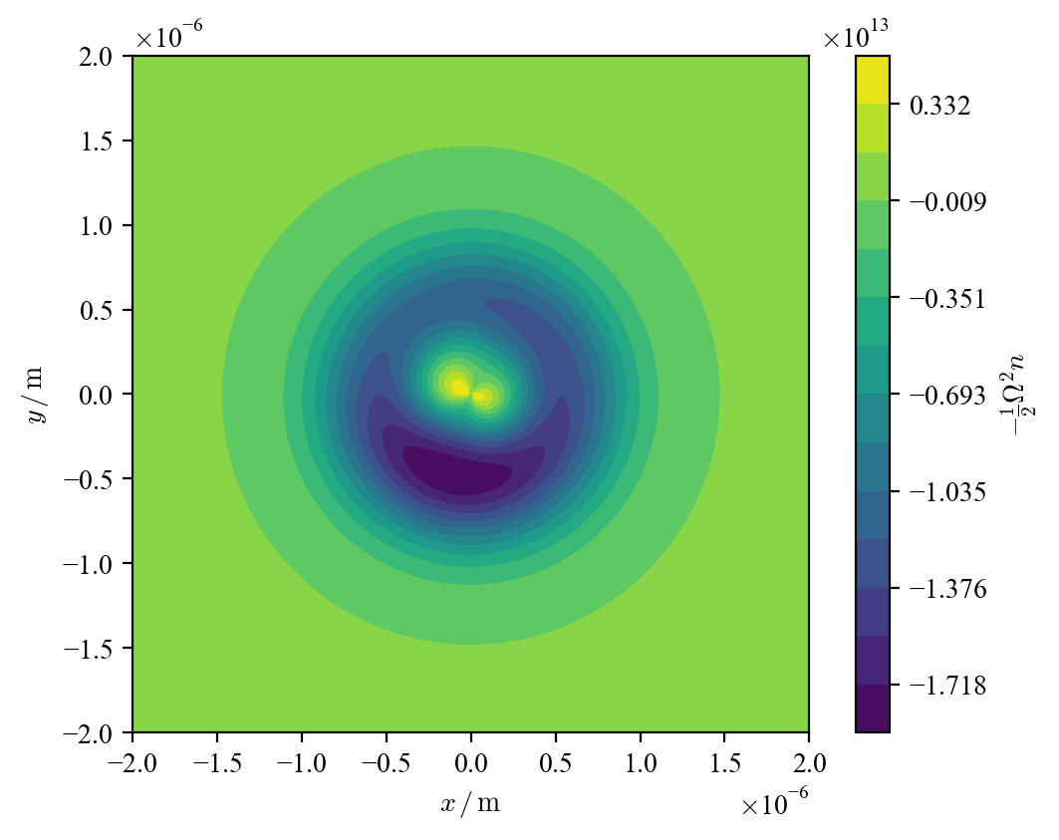
E1E2 couplings
Paraxial
Non-Paraxial

Slide 33
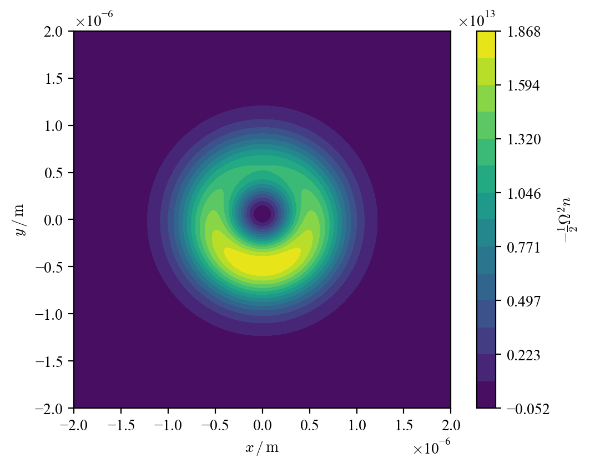
E1E2 couplings
Paraxial
Non-Paraxial
σ = −1
σ = −1

Slide 34

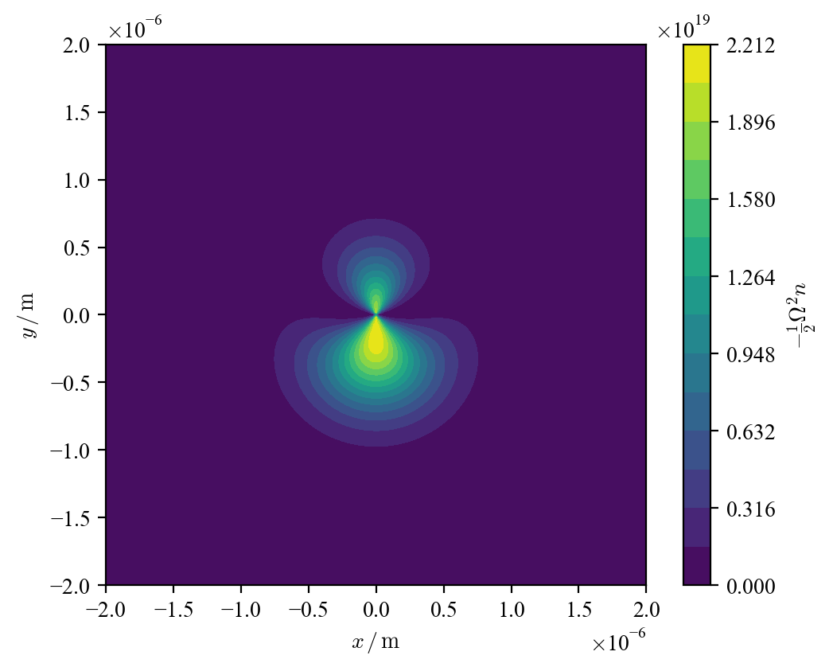
E2E2 couplings
Paraxial
Non-Paraxial
k = 2000π/w₀
k = 2000π/w₀

Slide 35
Conclusion
Chiroptical contributions to the transition rate can be theoretically analysed using QED
Investigation into this analysis can be done using computational visualization
There are some unexplained properties with regards to the graphs of the non-paraxial/longitudinal fields
The topic can be expanded upon by investigation into other couplings, e.g., M1E2.
Notes:
There is still ongoing development with OAM in light, VD and CVD.

