Slide 1

Creation of a Graphical User Interface for the Analysis of Quantum Dynamics Simulations
Scientific Computing Individual Research Project PHAS0077
James (Wenzhao) Jia

Slide 2
Structure of the presentation
What is a quantum dynamics simulation?
Performing a quantum dynamics simulation in Quantics
Demonstration: Analysis in Quantics (without a GUI)
Aims of the project
Using the GUI’s analysis framework
Animated and contour plots
Usability design
Demonstration: Analysis in Quantics (with a GUI)
Limitations and conclusion

Slide 3
Quantum Dynamics Simulations
The behaviour of molecular systems are governed by quantum mechanics.
Processes at the molecular scale also often happen at a very fast timescale.
Experiments concerning these processes usually require accompanying simulations for interpretation.
A quantum dynamics simulation can be divided into three parts:
Set up initial Ψ(t₀) and parameters for propagation
Propagate Ψ(t₀) to Ψ(t.) and output information at each step
Analyse information

Slide 4
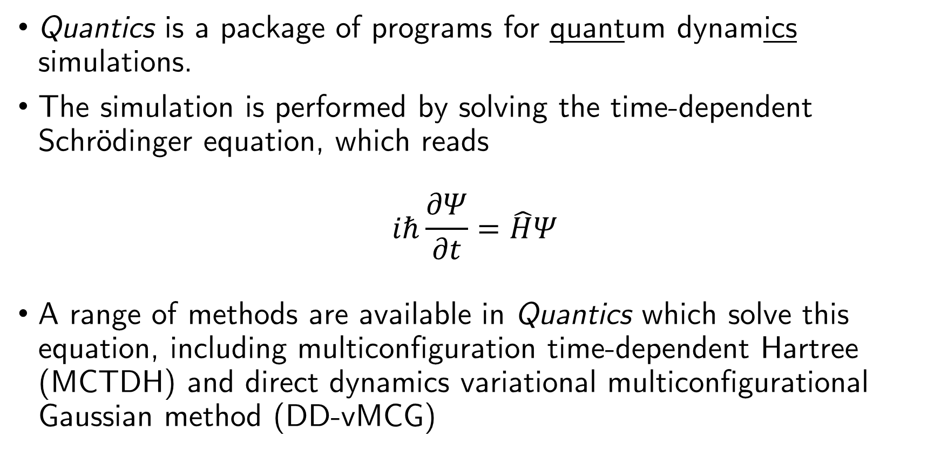
QUANTICS Suite
Quantics is a package of programs for quantum dynamics simulations.
The simulation is performed by solving the time-dependent Schrödinger equation, which reads
$$iℏ\frac{∂Ψ}{∂t}=\hat{H}Ψ$$
A range of methods are available in Quantics which solve this equation, including multiconfiguration time-dependent Hartree (MCTDH) and direct dynamics variational multiconfigurational Gaussian method (DD-vMCG)

Slide 5
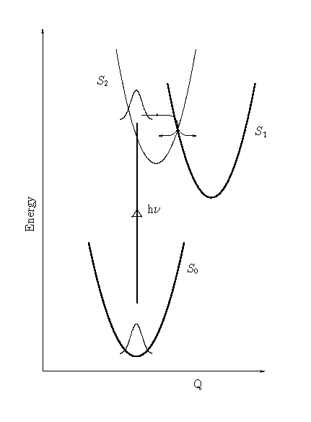
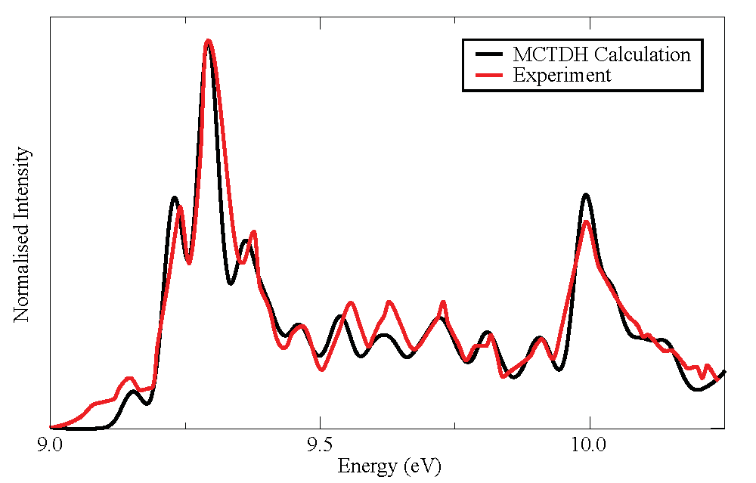
Butatriene absorption spectrum
Demonstration: https://youtu.be/mLO-WQW89uM

Slide 6
Improving the current pipeline
Would be much better if the command line interface (CLI) is not used at all!
Aim of the project is to develop a graphics user interface (GUI) to replace the use of the CLI
Quantics output
Existing analysis programs
Analysis output file
gnuplot
Analysis GUI
Call
Read

Slide 7
PyQt
PyQt is a cross-platform Python framework for creating GUIs.
Objects in the GUI are called “widgets” and are represented as instances of a class in the code.
Inheritance can add functionality to an existing class or change its behaviour.

Slide 8
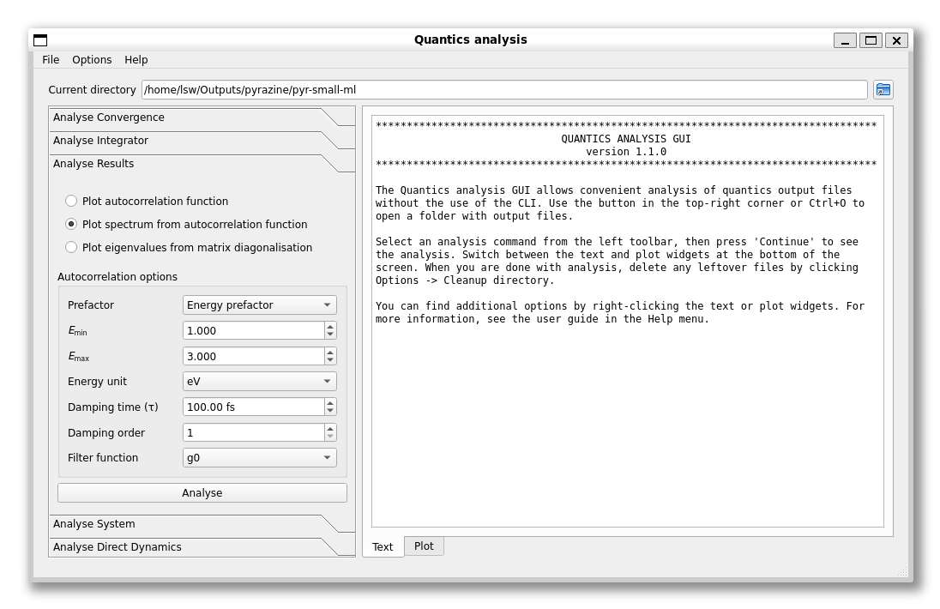
PyQt
QLineEdit

Slide 9
PyQt
QToolButton
QPushButton

Slide 10
PyQt
QDoubleSpinBox

Slide 11
PyQt
CustomTextWidget
(inherited from QPlainTextEdit)

Slide 12
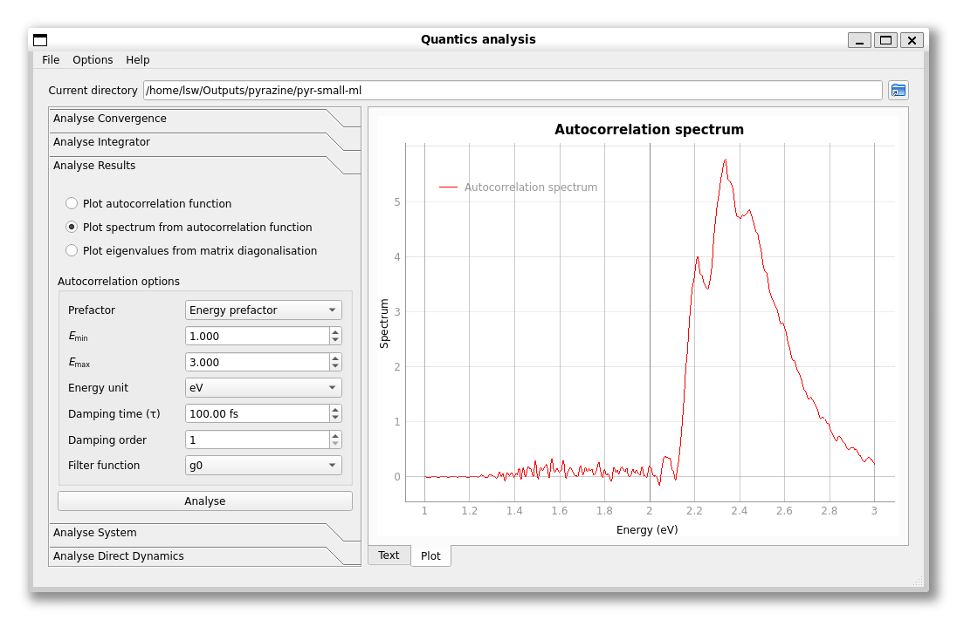
PyQt
CustomPlotWidget
(inherited from pyqtgraph’s PlotWidget)

Slide 13
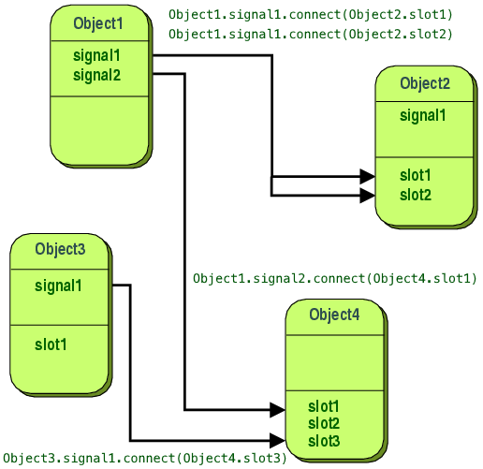
Signals and slots
A signal is emitted from a widget/object when it is interacted with in some way (e.g., button is pressed).
A slot is a function that is called when the corresponding signal is emitted.
Connections can be made to link signals and slots together.

Slide 14
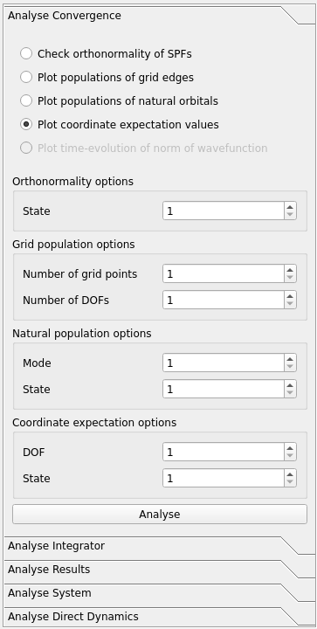
The analysis framework
AnalysisTab class created that represents one of tabs in the GUI.
Analysis programs in the CLI represented by analysis methods in a class inheriting from AnalysisTab.
Parameters to the program represented by widgets in a parameter container.
AnalysisTab class sets up functionality like
the method to call for each button,
the container to show for each button,
greying out “Analyse” for missing files

Slide 15
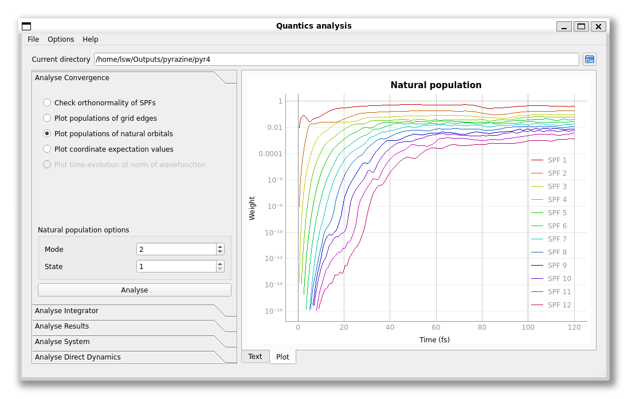
Analysis method example
rdcheck natpop 2 1

Slide 16
Animated plots
Animated plots are possible with the aid of the MediaWidget, which contains functionality to play, pause, and select timeframe.
The “scrubber” can be connected to a slot which can change the data in the plot widget
Animated plot can be saved to an .mp4 file by saving each frame as an image and combining using FFmpeg command
scrubber_pos = int(self.window().media.scrubber.value())
line1, line2 = self.window().plot.listDataItems()
line1.setData(self.window().data[scrubber_pos][:, 0],
self.window().data[scrubber_pos][:, 1])

Slide 17
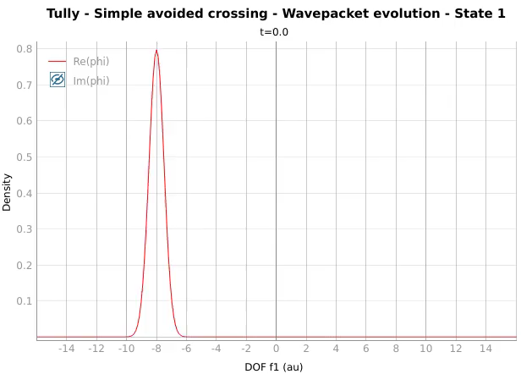
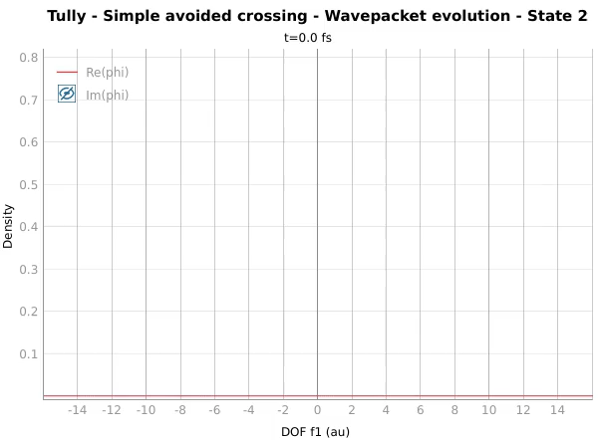
Scattering at an avoided crossing

Slide 18
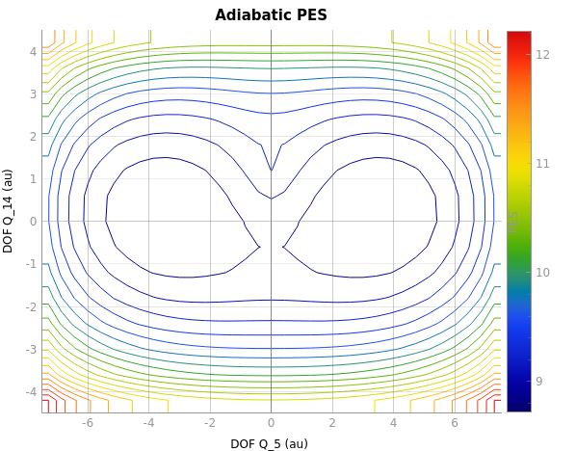
Contour plots
Contour plots not a built-in method in pyqtgraph, must implement manually
There is functionality to plot an isocurve (one contour line) however
Can use this to create a custom method that creates a contour plot
Animated contour plots also possible

Slide 19
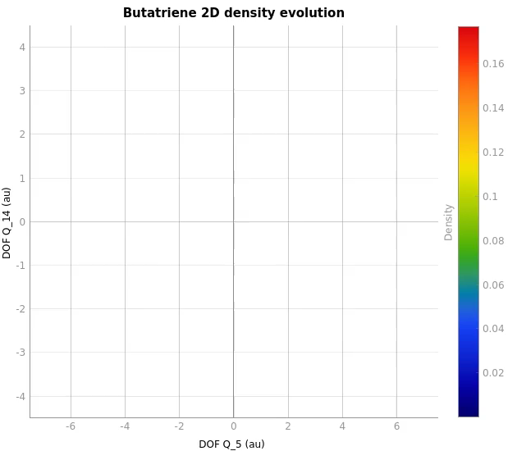
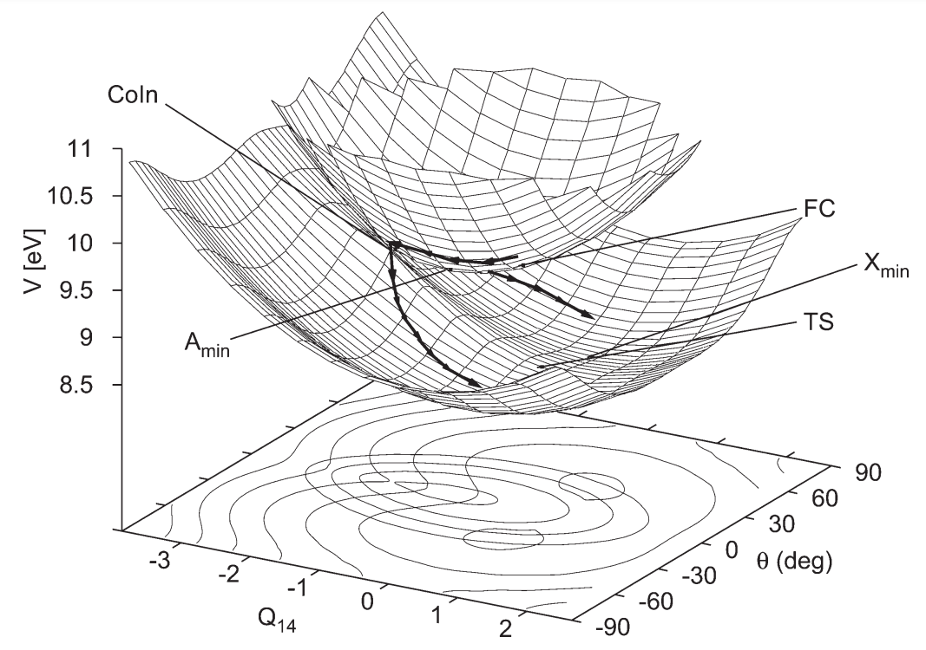
Bifurcation at a conical intersection

Slide 20
Usability Design
Is the GUI more usable than the CLI?
Demonstration: https://youtu.be/8RkOl0hXPwc
Effectiveness: how well users can do a task without getting stuck
Names of analysis programs do not need to be known
Parameters/inputs of analysis programs do not need to be known
Efficiency: how much effort needs to be expended to do a task
Plots are shown inside the GUI rather than in a pop-up window
Objects can be clicked on rather than typing in commands
Satisfaction: how comfortable the user feels when doing a task
Can be evaluated with a survey (but not enough people were able to respond for an analysis)

Slide 21
Limitations
3D plots such as surface plots not implemented—pyqtgraph has functionality for them but doesn’t work on my machine
Not all analysis programs in Quantics can be implemented in the GUI—there are far too many of them
Problems with the existing analysis programs will cause problems with the Python GUI
May be faster if Fortran arrays can be accessed directly from RAM rather than write to disk then read from disk—can be done using NumPy’s F2Py

Slide 22
Summary
A GUI that performs analysis for the Quantics package was developed
This GUI can be created in Python using PyQt (and pyqtgraph for plotting)
An analysis framework was created to make integrating analyses easier (with AnalysisTab)
We covered animated and contour plots in the GUI with examples
We explained how the GUI is more “usable” than the command line interface
Some limitations of the program were discussed

Slide 23
Any questions?

