Slide 1
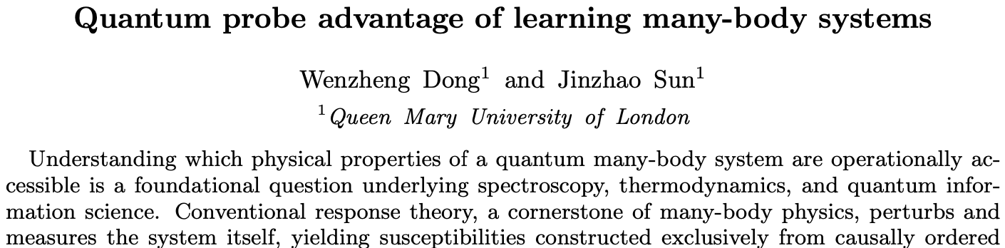

Slide 2
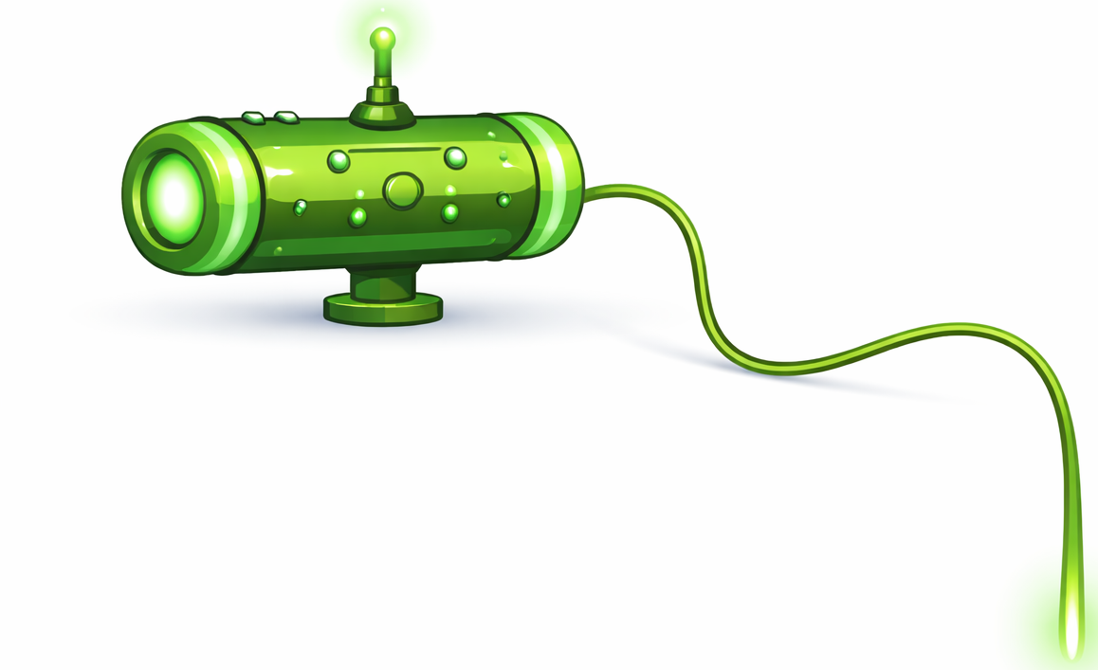
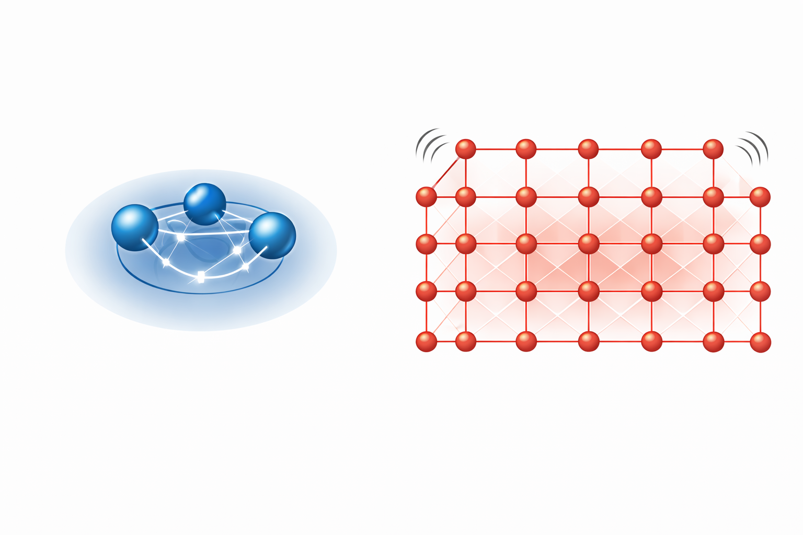

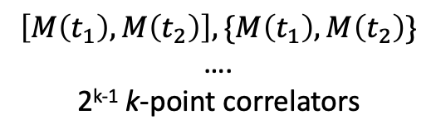
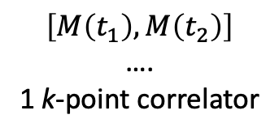
(a)
(b)
many-body system (M)
quantum probe (P)
many-body system (M)
$$\left[M\left(t_{1}\right),M\left(t_{2}\right)\right]$$
….
1 k-point correlator
$$\left[M\left(t_{1}\right),M\left(t_{2}\right)\right], \{M\left(t_{1}\right),M\left(t_{2}\right)\}$$
….
2^{k-1} k-point correlators

Slide 3






$$e^{−i H_{M}t}$$
m₃
$$\{\left\{M_{m3}\left(t1\right),M_{m2}\left(t2\right)\right\}±,M_{m2}\left(t3\right)\}±$$
$$ρ_{M}$$
m₂
m₁
(always-on P-M
coupling)
Open quantum system dynamics
q₁
$$ρ_{P}$$
q₂
{ $\left\langle O(T)\right\rangle ρ_{P}$ }
t₁
t₂
t₃

Slide 6
