Slide 1
Week 3_12 Spatial Regressions
CRP 3850/5850
Yujin Hazel Lee
Wenzheng Li

Slide 2
Objectives
Introduce new spatial terms
Learn different types of spatial models and their use
Run regressions for different models

Slide 3
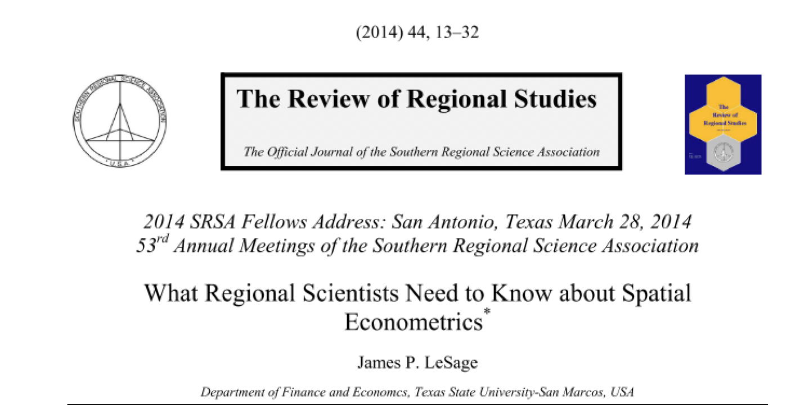

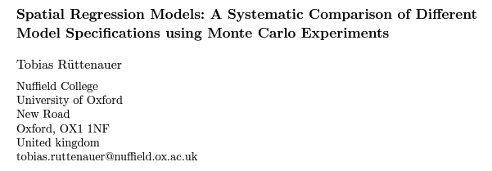
Highly Recommended Readings
Lesage, J., 2014. What Regional Scientists Need to Know about Spatial Econometrics
Chi and Zhu, 2008. Spatial Regression Models for Demographic Analysis
Ruttenauer, T., 2019. Spatial Regression Models: A Systematic Comparison of Different Model Specifications Using Monte Carlo Experiments

Slide 4
RECAP
Spatial Weights – contiguity/ distance-based/block weight/ Kernel matrices
Spatial Autocorrelation – Global Moran’s I, LISA map
Linear Regressions - OLS, Interpreting results
Spatial Regressions

Slide 5
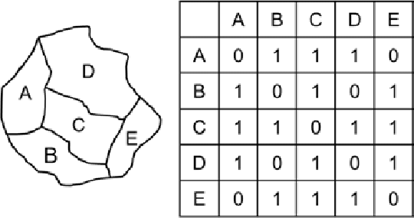
What is a Spatial Lag?
In linear regressions, a ‘lag’ shifts the variable by one or more periods in time
The ‘spatial lag operator’ (Wy or Wx or Wu) relates a variable at one point in space to the observation for that variable in other spatial units in the system
We assume that the values in one unit are indirectly influenced by the values found in the neighbors

Slide 6

Spatial Characteristics and Terminology
Spatial Dependence (= Spatial Autocorrelation) – lack of independence between observations - it relates to the characteristics of the observations in the dataset (i.e. distance)
Spatial Heterogeneity – lack of stability over space and the behavior of other relationships – geographical characteristics are considered as spatial heterogeneity
Spatial Regimes – aggregation of neighboring units that are homogenous in functional terms that “share the same relationship between a dependent variable and some covariates (i.e. urban/rural areas; coastal areas)

Slide 7
What is a Spatial Regression?
Assumes that spatial diffusion affects the choices and behavioral patterns of regions - adding spatially weighted variables into the regression
Based on the idea that social events are not simply an artifact of observed and unobserved variables, there’s a spatial component to understand neighbors’ behaviors
Depending on whether the dependent variable or independent variable is lagged, the name of the models will vary (taxonomically)
Spatial Regression is still a very new field, and is constantly developing

Slide 8
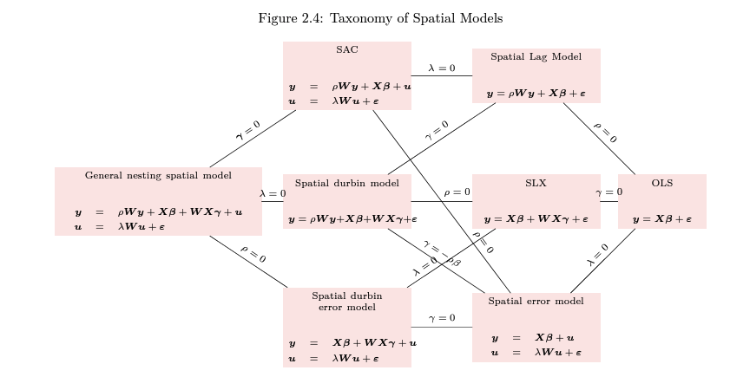
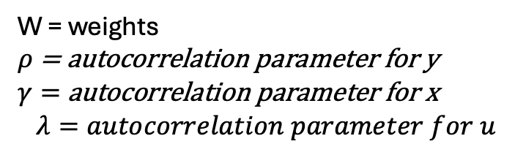
Taxonomy of Spatial Models
W = weights
$ρ$ = autocorrelation parameter for y
$γ=$ autocorrelation parameter for x
$$λ=autocorrelation parameter for u$$

Slide 9
Spatial Spillovers
Spatial Spillovers (Diffusion) results in Peer Effects (Indirect Effects)
The effect that neighboring regions gives to you, rather than characteristics of your own region
A
B
Y = Crime rate
X = Income, Education,
# of funds flowing to police, # of streetlights
Y = Crime rate
X = Income, Education,
# of funds flowing to police, # of streetlights

Slide 10
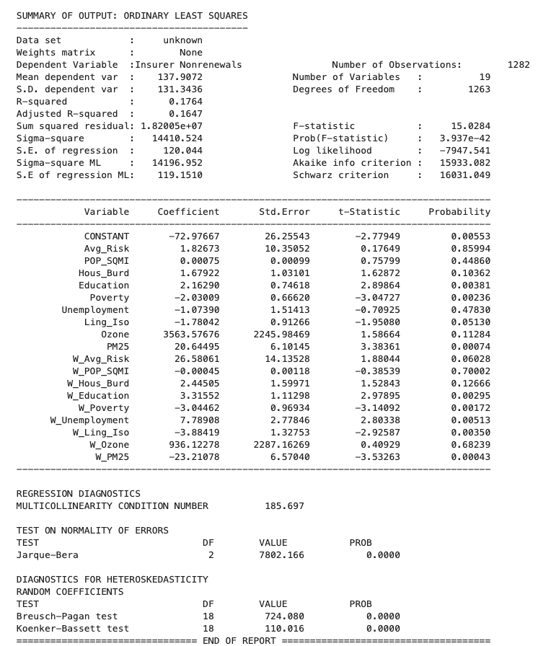
Model Interpretation
Python results will differ depending on the model you run
Basic statistics such as p-values, t-stats, and r-squared can be interpreted as the same way as we did in the linear regression
Results from the weighted (or lagged) variables will give you the spatial effects

Slide 11
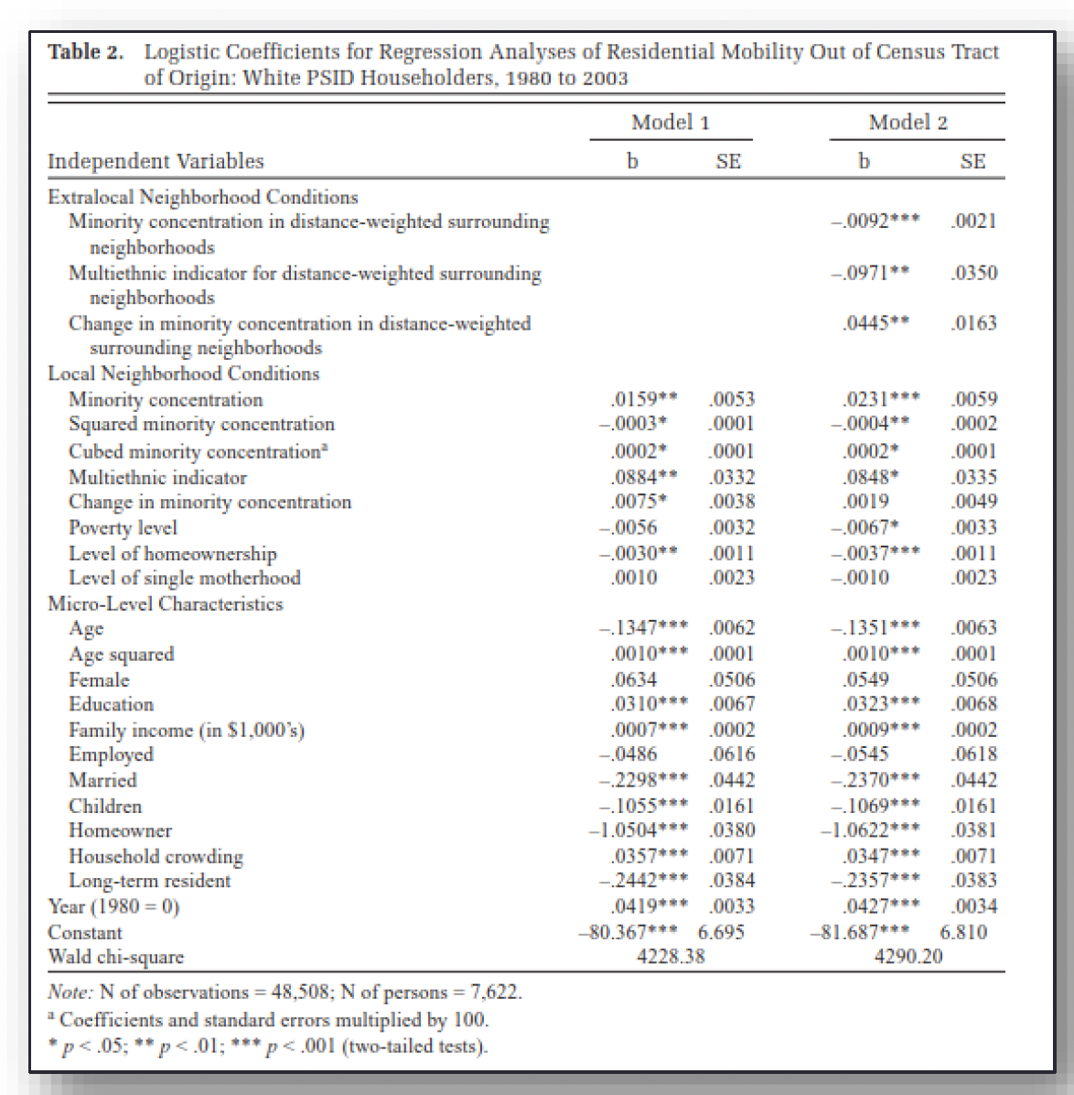
Model Interpretation
Direct and Indirect Effects are given separately for spatial regressions
Direct Effects ( Local effects) - how the independent variables within my area is correlated with the dependent variable within my area
Indirect Effects (Extralocal Effects) – known as the spillover effect. How the independent/dependent variables from my neighbors explains my dependent variable

Slide 12

Model Choice
Substantive choice
i.e. if we’re looking at voting results, because elections happen on a single day, it’s hard to argue that the results from neighboring regions will spillover
A lot of the spatial effects are not clear cut though
i.e. the feedback loop is unclear (whether there are global or local spillover effects)
Sometimes hard to discern to what extent indirect effects would exist – do we assume investment for infrastructure are local or global?

Slide 13
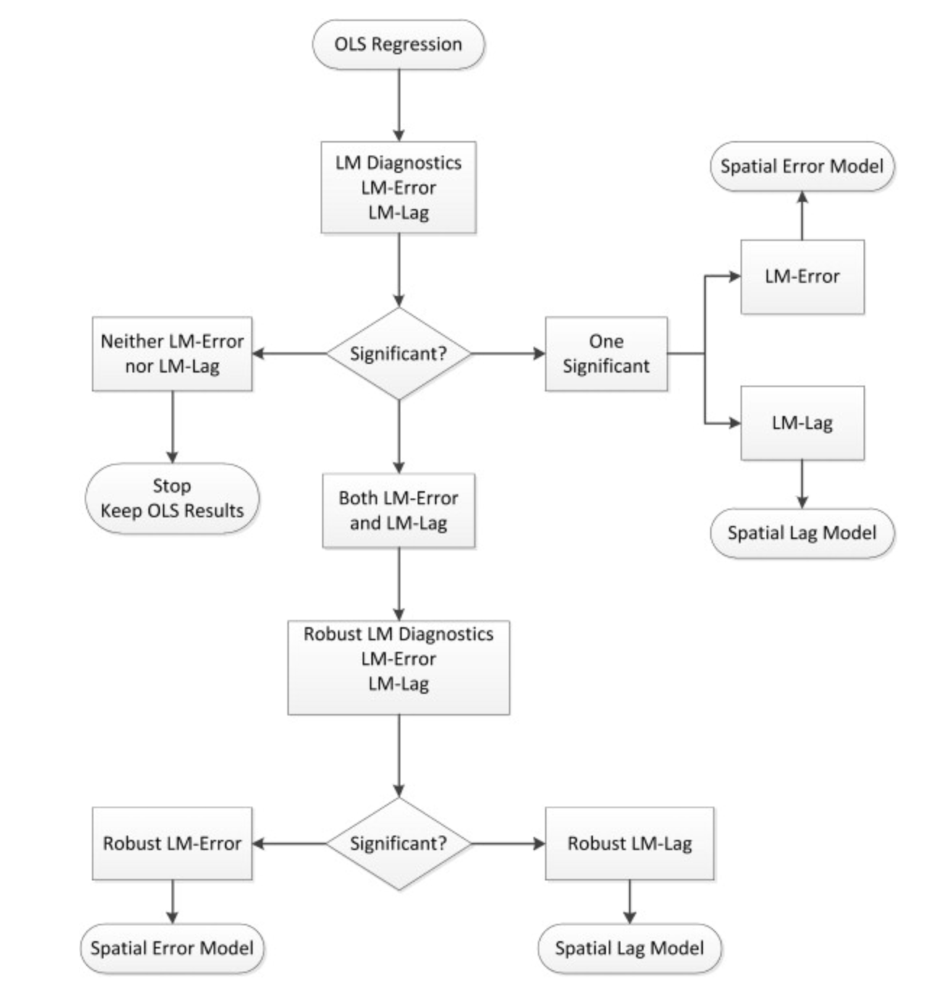
Model Choice
Data Driven Approach
Series of Lagrange-Multiplier tests that determine whether we would use a spatial lag or spatial error model

Slide 14
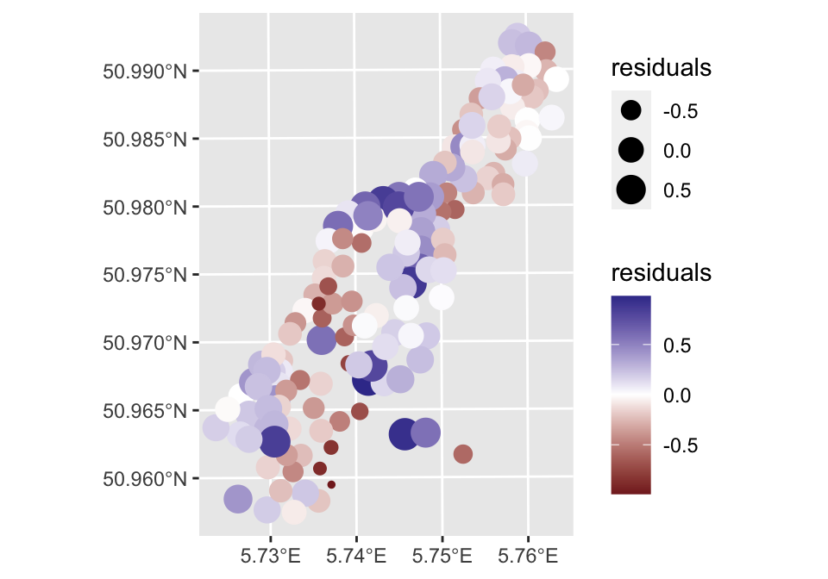
Non-Spatial Regressions
Assumption: the errors are not correlated (complete spatial randomness of error terms)
What if we see spatial autocorrelation in the error terms – would indicate that there are issues behind the structural ideas captured in the independent variables that have been unobserved

Slide 15
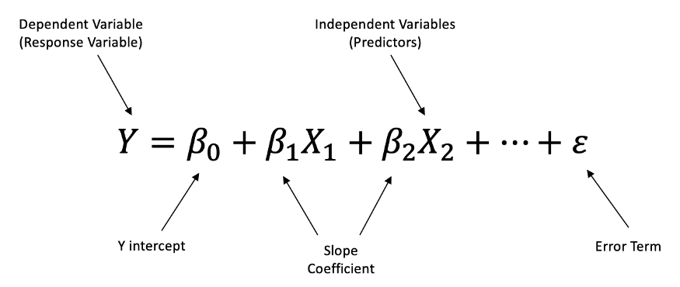
Non-Spatial Regressions
Why not include regional dummy variable for each state or unit of observation?
Less parsimonious (the general rule of thumb is that the less variables are better)
Lost opportunity if interested in diffusion

Slide 16
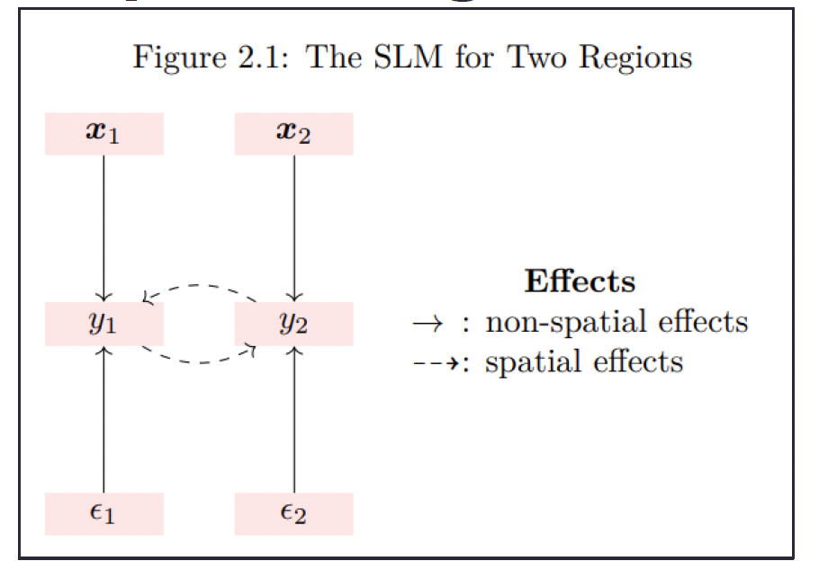
Spatial Lag Model
Global model where we assume that the y values of our neighbors will affect the y values of us
i.e. adoption of solar panels; air pollution
https://www.msarrias.com/uploads/3/7/7/8/37783629/spatialeconometrics.pdf

Slide 17
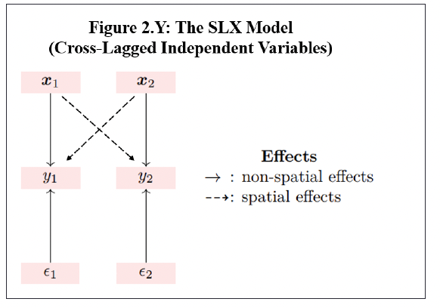
Spatially Lagged X Model (SLX)
Lagged X variable
Assuming that the neighbor’s x values will spillover to my Y
If we’re looking at the average number of pupils in a school district, the birthrate of my neighbors can also affect the pupils for school districts
https://www.msarrias.com/uploads/3/7/7/8/37783629/spatialeconometrics.pdf

Slide 18
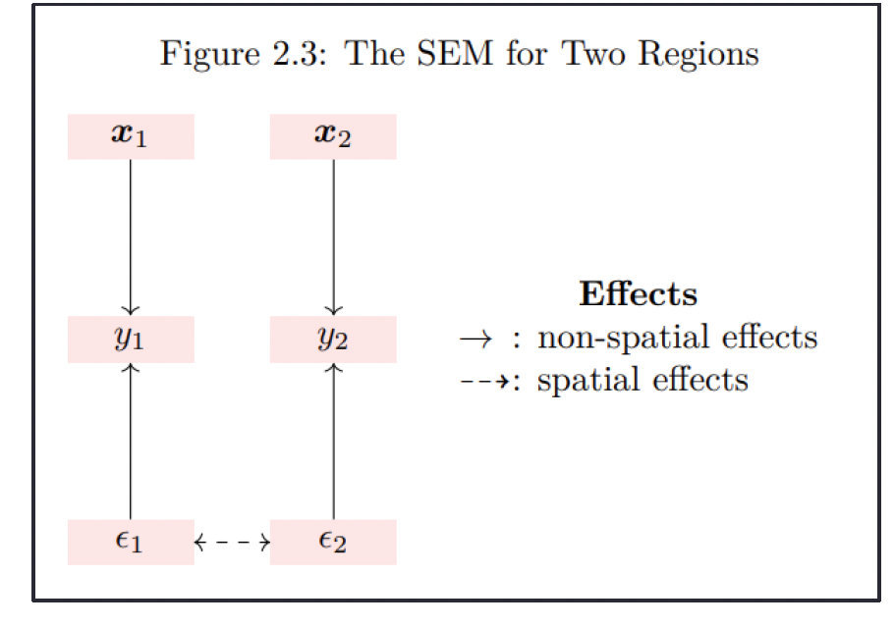
Spatial Error Model
Assumes that the y and x-variable is not subject to spatial diffusion
Autocorrelation parameter would be zero
No indirect (spillover) effects caused in this model
There could be spatial issues that are not included in the model – usually justified theoretically.
https://www.msarrias.com/uploads/3/7/7/8/37783629/spatialeconometrics.pdf

Slide 19
Taxonomy of Spatial Models

Slide 20

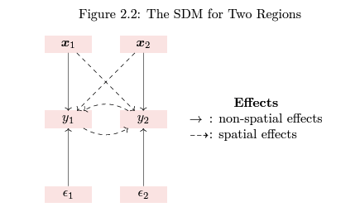
Spatial Durbin Model
Lagged x and y
https://www.msarrias.com/uploads/3/7/7/8/37783629/spatialeconometrics.pdf

Slide 21
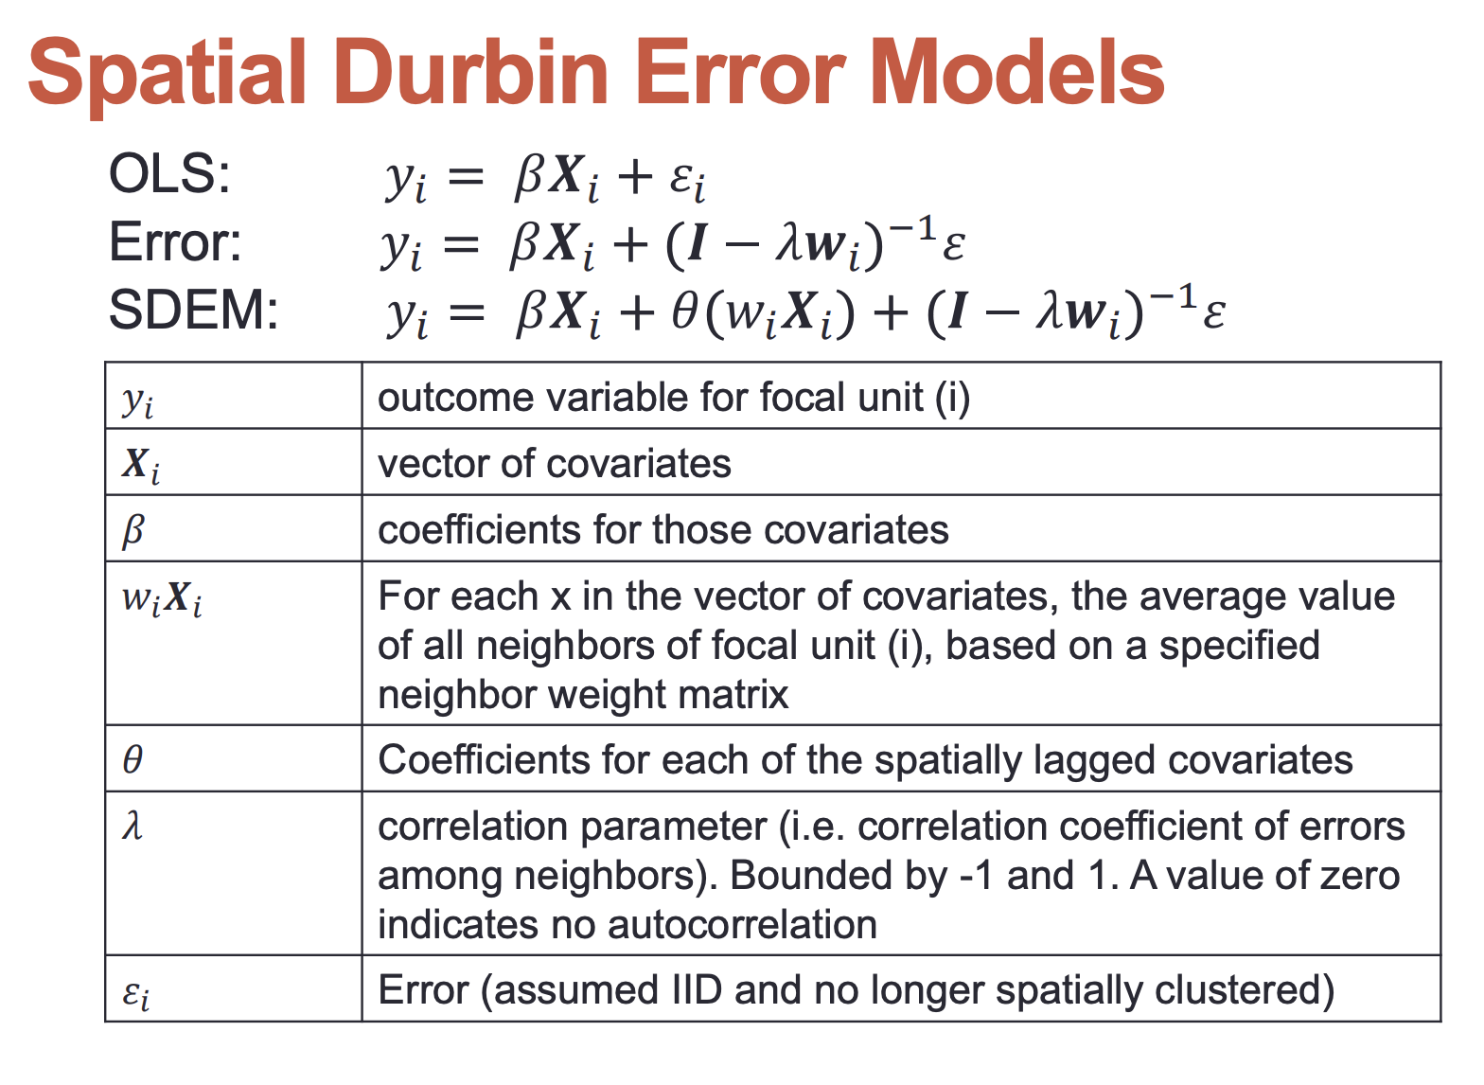
Spatial Durbin Error Model
Lagged X and error

Slide 22

