Slide 1
Week 3_12 Spatial Regressions
CRP 3850/5850
Yujin Hazel Lee
Wenzheng Li

Slide 2
Objectives
Understand the intuition behind spatial regression analysis
Learn diagnostic tests for spatial regressions
Run regressions for different models

Slide 3
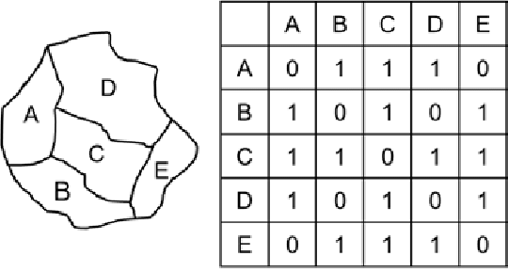
What is a Spatial Lag?
In linear regressions, a ‘lag’ shifts the variable by one or more periods in time
The ‘spatial lag operator’ (Wy or Wx or Wu) relates a variable at one point in space to the observation for that variable in other spatial units in the system
We assume that the values in one unit are indirectly influenced by the values found in the neighbors

Slide 4

Spatial Dependence and Spatial Heterogeneity
Spatial Dependence (= Spatial Autocorrelation) – lack of independence between observations - it relates to the characteristics of the observations in the dataset (i.e. distance)
Spatial Heterogeneity – lack of stability over space and the behavior of other relationships – geographical characteristics are considered as spatial heterogeneity

Slide 5
Spatial Spillovers
Spatial Spillovers (Diffusion) results in Peer Effects (Indirect Effects)
The effect that neighboring regions gives to you, rather than characteristics of your own region
A
B
Y = Crime rate
X = Income, Education,
# of funds flowing to police, # of streetlights
Y = Crime rate
X = Income, Education,
# of funds flowing to police, # of streetlights

Slide 6
What is a Spatial Regression?
Based on the assumption that spatial diffusion affects the choices and behavioral patterns of regions
Depending on whether the dependent variable or independent variable is lagged, the models can vary
Spatial Regression is still a very new field, and is constantly developing

Slide 7
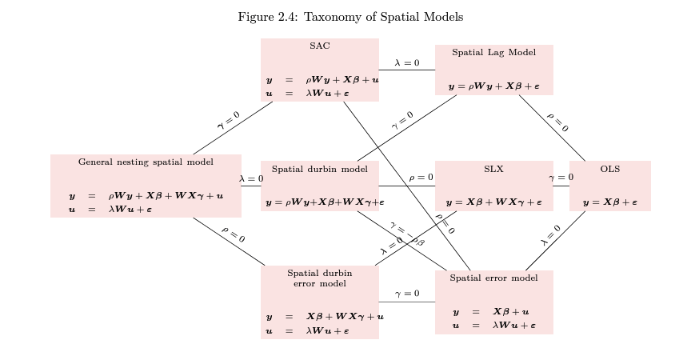
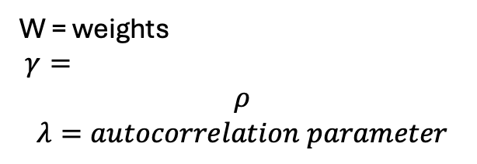
Taxonomy of Spatial Models
W = weights
$γ=$
$$ρ$$
$$λ=autocorrelation parameter$$

Slide 8
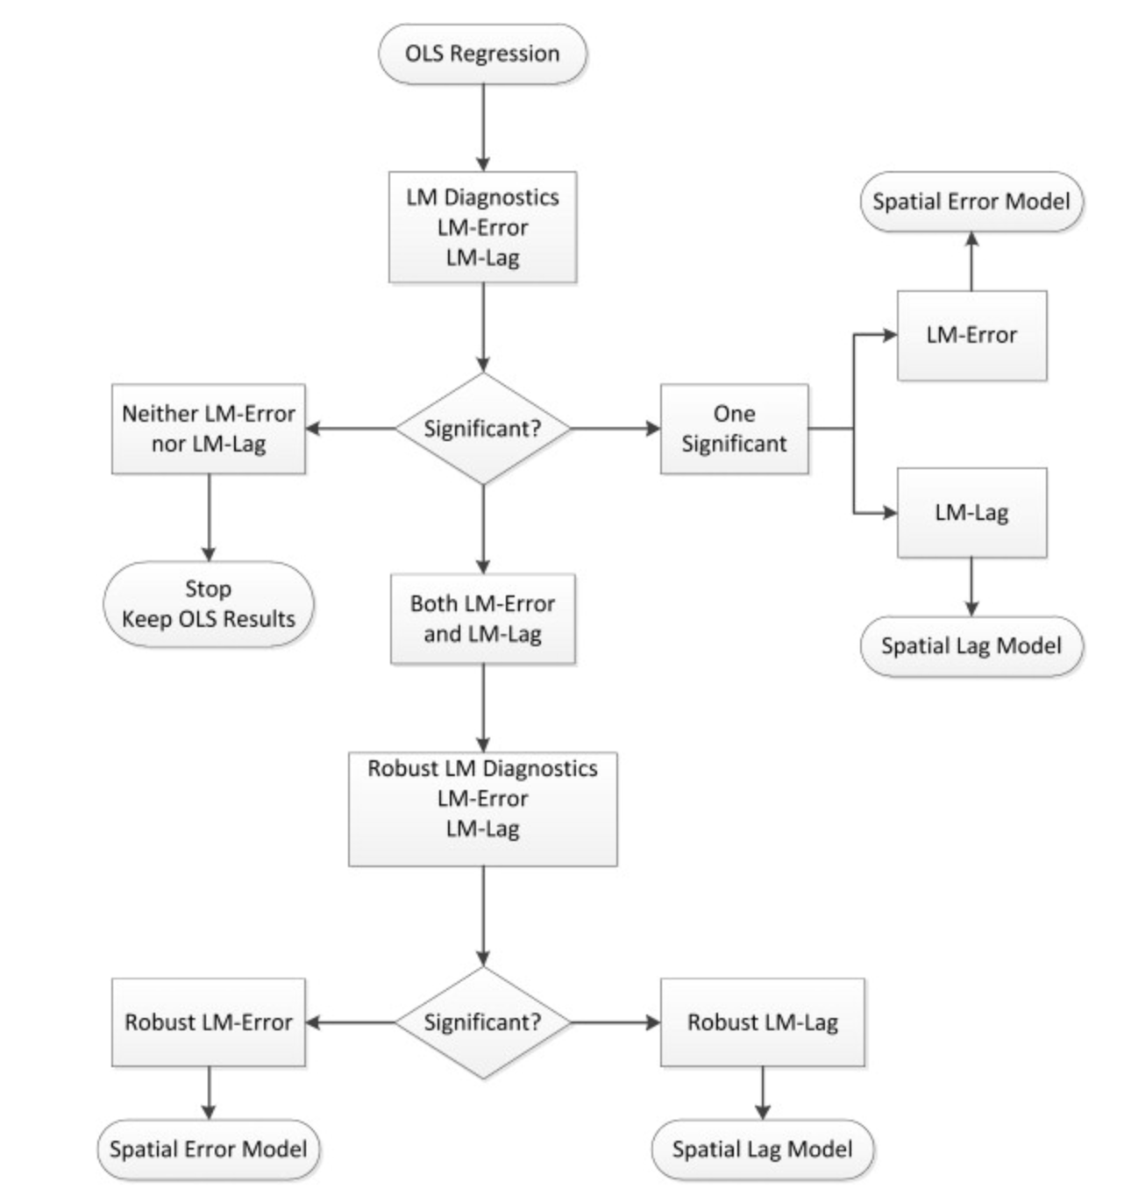
Model Choice
Data Driven Approach
Series of Lagrange-Multiplier tests that determine whether we would use a spatial lag or spatial error model

Slide 9
Model Choice
Substantive choice
i.e. if we’re looking at the characteristics of households using solar and peer effect

Slide 10
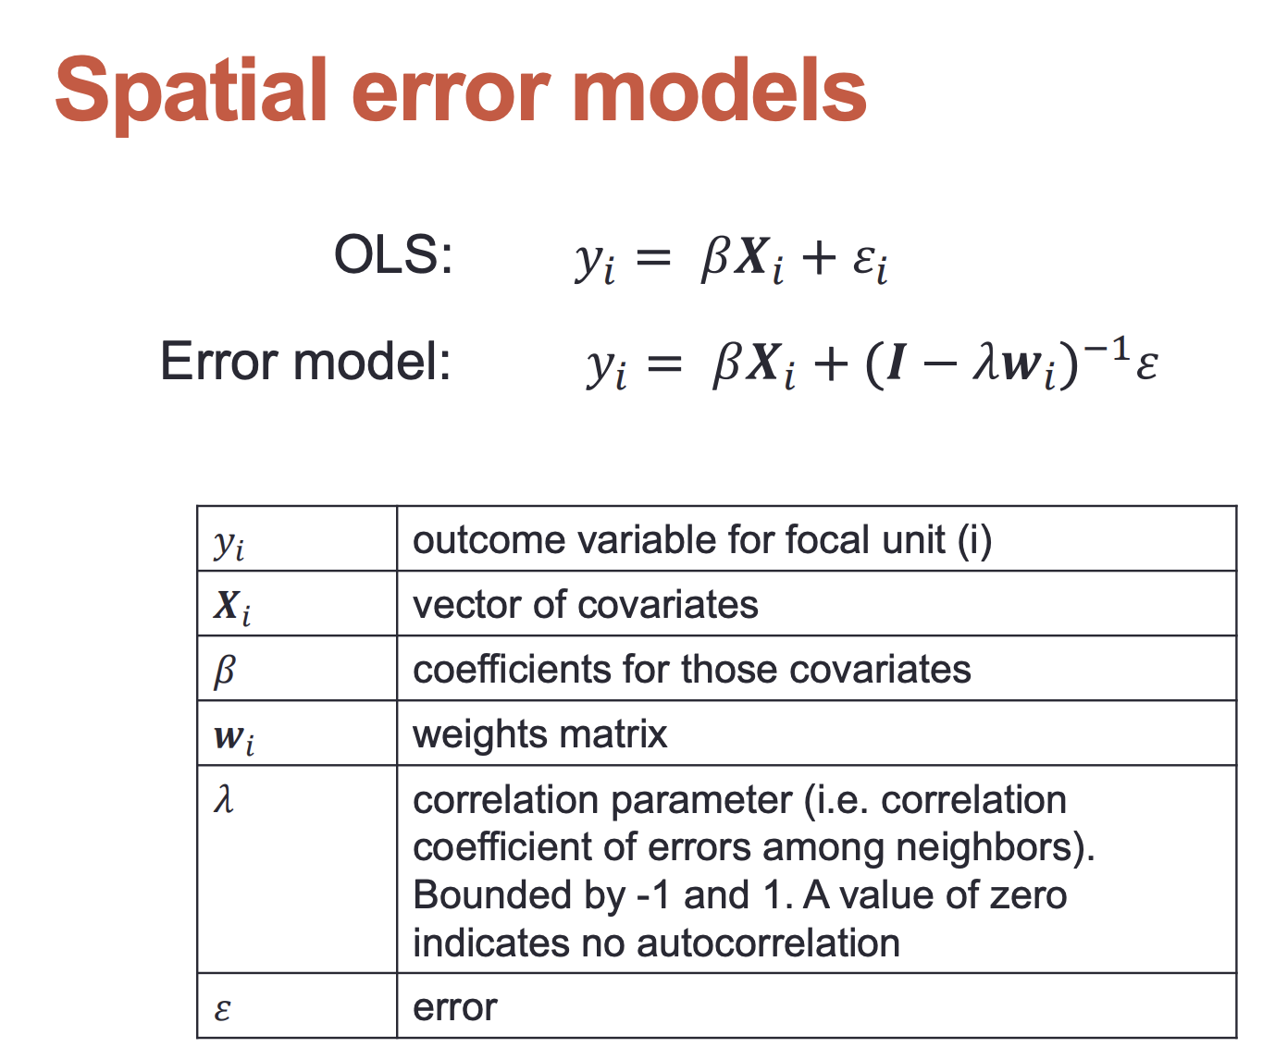
Non-Spatial Regressions

Slide 11
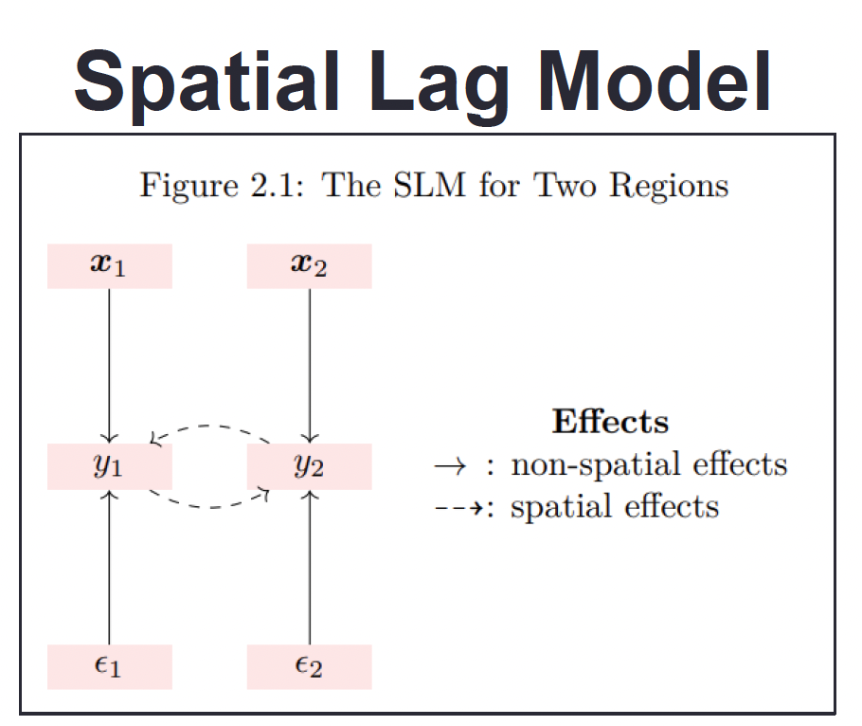
Spatial Lag Model
Lagged y

Slide 12

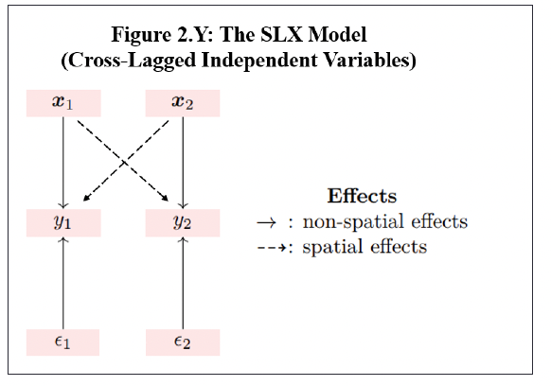
Spatially Lagged X Model (SLX)
Lagged x

Slide 13
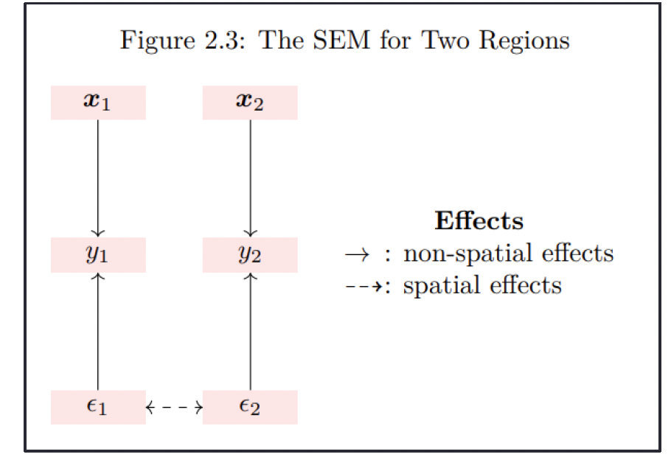
Spatial Error Model
Assumes that the y-variable is not subject to spatial diffusion
Autocorrelation parameter would be zero
No indirect (spillover) effects caused in this model

Slide 14

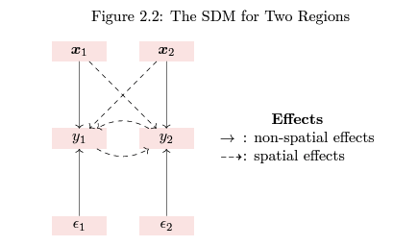
Spatial Durbin Model
Lagged x and y

Slide 15
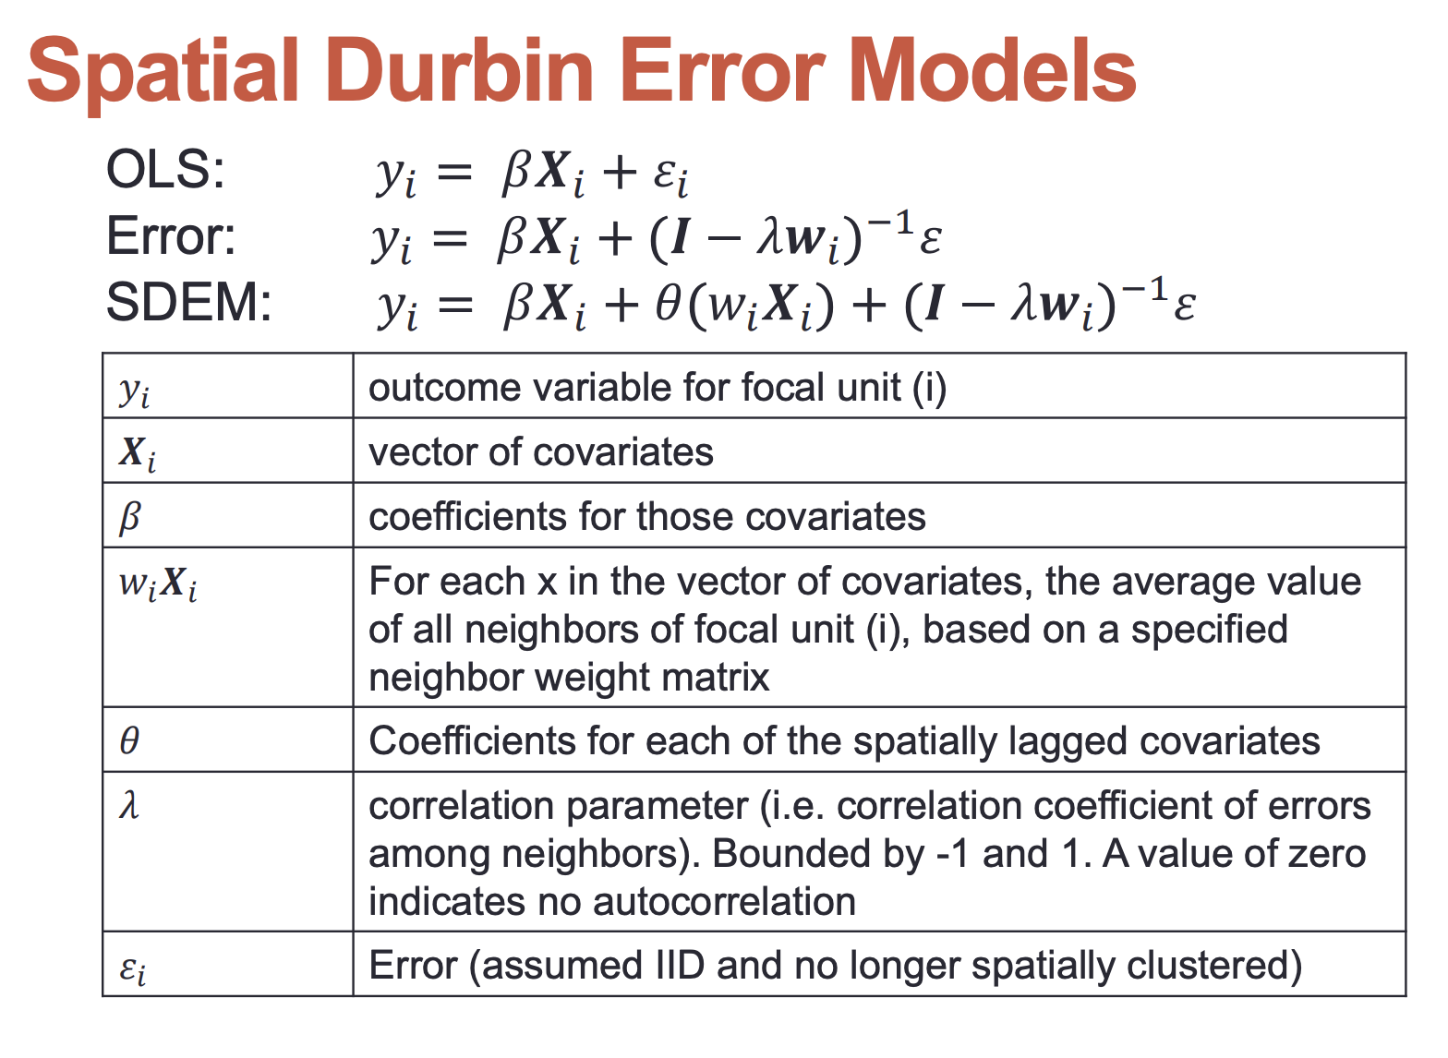
Spatial Durbin Error Model
Lagged X and error

Slide 17
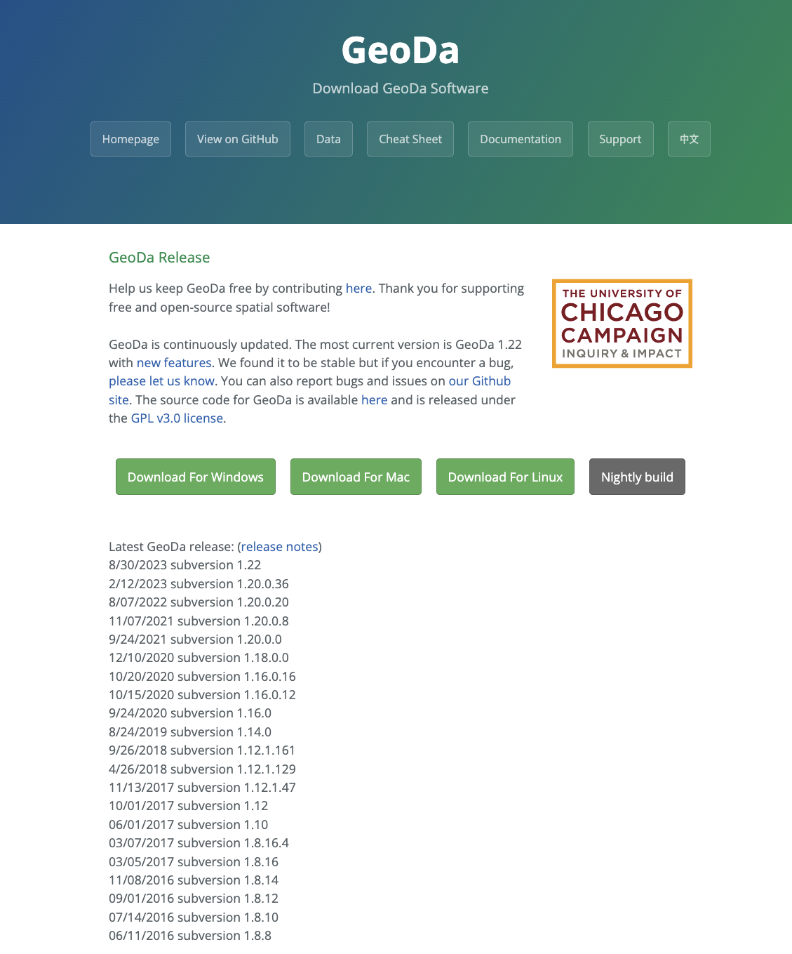
For tomorrow’s class
Download GeoDa

