Slide 1


Introduction to Big Data and Machine Learning CRP 3850/5850 Special Topics (Summer 2024)
Lecture 2 Basics of Python
Wenzheng Li
Hazel (Yujin) Lee
06/04/June

Slide 2
OUTLINE
Wenzheng Li, Hazel (Yujin) Lee
Jupyter notebook (continue)
“Hello World”

Slide 3
1
Jupyter notebook (continue)

Slide 4
Jupyter notebook
Jupyter notebook instruction:
https://jupyter.brynmawr.edu/services/public/dblank/Jupyter%20Notebook%20Users%20Manual.ipynb
https://www.youtube.com/watch?v=uVLzL5E-YBM

Slide 5
2
“Hello World”

Slide 6

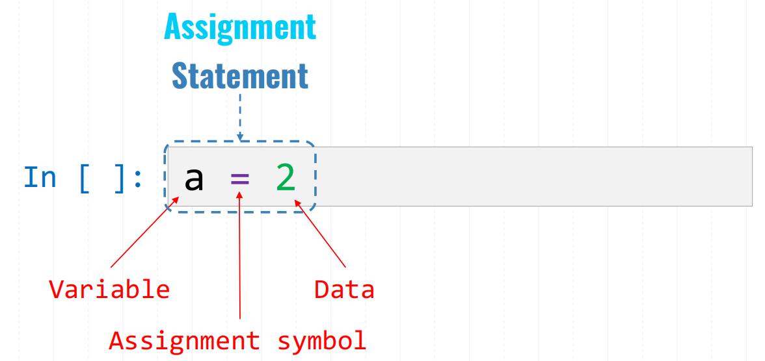
Basics of Python: Variables
Create a variable using “=” (e.g., a = 1)
Variable name:
can be any length
can consist of letters ( A-Z , a-z ), digits ( 0-9 ), and the underscore character ( _ )
CANNOT start with a digit
Never name a variable using built-in function names, e.g., print, len, list

Slide 7
Basics of Python: Variables
Types:
Numeric: integer (int), decimal number (float)
int: e.g., 10
float: e.g., 11.80353453
Text: string (str)
string: e.g., "Hello!“
Boolean: True or False (bool)
3==4 (False)
5 in [1,3,5,7] (True)
List: collection of numeric, string, or Boolean type data:
List: e.g., [1, “hello”, True]

Slide 8
Basics of Python:
Python counts from 0
Python built-in functions/methods
pre-defined functions that are readily available to use. No need to define these functions; we directly call them.
Built-in Functions:
type( ): check a variable type (integer, string….）
print( ): print a specified message to the screen
int( ): convert a variable into an integer: int(var1)
round(): round to the nearest integer

Slide 9
Basics of Python: Operators
Arithmetic operators:
+, -, *, /
%: mod, get the remainder of a division. e.g., 3%2=1
**: power. 10**3, ten to the third power
//: get the integer part of a quotient. e.g., 7//3=2
Comparison operators:
<, >, <=, >=
==: if the values of two operands are equal, "==" returns True, otherwise, it returns False
!=: if the values of two operands are NOT equal, "!=" returns True, otherwise, it returns False
Logical operators:
and: If both the operands are true then the condition becomes true.
or: If any of the two operands are true then the condition becomes true.
not: Get the reversed output

Slide 10
Basics of Python: List
Place all the items (elements) inside square brackets [ ], separated by commas.
Can have any number of items and they may be of different types
my_list = [1, "Hello", 3.4]
two ways to define a list:
using [ ]. For example, my_list = [1, "Hello", 3.4]
using list(range( )) — two functions: list( ) and range( )

Slide 11
Basics of Python: List
How to select an element or a subset of elements from a list?
indexing means selecting an individual element from a list using an index. An index denotes the position of an element in a list.
slicing means selecting a subset of elements from a list that is obtained based on the indexes.

Slide 12
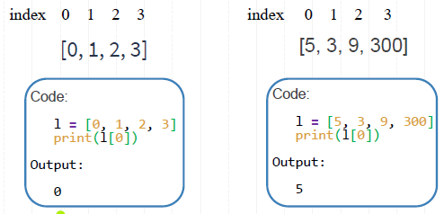
Basics of Python: List
Indexing
To select an element of the list, we use the index operator [ ]. e.g., my_list[index]
Always remember Python index counts from 0

Slide 13
Basics of Python: List
Slicing
To select a subset of elements, we can use my_list[start:stop]
The arguments start and stop denote the corresponding index. Note that the start bound is included in the output. The stop bound is one step BEYOND the element you want to select.
Example:
Index 0 1 2 3 4 5 6 7
lst = [15, "a", 14, 64, 75, 100, 110, 1000]
print(lst[2:5])
Output?

Slide 14

List-specific methods:
my_list.append(item)
adds an item to the end of the list
Item (an argument): the item to be added at the end of the list. The item can be any data type.
my_list.index(element)
returns the first index of the given element in the list
len(my_list)
Get the length of a list

Slide 15
Basics of Python: String
A sequence of characters, for example, "hello world" and "Way2go".
Double-quote and single-quote can be used interchangeably (e.g., “a” and ‘a’ are the same).
Concatenate two strings using +
How to get access to one character or a subset of characters in a string? Using indexing and slicing
String-specific methods:
str.find(): Returns the index of the first occurrence of the substring (if found). If not found, it returns -1.
str.replace(old_str,new_str) replace the old substring with the new substring
str.startswith(string) returns True if a string starts with the specified prefix. If not, it returns False.

Slide 16
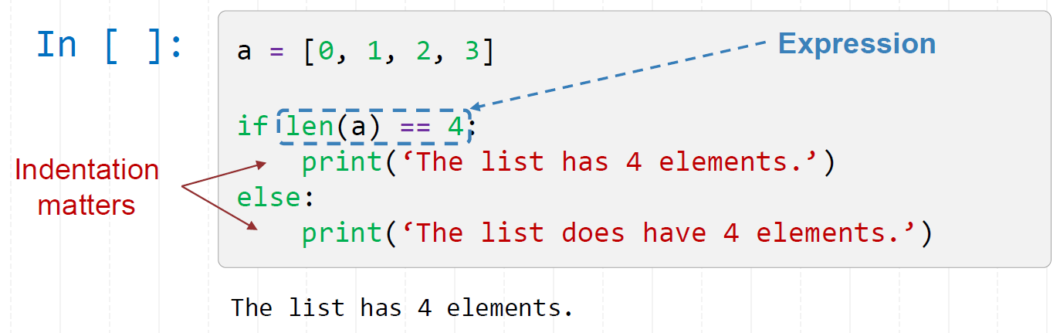
Basics of Python: if statement
The if statement is used when we want to execute a part of code (or make a certain decision) only if a certain condition is satisfied.

Slide 17
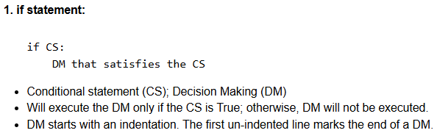
Basics of Python: for statement
A for-loop structure is used for iterating over a sequence (either a list or a string).

Slide 18
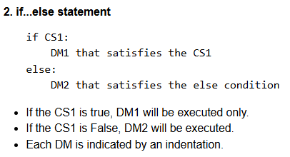
Basics of Python: for statement
A for-loop structure is used for iterating over a sequence (either a list or a string).

Slide 19
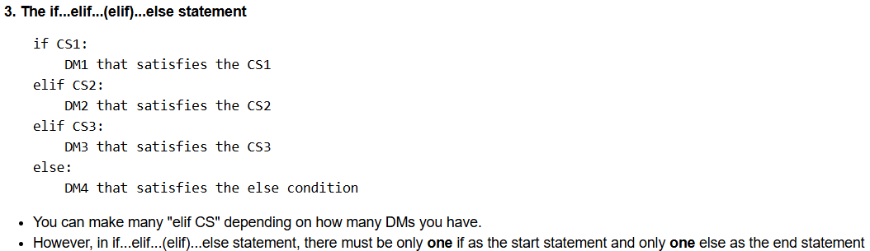
Basics of Python: for statement
A for-loop structure is used for iterating over a sequence (either a list or a string).

Slide 20
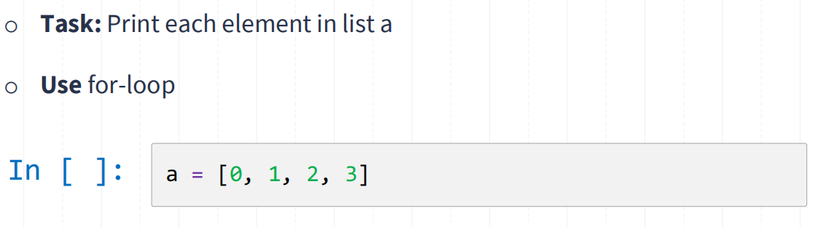
Basics of Python: for statement

Slide 21
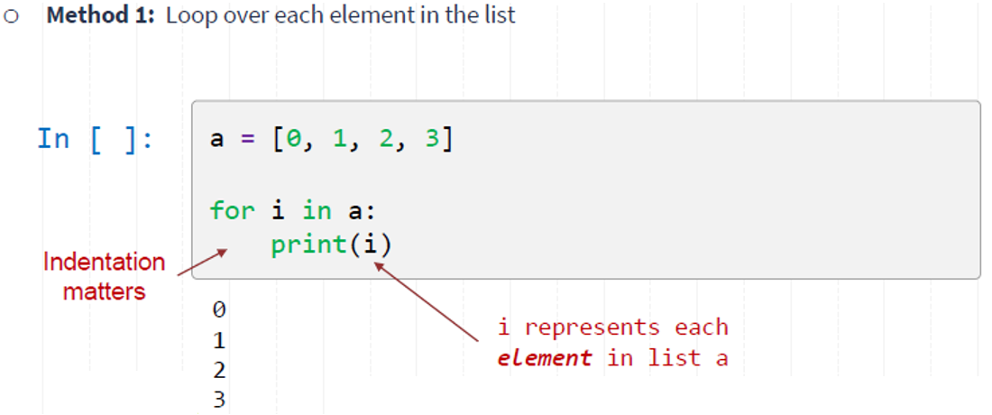
Basics of Python: for statement

Slide 22
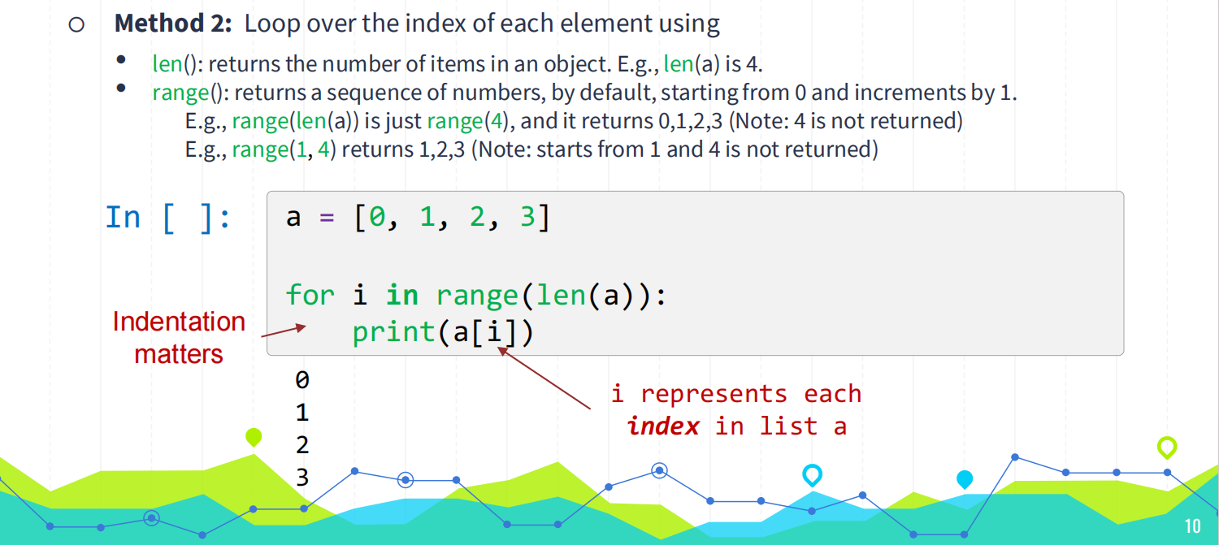
Basics of Python: for statement

Slide 23
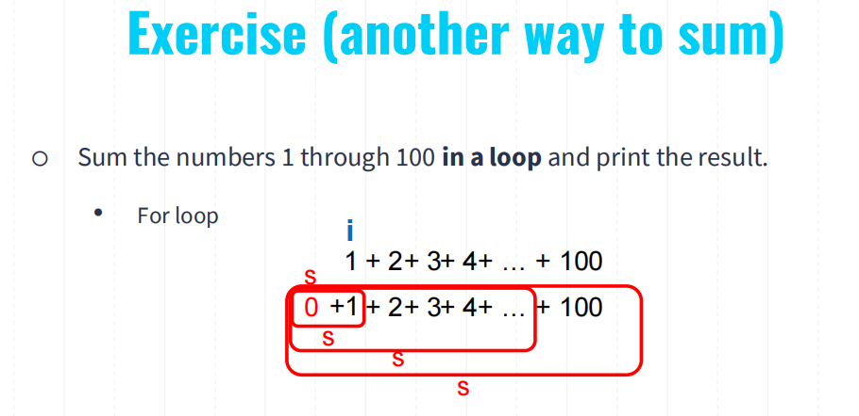

Slide 24
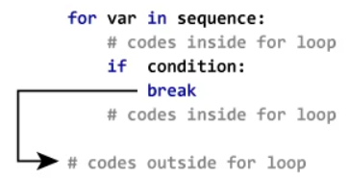
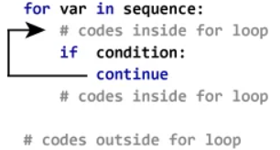
Optional: Basics of Python: For statement (continue and break)
break statement terminates the whole for-loop and jump into the next statement even if the current loop is not over yet.
continue statement terminates the current iteration of a loop, and starts the next iteration in the same loop.

Slide 25
Questions

