Slide 1
Week 3_12 Spatial Regressions
CRP 3850/5850
Yujin Hazel Lee
Wenzheng Li

Slide 2
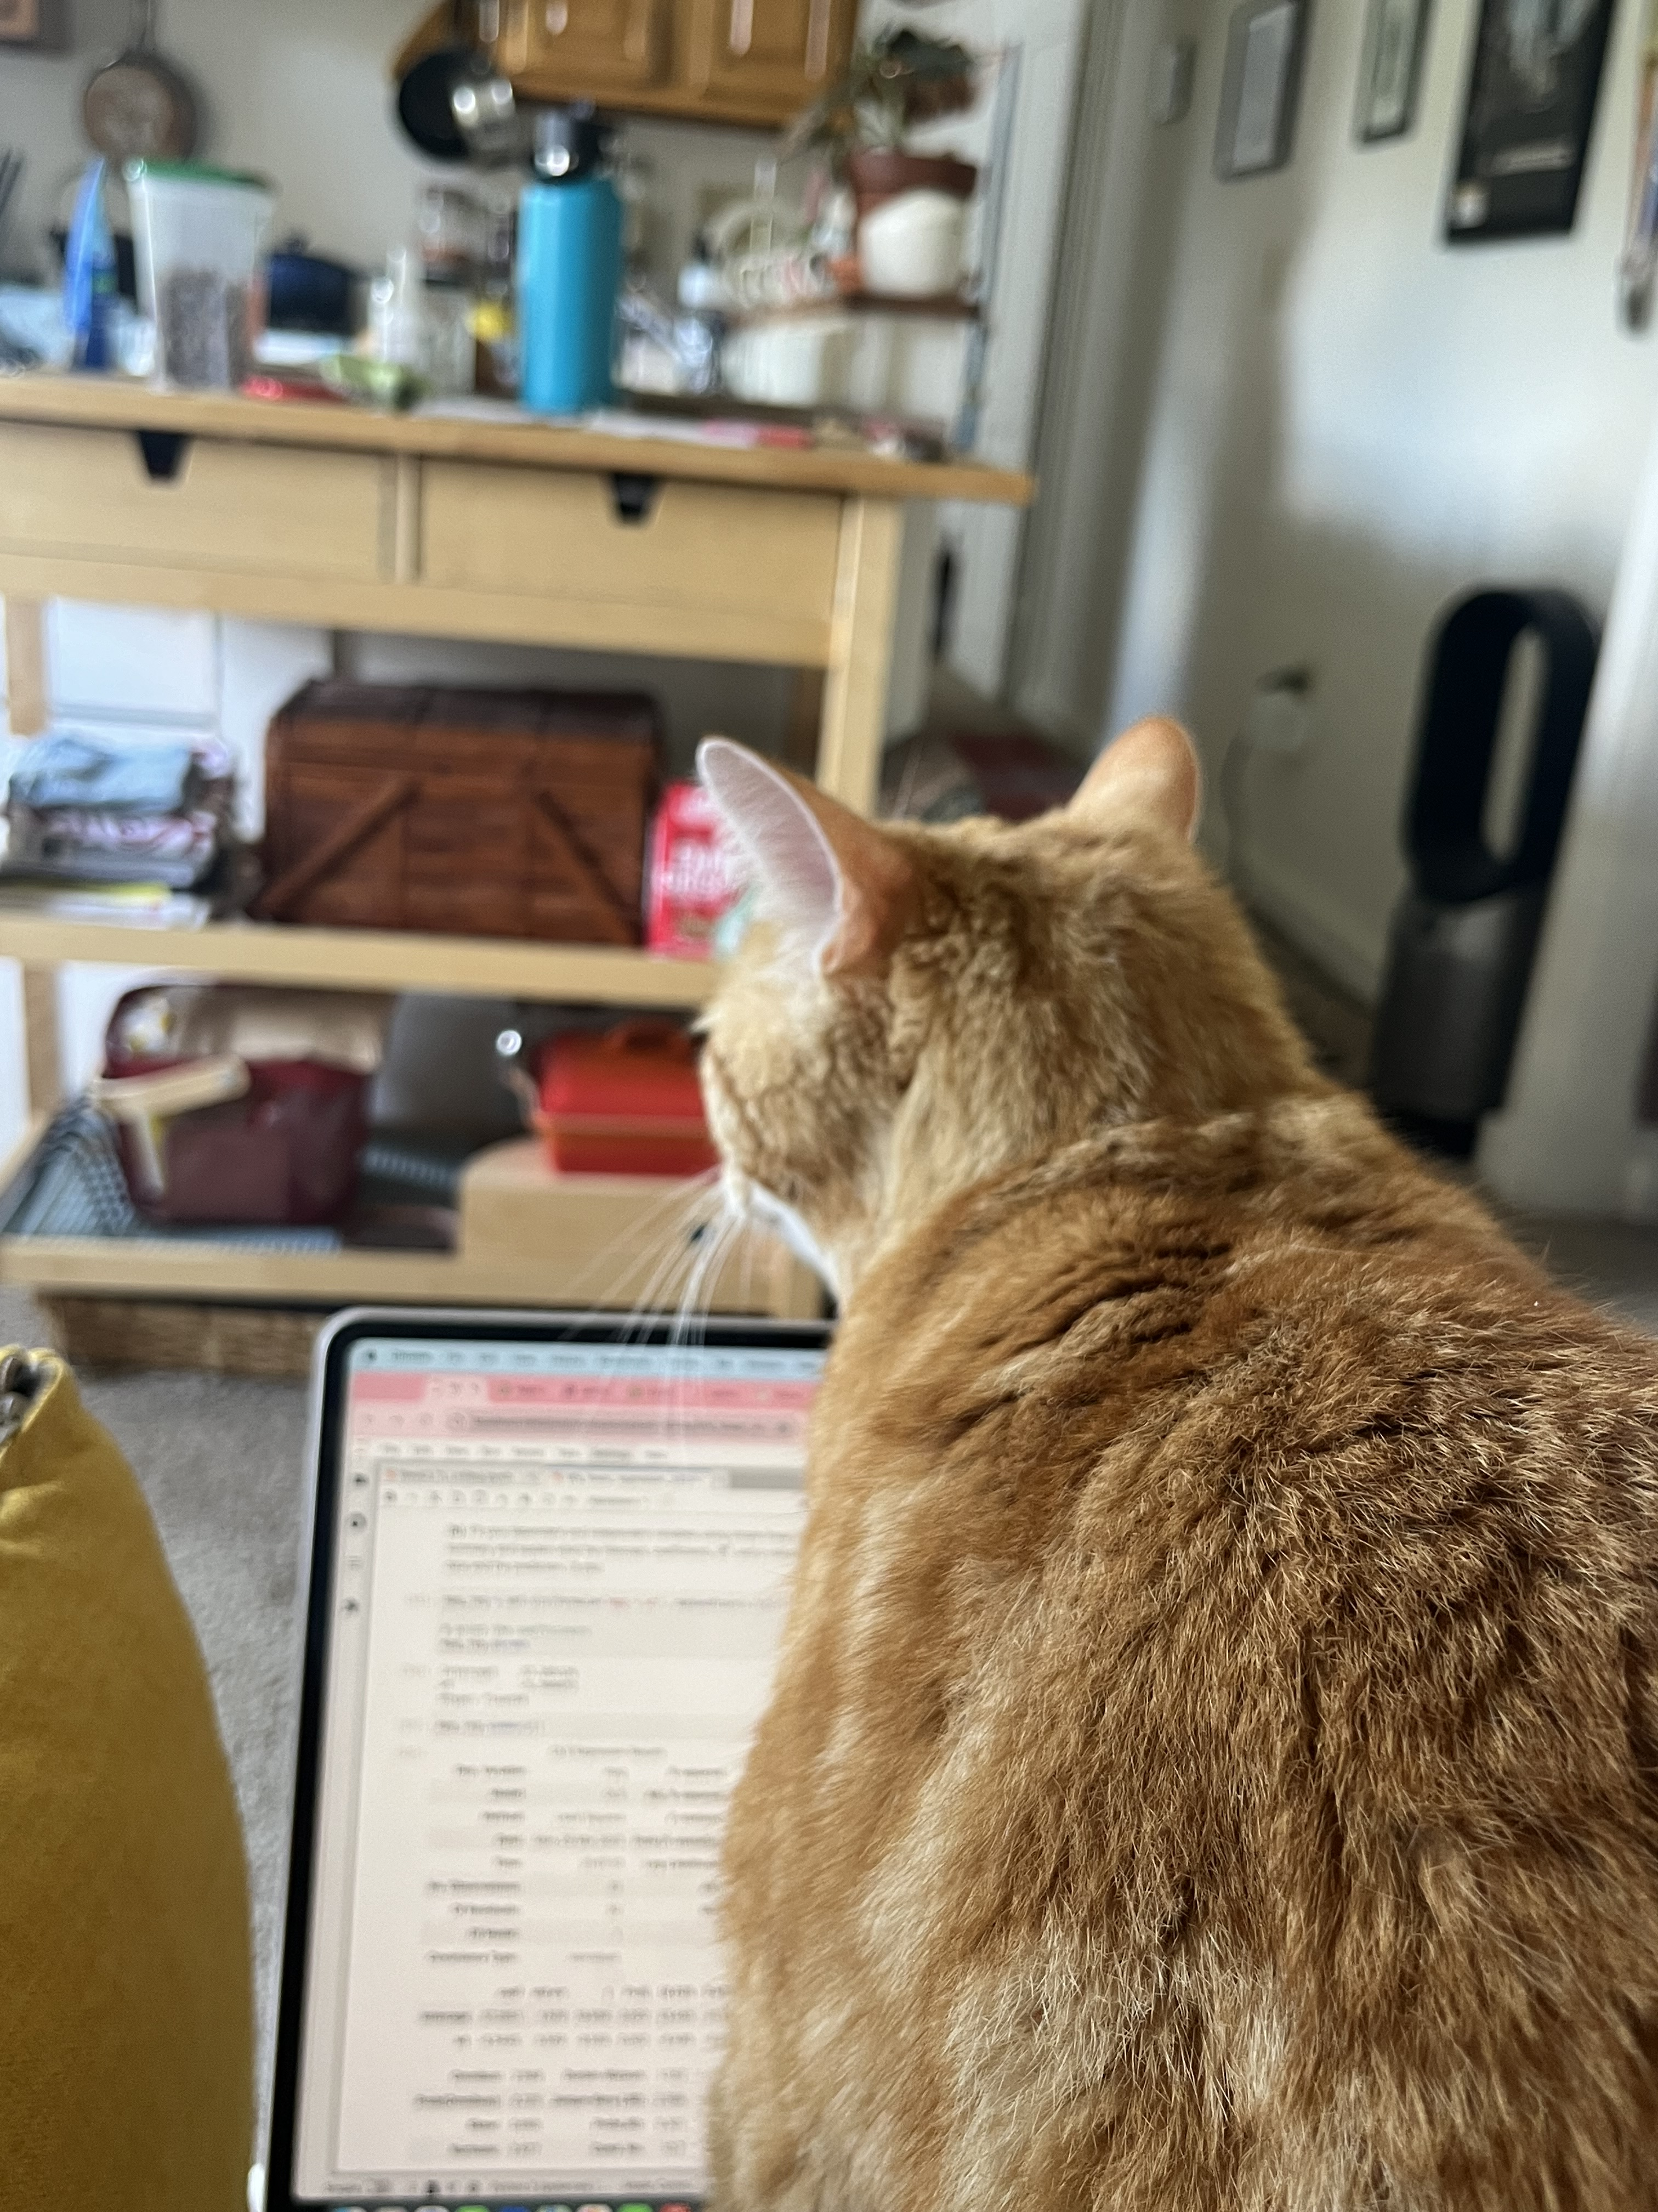
Objectives
Understand the intuition behind regression analysis
Learn the meaning behind t-stats, p-values, and coefficients
Code regression analysis in Python

Slide 3
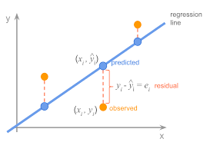
What is a Linear Regression?
A linear regression models the relationship between two variables by fitting a linear equation to the observed data
It is often referred to the ‘Ordinary Least Squares’ Model (OLS Model) because of how it minimizes the sum of squares of residuals

Slide 4
Basic Assumptions
A linear regression models the relationship between two variables by fitting a linear equation to the observed data
It is often referred to the ‘Ordinary Least Squares’ Model (OLS Model) because of how it minimizes the sum of squares of residuals

Slide 5
Linear Regression Forms

Slide 6
Basic Assumptions

Slide 7
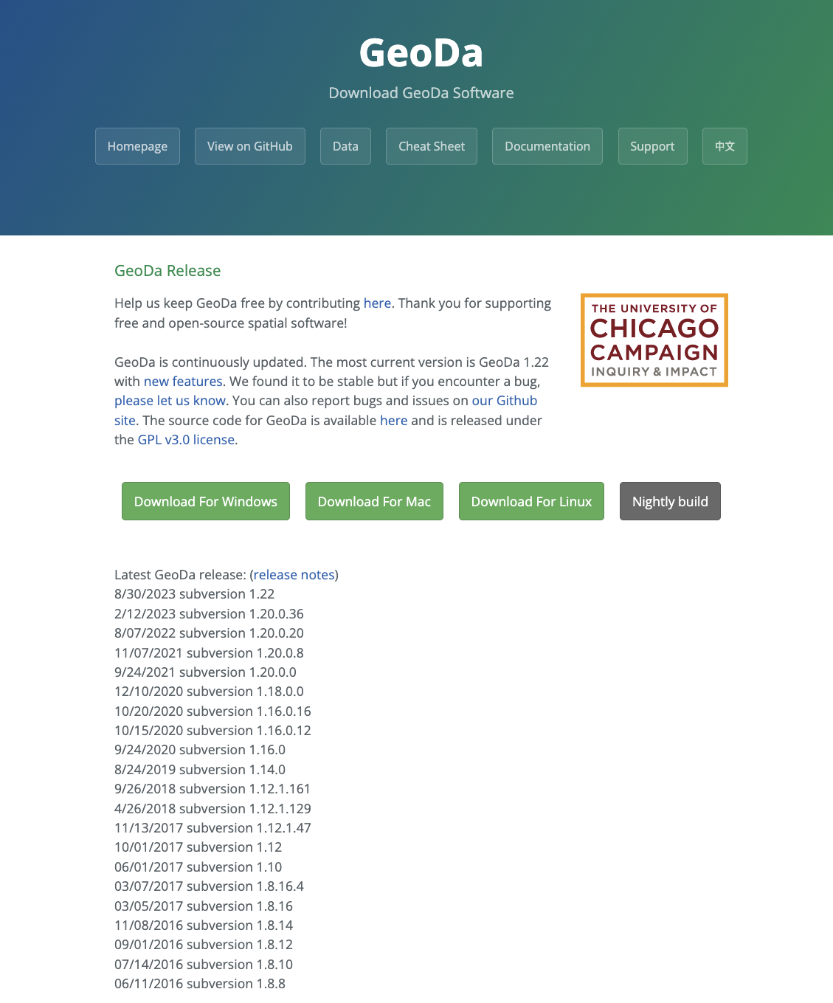
For tomorrow’s class
Download GeoDa

