Slide 2
//*[@id="resultsColumn"]/div[1]/div[2]/div[1]/div/div/div/a/div[2]/div/div[1]/div/div
//*[@id="resultsColumn"]/div[1]/div[2]/div[2]/div/div/div/a/div[2]/div/div[1]/div/div
//*[@id="resultsColumn"]/div[1]/div[2]/div[3]/div/div/div/a/div[2]/div/div[1]/div/div
//*[@id="resultsColumn"]/div[1]/div[2]/div[6]/div/div/div/a/div[2]/div/div[1]/div/div
//*[@id="resultsColumn"]/div[1]/div[2]/div[7]/div/div/div/a/div[2]/div/div[1]/div/div
//*[@id="resultsColumn"]/div[1]/div[2]/div[32]/div/div/div/a/div[2]/div/div[1]/div/div
The 1st house
The 2nd house
The 3rd house
The 4th house
The 5th house
·······
·······
·······
·······
The 30th (last) house

Slide 3
https://www.trulia.com/NY/Ithaca/' + str(page) + '_p/
The links toward individual housing websites
For example: https://www.trulia.com/p/ny/ithaca/124-pine-tree-rd-ithaca-ny-14850--2013606496
Six housing attributes
More detailed housing attributes

Slide 4
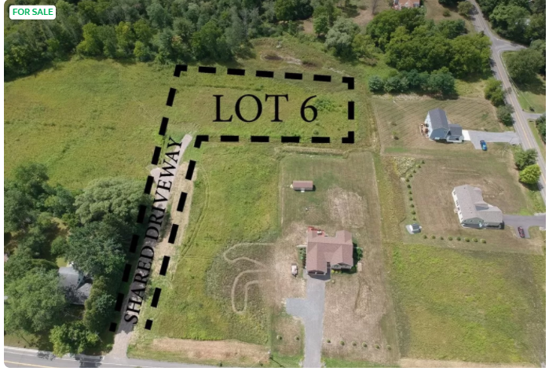
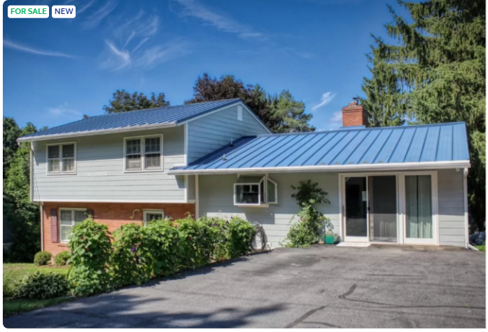
'https://www.trulia.com/property/5071635240-Lot-Six-Warren-Rd-Ithaca-NY-14850'
https://www.trulia.com/p/ny/ithaca/431-n-tioga-st-ithaca-ny-14850--2089326602'

