Slide 1
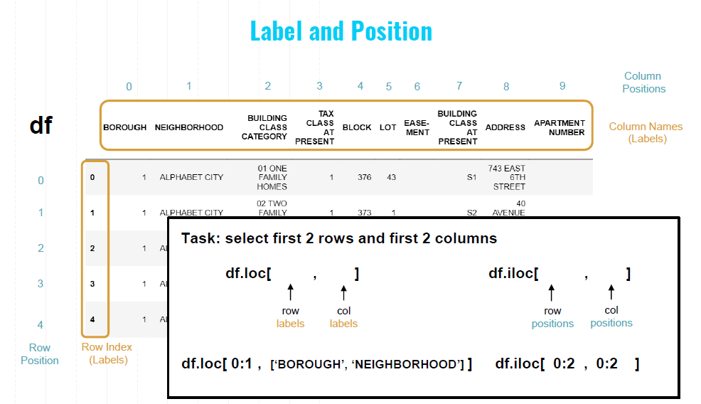

Slide 2
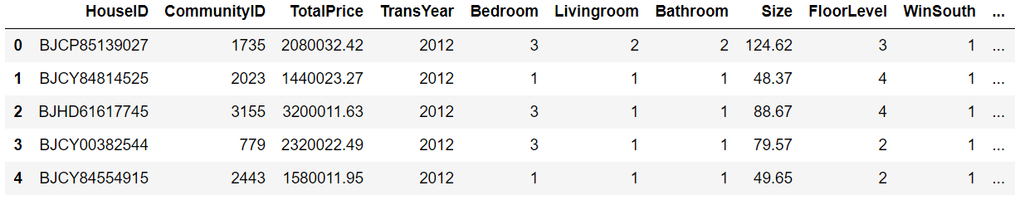
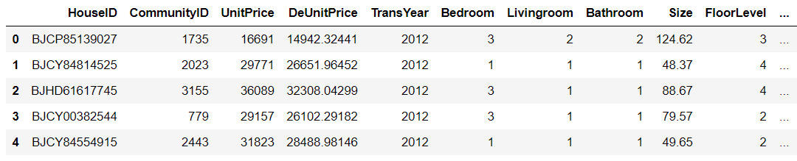
Label and Position
df
0 1 2 3 4 5 6 7 8 9
Column Positions
Column names
(Labels)
0
1
2
Task: select the first 2 rows and the first 2 columns
3
4
df.loc[ , ]
df.iloc[ , ]
Row
Positions
Row index
(Labels)
row
Labels
col
Labels
row
Positions
col
Positions
df.loc[ 0:1 , [ ‘HouseID’ , ‘CommunityID’ ]]
df.iloc[ 0:2 , 0:2 ]

Slide 3
Label and Position
df
0 1 2 3 4 5 6 7 8 9
Column Positions
Column names
(Labels)
0
1
2
Task: select the first 2 rows and the first 2 columns
3
4
df.loc[ , ]
df.iloc[ , ]
Row
Positions
Row index
(Labels)
row
Labels
col
Labels
row
Positions
col
Positions
df.loc[ 0:1 , [ ‘HouseID’ , ‘CommunityID’ ]]
df.iloc[ 0:2 , 0:2 ]

