Slide 1


Introduction to Big Data and Machine Learning CRP 3850/5850 Special Topics (Summer 2024)
Lecture 9 Web Data Collection
Wenzheng Li, Hazel (Yujin) Lee
06/13/2024

Slide 2
OUTLINE
Li, Hazel (Yujin) Lee
Web-scraping using Selenium
Interactive Mapping
Google Map API
OSMnx
Notes:
Selenium is a Python module (library/package) for web automation. It allows you to control a web browser through your scripts, enabling you to automate tasks such as filling out forms, clicking buttons, navigating pages, and extracting data. Selenium is commonly used for web scraping, automated testing of web applications, and performing repetitive web-based tasks.

Slide 3
0
Web-scraping

Slide 4
HTML (Hypertext Markup Language)
• HTML is the code read by a browser and defines the overall page structure
• A web page (or an html file) has two parts: a “head” and a “body”.
• ‘head’ contains
• the page title
• meta tags
• links to CSS
• Javascript
• other referenced items
• ‘body’ represents the browser window itself and contains all of the elements that make up the contents of the page.
Notes:
An HTML (HyperText Markup Language) file is a standard text file used to create and design webpages. You can also understand it as the code read by a browser and defines the overall page structure. Most of our website are written or designed by the HTML code.
A web page has two parts: a head and a body. The head contains the page title, meta tags, which save the meta information, such as the character encoding to ensure the website page shows correctly.
CSS (a stylesheet language) is used to control the presentation and layout of your web pages. And defines how elements should be rendered on screen
Other items: link tags, and img tags…

Slide 5
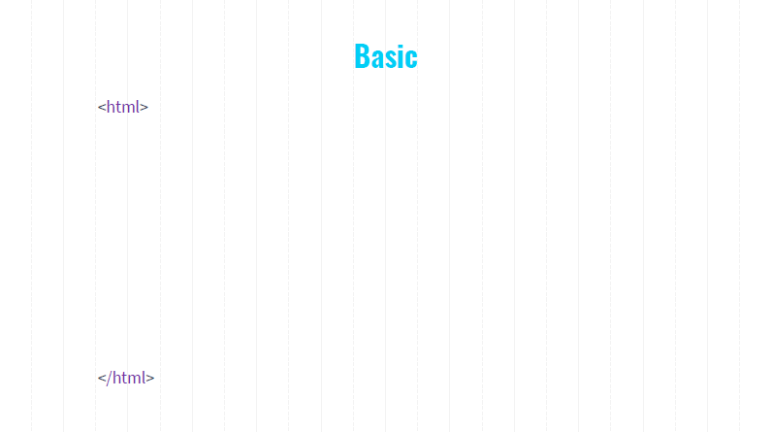
<!DOCTYPE html>
Notes:
An html (or a webpage) begins with <!DOCTYPE html>. It tells the web browser about the version of HTML that the page is written in. The < and >, you will frequently see them in html. These signs are used to define what is called an element, such as paragraphs, pictures, videos, links, etc. Each html tags or elements are enclosed by the angle bracket.
After we know the version, which is html5. We need to let the browser know this is an HTML document, so we write <html> and this element needs to be closed with </html>. Now everything that is contained within these two elements (or tags) will be a part of the webpage.

Slide 6
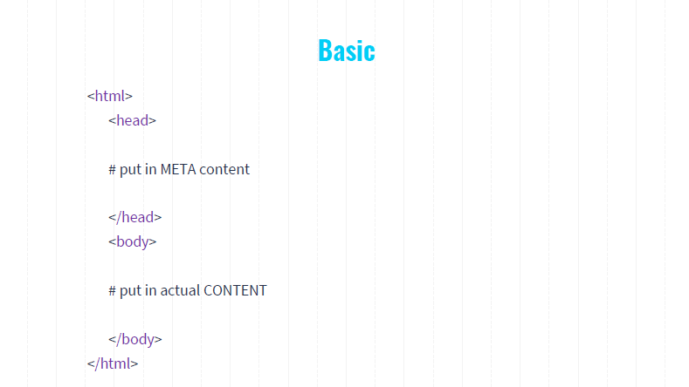
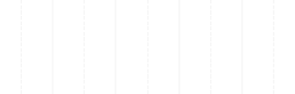
<!DOCTYPE html>
Notes:
Next, we include <head>, and similar to <html>, head need to closed with </head>. The head of your html file will contain metadata, the description and basic setting of your webpage, such as its title and linked resources like CSS and JavaScript files. Nothing in the head will show up when you load your page.

Slide 7
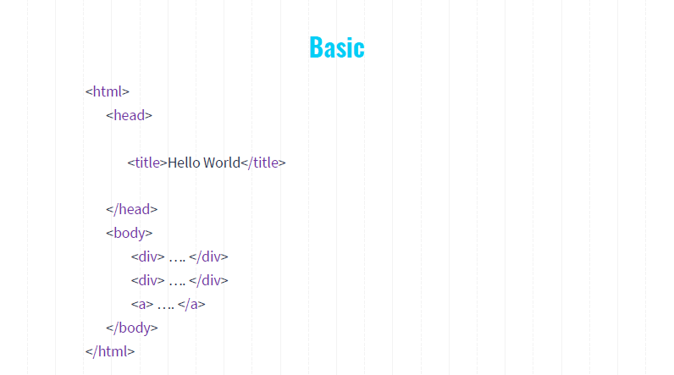
<!DOCTYPE html>
Notes:
For example, we can have a title tag, so we can say title, and closed with it as well. And our title, we can say hello world. This is the meta data that will not be shown in the web page. There are many different types of meta tags. For example, the CSS file that control how your website looks. But for webscrapying purpose, we just need to know the very basics of the html.

Slide 8
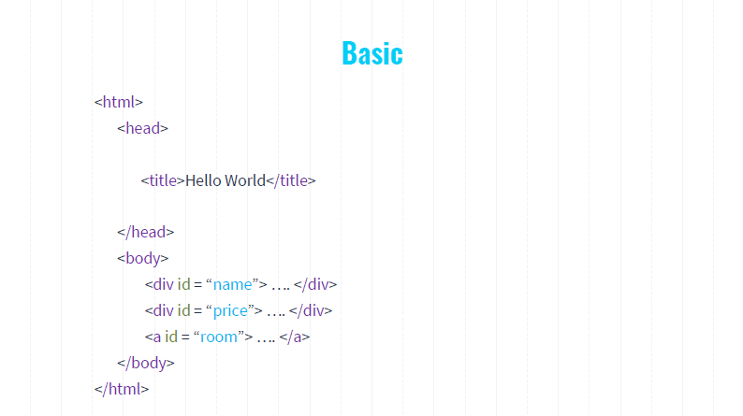
<!DOCTYPE html>
Notes:
Okay, so we have head, we must have a body, and this is something you need to close out. Everything in the body is going to get displayed on your website, visible to users
Here within the body, we have two div tags, that defines two sections in a website. One has an attribute id = “name” this is a unique identifier to an element. The ID attribute value must be unique within this document. Here one unique ID name, indicating the name of a housing. Another one has ID = price, suggesting this section saves housing price. The tag a is an Anchor tag for hyperlinks
<div>: Division tag for sections

Slide 9
<!DOCTYPE html>
<h1> to <h6>: Heading tags
<p>: Paragraph tag
<a>: Anchor tag for hyperlinks
<img>: Image tag
<div>: Division tag for sections
<span>: Inline container tag
Notes:
Okay, so we have head, we must have a body, and this is something you need to close out. Everything in the body is going to get displayed on your website.

Slide 10
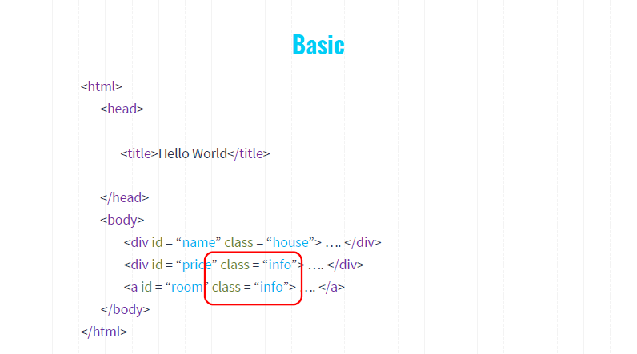
<!DOCTYPE html>
Notes:
Here the div tags have both ID and class attributes. the IDs are uniquely identifier of each element. the class attribute allows to change the style of how price, room, name content are presented. Multiple elements can share the same class, making it easier to apply consistent styles.

Slide 11
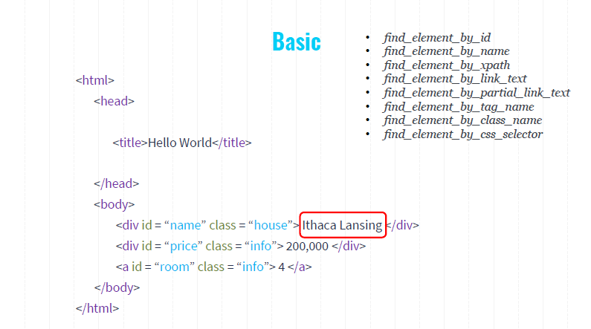
<!DOCTYPE html>
Notes:
Now we replace the placeholder with some actual content. This is the real information that are finally visible to browser users. And this are the information we want to collect from a website, like Ithaca Lansing, price is XX, and the number of rooms are 4. Here, the Selinium offers a set of functions to use to get these content.

Slide 12
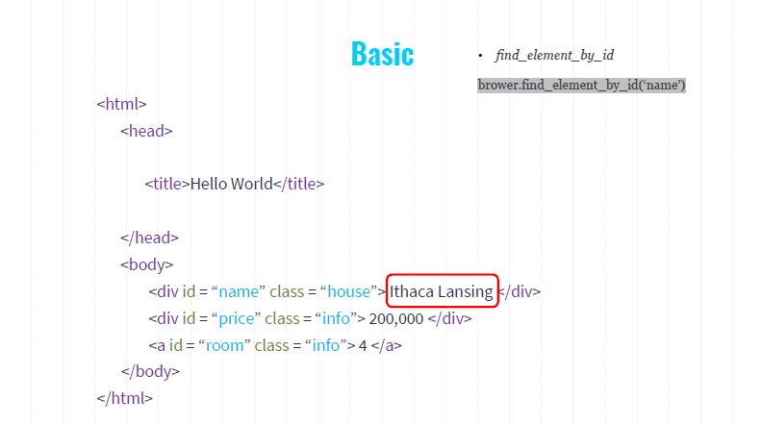
<!DOCTYPE html>
Notes:
The most straightforward one is to get the name by using this

Slide 13
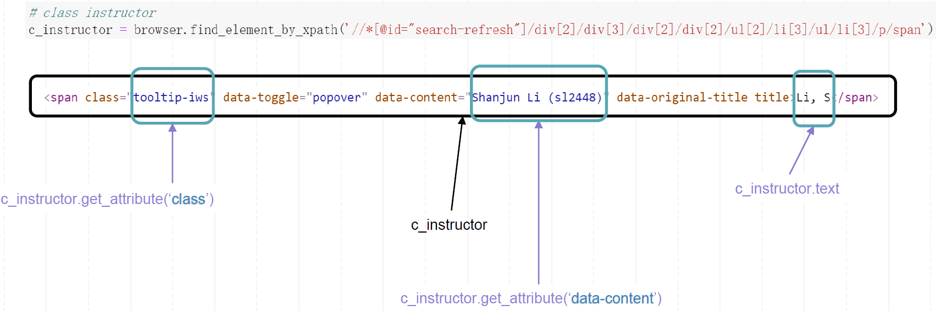
Get Attribute from An Element

Slide 14
Web Scraping in a Loop

Slide 15
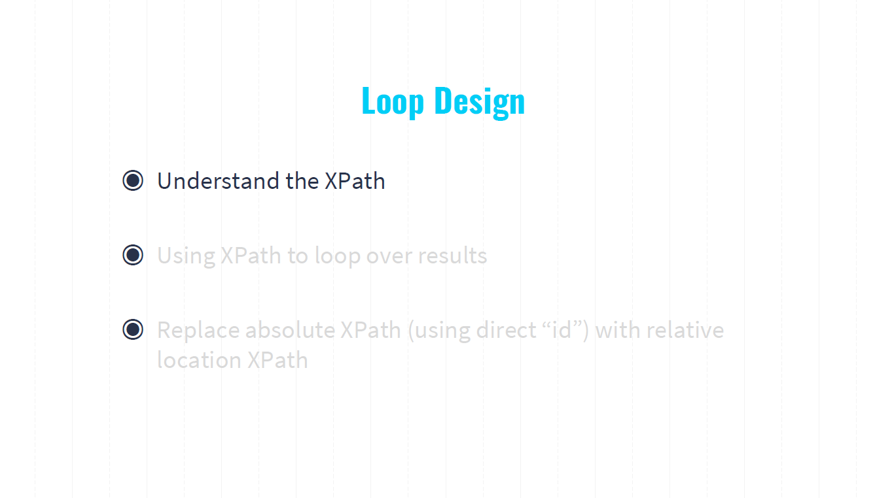

Slide 16
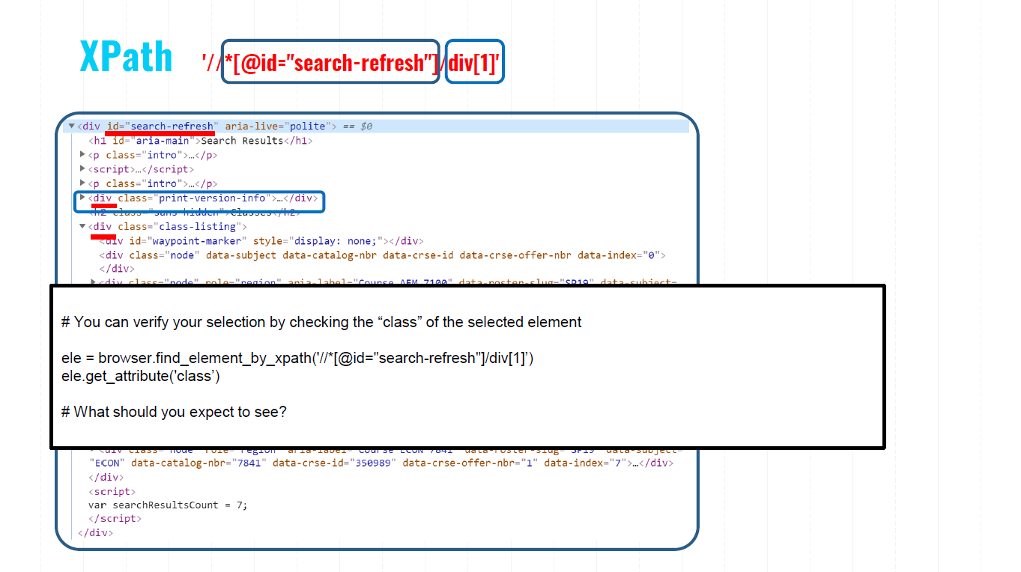

Slide 17
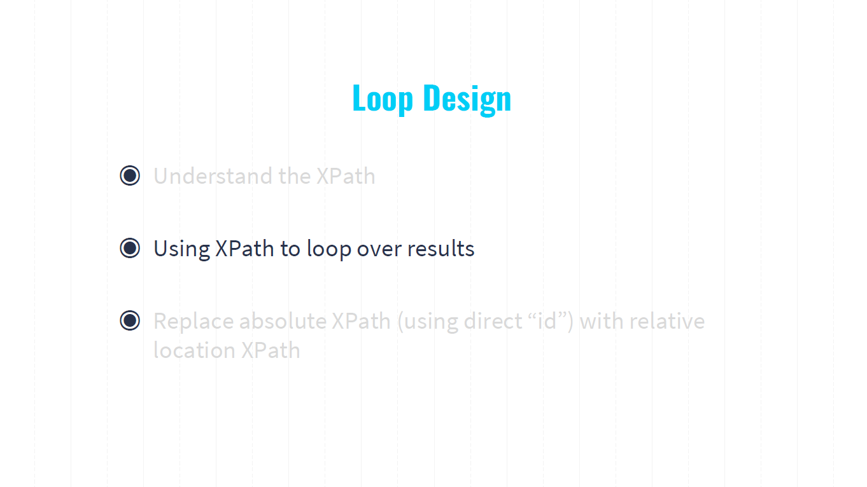

Slide 18
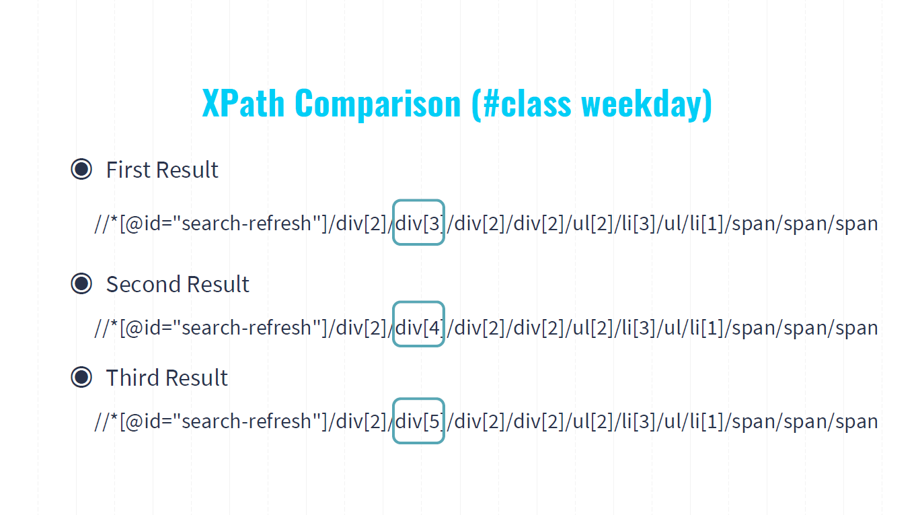

Slide 19
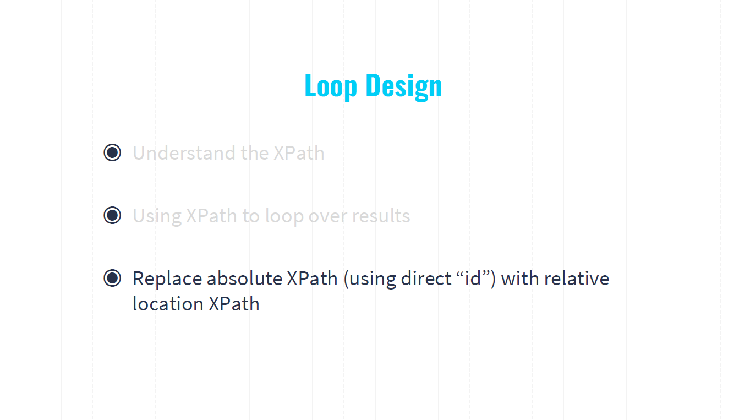

Slide 20
