Slide 1
Building Effective Agents
Erik Schluntz and Barry Zhang

Slide 2
What are Agents?
Agents can be fully autonomous systems performing complex tasks.
Some implementations follow predefined workflows.
At Anthropic, we distinguish between workflows and agents: workflows are predefined, agents are dynamically controlled by LLMs.

Slide 3
When (and when not) to use Agents
Use simplest solution first, increase complexity only when needed.
Agentic systems trade latency and cost for better task performance.
Workflows: Predictability and consistency for well-defined tasks.
Agents: Flexibility and model-driven decision-making for complex, scalable tasks.

Slide 4
Common Frameworks for Agents
LangGraph (LangChain): Simplifies LLM calls and tool integration.
Amazon Bedrock: Provides a robust AI Agent framework.
Rivet & Vellum: Offer streamlined tool definitions and chaining.
Warning: Frameworks can obscure underlying prompts, complicating debugging.

Slide 5
Building Blocks and Workflows
Augmented LLM: Enhances models with retrieval, tools, and memory, tailored to specific use cases.
Prompt Chaining: Breaks tasks into sequential steps, trading latency for accuracy.
Routing: Classifies inputs to specialized tasks, improving performance on diverse inputs.

Slide 6
Agents in Practice
Customer Support: Integrates chatbot interfaces with tool access for enhanced capabilities, enabling actions like issuing refunds and updating tickets.
Measurable Success: Companies use usage-based pricing models, charging only for successful resolutions, showcasing agent effectiveness.
Coding Agents: LLMs evolve from code completion to autonomous problem-solving, verified through automated tests and human review.

Slide 7
Key Principles for Building Effective Agents
Maintain simplicity in your agent's design.
Prioritize transparency by showing planning steps.
Thoroughly document and test your agent-computer interface (ACI).

Slide 8
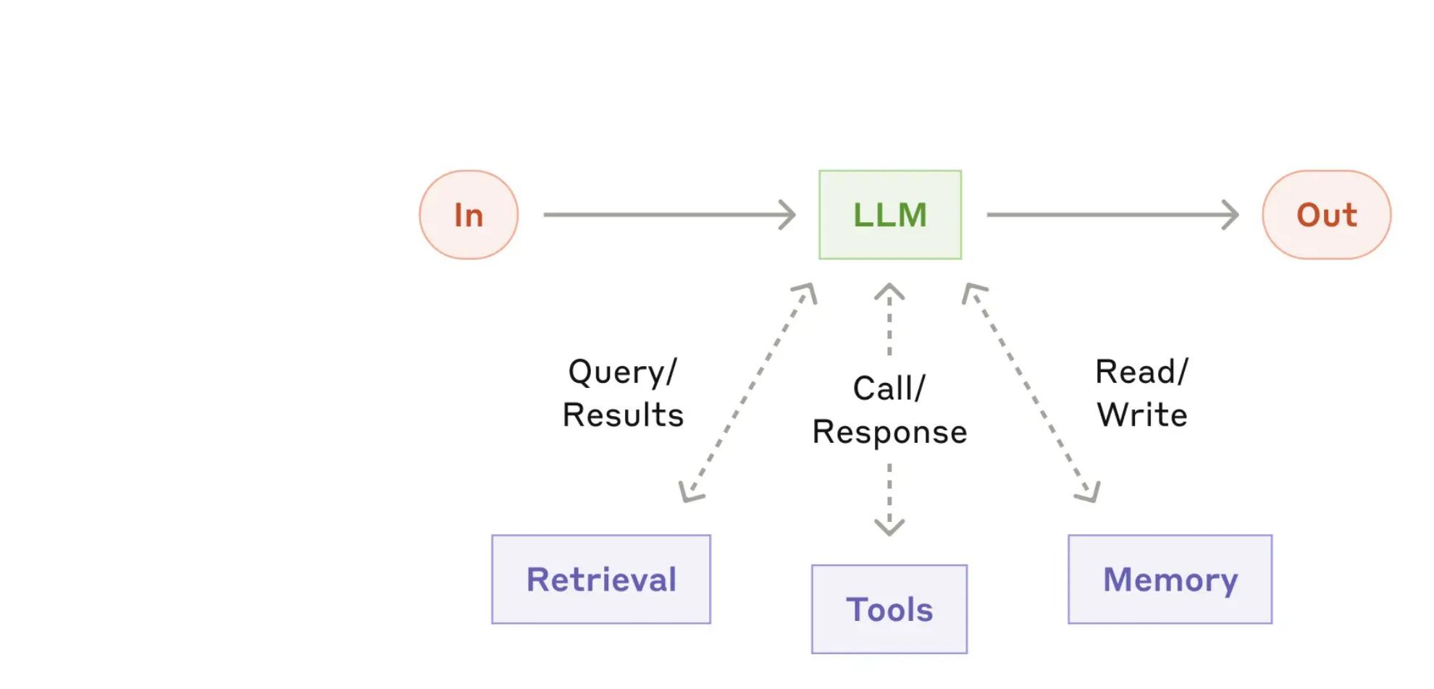
LLM Interaction
Input, LLM, and Output
Flowchart illustrating the interaction between input, LLM, and output, including retrieval, tools, and memory functions.

Slide 9
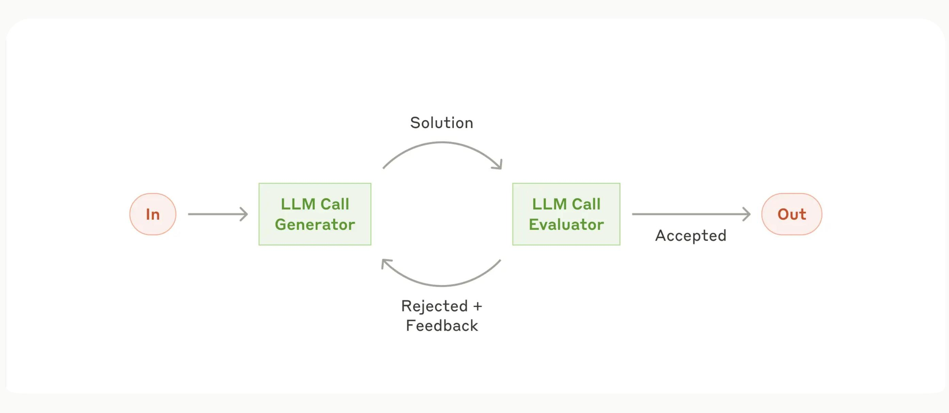
LLM Call Generator and Evaluator
Flowchart and Feedback Loop
This diagram illustrates the process from input to output through an LLM Call Generator and Evaluator. It includes a feedback loop for rejected solutions, ensuring continuous improvement and accuracy.

Slide 10
Thank you. Questions?

