Slide 1
FORESTRY SCIENCE LABORATORY

Slide 2

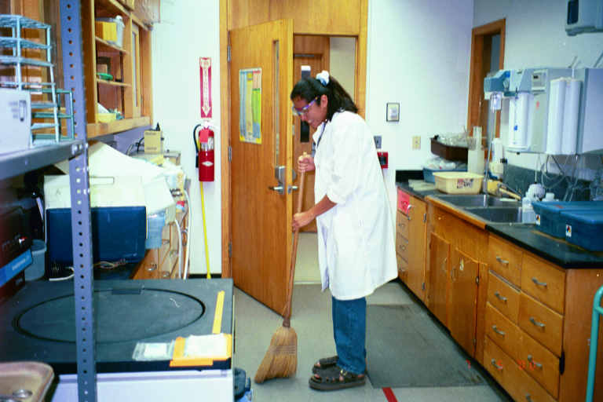
Here’s Lilly busy at her job
Notes:
Here’s Lily busy at her job

Slide 3
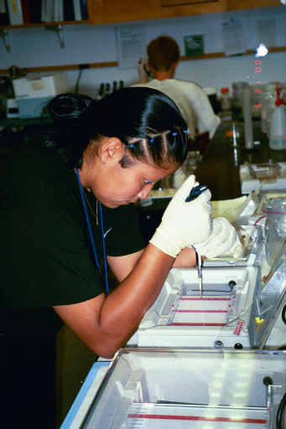
One of only pictures of Raven. She is loading a DNA sample for gel electrophoresis
Notes:
One of our only pictures of Raven. She is loading a DNA sample for gel electrophoresis

Slide 4
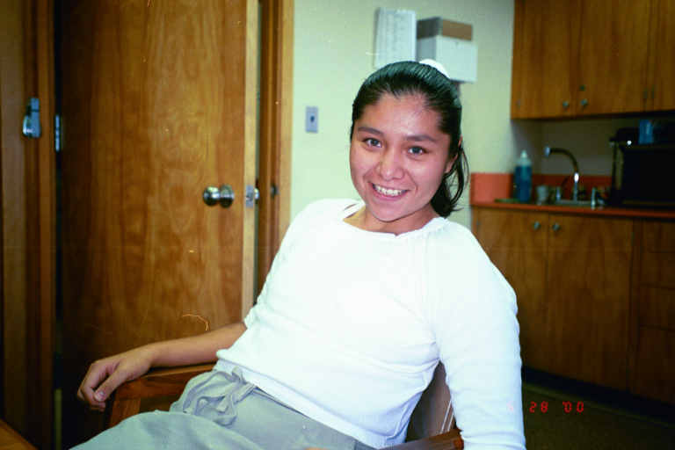
Lilly just chillin’

Slide 5
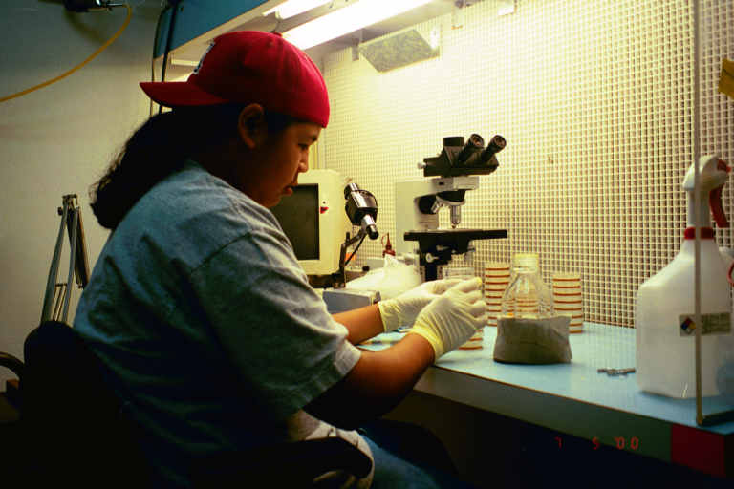
Here I am pouring a mixture into a small plate to grow diseases in

Slide 6

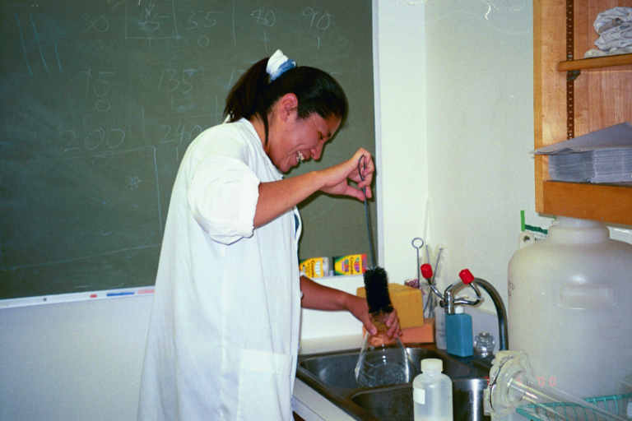
Lilly again , hard at work

Slide 7

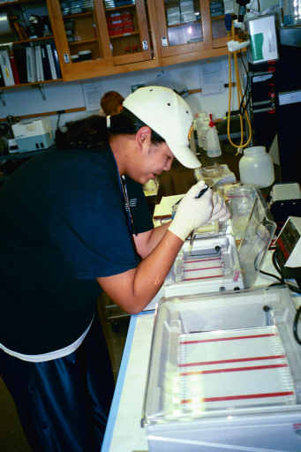
Now I’m trying to load DNA for gel electrophoresis

Slide 8
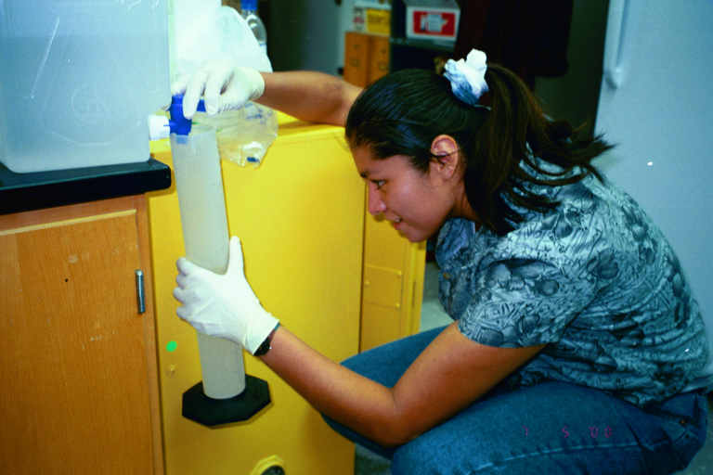
Lilly measuring distilled water

Slide 9

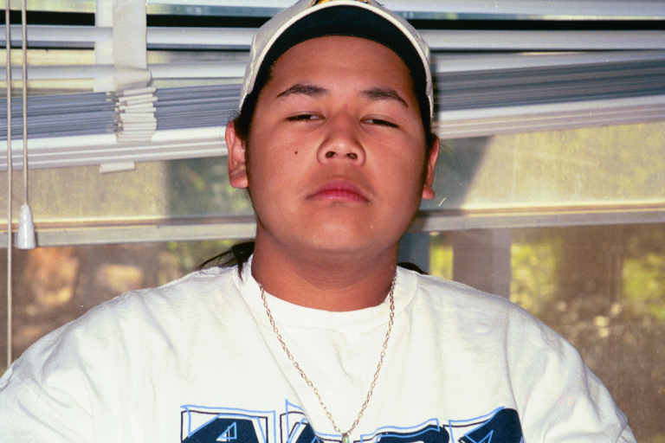
This is what happens when you get up at 6 in the morning

Slide 10
That is the end of our presentation

