Slide 1
SSD

Slide 2
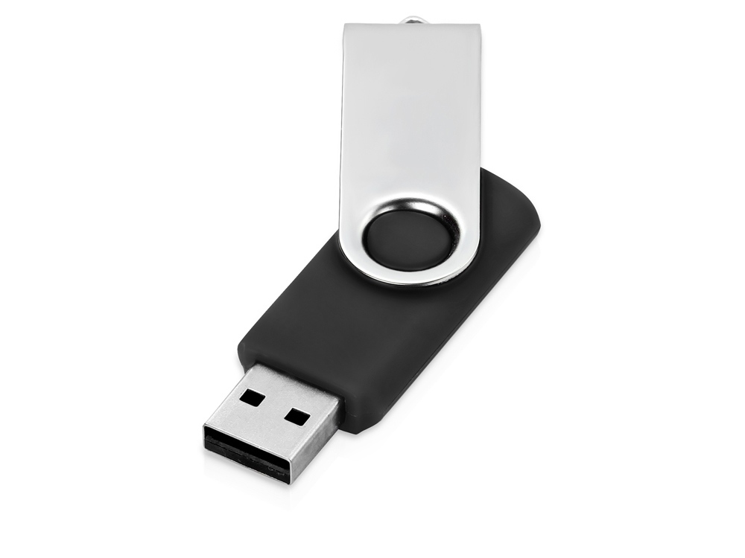
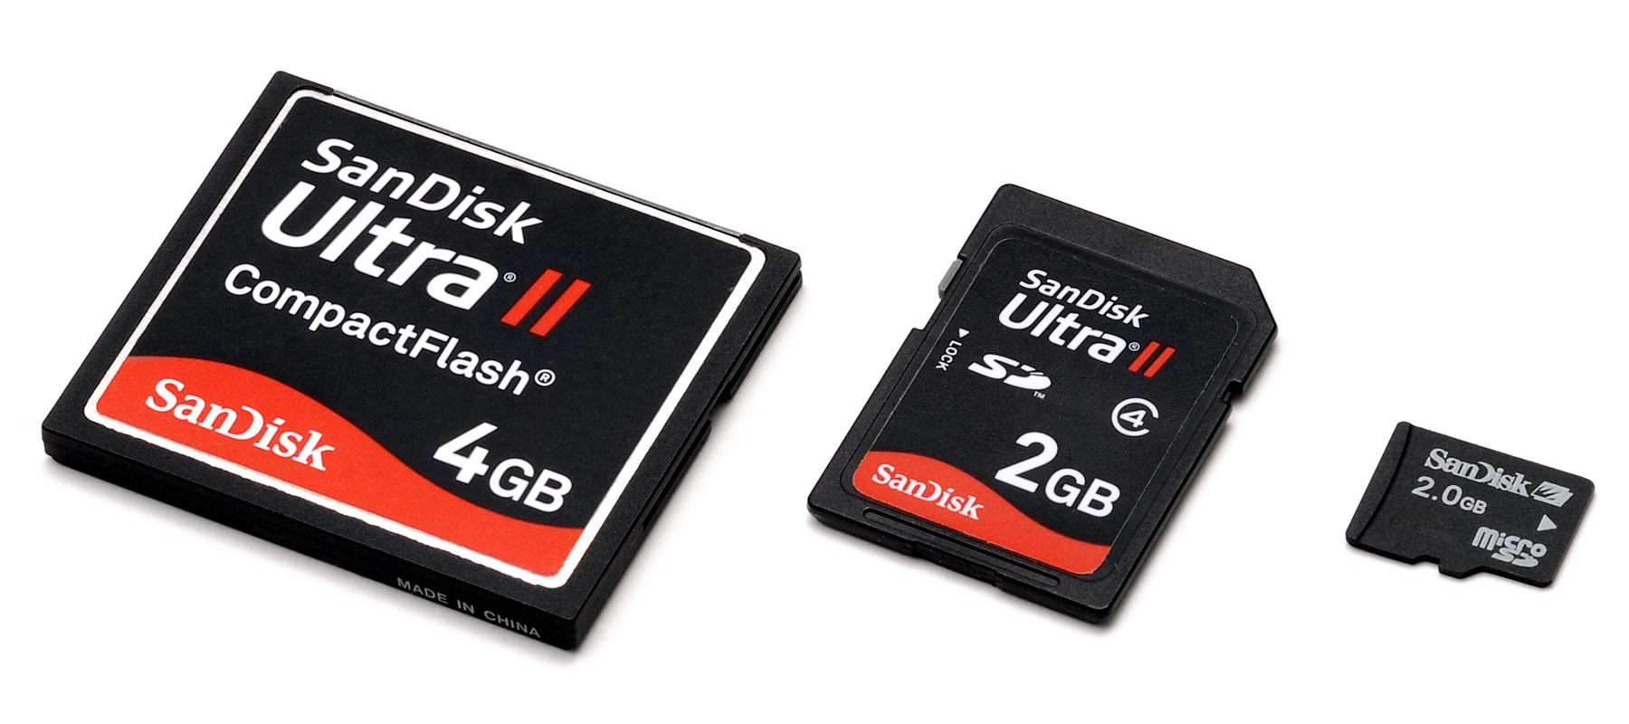
External drives
USB Flash Drive
CompactFlash, SD and microSD memory cards

Slide 3
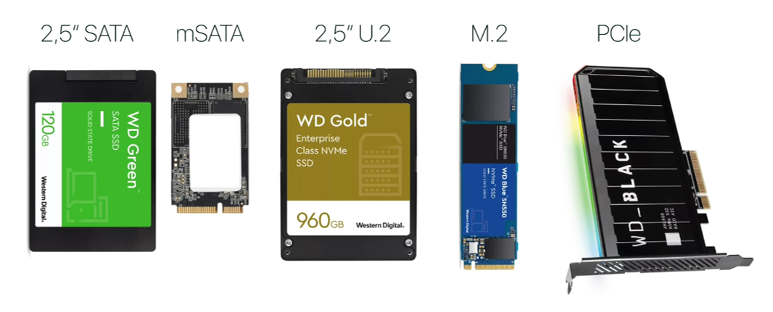
Embedded drives

Slide 4
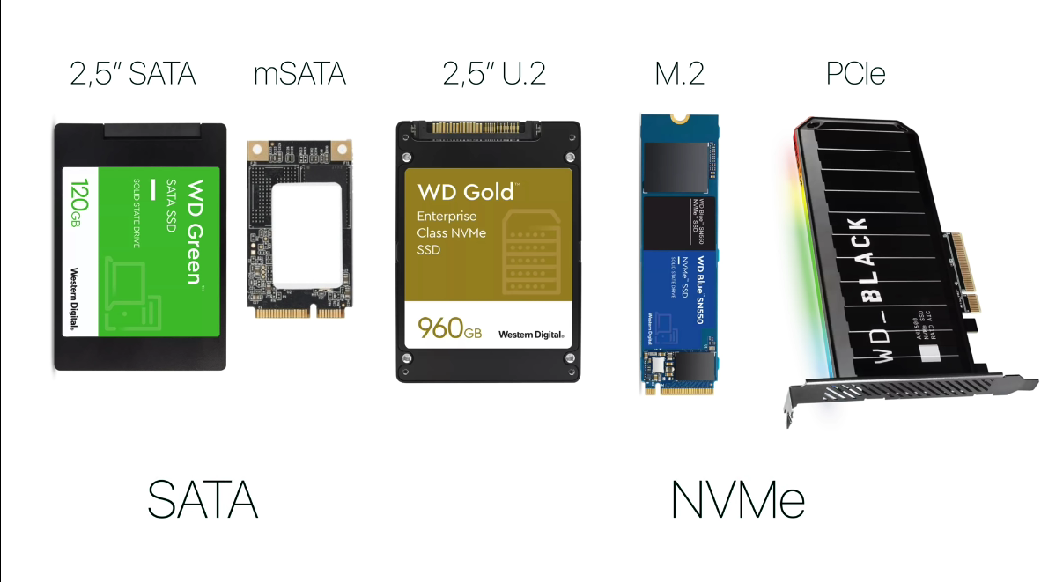
Form Factors: 5
Interfaces: 2

Slide 5
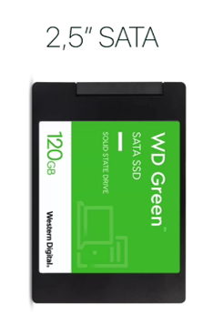
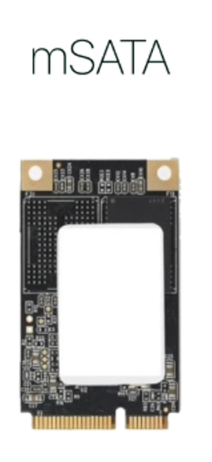
Only support
SATA
— old slow interface

Slide 6
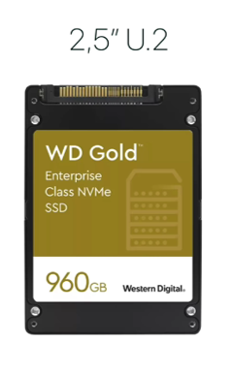
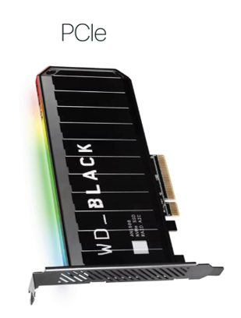
Only support
NVMe
— new fast interface
And they work via PCIe

Slide 7
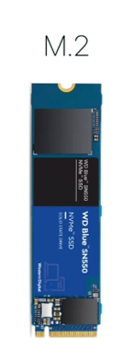
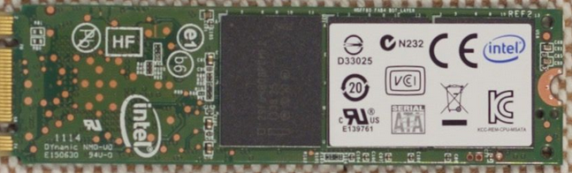
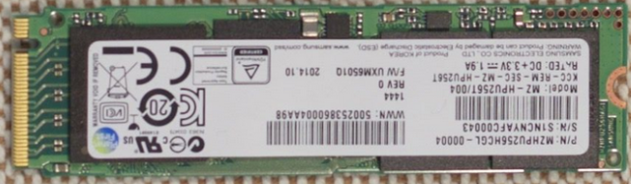
M.2 SATA
Support
SATA or NVMe
M.2 NVMe

Slide 8
Interface
SSD
main long - term memory
2, 5 ’’ SATA
SATA
SSD Minimization
mSATA
M.2 SATA
Rejection of SATA
NVMe
M.2 NVMe
(work via PCIe)

