Slide 1
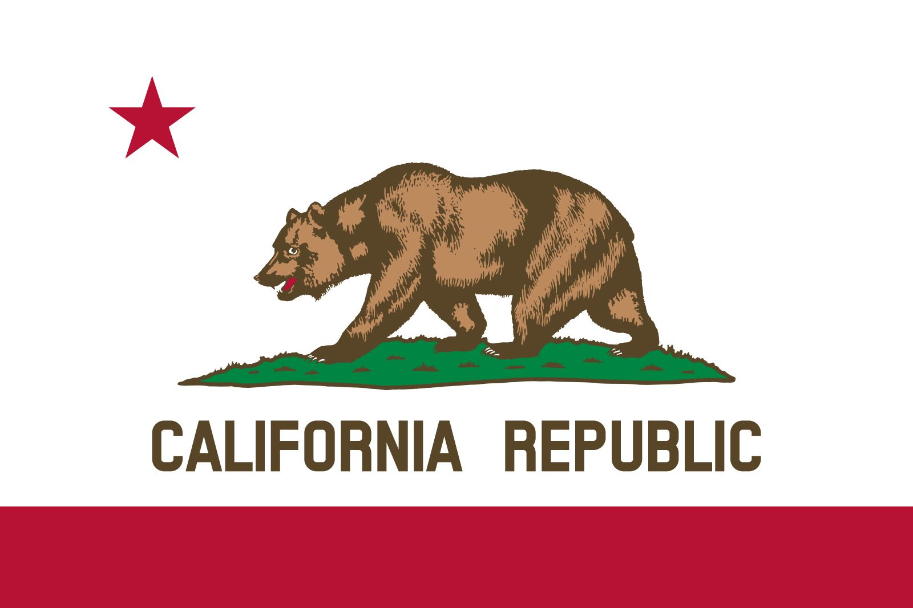
The 31st state

Slide 2
The Golden State is a nickname for the U.S. state of California.

Slide 3
