Slide 1
Email
— Electronic Mail
April-2022

Slide 2





Web-based
Email-Clients

Slide 3
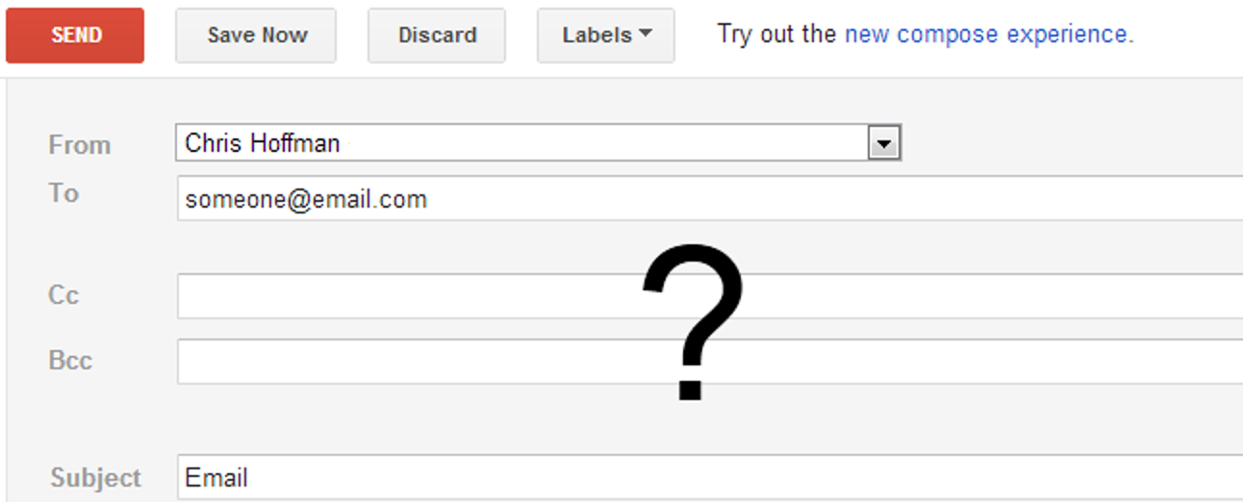
Structure of the Email

Slide 4
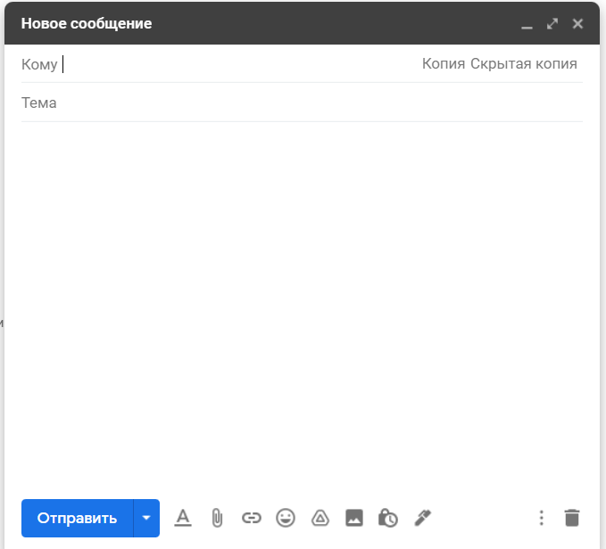

Slide 5
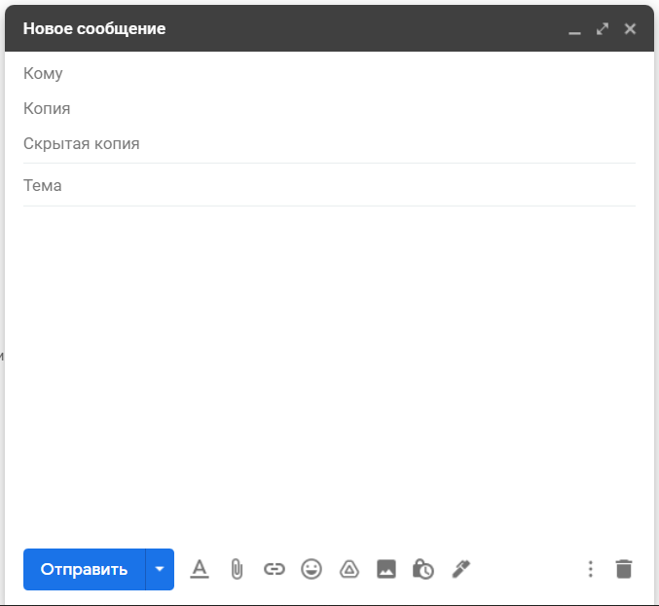
To
CC - Carbon Copy
BCC - Blind carbon copy

Slide 6
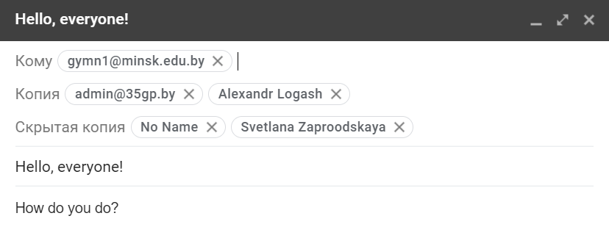

Slide 7
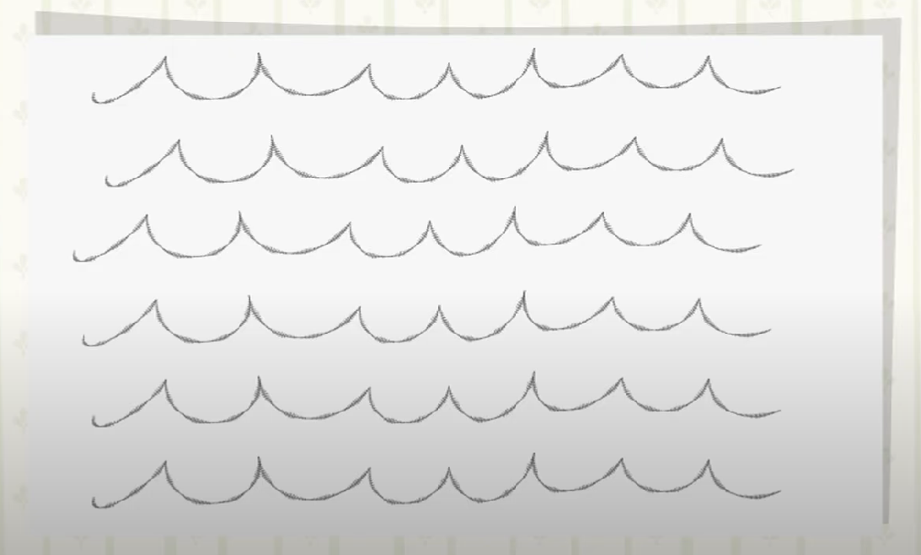
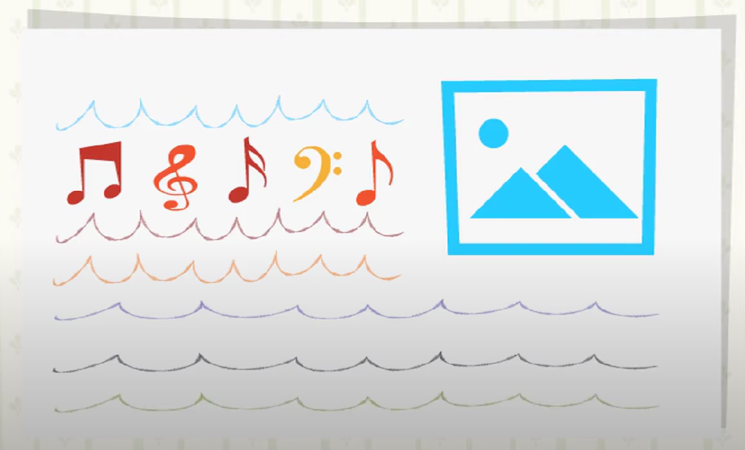
Email Formats
Plain Text (.txt)
Rich Text Format (.rtf)
Can be read by anyone, regardless of the Email app they use.
Doesn’t offer any text formatting options.
Allows text formatting options and inserting pictures and graphics.
It cannot be read by all email applications.

Slide 8
Which Protocols used in e-mail?

Slide 9
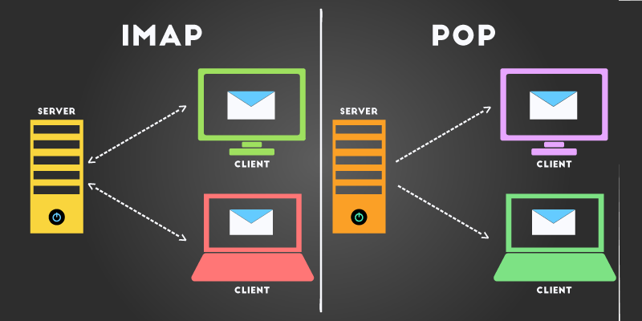
IMAP
Internet Message Access Protocol
is a standard client/server protocol for accessing e-mail from local server. It works well over slow connections and low data transfer.

Slide 10
POP 3
Post Office Protocol 3
protocol provides a simple, standardized way for users to access mailboxes. It download messages to their computers in one shot to minimize internet costs.

Slide 11
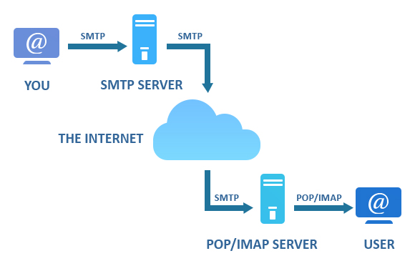
SMTP
Simple Mail Transfer Protocol
Protocol is used ONLY when you send email to another email users.

Slide 12
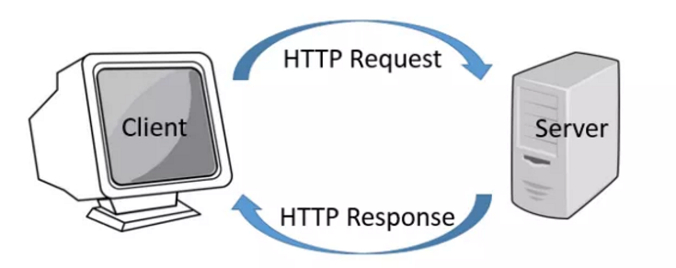
HTTP
Hyper Text Transfer Protocol
Is not protocol dedicated for email but it can be used for accessing mailbox.

