Slide 1
Master Mind
Crack the computer generated code!
2020 Kim Minki

Slide 2
1
About the App
2
About Input and Output
3
About the Code

Slide 3
Chapter 1
About the App

Slide 4
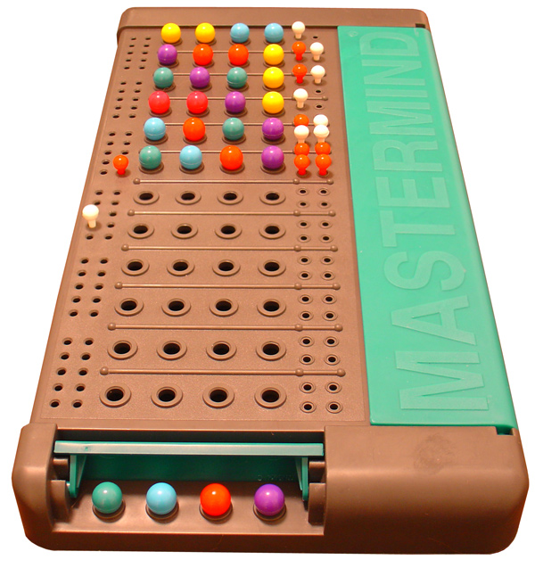

1. About the App
What is Mastermind?
A classic code breaking board game
Code contains colors and their position
8 colors + 4 positions
-> you can generate 8⁴ code
How to play?
Code-maker(computer) generates a code
Code-cracker(user) guesses the code
Code-maker(computer) gives a hint
- how many colors are right
- How many positions are right

Slide 5
1. About the App
You don’t need a partner!
Its free!
Save time!
Anytime no matter how long
Anywhere
Anybody
You don’t need to buy the game
No risk of damage
Unpack the game
Find the place to set up
Set up
Check if your partner is lying
Check mistakes
Reorganize after the game
-> Computer does it all!
Why not board game but Computer based game? What are the benefits?

Slide 6
1. About the App
Example
1. Yellow yellow green green
Colors matching : 1
Positions matching : 0
2. Yellow green pink blue
Colors matching : 3
Positions matching : 3
3. Green pink pink blue
Colors matching : 3
Positions matching : 3
4. Green green pink blue
Colors matching : 4
Positions matching : 4
Victory!
The Code : green green pink blue

Slide 7
Chapter 2
About the Input and Output

Slide 8
2. About the Input and Output
Computer
Guesses the code(input)
Computer
User
Shows how many colors are right
Shows how many positions are right
(output)
※User has 10 chances

Slide 9
Chapter 3
About the Code

Slide 10
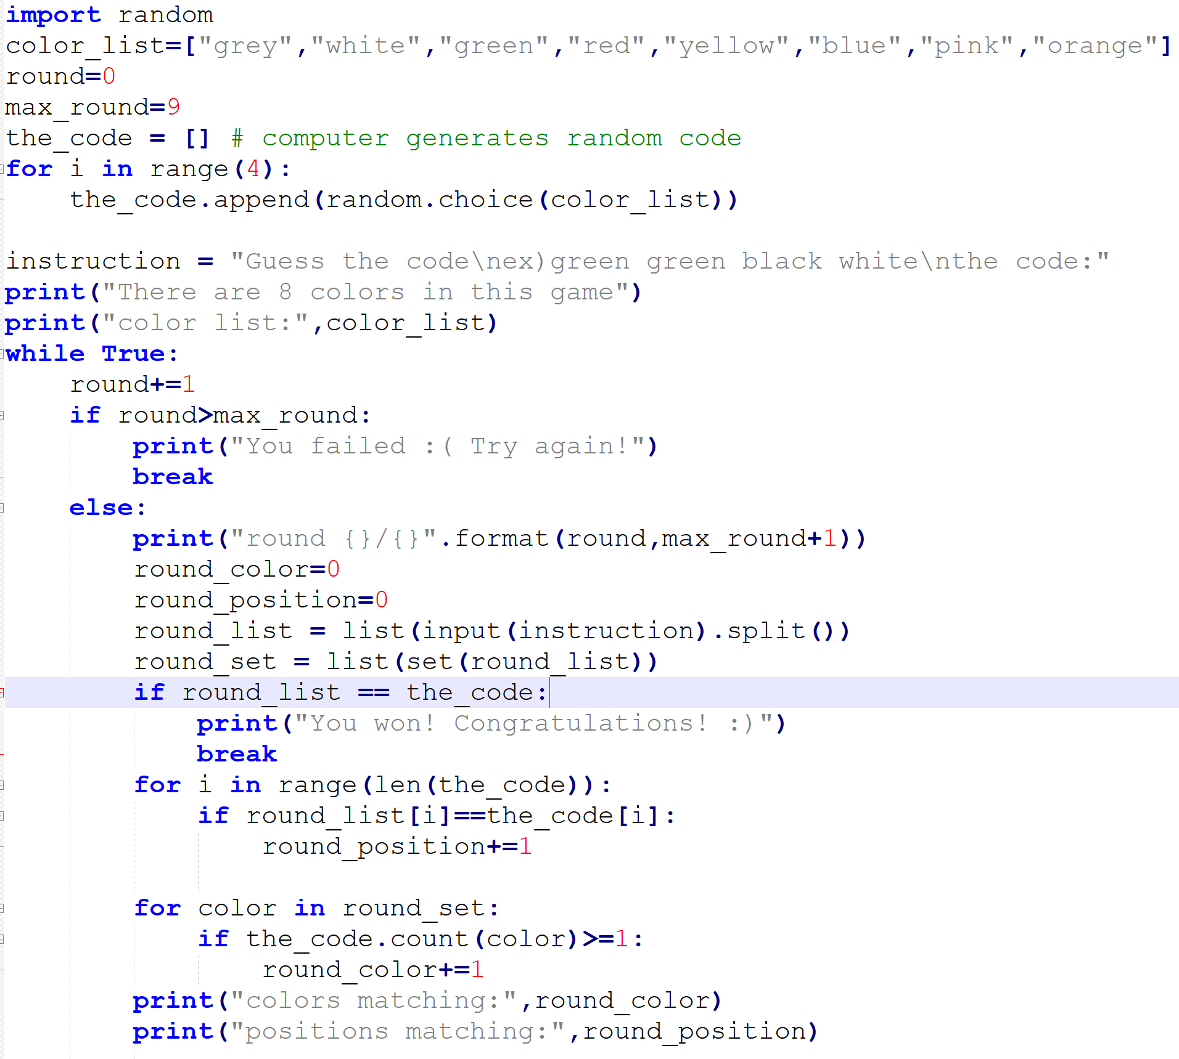
3. About the Code
Full Code

Slide 11
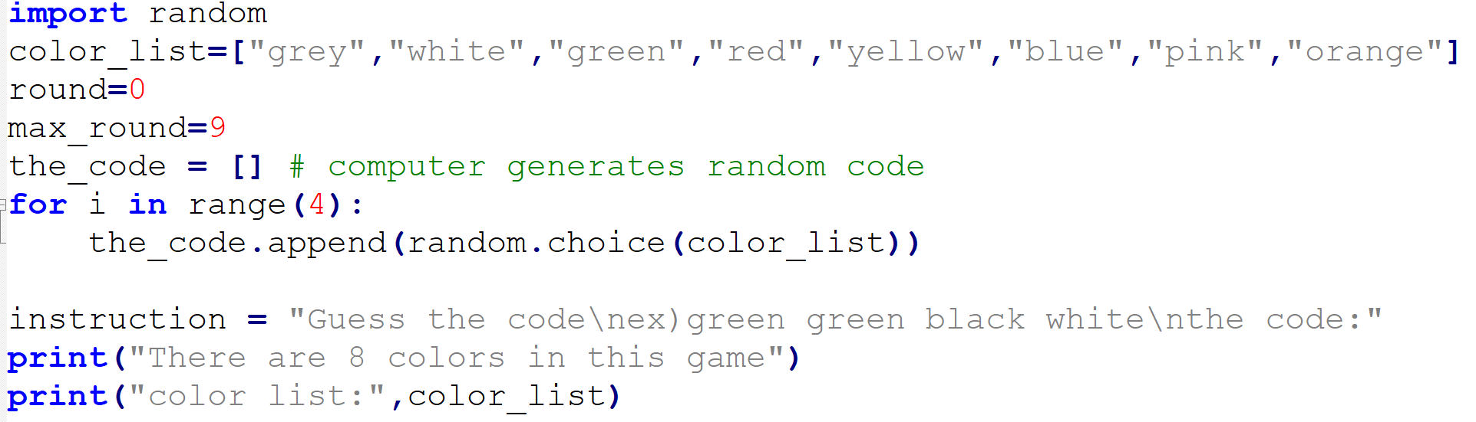
3. About the Code
Initialize variables to prepare the game
Initialize variables
Generates 4 letters code with random.choice() function out of 8 colors in color_list

Slide 12
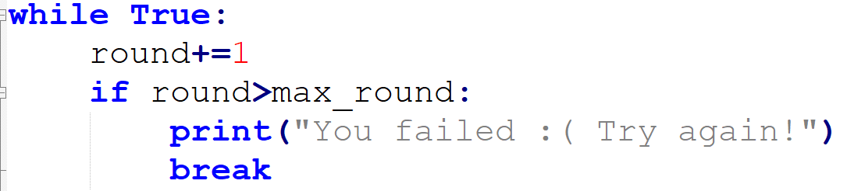
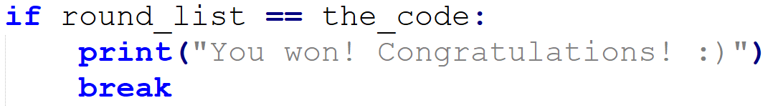
3. About the Code
Set the condition of end of the program(game)
Continue the game until the final round(round 10)
If victory or lose happens, end the loop(end the program)
(victory condition: guess the 4-letters code right, lose condition: fail 10 rounds)

Slide 13
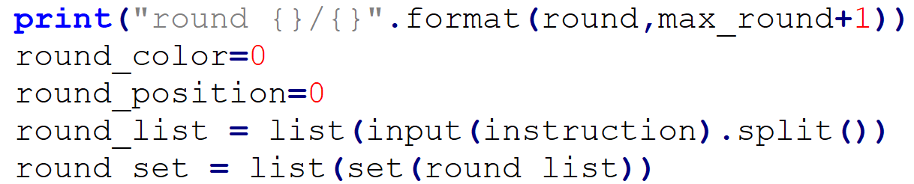
3. About the Code
Play the round
Show the current and max round
Initialize round_color and round_position for every round
Get the guess from the user’s input

Slide 14
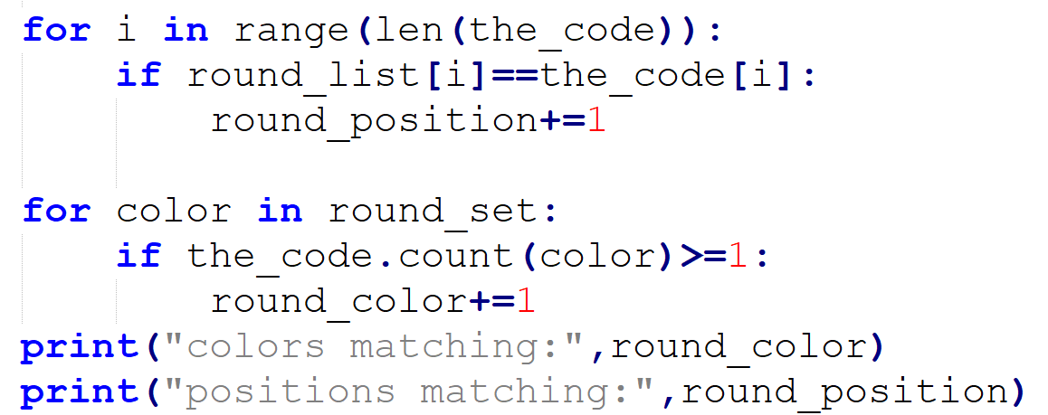
3. About the Code
Check the user’s guess
Check how many positions and colors are right from the user’s guess
Show how many colors and positions are right from the user’s guess

Slide 15
Thank you

