Slide 1
Scaffolding INGENUITY (Phase 1 - Plenum)
Notes:
teleprompter: Hello and welcome everyone. My name is Alexander Isop and today I am going to talk about Ingenuity, the first helicopter on Mars.
sound: PlenumSettingUpSessionStartup

Slide 2
CONTENTS
Notes:
teleprompter: But first, let me hand over to MARVIN, my display drone companion. He will support me a little bit with the introduction of my talk.
camera: expand_projection
rep_name: marvin
rep_interaction: reference
rep_interaction_switch: [2.25,1.6,1.0,3.141592654]

Slide 3
CONTENTS
Overview of contents:
  How did Ingenuity evolve over time?
  Why did NASA build Ingenuity?
  How does it work and what are the main components?
  What was one of the biggest challenges?
  How to imagine flying Ingenuity on Earth and on Mars?
Notes:
teleprompter: Add your slide notes here.
marvin_presenter: Hello and welcome everyone also from my sides. My name is Marvin and I am going to support Alex with the introduction of his talk. So, first, Alex is going to talk about how Ingenuity evolved over time. Second, Alex will give details about its motivation. Third, Alex will go deeper into core components of Ingenuity, its functioning and biggest challenges. And, in a final step, a virtual experiment is presented so the audience may better imagine what its like to fly Ingenuity on Mars.
rep_name: ingenuity
rep_interaction: takeoff

Slide 4
HOW DID INGENUITY EVOLVE OVER TIME?
Notes:
teleprompter: Well thank you MARVIN. As mentioned before, I would like to briefly talk about the evolution of Ingenuity.
camera: expand_projection
rep_name: marvin
rep_interaction: reference
rep_interaction_switch: [2.5,0.0,1.0,3.141592654]

Slide 5
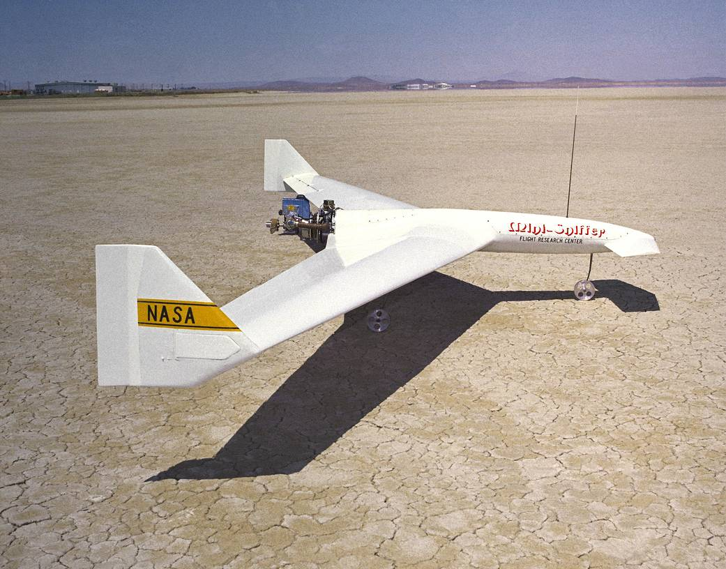
HOW DID INGENUITY EVOLVE OVER TIME?
How to even fly on Mars?
  "Flying" on Mars is a big challenge (thin atmosphere!)
  Need for efficient aircraft concepts
  Between 1975 and 1982 R&D was ongoing already to build a small aircraft („Mars Aircraft“)
  Until Ingenuity was developed >>> no other concept available that actually met the requirements!
Figure 1: Mini aircraft concept, the so called "Mini-Sniffer"
(NASA, 2023).
Notes:
teleprompter: So how easy or difficult is it for a helicopter to fly on Mars. And the answer is, its quite challenging due to a very low-pressure and low-density atmosphere close to ground. The development of according aircraft concepts started quite some time ago already, in the mid seventies. However, those were fixed wing aircrafts and until the development of Ingenuity no other concept actually met the requirements to hover close to the surface of Mars.
rep_name: ingenuity
rep_interaction: reference
rep_interaction_switch: [3.0,3.0,5.0,0.0]

Slide 6
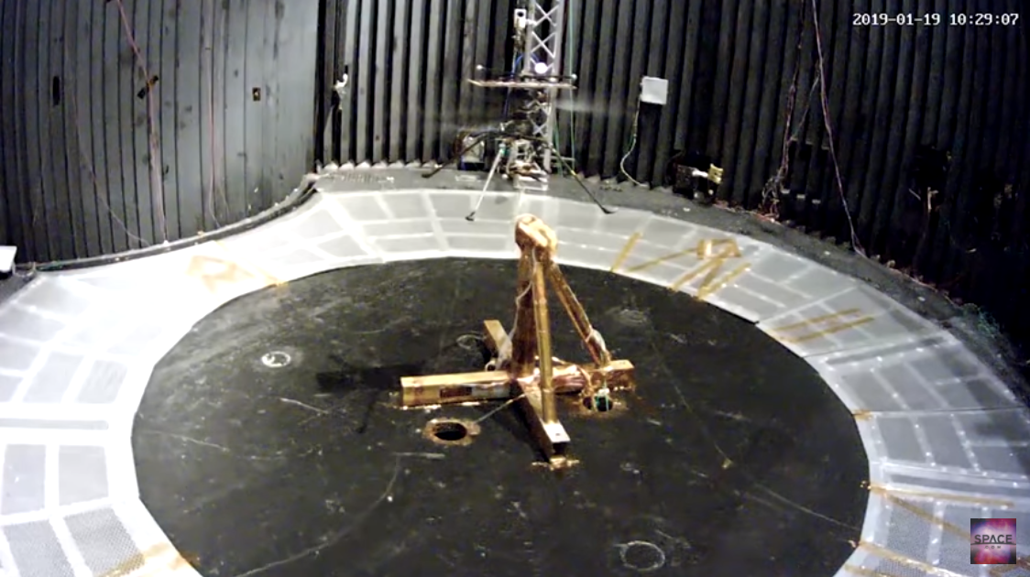
HOW DID INGENUITY EVOLVE OVER TIME?
First steps towards Ingenuity
  Much later in 2014 >>> new concept of a scout helicopter
  In 2017 first experiments in a Mars-like atmosphere
  Combined with temperature tests (-153deg to +20deg on Mars)
  In 2018 plans for participation with the Mars 2020 mission
Figure 2: Ingenuity prototype in a low-pressure test chamber (Space.com, 2019).
Notes:
teleprompter: Much later on, in 2012, the development of Ingenuity started off and, in 2014 the JPL published the concept for a scout helicopter to fly on Mars, for the first time. A couple of years later, experiments were conducted in a dedicated test-chamber under Mars-like conditions. In 2018 funding of Ingenuity was confirmed to also participate with the Mars 2020 mission and accompany the Perseverance Mars Rover.
rep_name: ingenuity
rep_interaction: reference
rep_interaction_switch: [1.0,3.0,1.0,0.0]

Slide 7
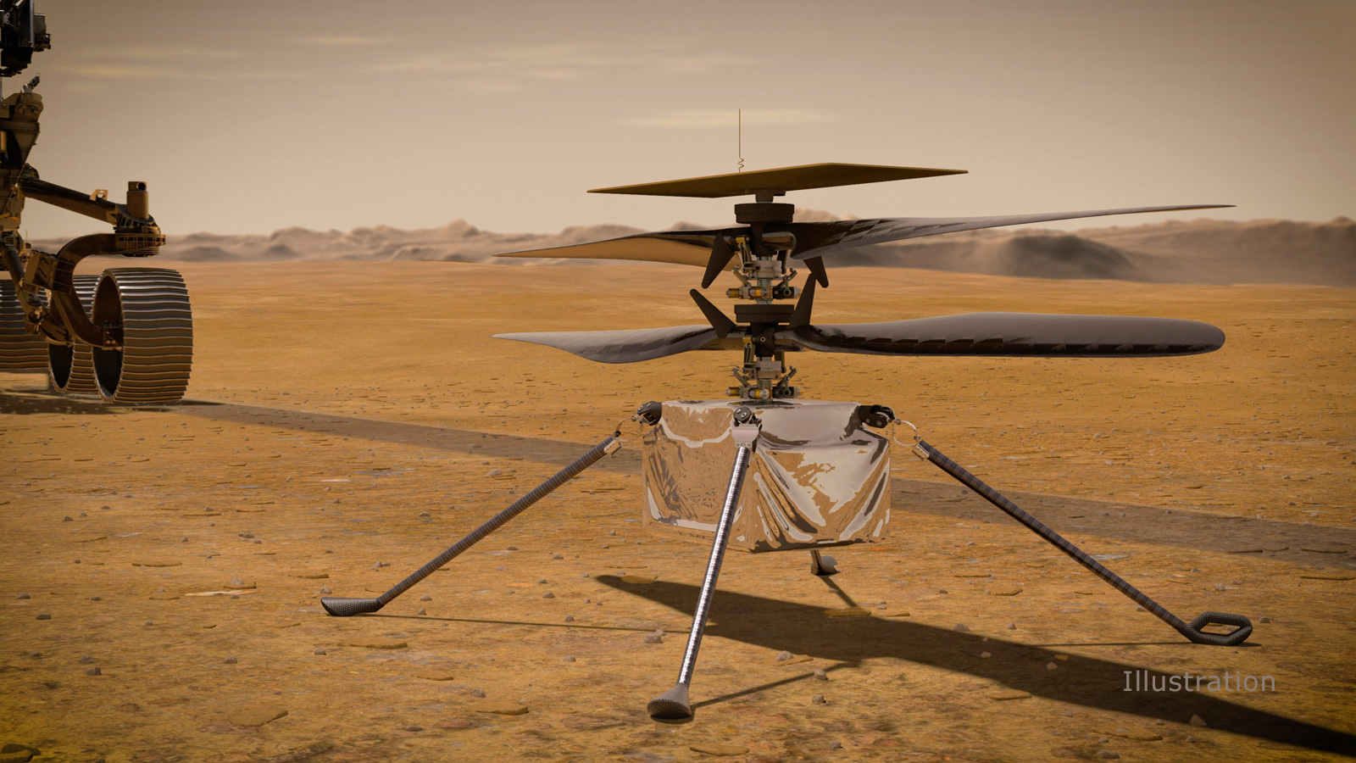
HOW DID INGENUITY EVOLVE OVER TIME?
Participation at Mars 2020
  In 2019 final tests with a first prototype
  In the dedicated vacuum chamber to ressemble the thin atmosphere and low temperature
  Low atmospheric pressure, enriched with CO2 mimicked challenging flight environment
  After launch of Mars 2020 mission, Ingenuity deployed at Mars on 4.April 2021
Figure 3: Ingenuity as landed on Mars, as part of the Mars 2020 mission, together with Perseverance (NASA, 2025).
Notes:
teleprompter: This was followed by final tests in 2019. More test flights were conducted under Mars-like conditions. Such conditions included a low-density atmosphere, which is approximately one percent of earths atmosphere, and low temperatures.
rep_name: ingenuity
rep_interaction: land

Slide 8
WHY DID NASA BUILD INGENUITY?
Notes:
teleprompter: So what was the intention behind the development of Ingenuity after all.
camera: expand_projection
rep_name: ingenuity
rep_interaction: shutdown

Slide 9
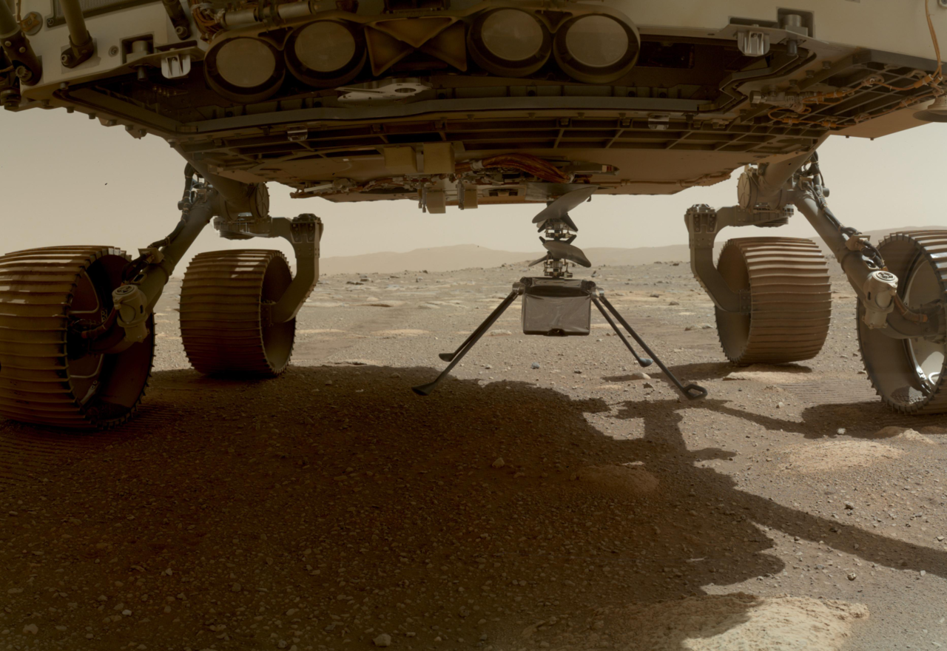
WHY DID NASA BUILD INGENUITY?
Motivation of Ingenuity:
  First integration of a flying robot into another wheeled robot to explore Mars
  Highly efficient propulsion system
  Technology-demonstrator >>> What is even possible?
Figure 4: Ingenuity deployed on Mars, from the Mars Exploration Rover (MER) "Perseverance" (SpaceFlight Now, 2024).
Notes:
teleprompter: For the first time, a flying robot accompanied a roving robot on Mars. As always, the goal was also to push technical limits and build a demonstrator. In particular, this concerns the propulsion system, which is actually highly efficient.
rep_name: ingenuity
rep_interaction: idle

Slide 10
HOW DOES IT WORK?
Notes:
teleprompter: Now I would like to go into details of Ingenuitys components and how they basically work.
camera: expand_projection

Slide 11
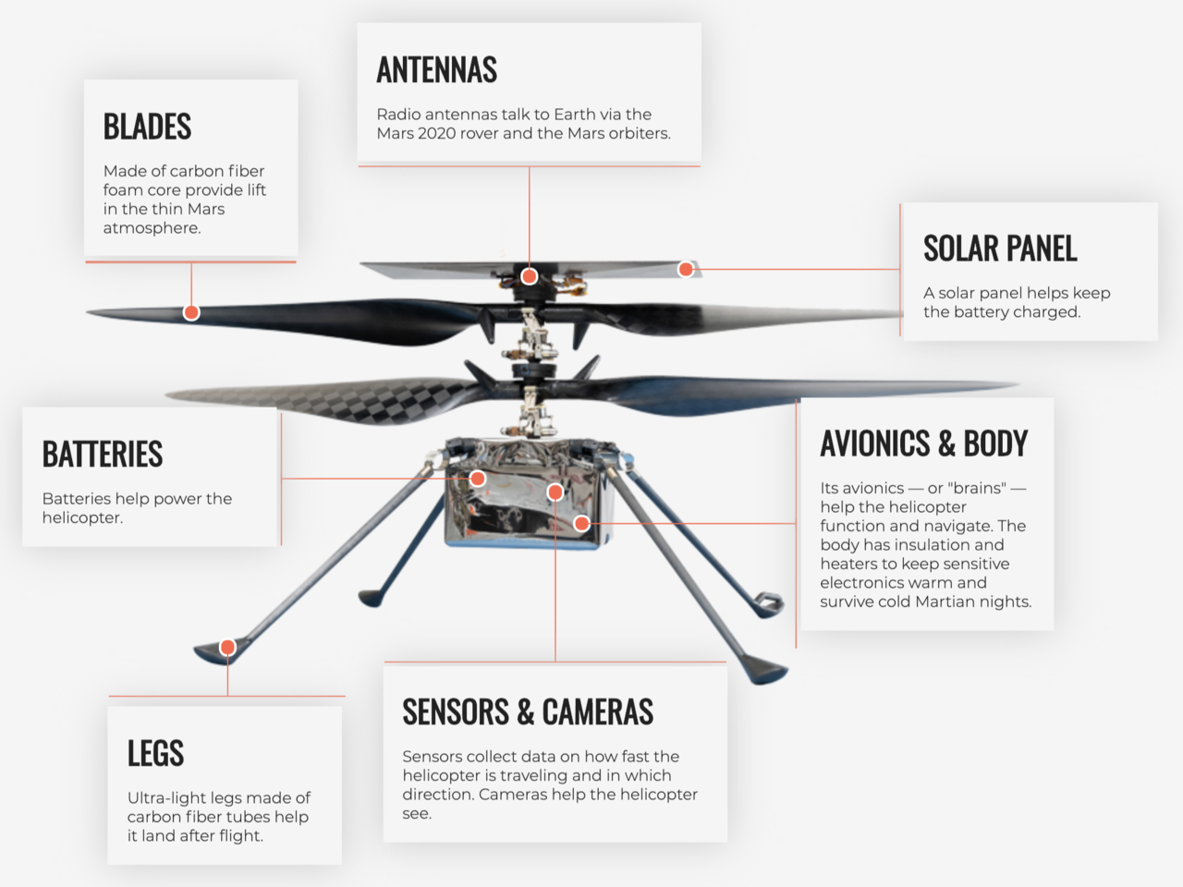
HOW DOES IT WORK?
Main components (1 of 5):
  Energy supply
    Solar panel >>> rovides power for the built in battery
    Li-Ion battery >>> must resist temperatures below -90deg
Figure 5: Main components of Ingenuity (NASA, 2025).
Notes:
teleprompter: With Ingenuity the energy does not come from a small nuclear power plant, but is taken from a lithium ion battery. And this battery, in turn, is charged with a solar panel. Mentionable is the wide temperature range, in which the battery has to reliably operate. The temperature on Mars may vary between minus 153 and plus 20 degrees Celsius.

Slide 12
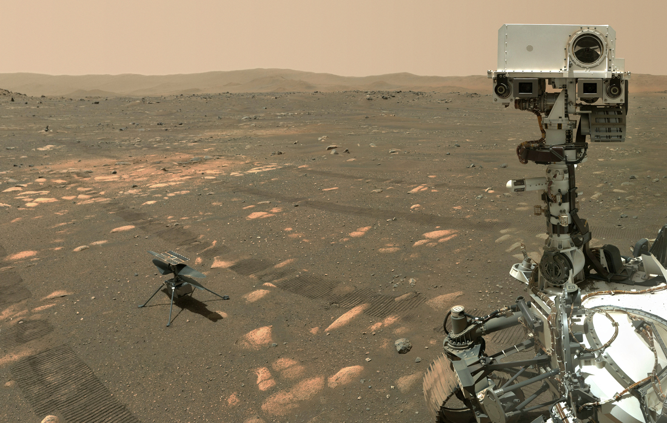
HOW DOES IT WORK?
Figure 6: Perseverance is taking a selfie, with Ingenuity in the background, on the 6.April 2021 (NASA, 2021).
Main components - ENERGY SUPPLY:
Notes:
teleprompter: So the solar panel is located at the top, whereas the battery is located in the main body of Ingenuity.
camera: [-1.0,-1.0,2.0,0.0,0.0,0.0]
camera_link: ingenuity/link_base

Slide 13
HOW DOES IT WORK?
Main components (2 of 5):
  Communication
    Radio antennas >>> establish communication to earth
    radio signals >>> are relayed via the MER and a dedicated orbiter
Figure 5: Main components of Ingenuity (NASA, 2024).
Notes:
teleprompter: Another important component are the antennas of Ingenuity to establish communication. They are monopole antennas and establish a communication link to the Mars Rover with thousand meters of range and up to 250kbit/s of bandwidth.

Slide 14
HOW DOES IT WORK?
Figure 6: Perseverance is taking a selfie, with Ingenuity in the background, on the 6.April 2021 (NASA, 2021).
Main components - COMMUNICATION:
Notes:
teleprompter: And here you can see the antennas mounted on the top of the solar panel.
camera: [-1.0,1.0,1.0,0.0,0.0,0.0]
camera_link: ingenuity/link_base

Slide 15
HOW DOES IT WORK?
Main components (3 of 5):
  Main body
    Avionics >>> the brains of Ingenuity to fly and navigate on Mars
    Sensors >>> provide valuable data to the Avionics for flight/navigation (IMU, cameras, other environmental sensors)
Figure 5: Main components of Ingenuity (NASA, 2024).
Notes:
teleprompter: Also, the main body holds other essential components like sensors and computers to control flight and navigate on Mars. There are inertial sensors and cameras to supply the avionics with vital data during flight.

Slide 16
HOW DOES IT WORK?
Figure 6: Perseverance is taking a selfie, with Ingenuity in the background, on the 6.April 2021 (NASA, 2021).
Main components - MAIN BODY:
Notes:
teleprompter: Inertial sensors, cameras, and avionics are located in the main body of Ingenuity.
camera: [-1.0,-0.1,0.5,0.0,0.0,0.0]
camera_link: ingenuity/link_base

Slide 17
HOW DOES IT WORK?
Main components (4 of 5):
  Landing gear
    Legs >>> need to be ultralightweight, however provide enough stability to safely land on Mars (carbon fiber tubes)
Figure 5: Main components of Ingenuity (NASA, 2024).
Notes:
teleprompter: To safely land on the surface of Mars, a robust and very lightweight landing gear is required. The landing gear of Ingenuity is ultralightweight, mainly consisting of hollow carbon fiber tubes.

Slide 18
HOW DOES IT WORK?
Figure 6: Perseverance is taking a selfie, with Ingenuity in the background, on the 6.April 2021 (NASA, 2021).
Main components - LANDING GEAR:
Notes:
teleprompter: And here you can see the landing gear, with its legs, made of carbon fiber.
camera: [-1.0,1.0,0.25,0.0,0.0,0.0]
camera_link: ingenuity/link_base

Slide 19
WHAT WAS ONE OF
THE BIGGEST CHALLENGES?
Notes:
teleprompter: And this leads us to the component, posing the biggest challenge during the design of Ingenuity. And this was actually the propulsion system. And at this point I may ask MARVIN what is even a propulsion system?
camera: expand_projection
rep_name: ingenuity
rep_interaction: reference
rep_interaction_switch: [1.0,3.0,1.0,0.0]

Slide 20
ONE OF THE BIGGEST CHALLENGES?
Main components (5 of 5):
  Propulsion system (rotors)
    co-axial (two) rotors >>> very efficient
    diameter is about 1.2m, however weight is just 28g for one rotor
    build of a carbon-fiber coated foam core
    considerably high RPM (2537rpm just before take-off)
Figure 5: Main components of Ingenuity (NASA, 2024).
Notes:
teleprompter: Thank you MARVIN once again. The propulsion system consists of two coaxial ultralightweight rotors. According to legend, one rotor weighs 28 grams only and is built of carbon fiber coated foam. The rotational speed is also considerably high with up to 2700rpm.
rep_name: ingenuity
rep_interaction: startup

Slide 21
HOW DOES IT WORK?
Figure 6: Perseverance is taking a selfie, with Ingenuity in the background, on the 6.April 2021 (NASA, 2021).
Main components - PROPULSION SYSTEM:
Notes:
teleprompter: And here you can see the rotors in detail, with a diameter of approximately one point two meters.
rep_name: ingenuity
rep_interaction: takeoff

Slide 22
HOW TO IMAGINE FLYING INGENUITY
ON EARTH AND ON MARS?
Notes:
teleprompter: Finally, I would like to give you an impression of how it could look like to hover with Ingenuity on Mars.
rep_name: ingenuity
rep_interaction: reference
rep_interaction_switch: [1.0,3.0,5.0,0.0]

Slide 23
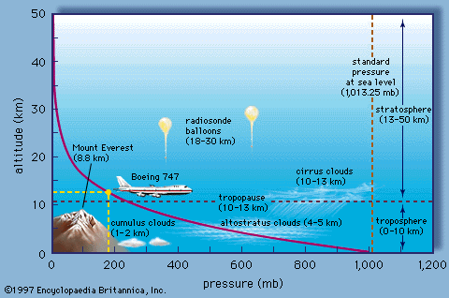
HOW TO IMAGINE FLYING INGENUITY?
Flying on Mars:
  Gravity is three times lower than on earth with g_{M}=3.73m/s²
  however, atmosphere is very thin >>> about 6-7mBar close to ground (less than 1% of pressure on Earth), same with density (1-2% of earth)
  equivalent to 45km of altitude on earth >>> bad conditions for a "propelled" aircraft...
Figure 7: Air pressure, depending on altitude, on earth (Atmo, 2025).
Notes:
teleprompter: The big challenge ist the thin atmosphere with a density that is roughly 100 times lower than on earth. This would be the same as to fly at an altitude of 45 kilometers on erth. And these are indeed difficult flight conditions for a helicopter.
camera: [-1.0,-1.0,2.0,0.0,0.0,0.0]
camera_link: ingenuity/link_base
rep_name: ingenuity
rep_interaction: reference
rep_interaction_switch: [10.0,5.0,5.0,0.0]

Slide 24
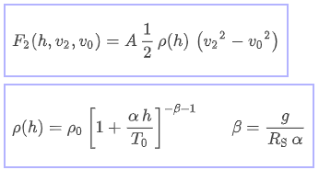
HOW TO IMAGINE FLYING INGENUITY?
Quick experiment (EARTH):
  Flying on Eearth
    m_{ING}=1.8kg
    g_{E}=9.81m/s²
    p_{E}=1013mBar at sealevel
    ρ_{E}=1.293kg/m³
Figure 7: Air pressure, depending on altitude, on earth (Atmo, 2025).
Notes:
teleprompter: And now for sakes of comparison, essential physical quantities for a flight on earth are provided. And with earths atmospheric density it would work quite well.

Slide 25
HOW TO IMAGINE FLYING INGENUITY?
Flying on EARTH:
Figure 6: Perseverance is taking a selfie, with Ingenuity in the background, on the 6.April 2021 (NASA, 2021).
Notes:
teleprompter: Here I can provide a flight experiment on earth with simulated wind gusts. And lets see how stable the flight will look like.
camera: [-2.0,-2.0,-2.0,0.0,0.0,0.0]
camera_link: ingenuity/link_base
rep_name: ingenuity
rep_interaction: sequence
rep_sequence_duration: 20.0
rep_sequence_state: [0.0,10.0,5.0,5.0,0.0,0.0,0.0]
rep_sequence_twist: [5.0,0.0,1.0,0.0,0.0,0.0,0.0, 10.0,0.0,1.0,0.5,0.0,0.0,0.0, 15.0,0.0,0.0,0.0,0.0,0.0,0.0]
rep_sequence_force: [15.0,0.0,0.0,0.0,0.0,0.0,0.0]

Slide 26
HOW TO IMAGINE FLYING INGENUITY?
Quick experiment (MARS):
  Flying on Mars
    m_{ING}=1.8kg
    g_{M}=3.73m/s² (nice!)
Figure 7: Air pressure, depending on altitude, on earth (Atmo, 2025).
Notes:
teleprompter: And now we switch to the more challenging flight environment on Mars. However, in a first step one might think that its much easier due to the much lower gravity on Mars.

Slide 27
HOW TO IMAGINE FLYING INGENUITY?
Flying on MARS:
  In terms of mass >>>
  Means saving roughly (3.73m/s² / 9.81m/s² = 0.3802) 62% of "weight"
  During hover >>>
  on Earth - F_{T,E}=m_{ING}*g_{E}=
  1.8kg*9.81m/s²=17.66N
  on Mars - F_{T,M}=m_{ING}*g_{M}=
  1.8kg*3.73m/s²=6.71N
Figure 6: Perseverance is taking a selfie, with Ingenuity in the background, on the 6.April 2021 (NASA, 2021).
Notes:
teleprompter: This lower gravity would mean saving roughly 62 percent of Ingenuitys weight if it is hovering on Mars. Which is nice, right?
camera: [-2.0,-2.0,-2.0,0.0,0.0,0.0]
camera_link: ingenuity/link_base
rep_name: world
rep_interaction: gravity
rep_interaction_switch: [0.0,0.0,-3.73]

Slide 28
HOW TO IMAGINE FLYING INGENUITY?
Quick experiment (MARS):
  Flying on Mars
    p_{M}=6-7mBar close to ground
    ρ_{M}=0.013-0.02kg/m³
    or 1-2% of ρ_{E} (bad! ^^)
Figure 7: Air pressure, depending on altitude, on earth (Atmo, 2025).
Notes:
teleprompter: However, due to the low density, we would loose ninetynine percent of the produced thrust on earth. And you can make an educated guess already, this is quite bad for a stable hover flight. So what would happen is actually this.

Slide 29
HOW TO IMAGINE FLYING INGENUITY?
Flying on Mars:
  However, in terms of lift >>> means loosing up to 99% of generated thrust
  During hover on Mars >>>
With Earth's atmosphere on Mars - F_{T1}=m_{ING}*g_{M}=1.8kg*3.73m/s²=6.71N
With actual atmosphere - F_{T2}=F_{T1}*1%=0.0671N
Figure 6: Perseverance is taking a selfie, with Ingenuity in the background, on the 6.April 2021 (NASA, 2021).
Notes:
teleprompter: So this was not actually a soft and gentle landing, however Ingenuity is still alive and rotors are bravely spinning. Someone just needs to pick it up and properly put it on the ground, so I guess everythings fine there.
camera: [-2.0,-0.5,0.5,0.0,0.0,0.0]
camera_link: ingenuity/link_base
rep_name: ingenuity
rep_interaction: idle

Slide 30
SCAFFOLDING INGENUITY
(Phase 2 - Cooperative Learning)
Notes:
teleprompter: Finally, I would like to give you an impression of how it could look like to hover with Ingenuity on Mars.
rep_name: ingenuity
rep_interaction: reference
rep_interaction_switch: [1.0,3.0,5.0,0.0]

Slide 31
SCAFFOLDING INGENUITY
Cooperative Learning:
  I now share instructions and additional teaching/learning material.
  Then we will switch learning mode and "scaffold" Ingenuity.
  You build groups of two and, first individually then with your partner, brainstorm about a specific part of Ingenuity.
  Create your own slide set from the shared teaching/learning material.
  After you finished, don't forget to self-evaluate and SHARE your findings!
Figure 6: Perseverance is taking a selfie, with Ingenuity in the background, on the 6.April 2021 (NASA, 2021).
Notes:
teleprompter: So this was not actually a soft and gentle landing, however Ingenuity is still alive and rotors are bravely spinning. Someone just needs to pick it up and properly put it on the ground, so I guess everythings fine there.
camera: [-2.0,-0.5,0.5,0.0,0.0,0.0]
camera_link: ingenuity/link_base
rep_name: ingenuity
rep_interaction: idle

Slide 32
SCAFFOLDING INGENUITY
(Group-Based Presentation & Open Discussion)
Notes:
teleprompter: Finally, I would like to give you an impression of how it could look like to hover with Ingenuity on Mars.
rep_name: ingenuity
rep_interaction: reference
rep_interaction_switch: [1.0,3.0,5.0,0.0]

Slide 33
SCAFFOLDING INGENUITY
Group-Based Presentation & Open Discussion:
  I noticed your self-evaluations.
  I will now load the slide set of each group and you present your findings.
  Depending on your learning progress I can give you hints/tips and feedback.
  Finally the whole group can freely discuss findings and problems!
Figure 6: Perseverance is taking a selfie, with Ingenuity in the background, on the 6.April 2021 (NASA, 2021).
Notes:
teleprompter: So this was not actually a soft and gentle landing, however Ingenuity is still alive and rotors are bravely spinning. Someone just needs to pick it up and properly put it on the ground, so I guess everythings fine there.
camera: [-2.0,-0.5,0.5,0.0,0.0,0.0]
camera_link: ingenuity/link_base
rep_name: ingenuity
rep_interaction: idle

Slide 34
BIBLIOGRAPHY
(Modern Language Association)
Notes:
teleprompter: Last but not least, just a quick look on the bibliography.
camera: expand_projection
rep_name: ingenuity
rep_interaction: state
rep_interaction_switch: [10.0,5.0,0.5,0.0]

Slide 35
BIBLIOGRAPHY
Henderson, Ryan M. "Mini-Sniffer." NASA, (19 Dec. 2023), https://www.nasa.gov/gallery/mini-sniffer/.
Wall, Mike. "Ready for the Red Planet! NASA's Mars Helicopter Aces Key Flight Tests." Space.com, (29 Mar. 2019), https://www.space.com/nasa-mars-helicopter-aces-flight-tests.html.
Jet Propulsion Laboratory. "Mars Helicopter - Ingenuity." NASA, (10 Aug. 2025), https://www.jpl.nasa.gov/missions/ingenuity/.
SpaceFlight Now. "Perseverance rover begins steps to deploy Mars helicopter." NASA, (30 Mar. 2021), https://spaceflightnow.com/2021/03/30/perseverance-rover-begins-steps-to-deploy-mars-helicopter/
Notes:
teleprompter: Add your slide notes here.

Slide 36
BIBLIOGRAPHY
Starobserver. "Perseverance posiert mit Ingenuity." NASA,
(7 Jun. 2021), https://www.starobserver.org/tag/ingenuity/.
JPL. "Anatomy of a Mars Helicopter." NASA, (10 Aug. 2025), https://www.jpl.nasa.gov/news/press_kits/ingenuity/landing/mission/spacecraft/.
Atmo. "Vertical Structure of the Atmosphere." atmo.arizona.edu, (10 Aug. 2025). http://www.atmo.arizona.edu/students/courselinks/spring08/atmo336s1/courses/summer11/atmo336/lectures/sec1/structure_sum20.html.
Notes:
teleprompter: Add your slide notes here.

Slide 37
Thank you for your
PRESENCE and ATTENTION!
Notes:
teleprompter: So, I hope you enjoyed the talk and you got the idea and potential of this presented teaching and learning tool. Finally, thank you for your presence and attention and good bye.
camera: expand_projection

Slide 38
END OF PRESENTATION!
Notes:
teleprompter: Add your slide notes here.
camera: overview
sound: PlenumSettingUpSessionClose

