Slide 1
PRESENTER Interactions (Input Devices)
Notes:
teleprompter: Add slide notes here
sound: PlenumSettingUpSessionStartup

Slide 2
Contents
INPUT DEVICES Overview
INTERACTIONS Overview
  SCENE Interactions
  CAMERA Interactions
  PRESENTER HELPER Interactions
  AUDIENCE Interactions
  EVALUATION Interactions
  REP Interactions
  LEARNING MODE Interactions
BIBLIOGRAPHY
Notes:
teleprompter: Add slide notes here

Slide 3
INPUT DEVICES Overview
Notes:
teleprompter: Add slide notes here
camera: expand_projection

Slide 4
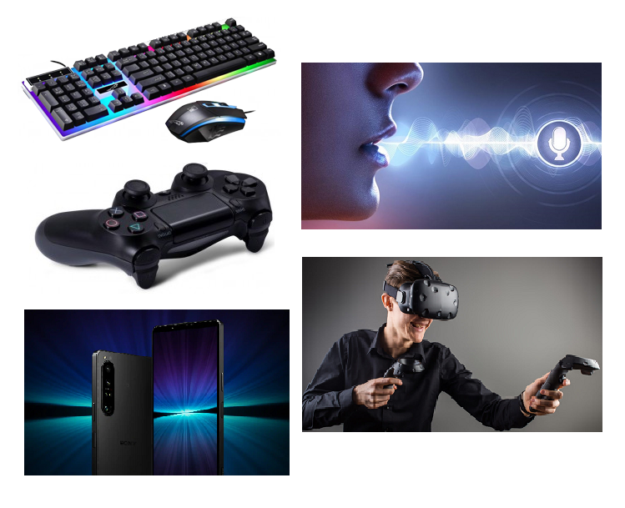
INPUT DEVICES Overview
Available Devices:
  An interaction in OA is always based on a trigger, for example, enabled via an input device.
  Input devices may be:
    Keyboard
    Mouse
    Joypad
    VR HMD (HTC Vive)
    Mobile Device (running Android)
    Voice
    Body Interactions
Available Input Devices:
Notes:
teleprompter: Add slide notes here

Slide 5
INPUT DEVICES Overview
Input Device Categories:
  [KEY] Keyboard
  [PAC] Point-And-Click
  [JOY] Joypad
  [VIV] HTC Vive
  [MOB] Mobile Device
  [VOI] Voice Commands
  [BOI] Body Interaction
Categories:
[KEY]
[VOI]
[PAC]
[JOY]
[BOI]
[VIV]
[MOB]
Notes:
teleprompter: Add slide notes here

Slide 6
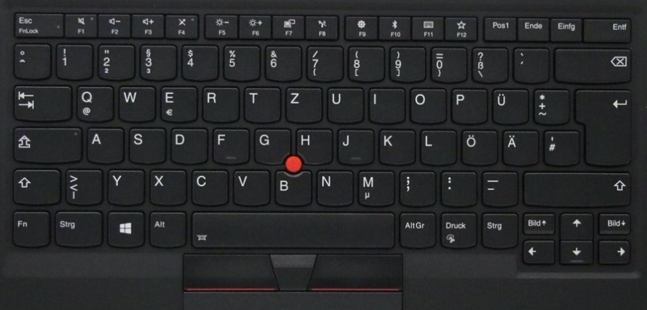
[KEY] Keyboard
Keyboard Layout (Modifier Keys):
1st modifier
Key TAB
2nd modifier
Key CAPS
Notes:
teleprompter: Add slide notes here

Slide 7
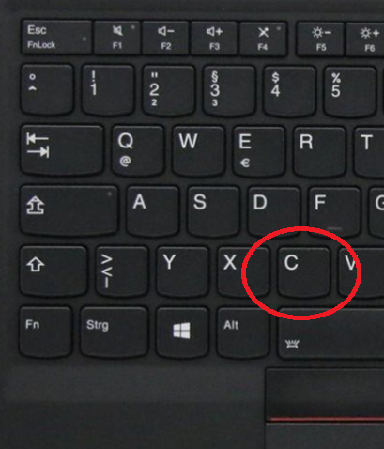
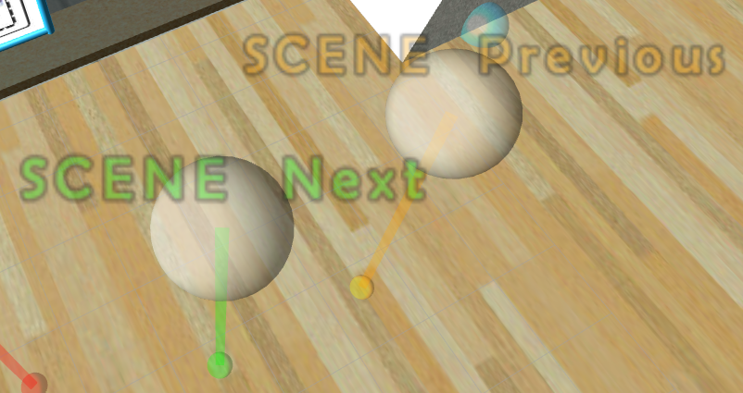
[PAC] Point-And-Click (Mouse)
Keyboard Shortcut and PAC (Mouse) gestures:
Click onto according trigger,
inside the ROS [1] RViz scene!
Notes:
teleprompter: Add slide notes here

Slide 8
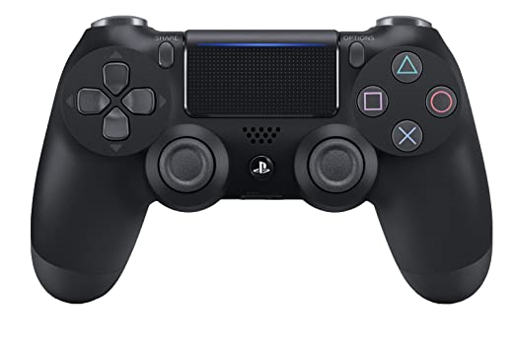
[JOY] Joypad
Joypad Buttons and Axes [2]:
Button L1
Axis L2
Button R1
Axis R2
SHARE
OPTIONS
Button Δ
Button ○
Button X
Button □
Cursor
Down, Up,
Left, Right
Joystick Left
Axis Down, Up, Left Right
Button
Joystick Right
Axis Down, Up, Left Right
Button
Notes:
teleprompter: Add slide notes here

Slide 9
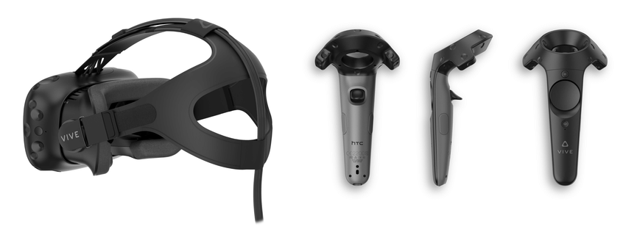
[VIV] HTC Vive
HTC Vive Buttons and Axes [3]:
MENU
TRIGGER
GRIP
TOUCHPAD
LEFT Controller
RIGHT Controller
Notes:
teleprompter: Add slide notes here

Slide 10
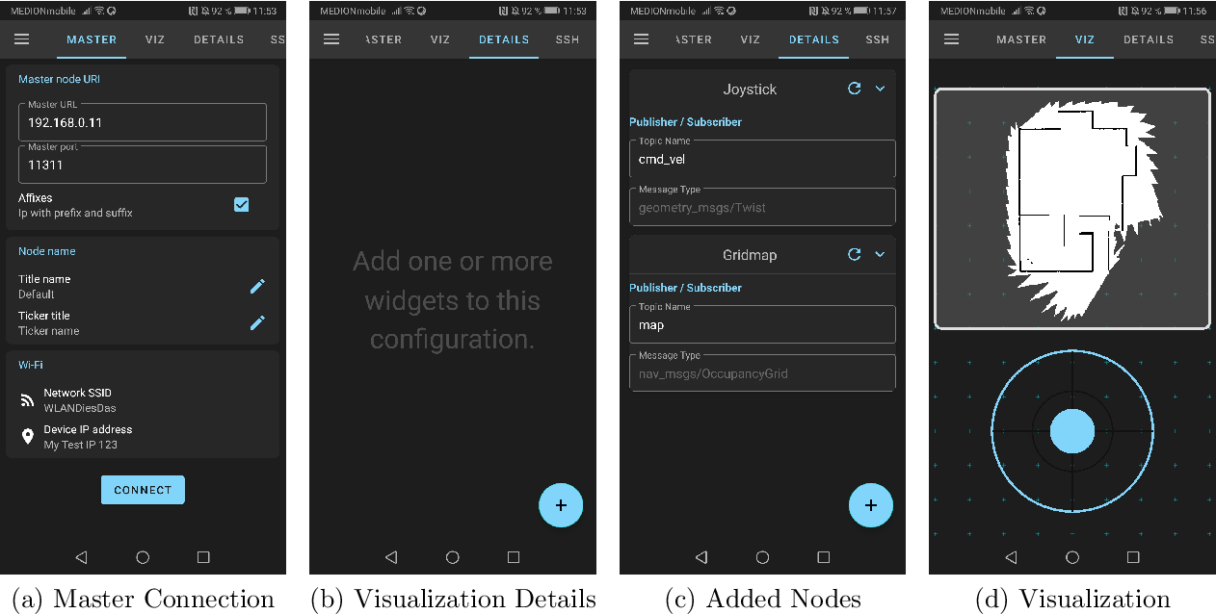
[MOB] Mobile Device
Mobile Device Layout (ROS-Mobile App [4]):
Notes:
teleprompter: Add slide notes here

Slide 11
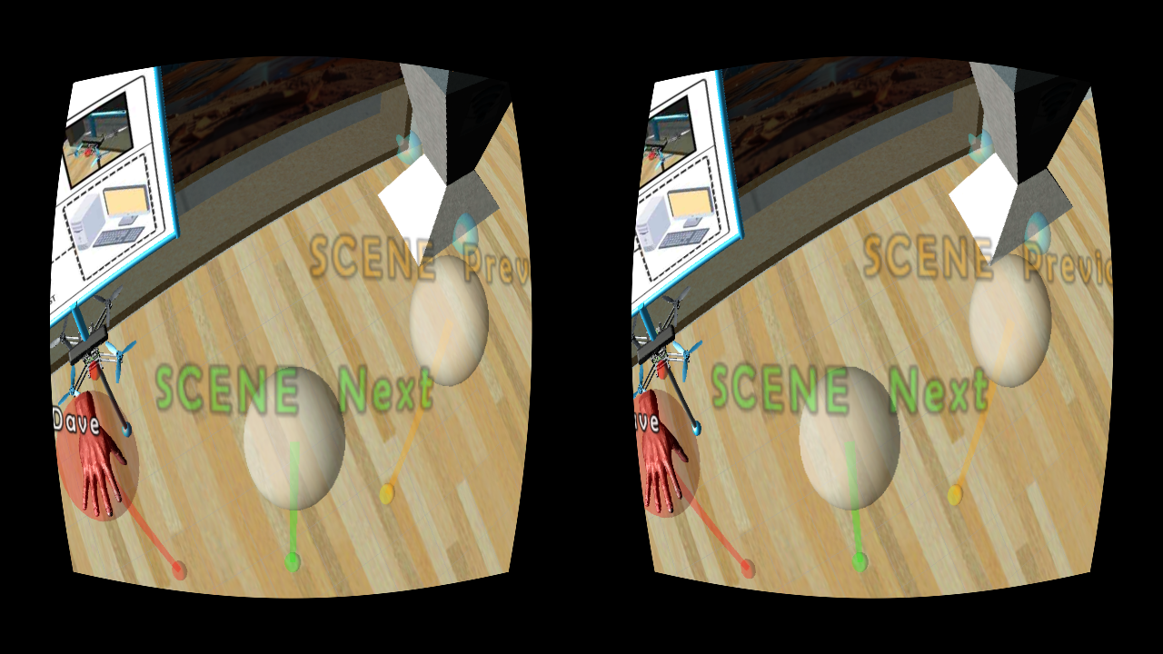
[MOB] Mobile Device
Example Stereo View („ROS-Mobile"-App [4]):
Notes:
teleprompter: Add slide notes here

Slide 12
[VOI] Voice Commands
Picovoice Command Schemes (INTEL):
IntelTrigger: - Intel $politeness:politeness trigger (the) $trigger:trigger
IntelShutdownRep: - Intel $politeness:politeness shutdown (the) $rep:rep
IntelTellAboutYourself:
- Intel can you introduce yourself
- Intel would you like to introduce yourself
- Intel can you tell us a little bit about yourself
IntelSelectRep: - Intel $politeness:politeness select (the) $rep:rep
IntelEngageRep: - Intel $politeness:politeness engage (the) $rep:rep
IntelSelectAudience: - Intel $politeness:politeness select audience $audience_id:audience_id
Notes:
teleprompter: Add slide notes here

Slide 13
[VOI] Voice Commands
Picovoice Command Schemes (MARVIN):
MarvinTellMood: - Marvin how do you feel today
MarvinTellAge: - Marvin what is your age
MarvinTellWeight: - Marvin what is your current weight
MarvinTellSatisfaction: - Marvin are you satisfied with yourself
MarvinFlyToAudience: - Marvin $politeness:politeness fly to audience $audience_id:audience_id
MarvinTellAboutYourself:
- Marvin can you introduce yourself
- Marvin would you like to introduce yourself
- Marvin can you tell us a little bit about yourself
MarvinFlyToRep: - Marvin $politeness:politeness fly to (the) $rep:rep
MarvinSetupRepAtWaypoint: - Marvin $politeness:politeness setup (the) $rep:rep at waypoint $waypoint:waypoint
MarvinTrigger: - Marvin $politeness:politeness trigger (the) $trigger:trigger
MarvinFlyToWaypoint: - Marvin $politeness:politeness fly to waypoint $waypoint:waypoint
MarvinSetupAudienceAtWaypoint: - Marvin $politeness:politeness setup audience $audience_id:audience_id at waypoint $waypoint:waypoint
Notes:
teleprompter: Add slide notes here

Slide 14
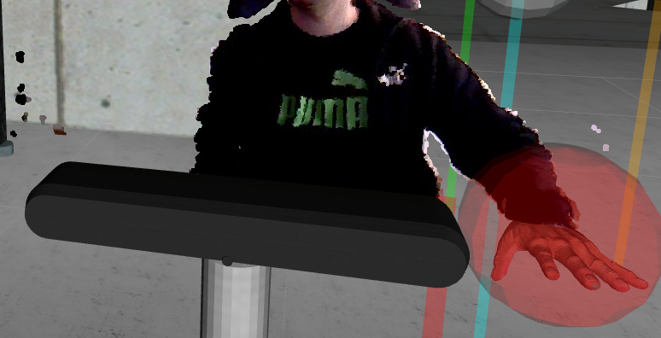
[BOI] Body Interactions
Body Interaction:
  To activate triggers by body interaction, an RGBD sensor (Kinect-like sensor) is required [5].
  If the 3D presence mode is enabled, you can move your right hand into the following virtual triggers:
    SCENE Next (green)
    SCENE Previous (orange)
Interaction from OA:
Notes:
teleprompter: Add slide notes here

Slide 15
INTERACTIONS Overview
Notes:
teleprompter: Add slide notes here'
camera: expand_projection

Slide 16
1.SCENE Interactions
Notes:
teleprompter: Add slide notes here
camera: presenter

Slide 17
SCENE SELECT Previous
Interaction Description:
  Move back to the previous scene (slide).
Available Inputs:
  [KEY] Key Tab + Key Left
  [JOY] Button Options + Cursor Left
  [MOB] Button
  "SCENE Previous"
  [VOI] "Intel, please trigger (the) scene previous!"
  [BOI] Put left hand into orange trigger!
Interaction in OA:
Notes:
teleprompter: Add slide notes here

Slide 18
SCENE SELECT Next
Interaction Description:
  Move on to the next scene (slide).
Available Inputs:
  [KEY] Key Tab + Key Right
  [JOY] Button Options + Cursor Right
  [MOB] Button
  "SCENE Next"
  [VOI] "Intel, please trigger (the) scene next!"
  [BOI] Put left hand into green trigger!
Interaction in OA:
Notes:
teleprompter: Add slide notes here

Slide 19
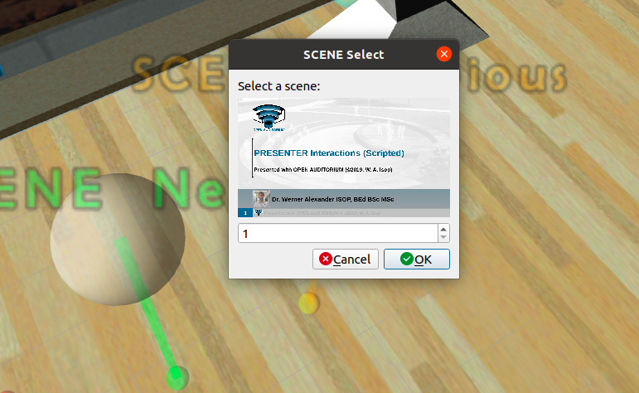
SCENE SELECT Number
Interaction Description:
  Select a specific scene (slide) and move to it.
Available Inputs:
  [KEY] Key Tab +
  Key Shift Left
Interaction in OA:
Notes:
teleprompter: Add slide notes here

Slide 20
2.CAMERA Interactions
Notes:
teleprompter: Add slide notes here
camera: presenter

Slide 21
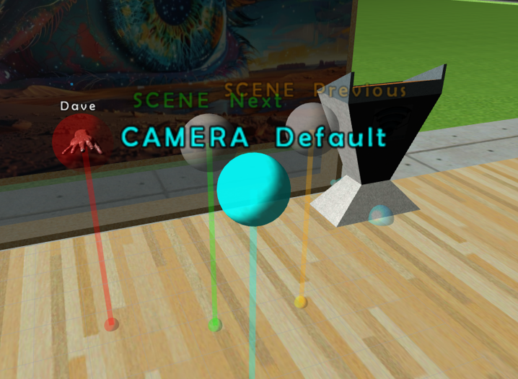
CAMERA Default
Interaction Description:
  Resets the camera to the predefined default view.
Available Inputs:
  [KEY] Key Tab + Key Down
  [JOY] Button Options + Cursor Down
  [MOB] Button
  "CAMERA Default"
  [VOI] "Intel, please trigger (the) camera default!"
Interaction in OA:
Notes:
teleprompter: Add slide notes here

Slide 22
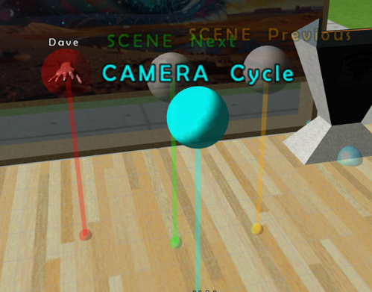
CAMERA Cycle
Interaction Description:
  Cycle the virtual camera to the next predefined view.
Available Inputs:
  [KEY] Key Tab + Key Up
  [JOY] Button Options + Cursor Up
  [MOB] Button
  "CAMERA Cycle"
  [VOI] "Intel, please trigger (the) camera cycle!"
Interaction in OA:
Notes:
teleprompter: Add slide notes here

Slide 23
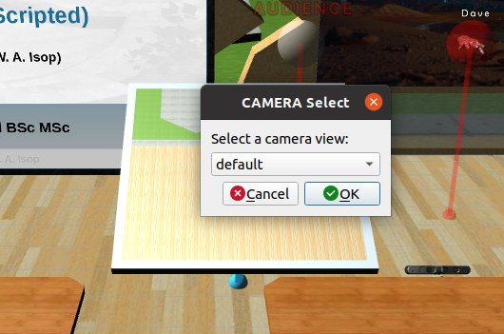
CAMERA Select
Interaction Description:
  Select a predefined camera view.
Available Inputs:
  [KEY] Key Tab + Key Y
Interaction in OA:
Notes:
teleprompter: Add slide notes here

Slide 24
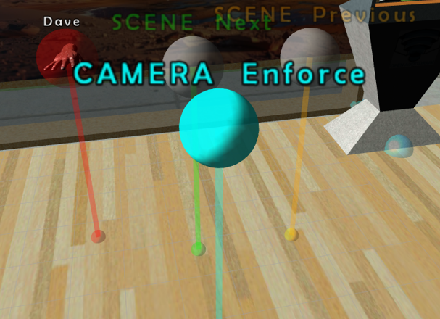
CAMERA Enforce
Interaction Description:
  Enforce the cameras of the audience to follow the presenter's camera.
  In between view changes the audience's listeners are still free to move.
Available Inputs:
  [KEY] Key Tab + Key Z
Interaction in OA:
Notes:
teleprompter: Add slide notes here

Slide 25
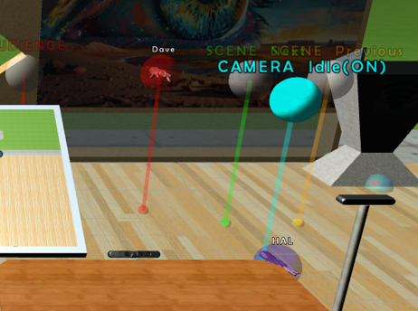
CAMERA Idle
Interaction Description:
  Put the presenter's camera into an idle mode (e.g., indicating breaks).
Available Inputs:
  [KEY] Key Tab + Key ESC
  [JOY] Button PS +
  Button X
  [MOB] Button
  "CAMERA Idle"
  [VOI] "Intel please trigger (the) camera idle!"
Interaction in OA:
Notes:
teleprompter: Add slide notes here

Slide 26
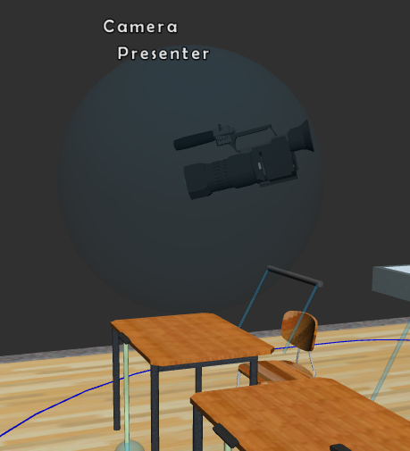
CAMERA Follow
Interaction Description:
  Let the presenter's camera follow the head of the presenter.
Available Inputs:
  [KEY] Key Tab + Key F
  [JOY] Button Share +
  Button PS
  [MOB] Button
  "CAMERA Follow"
  [VOI] "Intel please trigger (the) camera follow!"
Interaction in OA:
Notes:
teleprompter: Add slide notes here

Slide 27
3.PRESENTER HELPER Interactions
Notes:
teleprompter: Add slide notes here
camera: presenter

Slide 28
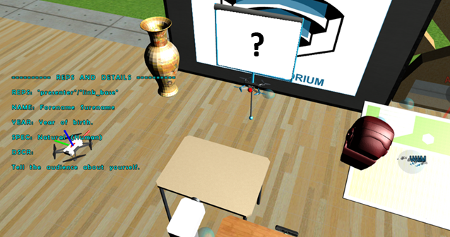
PRESENTER Introduction
Interaction Description:
  Switch to an introduction mode, where presenter details are shown.
Available Inputs:
  [KEY] Key Tab + Key I
  [JOY] Button PS +
  Button Δ
  [MOB] Button "INTRODUCTION"
  [VOI] "Intel please trigger (the) introduction!"
Interaction in OA:
Notes:
teleprompter: Add slide notes here

Slide 29
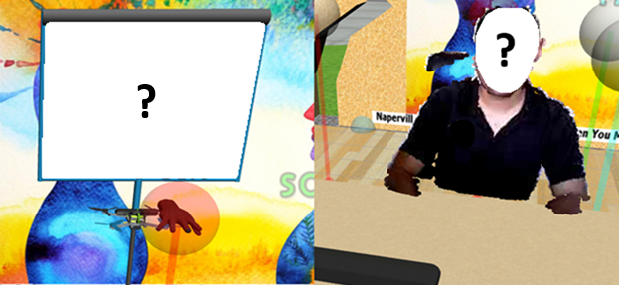
PRESENTER Presence Mode
Interaction Description:
  Change presence modes between OFF, 2D and 3D.
Available Inputs:
  [KEY] Key Tab + Key O
  [JOY] Button Options + Button Select
  [MOB] Button "PRESENCE"
  [VOI] "Intel please trigger (the) presence!"
Interaction in OA:
2D MODE
3D MODE
Notes:
teleprompter: Add slide notes here

Slide 30
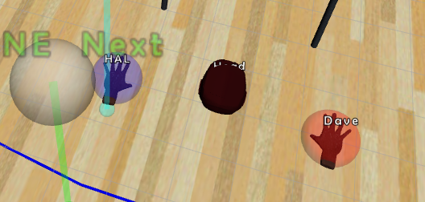
PRESENTER Body Interaction
Interaction Description:
  Toggle body interaction. Steer virtual hand pointers either with the joypad or your hands (requires a 3D-sensor!)
Available Inputs:
  [KEY] Key Tab + Key B
  [JOY] Joystick Left Button +
  Joystick Right Button
  [MOB] Button "BODY INT."
  [VOI] "Intel please trigger (the) body interaction!"
Interaction in OA:
Notes:
teleprompter: Add slide notes here

Slide 31
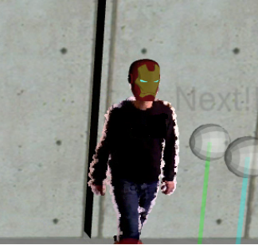
PRESENTER Avatar
Interaction Description:
  Toggle an avatar on top of the presenter's head
  (requires a 3D-sensor!)
Available Inputs:
  [KEY] Key Tab + Key V
  [JOY] Button SHARE + Button CROSS
  [MOB] Button "AVATAR"
  [VOI] "Intel please trigger (the) avatar!"
Interaction in OA:
Notes:
teleprompter: Add slide notes here

Slide 32
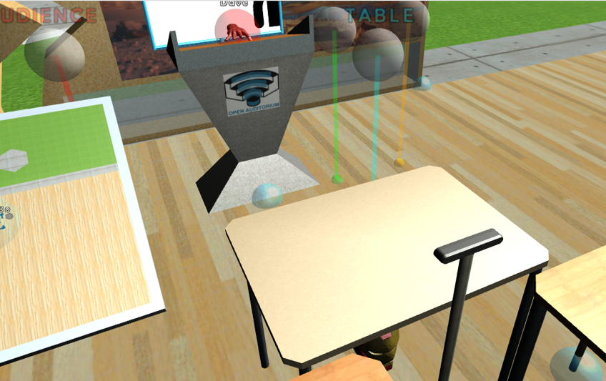
PRESENTER Lectern
Interaction Description:
  Toggle a lectern inside the presenter's workspace.
Available Inputs:
  [KEY] Key Tab + Key L
  [JOY] Button SHARE + Button TRIANGLE
  [MOB] Button "TABLE"
  [VOI] "Intel please trigger (the) lectern!"
Interaction in OA:
Notes:
teleprompter: Add slide notes here

Slide 33
PRESENTER Table
Interaction Description:
  Toggle a table inside the presenter's workspace.
Available Inputs:
  [KEY] Key Tab + Key T
  [JOY] Button SHARE + Button RECTANGLE
  [MOB] Button "TABLE"
  [VOI] "Intel please trigger (the) table!"
Interaction in OA:
Notes:
teleprompter: Add slide notes here

Slide 34
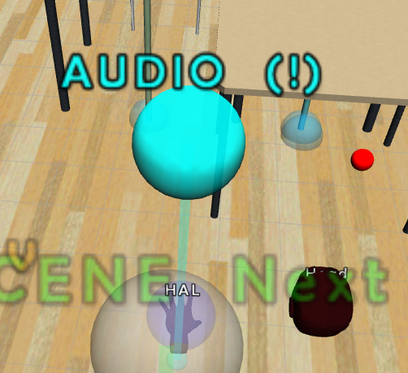
PRESENTER Audio
Interaction Description:
  Toggle the audio communication to the audience.
Available Inputs:
  [KEY] Key Tab + Key Q
  [JOY] Button SHARE + Button CIRCLE
  [MOB] Button "AUDIO"
  [VOI] "Intel please trigger (the) audio!"
Interaction in OA:
Notes:
teleprompter: Add slide notes here

Slide 35
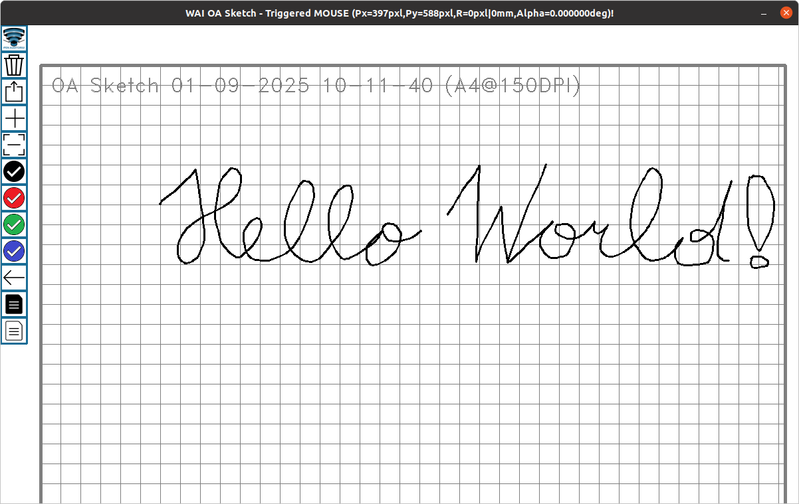
PRESENTER Sketch
Interaction Description:
  Open a virtual blackboard, where you can sketch content and send it to the projector.
Available Inputs:
  [KEY] Key Tab + Key P
  [MOB] Button "SKETCH"
  [VOI] "Intel please trigger (the) sketch!"
Interaction in OA:
Notes:
teleprompter: Add slide notes here

Slide 36
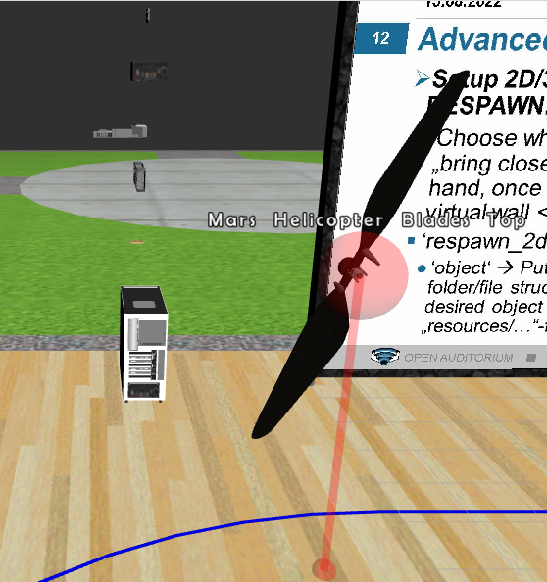
PRESENTER Respawn 2D/3D
Interaction Description:
  Respawn a REP from 2D (right half of the slide) into 3D.
Available Inputs:
  [JOY] Joystick Left/Right Axis + Axis L2
Interaction in OA:
Notes:
teleprompter: Add slide notes here

Slide 37
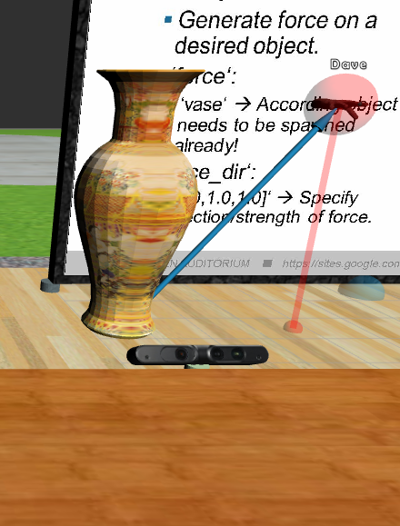
PRESENTER Force
Interaction Description:
  Apply a force to a REP.
Available Inputs [JOY]:
  (1) Select REP with >>> Joystick Left/Right Axis + Axis R2 (blueish sphere!)
  (2) Span Force-Vector with >>> Left/Right Joystick Axis
  (3) Apply FORCE with >>> Joystick Left/Right Axis + Axis R2
Interaction in OA:
Notes:
teleprompter: Add slide notes here

Slide 38
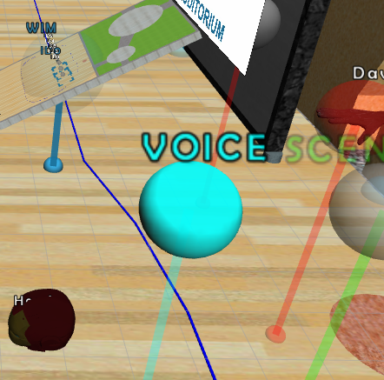
PRESENTER Voice Command
Interaction Description:
  Trigger the sensing of a voice command.
Available Inputs:
  [KEY] Key Tab + Key C
  [JOY] Button PS +
  Button CIRCLE
  [MOB] Button "VOICE"
Interaction in OA:
Notes:
teleprompter: Add slide notes here

Slide 39
PRESENTER Voice Prompt
Interaction Description:
  Trigger natural language based prompting of MARVIN the display drone.
Available Inputs:
  [KEY] Key Tab + Key X
  [JOY] Button ??? +
  Button ???
  [MOB] Button "VOICE"
Interaction in OA:
Notes:
teleprompter: Add slide notes here

Slide 40
4.AUDIENCE Interactions
Notes:
teleprompter: Add slide notes here
camera: presenter

Slide 41
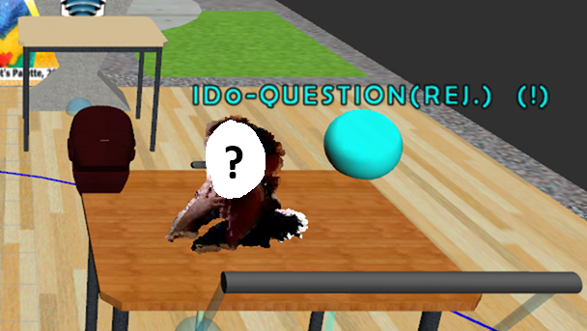
AUDIENCE REQUEST Reject
Interaction Description:
  Reject most recent audience request from queue.
Available Inputs:
  [KEY] Key Tab + Key Ins/Einfg
  [JOY] PS Button +
  Left Joystick Button
  [MOB] Button "AUDIENCE Reject"
Interaction in OA:
Notes:
teleprompter: Add slide notes here

Slide 42
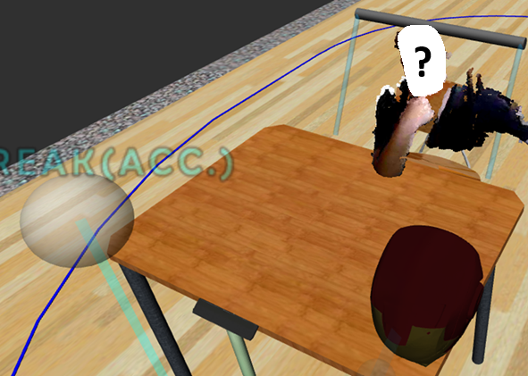
AUDIENCE REQUEST Accept
Interaction Description:
  Accept most recent audience request from queue and focus and select ID!
Available Inputs:
  [KEY] Key Tab + Key Home/Pos1
  [JOY] PS Button +
  Right Joystick Button
  [MOB] Button "AUDIENCE Accept"
Interaction in OA:
Notes:
teleprompter: Add slide notes here

Slide 43
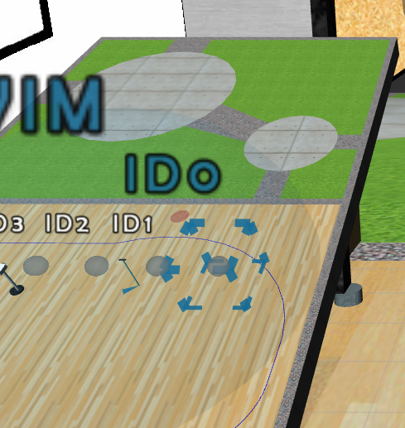
AUDIENCE Focus Down
Interaction Description:
  Move the focus of the audience one row down inside the WIM.
Available Inputs:
  [KEY] Key Tab + Key S
  [JOY] Button SHARE + Left Joystick Down
  [MOB] Button "AUDIENCE Down"
Interaction in OA:
Notes:
teleprompter: Add slide notes here

Slide 44
AUDIENCE Focus Up
Interaction Description:
  Move the focus of the audience one row up inside the WIM.
Available Inputs:
  [KEY] Key Tab + Key W
  [JOY] Button SHARE + Left Joystick Up
  [MOB] Button "AUDIENCE Up"
Interaction in OA:
Notes:
teleprompter: Add slide notes here

Slide 45
AUDIENCE Focus Left
Interaction Description:
  Move the focus on the audience one listener to the left (increase ID minus one) inside the WIM.
Available Inputs:
  [KEY] Key Tab + Key A
  [JOY] Button SHARE + Left Joystick Left
  [MOB] Button "AUDIENCE Left"
Interaction in OA:
Notes:
teleprompter: Add slide notes here

Slide 46
AUDIENCE Focus Right
Interaction Description:
  Move the focus on the audience one listener to the right (decrease ID plus one) inside the WIM..
Available Inputs:
  [KEY] Key Tab + Key D
  [JOY] Button SHARE + Left Joystick Right
  [MOB] Button "AUDIENCE Right"
Interaction in OA:
Notes:
teleprompter: Add slide notes here

Slide 47
AUDIENCE Focus Number
Interaction Description:
  Select listener ID by number and focus with virtual camera.
Available Inputs:
  [KEY] Key Tab +
  Key <
  [JOY] ??? + ???
  [MOB] Button "AUDIENCE Number"
Interaction in OA:
Notes:
teleprompter: Add slide notes here

Slide 48
AUDIENCE Select
Interaction Description:
  Select listener with focused ID and focus with virtual camera.
Available Inputs:
  [KEY] Key Tab +
  Key Shift Right
  [JOY] Button SHARE + Left Joystick Button
  [MOB] Button "AUDIENCE Select"
Interaction in OA:
Notes:
teleprompter: Add slide notes here

Slide 49
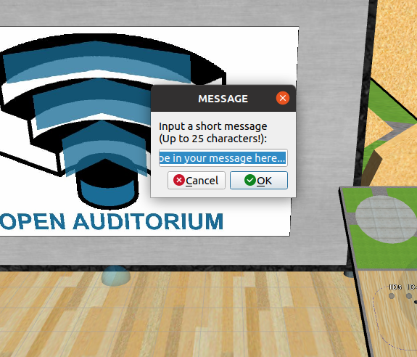
AUDIENCE Message
Interaction Description:
  Send short message to whole audience (Max. 100 Characters).
Available Inputs:
  [KEY] Key Tab + Key M
  [MOB] Button "AUDIENCE Message"
Interaction in OA:
Notes:
teleprompter: Add slide notes here

Slide 50
AUDIENCE Message to Listener
Interaction Description:
  Send short message to specific audience listener (Max. 100 Characters).
Available Inputs:
  [KEY] Key Tab + Key N
Interaction in OA:
Notes:
teleprompter: Add slide notes here

Slide 51
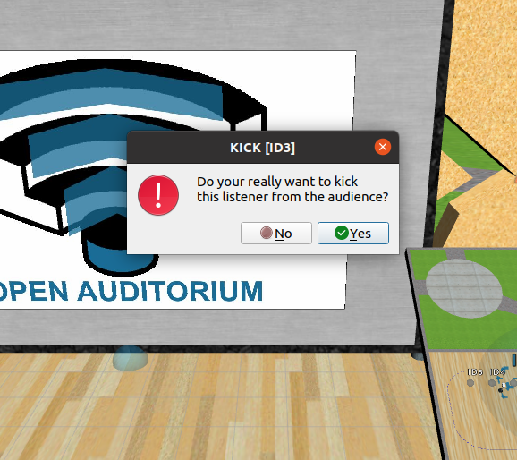
AUDIENCE Kick
Interaction Description:
  Kick focused listener ID from audience.
Available Inputs:
  [KEY] Key Tab + Key ,
  [MOB] Button "AUDIENCE Kick"
Interaction in OA:
Notes:
teleprompter: Add slide notes here

Slide 52
EVALUATION Interactions
Notes:
teleprompter: Add slide notes here
camera: presenter

Slide 53
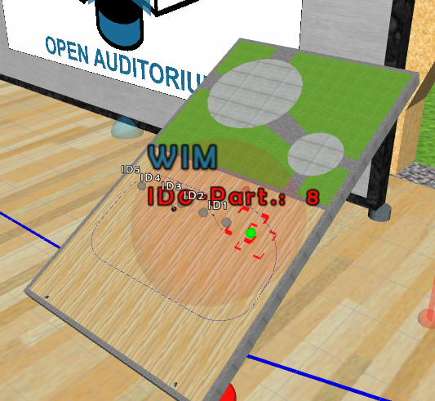
AUDIENCE EVAL Participation
Interaction Description:
  Evaluate participation of currently focused audience ID with -,~,+ and a custom score.
Available Inputs [KEY] :
  Key Tab + Key - (Minus)
  Key Tab + Key # (Tilde)
  Key Tab + Key + (Plus)
  Key Tab + Key . (Score)
Interaction in OA:
Notes:
teleprompter: Add slide notes here

Slide 54
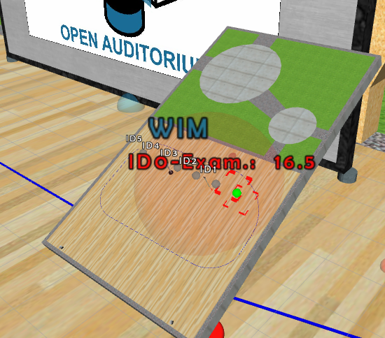
AUDIENCE EVAL Examination
Interaction Description:
  Evaluate examination of currently focused audience ID with 1,2,3,4,5 and a custom score.
Available Inputs [KEY] :
  Key Tab + Key 5 (Insufficient)
  Key Tab + Key 4 (Sufficient)
  Key Tab + Key 3 (Satisfactory)
  Key Tab + Key 2 (Good)
  Key Tab + Key 1 (Very Good)
  Key Tab + Key 0 (Score)
Interaction in OA:
Notes:
teleprompter: Add slide notes here

Slide 55
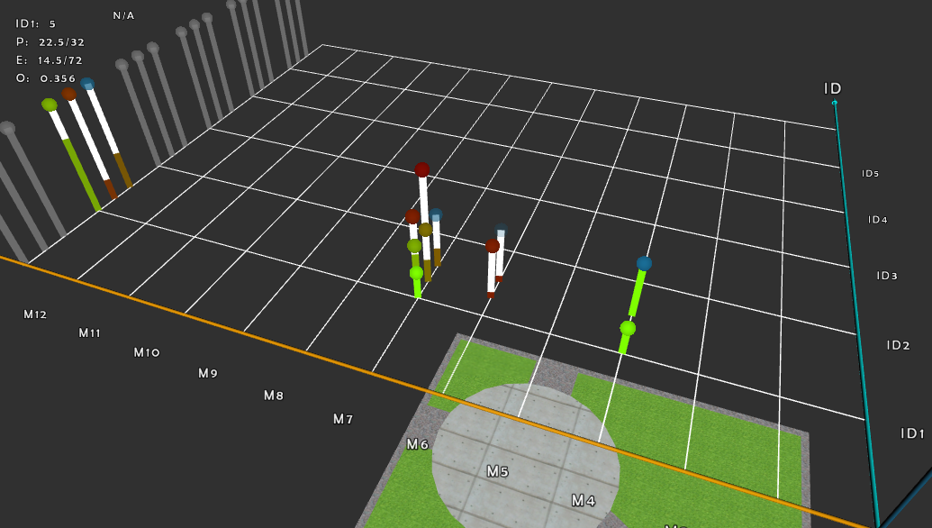
AUDIENCE EVAL Graph
Interaction Description:
  Switch to evaluation graph (overview of all evaluations of audience).
Available Inputs:
  [KEY] Key Tab + Key E
  [JOY] Button L1 +
  Button R1
  [MOB] Button "AUDIENCE Eval Graph"
Interaction in OA:
Notes:
teleprompter: Add slide notes here

Slide 56
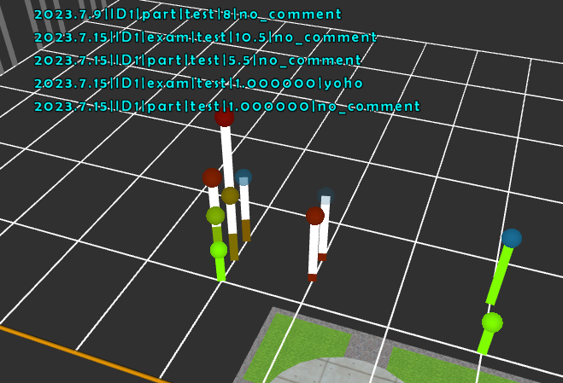
AUDIENCE EVAL Graph Inspect
Interaction Description:
  Inspect evaluations per eval period with a [PAC] interaction inside graph (default is one month!).
Available Inputs:
  [PAC] Press Key C and click on an evaluation inside a desired eval period.
Interaction in OA:
Notes:
teleprompter: Add slide notes here

Slide 57
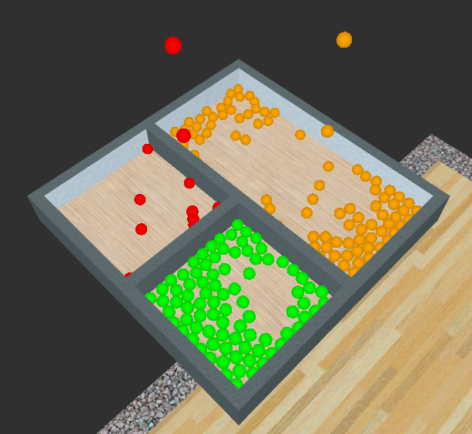
AUDIENCE EVAL Bowl
Interaction Description:
  Evaluation bowl metaphor, based on three different boxes for the eval scores.
Available Inputs:
  [KEY] Key Tab + Key 6
  [MOB] Button "AUDIENCE Eval Bowl"
Interaction in OA:
Notes:
teleprompter: Add slide notes here

Slide 58
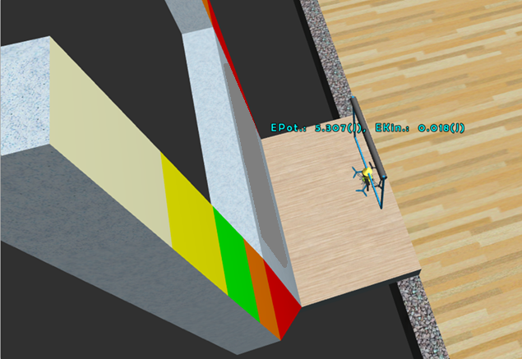
AUDIENCE EVAL Marvin
Interaction Description:
  Evaluation metaphor, based on MARVIN. Marvin symbolizes score with his flight height when trying to overcome an obstacle.
Available Inputs:
  [KEY] Key Tab + Key 7
  [MOB] Button "AUDIENCE Eval Marvin"
Interaction in OA:
Notes:
teleprompter: Add slide notes here

Slide 59
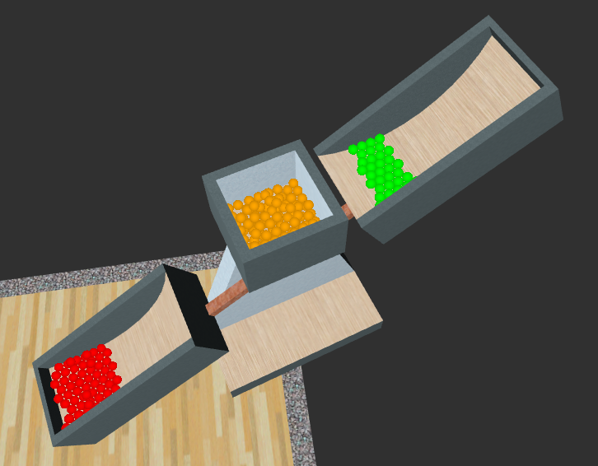
AUDIENCE EVAL Weight Balance
Interaction Description:
  Evaluation weight balance metaphor. The overwhelming type of score produces more weight.
Available Inputs:
  [KEY] Key Tab + Key 8
  [MOB] Button "AUDIENCE Eval Balance"
Interaction in OA:
Notes:
teleprompter: Add slide notes here

Slide 60
REP Interactions
Notes:
teleprompter: Add slide notes here
camera: presenter

Slide 61
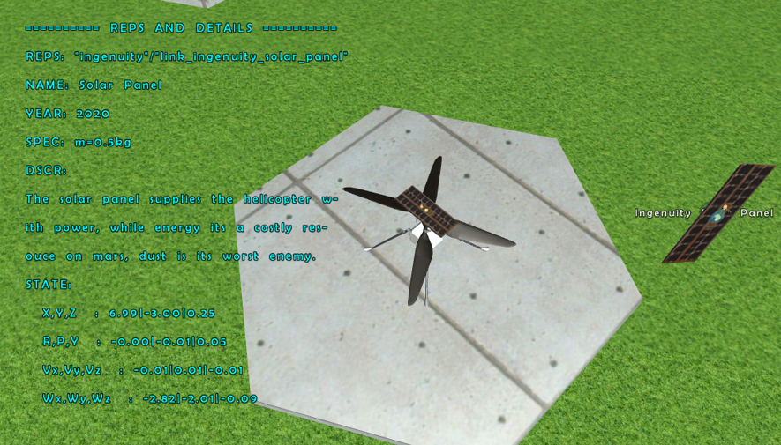
REP Focus Previous
Interaction Description:
  Focus REP, chosen from a list of registered REP's.
Available Inputs:
  [KEY] Key Tab + Key H
  [JOY] ??? + ???
  [MOB] ??? + ???
Interaction in OA:
Notes:
teleprompter: Add slide notes here

Slide 62
REP DETAIL Select
Interaction Description:
  Select currently focused REP and DETAIL.
Available Inputs:
  [KEY] Key Tab + Key G
  [JOY] Button OPTIONS +
  Left Joystick Button
  [MOB] Button
  "REP DETAIL Select"
Interaction in OA:
Notes:
teleprompter: Add slide notes here

Slide 63
REP DETAIL Rotation
Interaction Description:
  Toggle rotation of currently selected REP and DETAIL.
Available Inputs:
  [KEY] Key Tab + Key R
  [JOY] Button OPTIONS + PS Button
  [MOB] Button
  "REP DETAIL Rotation"
Interaction in OA:
Notes:
teleprompter: Add slide notes here

Slide 64
LEARNING MODE Interactions
Notes:
teleprompter: Add slide notes here
camera: presenter

Slide 65
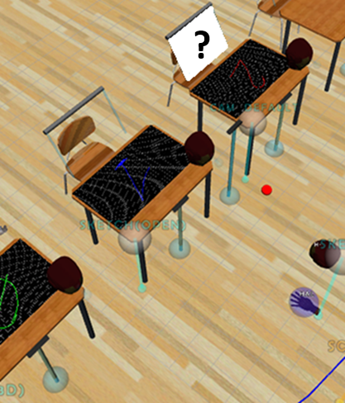
LEARNING MODE Plenum
Interaction Description:
  Switch to a classic plenum-like setup for knowledge transfer in OA.
Available Inputs:
  [KEY] Key Caps + Key 1
Interaction in OA:
Notes:
teleprompter: Add slide notes here

Slide 66
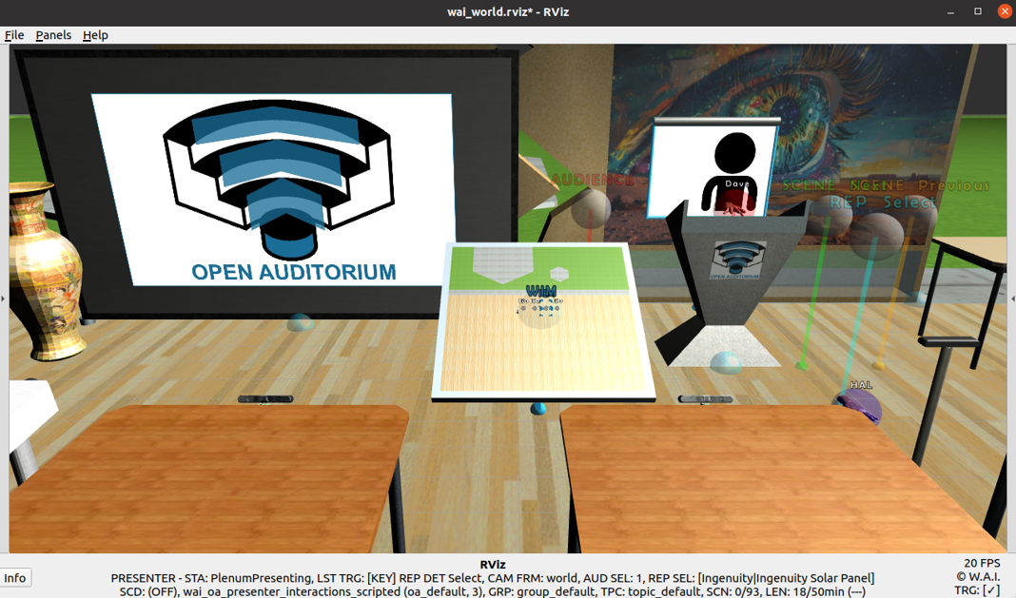
LEARNING MODE Plenum
Notes:
teleprompter: Add slide notes here

Slide 67
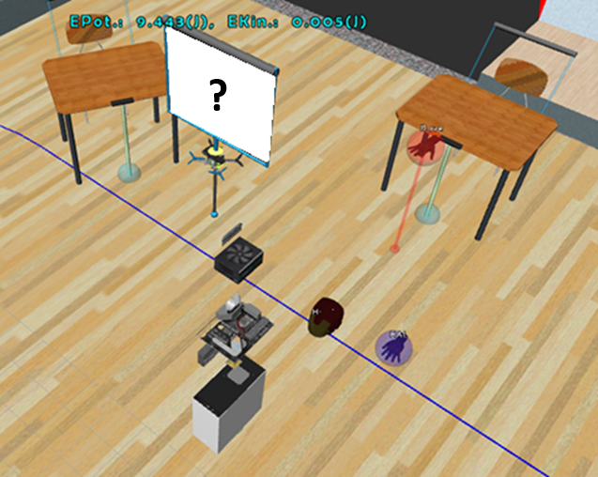
LEARNING MODE Cooperative
Interaction Description:
  Switch to a more cooperative (circular) setup for knowledge transfer in OA.
Available Inputs:
  [KEY] Key Caps + Key 2
Interaction in OA:
Notes:
teleprompter: Add slide notes here

Slide 68
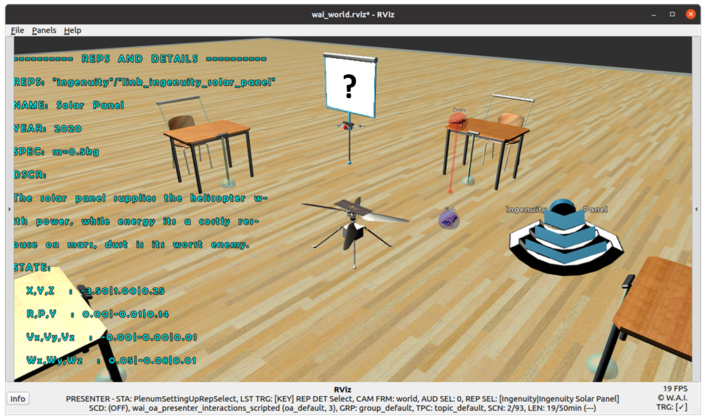
LEARNING MODE Cooperative
Notes:
teleprompter: Add slide notes here

Slide 69

LEARNING MODE More to Come… : )
Interaction Description:
  Feel free to add your own teaching and learning methods! ^^
Available Inputs:
  [KEY] Key Caps +
  Key …
Interaction in OA:
Notes:
teleprompter: Add slide notes here

Slide 70
BIBLIOGRAPHY
Notes:
teleprompter: Add slide notes here'

Slide 71
BIBLIOGRAPHY
[1] Quigley, Morgan, et al. "ROS: an open-source Robot Operating System." ICRA workshop on open source software. Vol. 3. No. 3.2. 2009.
[2] Lohmann, R. J. "Shared Play with the Push of a Button: a Mixed-Method Analysis of Sony PlayStation 4’s Share-Platform." MS thesis. 2014.
[3] Luckett, Ethan. "A quantitative evaluation of the htc vive for virtual reality research." 2018.
[4] Rottmann, N., Studt, N., Ernst, F. and Rueckert, E. "Ros-mobile: An android application for the robot operating system." arXiv 2020. arXiv preprint arXiv:2011.02781.
[5] Majgaard, Gunver. "Embodied interaction design in engineering education using asus xtion pro." Int. Conf. Interfaces and Human Computer Interaction. 2013.
Notes:
teleprompter: Add slide notes here

Slide 72
Thank you for your
PRESENCE and ATTENTION!
Notes:
teleprompter: Add slide notes here
camera: expand_projection

Slide 73
END OF PRESENTATION!
Notes:
teleprompter: Add slide notes here
camera: overview
sound: PlenumSettingUpSessionClose

