Slide 1
Scaffolding Ingenuity (Group 1 - Rotor)
Notes:
teleprompter: Add your slide notes here.
sound: PlenumSettingUpSessionStartup

Slide 2
What to do next?
Notes:
teleprompter: Add your slide notes here.
camera: expand_projection

Slide 3
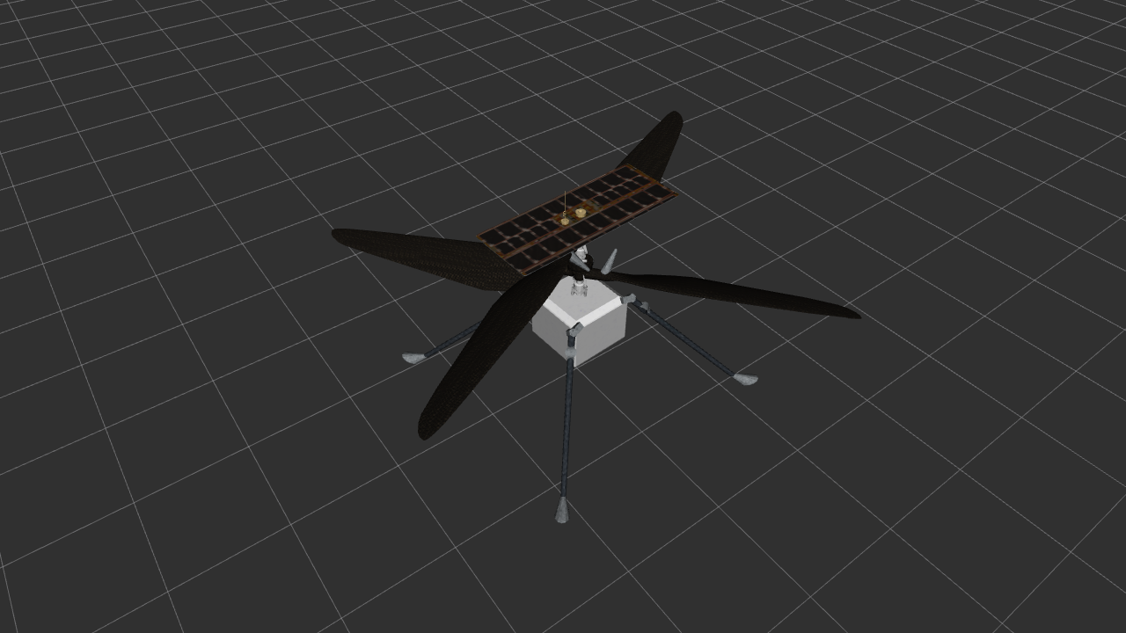
What to do next?
Next steps to scaffold Ingenuity:
  Keep in mind your designated part (e.g, "Rotor")
  Rethink of prior knowledge you heard in the plenum session!
  Use the SKETCH Tool to build a mindmap on your own!
  Ask for help or tips if necessary (Educator or Intel)!
  Once ready, share the mindmap with your partner!
  Collaborate and summarize your findings in this slide set!
  Self-evaluate your learning progress!
  Share your work with the educator!
Notes:
teleprompter: Add your slide notes here.

Slide 4
Summary Of Your Findings
(Group 1 - Rotor)
Notes:
teleprompter: Add your slide notes here.
camera: expand_projection

Slide 5
Summary Of Your Findings
Group 1 - Rotor:
  Produces thrust/lift
  Co-axial arrangement (2 rotors), enhances producing thrust
  Very lightweight ~35g
  Made of carbon fiber
  Made of foam
Notes:
teleprompter: Add your slide notes here.

Slide 6
END OF PRESENTATION!
Notes:
teleprompter: Add your slide notes here.
camera: overview
sound: PlenumSettingUpSessionClose

