Slide 1
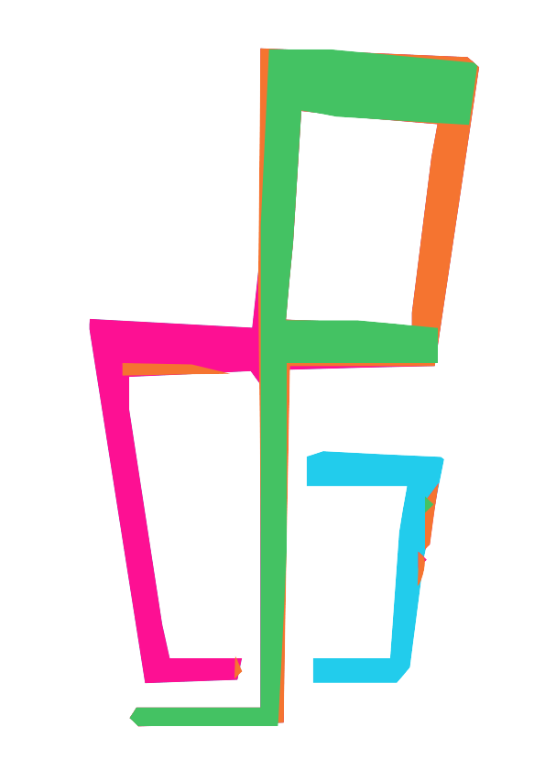
Werckmeister
Conduction Rules
Separate What and How
Notes:
The Conduction Rules allow you to separate between what notes to play and how to perform them.

Slide 2
The raw material
Notes:
Take for example this High Hat figure.
Without any articulation it sounds like that.

Slide 3
Add some articulation
!pph16 !pph !ffh !pph !pph !pph !ffh !pph
!pph !pph !ffh !pph !pph !pph !ffh !pph
Notes:
So lets add some articulation to that.
To avoid having a unreadble sheet source, we want to separate the velocity information from the actual sheet.
So we using the conduction rule feature.

Slide 4
Add some articulation
instrument(drums) pitch(h) onBeat(1.5 2.5 3.5 4.5)
{
velocity += 50%;
}
Notes:
First we need to select on which note a rule applies.
In this example we select:
the notes related to the insrtrument „drums“
the pitch „h“, meaning the high hat notes
every .5 note, which means the notes on the „off beat“
And finally we describe what we want to do with these notes. In this case we want to emphasize the off beat notes. So we add 50% to the velocity value.

Slide 5
The Result
Notes:
Lets hear the result.

Slide 6
werckmeister https://werckme.github.io

