Slide 1

Computer science
Smart Student Attendance System
GRADUATION PROJECT (2021)

Slide 2
PROJECT TEAM
Abdelrhman Talat Abdelrhman
Aisha Gamal Ahmed Ali
Ammar Yasser Werdani
Mohamed Ayman Hamed
Omar elsayed abdelnasser
Omar Shokri Al Rajhi
SUPERVISOR
Ass. Prof. Dr. Noha Heikal
ASSISTANT
Eng. Nehad ElSharkawy

Slide 3
ABSTRACT
We wanted to create something that helps protect the students as well as the teacher in light of the current circumstances and the spread of the new [Covid-19], so we created the Smart Student Attendance System.
It is a facial recognition system that facilitates recording the daily attendance of the student by taking a picture of his face in an easy way to interact with it.
Face recognition is a method of identifying or verifying the identity of an individual using their face.
Smart Student Attendance System helps the user to save time and effort by providing a high usability desktop app.
The system is as understandable and smooth as possible.

Slide 4
Motivation
The motivation behind building this project is that it is one of the most successful.
This project provides safety as it reduces the risks students are exposed to because :
Reduces congestion.
It saves time.
It also prevents any error in recording students' attendance.
Automatic photo capture.

Slide 5
Objectives
Functional Requirements :
To analyzes the image and extracts the distinctive features of the face.
To compares it to the particles saved in the database associated with the system.
To make sure that these features are present in the institution’s database.
To show the attendance in Excel sheet.
To send report to the student and the instructor.

Slide 6
Objectives
Non Functional Requirements :
Time saving
Accuracy
User friendly
High interactivity
Customization

Slide 7




Tools we used
Python
QT-designer
Open CV
Face Recognition

Slide 8





Comparing between Visual Search, F.R , Medical, Our project
Service | O.S
Attendance system | Att/ Leave | Excel Sheet | Face rec | Accuracy % | IOS | Windows | Android
Visual Search |  |  | CNN | 90.5 %
F.R Attendance System |  |  | LBPH | 54.8 %
Proposal 1 |  |  | SVM | 87.6%
Proposal 2 |  |  | CNN | 99.3 %

Slide 9
Face-recognition
Recognize and manipulate faces from Python or from the command line with the world’s simplest face recognition library.
Built using dlib’s state-of-the-art face recognition
built with deep learning. The model has an accuracy of 99.38% on the
Labeled Faces in the Wild benchmark.

Slide 10
Deep learning(CNN)
Deep Learning is a term used to describe a mathematical model for machine learning that emulates a human brain,creating a large neural network.
Deep learning is a machine learning technique that teaches computers to do what comes naturally to humans which is learning by example.
Deep learning is getting lots of attention lately and for good reason.
It’s achieving results that were not possible before.

Slide 11
Deep learning(CNN)
Convolutional neural networks (ConvNets or CNNs) are a type of neural network that has been proven to be effective in various fields such as image recognition and classification.
Filter neural networks have great success in distinguishing faces, inanimate objects, and traffic signals.

Slide 12
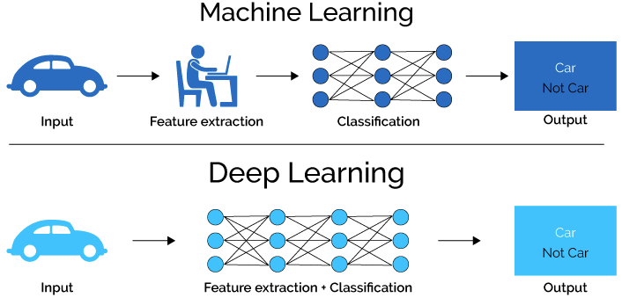
Deep learning vs. Machine Learning

Slide 13
CNN layers
Convolution
التفافي
Max Pooling
تجميع الميزات
Flattening
جعله مسطح
Full Connection
اتصال كلي
Finding the features and apply filers
استخراج الميزات وتطبيق المرشحات
Downsize the image and keep the important features
تقليل الحجم والحفاظ علي الميزات المهمة
Convert to 1 dimension array(vector)
تحويل الي مصفوفة ذات بعد واحد (مسطحه)
Building all needed connections
بناء جميع الموصلات في الشبكة(الطبقات الخفية)

Slide 14
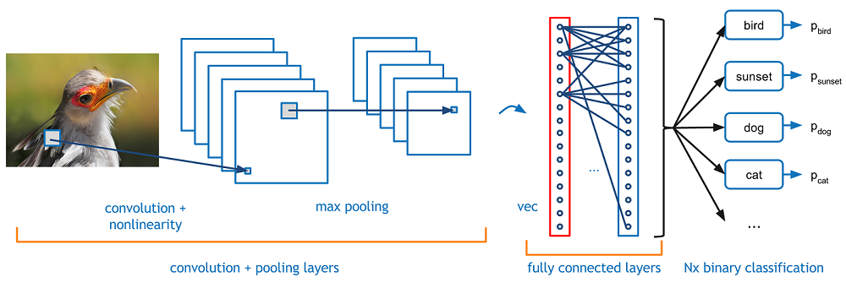
CNN layers

Slide 15

System Requirements Specification
is a document or set of documentation that describes the features and behavior of a system or software application .
Flow chart
Use case diagram
Sequence diagram

Slide 16
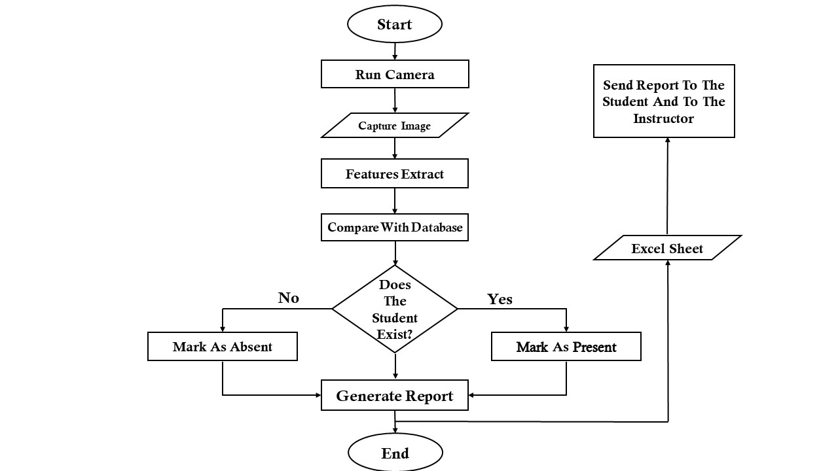
Flow chart

Slide 17
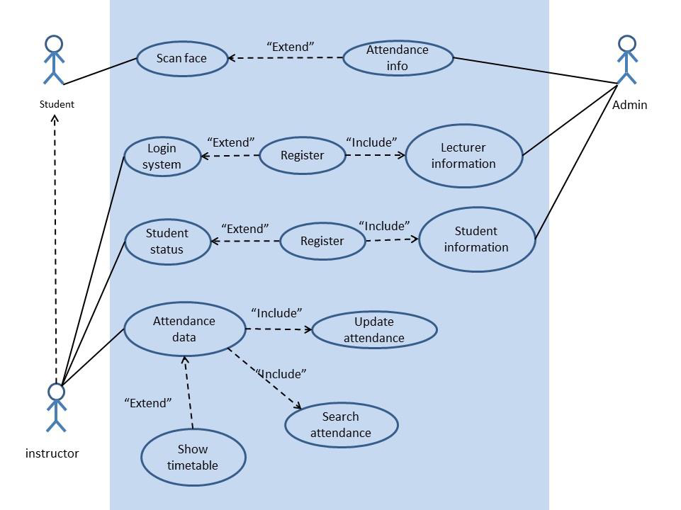
Use Case

Slide 18
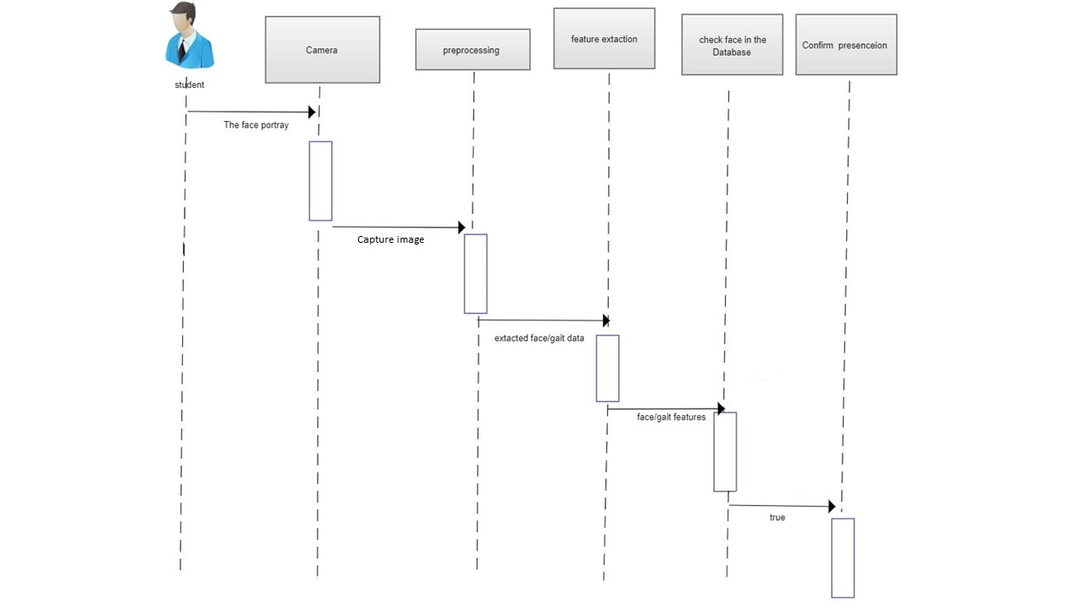
Sequence Diagram

Slide 19
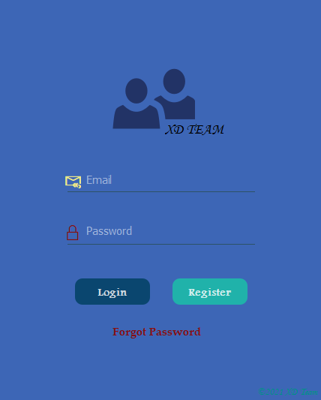
UI- login

Slide 20
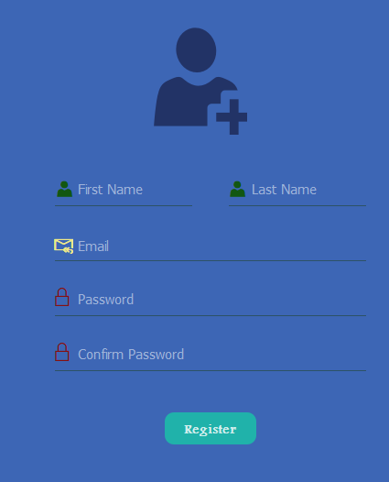
UI- Register

Slide 21
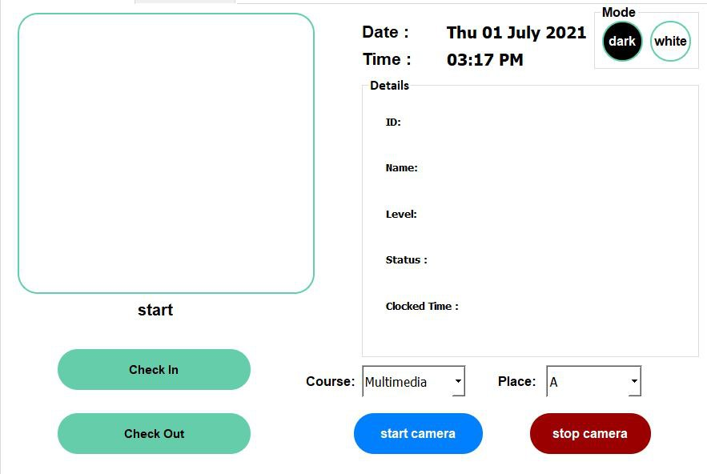
UI- Main

Slide 22
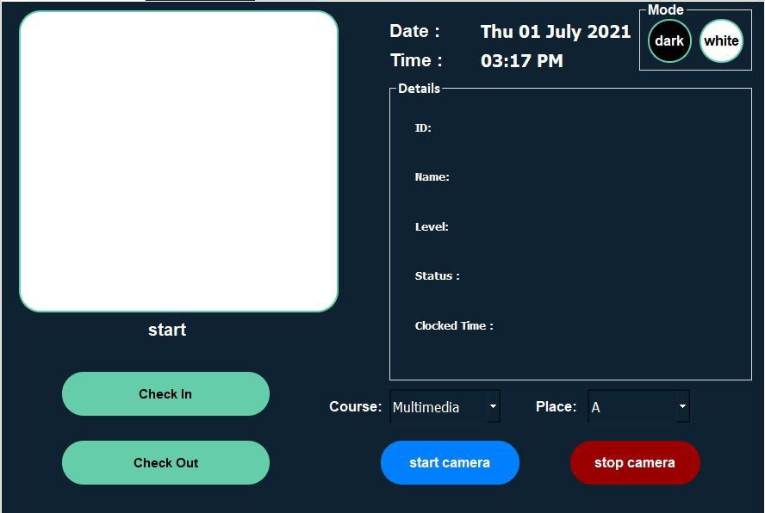
UI- Main

Slide 23
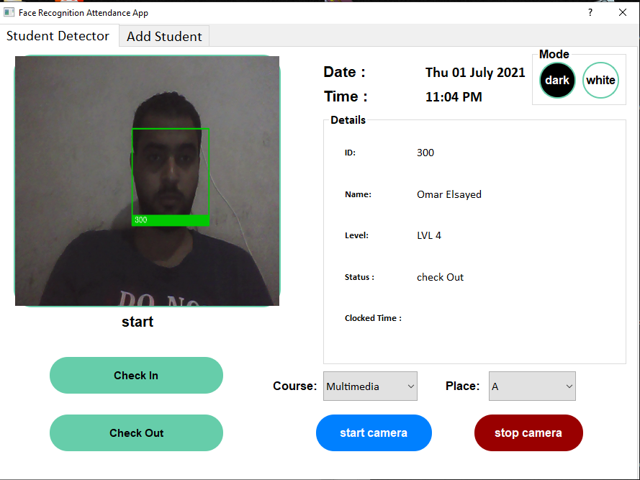

Slide 24
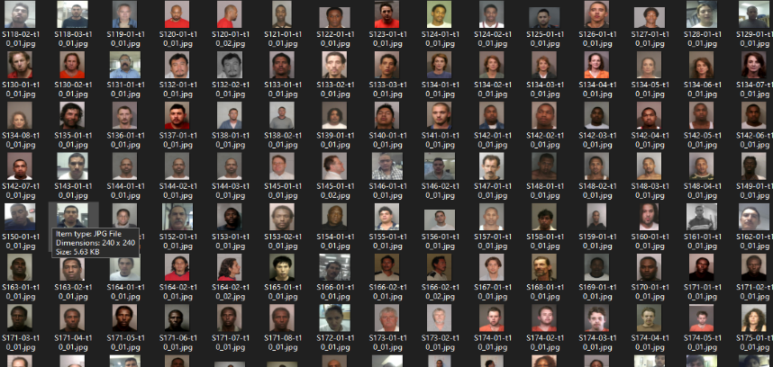
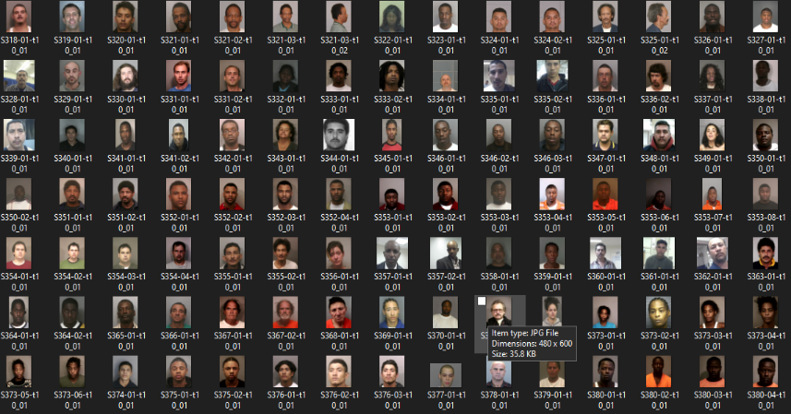
Dataset for images

Slide 25

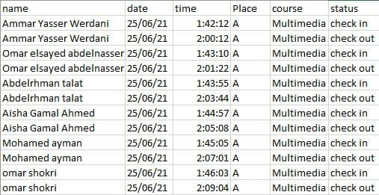
EXCEL-SHEET

Slide 26
Conclusion
The project entitled Building a “Smart Student Attendance System” by python with deep learning completed successfully.
The system has been developed with much care and free of errors at the same time .
the purpose of building this project is that It is important for universities in light of the spread of the new Corona virus [Coved-19].

Slide 27
Conclusion
Because :
Reduces congestion.
It saves time.
It also prevents any error in recording students 'attendance.
Automatic photo capture.
our project was born to make life easier, simpler and more protective

Slide 28
Future Work
Even after reaching this milestone, we still want to improve Some aspects such as:
Increasing the amount of services provided by our system By:
Enabling the system to send emails, SMS and more.
Add a function that calculates the maximum student absence and sends a warning
SMS to him.
Linking the system to a database that contains the student's schedule of subjects so that the student is not allowed to enter untimely.

Slide 29
Any Questions ?

Slide 30
Thank you ...

