Slide 1
Electricity Production USA & Germany 2000-2014

Slide 2
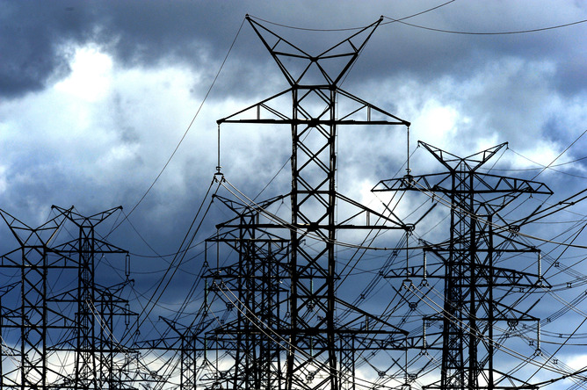
Intro: Electricity Production in US & Germany
Total Production
& Sources as a percent of total.
All data is from The World Bank.
Not all relevant data
was updated after 2014.
Data presented is from 2000
through 2014.
Source: https://databank.worldbank.org/source/world-development-indicators
This Photo by Unknown Author is licensed under CC BY-ND

Slide 3
Population Comparison

Slide 4
Total Electricity Consumption

Slide 5
Per Capita Electricity Consumption 2000-2014 Average Annual Consumption in Kilowatt hours Per Person

Slide 6

Summary: Total and Per Capita Electricity Consumption
Average annual values from 2000 through 2014:
German population: 82 million
US population: 300 million
German electrical use: 580 trillion kWh
US electrical use: 4000 trillion kWh
Per Capita use in Germany: 7100 kWh
Per Capita use in USA: 13000 kWh
This Photo by Unknown Author is licensed under CC BY-ND

Slide 7
Sources of Electricity as Percent of Total

Slide 8
Summary of Electrical Sources
Average Annual Values 2000-2014, as a percentage of the nation’s total electrical production:
Germany – Fossil Fuels: 61%
USA – Fossil Fuels: 70%
Germany – Nuclear: 23%
USA – Nuclear: 19%
Germany – Hydroelectric: 3%
USA – Hydroelectric: 6%
Germany – Non-Hydro Renewables: 11%
USA – Non-Hydro Renewables: 3%

Slide 9
Data Links
All data was sourced from The World Bank’s World Development Indicators and was last updated 2/15/2021
https://databank.worldbank.org/source/world-development-indicators
The data analysis can be found here:

