Slide 1

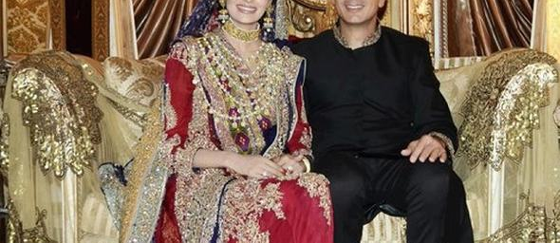
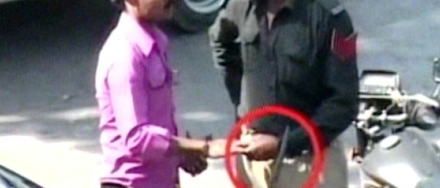
RISH
An App for
W
T
A

Slide 2
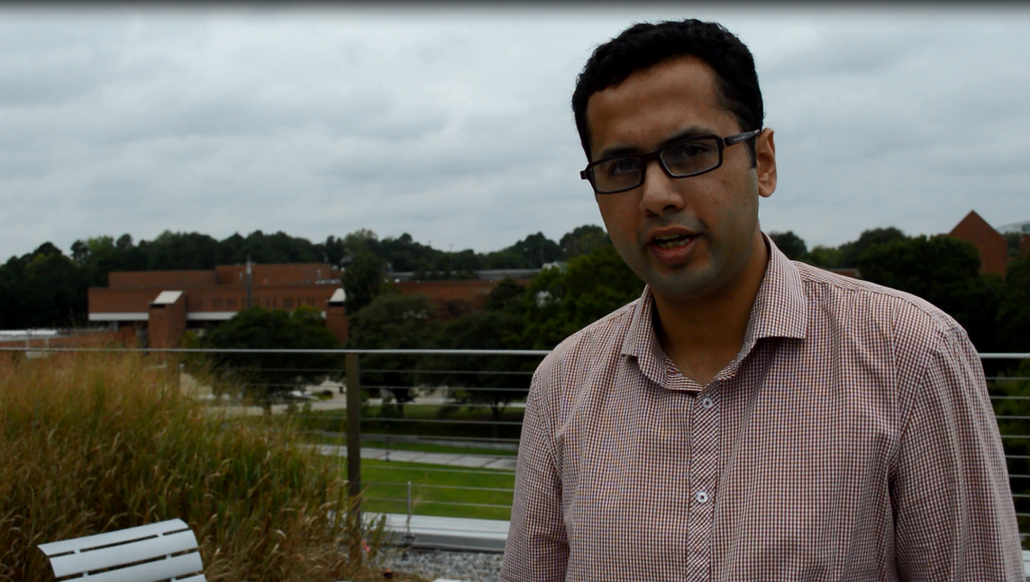
Sneak Preview

Slide 3
Problem
Bribery is prevalent across the world
No data collected and available
Current measurement is perceived corruption (normative statement)
RISHWAT – AN APP TO ERADICATE BRIBERY

Slide 4
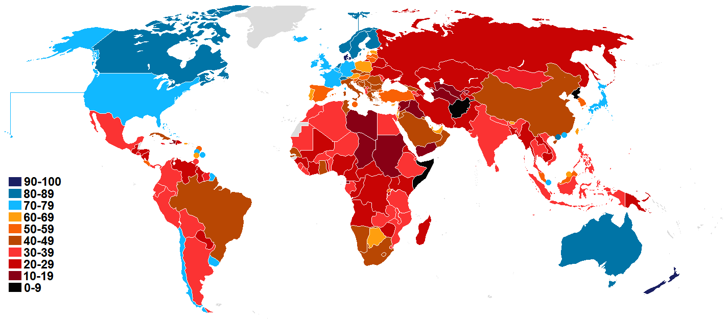
Corruption perception index 2013
Pakistan scored 127 out of 175
175th Being the most corrupt
US scored 19 th out of 175
175th Being the most corrupt
Austria scored 26th out of 175
175th Being the most corrupt
RISHWAT – AN APP TO ERADICATE BRIBERY

Slide 5
Objectives
Short Term
Data Collection
Engaging (FUN APP!!!)
Long Term
Eradication of bribery
Sustainable revenue model
Present data by Transparency International index based on "by their perceived levels of corruption, as determined by expert assessments and opinion surveys.”^{[1]}
[1]Transparency International (2011). "Corruption Perceptions Index". Transparency International. Retrieved 1 December 2011
RISHWAT – AN APP TO ERADICATE BRIBERY

Slide 6
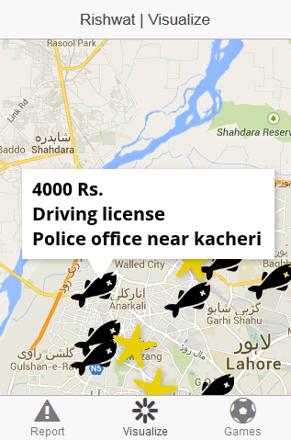
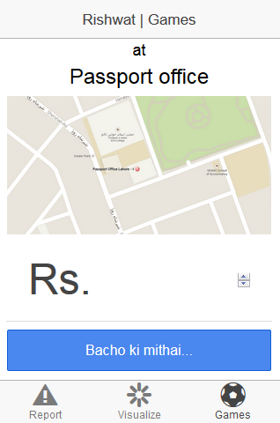
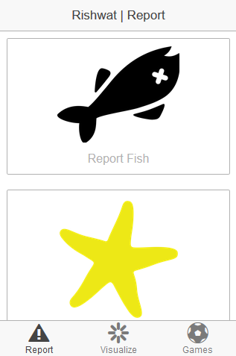
RISHWAT – The App
REPORT VISUALIZE ENGAGE (FUN!)
= Get Information =Become aware
RISHWAT – AN APP TO ERADICATE BRIBERY

Slide 7
Market
Cellphone users 139.20 million^{[1]} at the end of May 2014
72% using smart phones, 28% other platforms^{[2]}
52% access internet on 3G, EDGE, GPRS^{[2]}
16% buy apps 84% use free apps^{[2]}
Market share of Apps: 90% social networking, 72% Games ^{[2]}
University, College going students are VERY IMPORTANT
Literacy rate 55%^{[3]}
[1] http://propakistani.pk/2014/07/10/mobile-phone-users-in-pakistan-cross-139-2-million-mark/
[2] http://grappetite.com/blog/smartphone-usage-in-pakistan/
[3] http://www.brecorder.com/top-news/1-front-top-news/87662-global-literacy-rate-pakistan-ranks-113th-among-120-nations-.html

Slide 8
Successful examples from Pakistan
Groopic by Eyedeus
Clean Lahore app by Dr. Umar Saif
Duddoo Aur Dhobi by JugnooMedia
Olaround developed by Bramerz
HBL MoneyWise developed by HBL Pakistan
Kamaal campaign by EFU life insurance
“easypaisa” by Telenor and Tameer Microfinance Bank
UBL Omni by UBL
What do these Apps have in common & different?
RISHWAT – AN APP TO ERADICATE BRIBERY
Notes:
http://www.dawn.com/news/1052446

Slide 9
Business Opportunity
No data
potential to break the market
be a leader in Pakistan & around the world
RISHWAT – AN APP TO ERADICATE BRIBERY

Slide 10
Potential usage/ Future products
Raw DATA ( in itself the first of its kind)
Relation between bribery and poverty areas
Inflations vs bribery chart
Salary bracket vs bribery chart
Revenue of the department vs bribery chart
Bribery near utility billing dates, Ramadan, Eid and other festivals
RISHWAT – AN APP TO ERADICATE BRIBERY

Slide 11
Potential partners in short run
Mentor
ATDC Georgia Tech
Open Atlanta
Sponsor/Partners
UNDP
USAID
Open Atlanta
CGAP by Bill & Mellinda Gates Foundation
RISHWAT – AN APP TO ERADICATE BRIBERY

Slide 12
Potential International clients in Long run
African Development Bank
Bertelsmann Foundation
Economist Intelligence Unit
Freedom House
Global Insight
International Institute for Management Development
Political and Economic Risk Consultancy
Political Risk Services
World Economic Forum
World Bank
World Justice Project
RISHWAT – AN APP TO ERADICATE BRIBERY

Slide 13
Potential client
Governments
NGO’s
Multi national companies
Universities
Research Institutes
RISHWAT – AN APP TO ERADICATE BRIBERY

Slide 14
Financing
Initial funding for App Development and Marketing by Sponsor
Potential business models:
Sales to clients
Freemium model (Users pay for more information)
Donations by users (Social impact, CSR and help save money)
In-App advertisement
RISHWAT – AN APP TO ERADICATE BRIBERY

Slide 15
Start-up Time line
Market study –2 Months
App Design-- 2 Month
Pre-launch– 2 Month
Startup (roles and responsibilities)
Freemium
Paid App
Study customer response
In App metric study (touch area, time of usage etc.)
Sales response (Freemium vs Paid App)
RISHWAT – AN APP TO ERADICATE BRIBERY

Slide 16
Future Feature
Photo/ Video
Live stream
Log in with facebook
Stories/Jokes
Alarming
Push notification
RISHWAT – AN APP TO ERADICATE BRIBERY

Slide 17
THANK YOU
PAKATHON ATLANTA
PSA at GEORGIA TECH
MENTORS
FULBRIGHT
RISHWAT – AN APP TO ERADICATE BRIBERY

