Slide 1
An Intro to Computer System
W2D1: A Quick Tour to
PL & Compiler
Jian Weng
Computer Science
CEMSE, KAUST

Slide 2
Resources
https://github.com/were/cs-294z/
My office: Building 1, 4414
My email: jian.weng@kaust.edu.sa
Remember to make an appointment first

Slide 3
Roadmap
Programming Language
  Characterizing a programming language
Compiler Pipeline

Slide 4
Characterizing a Programming Lang.
Before starting a new project, what language do you choose? Why?
Characterizing a programing language
  Target Application
  Developer Experience
  Performance
  Libraries

Slide 5
Programming Language: Programmability
General-purpose
  E.g. Java/Python/C/C++/Rust
  Theoretically, for anything you want
Domain-specific
  E.g. HTML/Markdown/PyTorch/TensorFlow
  For only specific tasks, but easier to write

Slide 6
Performance: Managed & Unmanaged
If the language is managed by a virtual runtime environment
Unmanaged
  C/C++/Rust(?)
  Compiler compiles to a native environment
Managed
  Java/JavaScript/C#/Python
  Runs on a virtual interpreter

Slide 7
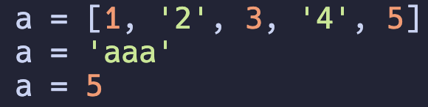
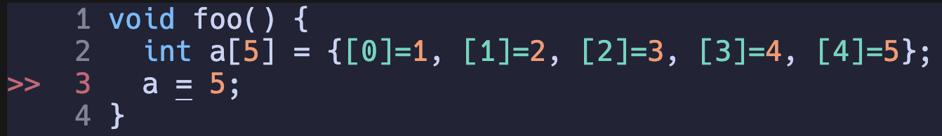
Tradeoff: Performance & Flexibility
Python: Dynamic-typed managed language can even do this ☺
C: Static-typed unmanaged language cannot ☹
But, at what cost?
A “left value identifier” is just a handle to the value, which can be anything
A “left value identifier” is represents its dedicated memory allocated

Slide 8
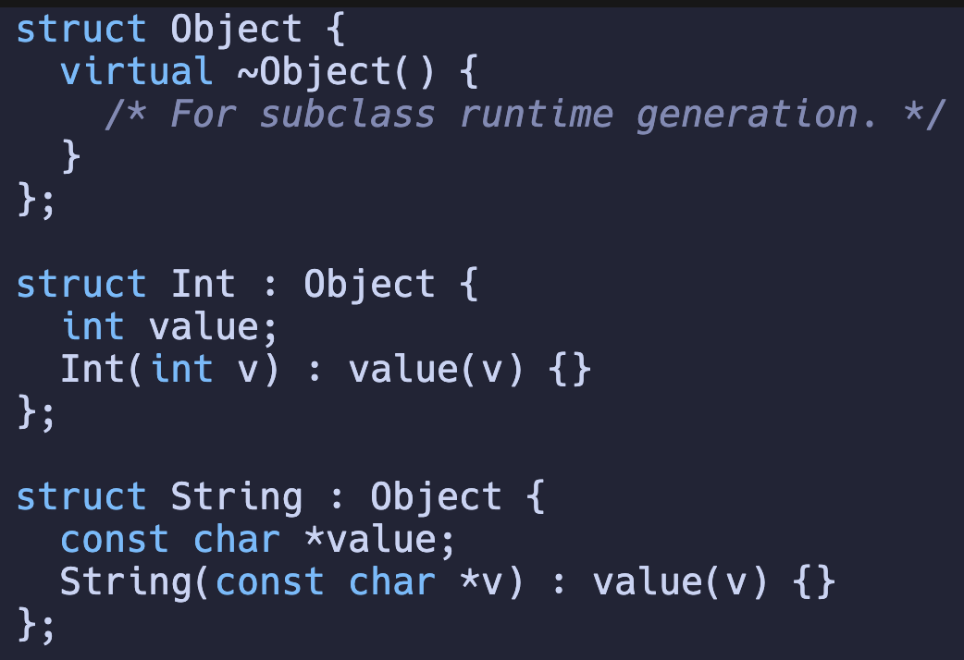
Performance & Flexibility: Heavier Runtime
There is no magic in this world
  You need to declare a base object that is “array-able”
Do not mix this runtime with that runtime

Slide 9
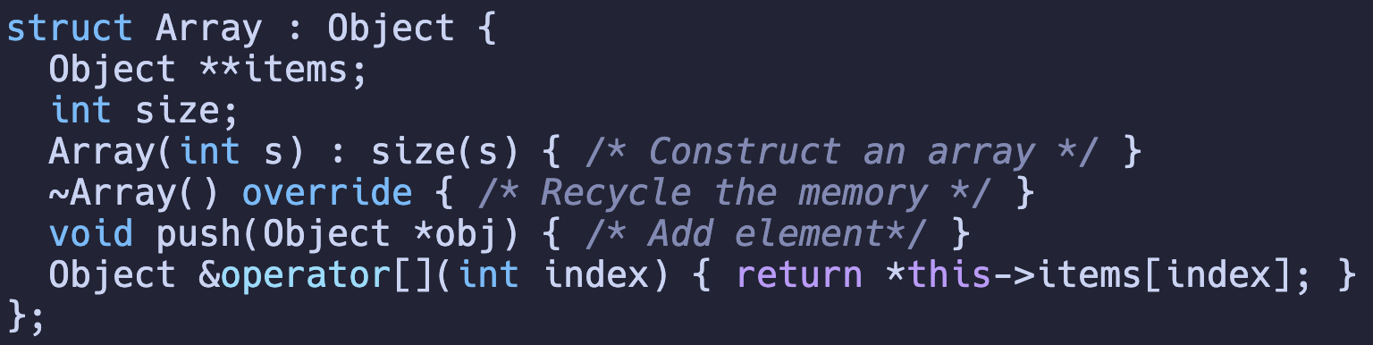
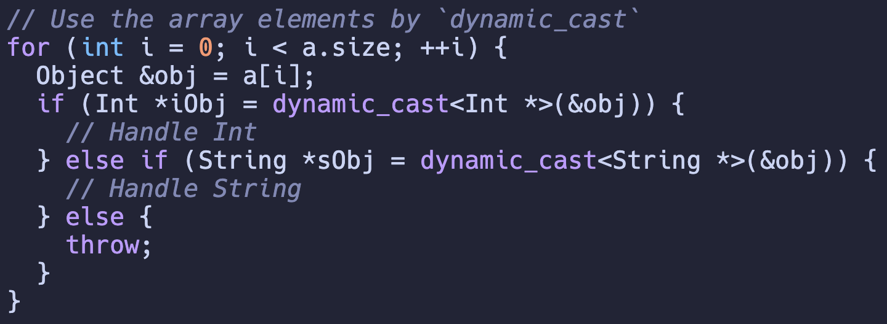
Managed Runtime (CONT’D)
Then we are have an array of Objects

Slide 10
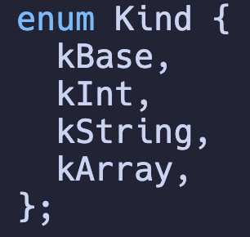
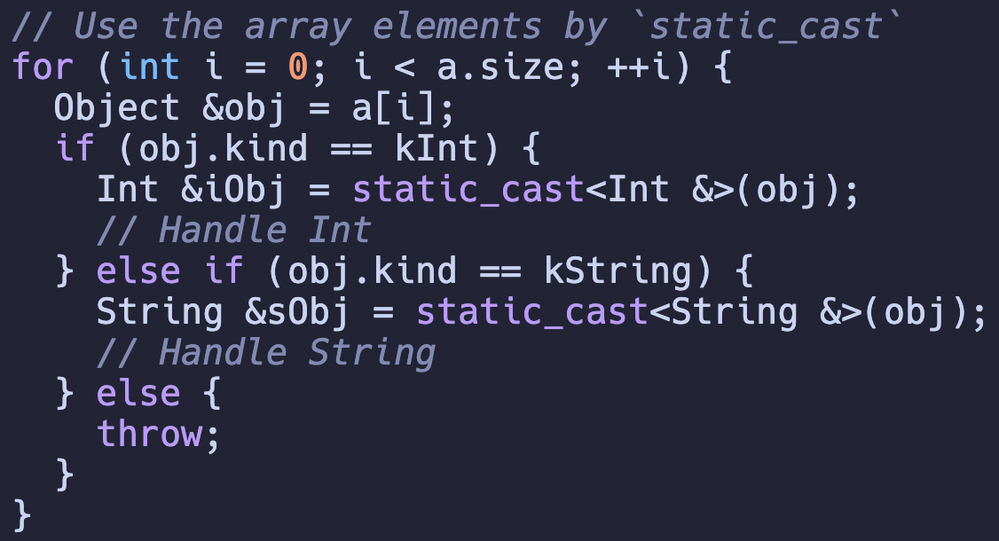
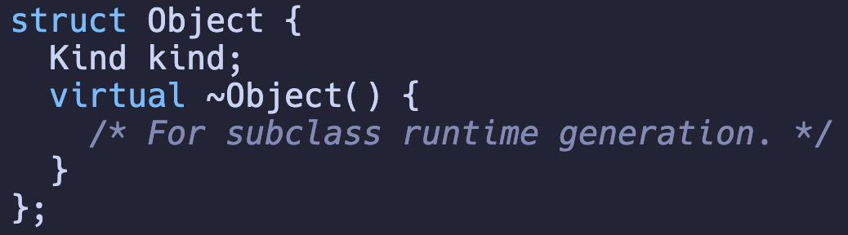
Unmanaged Runtime: Demystified
What if I do this?
Which performance is better?
Manually manage the subclass of each subclass.

Slide 11
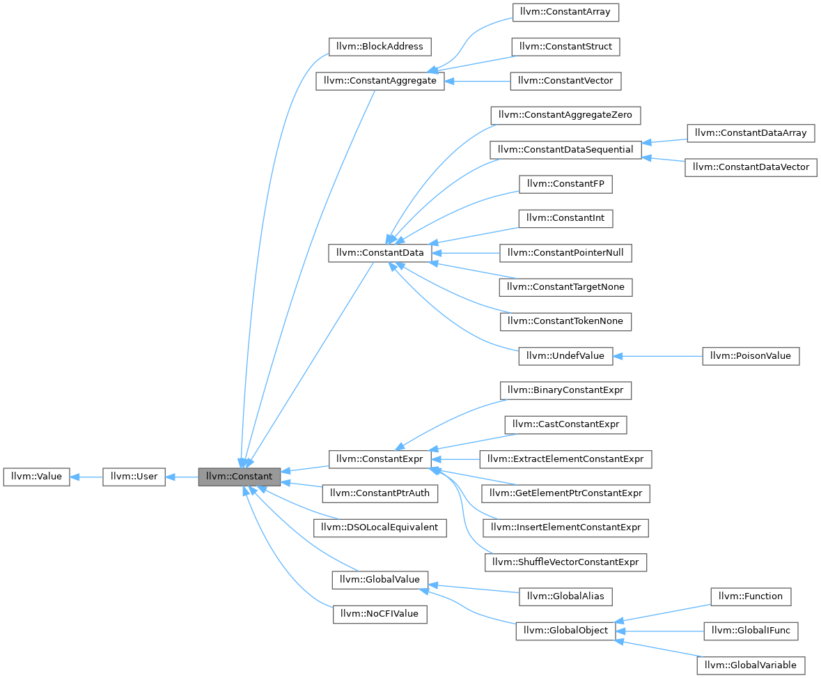
Unmanaged Runtime
Theoretically, there should be no difference between these two, but it will degrade the performance when over-complicated.
RTTI: -fno-rtti
  Runtime type info
Source: https://stackoverflow.com/questions/22288347/dynamic-cast-vs-virtual-function-vs-member-enum

Slide 12

Unmanaged Runtime: Conclusion
Source: Age of Ultron (2015)

Slide 13
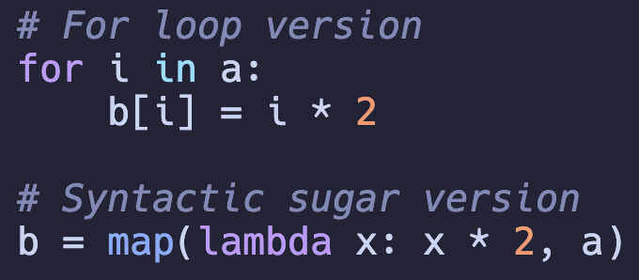
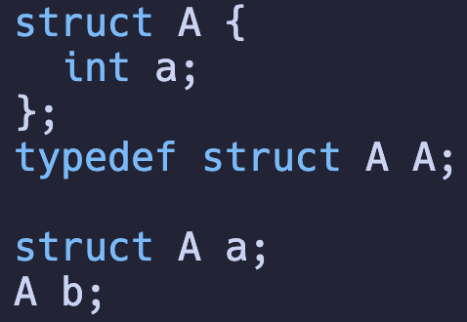
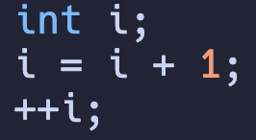
Syntactical Sugar: Oh! Sweet!
Python: Map or For-loop?
C: Self-increase
C: Type Decl
Exemplify the language features that makes you program more easily, while you can still program without them.

Slide 14
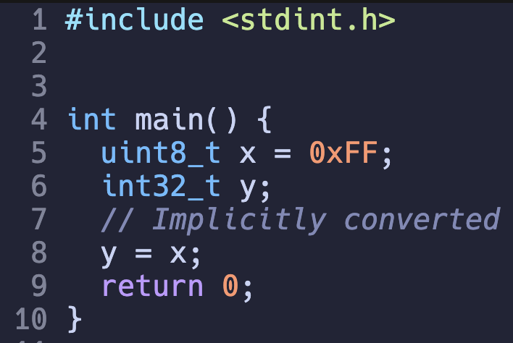
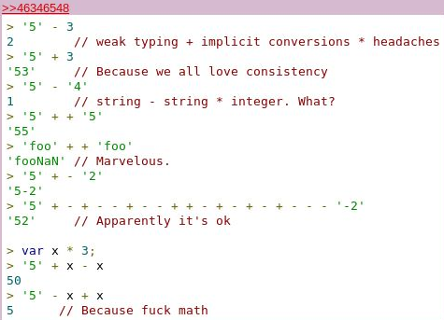
Syntactical Salt: Do (not) get addicted!
It is OK to do this in C
This makes code concise
You can even do this in JS!

Slide 15
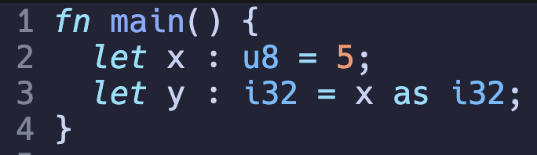
Syntactical Salt (CONT’D)
You are not allowed to do this in Rust (that freely).
Make you program harder to avoid unnecessary errors.

Slide 16
Dynamic/Static Type & Weak/Strong Type are orthogonal!
This is dynamic type in Python
This is weak type in C
This is both dynamic and weak typed in JS

Slide 17
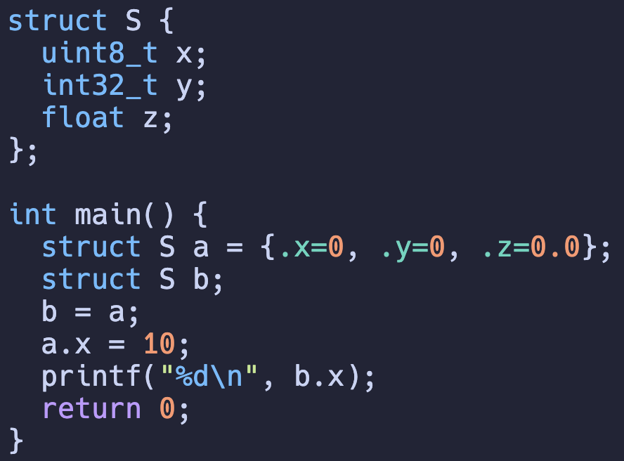
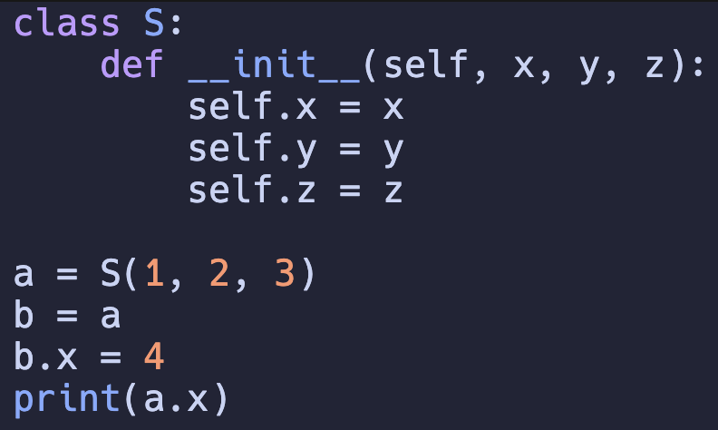
Structs
What are the key differences between C and Python/Java on structs?
  Pointer references

Slide 18
Summary
Tradeoffs
  Performance vs Developer Experience
  Performance vs Expressiveness
Characterization
  Expressiveness
  Managed/Unmanaged
  Compiled/Interpreted

Slide 19
Summary: Compiler
Tradeoffs
  Performance vs Developer Experience
  Performance vs Expressiveness
Characterization
  Expressiveness: General-purpose
  Managed/Unmanaged
  Compiled/Interpreted

Slide 20
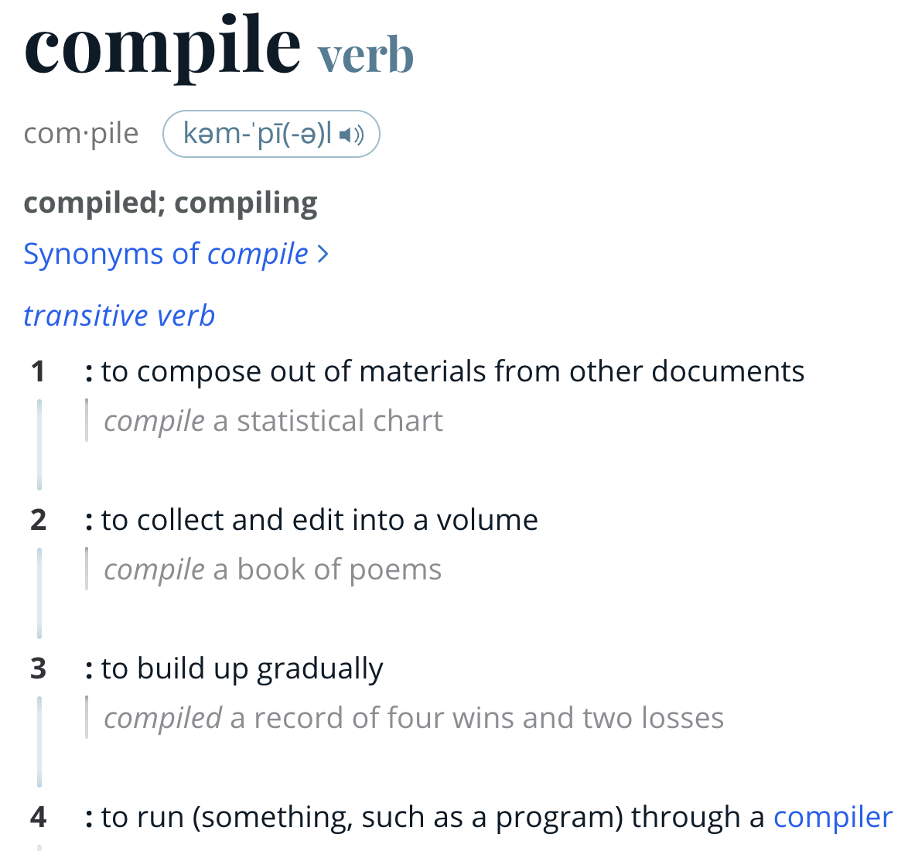

Roadmap
Programming Language
Compiler Pipeline
  Frontend
  Backend

Slide 21
LLVM: Compiler Infrastructure
LLVM: Low-level Virtual Machine
  https://www.llvm.org/
https://releases.llvm.org/
  Download one!
https://llvm.org/docs/GettingStarted.html
  Build your own
It is high recommended to have LLVM infrastructure setup to run the examples
If you build it, be careful with the parallelism
  -DLLVM_PARALLEL_{COMPILE,LINK,TABLEGEN}_JOBS=N

Slide 22

LLVM: Compiler Infrastructure
Spoiler: You need CMake to build LLVM, but I will talk about C build system next class…

Slide 23
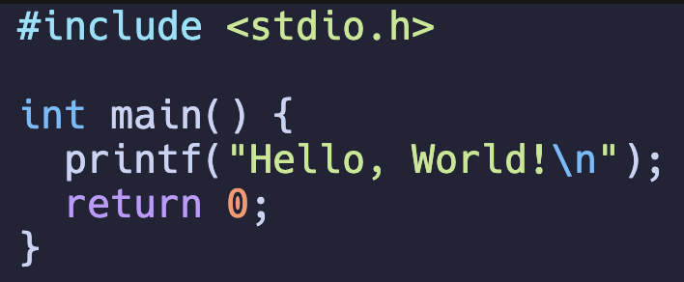
Compiler Pipeline
What happens after typing this?
> clang main.c -o main -O3
PP
Tokenizer
Parser
IR CodeGen
Optimizer
Inst Select
Register Allocation
Machine Rel. Opt.
Assembler
Link Lib
Frontend
Backend

Slide 24
Preprocessor
Resolve all the macros
> clang main.c -E
PP

Slide 25
Tokenizer: Split the program in "words"
Keyword int
Identifier main
LeftPran (
RightPran )
LeftBrace {
Identifier printf
LeftPran (
StringLiteral " Hello, World!\n "
RightPran )
Semicolon ;
Keyword return
IntLiteral 0
Semicolon ;
RightBrace }
Sorry, we do not have a command here
PP
Tokenizer

Slide 26
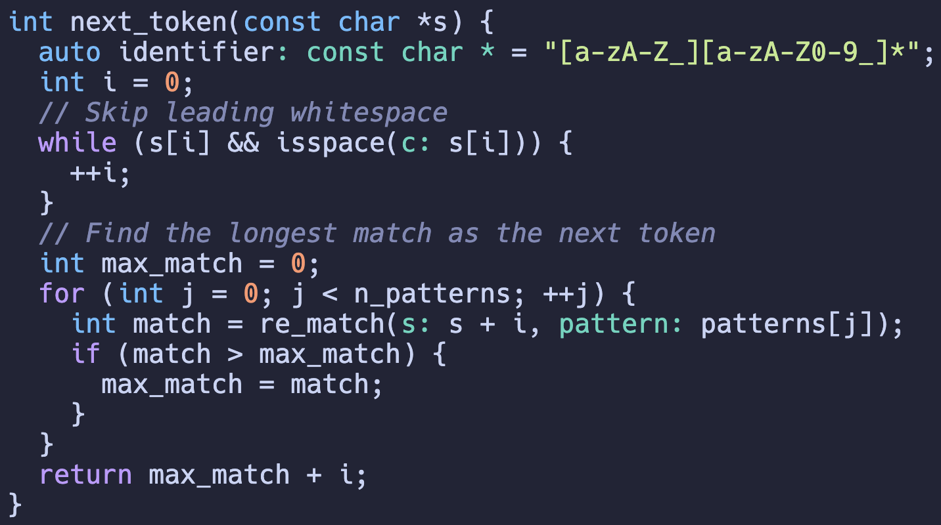
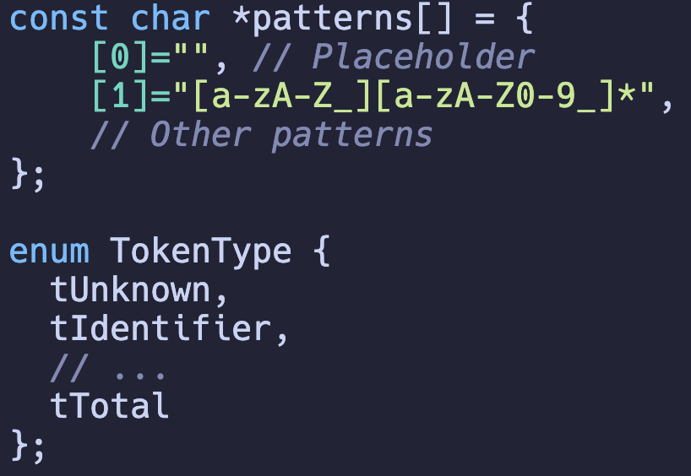
Tokenizer: Regex
Regex: Regular Expression
Skip all the white spaces and match the longest Regex
Notes:
Ask them if they already know Regex.

Slide 27
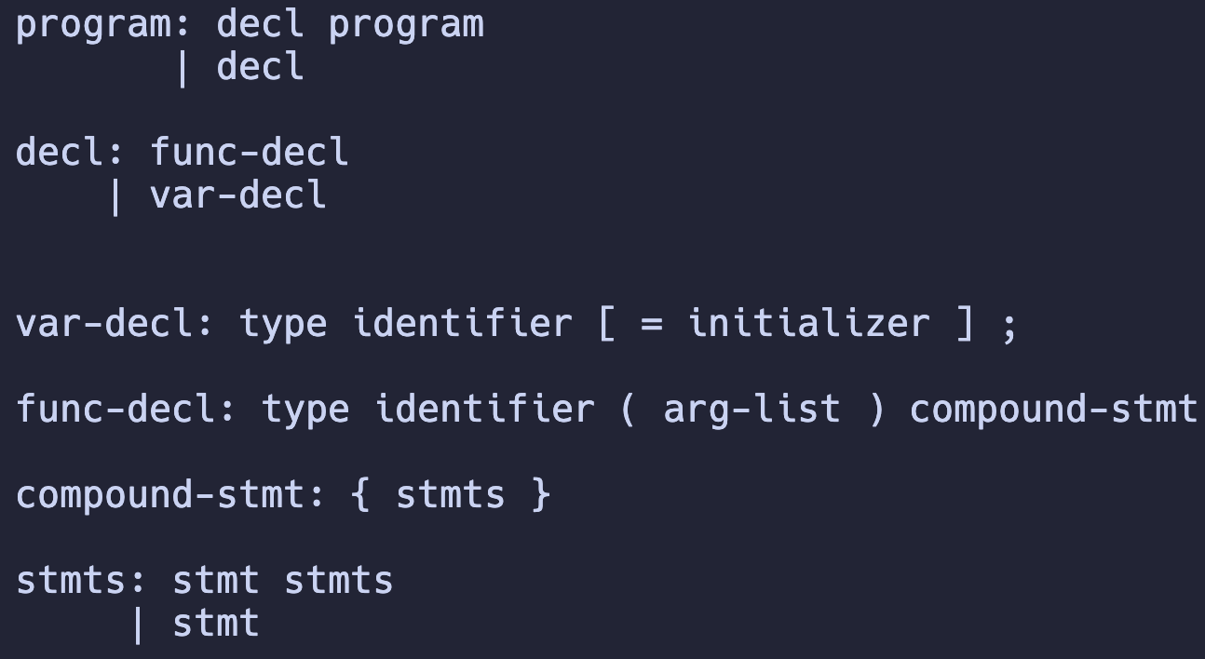
Parser: Organize the tokens
Formal Rule: Context Free Grammar

Slide 28
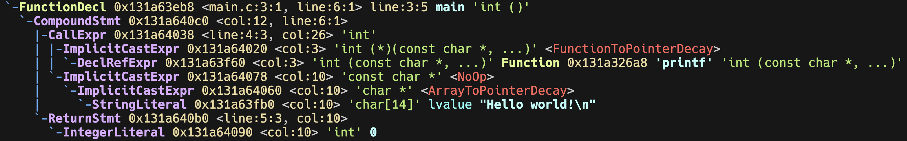
Tokenizer & Parser: A Demonstration
How it works in a commercial compiler?
clang –Xclang –ast-dump main.c
This is a sub-option to clang, not to the compiler itself
PP
Tokenizer
Parser
Frontend

Slide 29

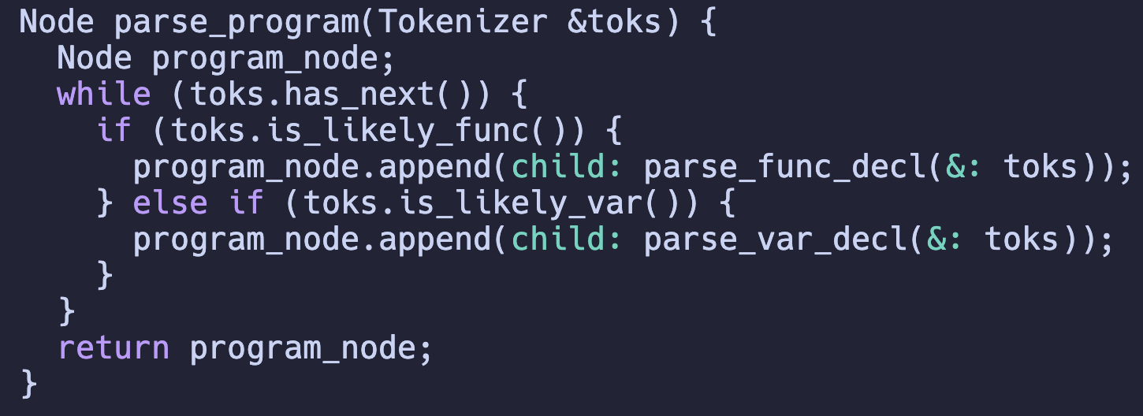
Tokenizer & Parser: Implementation
Generator (99% textbook will tell you to do this)
  C-family: flex (regex+token) & bison (grammar)
Decedent Recursion
  But actually 99% compiler projects does this

Slide 30
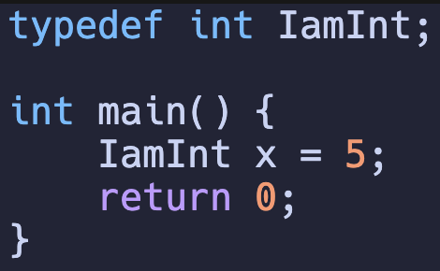
Why?
Modern languages are no long that context-free.
decl: type id = initializer
You can hardly know an Identifier is a type or a variable identifier w/o context knowledge.

Slide 31
Ad: Rust Variant is a good fit!
union Token {
char * id,
int64_t i,
...
};
enum Token {
Identifier(String),
IntLiteral(i64),
...
};
enum kToken {
Identifier,
IntLiteral,
...
};
match tok {
Identifier(id) => {}
IntLiteral(i) => {}
...
}

Slide 32
Even worse! My vision is not that far ☹
C’s grammar is poorly designed
Why is it likely?

Slide 33
A bad “likely”
When it comes to int + identifier, what should I do?
int a;
typedef int int32_t;
int main() {
int32_t x;
x = 1;
}

Slide 34
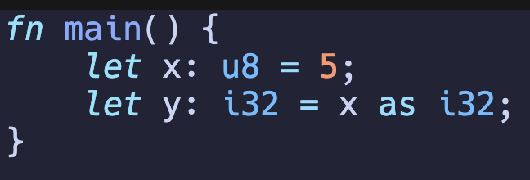
Parsers are simpler in modern languages
Recap: Keywords hint the parser

Slide 35
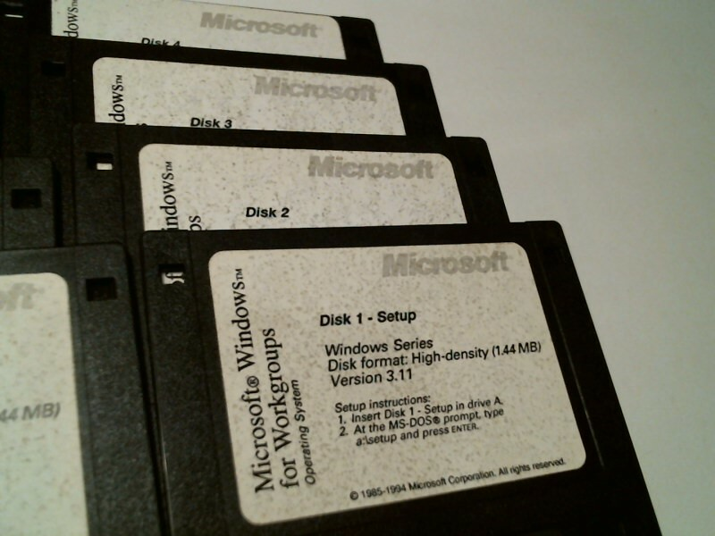
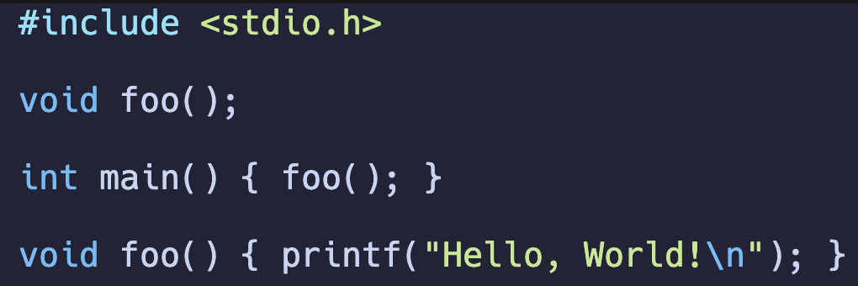
Another Historical Legacy: One-pass Compilation
Why do we bother to separate the declaration and implementation?

Slide 36
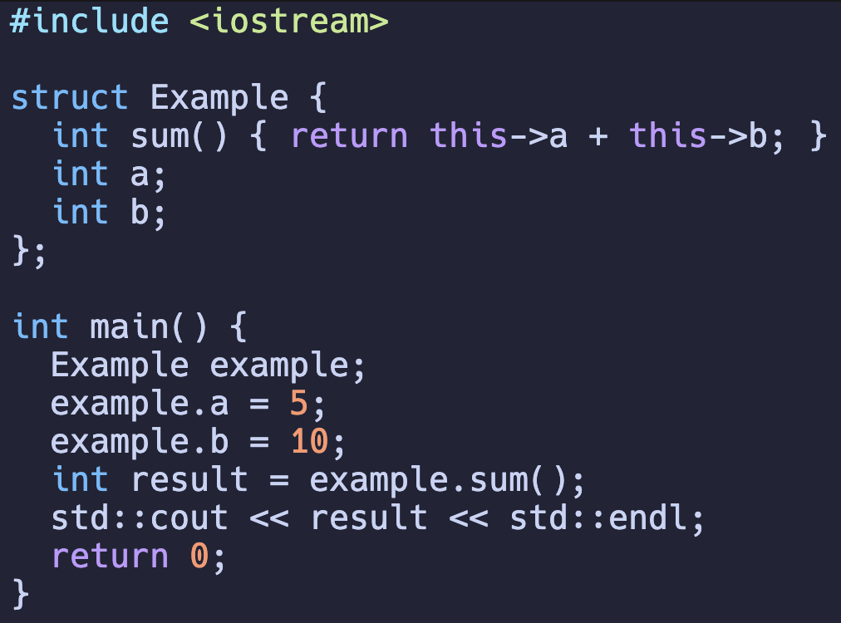
Compromise: I should scan it multiple times conditionally in C++ era.
Actually, within a struct, it is scanned more than once!
But still, other functions suffer from one-pass scan.

Slide 37
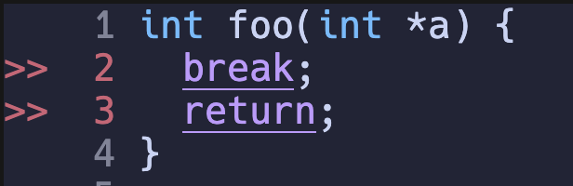
Semantics Check
The program below fits in the syntax of C, but semantically fails
PP
Tokenizer
Parser
Sema Check
Frontend

Slide 38
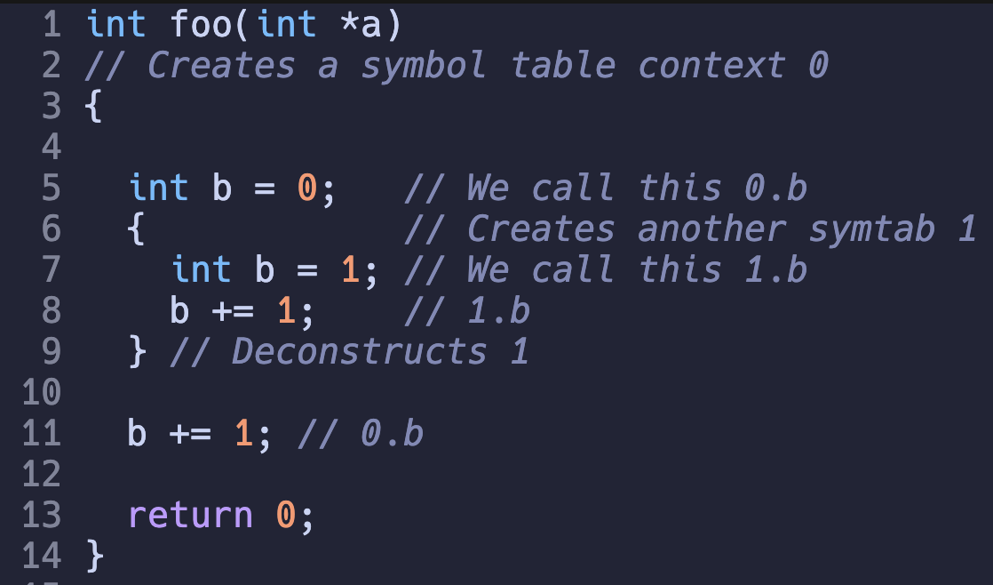
Semantics Check (Symbol Table)
Symbol table context scope

Slide 39
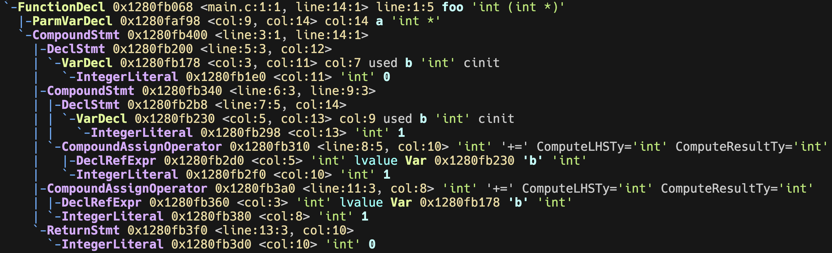
Implementation
Ideally, this can be summarized into three rules
  When entering a CompoundStmt, create a new ctx
    When leaving destroy
  When entering a DeclStmt, put it into the ctx
  When entering a reference, find it in ctx stack

Slide 40
Implementation
Key Behavior: We the behaviors on each AST node depends on its subclass
  Trivial Solution: Virtual Function
  Pros: Straightforward and effective
  Cons: ?

Slide 41
Virtual Function: An invasive solution
Add a virtual method to each node for semantics check.
Pros: Straight forward
Cons: Invasive, very invasive.
  Why is it bad?
Keep in ur mind: I am working on a big proj, and I am working w/ others
class CompoundStmt : ASTNode {
virtual void semanticsCheck(...) {
// create the context
} }
class DeclStmt : ASTNode {
virtual void semanticsCheck(...) {
// add it to the context
} }
class RefVar : ASTNode {
virtual void semanticsCheck(...) {
// find it from the context
} }

Slide 42
Visitor Pattern is a Visitor
Visitor pattern is a visitor to traverse each node in depth first
class VisitorBase {
virtual void visit(CompoundStmt *s) {
for (auto &stmt : s->stmts) {
this->visit(s); } }
virtual void visit(DeclStmt *s) {
this->visit(s->var);
if (s->init) this->visit(s->init); }
virtual void visit(RefVar *r) {
/*It is a leaf*/ }
}

Slide 43
Visitor Pattern: Passive Voice
Visitor pattern is a visitor to traverse each node in depth first
class Sema : VisitorBase {
void visit(CompoundStmt *s) override {
this->ctx.push();
for (auto &stmt : s->stmts) {
this->visit(s); } this->ctx.pop(); }
void visit(DeclStmt *s) override {
this->ctx.add(s->var);
if (s->init) this->visit(s->init); }
virtual void visit(RefVar *r) {
this->ctx.find(r); }
}

Slide 44
Visitor Pattern: A Low-invasion Alternative
Before: Modify the `.h` node declaration
  Will be discussed later. Modifying `.h` is evil.
After: Extend your related Visitor in each module
  Only affects the module itself

Slide 45
IR CodeGen
Generate a near-ASM representation
It actually still works without -S
Compile w/o link
Text format
> clang main.c –c –O2 –S –emit-llvm
Optimize
Emit the LLVM IR
PP
Tokenizer
Parser
IR CodeGen
Frontend

Slide 46
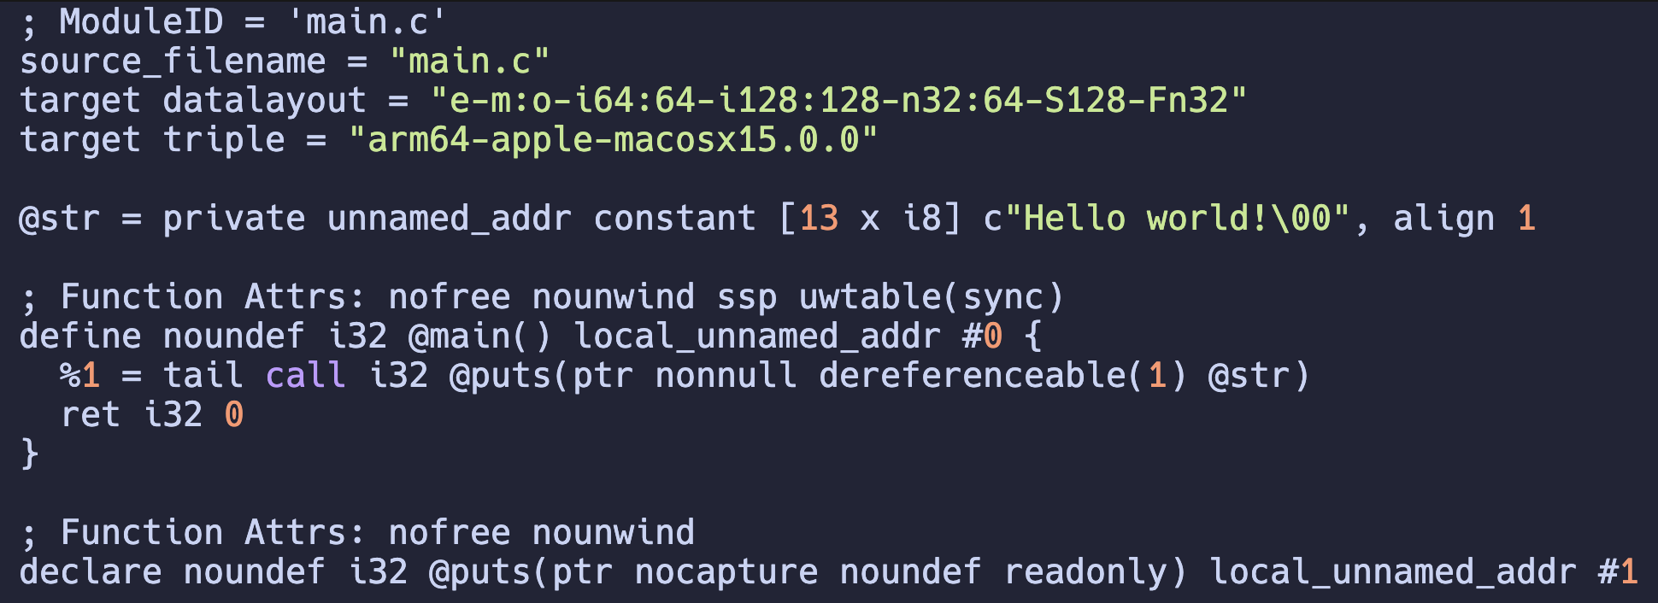
IR CodeGen
Generate a near-ASM representation
Compile w/o link
Text format
clang main.c –c –O2 –S –emit-llvm
Optimize
Emit the LLVM IR

Slide 47
Intermediate Representation
NxM-Effort
N+M-Effort
X86
X86
C
C
ARM
ARM
C++
C++
RISCV
IR
RISCV
Rust
Rust
PowerPC
PowerPC
Go
Go
Hexa
Hexa

Slide 48
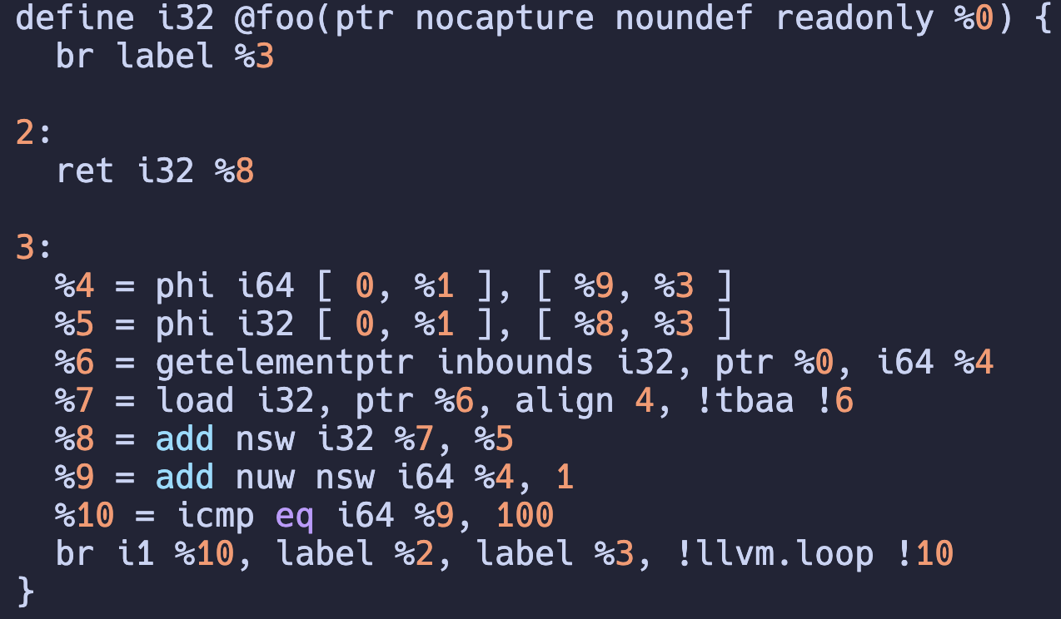
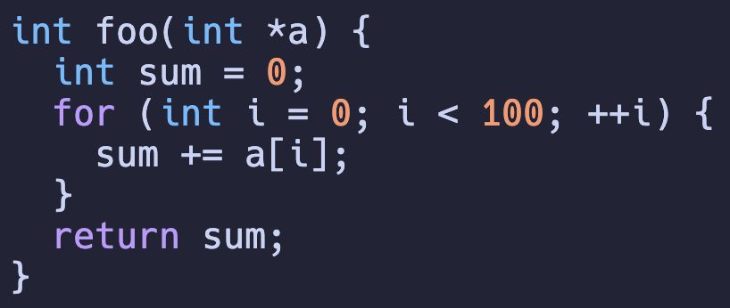
Intermediate Representation
Something nearer to assembly, but not an assembly
  3-address instruction
  Branches
Wait? What is PHI?

Slide 49
Machine-independent Optimizations
%3 = %1 + %2
%4 = %1 + %2
%5 = %3 + %4
%3 = %1 + %2
%4 = %3 + %3
%3 = %1 + %2
%4 = %3 << 1
CSE: %3 and %4 are the same, so we only compute it once!
Strength Reduction: A + A can be done by A * 2, which is simpler as A << 1
PP
Tokenizer
Parser
IR CodeGen
Optimizer
Frontend

Slide 50
Analyze first! Modify later.
You can easily make this mistake in C++
Why is it wrong?
// a is a vector
for (auto iter = a.begin(); i < a.end(); ++i) {
if (cond) a.erase(cond);
if (cond) a.push_back(/*something*/);
}

Slide 51
Analyze first! Modify later! (CONT’D)
In language level, Rust ensures you should do this!
// Rust
// a is Vec<_>
let mut idx : Option<usize> = None;
for (i, v) in a.iter().enumerate() {
if cond { idx = Some(i) };
}
if Some(idx) = idx {
a.remove(idx);
}

Slide 52
Machine-independent Optimizations (CONT’D)
Hoisting loop invariant
for i in 0..n
// %invar = compute a[i]
for j in 0..n
// use %invar[j]
for i in 0..n
for j in 0..n
// use a[i][j]

Slide 53
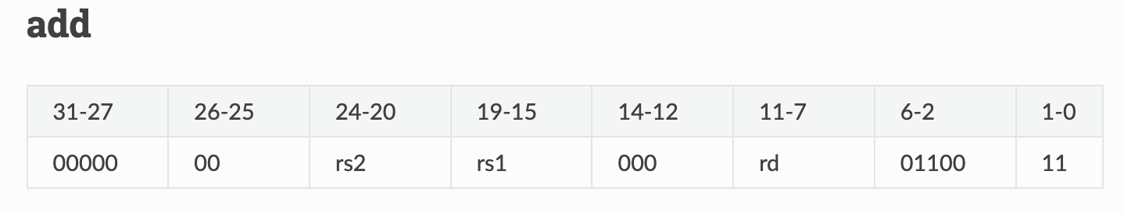
Backend: Target to a specific ISA
Code Selection
# %3 = %1 + %2
add a3, a1, a2
OK. It is as simple as expected.
PP
Tokenizer
Parser
IR CodeGen
Optimizer
Inst Select
Frontend

Slide 54
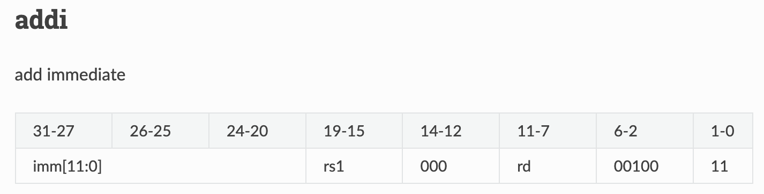
Code Selection (CONT’D)
# %2 = %1 + 2
addi a2, a1, 2
Phew~ It is as lucky as fitted.
PP
Tokenizer
Parser
IR CodeGen
Optimizer
Inst Select
Frontend

Slide 55
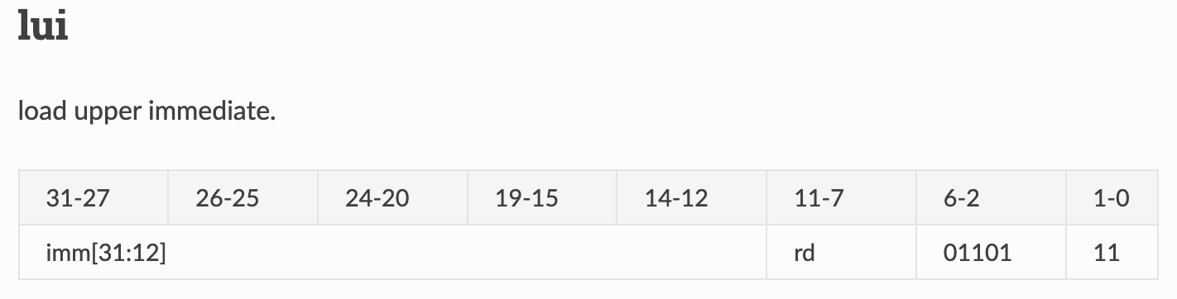
Code Selection (CONT’D)
# %2 = %1 + 1919810
lui a3, 468
xori a3, a3, 2882
addi a2, a1, a3
Wut? You do this?
468 << 12 | 2882 = 1919810
PP
Tokenizer
Parser
IR CodeGen
Optimizer
Inst Select
Frontend

Slide 56
Wait… What is the key differences b/t IR and ASM?
Infinite registers
llc main.ll –c –O1 –S
PP
Tokenizer
Parser
IR CodeGen
Optimizer
Inst Select
Register Allocation
Frontend
Backend

Slide 57
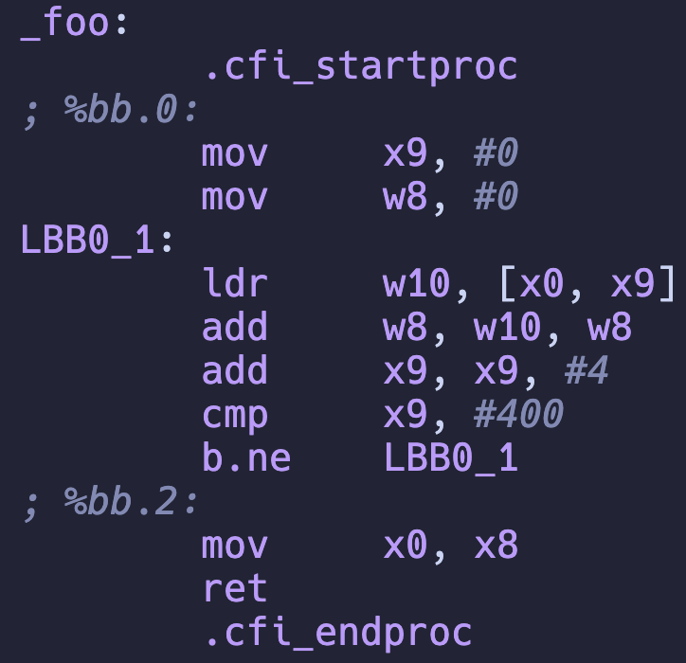
Code Select + Register Allocation
llc main.ll –o main.s

Slide 58
Still, it is far from executable yet…
> gcc main.s
> ls
... a.out ...
> a.out
Assembler and linkers are missing
  Assembler: Encode instruction text format to binaries
  Linker: Link runtime (?) libraries
PP
Tokenizer
Parser
IR CodeGen
Optimizer
Inst Select
Register Allocation
Machine Rel. Opt.
Assembler
Link Lib
Frontend
Backend

Slide 59
OK. A non-sense question.
What is the “entrance of a program”?
  main function is NOT the correct answer
> objdump –d a.out

