Slide 1
An Intro to Computer System
W3D1: A Deeper Tour to C/C++ Language
Jian Weng
Computer Science
CEMSE, KAUST

Slide 2
Roadmap
How much do you know C?
  Memory layouts
  Toolchains
  How do you work with others?
What are the differences b/t C & C++?

Slide 3
Where did you get the C compiler?
Quick question: Where did you get `gcc`, assuming you are using Ubuntu?
OK. Now you have a compiler.
Let’s write some C code.
> sudo apt update
> sudo apt install gcc

Slide 4
Arrays
What are arrays?
Arrays are a range of continuous memory allocated
Dude, there are no higher-dimension arrays.
  All the higher-dimension arrays are syntactical sugars
int a[100]; // 1d array
long b[200][100]; // 2d array

Slide 5
Alignment
Typically arrays are aligned by its scalar element
If unaligned, imaging each element may look like this:
How can we write a program to verify this?
uint8_t c[101]; // 101 bytes [7]
uint64_t d[5]; // but d is still aligned!

Slide 6
Flatten Arrays
Dude, there is no high-dimensional arrays
int b[200][100]; // 2d array
// use array
b[i][j]
// flattened array use
((int*)b)[i*100+j];

Slide 7
Global v.s. Local Arrays
Global Arrays
Local Arrays
// N has to be constant
int a[N];
void foo() {
int b = rand();
// This is allowed,
// but not recommended.
int a[b];
}

Slide 8
Flatten Arrays? Hint to pointer access!
In C, if you do this three. The function signature should be the same.
Wait, what is function signature?
  Let me explain it later
void foo(int *a) { }
void foo(int a[]) { }
void foo(int a[100]) { }

Slide 9
Hint to pointer access (CONT’D)
Actually, the compiler does not care about the 1st dimension.
void foo(int a[][100]) { } // GOOD!
void foo(int a[10000][100]) { } // GOOD!
void foo(int a[10000][]) { } // BAD!

Slide 10
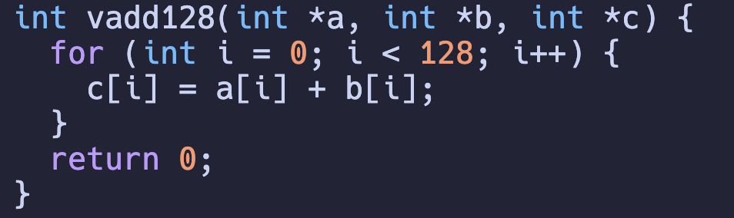
Even more hints to array access
clang array4.c –S –emit-llvm –O3
The generated code is a mess, why?

Slide 11
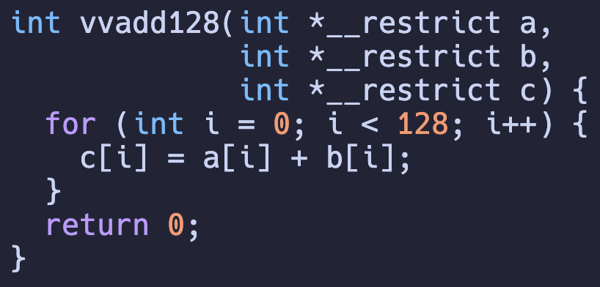
Even more hints to array access
clang array4.c –S –emit-llvm –O3
Why does it help?

Slide 12
Summary: Arrays
Arrays are continuous memory allocated
  All the arrays are essentially 1-d
    pointer=(∑(idx*stride))*sizeof(elem)
  In C, all the array passing are pointer passing
  Question: What if you want to pass a array by copying the array?

Slide 13
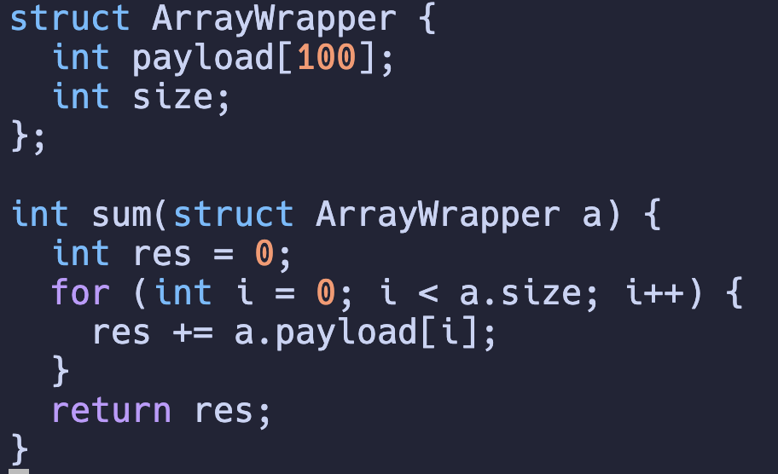
Struct of Array
Any argument passed to this function will be copied to the target function
What are structs?

Slide 14
Ad: Rust is a user-enforced C++
Rust uses its syntax to enforce the mistakes you may make in C++
struct A {
// ...
}
fn foo(a: A);
fn goo(a: &A);
fn main() {
let a = A { ... };
foo(a);
// Error! a’s lifetime ends.
goo(&a);
}
struct A {
// ...
};
// Bad!
void foo(A a);
// Good!
void goo(const A &a);

Slide 15
Struct: What is a struct?
Struct: A bundle of attributes
Question: What is the offset of each attribute?
Hint: Alignment
#include <stdint.h>
struct A {
int32_t i32;
int8_t i8;
int8_t another;
int64_t i64;
};

Slide 16
Struct (CONT’D)
A struct should be biggest attribute aligned.
(+8) – (+5) = 3, 3 bytes wasted by padding
#include <stdint.h>
struct A {
int32_t i32; // +0
int8_t i8; // +4
int8_t another; // +5
int64_t i64; // +8
};
Alignment
CPU is byte-addressable
Each k-byte element should have %k==0

Slide 17
Union
What is a union?
How is the union below aligned?
  Assuming we have a 64-bit machine
#include <stdint.h>
union A {
char *ptr,
char ch,
};

Slide 18
Union (Advanced Usage)
What is a union?
How to understand the union below’s usage?
#include <stdint.h>
union A {
int i,
float f,
};
int main() {
union A a;
a.f = 1.0;
printf("%0x%x\n", a.i);
}
int main() {
float f;
int i = *((int*)(&f));
printf("0x%x\n", i);
}
int main() {
float f;
printf("0x%x\n",
reinterpret_cast<int>(f));
}

Slide 19
Quiz: How to optimize the memory layout?
Reorder the attributes below to minimize the memory occupancy.
#include <stdint.h>
struct A {
int32_t i32; // +0
int8_t i8; // +4
int8_t another; // +5
int64_t i64; // +8
};

Slide 20
Summary: Arrays, and Structs
Both arrays and structs are essentially “pointer offsets”
struct A {
int32_t i32; // +0
int8_t i8; // +4
int8_t another; // +5
int64_t i64; // +8
};
struct A a;
a.i64;
ptr = (int64_t*)(((uint8_t*)&a) + 8);
*ptr;

Slide 21
Summary: Arrays, and Structs
Both arrays and structs are essentially “pointer offsets”
To conclude, I would rather call struct a “heterogeneous array”
uint32_t a[100];
// Normally
a[i] = 0;
// Break it down!
ptr = (((int8_t*)a) + i*4)
*ptr = 0;

Slide 22
Summary: Arrays, and Structs
What are the differences between these two?
uint32_t a[100];
// Be careful about left and
// right values
c = a[i] * 2;
a[i] = c + d;

Slide 23
Function Signature
An "Identifier" to the function
In C, this identifier is not ambiguous
  The parsed identifier token is also the only identifier to the function
But…
int foo();

Slide 24
Function Signature (CONT’D)
I did not talk about this syntactical sugar in last class
  Because I think it is evil 🤦🏻‍♀️
  This implicit signature style is explicitly disabled in modern languages because error-prone
clang main.c –S –emit-llvm -c
int foo();
int foo(int x);
int foo(float x);
_Z3foov
_Z3fooi
_Z3foof
Function argument list
C++ mangling padding
Function identifier string length is 3

Slide 25
Function Signature (CONT’D)
Any problem in computer system can be solve by another level of indirection
This introduces a new syntactical feature, while retaining backward compatibility
clang main.c –S –emit-llvm -c
int foo();
int foo(int x);
int foo(float x);
_Z3foov
_Z3fooi
_Z3foof
Function argument list
C++ mangling padding
Function identifier string length is 3

Slide 26
Recap: How should I deal with overloaded visitors in languages with overload disabled?
Visitor pattern is a visitor to traverse each node in depth first
class VisitorBase {
virtual void visit(CompoundStmt *s) {
for (auto &stmt : s->stmts) {
this->visit(s); } }
virtual void visit(DeclStmt *s) {
this->visit(s->var);
if (s->init) this->visit(s->init); }
virtual void visit(RefVar *r) {
/*It is a leaf*/ }
}

Slide 27
Recap: How should I deal with overloaded visitors in languages with overload disabled?
Answer: Manually rename the functions
class VisitorBase {
void visit_compound_stmt(CompoundStmt *s) {
for (auto &stmt : s->stmts) {
this->visit(s); } }
void visit_decl_stmt(DeclStmt *s) {
this->visit(s->var);
if (s->init) this->visit(s->init); }
void visit_var(RefVar *r) {
/*It is a leaf*/ }
}

Slide 28
Function Signature (CONT’D)
What if I do not want the mangling?
  Spoiler: This will be useful for your homework.
extern "C" {
// within this scope
// functions will not
// be mangled
int foo();
int foo(float x); // NOT GOOD!
}

Slide 29
What is next?
How many people still remember this?
In LLVM, Assembler and Linker are separated
In GCC, Linker is separated
Anyways, the compiler is just an “invoker”.
PP
Tokenizer
Parser
IR CodeGen
Optimizer
Inst Select
Register Allocation
Machine Rel. Opt.
Assembler
Link Lib
Frontend
Backend

Slide 30
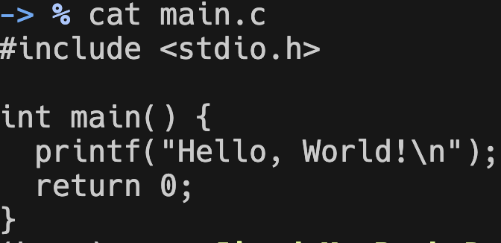
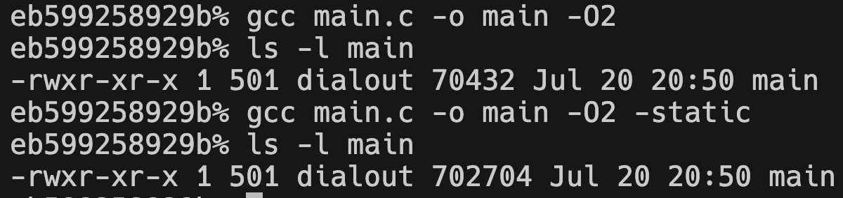
Link the libraries
Compile the program with different linkages
Non-static is 10x larger than static
Why?

Slide 31

Library Linkage (CONT’D)
How many people are playing games on Steam especially on Windows?
  Before installing in a game did you see what were installed?
Actually, these three are the same thing:
  Linux: .so
  MacOS: .dylib
  Windows: .dll
An executable w/o main entrance
Then, who drives the execution?
Source: https://en.wikipedia.org/wiki/DLL_hell

Slide 32

Dynamic/Static Linkage
Metaphor: I want a reference to a file in Linux in my project
  Option 1: Just copy it!
  Option 2: Link, a soft link.
    You may just regard soft link like a short cut
cp source dest # static linkage
ln –s source dest # dynamic linkage

Slide 33
Where did you get the C toolchain?
Quick question: Where did you get `gcc`, assuming you are using ubuntu?
Gcc is just a tool of the chain, what are else trying to help?
sudo apt update
sudo apt install gcc
sudo apt install build-essential

Slide 34
What are “others” trying to help?
Work on larger projects
Give your code for others’ use
Use others’ code
Separate works into pieces
Put back separated pieces into one

