Slide 1
Computer Architecture W6D2: Multithreading (Happy Summer Break🤦🏻‍♀️)
Jian Weng
Computer Science
CEMSE, KAUST

Slide 2
Roadmap
Multi-threading
Why?
How?
GPU: A super multi-threading

Slide 3
Why do we need multiple threads?
Parallelism? (//-ism)
Part of the story (More on this later)
Parallelism for what?
What is the granularity of parallelism?
Fine-grain: Instruction-level //-ism
Fine-grain: Data //-ism SIMD
Coarse-grain: Thread //-ism
?: Memory //-ism

Slide 4
Parallelism for what?
Performance and Utilization
Multi-issue has idles
4-way is typically 1.5-2 → Less than 50% utilization
Cache misses
Data depdences

Slide 5
Underutilization
Vertical waste
The whole pipeline not issued
Long latency dependences
Division?
Cache miss

Slide 6
Underutilization
Horizontal waste
Some of the issue width not util.
Fine-grain dependences
Data hazard? Especially RAW.
What should we do?
Borrow something do-able!

Slide 7
Fine-grain Solution: Software Pipelining
Why we are bad?
Dependences among instructions
What do we observe?
No dependences across the iterations
👉🏻 Borrow independent instructions from next iterations
// Original C Code
for (i=0; i<n; ++i)
c[i] += a[i] * b[i];
// A simple optimization
for (i=0; i<n; i += 2) {
c[i+0] += a[i+0] * b[i+0];
c[i+1] += a[i+1] * b[i+1]; }

Slide 8
Fine-grain Solution: Software Pipelining
loop:
load a[i+0], rs1
load b[i+0], rs2
load c[i+0], rs3
mul rs4, rs1, rs2
load a[i+1], rs1
add rs5, rs4, rs3
load b[i+1], rs2
store rs5, c[i+0]
load c[i+1], rs3
mul rs4, rs1, rs2
add rs5, rs3, rs4
# increase by 2
# loop back
Borrow independent instructions from next iterations
// A simple optimization
for (i=0; i<n; i += 2) {
c[i+0] += a[i+0] * b[i+0];
c[i+1] += a[i+1] * b[i+1]; }
Ooops? We are screwed again?

Slide 9
How many iterations should we unroll?
Revisit the data dependence graph
Fill the bubbles with borrowed instructions
A
☺
A
B
☺
B
C
A
B
C
☺
×
C
A
×
＋
×
B
☹
D
＋
＋
×
☹
C
D
D
＋
(a) Data Dependence Graph
(b) Serialize the execution
D
(c) Borrow instructions

Slide 10
How many iterations should we unroll?
Fill the bubbles with borrowed instructions
Theoretically, we can unroll more to get better performances
A
If not unrolled, we have 2 bubbles per iteration
Each iteration is 7-instruction
If unrolled by 2, we still have 2 bubbles per iteration
Each iteration is 13-instruction
Can we unroll infinitely?
Register pressure
Binary size
Sol: Cross-iteration execution schedule
B
C
×
A
＋
B
D
×
C
＋
D
Borrow instructions

Slide 11
How many iterations should we unroll?
Initialize the first loop
Sol: Cross-iteration execution schedule
Borrow ‘store’ from the prior iteration
Initialize the value computation outside
Cleanup the last one
☺
A
☺
B
C
×
D
＋
☺
Cleanup the last result

Slide 12
Wait! Let’s revisit the data dependence graph.
1
A
B
C
The last solution is a little bit ad-hoc
Do we have a formalized paradigm?
Execute across 4 iterations
Wait! How could we encode this?
2
×
3
＋
4
D
loop:
bring a[i] to reg1
bring b[i] to reg2
reg1 = reg1 * reg2
bring c[i] to reg3
reg3 = reg3 + reg1
send reg3 to c[i]
increase i by 1
go back to loop when i<n
Challenge: New data in this iteration may overwrite the old one before usage.

Slide 13

Intel Itanium
Dependent Instructions
Dynamic Register Indices
r_{i,j,k}
# load for this iteration
load a[i], r{0,1}
load b[i], r{2,3}
load c[i], r{4,5}
# compute for last iteration
r{6,7} = mul r{1,0}, {3,2}
r{8,9} = add r{6,7}, c{5,4}
store {9,8}
1
A
B
C
2
×
3
＋
4
D
Is the instruction order scheduling simplified because of more flexible borrow?

Slide 14
Intel Itanium (CONT’D)
Independent Instructions
VLIW Very Long Instruction Word
E.g. pack A, B, C into one slot.
1
A
B
C
# load for this iteration
{
load a[i], r{0,1}
load b[i], r{2,3}
load c[i], r{4,5}
}
2
×
3
＋
4
D
No, register ration x instruction packing makes the whole thing exponentially more complicated 😭

Slide 15
Multi-threading: An Intuitive Glance
This is a coarse-grain solution
Thread A: executes 10s for latency
Thread B: executes 20s for latency
Sequential execution: 10+20 = 30
Executes A and B together: Maybe 25s?
Fine, A is +15s slower (questionable)
B is (for sure) +5s slower
Improves -5s for executing both

Slide 16
Get back to these example
When thread A is idle
Can we use those un-used units for better performance?
Yes, but needs more support
What should we retain across different threads?

Slide 17
Goal: Execute across A & B
Borrow Thread B’s instruction to fill the execution pipeline
When A is idle for memory latency, B’s execution hides A’s idle
What additional support we need for this?

Slide 18
Implementing Multi-threading
IF: PC register
Duplicated: A.PC & B.PC
ALU
Not stateful
Shared
Soft states
Cache, BP?: Talked before
Registers
Logic registers
RS, ROB, and other bookkeeping

Slide 19
Implementing Multi-threading
Main Question
When to execute another thread?
Derived Question
How to manage thread states?
Key tradeoff
What kind of performance to achieve?
What kind of cost to pay?
Three designs
CG, FG, and SMT

Slide 20
Coarse Grain MT
Explicitly switch across threads
Before:
After:
Scheduler
IF
IF
ID
A.RF
ID
EX
B.RF
EX
MA
MA
WB
WB

Slide 21
Coarse Grain MT (CONT’D)
L2 | Mis
Switch across threads by scheduler
Scheduler arbitrates which to exec.
On L2 miss
Stateful partitioned
Register file
ROB
BP
No worse than 1 thread
Easy to impl.
Scheduler
IF
A.RF
ID
B.RF
EX
MA
WB

Slide 22
Fine Grain MT
Switches thread every cycle
No matter L2 miss
Pipeline threading states partitioned
As the same before
Tradeoffs
☺ Simple
☺ Tolerates high latency
☹ Significantly sacrifices single thread perf.
☹ Needs a lot of threads
GPU adopts this strategy!

Slide 23
Fine-Grain MT (CONT’D)
Round-robin Scheduling
Long in short: Take turns to execute
Trivial Solution:
grant = (grant + 1) % N
What if we have un-ready?
Grant to the “next ready” one
RR Sched.
IF
A.RF
ID
B.RF
EX
MA
WB

Slide 24
Round-robin Scheduler
Trivial Solution
grant = (grant + 1) % N
A more aggressive solution
Grant to “next ready” one
Assuming ready is the ready bit-vector
Next half: ready & ~(1 << last_grant)
First half: ready & ((1 << last_grant) - 1)
Select low bit of next half first higher than first half

Slide 25
SMT: Simultaneous MT
Finer than fine-grain scheduling
Thread executions are mixed
Aggressively issue all insts with valid operands across threads
Scheduling? Resource partitioning?
Example: Pentium 4 Hyperthreading
4 core, 8 thread

Slide 26
SMT Implementation
Wait, how can I deal with sooo many register partitions without an explicit boundary threads?
Recap: What did we do for OoO?

Slide 27
Too many data movements
Bookkeeping
Logics
IF
ID
Allocate on ROB
ROB
ROB to Reg
TMap to RS
ROB/Reg to Operand Buffer
EX
Check/update data validity
TMap
RS
Writes result
C
R
Reg
Commit result

Slide 28
Alternative: MIPS R10K
Big Idea: Use a big physical register file to hold all data without copies
☺ Registers are only for FUs
☹ ROB is just a side data structure for reordering

Slide 29
Alternative: MIPS R10K (CONT’D)
Architecture logic registers are fully gone, just like other register renamings
Fundamental Change: TMap
Instead of having a cyclic FIFO for ROB-based register renaming, a free list is maintained to allocate registers
ROB commitment frees allocated register

Slide 30
Key Challenge: Maintaining Renaming
Consider the example right
We have logic register r1-3
Physical register p1-7
Initially, p1-3 maps to r1-3
Key question
When to free the allocated physical register?
Wrong Answer: Free it upon retirement.
No register copy to it!
r1 = r2 + r3
r3 = r2 + r1
r1 = r2 * r3
r2 = r1 / r3

Slide 31
Register Renamed OoO
Bookkeeping
IF
Logics
ID
Allocate on ROB
ROB
EX
A super big centralized register file managed by renam-ing
Check/update data validity
RegN
Physical Register File
RS
Writes result
C
R
Commit result

Slide 32
SMT uses Register Renaming
Bookkeeping
IF
Sched
Logics
ID
Allocate on ROB
ROB
EX
Physical Register File
Pooling the register resources
Partition isolation done by renaming
Check/update data validity
RegN
RS
RegN
RegN
Writes result
C
R
Commit result

Slide 33
Summary
OoO is naturally a good fit SMT
Issue logic did not even changed!
Renaming logic is simply duplicated!
Thanks to Moore’s Law
More transistors, more registers, and more logics for more aggressive designs
#map-table = #threads * #logic-reg
#phy-reg = #threads * #logic-reg + #in-flight-insts

Slide 34
Other resources? LQ/SQ?
How are LSQs shared?
Dedicated or pooling?
N slots in LSQ, N/T entries each thread
☺ Simple! Isolate high/low ILP insts
☹ Low utilization sometimes
Dynamically shared
Allocation by thread tagging?
Non-memory-intensive ones may be stalled memory-intensive ones.

Slide 35
Other resources? BP?
Challenges
Sharing global states across many threads
Predict multiple threads together
Good
Less need for branch prediction?
Speculate less far in each thread
We have more borrowed parallelism already!

Slide 36
Helper thread for X?
Fork
Prefetching
Branching
Idea: Run a light-weighted pruned thread ahead to know the result early
Use the result to guide main execution
Pred
BR
Load
Speedup

Slide 37
Summary
Multi-threading
Coarse-grain parallelism is just part of the story
Threads hides the latency by filling in the idle pipeline
A part of transistor scaling, use unused resources

Slide 38
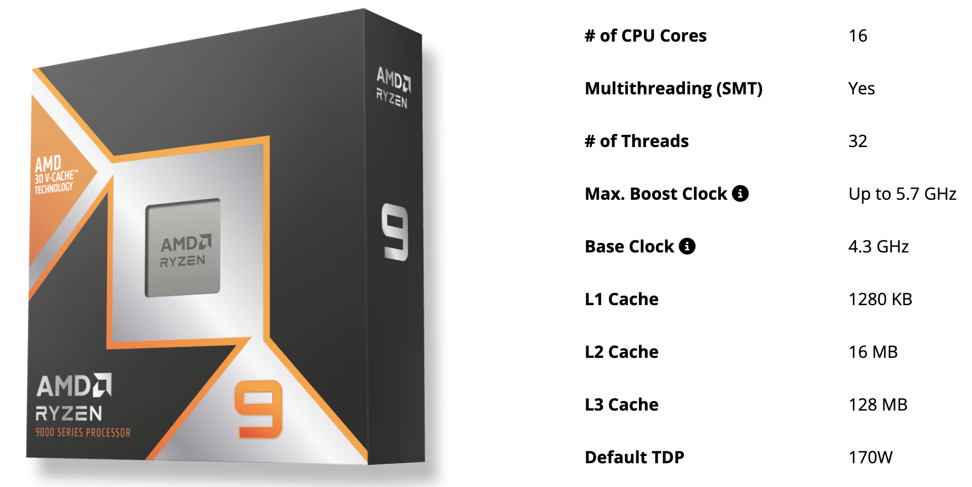
Motivation
Compute is fast!
Look at this CPU, whose clock rate is 4.3GHz
An addition can be done within ~0.23ns

Slide 39
Roadmap
Multi-threading
Why?
How?
GPU: A super multi-threading

